Slide 1
CURRENCY RECOGNITION
Man cannot detect a FAKE currency note, but a COMPUTER can.

Slide 2
TABLE OF CONTENTS
Introduction to currency recognition
Currency recognition using ORB algorithm
sample input and output
Applications
Conclusion

Slide 3
Introduction to currency recognition
Now a days Everything works with money and currency notes
makes more sense about money. At some places like bank large amount of money will be there , so counting of that money may takes more time when we do it with manual process, but if we use digital image processing techniques to do this task in a short span of time and it takes less cost.
And today fake currency is a biggest problem in the country now and it be resolved byusing our system.

Slide 4
CURRENCY RECOGNITION: Using ORB algorithm
ORB: An efficient alternative to SIFT or SURF in 2011. As the title says, it is a good alternative to SIFT and SURF in computation cost, matching performance and mainly the patents. Yes, SIFT and SURF are patented and you are supposed to pay them for its use. But ORB is not.
ORB is basically a fusion of FAST keypoint detector and BRIEF descriptor with many modifications to enhance the performance. First it use FAST to find keypoints, then apply Harris corner measure to find top N points among them. It also use pyramid to produce multiscale-features. But one problem is that, FAST doesn’t compute the orientation. So what about rotation invariance? Authors came up with following modification.

Slide 5
CURRENCY RECOGNITION: Using ORB algorithm
Sift Operator:
we saw some corner detectors like Harris etc. They are rotation-invariant, which means, even if the image is rotated, we can find the same corners.It is obvious because corners remain corners in rotated image also. But what about scaling? A corner may not be a corner if the image is scaled. For example, check a simple image below. A corner in a small image within a small window is flat when it is zoomed in the same window. So Harris corner is not scale invariant.
Sift operator is classified into FIVE types:
1. Scale-space Extrema Detection
2. Keypoint Localization
3. Orientation Assignment
4. Keypoint Descriptor
5. Keypoint Matching

Slide 6
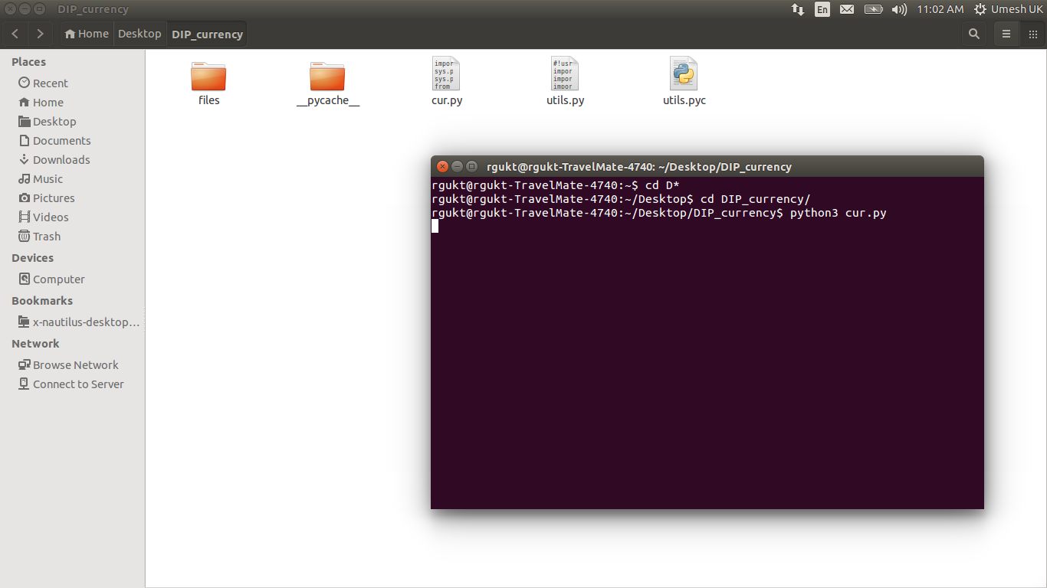
CURRENCY RECOGNITION: SAMPLE INPUT AND OUTPUT 1.First of all try to execute cur.py python file, we will get this window.

Slide 7
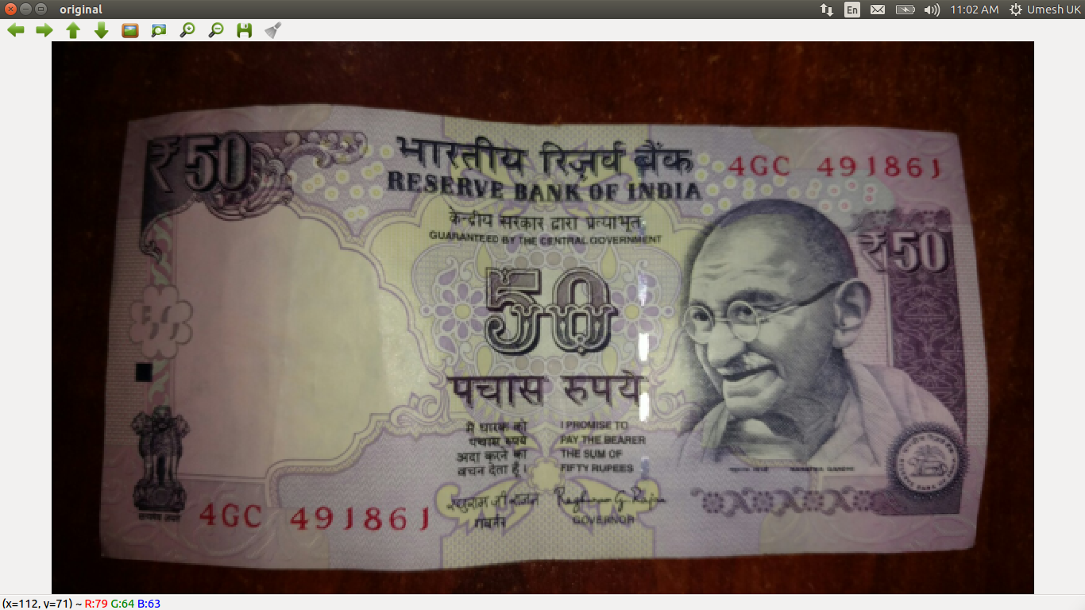
2.A new test image window will open after excetuing cur.py file , which is our input test image to detect which currency note it is.

Slide 8
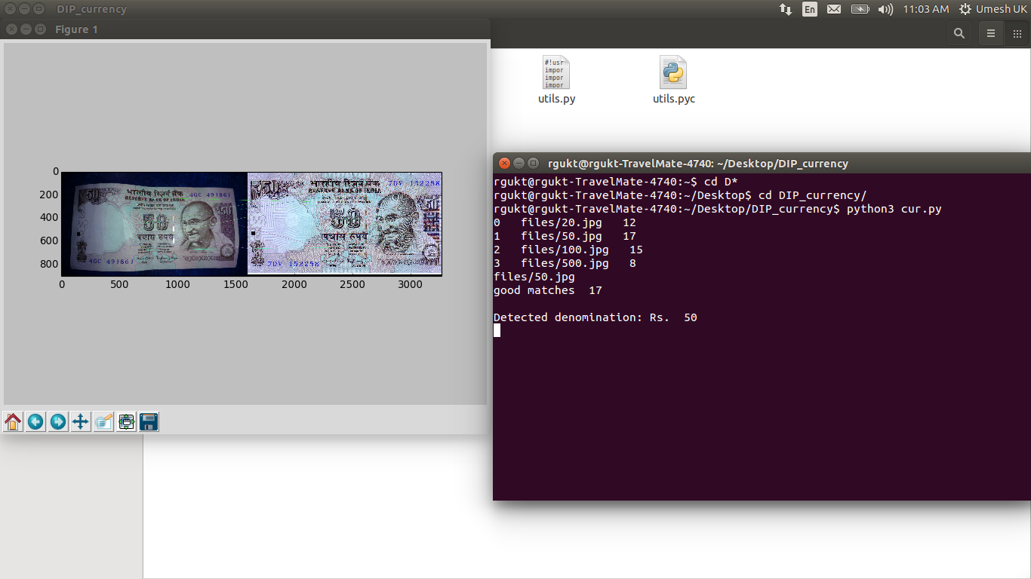
3.We will get match counts for every trained data set image and our program will select highest match counted value to detect the currency note.After that a plot will be displayed with the matched currency note along with test image.

Slide 9
APPLICATONS: -Able to Count the total worth of large amount of currency notes(Currency Counting Machine) -Able to detect Fake Notes based on similarity matches count. -It is to detect fake notes whenever we have large amount of currency.

Slide 10
CONCLUSION:
We have studied how similarities matches can be counted based on the keypoints and feature detection points which will be the most important criteria to compare two objects and checking the given test currency note is similiar to which training note is similiar to and declare that note as our final output and in near futre we can check whether given note is fake note or not based on the similarity of most points on original note with test note.

