Slide 1
Parallel Implemenation and Analysis of All Pairs Shortest Path Algorithm(Floyd-Warshall Algorithm)
Summer InternShip Project Presentation
By
THARIKOPPULA BINESH(R131983)
Under the Guidance of
Dr.Sathya Peri phd.
Dept. of CSE
Indian Institute of Technology(IIT),Hyderabad

Slide 2
Parallel Implemenation and Analysis of Floyd-Warshall Algorithm
Why Parallel Computing is Needed?
Most of the Today's computers are of having multi-core or multi-processors but while performing some operations/processes we are using only one processor we might not use all cores/processors effectively.
Instead of that, it is better to use all cores/processors to get higher effeciency.
Advantages of Parallel Computing:
Saving time
Solving larger problems
Providing concurrency
Saving cost

Slide 3
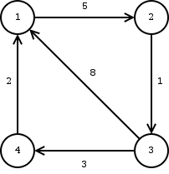
What is All Pairs Shortest Path Problem
It is nothing but finding the shortest path between each and every pair of nodes in the graph.
Shortest Path Weight From to Weight
1 2 5(1->2)
1 3 6(1->2->3) Likewise
but for 3 1 5(3->4->1) and 3->1 path weight is more so avoid that path.
The algorithms for finding the shortest path finds their application in many fields such as social networks, aviation, routing protocols,google maps etc.

Slide 4
Floyd-Warshall Algorithm
All Pairs Shortest Path Problem is Solved by this FW Algorithm and It requires a directed weighted graph with positive or negative edges.
The FW is a classic dynamic programming algorithm that solves the all-pairs shortest path (APSP) problem on directed weighted graphs G(V, E, w), where V = {1, ..., n} is a set of nodes, E ⊆ V xV are the edges and w is a weight function. The number of nodes is denoted by n and the number of edges by m.
Input the Graph as Adjacency matrix.
How Algorithm is Working?
We initialize the solution adjacency matrix same as the input graph matrix as a first step. Then we update the solution matrix by considering all vertices as an intermediate vertex. The idea is to one by one pick all vertices and updates all shortest paths which include the picked vertex as an intermediate vertex in the shortest path.

Slide 5
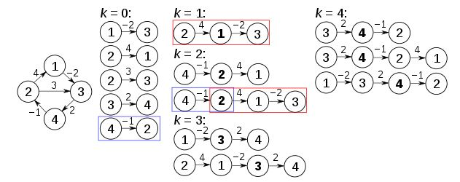
Standard Floyd-Warshall Algorithm
Pseudo Code:
1: for k = 1 → n do
2: for i = 1 → n do
3: for j = 1 → n do
4: A_{k}[i, j] = min(A_{k−1} [i, j],A_{k−1} [i, k] + A_{k−1} [k, j] )
5: end for
6: end for
7: end for
But Runtime Complexity of this SFW is O(n³).For large Graphs it takes huge amount of Time. So we must have to parallelize this Algorithm.

Slide 6
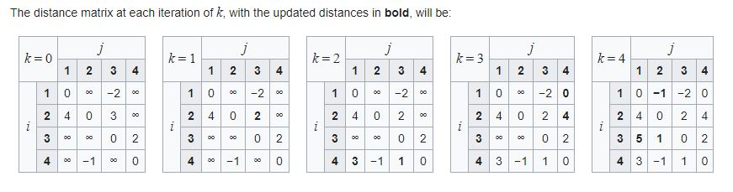
Standard Floyd-Warshall Algorithm
How Theoretically Standard FW Algorithm is Running:
Actually How Standard FW Algorithm is running:

Slide 7
Openmp
Openmp(Open multi-processing) is an application programming interface (API) that supports multi-platform shared memory multiprocessing programming in C, C++, and Fortran. It consists of a set of compiler directives, library routines, and environment variables that influence run-time behavior.
#pragma omp parallel is used to fork additional threads to carry out the work enclosed in the construct in parallel. The original thread will be denoted as master thread with thread ID 0.
One of Work-Sharing Construct is---> omp for or omp do: used to split up loop iterations among the threads, also called loop constructs.
#pragma omp parallel
for(int i=0; i<N; i++)
{ ... }
->This code creates a parallel region, and each individual thread executes what is in your loop. In other words, you do the complete loop N times, instead of N threads splitting up the loop and completing all iterations just once.
#pragma omp parallel #pragma omp parallel for
{#pragma omp for for(int i=0;i<N;++i)
for(int i=0;i<N;i++) (or) {....} //It splits the loop and assigns to threads
{....}
}

Slide 8
Parallelized Standard Floyd-Warshall Algorithm
for(int k=0;k<n;k++)
#pragma omp parallel for
for(i=0;i<n;i++)
for(int j=0;j<n;j++)
if(A[i][k]<INT_MAX && A[k][j]<INT_MAX)
{
int d=A[i][k]+A[k][j];
if (d<A[i][j])
A[i][j] = d; }
In the above PSFW #pragma omp parallel will divide the iterations of i among the number of threads. And Every thread will select one particular A[i,j] at particular time and executes it in parallel.
ex: For below matrix.
  1 2 3
  4 0 1
  3 6 2
  If three threads are there then, At a time 3 threads parallelly takes 3(means each thread gets one row) values and tries to update those values by performing
  min(A[i][j],A[i][k]+A[k][j]).

Slide 9
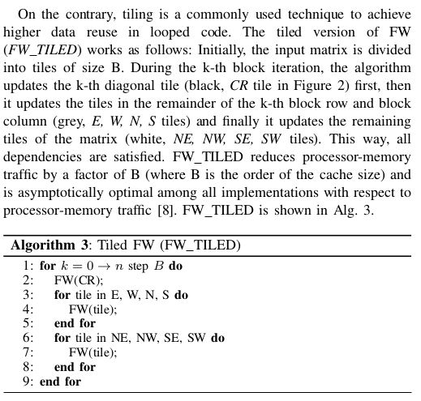
Parallelized Tiled Floyd-Warshall Algorithm

Slide 10
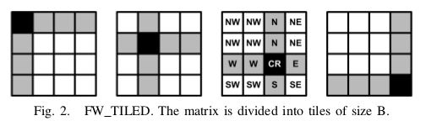
Parallelized Tiled Floyd-Warshall Algorithm
So in above diagram every square is a tile of size bXb and threads run CR first, then all tiles in CR row(E and W) parallely,then all tiles in CR column(N’s and S’s) parallely.And atlast our diagonals tiles(NE,NW,SE,SW) parallely.Then our CR tile points to next position like black tile moved from first diagram to second diagram and then performs updation of its adjacent tiles and soon until CR(main tile) reaches to last diagonal position.

Slide 11
Parallelized Tiled Floyd-Warshall Algorithm
What each thread is doing in PTFW?
Each thread would take one updateSubmatrix method to execute in parallel.
i.e.. updateSubmatrix(int a_row,int a_col,int b_row,int b_col,int c_row,int c_col,int **A,int b).
That is nothing but Applying Floyd-Warshall Algorithm on each Tile of size bXb in matrix A.
i.e..
for(k=0;k<b;k++)
  for(i=0;i<b;i++)
for(j=0;j<b;j++)
if(A[b_row+i][b_col+k]< INT_MAX && A[c_row+k][c_col+j]< INT_MAX )
{
A[a_row+i][a_col+j]=min(A[a_row+i][a_col+j],(A[b_row+i][b_col+k]+A[c_row+k][c_col+j]));
}

Slide 12
Experimental Results:
The architecture of my system is Intel® Core™ i3-5005U CPU @ 2GHz,2000Mhz, 2 Cores and 4 Logical processors and cache size is 128.
In my experimentation i have given Input from txt file with 3353 vertices and 8866 edges from sample3.txt with static block_size=128 and variable number of threads.
Matrix is 3353X3353 and i executed both Parallelized Standard FW and Parallelized Tiled FW algorithm on same architecture with same graph as input.
But the results were unexpected that Parallelized Standard FW remains constant with number of threads.
And Parallelized Tiled FW algorithm shows quite good results(less runtime) with the increase in number of threads.

Slide 13
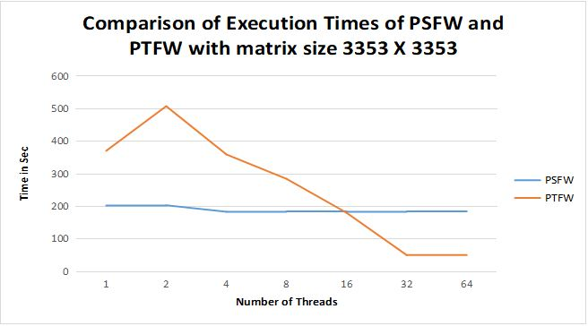
Experimental Results: With Tile-size 128X128
PSFW--- parallelized standard Floyd-Warshall Algorithm.
PTFW--- parallelized Tiled Floyd-Warshall Algorithm.

Slide 14
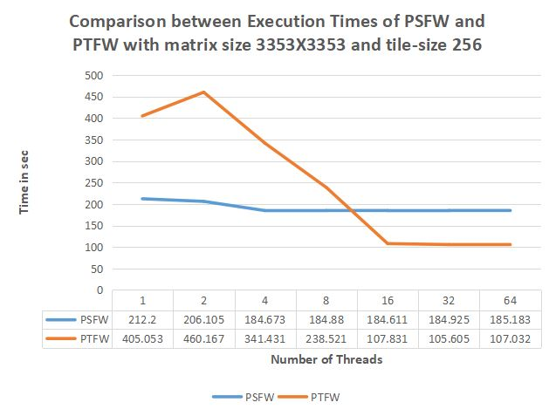
Experimental Results:
PSFW--- parallelized standard Floyd-Warshall Algorithm.
PTFW--- parallelized Tiled Floyd-Warshall Algorithm.

Slide 15
Conclusions
In this work we have experimented with the well known Floyd-Warshall algorithm, which solves the all-pairs shortest path problem on directed graphs.
First of all our Standard FW algorithm is taking exponential running times based on the number of vertices, but after parallelizing using OPENMP running times of Parllelized Standard FW became optimal than Sequential FW.
And From the comparison chart we can conclude that for considerably large graphs it is best to use parallelized Tiled FW Algorithm to achieve maximum effeciency but we must maintain some threshold number of threads.
And we should maintain the block size equal to the cache size of our system to achieve maximum efficiency.However usage of maximum number of threads depends on the number of cores and for small graphs it is better to use PSFW. But the real world graphs like social networks,google maps etc. deals with huge number of vertices so our parallelized Tiled FW will be useful evrywhere.
And for the systems with good architecture will be capable of spawning many threads , results in best performance of PTFW. That’s why parallelized Tiled FW Algorithm is asymptotically optimal among all implementations of FW algorithm because it reduces processor-memory traffic by factor of b where 'b' is dimension of the tile and runtime of PTFW is O(n³/b).

