Slide 1

Commercial Excellence Survey
DELOITTE RESEARCH STUDY
86 SENIOR EXECUTIVES
A comparative analysis of Leaders, Contenders, and Laggards across 86 Director-level and above commercial executives — revealing the measurable gap that separates top performers from the rest.
🏆 Leaders (n=18)
⚡ Contenders (n=43)
50% achieved 12%+ revenue growth. Zero missed their goals.
4.6% achieved 12%+ growth. Mostly in the 3–6% range.
📉 Laggards (n=25)
60% were flat or in revenue decline. Significant performance deficit.

Slide 2

Respondent Profile — Who Participated
All 86 respondents are Director-level and above, spanning Sales, Marketing, and Revenue Operations functions across three performance tiers.
Job Level Distribution
Top Departments
Level
Leaders
Contenders
Laggards
Department
Leaders
Contenders
Laggards
VP Level
27.8%
37.2%
36.0%
Sales / Biz Dev
38.9%
30.2%
24.0%
Director
33.3%
30.2%
28.0%
Marketing
22.2%
27.9%
28.0%
Senior Director
27.8%
11.6%
16.0%
Revenue Ops
16.7%
0.0%
4.0%
SVP / C-Level
11.1%
21.0%
20.0%
Sales Ops
0.0%
25.6%
16.0%
Leaders have stronger Sales and RevOps representation, indicating revenue-focused cross-functional leadership. Laggards show weaker Sales presence and zero RevOps representation.

Slide 3

Organization Scale — Size & Revenue
Leaders don't just outperform — they operate at a fundamentally different scale. Revenue and headcount advantages create a compounding investment capacity that fuels commercial excellence.
$6.2B
$5.4B
$3.7B
Leaders Revenue
Contenders Revenue
Laggards Revenue
Mean annual revenue 2024 — 68% more than Laggards
Mean annual revenue 2024
Mean annual revenue 2024 — concentrated in mid-market
Employee Size Bands
Revenue Bands (2024)
Band
Leaders
Laggards
Band
Leaders
Laggards
5,000–9,999 employees
44.4%
16.0%
$10B+
33.3%
12.0%
$5B–$9.9B
22.2%
8.0%
1,000–4,999 employees
22.2%
48.0%
$1B–$4.9B
38.9%
60.0%
Laggards are disproportionately concentrated in the mid-market ($1–5B), limiting their resource base and investment capacity for commercial excellence capabilities.

Slide 4
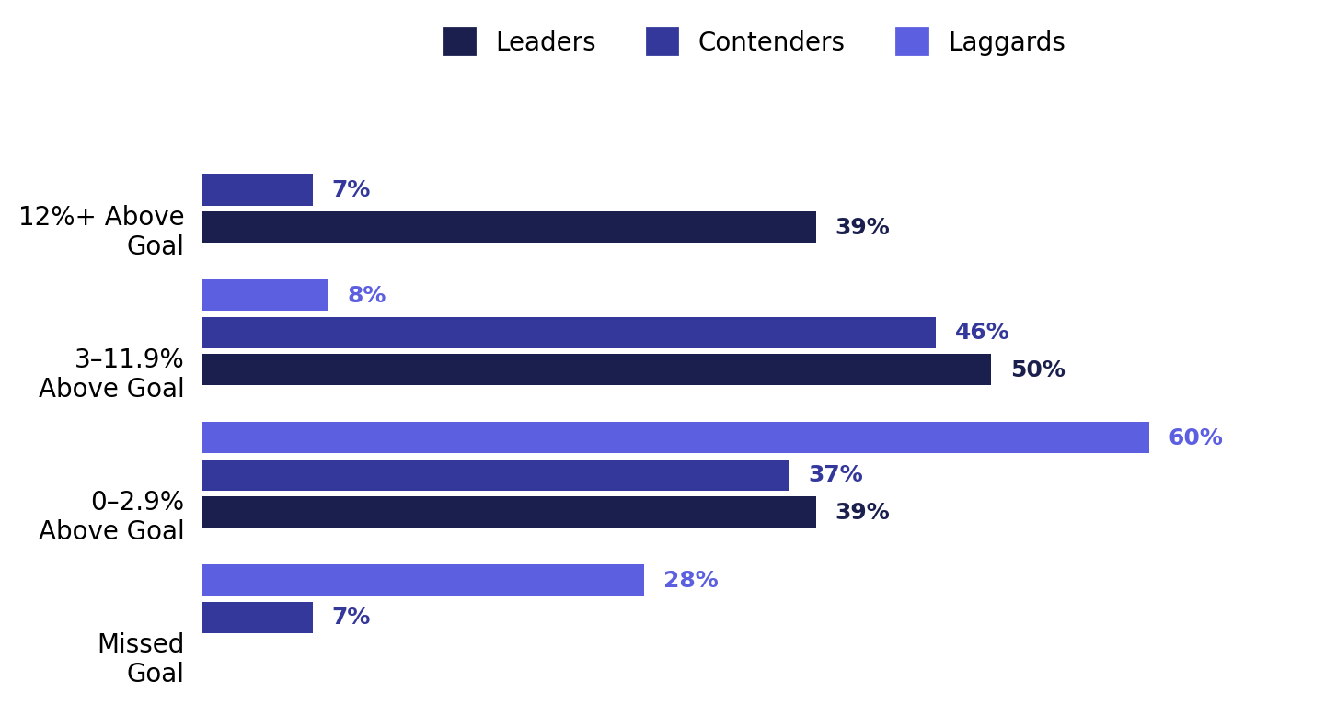
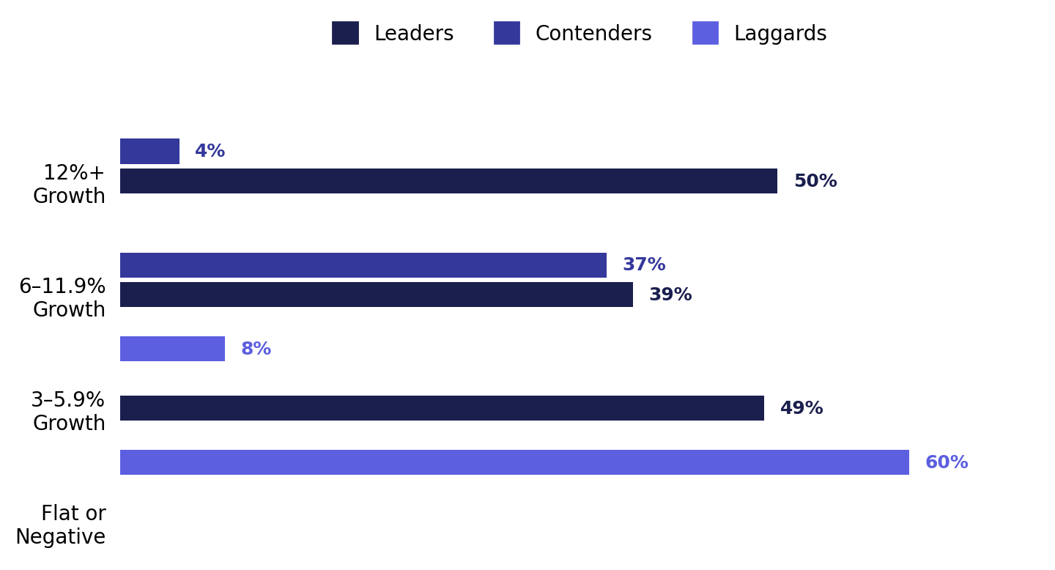

Revenue Performance — The Performance Chasm
The gap between Leaders and Laggards is not incremental — it is structural. Leaders grow at 5–8x the rate of Laggards, and not a single Leader missed their revenue goal.
Revenue vs. Goal Attainment (Last FY)
US Revenue Growth Rate (Last FY)
Commercial excellence directly and measurably drives superior growth velocity. Zero Leaders missed their goals; 28% of Laggards did. Leaders grow at 5–8x the rate of Laggards.

Slide 5

Strategic Goals vs. Key Challenges
While all groups share topline revenue growth as their primary goal, the maturity of their ambitions diverges sharply — Leaders focus on win rates while Laggards are still building GTM foundations.
Top Strategic Goals
Top Challenges
Goal
Leaders
Contenders
Laggards
Challenge
Leaders
Contenders
Laggards
Topline revenue growth
55.6%
55.8%
52.0%
Consistent sales process
44.4%
42.9%
54.2%
Increase win rates
50.0%
39.5%
32.0%
Prioritizing GTM offerings
44.4%
45.2%
37.5%
Optimize marketing funnel
38.9%
34.9%
32.0%
Budget constraints
27.8%
31.0%
41.7%
Internal GTM coordination
38.9%
19.0%
8.3%
Revenue ops effectiveness
27.8%
37.2%
32.0%
Data quality & enrichment
38.9%
28.6%
37.5%
Enhance GTM planning
5.6%
11.6%
24.0%
AI-driven CRM content
22.2%
25.6%
36.0%
Leaders' top unique challenge is internal coordination — a sign of greater organizational complexity. Laggards haven't even reached this level of sophistication yet. Budget constraints (42%) cap Laggard investment capacity.

Slide 6
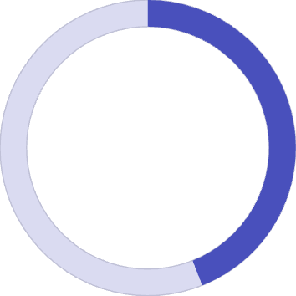
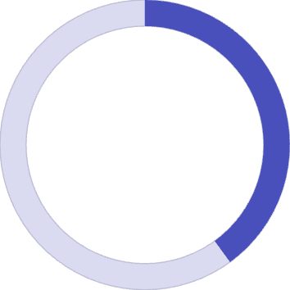
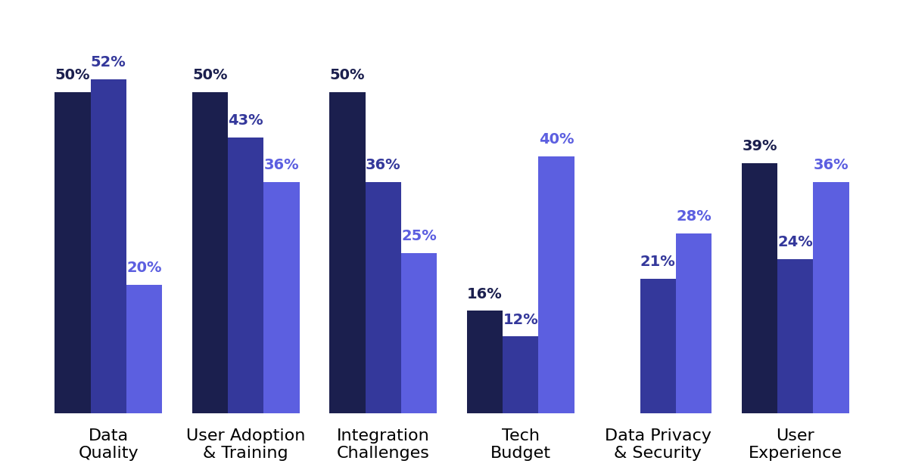
Sales Technology — Stack Maturity & Pain Points
Technology investment is a clear differentiator of commercial leadership. Leaders run complex, multi-tool stacks and face sophistication-level challenges. Laggards are still constrained by basic budget barriers.
44%
44%
40%
Leaders Use 5+ Tools
Laggards Use 1–2 Tools
Laggards: Budget Barrier
Weekly seller tool usage — highest complexity stack
Minimal tech stack — severely limiting commercial capability
Tech budget is the #1 challenge — vs. only 16.7% for Leaders
Biggest Tech Challenges by Group
Leaders
Contenders
Laggards

Slide 7
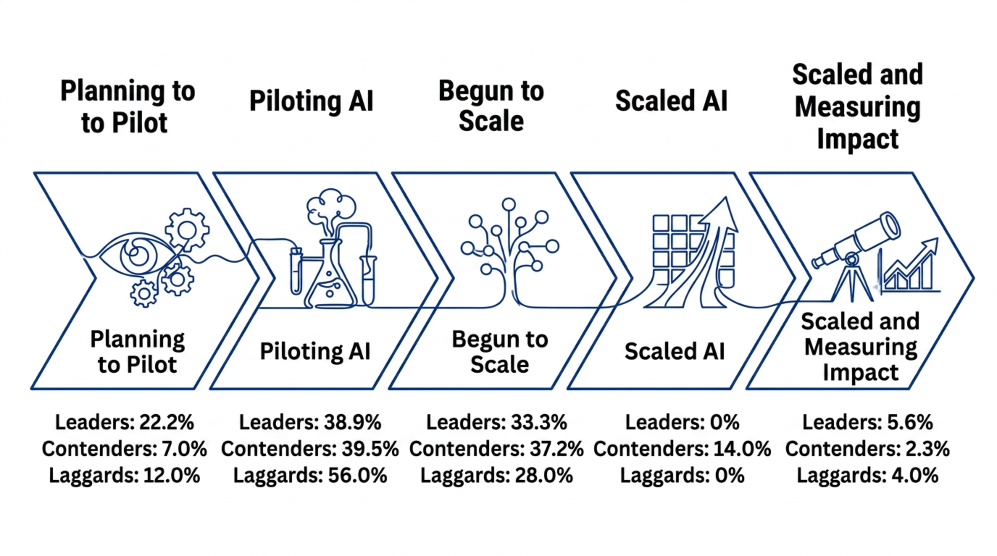



AI Adoption Maturity
AI maturity does not perfectly mirror commercial performance — but the risk is clear. Laggards are most concentrated in early piloting, while advantages compound for those who scale sooner.
Laggard Risk: 56% of Laggards are still just piloting AI — the highest concentration at the earliest stage. As AI scaling compounds advantages, delayed action risks a permanent performance gap.
Contender Surprise: Contenders lead in having fully scaled AI at 14% — outpacing both Leaders and Laggards. All groups remain in the early-to-mid AI journey overall.

Slide 8
Sales Enablement — Ownership & Governance
Where enablement sits in the org chart signals its cultural and strategic priority. Leaders treat it as a revenue function; Laggards treat it as an operational afterthought.
Who Oversees Sales Enablement
How Training Content is Governed
Owner
Leaders
Contenders
Laggards
Governance Model
Leaders
Contenders
Laggards
CRO / Head of Sales
50.0%
46.5%
24.0%
Sales Leadership decides
44.4%
39.5%
32.0%
Head of Sales Ops
22.2%
27.9%
44.0%
CMO
16.7%
18.6%
20.0%
Enablement Board/Council
22.2%
23.3%
8.0%
CFO
0.0%
2.3%
12.0%
Product/Marketing decides
16.7%
18.6%
36.0%
No strong governance
5.6%
7.0%
12.0%
Leaders: Strategic Ownership
Laggards: Operational Drift
50% anchor enablement under CRO with formal governance boards (22%) — treating it as a strategic revenue function.
44% cede control to Sales Ops; 36% to Product/Marketing. Only 8% have a formal enablement board — treating it as operational overhead.

Slide 9


Strategic Imperatives — The Path to Commercial Leadership
Six evidence-based imperatives separate Leaders from Laggards. These are not aspirational — they are the measurable behaviors that drive 5–8x revenue growth differentials.
Close the Performance Gap
Scale Enables Excellence
Leaders grew 12%+ while 60% of Laggards declined. Commercial excellence = measurable revenue advantage.
Leaders average $6.2B vs $3.7B for Laggards. Scale creates investment capacity for capabilities that drive more growth.
Invest in Tech Stack Depth
AI Is Table Stakes — Act Now
Leaders use 5+ tools with sophisticated integration. Laggards must break through the budget investment barrier.
All groups are still piloting. Laggards must accelerate AI scaling or risk falling permanently behind as advantages compound.
Elevate Enablement Ownership
Master Internal Coordination
Move enablement from Sales Ops to CRO leadership. Establish formal enablement boards for strategic governance.
Leaders' top pain point is cross-GTM coordination — Laggards haven't reached this complexity yet. Build the foundations first.
The performance gap is real, measurable, and actionable. Organizations that invest in commercial excellence capabilities today will compound their advantages — widening the gap further every year.

