Slide 1


…… Consumer Research
Mumbai
Delhi
Prepared by xxxx xxxx xxxx
FW Date – xx xx xxxx

Slide 2
Research Background
In packaged cake category, advanced cakes formats are driving growth & penetration. Layer cake is one such format and it contributes 14% of overall cake business, growing at 13% year on year. ITC, Dream Bake & Mondelez are brands which have Layer at Rs 15 in market.
Abc has launched Layer Enrobed at Rs.10, introducing a lot of excitement in the category and it has 69% share in the Rs 10 PP, that too with a new exciting enrobed variant.
Client wants to launch enrobed layer at Rs.10 to give direct competition to Abc at Rs.10.
Hence, client had developed a new recipe and tested it against Abc in February 2024, but the test product could not clear the action standards set at that time.
So, client has now developed new recipe of enrobed layer cake to be tested against Abc.

Slide 3
Research Objective | Methodology
To check product performance of test option FS18 Vs Abc.
Blind product evaluation in a CLT. Sequential monadic design. Each respondent tested two products (one sample of Client and in-market sample of xxxx- as per allocated panels. Panel allocation will be rotated.

Slide 4
Target Group
Males & Females from SEC A Households
Aged between 8-40 years, Split in three groups 8-16(40%), 17-27 (40%) and 28-40(20%).
Consume any packaged branded cakes regularly in their HH for the last 3 months
Branded Cake – Cake packaged and with a brand name on it (following forms – branded sliced cake/ bar cake, branded slab cake, Branded Layer/Pastry Cakes with some filling –center filled with vanilla/chocolate/strawberry, Branded Swiss Roll cake which is sponge cake roll filled with vanilla/chocolate/strawberry ).
Branded cakes considered for the study – Britannia, Cintu, Lavian, Cadbury (Mondelez), Sunfeast, Winkies (Dream cake), Switz, Biskfarm, Parle, Rich feast, Sobisco and Swissyum.
Non-rejectors of the chocolate flavour

Slide 5
Action Standard | Analysis
Superiority on Overall opinion AND Preference Vs Abc@90 & 95% CL two tailed.
JAR penalty analysis, top2box analysis, OO and preference read among chocobakes users!

Slide 6
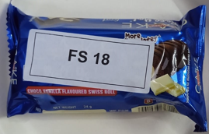

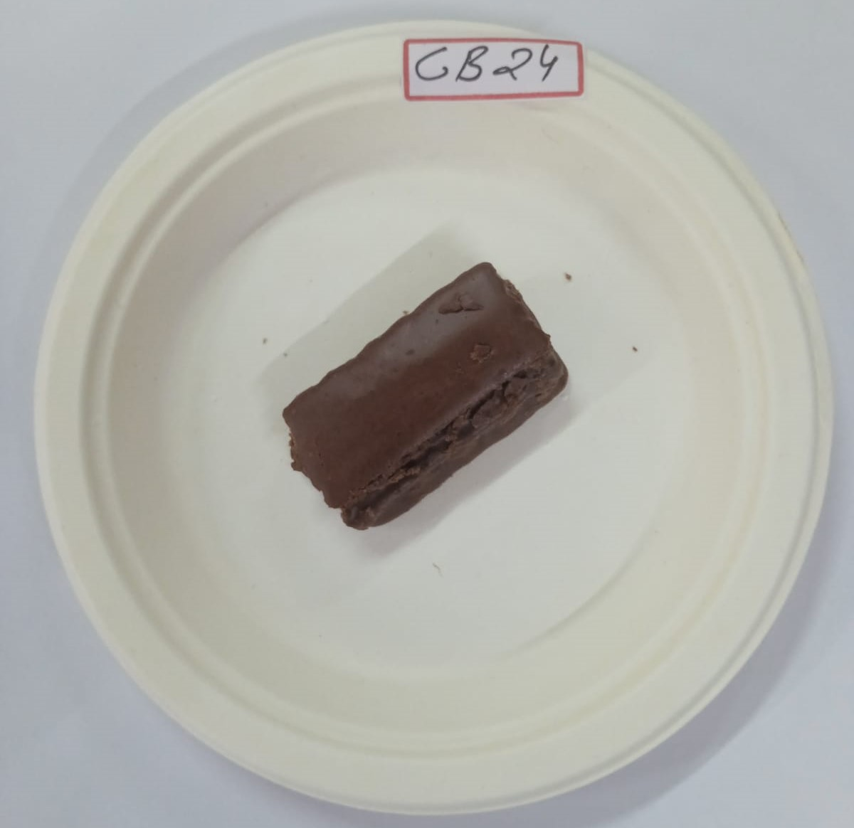
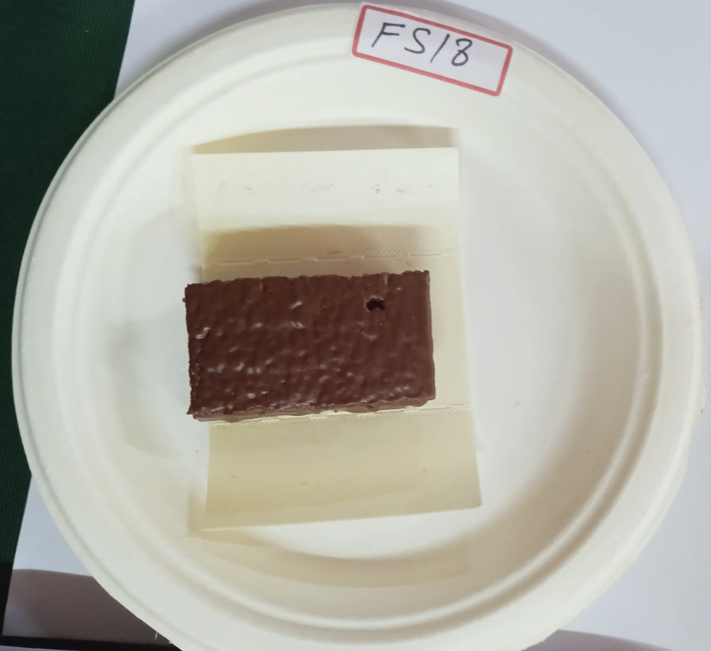
Centre | Sample Size
Mumbai = 90
19th Sep 2024
Sita Sindhu Bhavan Street no. 8, Sita sindhu bhavan,
near venus photo studio, Sen Nagar, Santacruz East,
Mumbai, Maharashtra 400055
20th Sep 2024
Anand Road, Sta Rd, Malad, Vijaykar Wadi, Malad West,
Mumbai, Maharashtra 400064
Delhi = 90
22nd Sep 2024
j-48, west Patel Nagar, new Delhi (West Delhi)
23rd Sep 2024
House no 44/10 Ashok Nagar, near Tilak Nagar, New Delhi
Prototype FS18 Vs Abc (CB 24)

Slide 7
Centre | Sample Size
Mumbai = 90
19th Sep 2024
Sita Sindhu Bhavan Street no. 8, Sita sindhu bhavan,
near venus photo studio, Sen Nagar, Santacruz East,
Mumbai, Maharashtra 400055
20th Sep 2024
Anand Road, Sta Rd, Malad, Vijaykar Wadi, Malad West,
Mumbai, Maharashtra 400064
Delhi = 90
22nd Sep 2024
j-48, west Patel Nagar, new Delhi (West Delhi)
23rd Sep 2024
House no 44/10 Ashok Nagar, near Tilak Nagar, New Delhi
Prototype FS18 Vs Abc (CB 24)
S8. You told you liked to eat cakes, please tell us which of the following brands have you been eaten in last 3 months in your household?
 | Total |  | Mumbai |  | Delhi
 | Count | Col % | Count | Col % | Count | Col %
Sample Size / Base | 129 |  | 78 |  | 51
Britannia | 192 | 100% | 96 | 100% | 96 | 100%
Cadbury (Mondelez) | 129 | 67% | 78 | 81% | 51 | 53%
Parle | 107 | 56% | 49 | 51% | 58 | 60%
Sunfeast | 97 | 51% | 28 | 29% | 69 | 72%
Winkies (Dream cake) | 36 | 19% | 2 | 2% | 34 | 35%
Rich feast | 23 | 12% | 1 | 1% | 22 | 23%
Biskfarm | 20 | 10% | 4 | 4% | 16 | 17%
Switz | 15 | 8% | 11 | 11% | 4 | 4%
Swissyum | 13 | 7% | 0 | 0% | 13 | 14%
Lavian | 5 | 3% | 4 | 4% | 1 | 1%
Cintu | 2 | 1% | 0 | 0% | 2 | 2%
Sobisco | 2 | 1% | 1 | 1% | 1 | 1%
The peoples have been eaten most in last 3 months top 3 brands are Britannia, Cadbury and Parle.

Slide 8
Research Flow
All the participants were recruited on the spot for the research followed by all the selected criteria's.
Take his/her consent to participate in the research and spend 20-25 min to complete the research process.
Screening : Ensure the correct respondent been selected for the research.
Interviewer introduction and familiar to the respondent about the purpose of the research and allowed them to follow the product testing process.
Interviewer ask some structured and unstructured questions to the participant for the respective products to collect the feedbacks.
Feedback has to be recorded on the questionnaire with proper logic checks.

Slide 9
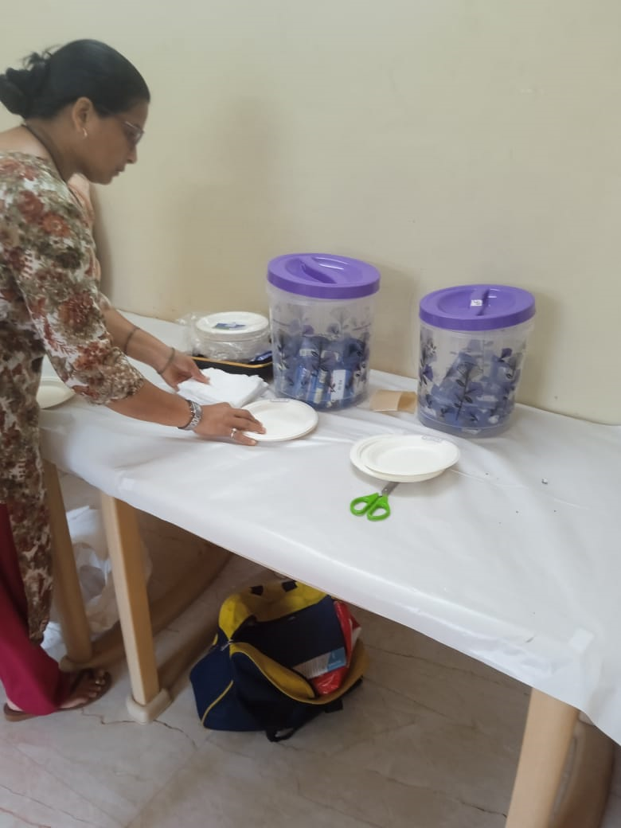
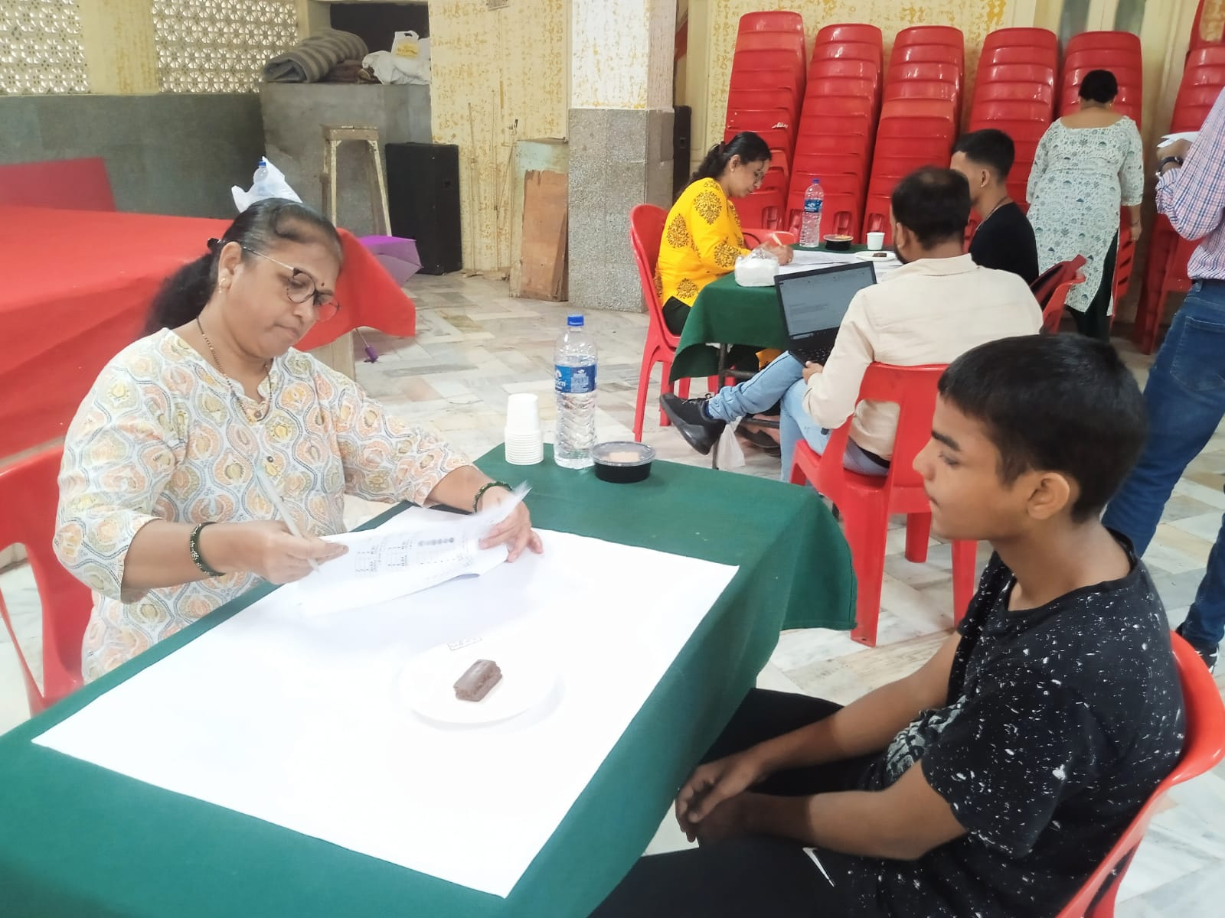
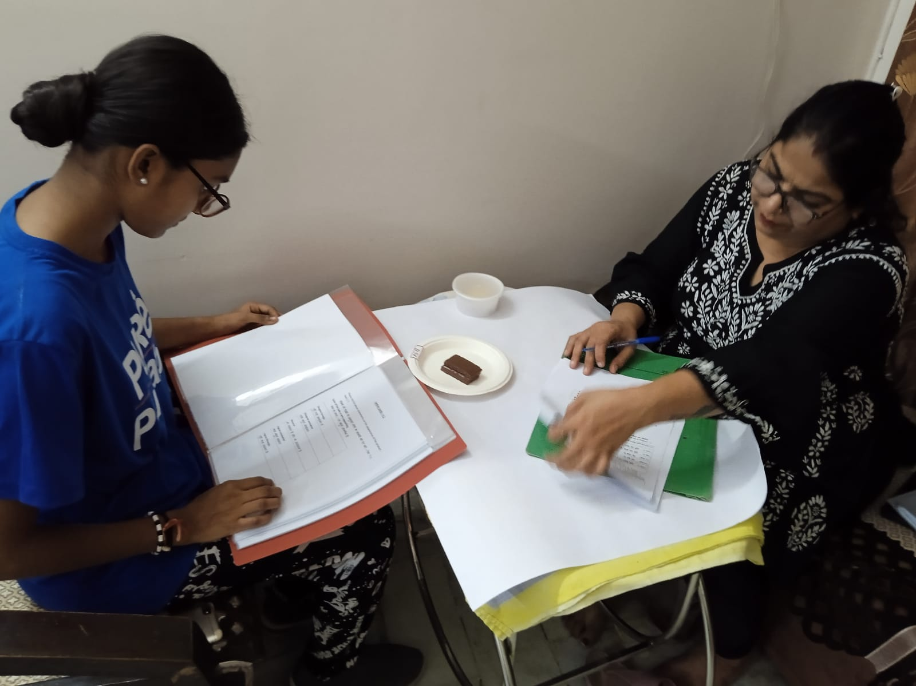
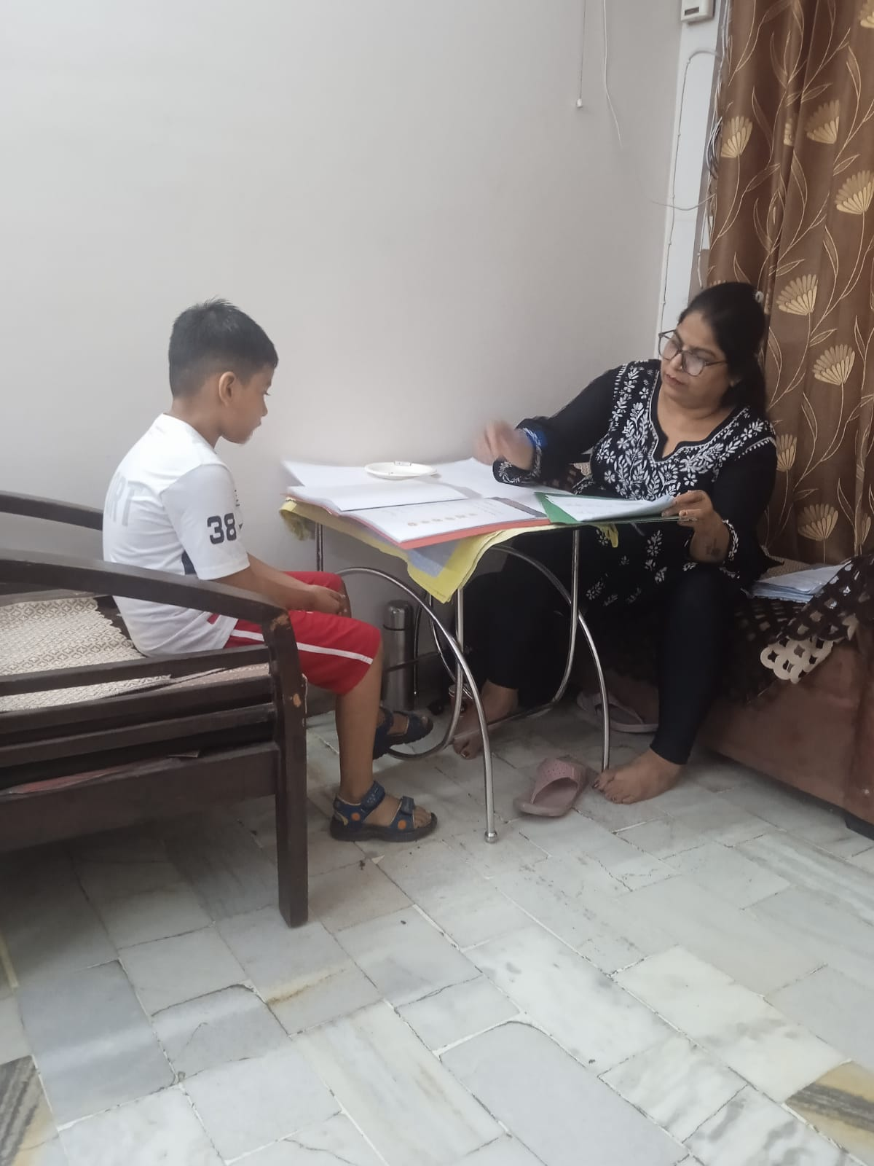
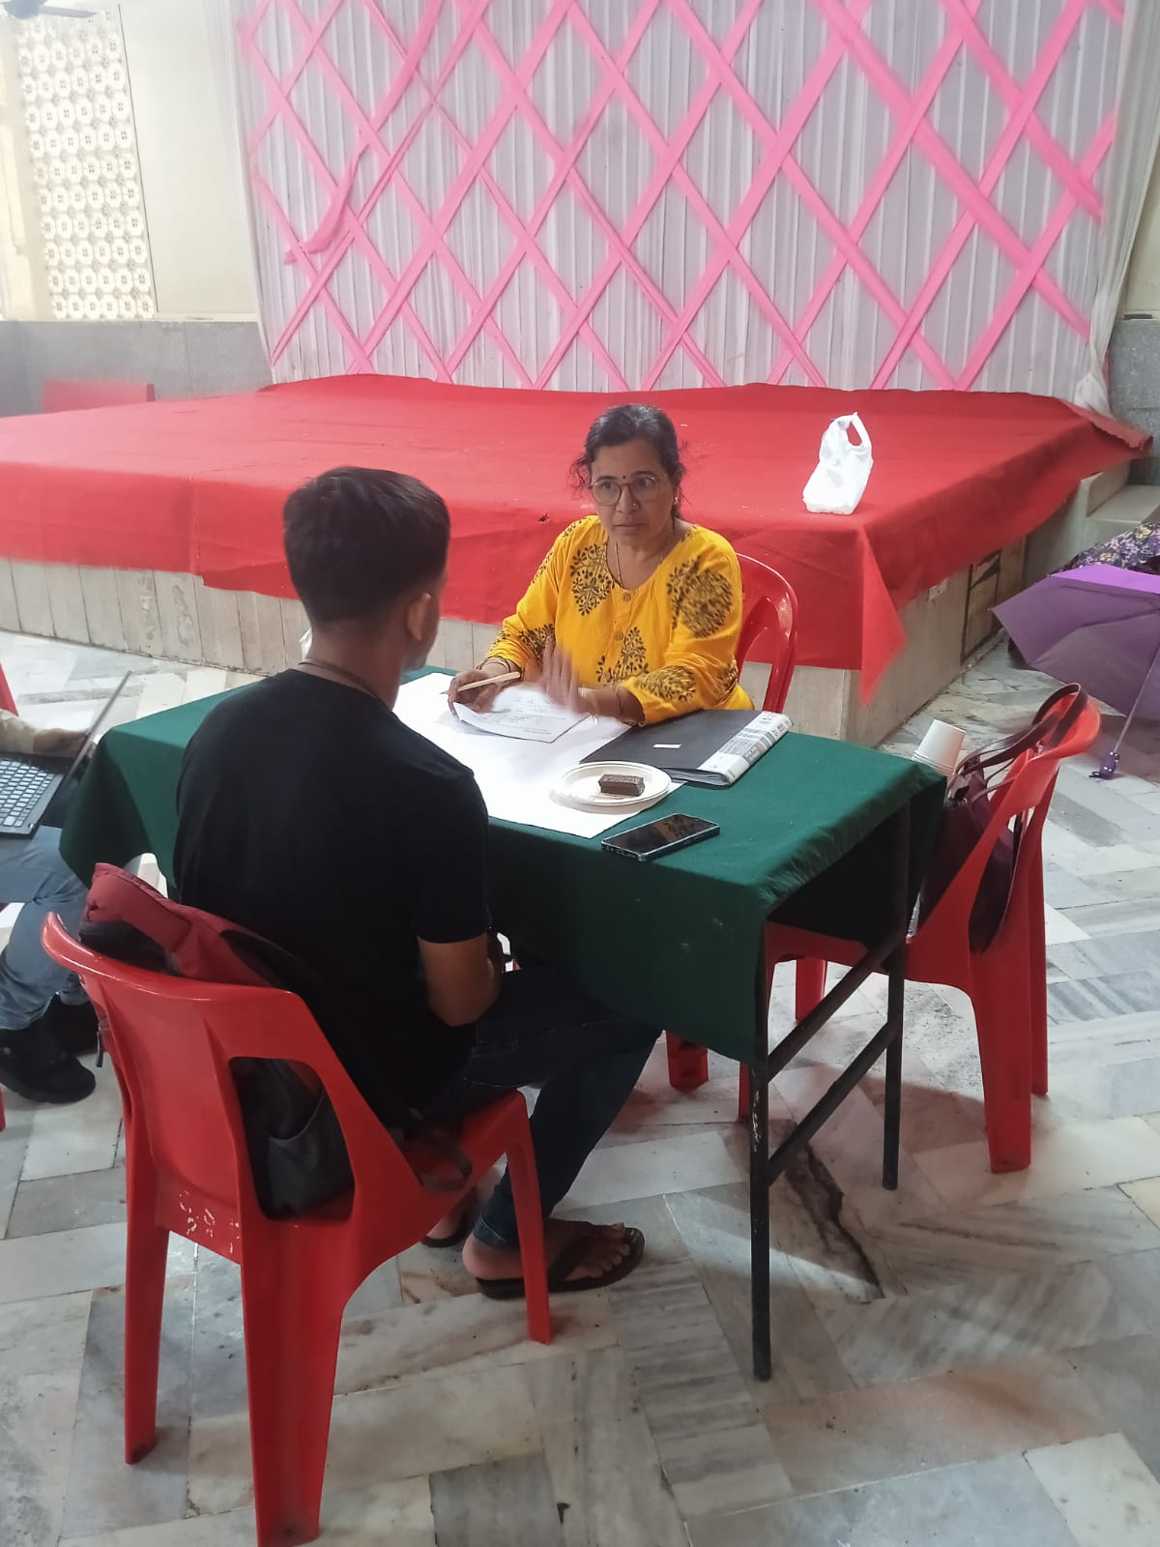
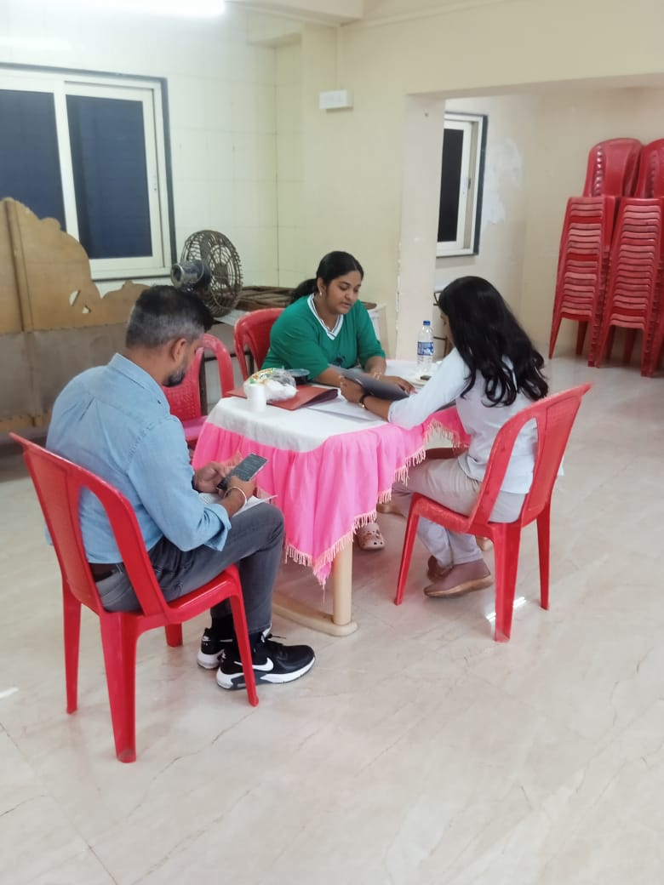
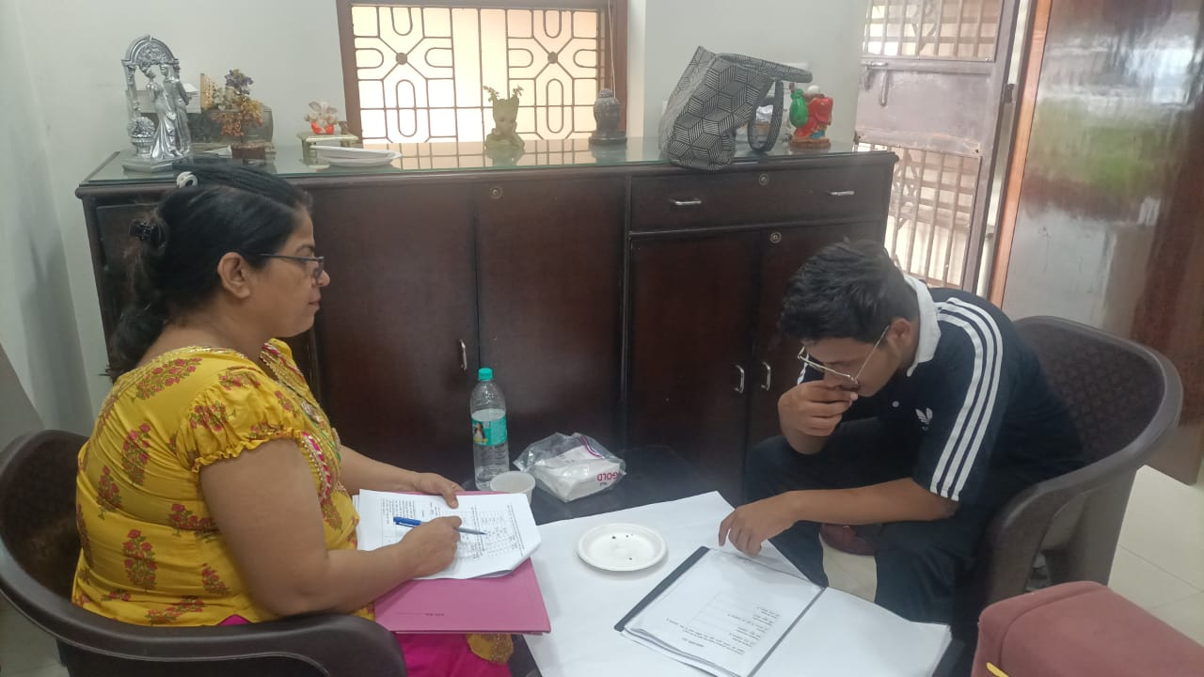
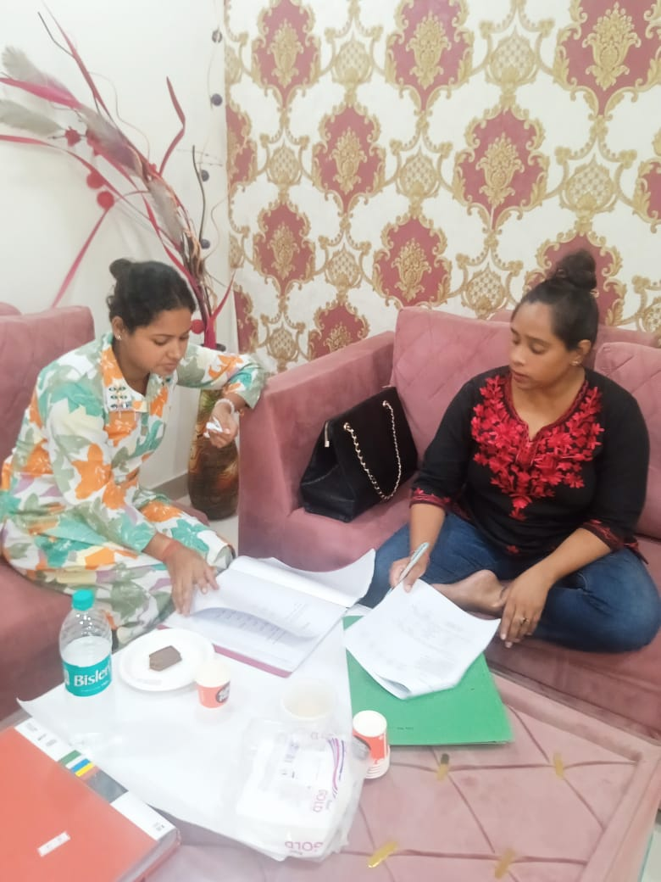
CLT : Primary Research

Slide 10

Executive Summary

Slide 11
Product performance:
Keeping in mind the action standards, FS 18 (Client) sample has performed better significantly and at par over CB 24 (Abc).
On Preference, FS 18 has been liked (58%) highest over CB 24 (42%) at All India level. Similar trend seen in Mumbai, Delhi and across demographics as well.
On Key Measure of Colour, Aroma, Taste, Texture, Bite, Aftertaste and Overall Likeability, FS 18 sample scores highest & at parity followed by CB 24 at All India level and as well as similar trend holds true for other demographics.
Except Mumbai product bitterness, Penalty analysis does not highlight any improvement opportunities and JAR scores are good for FS 18.
Mumbai consumers perceived more bitterness in product FS 18 in comparison of CB 24 and it needs to be reduced.

Slide 12
Consumers are preferred FS 18 product is significantly better over the CB 24. FS 18 sample (FS18) has preferred 58% while CB 24 sample (Abc) has preferred 42%. Whoever preferred product FS 18, they also rated a better score to its overall mean over CB 24.
Preference - Total
B
Overall mean score when preferred product…
B
b
Note:
Capital letter “B” use for 95% confidence interval level and Small letter “b” use for 90% confidence interval level
Green colour means, FS 18 is higher than CB 24 and Red colour means FS 18 is inferior than CB 24.

Slide 13
FS 18 product has significantly better preference over CB 24 across demographics.
Preference - Demographics
B
B
B
B
B
b
Note:
Capital letter “B” use for 95% confidence interval level and Small letter “b” use for 90% confidence interval level
Green colour means, FS 18 is higher than CB 24 and Red colour means FS 18 is inferior than CB 24.

Slide 14
Overall likeability is significantly better of FS 18 over CB 24.
How would you rate the overall liking of the product (Likeability)
TTB
b
B
80% | 71% |  |  | 93% | 79%
5.2 | 5.0 |  |  | 5.4 | 5.1
Mean
B
B
B
Note:
Capital letter “B” use for 95% confidence interval level and Small letter “b” use for 90% confidence interval level
Green colour means, FS 18 is higher than CB 24 and Red colour means FS 18 is inferior than CB 24.

Slide 15
In Delhi, male and elder age group consumers are liked significantly better to the FS 18 product over CB 24, while in Mumbai, male, female, small age, and mid-age group consumers stand at parity.
How would you rate the overall liking of the product (Likeability)
TTB
B
B
B
81% | 78% | 78% | 65% | 85% | 68% | 75% | 75% | 77% | 73% | 79% | 76% | 88% | 59%
5.3 | 5.2 | 5.1 | 4.8 | 5.3 | 5.0 | 5.1 | 5.0 | 5.2 | 5.1 | 5.1 | 5.1 | 5.4 | 4.6
Mean
B
B
B
B
B
B
B
B
Note:
Capital letter “B” use for 95% confidence interval level and Small letter “b” use for 90% confidence interval level
Green colour means, FS 18 is higher than CB 24 and Red colour means FS 18 is inferior than CB 24.

Slide 16
90%+ consumers stated Product FS 18 thickness is perfect at the combined and monadic level, and its JAR scores are significantly better than CB 24.
What do you think about the thickness of it (JAR)
JAR
B
B
91% | 77% |  |  | 94% | 84%
2.0 | 2.0 |  |  | 2.0 | 2.0
Mean
Note:
Capital letter “B” use for 95% confidence interval level and Small letter “b” use for 90% confidence interval level
Green colour means, FS 18 is higher than CB 24 and Red colour means FS 18 is inferior than CB 24.

Slide 17
FS 24 thickness is perfect, and its JAR level is significantly better across segments.
What do you think about the thickness of it (JAR)
JAR
b
B
B
b
B
B
b
89% | 78% | 93% | 75% | 92% | 73% | 89% | 80% | 89% | 77% | 92% | 78% | 91% | 74%
2.0 | 2.0 | 2.1 | 1.9 | 2.0 | 2.0 | 2.0 | 1.9 | 2.0 | 2.0 | 2.0 | 2.0 | 2.0 | 1.9
Mean
Note:
Capital letter “B” use for 95% confidence interval level and Small letter “b” use for 90% confidence interval level
Green colour means, FS 18 is higher than CB 24 and Red colour means FS 18 is inferior than CB 24.

Slide 18
92% and 95% at all and monadic level consumers agreed that the FS 18 product has a perfect soft bite. If see, these % are not bad, but in comparison perspective, 92% is significantly inferior to CB 24. Consumers are more agreeing that CB 24 has a perfect soft bite over FS 18.
Statement on the texture of the product (1/2) | This cake has a perfect soft bite (Agree/Disagree)
TTB
B
92% | 97% |  |  | 95% | 99%
4.6 | 4.7 |  |  | 4.8 | 4.8
Mean
Note:
Capital letter “B” use for 95% confidence interval level and Small letter “b” use for 90% confidence interval level
Green colour means, FS 18 is higher than CB 24 and Red colour means FS 18 is inferior than CB 24.

Slide 19
Mumbai, female and small age group consumers less agreed (significantly) with this statement for FS 18 that “This cake has a perfect soft bite." Delhi, male, mid, and elder age group consumers stand at par with this statement.
Statement on the texture of the product (1/2) | This cake has a perfect soft bite (Agree/Disagree)
TTB
b
b
b
93% | 98% | 92% | 96% | 94% | 97% | 91% | 97% | 93% | 98% | 90% | 97% | 94% | 94%
4.6 | 4.7 | 4.6 | 4.7 | 4.7 | 4.6 | 4.5 | 4.8 | 4.6 | 4.8 | 4.5 | 4.6 | 4.8 | 4.7
Mean
B
B
B
Note:
Capital letter “B” use for 95% confidence interval level and Small letter “b” use for 90% confidence interval level
Green colour means, FS 18 is higher than CB 24 and Red colour means FS 18 is inferior than CB 24.

Slide 20
Mean Drop Penalty Analysis
Penalty (mean-drop) analysis is used by market researchers and product developers to gain an understanding of the product attributes that most affect liking, purchase interest or any other product-related measure. Product attributes used in penalty analysis are measured with “Just -about-right” (JAR) scales. These are categorical scales in which some points represent “too little” of a particular attribute, some points represent “too much,” and one point represents “Just -about-right” Penalty analysis measures the change in product liking (or any other measure) due to that product having “too much” or “too little” of the attribute of interest.
Penalty analysis is a method used in sensory data analysis to identify potential directions for the improvement of products, on the basis of surveys performed on consumers
Mean-Drop analysis only done when 20% or more of respondents rate attribute “NOT-JAR”.
Total Penalty represents the amount the overall liking score would increase if all of the “Not-JAR” respondents moved into the JAR category.
If the total penalty score =>.25, consider under action level.

Slide 21
Mean Drop Penalty Analysis : Impact on Overall likeability (F 18)
Combined Center
No penalty score has been registered for any attributes.
High
Concern
Area
Moderate Area
Low Concern Area
Note: Mean drop penalty analysis done for product F 18

Slide 22
Mean Drop Penalty Analysis: Impact on respective likeability attributes (F 18)
Combined Center
No penalty score has been registered for any attributes.
High
Concern
Area
Moderate Area
Low Concern Area
Bite
Moistness
Sweetness
Bitterness
Note: Mean drop penalty analysis done for product F 18

Slide 23
Mean Drop Penalty Analysis : Impact on Overall likeability (F 18)
Mumbai
Too bitterness falls under the risk area and suggested an action plan further.
High
Concern
Area
Moderate Area
Low Concern Area
Note: Mean drop penalty analysis done for product F 18

Slide 24
Mean Drop Penalty Analysis: Impact on respective likeability attributes (F 18)
Mumbai
No penalty score has been registered for any attributes.
High
Concern
Area
Moderate Area
Low Concern Area
Bite
Moistness
Sweetness
Bitterness
Note: Mean drop penalty analysis done for product F 18

Slide 25
Mean Drop Penalty Analysis : Impact on Overall likeability (F 18)
Delhi
No penalty score has been registered for any attributes.
High
Concern
Area
Moderate Area
Low Concern Area
Note: Mean drop penalty analysis done for product F 18

Slide 26
Mean Drop Penalty Analysis: Impact on respective likeability attributes (F 18)
Delhi
No penalty score has been registered for any attributes.
High
Concern
Area
Moderate Area
Low Concern Area
Bite
Moistness
Sweetness
Bitterness
Note: Mean drop penalty analysis done for product F 18

Slide 27
Attributes summary of product FS 18
 |  | Likeablity
 |  | Total | Monadic | Mumbai | Delhi
 |  | FS 18 | FS 18 | FS 18 | FS 18
Colour | Mean | 5.1 | 5.1 | 5.1 | 5.2
 | TTB | 80% | 81% | 80% | 79%
Chocolatey aroma | Mean | 5.1 | 5.2 | 5.1 | 5.1
 | TTB | 97% | 50% | 49% | 48%
Cake like aroma | Mean | 5.1 | 5.1 | 4.9 | 5.3
 | TTB | 76% | 80% | 71% | 81%
Overall likeability of the aroma | Mean | 5.1 | 5.1 | 5.0 | 5.1
 | TTB | 78% | 82% | 78% | 77%
Bite | Mean | 5.1 | 5.3 | 5.0 | 5.2
 | TTB | 78% | 88% | 75% | 80%
Product sticking to your fingers | Mean | 5.1 | 5.1 | 5.0 | 5.1
 | TTB | 77% | 85% | 72% | 81%
Stickiness | Mean | 5.1 | 5.1 | 5.0 | 5.1
 | TTB | 75% | 81% | 76% | 74%
Moistness | Mean | 5.0 | 5.0 | 4.8 | 5.2
 | TTB | 75% | 80% | 69% | 81%
Product retaining the shape (doesn’t break and crumble) | Mean | 5.2 | 5.3 | 5.2 | 5.2
 | TTB | 84% | 87% | 84% | 83%
 |  | Likeablity
 |  | Total | Monadic | Mumbai | Delhi
 |  | FS 18 | FS 18 | FS 18 | FS 18
Sweetness | Mean | 5.1 | 5.3 | 5.0 | 5.2
 | TTB | 80% | 89% | 78% | 81%
Bitterness | Mean | 4.7 | 4.9 | 4.4 | 5.0
 | TTB | 64% | 70% | 51% | 77%
Chocolatiness | Mean | 5.2 | 5.4 | 5.1 | 5.2
 | TTB | 97% | 50% | 49% | 48%
Cake like flavor of the product | Mean | 5.2 | 5.2 | 5.0 | 5.3
 | TTB | 80% | 84% | 78% | 83%
Dissolves in your mouth | Mean | 5.2 | 5.4 | 5.1 | 5.2
 | TTB | 79% | 88% | 79% | 78%
Sweet lingering taste | Mean | 5.2 | 5.3 | 5.2 | 5.1
 | TTB | 81% | 90% | 83% | 79%
Lingering chocolatiness | Mean | 5.1 | 5.3 | 5.1 | 5.2
 | TTB | 78% | 86% | 78% | 77%
Overall liking | Mean | 5.2 | 5.4 | 5.3 | 5.1
 | TTB | 80% | 93% | 81% | 78%
B
Preference
FS 18 is significantly liked and parity to CB 24 at TTB and mean scores. No inferior score has been noticed for FS 18 against CB 24.
FS 18 is significantly better than CB 24 @ 95% C.I.L
FS 18 is significantly better than CB 24 @ 90% C.I.L
FS 18 is significantly inferior than CB 24 @ 95% C.I.L
FS 18 is significantly inferior than CB 24 @ 90% C.I.L
FS 18 is parity with CB 24

Slide 28
Attributes summary of product FS 18
 | JAR
 | Total | Monadic | Mumbai | Delhi
 | FS 18 | FS 18 | FS 18 | FS 18
Size | 86% | 88% | 84% | 89%
Thickness | 91% | 94% | 89% | 93%
Bite of the product | 83% | 88% | 79% | 86%
Moistness of the product | 87% | 92% | 86% | 88%
Sweetness of the product | 82% | 88% | 77% | 88%
Bitterness of the product | 73% | 78% | 59% | 88%
B
Preference
FS 18 is significantly liked and parity to CB 24 at JAR scores. No inferior score has been noticed for FS 18 against CB 24 except Mumbai sweetness.
FS 18 is significantly better than CB 24 @ 95% C.I.L
FS 18 is significantly better than CB 24 @ 90% C.I.L
FS 18 is significantly inferior than CB 24 @ 95% C.I.L
FS 18 is significantly inferior than CB 24 @ 90% C.I.L
FS 18 is parity with CB 24

Slide 29
Attributes summary of product FS 18
 |  | Agree/Disagree
 |  | Total | Monadic | Mumbai | Delhi
 |  | FS 18 | FS 18 | FS 18 | FS 18
Color of the Cake is very appealing | Mean | 4.6 | 4.6 | 4.5 | 4.8
 | TTB | 95% | 93% | 92% | 98%
Size of the Cake is perfect | Mean | 4.6 | 4.6 | 4.4 | 4.8
 | TTB | 91% | 91% | 85% | 96%
Appearance of the Cake makes me want to eat more | Mean | 4.7 | 4.8 | 4.6 | 4.8
 | TTB | 95% | 98% | 95% | 96%
This aroma reminds me of rich melting chocolate | Mean | 4.5 | 4.6 | 4.4 | 4.6
 | TTB | 92% | 93% | 91% | 94%
Aroma of the product makes me want to eat more | Mean | 4.6 | 4.6 | 4.5 | 4.6
 | TTB | 92% | 94% | 92% | 93%
It has a rich chocolaty aroma | Mean | 4.5 | 4.6 | 4.4 | 4.6
 | TTB | 92% | 94% | 91% | 92%
The aroma has the best combination of a cake and chocolate | Mean | 4.7 | 4.8 | 4.7 | 4.7
 | TTB | 94% | 100% | 96% | 92%
 |  | Agree/Disagree
 |  | Total | Monadic | Mumbai | Delhi
 |  | FS 18 | FS 18 | FS 18 | FS 18
This cake has a perfect soft bite | Mean | 4.6 | 4.8 | 4.6 | 4.6
 | TTB | 92% | 95% | 93% | 92%
This cake doesn’t crumble when I take a bite | Mean | 4.6 | 4.7 | 4.7 | 4.6
 | TTB | 94% | 95% | 96% | 92%
This cake has perfect sweetness | Mean | 4.6 | 4.7 | 4.4 | 4.7
 | TTB | 90% | 92% | 88% | 92%
This cake has perfect taste |  | 4.6 | 4.7 | 4.6 | 4.6
 |  | 92% | 96% | 91% | 93%
Less Bitterness | Mean | 4.1 | 4.2 | 3.9 | 4.4
 | TTB | 78% | 78% | 72% | 83%
I really enjoyed the consuming the product | Mean | 4.6 | 4.8 | 4.6 | 4.7
 | TTB | 92% | 97% | 92% | 92%
It has a rich chocolaty flavor | Mean | 4.6 | 4.7 | 4.5 | 4.6
 | TTB | 90% | 96% | 90% | 91%
B
Preference
FS 18 is significantly liked and parity to CB 24 at agreement level at many attributes. Inferior scores have been noticed for FS 18 against CB 24 at bite, sweetness, bitterness, and enjoy the consuming the product.
FS 18 is significantly better than CB 24 @ 95% C.I.L
FS 18 is significantly better than CB 24 @ 90% C.I.L
FS 18 is significantly inferior than CB 24 @ 95% C.I.L
FS 18 is significantly inferior than CB 24 @ 90% C.I.L
FS 18 is parity with CB 24

Slide 30
Summary : SWOT analysis for product FS 18
. Colour
. Product sticking on fingers
. Stickiness
. Shape (Doesn’t crumble)
. Chocolatiness
. Sweet lingering taste
. Lingering chocolatiness
. Overall liking
Too Bitter
Too bitterness has been impacting the product's overall liking score. Product overall score can increase by reducing bitterness.
Needs to reduce bitterness
Strength
Weak
Opportunity
Threat

Slide 31
Driver Analysis : FS 18
Key Driver Analysis is used to identify the key drivers (or, factors) that influence Overall liking. The following top six elements or variables that have the most significant impact on Overall liking.
Key drivers

Slide 32
Driver Analysis : CB 24
Key Driver Analysis is used to identify the key drivers (or, factors) that influence Overall liking. The following top six elements or variables that have the most significant impact on Overall liking.
Key drivers
Key drivers

Slide 33

Recommendation
Product FS 18 has met the action standard. The product is superior on overall liking and preference vs. CB24. In the whole of the research, it has been noticed that product FS 18 has better performed, and some where it stands at par with CB 24. Wherever it appears in the red zone post-penalty analysis, only one parameter "too bitter" falls under the risk area.
Mumbai consumers found too bitterness in product FS 18, which is blocking to increase its overall liking mean score.
However, the too-bitterness consumer percentage is 13%, which is less than 20%. Theoretical, Mean-Drop analysis only done when 20% or more of respondents rate attribute “NOT-JAR”. So here only 13% of consumers have found bitterness in the product; hence, consideration for further modification in the product is not strictly applicable.
So, recommend, can go-ahead with this product FS 18 to the next level with or without reduce the bitterness.

Slide 34


Slide 35
Cadbury Chocobakes users have significantly liked FS 18 over CB 24 in total (60%:40%), and the same trend is seen in some demographic data. FS 18 has preferred better and significantly over CB 24 across.
Preference – Total and Demographics
This analysis based on Cadbury (Mondelez) users only
Total
B
b
B
b
b
B
Note:
Capital letter “B” use for 95% confidence interval level and Small letter “b” use for 90% confidence interval level
Green colour means, FS 18 is higher than CB 24 and Red colour means FS 18 is inferior than CB 24.

Slide 36
FS 18 is directionally and significantly better than CB 24. Chocobakes users have liked better to FS 18 over CB 24.
How would you rate the overall liking of the product (Likeability)
This analysis based on Cadbury (Mondelez) users only
TTB
b
79% | 73% |  |  | 94% | 83%
5.2 | 5.0 |  |  | 5.4 | 5.2
Mean
B
b
Note:
Capital letter “B” use for 95% confidence interval level and Small letter “b” use for 90% confidence interval level
Green colour means, FS 18 is higher than CB 24 and Red colour means FS 18 is inferior than CB 24.

Slide 37
All the Chocobakes users have liked equally to both products except male and elder age categories. Male and elderly consumers have liked significantly better FS 18 over CB 24.
How would you rate the overall liking of the product (Likeability)
This analysis based on Cadbury (Mondelez) users only
TTB
B
81% | 78% | 76% | 65% | 84% | 68% | 75% | 78% | 77% | 76% | 81% | 70% | 81% | 69%
5.3 | 5.2 | 5.1 | 4.8 | 5.2 | 5.0 | 5.2 | 5.0 | 5.2 | 5.1 | 5.2 | 5.0 | 5.4 | 4.8
Mean
b
B
B
B
Note:
Capital letter “B” use for 95% confidence interval level and Small letter “b” use for 90% confidence interval level
Green colour means, FS 18 is higher than CB 24 and Red colour means FS 18 is inferior than CB 24.

