Slide 1
Vincent van Gogh: A Life in Color
The Creative Journey of the Artist Who Changed How We See
[Presenter Name] | [Date] | [Venue]
Notes:
Welcome. Today we're going to walk through the life of Vincent van Gogh — not just the iconic paintings, but the story of how they came to be. In just ten years, he created over 2,100 artworks. He sold only one painting in his lifetime. And yet today, his Starry Night is one of the most recognized images on earth. How did that happen? That's the journey we're taking.

Slide 2
INTRODUCTION
He Sold One Painting in His Lifetime. Today, His Work Defines Modern Art.
400 francs → $82.5 million
Only one confirmed sale during his lifetime: The Red Vineyard, sold for 400 francs to Anna Boch at the 1890 Les XX exhibition in Brussels
In 1990, Portrait of Dr. Gachet sold for $82.5 million at Christie's — a world record at the time
During his 10-year career (1880–1890): ~860–900 oil paintings and ~1,100 drawings — roughly one artwork every 36 hours
His sister-in-law Johanna van Gogh-Bonger published his letters and organized posthumous exhibitions, driving his global recognition
Today his paintings hang in the world's greatest museums: MoMA, Musée d'Orsay, the Van Gogh Museum
Source: Met Museum; Britannica; Wikipedia (List of works, The Red Vineyard); Death of VG Wikipedia
Van Gogh: The Artist's Journey
2
Notes:
Let me start with a paradox. Vincent van Gogh is one of the most famous artists in history — but during his lifetime, he was almost completely unknown. He sold exactly one painting while he was alive, for the equivalent of about 80 dollars today. A century later, one of his portraits sold for 82.5 million dollars. The question is: what happened in between? And the answer is a story of relentless creation against every imaginable obstacle.

Slide 3
INTRODUCTION
He Tried Being an Art Dealer, a Teacher, and a Preacher. None of It Worked.
Born March 30, 1853, in Zundert, Netherlands (Brabant region) — eldest of six children of a Protestant pastor, Theodorus van Gogh
Age 16: Apprenticed to art dealers Goupil & Cie in The Hague; worked in London (1873–1875) and Paris (1875–1876)
Grew to dislike art dealing; became increasingly solitary after a romantic rejection in London, 1874
Worked as a language teacher, lay preacher in England, and briefly a bookseller in Dordrecht (1877)
1878–1879: Missionary work among impoverished coal miners in the Borinage (southwestern Belgium); gave away all possessions
Dismissed by church authorities for 'too-literal interpretation of Christian teaching' — a profound crisis that became the catalyst for his art
Source: Britannica; Met Museum Heilbrunn Timeline. Confidence: HIGH.
Van Gogh: The Artist's Journey
3
Notes:
Van Gogh didn't grow up dreaming of being an artist. He tried being an art dealer, a teacher in England, and a missionary to coal miners in Belgium. He was fired from the church for being too zealous — for actually living among the poor instead of just preaching at them. By age 27, he had failed at everything he'd tried. And that's exactly when he finally found his calling.

Slide 4
INTRODUCTION
“
"They think I'm a madman because I wanted to be a true Christian. They turned me out like a dog, saying that I was causing a scandal. I want to give the wretched a brotherly message. When I sign my paintings 'Vincent,' it is as one of them."
— Vincent van Gogh, letter to Theo, 1880 (Borinage period)
In the winter of 1879–1880, after dismissal from missionary work and during a profound spiritual crisis, Van Gogh began to draw seriously. He discovered his vocation as an artist at age 27, translating his mission to serve the poor into a new language: paint.
Source: Britannica; Van Gogh Letters project (vangoghletters.org). Confidence: HIGH.
Van Gogh: The Artist's Journey
4
Notes:
After the church turned him away, Van Gogh wrote these words to his brother Theo. He wasn't abandoning his mission to serve the poor — he was translating it into a new language: paint. When he signed his paintings 'Vincent,' he said, it was as one of them — one of the working people, the suffering people. This was the seed of everything that followed. He was 27, with no formal training, and yet this was the moment he became an artist.

Slide 5
PART 1
The Dutch Years
1880–1886: Self-Taught Beginnings in the Dark Palette of the North
Notes:
For the next six years, Van Gogh taught himself to be an artist in the Netherlands. These are the years of dark earth tones, peasant subjects, and the slow, painful acquisition of craft. He worked in Etten, The Hague, Drenthe, Nuenen, and briefly Antwerp — each place adding a layer to his understanding. We begin with his first masterpiece.

Slide 6
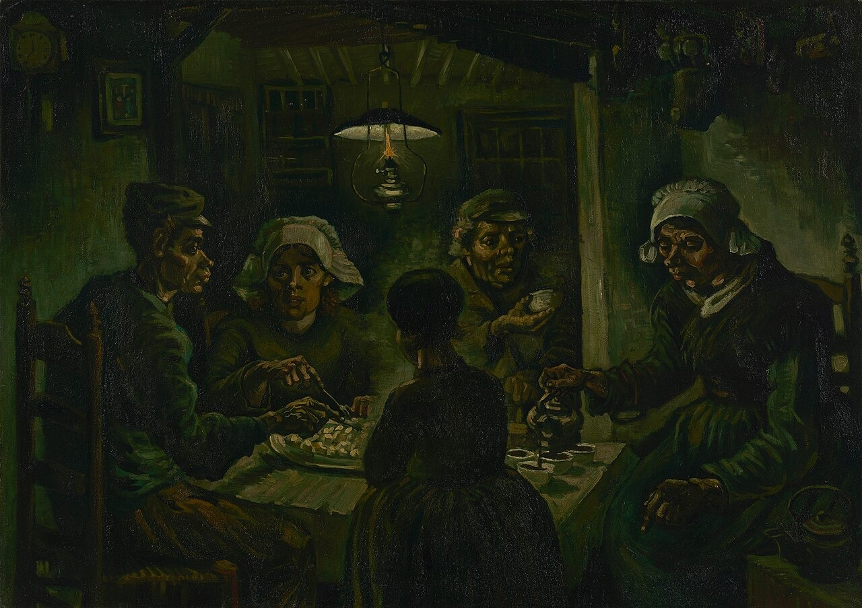
PART 1: THE DUTCH YEARS
"They Have Tilled the Earth Themselves with the Same Hands They Are Putting in the Dish."
Painted April–May 1885 in Nuenen, after 40+ studies of peasant heads during the winter of 1884–1885
Van Gogh's first large-scale, multi-figure composition — his first attempt at a 'masterpiece'
Depicts a peasant family sharing potatoes by lamplight in a cramped, dark room — hands roughened by labor
Van Gogh's stated intent: to convey the dignity and harshness of peasant life, not romanticize it — the painting should 'smell of bacon, smoke, and potato steam'
Dark earthy palette characteristic of his Dutch period; coarse application of paint; influenced by Millet and the Barbizon school
The Potato Eaters, 1885. Van Gogh Museum, Amsterdam.
Source: Met Museum; Van Gogh Museum; Britannica Confidence: HIGH.
Van Gogh: The Artist's Journey
6
Notes:
This is The Potato Eaters — Van Gogh's first major work. Look at the hands. These are hands that have worked the soil all day, and now they're reaching for the same potatoes they planted. Van Gogh said he wanted the painting to smell of bacon, smoke, and potato steam. It's dark, it's coarse, and it's completely intentional. This is not a pretty picture of rural life — it's an honest one. He painted over forty studies of peasant heads to prepare for this single composition.

Slide 7
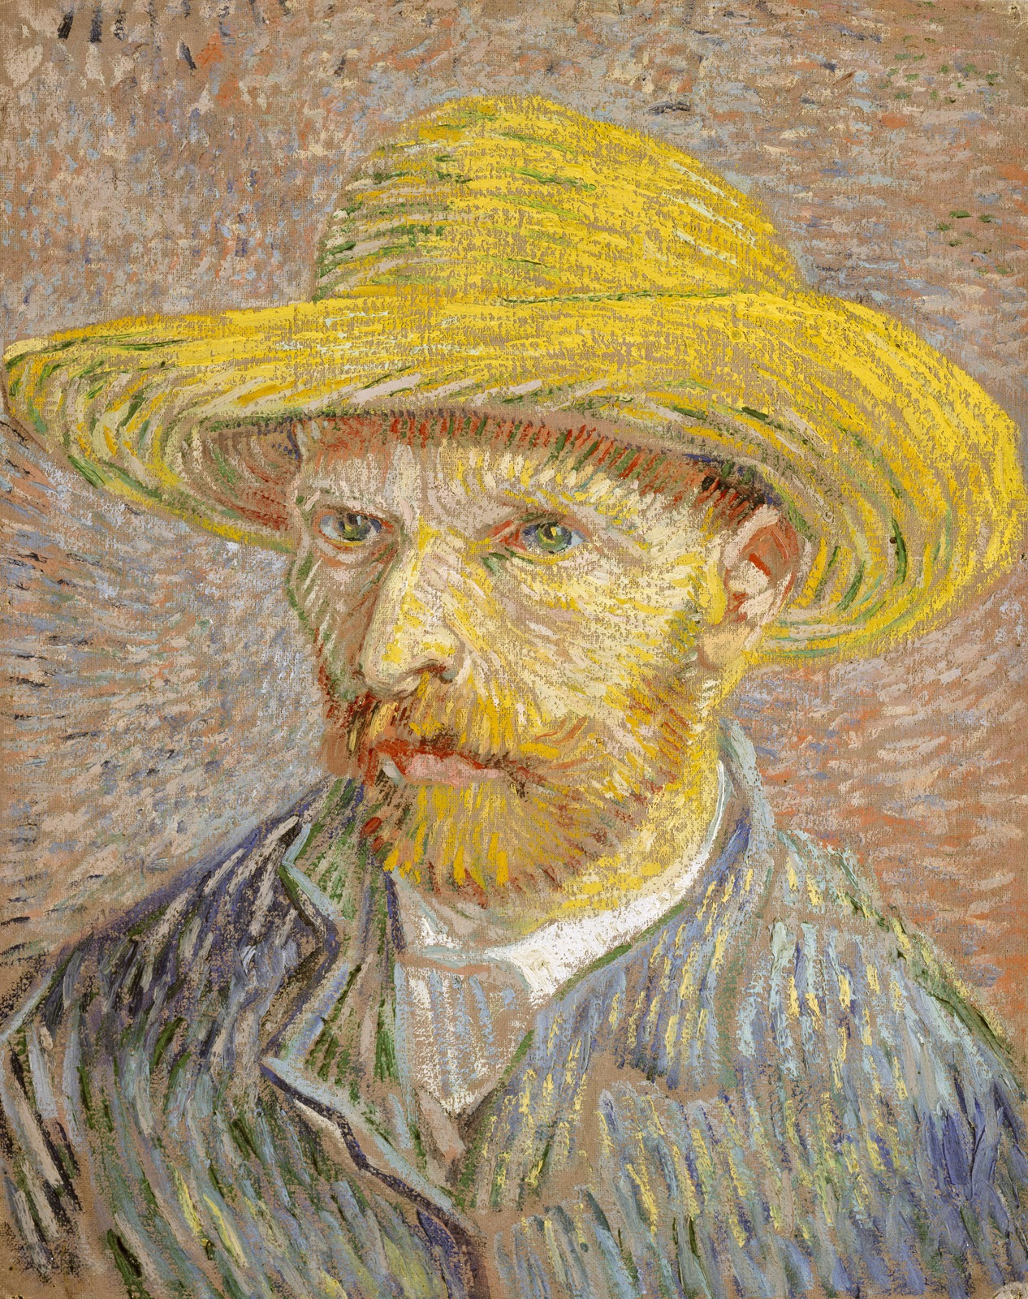
PART 1: THE DUTCH YEARS → PARIS
In Two Years, Paris Transformed Everything He Knew About Color.
This self-portrait was painted on the reverse of an earlier dark peasant study — a perfect metaphor for the transformation.
Moved to Paris in February 1886; lived with brother Theo, an art dealer at Boussod, Valadon et Cie
Studied at Fernand Cormon's studio; met the avant-garde: Émile Bernard, Paul Gauguin, Camille Pissarro, Georges Seurat, Henri de Toulouse-Lautrec, Paul Signac, and Edgar Degas
Witnessed Impressionist works firsthand and Neo-Impressionist innovations by Seurat and Signac — lightened his palette dramatically
Began collecting Japanese ukiyo-e prints obsessively — amassed hundreds that transformed his composition, cropping, and use of flat color
Painted more than 20 self-portraits in Paris — using himself as a laboratory to explore complementary color contrasts
Self-Portrait with Straw Hat, 1887. Metropolitan Museum of Art, New York.
Source: Met Museum; Britannica; Wikipedia Japonaiserie. Confidence: HIGH.
Van Gogh: The Artist's Journey
7
Notes:
When Van Gogh arrived in Paris in 1886, he was still painting in dark, muddy tones. Two years later, he left for the south of France with a palette exploding in color. What happened? He met the Impressionists. He saw what Seurat was doing with dots of pure color. He fell in love with Japanese prints. And he painted himself over and over — more than 20 self-portraits — using his own face as a laboratory for color. Remarkably, this bright self-portrait was painted on the back of an old dark Dutch peasant study. The transformation was literally two sides of the same canvas.

Slide 8
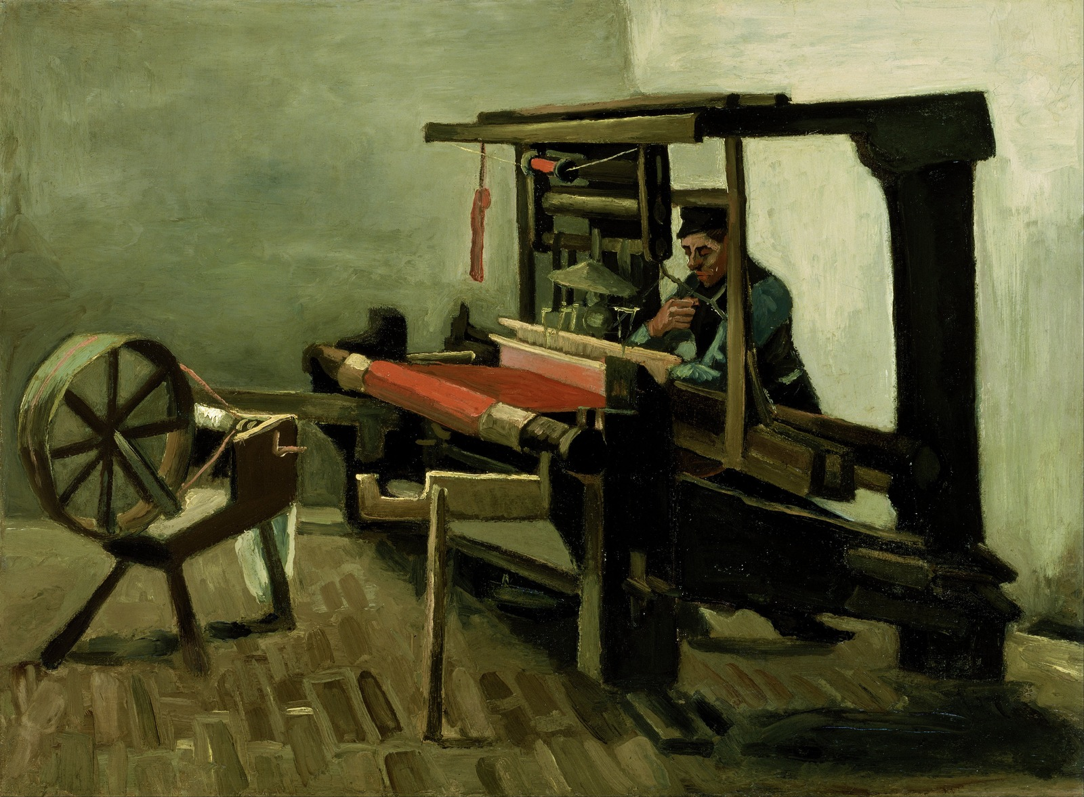
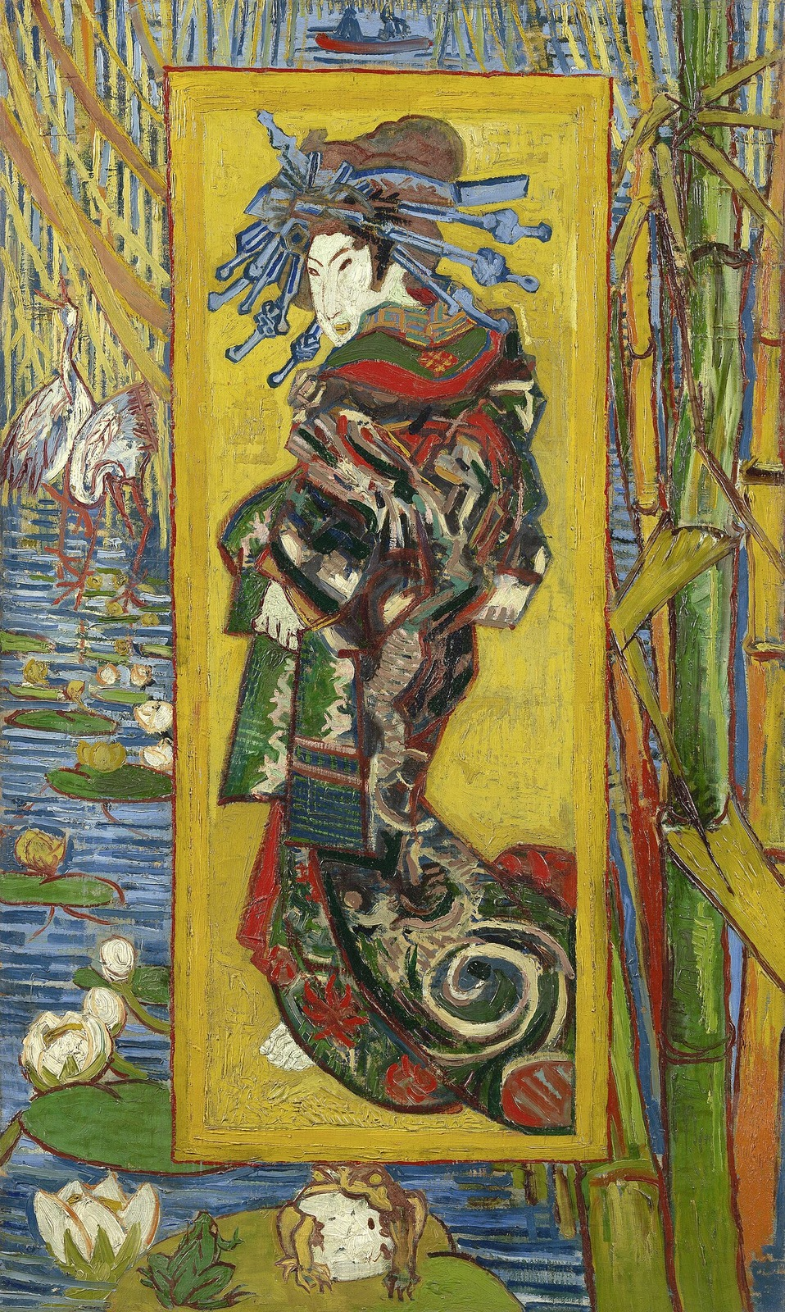
PART 1: THE DUTCH YEARS
Two Years Changed Everything: From the Dark North to the Color of Light.
Nuenen, 1885 — The Dutch Period
Paris, 1887 — The Awakening
The Weaver, 1884. Van Gogh Museum, Amsterdam.
The Courtesan (after Eisen), 1887. Van Gogh Museum, Amsterdam.
Dark, earthy palette; coarse brushwork; somber working-class subjects. Influenced by Millet, Barbizon school, and Dutch Masters. Heavy browns and muted tones dominate.
Light, vibrant palette; bold outlines from Japanese prints; flat color areas; unusual cropping. Japonisme, Impressionist brushwork, and complementary color theory transform his entire visual language.
Source: Met Museum; Van Gogh Museum. Sections 2.3–2.4 (Dutch style), 3.2 (Paris transformation). Confidence: HIGH.
Van Gogh: The Artist's Journey
8
Notes:
Look at these two paintings, made barely two years apart. On the left, The Weaver from his time in Nuenen — dark, heavy, the brown of the Dutch interior. On the right, The Courtesan from Paris — a direct copy of a Japanese woodblock print, alive with vibrant reds, yellows, and decorative patterns. This is not just a change in taste. This is a complete reinvention of how Van Gogh saw the world. Paris gave him new eyes — and Japanese art gave him a new visual vocabulary.

Slide 9
PART 2
Arles — The Southern Light
1888–1889: The Search for the Studio of the South, and the Most Prolific Months of His Life
Notes:
In February 1888, Van Gogh left Paris and headed south — to Arles, in Provence. He was looking for something: a clarity of light, a community of artists, a place where color could burn as bright as the Mediterranean sun. What followed were the most productive 15 months of his life — and the most shattering crisis he had ever faced. The Yellow House, the Sunflowers, the night cafés — this is where Van Gogh became Van Gogh.

Slide 10
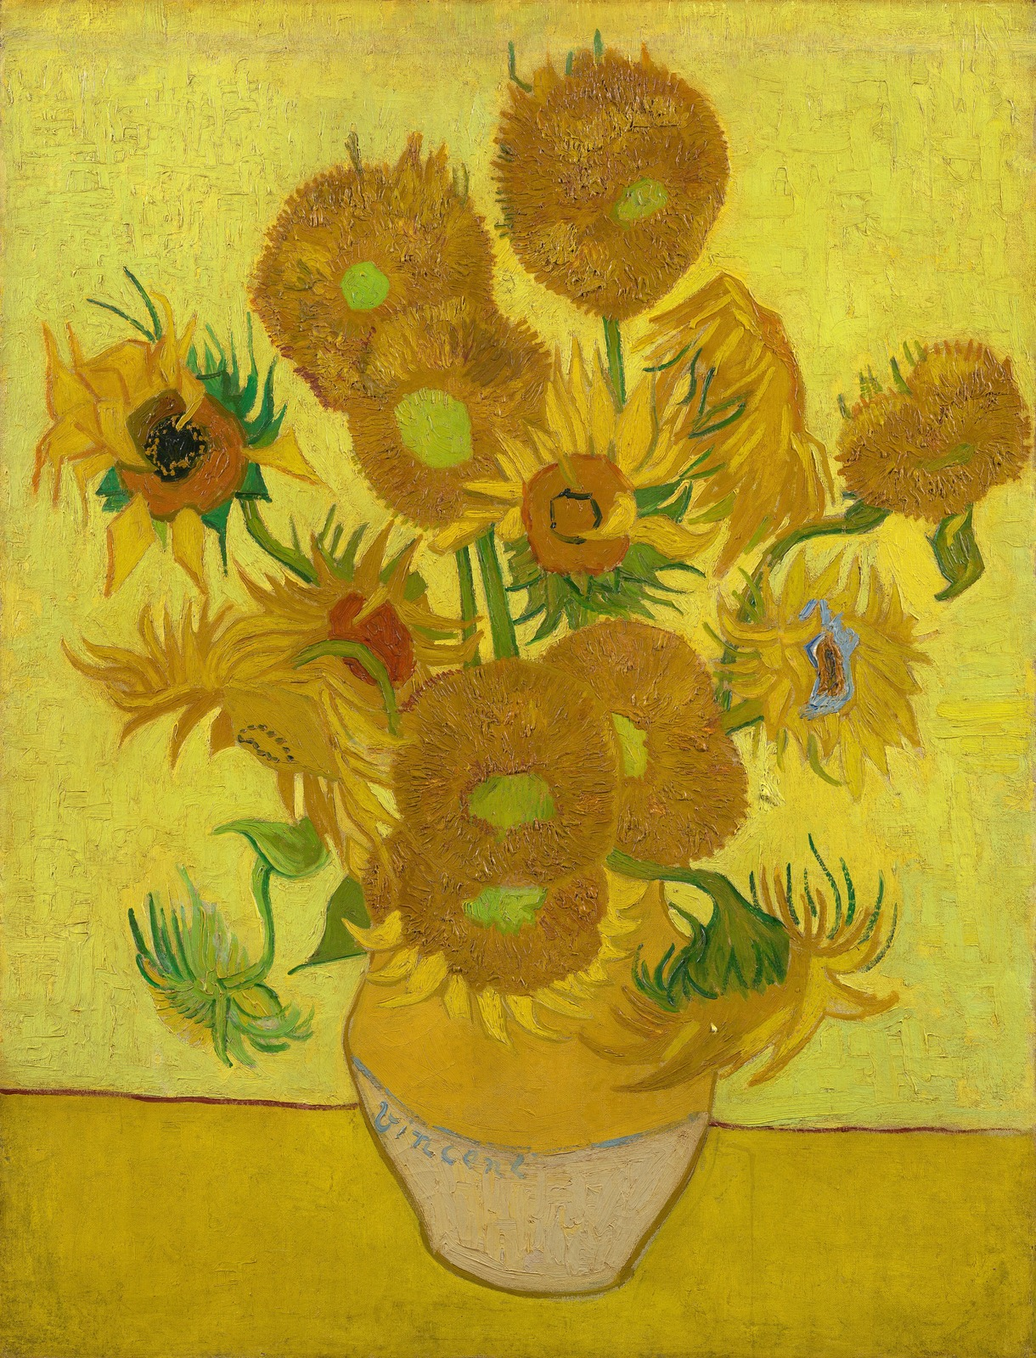
PART 2: ARLES — THE SOUTHERN LIGHT
He Painted Sunflowers to Decorate a Room for a Friend Who Would Soon Betray Him.
Rented the Yellow House in May 1888; painted it in September — a symbol of his dream to create an artists' community, the 'Studio of the South'
Painted the Sunflowers series (multiple versions, August 1888) specifically to decorate the guest room for Paul Gauguin's anticipated arrival
The Sunflowers are among his most iconic works — versions now at the National Gallery London, Van Gogh Museum, Neue Pinakothek Munich, and Sompo Museum Tokyo
Also painted The Bedroom (3 versions, October 1888) — a deeply personal interior where color conveys rest and tranquility
Produced the Flowering Orchards series (14 paintings, March–April 1888), capturing the Provençal spring in radiant color
Sunflowers (F.458), 1889. Van Gogh Museum, Amsterdam. Repetition of the 4th version.
Source: Met Museum; National Gallery; Van Gogh Museum. Section 4.3 (key works table). Confidence: HIGH.
Van Gogh: The Artist's Journey
10
Notes:
Van Gogh rented this small yellow house in Arles and began preparing for the arrival of Paul Gauguin, an artist he deeply admired. He painted the Sunflowers — not as a casual still life, but as a gift, a welcome, an offering to a colleague he hoped would become his collaborator in a new artists' community. This was a moment of pure optimism. He believed he was building something — a studio, a community, a home for a new kind of art. He didn't know that in just a few months, it would all come crashing down.

Slide 11
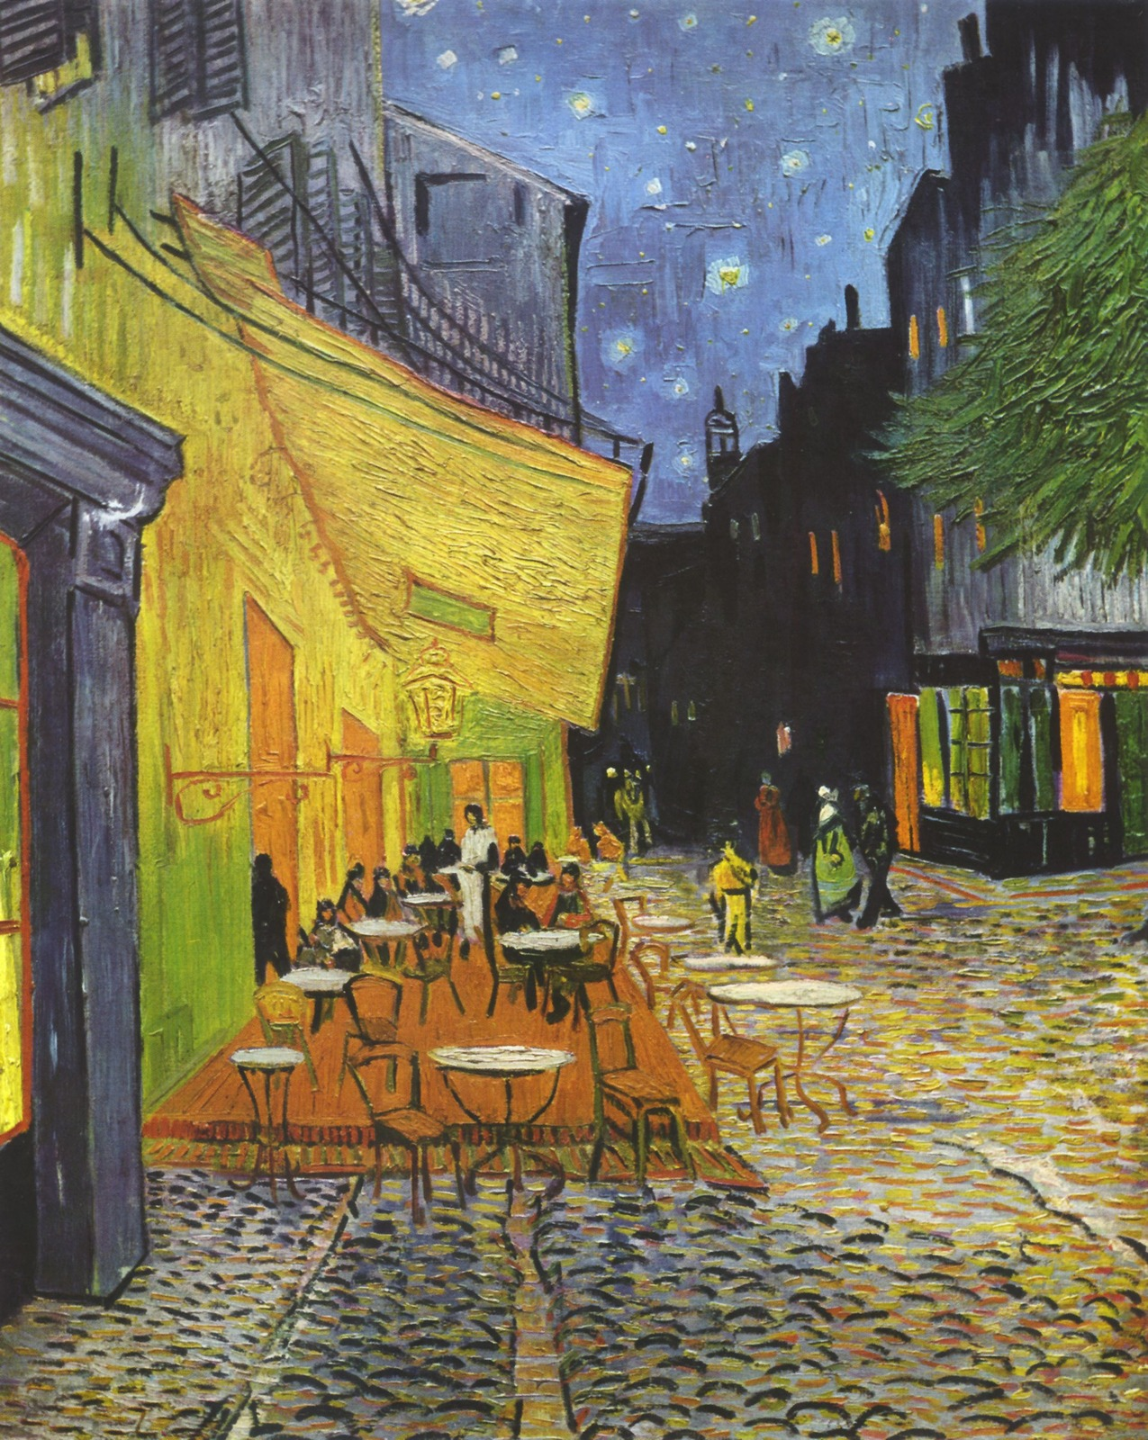
PART 2: ARLES — THE SOUTHERN LIGHT
He Didn't Paint the Night Black. He Painted It in Blues, Greens, and Gold.
Café Terrace at Night (September 1888) — the first painting in which Van Gogh used a starry night background. Painted on location using gaslight; no black was used for the sky.
Starry Night Over the Rhône (September 1888) — depicts the river at night with gas lighting reflecting in the water and the constellation of the Great Bear overhead
The Night Café (September 1888) — a deliberately unsettling interior where clashing reds and greens express 'the terrible passions of humanity'
Van Gogh's innovation: night wasn't the absence of light — it was a different kind of light, rich with color and emotion. He painted darkness using blues, violets, and greens.
Café Terrace at Night, 1888. Kröller-Müller Museum, Otterlo.
Source: Met Museum; Section 4.3 (key works table); Section 7.3 (color as emotional expression). Confidence: HIGH.
Van Gogh: The Artist's Journey
11
Notes:
Look at this painting — Café Terrace at Night. There is no black in this night sky. Van Gogh painted the darkness using blues, violets, and greens. He painted the café light in gold. He understood something revolutionary: that night isn't the absence of light — it's a different quality of light entirely. The stars aren't just pinpricks — they're living presences. He painted this on the street, using gas lamps to see his canvas. Think about that — an artist standing on a cobblestone street in 1888, revolutionizing how we see the night.

Slide 12
PART 2: ARLES — THE SOUTHERN LIGHT
Gauguin Arrived on October 23. By December 23, Van Gogh Had Cut Off His Own Ear.
Nine weeks. Two artists. One Yellow House. And an ending that changed art history.
Paul Gauguin arrived in Arles on October 23, 1888; they lived and painted together for ~9 weeks, including side-by-side paintings of Les Alyscamps
The two artists had fundamentally different temperaments: Gauguin was domineering and critical; Van Gogh was emotionally volatile and craved collaboration
On December 23, 1888, after a heated argument, Van Gogh cut off part of his left ear with a razor — he wrapped the severed ear and delivered it to a woman at a nearby brothel
Gauguin left Arles abruptly; Van Gogh was hospitalized. The dream of the Studio of the South died in a single night.
After returning from the hospital in January 1889, Van Gogh painted again immediately — including his Self-Portrait with Bandaged Ear, a document of survival
Source: Britannica; Met Museum; Death of VG Wikipedia. Sections 4.4–4.6. Confidence: HIGH.
Van Gogh: The Artist's Journey
12
Notes:
This is the story that everyone knows — or thinks they know. Gauguin came to Arles in October 1888. For nine weeks, they painted together, drank together, argued furiously. Then on December 23, Van Gogh cut off part of his ear. But here's what's often missed: after being released from the hospital in January 1889, the first thing he did was paint. Even in the aftermath of catastrophe, he kept working. The Studio of the South was dead. But the painting never stopped.

Slide 13
PART 3
Saint-Rémy — Painting as Survival
1889–1890: One Year in an Asylum, ~150 Canvases, and the Birth of an Icon
Notes:
In May 1889, fearing another breakdown, Van Gogh voluntarily checked himself into the Saint-Paul-de-Mausole asylum in Saint-Rémy. He would spend a year there. Confined to the asylum grounds, then a walled garden, and eventually allowed brief excursions into the countryside — he painted about 150 canvases. Including the single most famous painting in the history of art. This is the paradox at the heart of Van Gogh's story: in the place of his greatest confinement, he produced his most transcendent work.

Slide 14
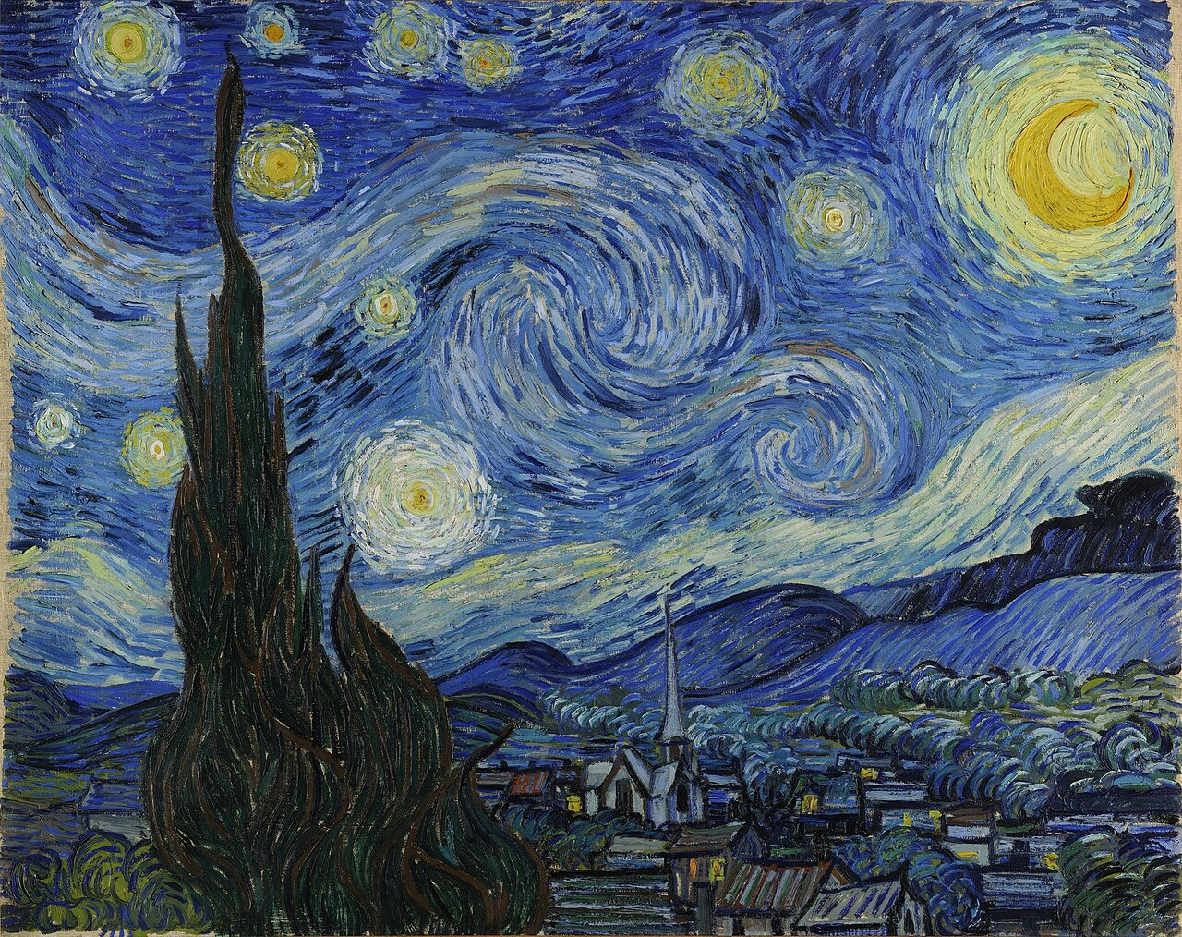
He Painted the Entire Cosmos from a Room in an Asylum.
The cypress tree was not in the actual view from his window. He added it from memory — a dark flame connecting earth and sky.
The Starry Night, 1889. Oil on canvas, 73.7 cm × 92.1 cm. Museum of Modern Art (MoMA), New York.
Source: MoMA; Met Museum; Section 5.3 (key works: The Starry Night). Painted June 1889, Saint-Paul-de-Mausole asylum, Saint-Rémy-de-Provence. Confidence: HIGH.
Van Gogh: The Artist's Journey
14
Notes:
This is it. The Starry Night — painted in June 1889, from a window in a mental asylum. That cypress tree in the foreground? It wasn't actually there. Van Gogh added it from memory. The village below? Idealized. The sky — those swirling, pulsing currents of blue and gold — that's not what you see when you look up. That's what you feel. This is the work of an artist who had lost almost everything, but who could still see, and paint, the sublime. Let's just look at it for a moment.

Slide 15
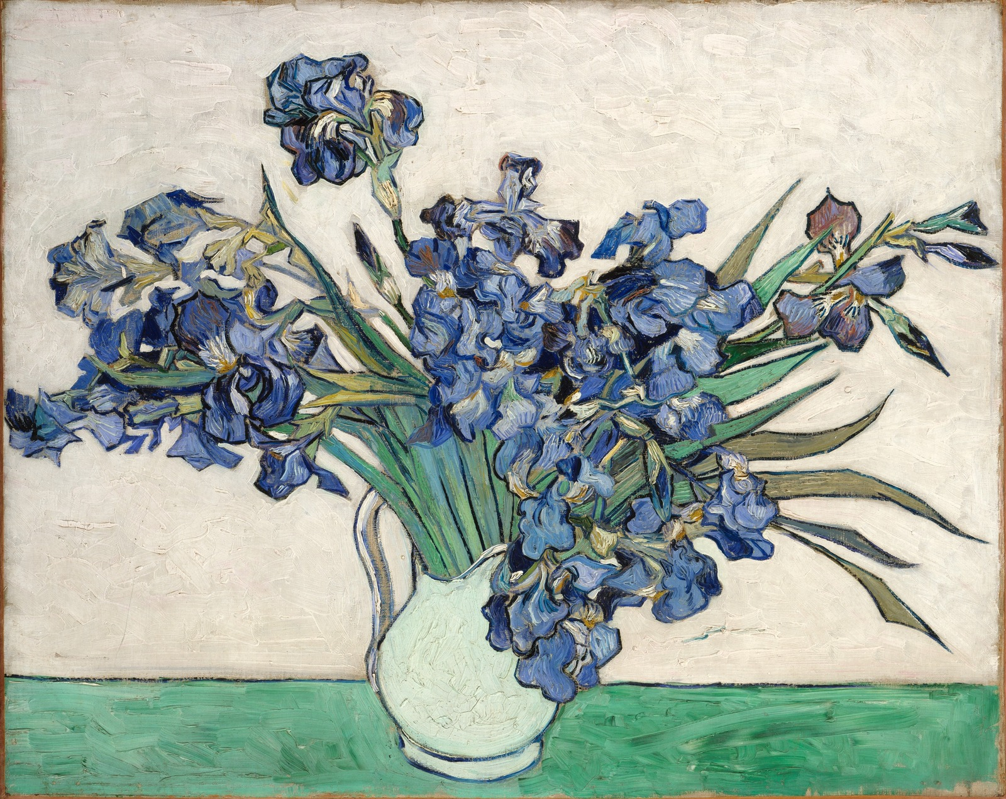
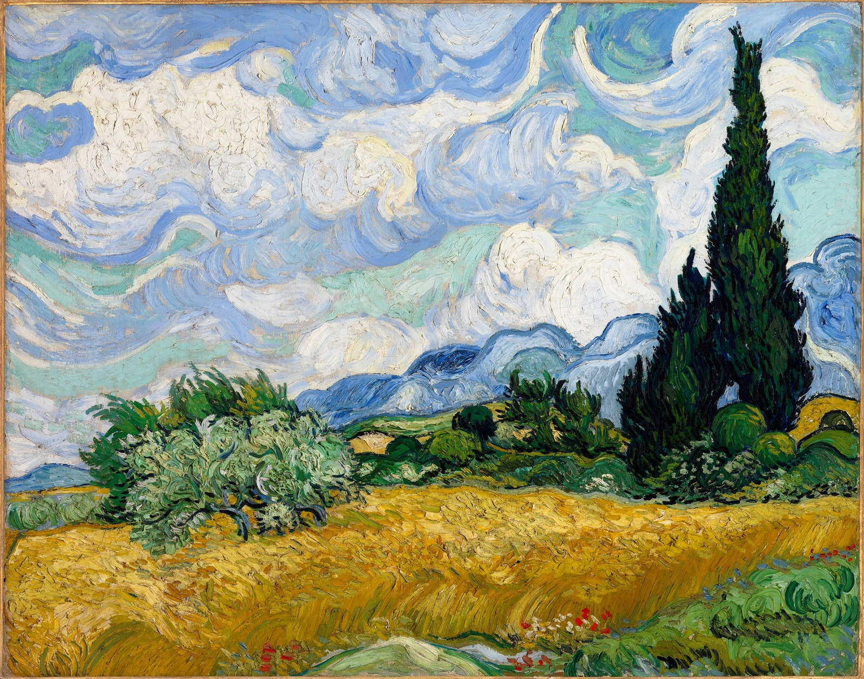
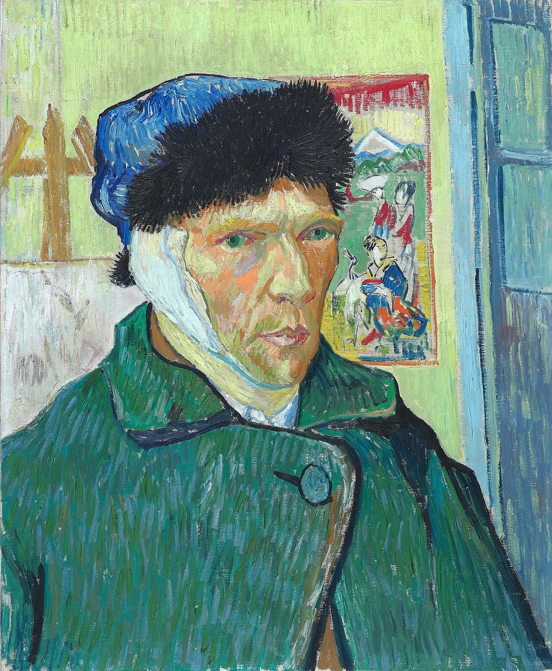
In the Garden of an Asylum, He Found the Entire Natural World.
Irises, 1889. J. Paul Getty Museum, Los Angeles.
Wheat Field with Cypresses, 1889. National Gallery, London.
Self-Portrait with Bandaged Ear, 1889. Courtauld Institute of Art, London.
Despite three major relapses during his year at Saint-Rémy (July 1889, December 1889, and January–March 1890), Van Gogh continued to paint between each episode. He likened the cypress form to an 'Egyptian obelisk' in a letter to Theo. These works — from vivid florals to turbulent landscapes to unflinching self-examination — are not the work of a broken man. They are the work of someone fighting to stay alive through the act of creation.
Source: Met Museum; Getty Center; Courtauld Institute. Sections 5.3 (key works), 5.4 (cypresses), 5.6 (mental health timeline). Confidence: HIGH.
Van Gogh: The Artist's Journey
15
Notes:
Take a moment to scan these three works, all created during Van Gogh's year in the asylum at Saint-Rémy. Irises — painted in the garden in his first weeks, full of life and vibrant color. Wheat Field with Cypresses — that dark, flame-like tree he compared to an Egyptian obelisk, the Provençal landscape transformed into something almost visionary. And his Self-Portrait with Bandaged Ear — an unflinching look at himself after the crisis, a document of survival and self-knowledge. In the span of this one year, confined and suffering, he produced some of the most life-affirming art the world has ever seen. This was not a man giving up — this was a man holding on through the only means he had.

Slide 16
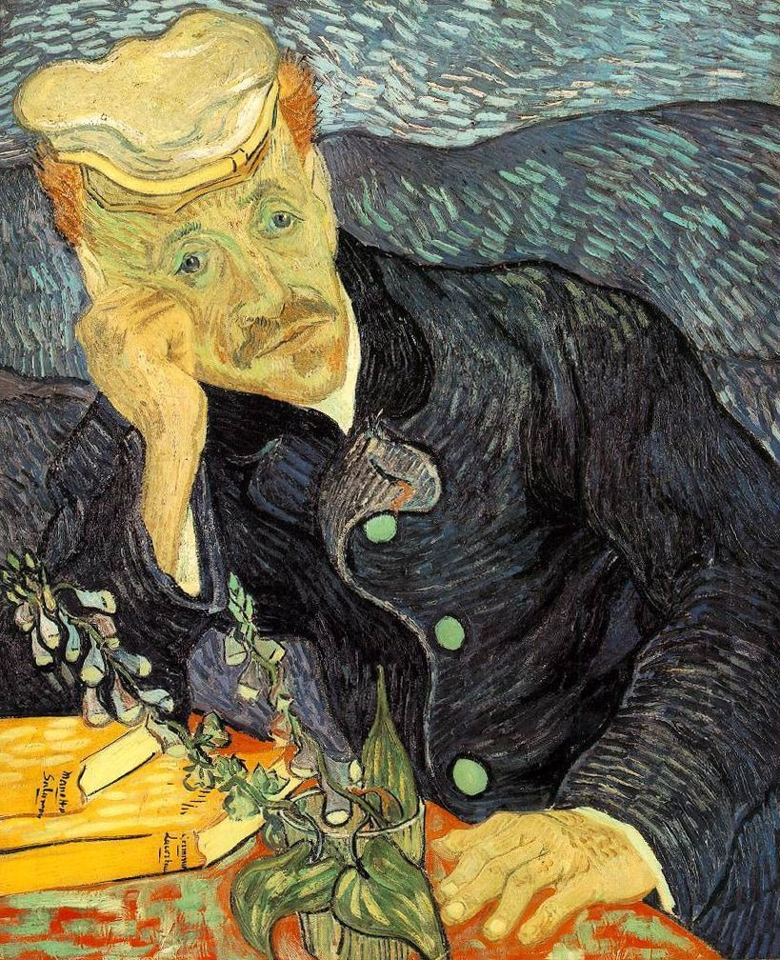
DENOUEMENT: AUVERS-SUR-OISE
He Averaged a Painting a Day. He Had 70 Days Left.
Discharged from Saint-Rémy in May 1890; moved to Auvers-sur-Oise (~30 km north of Paris) to be near his brother Theo
Placed under the care of Dr. Paul Gachet, a homeopathic physician and amateur painter — Van Gogh later assessed Gachet as 'sicker than I am'
Spent a few days in Paris with Theo, his wife Jo, and their newborn son Vincent Willem before settling in Auvers
Produced over 70 paintings in approximately 70 days — a staggering pace of one painting per day
Key works from this period: Portrait of Dr. Gachet (two versions, June 1890), The Church at Auvers, Daubigny's Garden, Wheatfield with Crows
Portrait of Dr. Gachet, 1890. Private collection.
Source: Met Museum; Death of VG Wikipedia. Sections 6.1–6.3. Confidence: HIGH.
Van Gogh: The Artist's Journey
16
Notes:
Van Gogh left the asylum in May 1890 and moved to Auvers-sur-Oise, a small town just north of Paris. He was 37 years old. In the 70 days he had left, he painted more than 70 canvases — a painting a day. This is the portrait of Dr. Gachet, the physician tasked with his care. Look at the expression on his face — the weariness, the sadness, the foxglove plant on the table — digitalis, a heart medicine. Van Gogh later wrote to Theo: 'He is sicker than I am, I think.' It was to be Van Gogh's final productive period, a desperate, beautiful creative burst.

Slide 17
DENOUEMENT: THE FINAL LETTERS
“
"I feel like a failure... And the prospect grows darker, I see no happy future at all."
— Letter to Theo, July 10, 1890
"I am in a mood of almost too much calm, just the mood needed for painting this."
— Letter to his mother and sister, circa July 12, 1890
"I am giving my canvases my undivided attention... I am trying to do as well as certain painters whom I have greatly loved and admired."
— Letter to Theo, July 23, 1890 (his last letter)
In the span of two weeks, Van Gogh moved from declaring himself a failure to speaking of calm focus to pouring his final energies into his canvases. These letters reveal a man fighting to make meaning through art until the very end.
Source: Death of VG Wikipedia; Van Gogh Letters project (vangoghletters.org). Section 6.4 (changing mood, letter excerpts); Section 9 (key quotes). Confidence: HIGH.
Van Gogh: The Artist's Journey
17
Notes:
In the last month of his life, Van Gogh's letters tell a story of violent emotional swings. On July 10th, 1890, he writes to Theo that he feels like a failure and sees no happy future. Just two days later, he tells his mother he is in a mood of 'almost too much calm.' And on July 23rd — in what may have been his last letter to Theo — he says he is giving his canvases his undivided attention and is trying to do as well as the painters he most admired. This is not a simple story of despair. It's a story of someone holding on to painting as the one thing that still made sense.

Slide 18
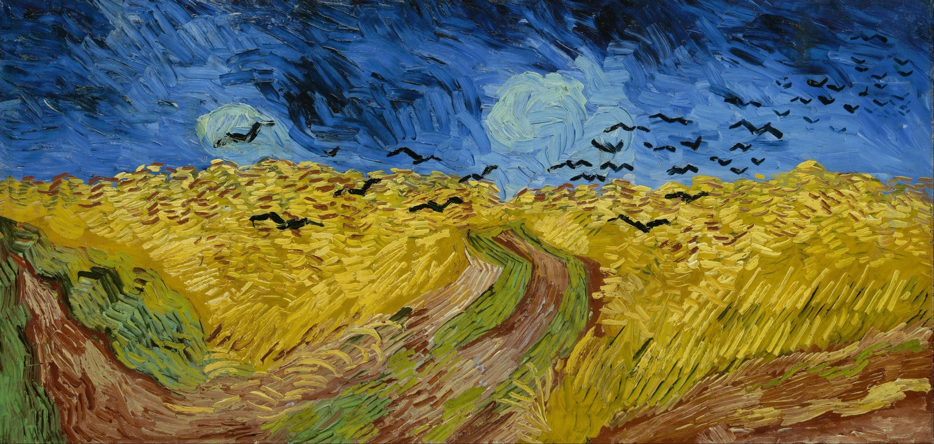
DENOUEMENT: JULY 27–29, 1890
He Walked Into a Wheat Field on July 27, 1890. Two Days Later, He Was Gone.
Sunday evening, July 27, 1890: Van Gogh walked into a wheat field near Auvers and shot himself in the chest with a revolver
He returned to his inn around 9 PM, climbed the stairs to his room; Dr. Gachet dressed the wound but considered it hopeless
Theo arrived the next afternoon and stayed by Vincent's bedside; his last words to his brother were: 'La tristesse durera toujours' — The sadness will last forever
Died at approximately 1:30 AM on July 29, 1890 — aged 37. At his funeral on July 30, his coffin was surrounded by his last canvases and masses of yellow flowers.
Theo died six months later on January 25, 1891; in 1914, he was reburied beside Vincent in the small cemetery on the hill above the Auvers wheat fields
Wheat Field with Crows, 1890. Van Gogh Museum, Amsterdam.
Source: Death of VG Wikipedia; Met Museum; Britannica. Sections 6.5 (the shooting, death), 6.6 (funeral). Confidence: HIGH. Alternative theory by Naifeh & Smith (2011) widely disputed.
Van Gogh: The Artist's Journey
18
Notes:
On July 27, 1890, Van Gogh walked into a wheat field and shot himself. He didn't die instantly — he walked back to the inn, climbed the stairs to his room, and lay on his bed. Theo arrived the next day. They talked through the night. Vincent's last words to his brother were: 'The sadness will last forever.' He died at 1:30 in the morning on July 29th. At his funeral, his coffin was surrounded by his last canvases and masses of yellow flowers — dahlias and sunflowers. Theo died six months later. They are buried side by side in the cemetery at Auvers, two brothers reunited in the wheat fields.

Slide 19
REFLECTION: STYLE EVOLUTION
In One Decade, He Reinvented What a Painting Could Be.
Self-taught beginnings: watercolors and early oils, instruction from cousin Anton Mauve. First independent works — dark, moody Dutch realism with rural subjects.
Lightened palette; Impressionist broken brushstrokes; Neo-Impressionist pointillism experiments. 20+ self-portraits as color studies. Japonisme: bold outlines, flat color, unusual cropping.
Continued bold color; thickest impasto of career. Emotional and symbolic use of form — cypresses as obelisks, stars as cosmic forces. ~150 canvases painted from asylum confinement.
1880–1883
1886–1887
1889–1890
The Hague / Drenthe
Paris
Saint-Rémy
1883–1885
1888–1889
May–July 1890
Nuenen
Arles
Auvers-sur-Oise
40+ peasant head studies; The Potato Eaters — first major composition. Dark earthy palette; focused on rural labor. Influence of Millet and Barbizon school.
Full maturation of personal style. Bold, vibrant colors; distinctive swirling brushwork; thick impasto. Series approach (Sunflowers, Orchards). Night scenes revolutionize color use.
Late style: broader, more agitated brushwork; double-square canvases. 70+ paintings in 70 days. Wheat fields, portraits, and rural motifs in a final creative crescendo.
Source: Met Museum; Britannica. Section 7 (Artistic Techniques & Style Evolution), 7.1–7.5. Confidence: HIGH.
Van Gogh: The Artist's Journey
19
Notes:
Here's the arc of Van Gogh's entire creative life — six periods, ten years. From the dark, heavy brushstrokes of the Dutch period in The Hague and Nuenen, through the color explosion of Paris and the full maturation in Arles, to the transcendent, emotional landscapes of Saint-Rémy and the desperate final burst at Auvers. Notice: he never stayed still. Each period was an experiment, a reaching for something he hadn't done before. He taught himself everything — and in the process, he taught the world a new way to see. The progress is staggering when you see it all laid out like this.

Slide 20
"The Sadness Will Last Forever." But So Does the Art.
2,100 Artworks. 820 Letters. One Voice That Changed the World.
Van Gogh's story is not ultimately about mental illness or tragedy — it is about the fierce, life-consuming dedication of an artist who found, in paint, a language for everything he had to say. From the dark potato fields of Nuenen to the blazing wheat fields of Auvers, he gave everything to his craft. In just ten years, he created a body of work that rippled through Fauvism, German Expressionism, and Abstract Expressionism — changing the course of modern art forever.
Thank you. | [Presenter Name] | [Contact / Institution]
Notes:
Van Gogh's last words were 'The sadness will last forever.' And in one sense, the sadness of his story does endure — the struggle, the loneliness, the early death at 37. But here's what also endures: 2,100 artworks. 820 letters. A body of work that changed the course of modern art. His paintings hang in every major museum in the world. His letters have been read by millions. Van Gogh spent his whole life trying to communicate something — first as a preacher, then as an artist. He failed as a preacher. But as a painter, he found his congregation. And his voice has never stopped speaking. Thank you.

