Slide 1

Canadian Bioinformatics Workshops
www.bioinformatics.ca
bioinformaticsdotca.github.io

Slide 2


Slide 3
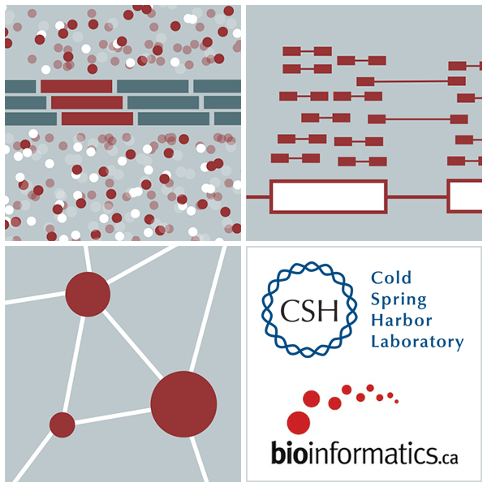

RNA-Seq Module 2 SAM/BAM/BED formats
Kelsy Cotto, Malachi Griffith, Chris Miller, Peter Ronning
High-Throughput Biology: From Sequence to Networks
March 11-17, 2019
Workshop icon

Slide 4
Learning objectives of the course
Module 1: Introduction to RNA Sequencing
Module 2: Alignment and Visualization
Module 3: Expression and Differential Expression
Module 4: Alignment Free Expression Estimation
Module 5: Isoform Discovery and Alternative Expression
Tutorials
Provide a working example of an RNA-seq analysis pipeline
Run in a ‘reasonable’ amount of time with modest computer resources
Self contained, self explanatory, portable

Slide 5
Learning objectives of module 2
Introduction to the BAM and BED formats
Basic manipulation of BAMs

Slide 6
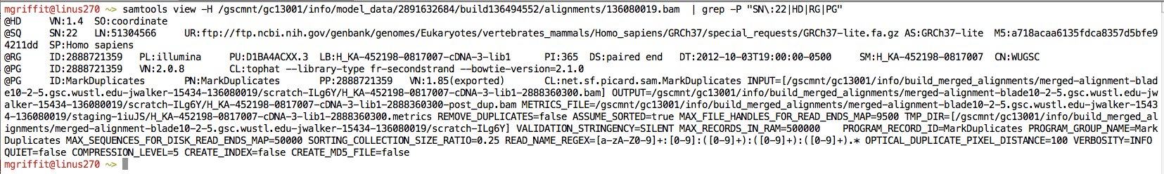
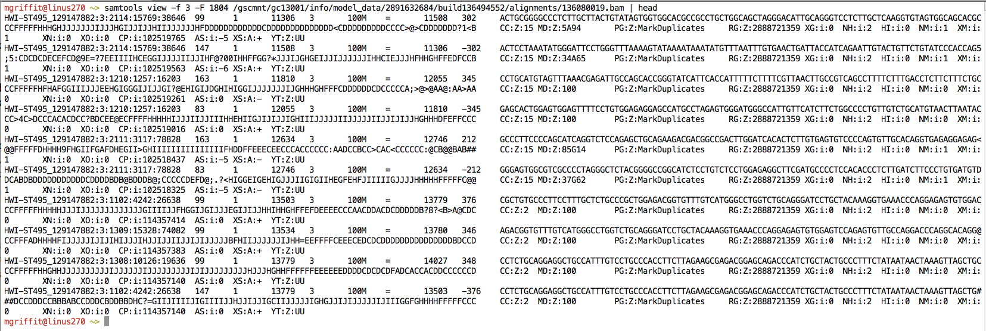
Example of SAM/BAM file format
Example SAM/BAM header section (abbreviated)
Example SAM/BAM alignment section (only 10 alignments shown)

Slide 7
Introduction to the SAM/BAM format
The specification
http://samtools.sourceforge.net/SAM1.pdf
The SAM format consists of two sections:
Header section
Used to describe source of data, reference sequence, method of alignment, etc.
Alignment section
Used to describe the read, quality of the read, and nature alignment of the read to a region of the genome
BAM is a compressed version of SAM
Compressed using lossless BGZF format
Other BAM compression strategies are a subject of research. See ‘CRAM’ format for example
BAM files are usually ‘indexed’
A ‘.bai’ file will be found beside the ‘.bam’ file
Indexing aims to achieve fast retrieval of alignments overlapping a specified region without going through the whole alignments. BAM must be sorted by the reference ID and then the leftmost coordinate before indexing

Slide 8
SAM/BAM header section
Used to describe source of data, reference sequence, method of alignment, etc.
Each section begins with character ‘@’ followed by a two-letter record type code. These are followed by two-letter tags and values
@HD The header line
VN: format version
SO: Sorting order of alignments
@SQ Reference sequence dictionary
SN: reference sequence name
LN: reference sequence length
SP: species
@RG Read group
ID: read group identifier
CN: name of sequencing center
SM: sample name
@PG Program
PN: program name
VN: program version

Slide 9
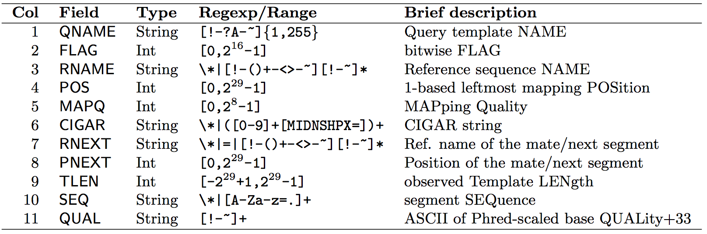
SAM/BAM alignment section
Example values
QNAME e.g. HWI-ST495_129147882:1:2302:10269:12362 (QNAME)
FLAG e.g. 99
RNAME e.g. 1
POS e.g. 11623
MAPQ e.g. 3
CIGAR e.g. 100M
RNEXT e.g. =
PNEXT e.g. 11740
TLEN e.g. 217
SEQ e.g. CCTGTTTCTCCACAAAGTGTTTACTTTTGGATTTTTGCCAGTCTAACAGGTGAAGCCCTGGAGATTCTTATTAGTGATTTGGGCTGGGGCCTGGCCATGT
QUAL e.g. CCCFFFFFHHHHHJJIJFIJJJJJJJJJJJHIJJJJJJJIJJJJJGGHIJHIJJJJJJJJJGHGGIJJJJJJIJEEHHHHFFFFCDCDDDDDDDB@ACDD

Slide 10
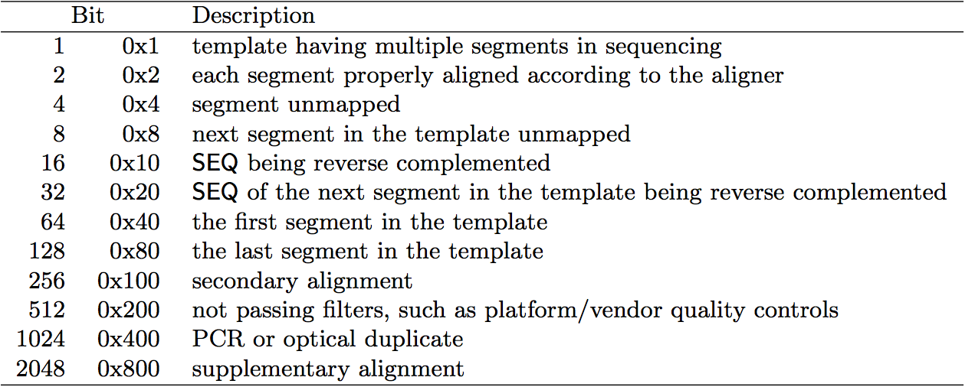
SAM/BAM flags explained
http://broadinstitute.github.io/picard/explain-flags.html
12 bitwise flags describing the alignment
These flags are stored as a binary string of length 11 instead of 11 columns of data
Value of ‘1’ indicates the flag is set. e.g. 00100000000
All combinations can be represented as a number from 1 to 2048 (i.e. 2¹¹-1). This number is used in the BAM/SAM file. You can specify ‘required’ or ‘filter’ flags in samtools view using the ‘-f’ and ‘-F’ options respectively
Note that to maximize confusion, each bit is described in the SAM specification using its hexadecimal representation (i.e., '0x10' = 16 and '0x40' = 64).

Slide 11
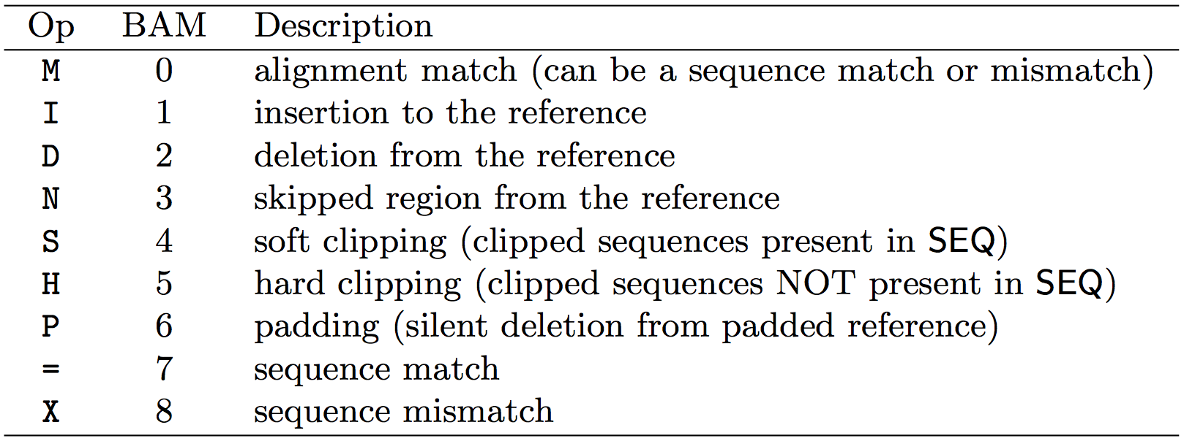
CIGAR strings explained
The CIGAR string is a sequence of base lengths and associated ‘operations’ that are used to indicate which bases align to the reference (either a match or mismatch), are deleted, are inserted, represent introns, etc.
e.g. 81M859N19M
A 100 bp read consists of: 81 bases of alignment to reference, 859 bases skipped (an intron), 19 bases of alignment

Slide 12
Introduction to the BED format
When working with BAM files, it is very common to want to examine a focused subset of the reference genome
e.g. the exons of a gene
These subsets are commonly specified in ‘BED’ files
https://genome.ucsc.edu/FAQ/FAQformat.html#format1
Many BAM manipulation tools accept regions of interest in BED format
Basic BED format (tab separated):
Chromosome name, start position, end position
Coordinates in BED format are 0 based

Slide 13
Manipulation of SAM/BAM and BED files
Several tools are used ubiquitously in sequence analysis to manipulate these files
SAM/BAM files
samtools
bamtools
picard
BED files
bedtools
bedops

Slide 14
How should I sort my SAM/BAM file?
Generally BAM files are sorted by position
This is for performance reasons
When sorted and indexed, arbitrary positions in a massive BAM file can be accessed rapidly
Certain tools require a BAM sorted by read name
Usually this is when we need to easily identify both reads of a pair
The insert size between two reads may be large
In fusion detection we are interested in read pairs that map to different chromosomes…

