Slide 1
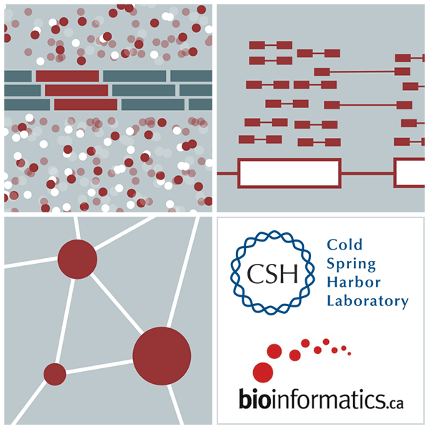

RNA-Seq Module 7 Indexing
Kelsy Cotto, Malachi Griffith, Chris Miller, Peter Ronning
Workshop icon

Slide 2
Indexing allows rapid access in massive files
A recurring theme in genome analysis is the need to index files
Indexing builds a kind of table-of-contents so that a specific position in a (sorted) file can be jumped to directly, rather than having to read/scan through the entire file to find that position
Indexing may require significant compute/time but typically only occurs once
Each application may require a different indexing strategy
Just a few examples include:
Index a reference.fasta file (e.g., with bwa index) for use with aligners (e.g., bwa mem)
Index a sequence.bam file (e.g., with samtools index, picard, etc) for use with IGV and other applications
Index a reference.fasta file (e.g., with hisat2-build) for use with a splice-aware aligner (e.g., HISAT2)
Index a VCF file (e.g., with GATK IndexFeatureFile) for use with variant filtering software
Many more…

Slide 3
Example index applications and associated files
Source file | Indexed file | Indexing tool | Use case
.bam | .bai | samtools index | Visualize bam in IGV
.fasta | .fai | faidx

