Slide 1
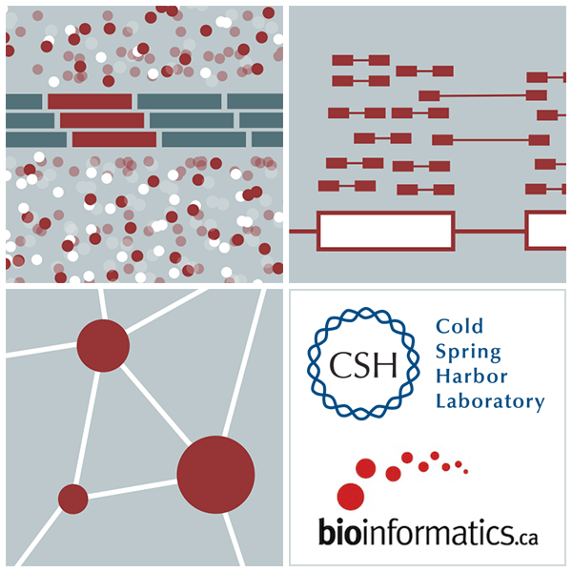

RNA-Seq Module 7 Indexing
Kelsy Cotto, Malachi Griffith, Chris Miller, Peter Ronning
Workshop icon

