Slide 1


Canadian Bioinformatics Workshops
www.bioinformatics.ca
bioinformaticsdotca.github.io
Supported by

Slide 2
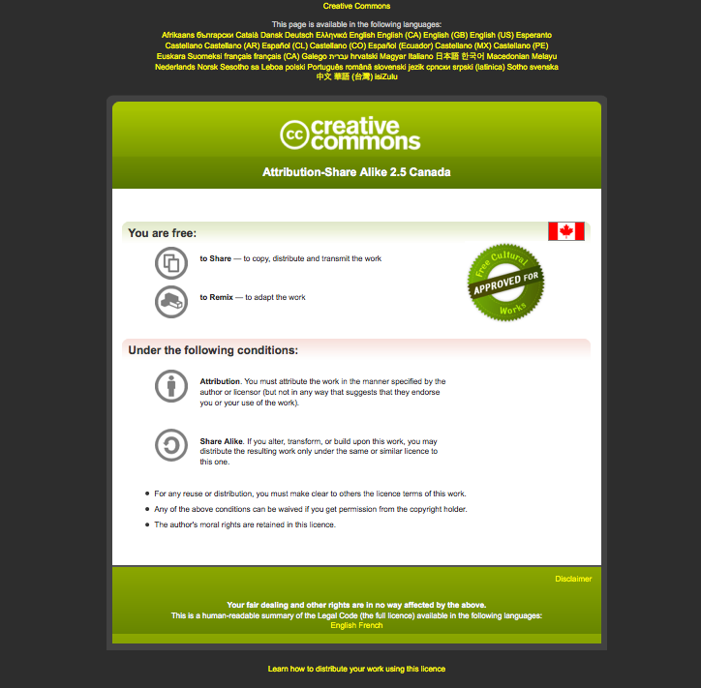

Slide 3
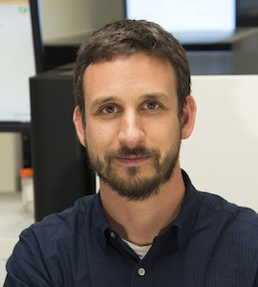
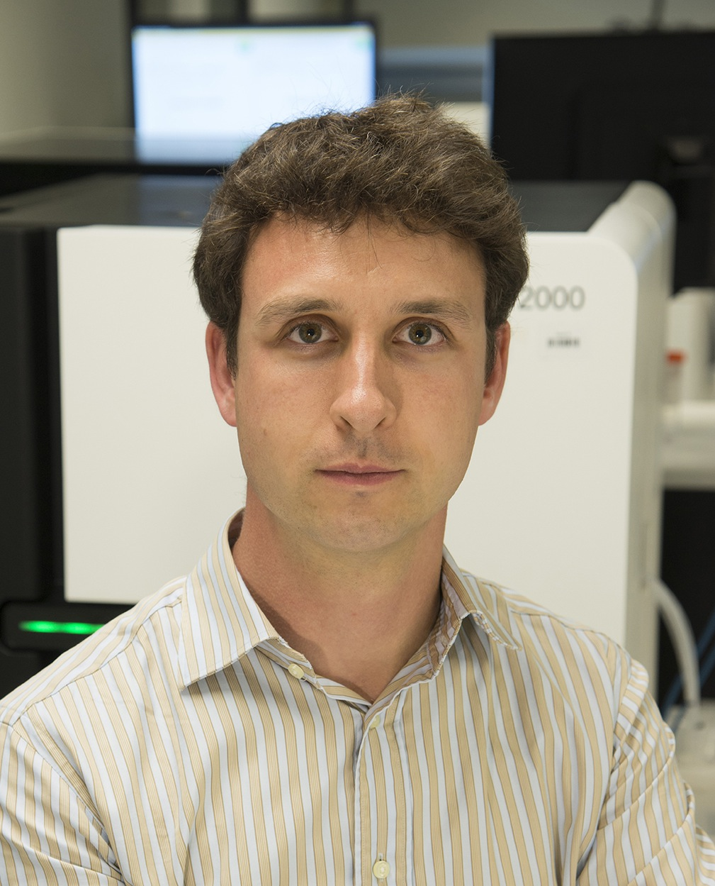
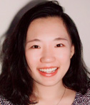
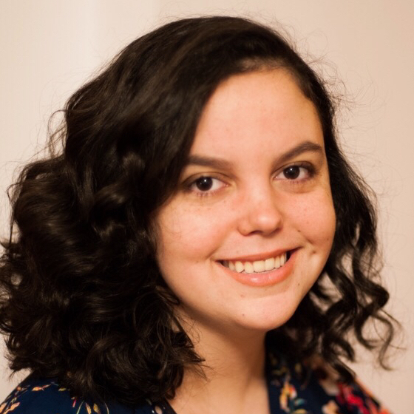
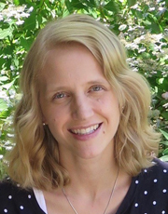
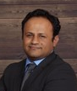


Introductions to Washington University instructors
Kelsy Cotto
PhD candidate
Allegra Petti
Assistant Professor of Medicine
Saad Khan
Bioinformatics Scientist
Malachi Griffith Assistant Professor of Medicine Assistant Professor of Genetics
Assistant Director, MGI
Obi Griffith, PhD
Associate Professor of Medicine Associate Professor of Genetics
Assistant Director, MGI
Huiming Xia
PhD candidate
PETTI LAB
www.griffithlab.org

Slide 4
Informatics background poll
Student poll
Are you doing genomics research?
Do you consider yourself a bioinformatician?
What kind of NGS data are you working with?
WGS?
Exome?
RNAseq?
Epigenome?
Single cell?
Other?
What organism do you work with?
Did you bring data?

Slide 5
Student poll continued
Not counting the pre-requisites and materials for this course:
Are you familiar with linux/command line?
Intermediate?
Expert?
Do you sometimes write code?
What language?
Are you familiar with R?
Intermediate?
Expert?
Do you use git/github?

Slide 6




We are on a Coffee Break & Networking Session
Workshop Sponsors:

