Slide 1


RNA-Seq Module 8 Alignment
Kelsy Cotto, Malachi Griffith, Chris Miller, Peter Ronning
Workshop icon

Slide 2


Alignment - How does it work?
Alignment is about fitting individual pieces (reads) into the correct part of the puzzle
The human genome project gave us the picture on the box cover (the reference genome)
Imperfections in how the pieces fit can indicate damage to a copy of the picture
AGCCTGAGACCGTAAAAAAGTCAAG
|||||||||||||||||
GAGACCGTAAAAACGTC
Reference:
A read sequence:
A variant!

Slide 3
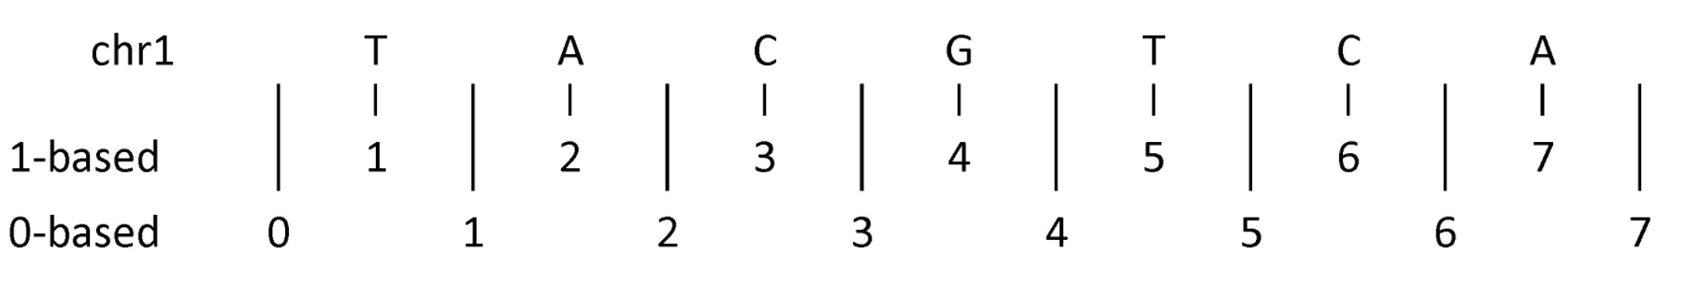
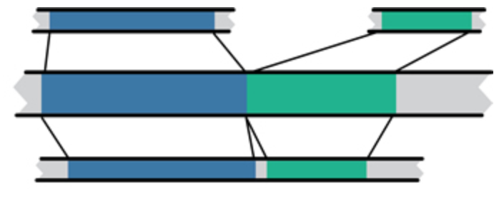
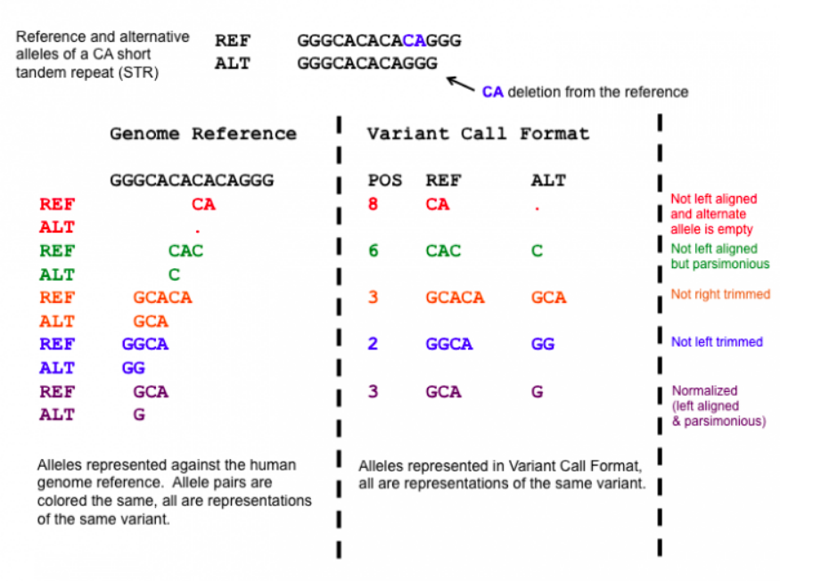
Common sources of confusion
Genomic coordinate systems
1-based vs. 0-based
Genome builds
And annotation builds
“Liftover” tools
Left-shifted vs right-shifted
Mouse mm10
Human hg19
Human GRCh37

Slide 4
0-based vs 1-based methods to indicate a nucleotide positions
chr1 |  | T |  | A |  | C |  | G |  | T |  | C |  | A
1-based |  | 1 |  | 2 |  | 3 |  | 4 |  | 5 |  | 6 |  | 7
0-based | 0 |  | 1 |  | 2 |  | 3 |  | 4 |  | 5 |  | 6 |  | 7
 | 1-based | 0-based
Indicate a single nucleotide | chr1:4-4 G | chr1:3-4 G
Indicate a range of nucleotides | chr1:2-4 ACG | chr1:1-4 ACG
Indicate a single nucleotide variant | chr1:5-5 T/A | chr1:4-5 T/A
1-based coordinate system
Single nucleotides, variant positions, or ranges are specified directly by their corresponding nucleotide numbers
GFF, SAM, VCF, Ensembl browser, …
0-based coordinate system
Single nucleotides, variant positions, or ranges are specified by the coordinates that flank them
BED, BAM, UCSC browser, …

Slide 5
Variant shifting (alignment) and parsimony/trimming
Parsimony = representing variant in as few nucleotides as possible without reducing the length of any allele to 0
Left (right) aligning = shifting the start position of a variant as far to the left (right) as possible
Notes:
https://genome.sph.umich.edu/wiki/Variant_Normalization
Parsimony means representing a variant in as few nucleotides as possible without reducing the length of any allele to 0.
Left aligning a variant means shifting the start position of that variant to the left till it is no longer possible to do so.
The representation of variants in a VCF file requires that no alleles in the REF and ALT field are represented with an empty string (empty allele). The red indel has an illegal VCF representation.
The green variant is not left aligned as you can prefix an A nucleotide on the left side of the variant's alleles and truncate the C on the right side of the variant's alleles. It is however parsimonious.
The orange variant is left aligned but is not right parsimonious.
The blue variant is left aligned but not left parsimonious.
The maroon variant is left aligned and parsimonious.

Slide 6
RNA-seq alignment challenges
Computational cost
100’s of millions of reads
Introns!
Spliced vs. unspliced alignments
Can I just align my data once using one approach and be done with it?
Unfortunately probably not
Is HISAT2 the only mapper to consider for RNA-seq data?
http://www.biostars.org/p/60478/

Slide 7
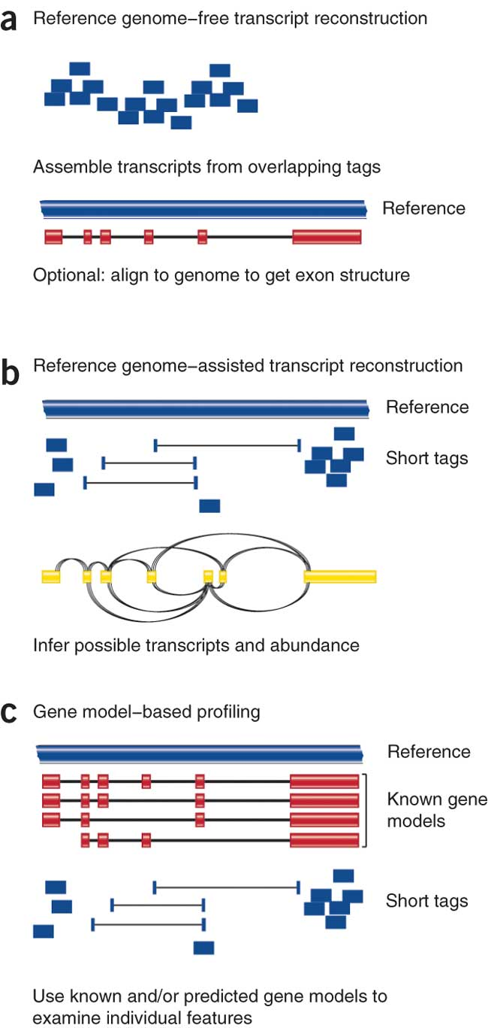
Three RNA-seq mapping strategies
De novo assembly
Align to transcriptome
Align to reference genome
Diagrams from Cloonan & Grimmond, Nature Methods 2010

Slide 8
Which alignment strategy is best?
De novo assembly
If a reference genome does not exist for the species being studied
If complex polymorphisms/mutations/haplotypes might be missed by comparing to the reference genome
Align to transcriptome
If you have short reads (< 50bp)
Align to reference genome
All other cases
Each strategy involves different alignment/assembly tools

Slide 9
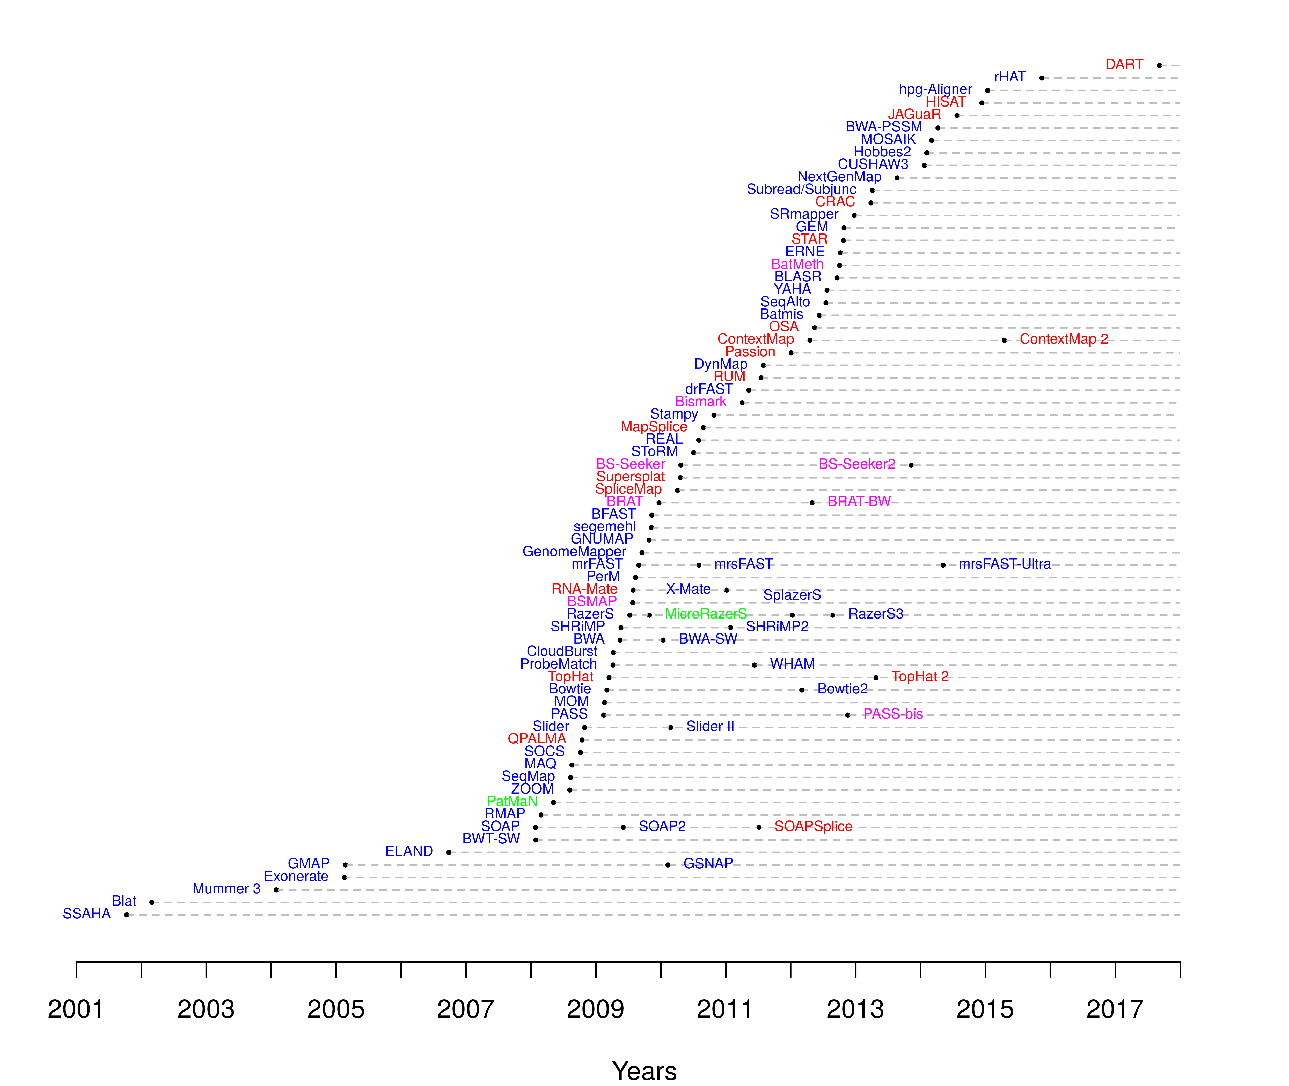
Which read aligner should I use?
RNA
Bisulfite
DNA
microRNA
http://wwwdev.ebi.ac.uk/fg/hts_mappers/

Slide 10
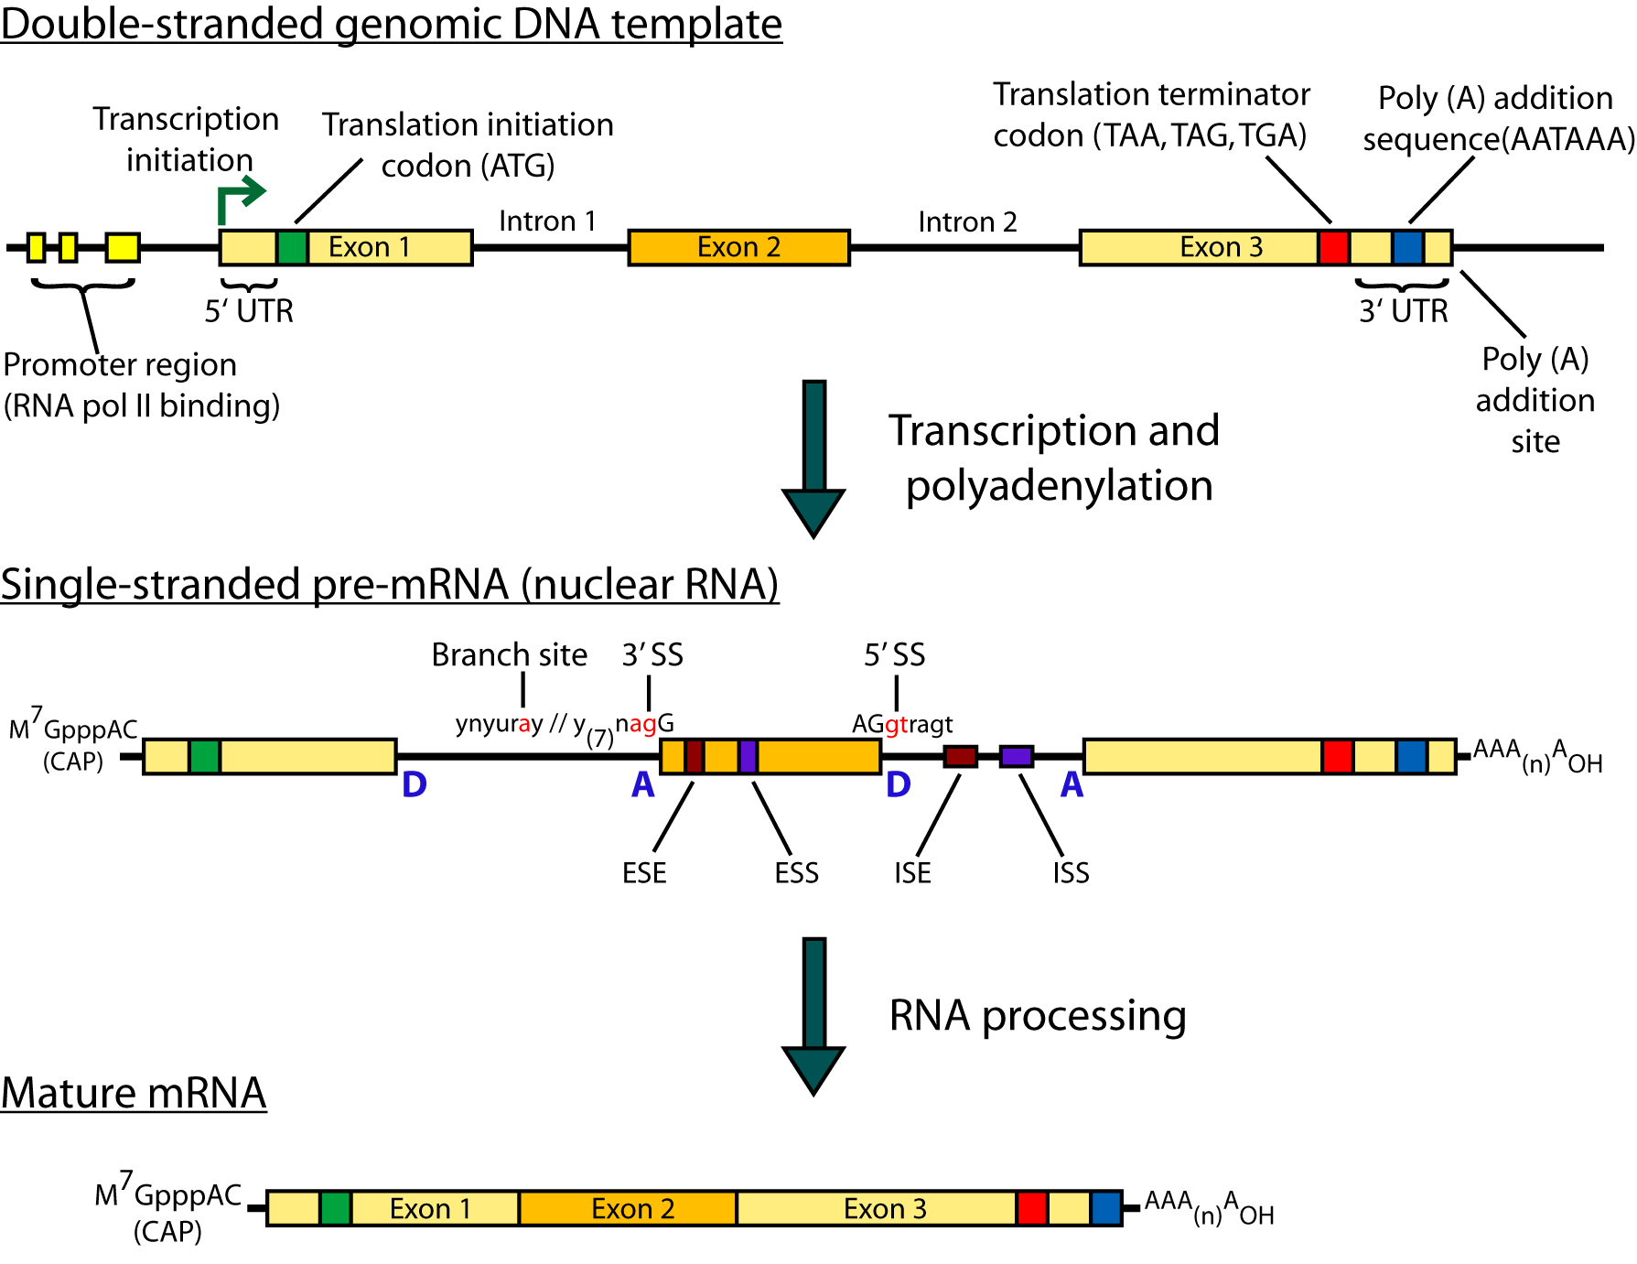
Should I use a splice-aware or unspliced mapper?
RNA-seq reads may span large introns
The fragments being sequenced in RNA-seq represent mRNA and therefore the introns are removed
But we are usually aligning these reads back to the reference genome
Unless your reads are short (<50bp) you should use a splice-aware aligner
HISAT2, STAR, MapSplice, etc.

Slide 11
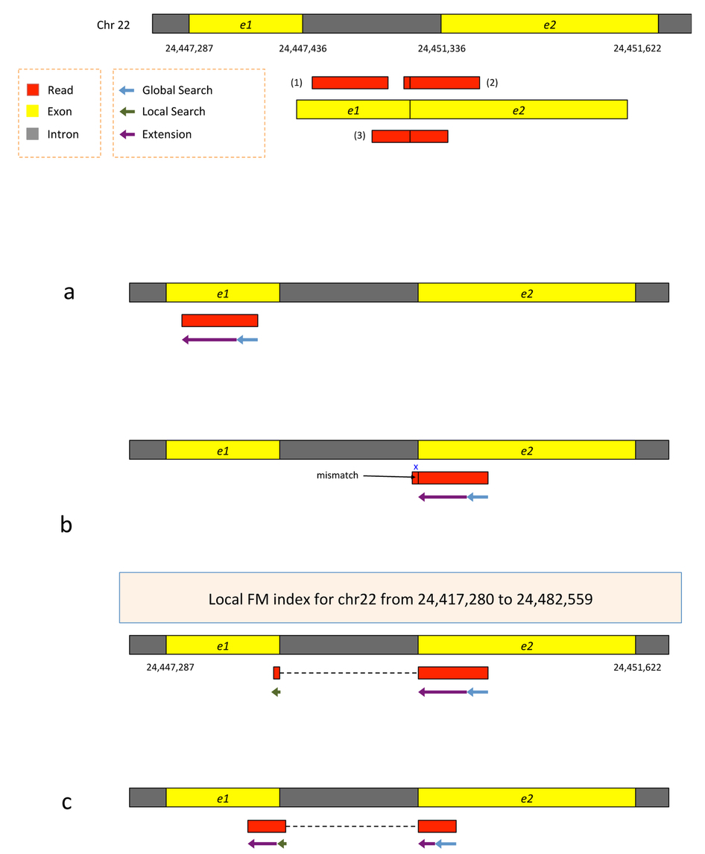
HISAT/HISAT2
HISAT is a ‘splice-aware’ RNA-seq read aligner
Requires a reference genome
Very fast
Uses an indexing scheme based on the Burrows-Wheeler transform and the Ferragina-Manzini (FM) index
Multiple types of indexes for alignment
a whole-genome FM index to anchor each alignment
numerous local FM indexes for very rapid extensions of these alignments.
Whole-genome indices with SNPs and known transcript structures accounted for
Kim et al. 2015. Nat Methods 12:357–360
Notes:
HISAT's hierarchical index for the human genome contains 48,000 local FM indexes, each representing a genomic region of ~64,000 bp.

Slide 12
HISAT/HISAT2
Uses hierarchical indexing algorithm and several adaptive strategies, based on the position of a read with respect to splice sites
First tries to find candidate locations across the target genome from which the read may have originated by mapping part of each read using the global FM index, which in most cases identifies one or a small number of candidates.
Then selects one of ~48,000 local indexes for each candidate and uses it to align the remainder of the read.
For paired reads, each mate is separately aligned and the alignments of both mates are combined.
If a read fails to align, then the alignments of its mate are used as anchors to map the unaligned mate
Kim et al. 2015. Nat Methods 12:357–360
Notes:
HISAT's hierarchical index for the human genome contains 48,000 local FM indexes, each representing a genomic region of ~64,000 bp.

Slide 13
HISAT/HISAT2
First align read with global index (slower)
Once at least 28bp and exactly one location switch to extension mode against reference genome (faster)
Notes:
Alignment of exonic reads and long- and intermediate-anchored reads.
Given two exons from a gene on human chromosome 22, separated by a 3,899-bp intron, suppose the genomic region is transcribed and spliced and we have three reads sequenced from the resulting transcript: (i) an exonic read, (ii) a read spanning two exons with an 8-bp anchor in one exon and (iii) a read spanning two exons with 50 bp in each exon (Supplementary Fig. 8). All the reads are assumed to be error free and 100 bp long. We can apply hierarchical indexing to align each of these reads rapidly and correctly. We align the first read using the global FM-index (Supplementary Fig. 8a). Because global search is relatively time consuming, we change strategies when the partial alignment meets two conditions: (i) it is at least 28 bp long and (ii) it maps onto exactly one location. For the read shown in the figure, the 28-bp sequence on its right end maps uniquely, allowing us to stop the global search operation at that point. From there, we extend the partial alignment by directly comparing the remaining sequence and the corresponding genomic sequence, which we can extract directly from the genome using the mapped location as an index. Because the read is error free and contained within one exon, the extension operation sweeps across the remaining 72 bp, completing the alignment for the read. Note that we could perform this alignment using the global FM index, as TopHat2 does, but the combination of global search and local extension is faster.
For the second read, which has a very short 8-bp anchor on the left side, we first try to map the read using global search, moving right to left (Supplementary Fig. 8b). The first 28 bp on the right end of the read maps uniquely, allowing us to anchor the alignment and halt the global search. We then extend the alignment until we encounter a mismatch at the 93rd base. This mismatch occurs when the alignment extension reaches the intron. At this point we pause the search, retrieve the local FM index that contains this location and align the remaining 8 bp using this index. Because the index covers only a small region, in this case we find just one match for the 8-bp segment. Finally, we check whether the two partial alignments (8 bp and 92 bp) are compatible with each other (for example, in the correct orientation) and then combine them to produce a spliced alignment of the original read.
Note that if we searched for an 8-bp sequence in the global index, we would expect to find an average of ~48,000 matching locations in the human genome (and sometimes many more). Instead of examining 48,000 possible locations, we use one of the local FM indexes, which is expected to contain just one copy of a given 8-bp sequence, on average. This two-stage hierarchical indexing allows us to avoid examining tens of thousands of candidate locations for short anchors, which in turn dramatically speeds up the overall alignment algorithm.
The third read has long anchors (50 bp each) in each exon. We first align the read beginning on the right, using global search as we did before. After the first 28 bp is uniquely mapped, we switch to the extension operation, which further aligns 22 bp and stops after a mismatch at the 51st base. We then choose a local FM index and perform a local search using the first 8 bp of the remaining part of the read. Once this 8 bp is found, HISAT again uses the extension operation to align the rest of the read (Supplementary Fig. 8c). Note that if the 8-bp prefix mapped to too many locations, HISAT would use a longer prefix to reduce the number of potential locations to 5 or fewer.
As we can see from these examples, we can combine global search, local search and directed read extension to achieve rapid yet sensitive alignment. Note that when a read has multiple spliced alignments, HISAT prefers to report alignments that use the canonical GT and AG dinucleotides on the ends of the intron. From any remaining alignments after this filter, it reports the one with the shortest intron length. HISAT provides several parameters with which users can customize its alignment strategy, including adjustable penalties for mismatches, indels and noncanonical splice sites (Supplementary Note).

Slide 14
HISAT/HISAT2
Again use global search until exactly one match of at least 28bp (slower)
Extend as before until mismatch at 93bp (faster)
Switch to local FM index to align remaining 8bp
Because the index covers only a small region, in this case we find just one match for the 8-bp segment.
Check for compatibility and combine into single spliced alignment
Notes:
Alignment of exonic reads and long- and intermediate-anchored reads.
Given two exons from a gene on human chromosome 22, separated by a 3,899-bp intron, suppose the genomic region is transcribed and spliced and we have three reads sequenced from the resulting transcript: (i) an exonic read, (ii) a read spanning two exons with an 8-bp anchor in one exon and (iii) a read spanning two exons with 50 bp in each exon (Supplementary Fig. 8). All the reads are assumed to be error free and 100 bp long. We can apply hierarchical indexing to align each of these reads rapidly and correctly. We align the first read using the global FM-index (Supplementary Fig. 8a). Because global search is relatively time consuming, we change strategies when the partial alignment meets two conditions: (i) it is at least 28 bp long and (ii) it maps onto exactly one location. For the read shown in the figure, the 28-bp sequence on its right end maps uniquely, allowing us to stop the global search operation at that point. From there, we extend the partial alignment by directly comparing the remaining sequence and the corresponding genomic sequence, which we can extract directly from the genome using the mapped location as an index. Because the read is error free and contained within one exon, the extension operation sweeps across the remaining 72 bp, completing the alignment for the read. Note that we could perform this alignment using the global FM index, as TopHat2 does, but the combination of global search and local extension is faster.
For the second read, which has a very short 8-bp anchor on the left side, we first try to map the read using global search, moving right to left (Supplementary Fig. 8b). The first 28 bp on the right end of the read maps uniquely, allowing us to anchor the alignment and halt the global search. We then extend the alignment until we encounter a mismatch at the 93rd base. This mismatch occurs when the alignment extension reaches the intron. At this point we pause the search, retrieve the local FM index that contains this location and align the remaining 8 bp using this index. Because the index covers only a small region, in this case we find just one match for the 8-bp segment. Finally, we check whether the two partial alignments (8 bp and 92 bp) are compatible with each other (for example, in the correct orientation) and then combine them to produce a spliced alignment of the original read.
Note that if we searched for an 8-bp sequence in the global index, we would expect to find an average of ~48,000 matching locations in the human genome (and sometimes many more). Instead of examining 48,000 possible locations, we use one of the local FM indexes, which is expected to contain just one copy of a given 8-bp sequence, on average. This two-stage hierarchical indexing allows us to avoid examining tens of thousands of candidate locations for short anchors, which in turn dramatically speeds up the overall alignment algorithm.
The third read has long anchors (50 bp each) in each exon. We first align the read beginning on the right, using global search as we did before. After the first 28 bp is uniquely mapped, we switch to the extension operation, which further aligns 22 bp and stops after a mismatch at the 51st base. We then choose a local FM index and perform a local search using the first 8 bp of the remaining part of the read. Once this 8 bp is found, HISAT again uses the extension operation to align the rest of the read (Supplementary Fig. 8c). Note that if the 8-bp prefix mapped to too many locations, HISAT would use a longer prefix to reduce the number of potential locations to 5 or fewer.
As we can see from these examples, we can combine global search, local search and directed read extension to achieve rapid yet sensitive alignment. Note that when a read has multiple spliced alignments, HISAT prefers to report alignments that use the canonical GT and AG dinucleotides on the ends of the intron. From any remaining alignments after this filter, it reports the one with the shortest intron length. HISAT provides several parameters with which users can customize its alignment strategy, including adjustable penalties for mismatches, indels and noncanonical splice sites (Supplementary Note).

Slide 15
HISAT/HISAT2
Again use global search until exactly one match of at least 28bp (slower)
Extend as before until mismatch at 51bp (faster)
Switch to local FM index to align first 8bp of remaining read
If too many matches increase prefix size
Extend again
Check for compatibility and combine into single spliced alignment
Notes:
Alignment of exonic reads and long- and intermediate-anchored reads.
Given two exons from a gene on human chromosome 22, separated by a 3,899-bp intron, suppose the genomic region is transcribed and spliced and we have three reads sequenced from the resulting transcript: (i) an exonic read, (ii) a read spanning two exons with an 8-bp anchor in one exon and (iii) a read spanning two exons with 50 bp in each exon (Supplementary Fig. 8). All the reads are assumed to be error free and 100 bp long. We can apply hierarchical indexing to align each of these reads rapidly and correctly. We align the first read using the global FM-index (Supplementary Fig. 8a). Because global search is relatively time consuming, we change strategies when the partial alignment meets two conditions: (i) it is at least 28 bp long and (ii) it maps onto exactly one location. For the read shown in the figure, the 28-bp sequence on its right end maps uniquely, allowing us to stop the global search operation at that point. From there, we extend the partial alignment by directly comparing the remaining sequence and the corresponding genomic sequence, which we can extract directly from the genome using the mapped location as an index. Because the read is error free and contained within one exon, the extension operation sweeps across the remaining 72 bp, completing the alignment for the read. Note that we could perform this alignment using the global FM index, as TopHat2 does, but the combination of global search and local extension is faster.
For the second read, which has a very short 8-bp anchor on the left side, we first try to map the read using global search, moving right to left (Supplementary Fig. 8b). The first 28 bp on the right end of the read maps uniquely, allowing us to anchor the alignment and halt the global search. We then extend the alignment until we encounter a mismatch at the 93rd base. This mismatch occurs when the alignment extension reaches the intron. At this point we pause the search, retrieve the local FM index that contains this location and align the remaining 8 bp using this index. Because the index covers only a small region, in this case we find just one match for the 8-bp segment. Finally, we check whether the two partial alignments (8 bp and 92 bp) are compatible with each other (for example, in the correct orientation) and then combine them to produce a spliced alignment of the original read.
Note that if we searched for an 8-bp sequence in the global index, we would expect to find an average of ~48,000 matching locations in the human genome (and sometimes many more). Instead of examining 48,000 possible locations, we use one of the local FM indexes, which is expected to contain just one copy of a given 8-bp sequence, on average. This two-stage hierarchical indexing allows us to avoid examining tens of thousands of candidate locations for short anchors, which in turn dramatically speeds up the overall alignment algorithm.
The third read has long anchors (50 bp each) in each exon. We first align the read beginning on the right, using global search as we did before. After the first 28 bp is uniquely mapped, we switch to the extension operation, which further aligns 22 bp and stops after a mismatch at the 51st base. We then choose a local FM index and perform a local search using the first 8 bp of the remaining part of the read. Once this 8 bp is found, HISAT again uses the extension operation to align the rest of the read (Supplementary Fig. 8c). Note that if the 8-bp prefix mapped to too many locations, HISAT would use a longer prefix to reduce the number of potential locations to 5 or fewer.
As we can see from these examples, we can combine global search, local search and directed read extension to achieve rapid yet sensitive alignment. Note that when a read has multiple spliced alignments, HISAT prefers to report alignments that use the canonical GT and AG dinucleotides on the ends of the intron. From any remaining alignments after this filter, it reports the one with the shortest intron length. HISAT provides several parameters with which users can customize its alignment strategy, including adjustable penalties for mismatches, indels and noncanonical splice sites (Supplementary Note).

Slide 16
Should I allow ‘multi-mapped’ reads?
Depends on the application
In *DNA* analysis it is common to use a mapper to randomly select alignments from a series of equally good alignments
In *RNA* analysis this is less common
Perhaps disallow multi-mapped reads if you are variant calling
Definitely should allow multi-mapped reads for expression analysis with Cufflinks (and StringTie?)
Definitely should allow multi-mapped reads for gene fusion discovery

Slide 17
What is the output of HISAT2?
A SAM/BAM file
SAM stands for Sequence Alignment/Map format
BAM is the binary version of a SAM file
Remember, compressed files require special handling compared to plain text files
How can I convert BAM to SAM?
http://www.biostars.org/p/1701/

