Slide 1

Canadian Bioinformatics Workshops
www.bioinformatics.ca
bioinformaticsdotca.github.io

Slide 2


Slide 3
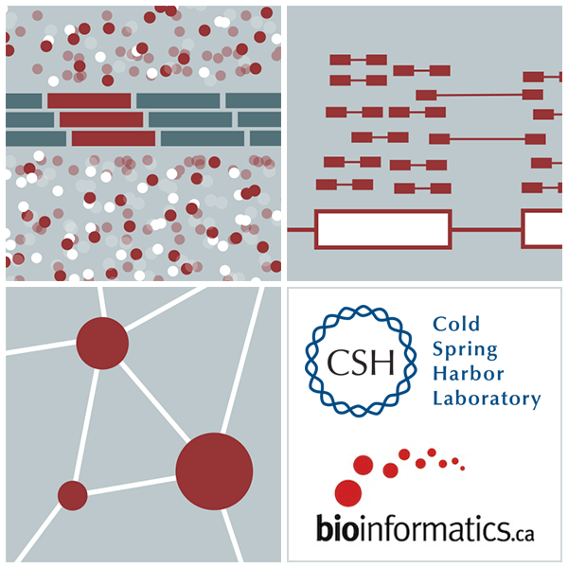

RNA-Seq Module 2 Alignment
Kelsy Cotto, Malachi Griffith, Chris Miller, Peter Ronning
High-Throughput Biology: From Sequence to Networks
March 11-17, 2019
Workshop icon

