Slide 1
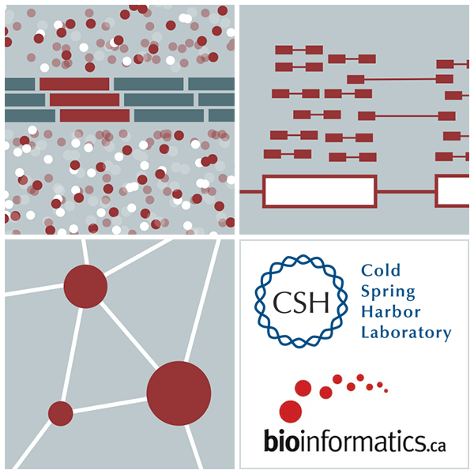

RNA-Seq Module 2 Alignment vs Assembly vs Kmer
Kelsy Cotto, Malachi Griffith, Chris Miller, Peter Ronning
Workshop icon

