Slide 1
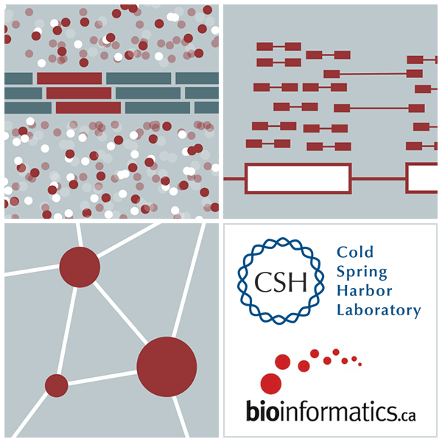

RNA-Seq Module 9 Alignment Free Expression Estimation (Kallisto)
Kelsy Cotto, Malachi Griffith, Chris Miller, Peter Ronning
Workshop icon

