Slide 1

Canadian Bioinformatics Workshops
www.bioinformatics.ca
bioinformaticsdotca.github.io

Slide 2


Slide 3
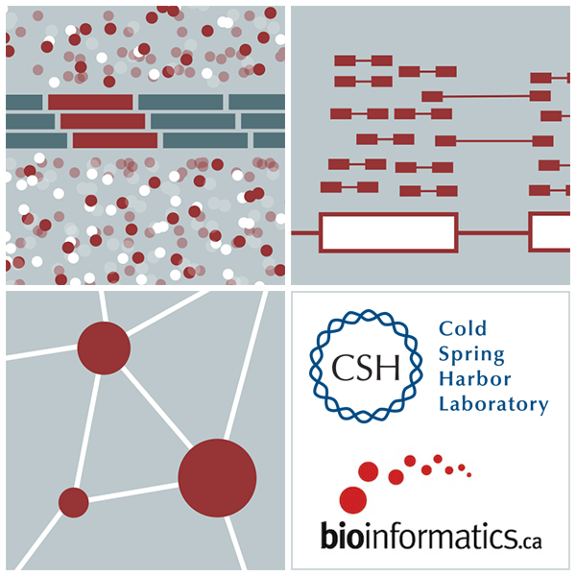

RNA-Seq Module 2 Alignment and Visualization
Kelsy Cotto, Malachi Griffith, Chris Miller, Peter Ronning
High-Throughput Biology: From Sequence to Networks
March 11-17, 2019
Workshop icon

Slide 4
Learning objectives of the course
Module 1: Introduction to RNA Sequencing
Module 2: Alignment and Visualization
Module 3: Expression and Differential Expression
Module 4: Alignment Free Expression Estimation
Module 5: Isoform Discovery and Alternative Expression
Tutorials
Provide a working example of an RNA-seq analysis pipeline
Run in a ‘reasonable’ amount of time with modest computer resources
Self contained, self explanatory, portable

Slide 5
Learning objectives of module 2
RNA-seq alignment challenges and common questions
Alignment strategies
HISAT2
Introduction to the BAM and BED formats
Basic manipulation of BAMs
Visualization of RNA-seq alignments in IGV
Alignment QC Assessment
BAM read counting and determination of variant allele expression status

Slide 6
RNA-seq alignment challenges
Computational cost
100’s of millions of reads
Introns!
Spliced vs. unspliced alignments
Can I just align my data once using one approach and be done with it?
Unfortunately probably not
Is HISAT2 the only mapper to consider for RNA-seq data?
http://www.biostars.org/p/60478/

Slide 7
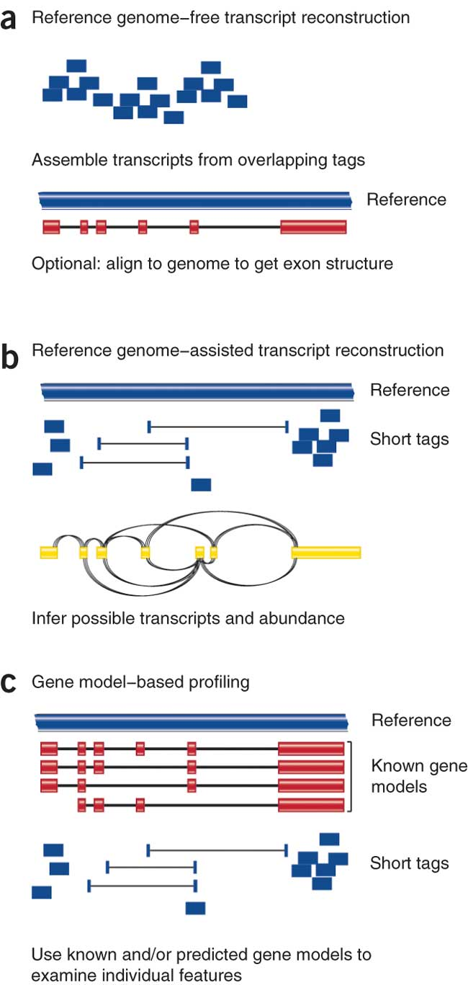
Three RNA-seq mapping strategies
De novo assembly
Align to transcriptome
Align to reference genome
Diagrams from Cloonan & Grimmond, Nature Methods 2010

Slide 8
Which alignment strategy is best?
De novo assembly
If a reference genome does not exist for the species being studied
If complex polymorphisms/mutations/haplotypes might be missed by comparing to the reference genome
Align to transcriptome
If you have short reads (< 50bp)
Align to reference genome
All other cases
Each strategy involves different alignment/assembly tools

Slide 9
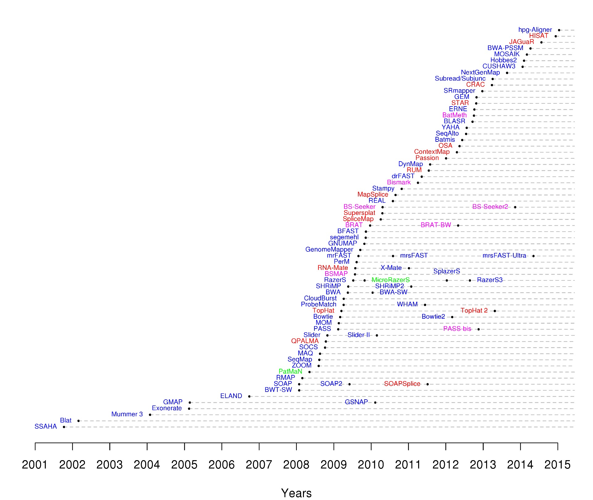
Which read aligner should I use?
RNA
Bisulfite
DNA
microRNA
http://wwwdev.ebi.ac.uk/fg/hts_mappers/

Slide 10
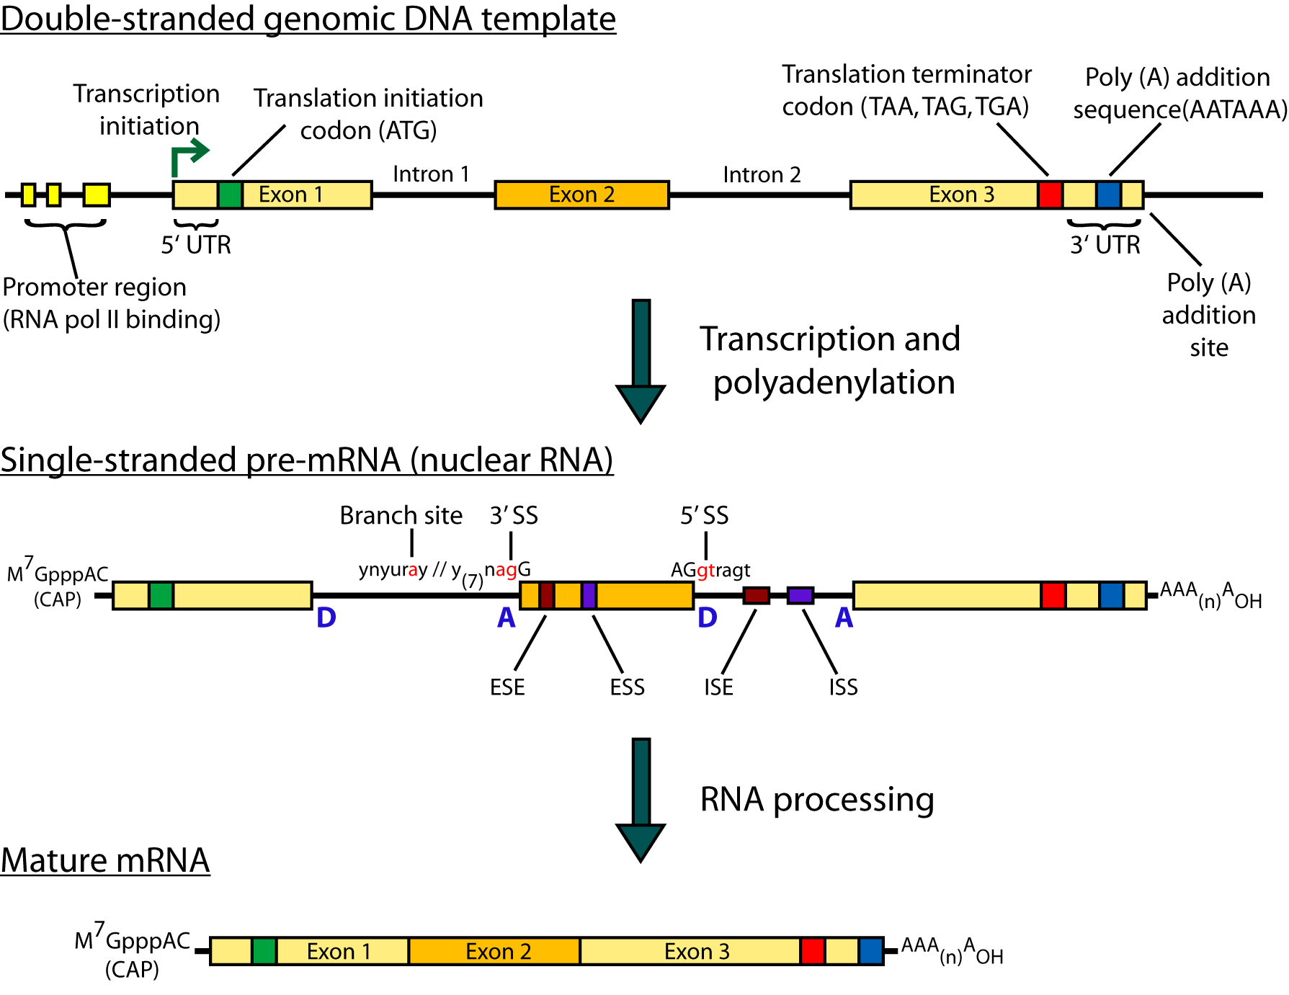
Should I use a splice-aware or unspliced mapper?
RNA-seq reads may span large introns
The fragments being sequenced in RNA-seq represent mRNA and therefore the introns are removed
But we are usually aligning these reads back to the reference genome
Unless your reads are short (<50bp) you should use a splice-aware aligner
HISAT2, STAR, MapSplice, etc.

Slide 11
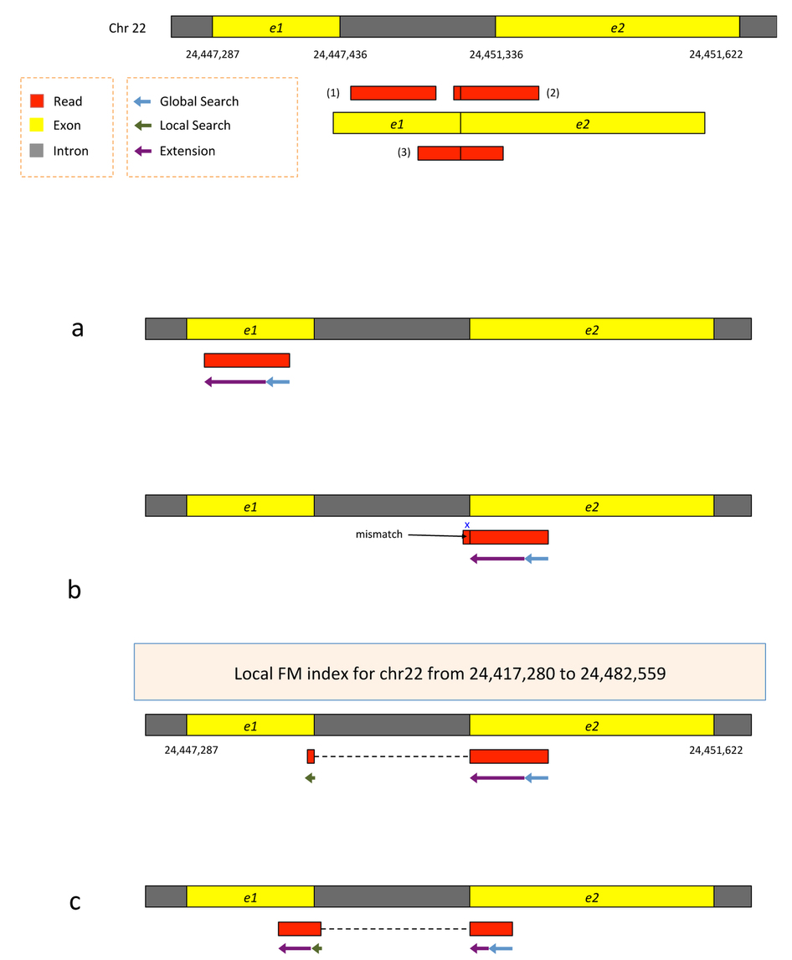
HISAT/HISAT2
HISAT is a ‘splice-aware’ RNA-seq read aligner
Requires a reference genome
Very fast
Uses an indexing scheme based on the Burrows-Wheeler transform and the Ferragina-Manzini (FM) index
Multiple types of indexes for alignment
a whole-genome FM index to anchor each alignment
numerous local FM indexes for very rapid extensions of these alignments.
Whole-genome indices with SNPs and known transcript structures accounted for
Kim et al. 2015. Nat Methods 12:357–360
Notes:
HISAT's hierarchical index for the human genome contains 48,000 local FM indexes, each representing a genomic region of ~64,000 bp.

Slide 12
HISAT/HISAT2
Uses hierarchical indexing algorithm and several adaptive strategies, based on the position of a read with respect to splice sites
First tries to find candidate locations across the target genome from which the read may have originated by mapping part of each read using the global FM index, which in most cases identifies one or a small number of candidates.
Then selects one of ~48,000 local indexes for each candidate and uses it to align the remainder of the read.
For paired reads, each mate is separately aligned and the alignments of both mates are combined.
If a read fails to align, then the alignments of its mate are used as anchors to map the unaligned mate
Kim et al. 2015. Nat Methods 12:357–360
Notes:
HISAT's hierarchical index for the human genome contains 48,000 local FM indexes, each representing a genomic region of ~64,000 bp.

Slide 13
HISAT/HISAT2
First align read with global index (slower)
Once at least 28bp and exactly one location switch to extension mode against reference genome (faster)
Notes:
Alignment of exonic reads and long- and intermediate-anchored reads.
Given two exons from a gene on human chromosome 22, separated by a 3,899-bp intron, suppose the genomic region is transcribed and spliced and we have three reads sequenced from the resulting transcript: (i) an exonic read, (ii) a read spanning two exons with an 8-bp anchor in one exon and (iii) a read spanning two exons with 50 bp in each exon (Supplementary Fig. 8). All the reads are assumed to be error free and 100 bp long. We can apply hierarchical indexing to align each of these reads rapidly and correctly. We align the first read using the global FM-index (Supplementary Fig. 8a). Because global search is relatively time consuming, we change strategies when the partial alignment meets two conditions: (i) it is at least 28 bp long and (ii) it maps onto exactly one location. For the read shown in the figure, the 28-bp sequence on its right end maps uniquely, allowing us to stop the global search operation at that point. From there, we extend the partial alignment by directly comparing the remaining sequence and the corresponding genomic sequence, which we can extract directly from the genome using the mapped location as an index. Because the read is error free and contained within one exon, the extension operation sweeps across the remaining 72 bp, completing the alignment for the read. Note that we could perform this alignment using the global FM index, as TopHat2 does, but the combination of global search and local extension is faster.
For the second read, which has a very short 8-bp anchor on the left side, we first try to map the read using global search, moving right to left (Supplementary Fig. 8b). The first 28 bp on the right end of the read maps uniquely, allowing us to anchor the alignment and halt the global search. We then extend the alignment until we encounter a mismatch at the 93rd base. This mismatch occurs when the alignment extension reaches the intron. At this point we pause the search, retrieve the local FM index that contains this location and align the remaining 8 bp using this index. Because the index covers only a small region, in this case we find just one match for the 8-bp segment. Finally, we check whether the two partial alignments (8 bp and 92 bp) are compatible with each other (for example, in the correct orientation) and then combine them to produce a spliced alignment of the original read.
Note that if we searched for an 8-bp sequence in the global index, we would expect to find an average of ~48,000 matching locations in the human genome (and sometimes many more). Instead of examining 48,000 possible locations, we use one of the local FM indexes, which is expected to contain just one copy of a given 8-bp sequence, on average. This two-stage hierarchical indexing allows us to avoid examining tens of thousands of candidate locations for short anchors, which in turn dramatically speeds up the overall alignment algorithm.
The third read has long anchors (50 bp each) in each exon. We first align the read beginning on the right, using global search as we did before. After the first 28 bp is uniquely mapped, we switch to the extension operation, which further aligns 22 bp and stops after a mismatch at the 51st base. We then choose a local FM index and perform a local search using the first 8 bp of the remaining part of the read. Once this 8 bp is found, HISAT again uses the extension operation to align the rest of the read (Supplementary Fig. 8c). Note that if the 8-bp prefix mapped to too many locations, HISAT would use a longer prefix to reduce the number of potential locations to 5 or fewer.
As we can see from these examples, we can combine global search, local search and directed read extension to achieve rapid yet sensitive alignment. Note that when a read has multiple spliced alignments, HISAT prefers to report alignments that use the canonical GT and AG dinucleotides on the ends of the intron. From any remaining alignments after this filter, it reports the one with the shortest intron length. HISAT provides several parameters with which users can customize its alignment strategy, including adjustable penalties for mismatches, indels and noncanonical splice sites (Supplementary Note).

Slide 14
HISAT/HISAT2
Again use global search until exactly one match of at least 28bp (slower)
Extend as before until mismatch at 93bp (faster)
Switch to local FM index to align remaining 8bp
Because the index covers only a small region, in this case we find just one match for the 8-bp segment.
Check for compatibility and combine into single spliced alignment
Notes:
Alignment of exonic reads and long- and intermediate-anchored reads.
Given two exons from a gene on human chromosome 22, separated by a 3,899-bp intron, suppose the genomic region is transcribed and spliced and we have three reads sequenced from the resulting transcript: (i) an exonic read, (ii) a read spanning two exons with an 8-bp anchor in one exon and (iii) a read spanning two exons with 50 bp in each exon (Supplementary Fig. 8). All the reads are assumed to be error free and 100 bp long. We can apply hierarchical indexing to align each of these reads rapidly and correctly. We align the first read using the global FM-index (Supplementary Fig. 8a). Because global search is relatively time consuming, we change strategies when the partial alignment meets two conditions: (i) it is at least 28 bp long and (ii) it maps onto exactly one location. For the read shown in the figure, the 28-bp sequence on its right end maps uniquely, allowing us to stop the global search operation at that point. From there, we extend the partial alignment by directly comparing the remaining sequence and the corresponding genomic sequence, which we can extract directly from the genome using the mapped location as an index. Because the read is error free and contained within one exon, the extension operation sweeps across the remaining 72 bp, completing the alignment for the read. Note that we could perform this alignment using the global FM index, as TopHat2 does, but the combination of global search and local extension is faster.
For the second read, which has a very short 8-bp anchor on the left side, we first try to map the read using global search, moving right to left (Supplementary Fig. 8b). The first 28 bp on the right end of the read maps uniquely, allowing us to anchor the alignment and halt the global search. We then extend the alignment until we encounter a mismatch at the 93rd base. This mismatch occurs when the alignment extension reaches the intron. At this point we pause the search, retrieve the local FM index that contains this location and align the remaining 8 bp using this index. Because the index covers only a small region, in this case we find just one match for the 8-bp segment. Finally, we check whether the two partial alignments (8 bp and 92 bp) are compatible with each other (for example, in the correct orientation) and then combine them to produce a spliced alignment of the original read.
Note that if we searched for an 8-bp sequence in the global index, we would expect to find an average of ~48,000 matching locations in the human genome (and sometimes many more). Instead of examining 48,000 possible locations, we use one of the local FM indexes, which is expected to contain just one copy of a given 8-bp sequence, on average. This two-stage hierarchical indexing allows us to avoid examining tens of thousands of candidate locations for short anchors, which in turn dramatically speeds up the overall alignment algorithm.
The third read has long anchors (50 bp each) in each exon. We first align the read beginning on the right, using global search as we did before. After the first 28 bp is uniquely mapped, we switch to the extension operation, which further aligns 22 bp and stops after a mismatch at the 51st base. We then choose a local FM index and perform a local search using the first 8 bp of the remaining part of the read. Once this 8 bp is found, HISAT again uses the extension operation to align the rest of the read (Supplementary Fig. 8c). Note that if the 8-bp prefix mapped to too many locations, HISAT would use a longer prefix to reduce the number of potential locations to 5 or fewer.
As we can see from these examples, we can combine global search, local search and directed read extension to achieve rapid yet sensitive alignment. Note that when a read has multiple spliced alignments, HISAT prefers to report alignments that use the canonical GT and AG dinucleotides on the ends of the intron. From any remaining alignments after this filter, it reports the one with the shortest intron length. HISAT provides several parameters with which users can customize its alignment strategy, including adjustable penalties for mismatches, indels and noncanonical splice sites (Supplementary Note).

Slide 15
HISAT/HISAT2
Again use global search until exactly one match of at least 28bp (slower)
Extend as before until mismatch at 51bp (faster)
Switch to local FM index to align first 8bp of remaining read
If too many matches increase prefix size
Extend again
Check for compatibility and combine into single spliced alignment
Notes:
Alignment of exonic reads and long- and intermediate-anchored reads.
Given two exons from a gene on human chromosome 22, separated by a 3,899-bp intron, suppose the genomic region is transcribed and spliced and we have three reads sequenced from the resulting transcript: (i) an exonic read, (ii) a read spanning two exons with an 8-bp anchor in one exon and (iii) a read spanning two exons with 50 bp in each exon (Supplementary Fig. 8). All the reads are assumed to be error free and 100 bp long. We can apply hierarchical indexing to align each of these reads rapidly and correctly. We align the first read using the global FM-index (Supplementary Fig. 8a). Because global search is relatively time consuming, we change strategies when the partial alignment meets two conditions: (i) it is at least 28 bp long and (ii) it maps onto exactly one location. For the read shown in the figure, the 28-bp sequence on its right end maps uniquely, allowing us to stop the global search operation at that point. From there, we extend the partial alignment by directly comparing the remaining sequence and the corresponding genomic sequence, which we can extract directly from the genome using the mapped location as an index. Because the read is error free and contained within one exon, the extension operation sweeps across the remaining 72 bp, completing the alignment for the read. Note that we could perform this alignment using the global FM index, as TopHat2 does, but the combination of global search and local extension is faster.
For the second read, which has a very short 8-bp anchor on the left side, we first try to map the read using global search, moving right to left (Supplementary Fig. 8b). The first 28 bp on the right end of the read maps uniquely, allowing us to anchor the alignment and halt the global search. We then extend the alignment until we encounter a mismatch at the 93rd base. This mismatch occurs when the alignment extension reaches the intron. At this point we pause the search, retrieve the local FM index that contains this location and align the remaining 8 bp using this index. Because the index covers only a small region, in this case we find just one match for the 8-bp segment. Finally, we check whether the two partial alignments (8 bp and 92 bp) are compatible with each other (for example, in the correct orientation) and then combine them to produce a spliced alignment of the original read.
Note that if we searched for an 8-bp sequence in the global index, we would expect to find an average of ~48,000 matching locations in the human genome (and sometimes many more). Instead of examining 48,000 possible locations, we use one of the local FM indexes, which is expected to contain just one copy of a given 8-bp sequence, on average. This two-stage hierarchical indexing allows us to avoid examining tens of thousands of candidate locations for short anchors, which in turn dramatically speeds up the overall alignment algorithm.
The third read has long anchors (50 bp each) in each exon. We first align the read beginning on the right, using global search as we did before. After the first 28 bp is uniquely mapped, we switch to the extension operation, which further aligns 22 bp and stops after a mismatch at the 51st base. We then choose a local FM index and perform a local search using the first 8 bp of the remaining part of the read. Once this 8 bp is found, HISAT again uses the extension operation to align the rest of the read (Supplementary Fig. 8c). Note that if the 8-bp prefix mapped to too many locations, HISAT would use a longer prefix to reduce the number of potential locations to 5 or fewer.
As we can see from these examples, we can combine global search, local search and directed read extension to achieve rapid yet sensitive alignment. Note that when a read has multiple spliced alignments, HISAT prefers to report alignments that use the canonical GT and AG dinucleotides on the ends of the intron. From any remaining alignments after this filter, it reports the one with the shortest intron length. HISAT provides several parameters with which users can customize its alignment strategy, including adjustable penalties for mismatches, indels and noncanonical splice sites (Supplementary Note).

Slide 16
Should I allow ‘multi-mapped’ reads?
Depends on the application
In *DNA* analysis it is common to use a mapper to randomly select alignments from a series of equally good alignments
In *RNA* analysis this is less common
Perhaps disallow multi-mapped reads if you are variant calling
Definitely should allow multi-mapped reads for expression analysis with Cufflinks (and StringTie?)
Definitely should allow multi-mapped reads for gene fusion discovery

Slide 17
What is the output of HISAT2?
A SAM/BAM file
SAM stands for Sequence Alignment/Map format
BAM is the binary version of a SAM file
Remember, compressed files require special handling compared to plain text files
How can I convert BAM to SAM?
http://www.biostars.org/p/1701/

Slide 18
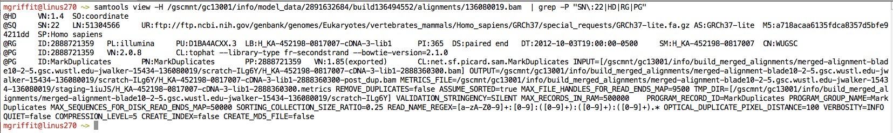
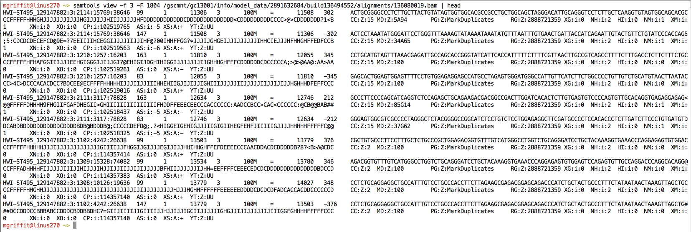
Example of SAM/BAM file format
Example SAM/BAM header section (abbreviated)
Example SAM/BAM alignment section (only 10 alignments shown)

Slide 19
Introduction to the SAM/BAM format
The specification
http://samtools.sourceforge.net/SAM1.pdf
The SAM format consists of two sections:
Header section
Used to describe source of data, reference sequence, method of alignment, etc.
Alignment section
Used to describe the read, quality of the read, and nature alignment of the read to a region of the genome
BAM is a compressed version of SAM
Compressed using lossless BGZF format
Other BAM compression strategies are a subject of research. See ‘CRAM’ format for example
BAM files are usually ‘indexed’
A ‘.bai’ file will be found beside the ‘.bam’ file
Indexing aims to achieve fast retrieval of alignments overlapping a specified region without going through the whole alignments. BAM must be sorted by the reference ID and then the leftmost coordinate before indexing

Slide 20
SAM/BAM header section
Used to describe source of data, reference sequence, method of alignment, etc.
Each section begins with character ‘@’ followed by a two-letter record type code. These are followed by two-letter tags and values
@HD The header line
VN: format version
SO: Sorting order of alignments
@SQ Reference sequence dictionary
SN: reference sequence name
LN: reference sequence length
SP: species
@RG Read group
ID: read group identifier
CN: name of sequencing center
SM: sample name
@PG Program
PN: program name
VN: program version

Slide 21
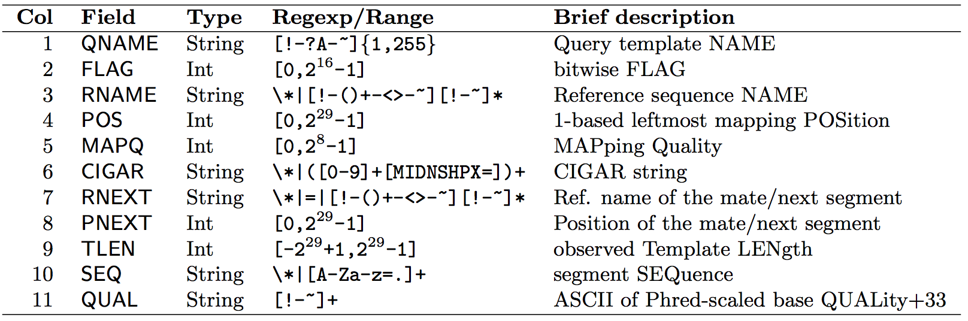
SAM/BAM alignment section
Example values
QNAME e.g. HWI-ST495_129147882:1:2302:10269:12362 (QNAME)
FLAG e.g. 99
RNAME e.g. 1
POS e.g. 11623
MAPQ e.g. 3
CIGAR e.g. 100M
RNEXT e.g. =
PNEXT e.g. 11740
TLEN e.g. 217
SEQ e.g. CCTGTTTCTCCACAAAGTGTTTACTTTTGGATTTTTGCCAGTCTAACAGGTGAAGCCCTGGAGATTCTTATTAGTGATTTGGGCTGGGGCCTGGCCATGT
QUAL e.g. CCCFFFFFHHHHHJJIJFIJJJJJJJJJJJHIJJJJJJJIJJJJJGGHIJHIJJJJJJJJJGHGGIJJJJJJIJEEHHHHFFFFCDCDDDDDDDB@ACDD

Slide 22
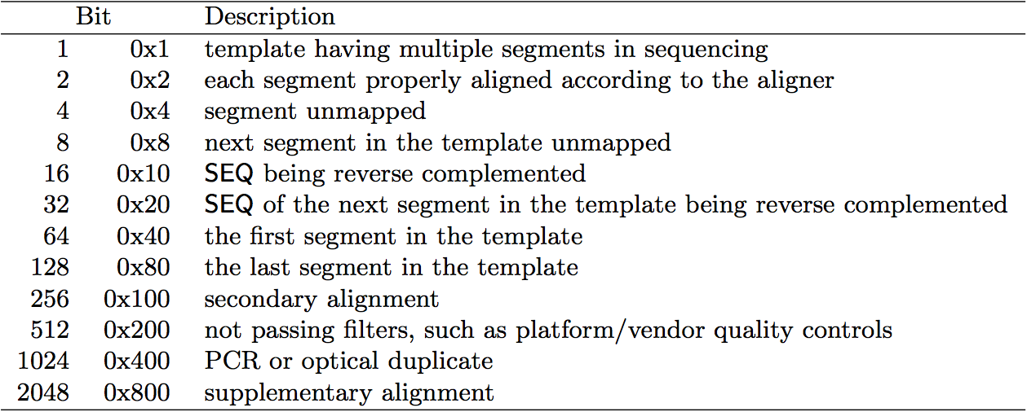
SAM/BAM flags explained
http://broadinstitute.github.io/picard/explain-flags.html
12 bitwise flags describing the alignment
These flags are stored as a binary string of length 11 instead of 11 columns of data
Value of ‘1’ indicates the flag is set. e.g. 00100000000
All combinations can be represented as a number from 1 to 2048 (i.e. 2¹¹-1). This number is used in the BAM/SAM file. You can specify ‘required’ or ‘filter’ flags in samtools view using the ‘-f’ and ‘-F’ options respectively
Note that to maximize confusion, each bit is described in the SAM specification using its hexadecimal representation (i.e., '0x10' = 16 and '0x40' = 64).

Slide 23
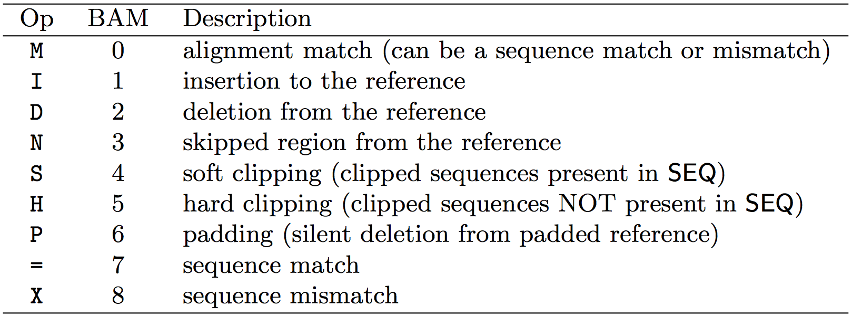
CIGAR strings explained
The CIGAR string is a sequence of base lengths and associated ‘operations’ that are used to indicate which bases align to the reference (either a match or mismatch), are deleted, are inserted, represent introns, etc.
e.g. 81M859N19M
A 100 bp read consists of: 81 bases of alignment to reference, 859 bases skipped (an intron), 19 bases of alignment

Slide 24
Introduction to the BED format
When working with BAM files, it is very common to want to examine a focused subset of the reference genome
e.g. the exons of a gene
These subsets are commonly specified in ‘BED’ files
https://genome.ucsc.edu/FAQ/FAQformat.html#format1
Many BAM manipulation tools accept regions of interest in BED format
Basic BED format (tab separated):
Chromosome name, start position, end position
Coordinates in BED format are 0 based

Slide 25
Manipulation of SAM/BAM and BED files
Several tools are used ubiquitously in sequence analysis to manipulate these files
SAM/BAM files
samtools
bamtools
picard
BED files
bedtools
bedops

Slide 26
How should I sort my SAM/BAM file?
Generally BAM files are sorted by position
This is for performance reasons
When sorted and indexed, arbitrary positions in a massive BAM file can be accessed rapidly
Certain tools require a BAM sorted by read name
Usually this is when we need to easily identify both reads of a pair
The insert size between two reads may be large
In fusion detection we are interested in read pairs that map to different chromosomes…

Slide 27
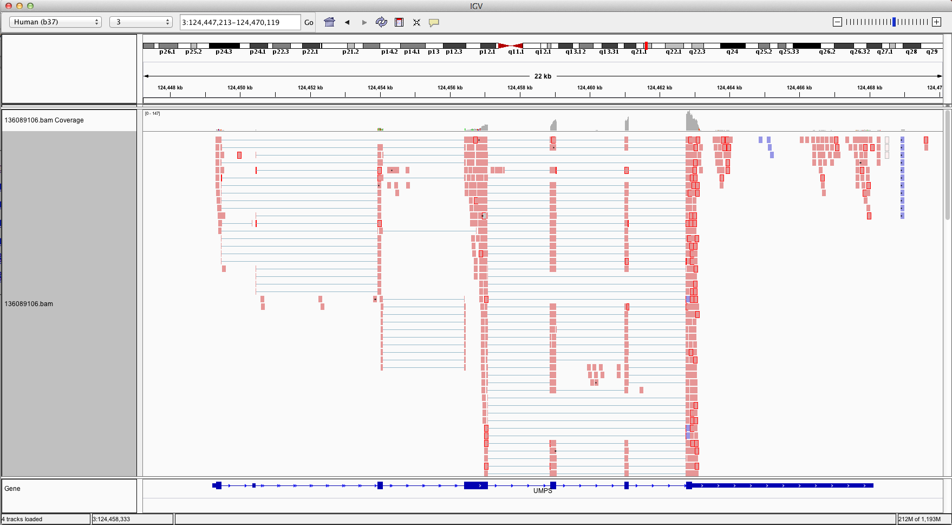
Visualization of RNA-seq alignments in IGV browser
Ideogram
Coverage
pileup
Control pop-up info
Viewer position
Coverage
track
Coverage
scale
Single reads, not spliced
+ve
strand
-ve
strand
Reads track
Single reads, spliced
Gene track

Slide 28
Alternative viewers to IGV
Alternative viewers to IGV
http://www.biostars.org/p/12752/
http://www.biostars.org/p/71300/
Artemis, BamView, Chipster, gbrowse2, GenoViewer, MagicViewer, Savant, Tablet, tview

Slide 29
Alignment QC Assessment
3' and 5' Bias
Nucleotide Content
Base/Read Quality
PCR Artifact
Sequencing Depth
Base Distribution
Insert Size Distribution

Slide 30
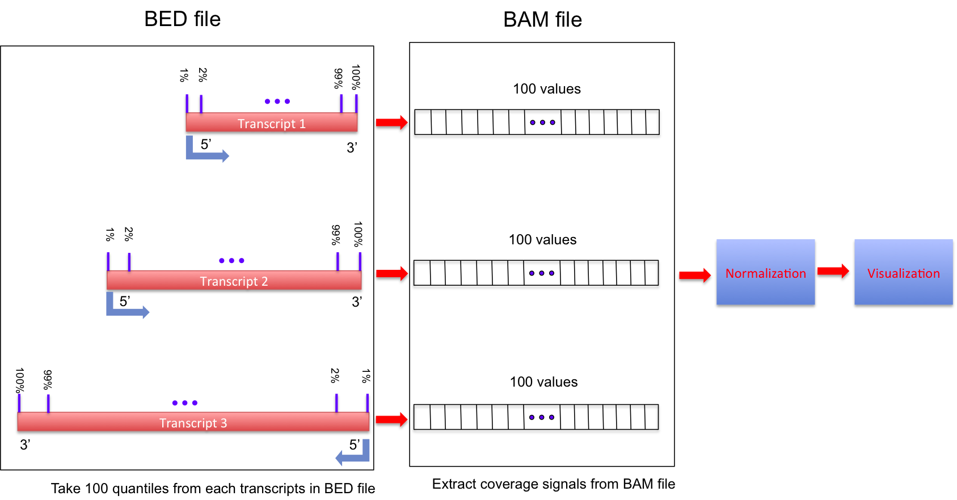
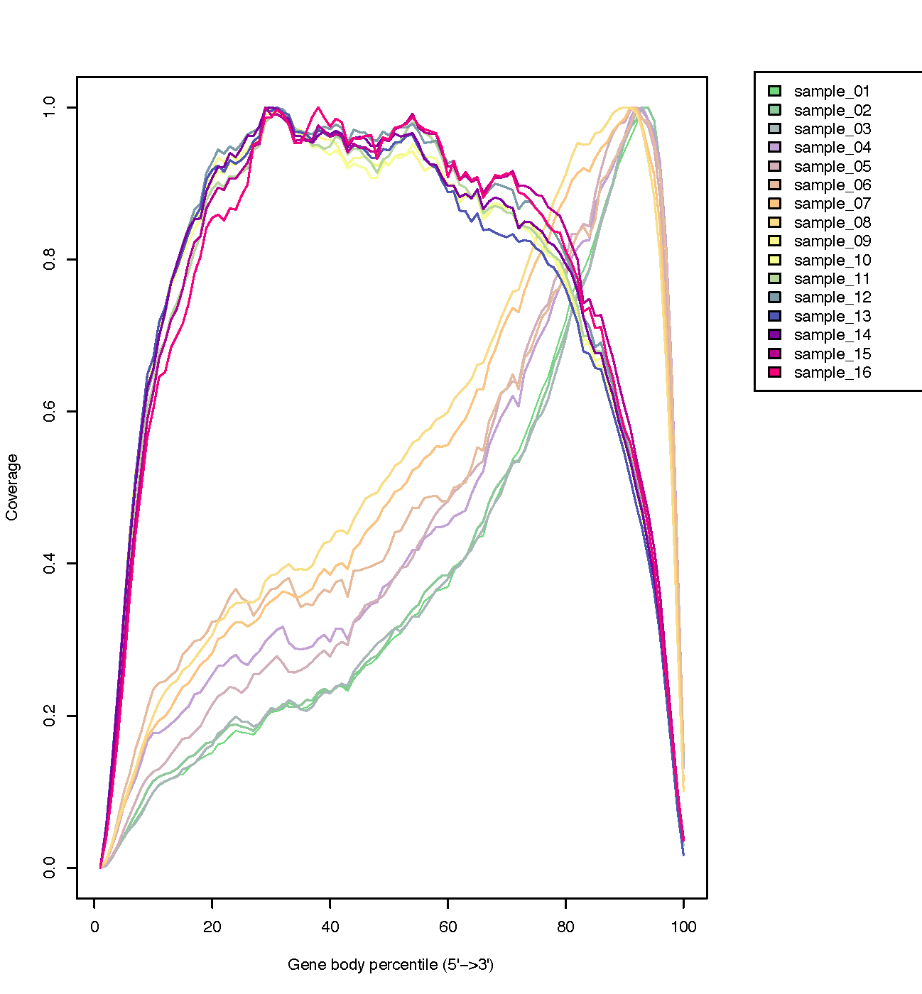
Alignment QC: 3' & 5' Bias
http://rseqc.sourceforge.net/

Slide 31
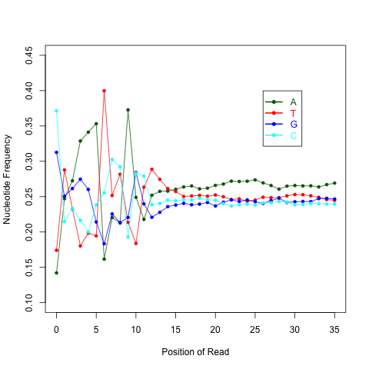
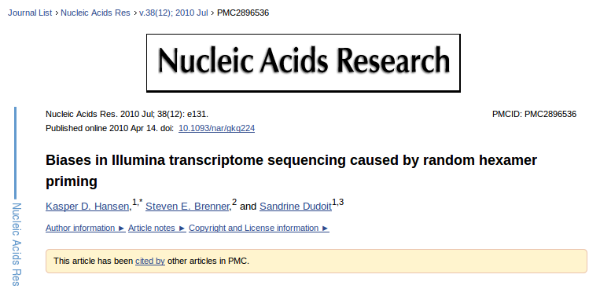
Alignment QC: Nucleotide Content
Random primers are used to reverse transcribe RNA fragments into double-stranded complementary DNA (dscDNA)
Causes certain patterns to be over represented at the beginning (5’end) of reads
Deviation from expected A%=C%=G%=T%=25%
http://rseqc.sourceforge.net/

Slide 32
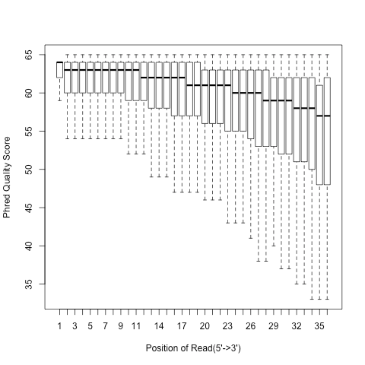
Alignment QC: Quality Distribution
Phred quality score is widely used to characterize the quality of base-calling
Phred quality score = -10xlog(10)P, here P is probability that base-calling is wrong
Phred score of 30 means there is 1/1000 chance that the base-calling is wrong
The quality of the bases tend to drop at the end of the read, a pattern observed in sequencing by synthesis techniques

Slide 33
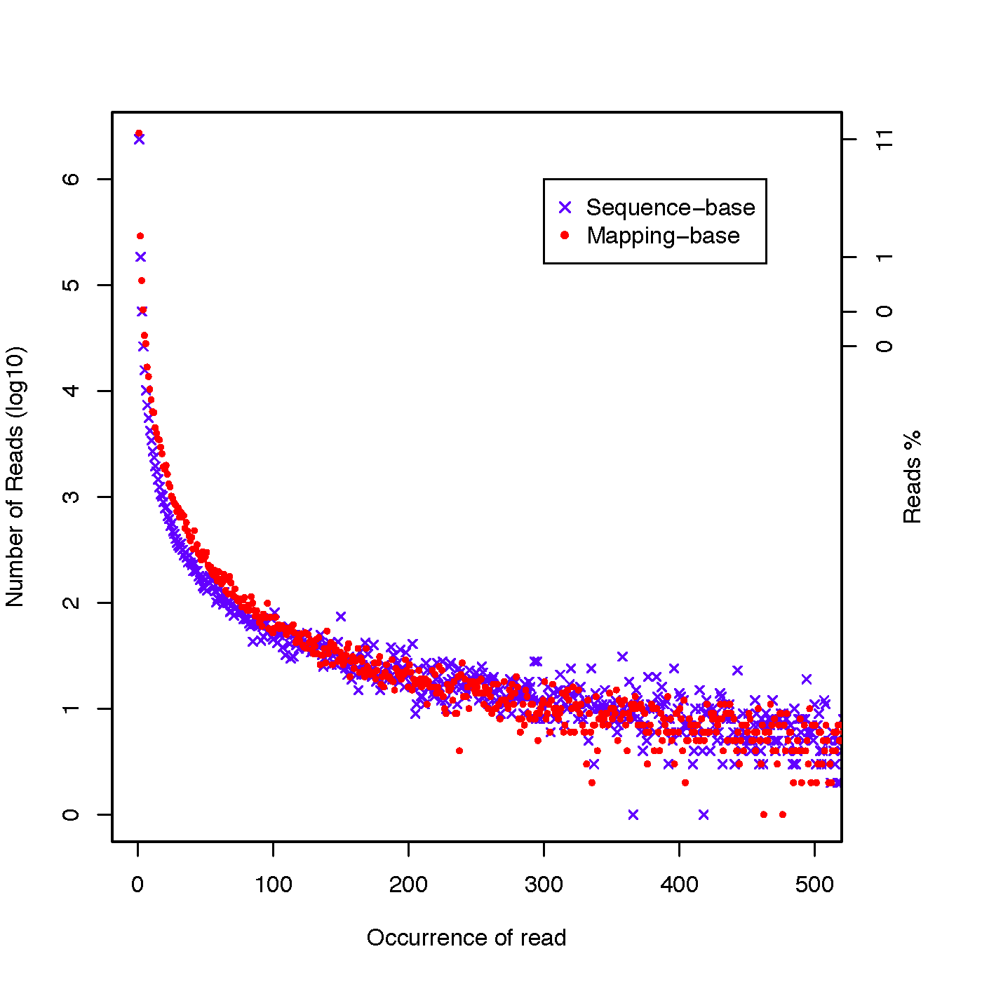
Alignment QC: PCR Duplication
Duplicate reads are reads that have the same start/end positions and same exact sequence
In DNA-seq, reads/start point is used as a metric to assess PCR duplication rate
In DNA-seq, duplicate reads are collapsed using tools such as picard
How is RNA-seq different from DNA-seq?
http://rseqc.sourceforge.net/

Slide 34
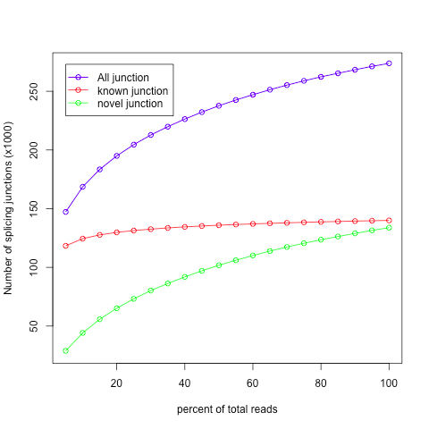
Alignment QC: Sequencing Depth
Have we sequenced deep enough?
In DNA-seq, we can determine this by looking at the average coverage over the sequenced region. Is it above a certain threshold?
In RNA-seq, this is a challenge due to the variability in gene abundance
Use splice junctions detection rate as a way to identify desired sequencing depth
Check for saturation by resampling 5%, 10%, 15%, ..., 95% of total alignments from aligned file, and then detect splice junctions from each subset and compare to reference gene model.
This method ensures that you have sufficient coverage to perform alternative splicing analyses

Slide 35
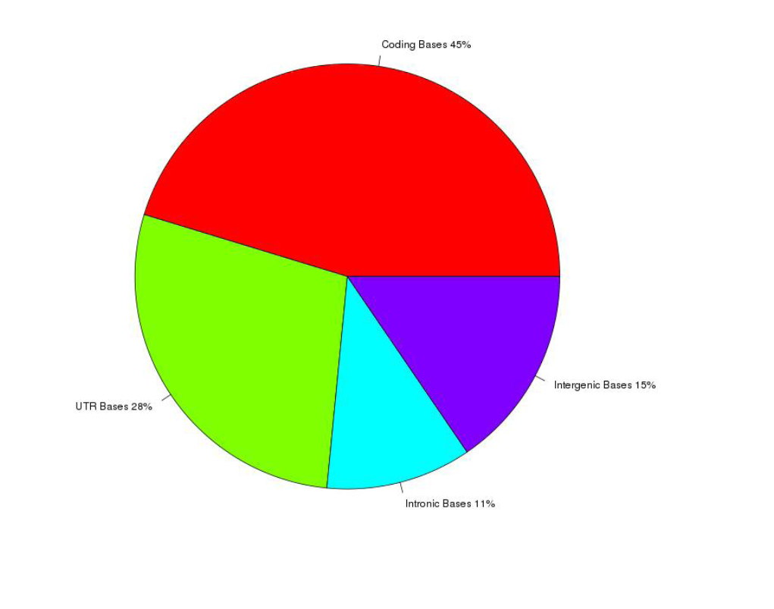
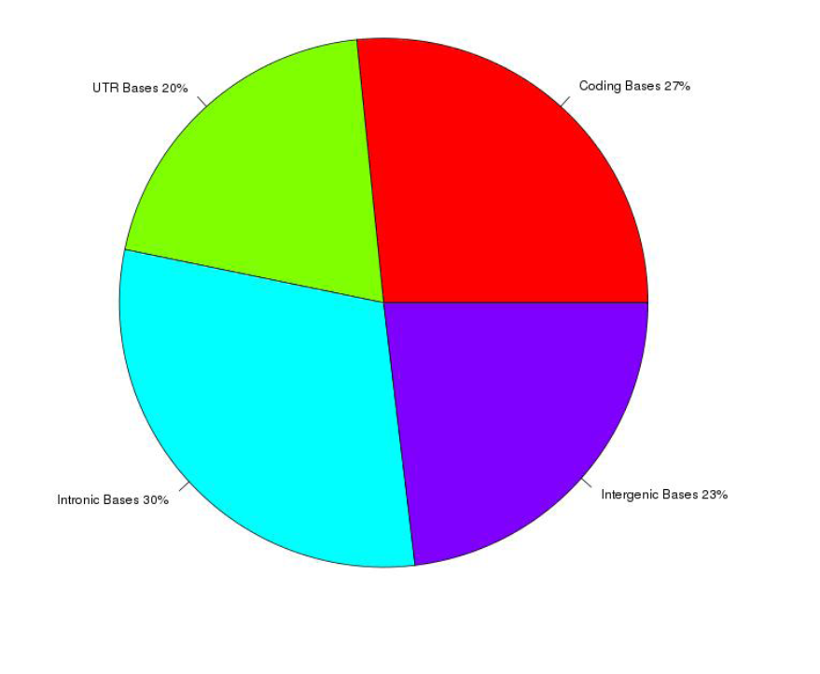
Alignment QC: Base Distribution
Whole Transcriptome Library
PolyA mRNA library
Your sequenced bases distribution will depend on the library preparation protocol selected

Slide 36
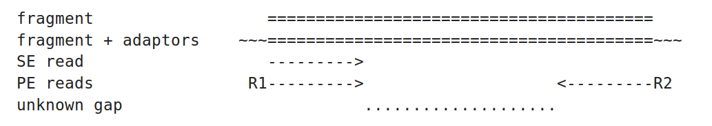
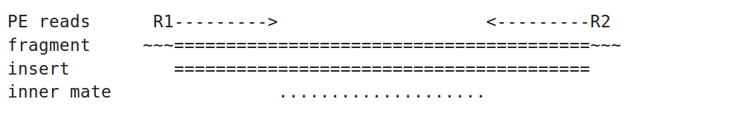
Alignment QC: Insert Size
http://thegenomefactory.blogspot.ca/2013/08/paired-end-read-confusion-library.html

Slide 37
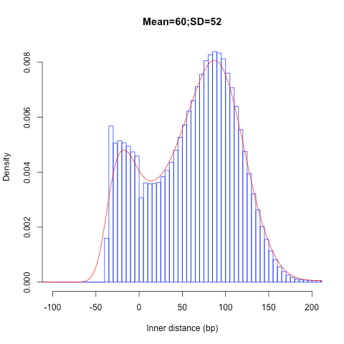
Alignment QC: Insert Size
Consistent with library size selection?
http://rseqc.sourceforge.net/

Slide 38
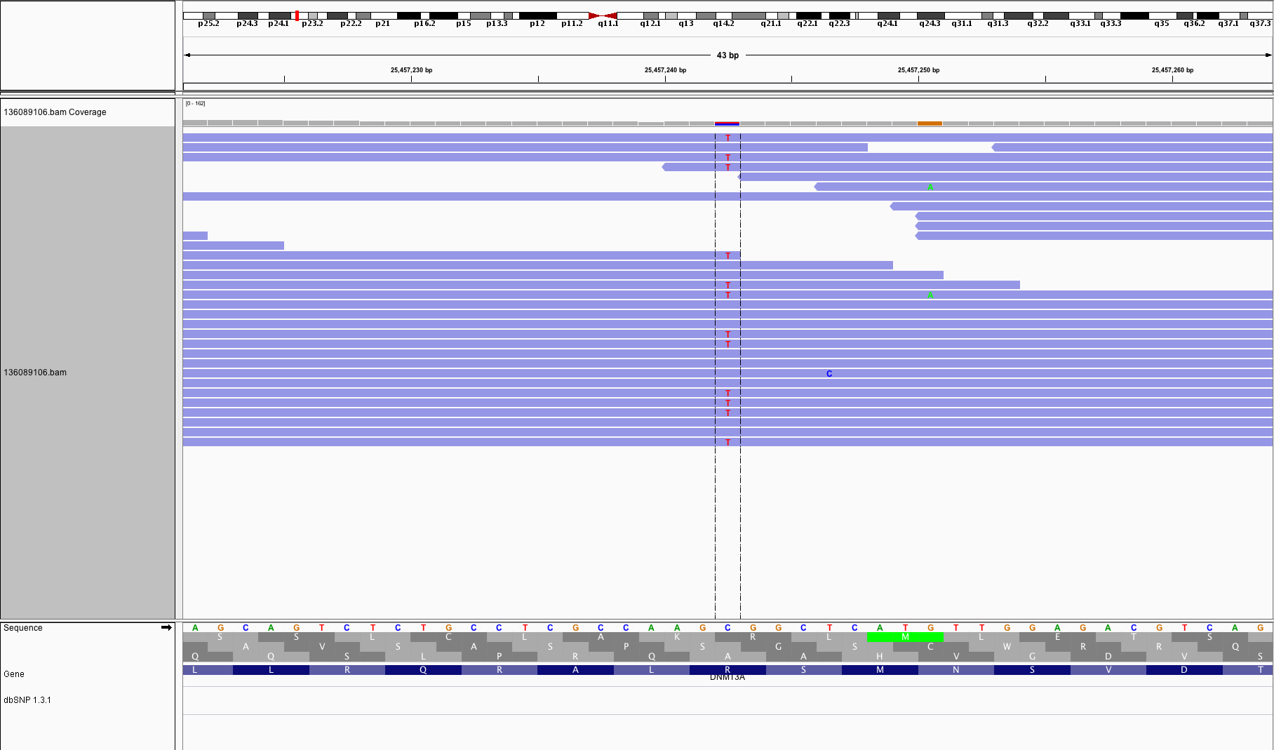
BAM read counting and variant allele expression status
A variant C->T is observed in 12 of 25 reads covering this position. Variant allele frequency (VAF) 12/25 = 48%.
Both alleles appear to be expressed equally (not always the case) -> heterozygous, no allele specific expression
How can we determine variant read counts, depth of coverage, and VAF without manually viewing in IGV?

Slide 39
Introduction to tutorial
(Module 2)

Slide 40
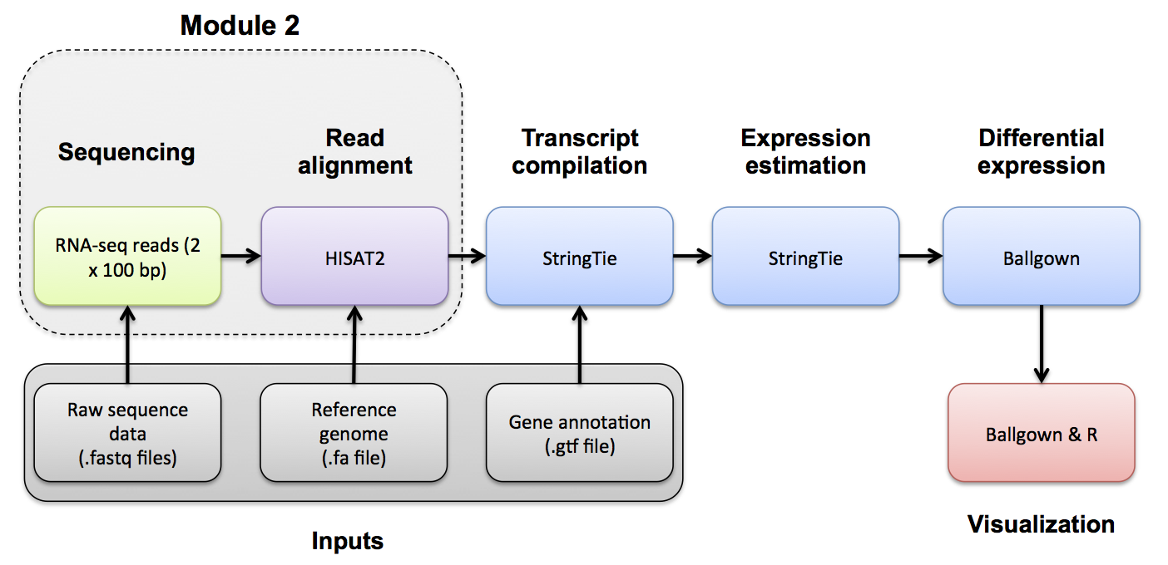
Bowtie/Tophat/Cufflinks/Cuffdiff RNA-seq Pipeline

Slide 41




We are on a Coffee Break & Networking Session
Workshop Sponsors:

