Slide 1

Canadian Bioinformatics Workshops
www.bioinformatics.ca
bioinformaticsdotca.github.io

Slide 2


Slide 3
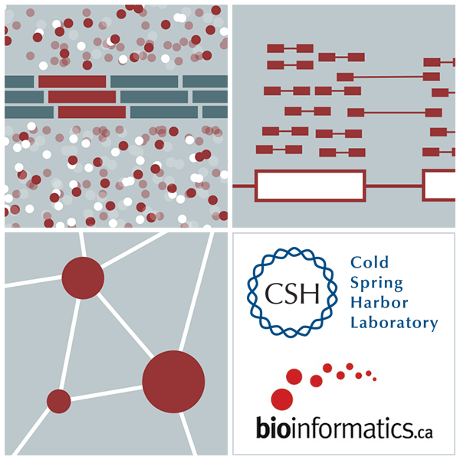

RNA-Seq Module 3 Expression and Differential Expression
Kelsy Cotto, Malachi Griffith, Chris Miller, Peter Ronning
High-Throughput Biology: From Sequence to Networks
March 11-17, 2019
Workshop icon

Slide 4
Learning objectives of the course
Module 1: Introduction to RNA Sequencing
Module 2: Alignment and Visualization
Module 3: Expression and Differential Expression
Module 4: Alignment Free Expression Estimation
Module 5: Isoform Discovery and Alternative Expression
Tutorials
Provide a working example of an RNA-seq analysis pipeline
Run in a ‘reasonable’ amount of time with modest computer resources
Self contained, self explanatory, portable

Slide 5
Learning Objectives of Module 3
Expression estimation for known genes and transcripts
‘FPKM’ expression estimates vs. ‘raw’ counts
Differential expression methods
Downstream interpretation of expression and differential estimates
multiple testing, clustering, heatmaps, classification, pathway analysis, etc.

Slide 6
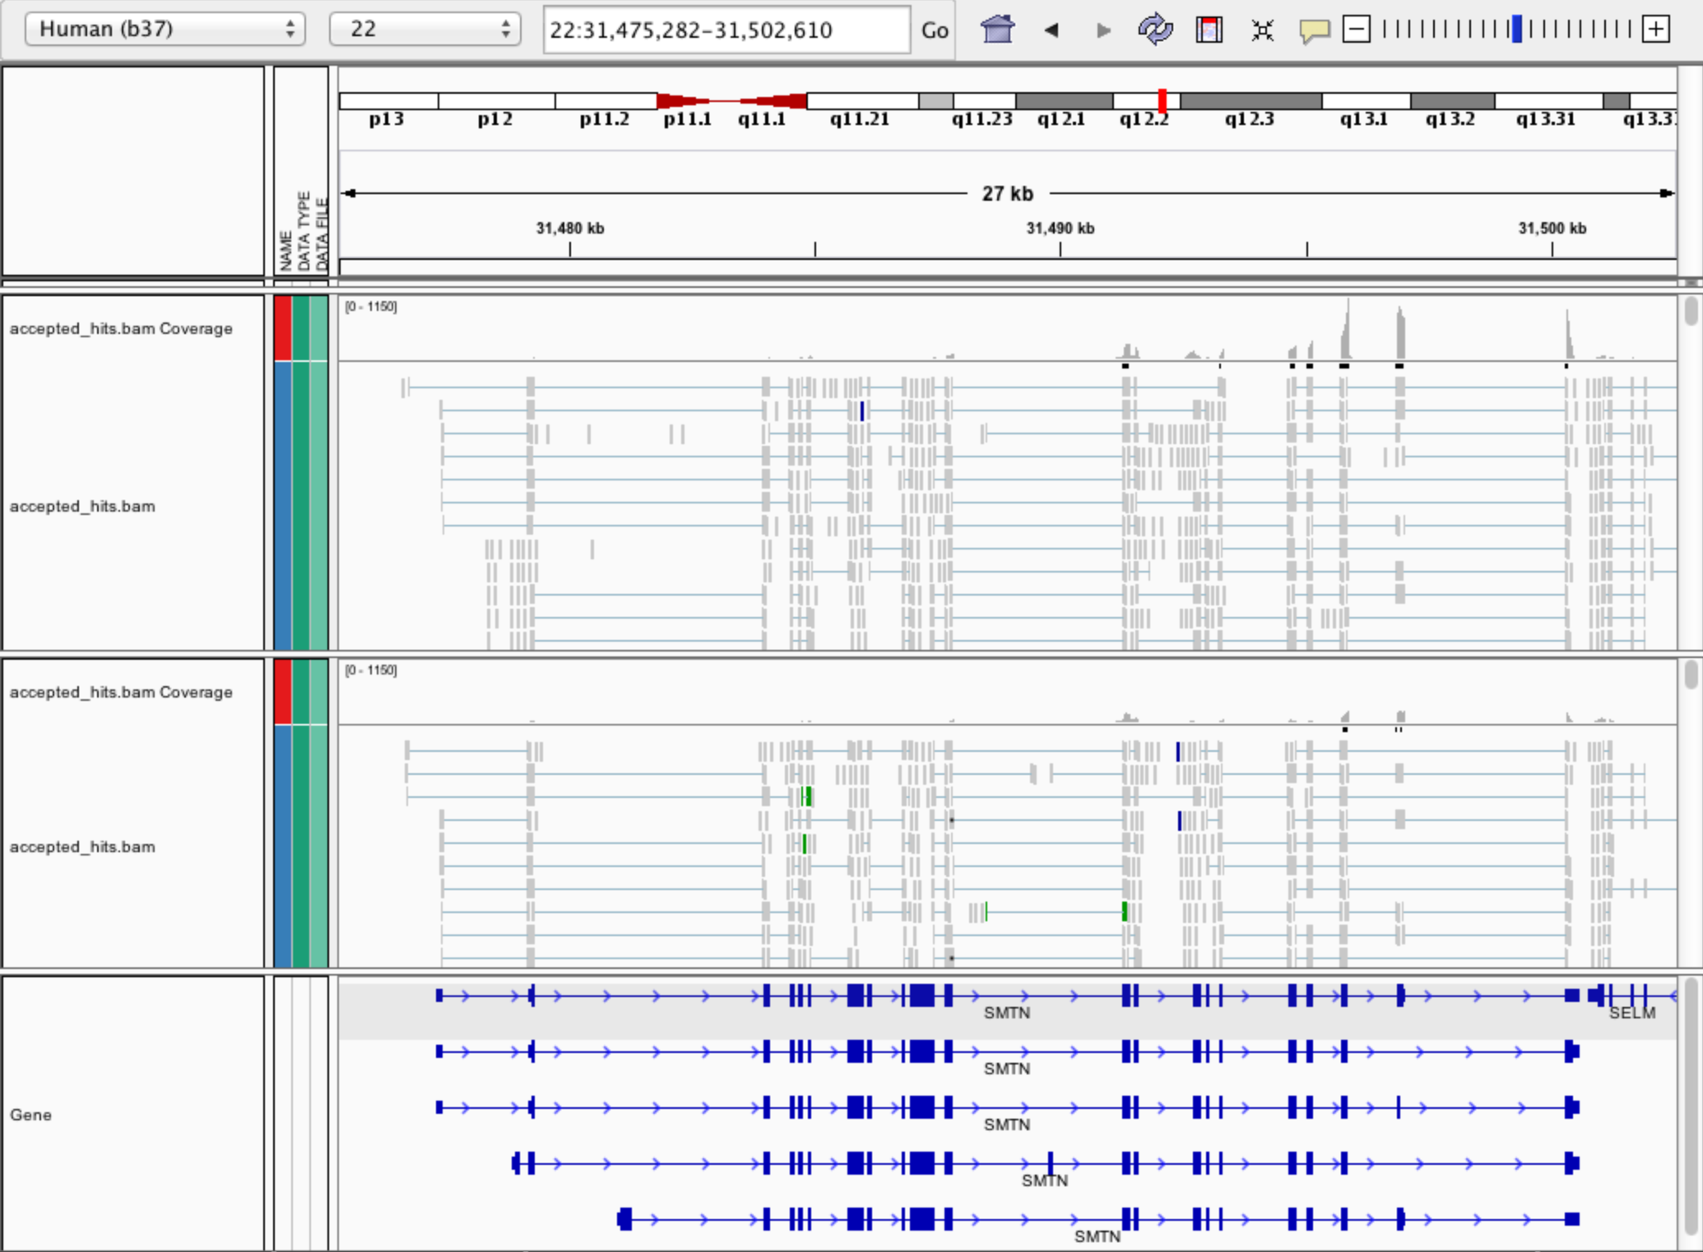
Expression estimation for known genes and transcripts
3’ bias
Down-regulated

Slide 7
What is FPKM (RPKM)
RPKM: Reads Per Kilobase of transcript per Million mapped reads.
FPKM: Fragments Per Kilobase of transcript per Million mapped reads.
In RNA-Seq, the relative expression of a transcript is proportional to the number of cDNA fragments that originate from it. However:
The number of fragments is also biased towards larger genes
The total number of fragments is related to total library depth
FPKM (RPKM) attempt to normalize for gene size and library depth
FPKM (RPKM) = (10^9 * C) / (N * L)
C = number of mappable reads/fragments for a gene/transcript/exon/etc
N = total number of mappable reads/fragments in the library
L = number of base pairs in the gene/transcript/exon/etc
http://www.biostars.org/p/11378/
http://www.biostars.org/p/68126/

Slide 8
How do FPKM and TPM differ?
TPM: Transcript per Kilobase Million
The difference is in the order of operations:
FPKM
1) Determine total sample fragment count and divide by 1,000,000
“per million” scaling factor
2) Divide each gene/transcript fragment count by #1
fragments per million, FPM
3) Divide each FPM by length of each gene/transcript in kilobases (FPKM)
TPM
1) Divide each fragment count by length of each transcript in kilobases
fragments per kilobase, FPK
2) Sum all FPK values for the sample and divide by 1,000,000
“per million” scaling factor
3) Divide #1 by #2 (TPM)
The sum of all TPMs in each sample is the same. Easier to compare across samples!
http://www.rna-seqblog.com/rpkm-fpkm-and-tpm-clearly-explained/
https://www.ncbi.nlm.nih.gov/pubmed/22872506
Notes:
When you use TPM, the sum of all TPMs in each sample are the same. This makes it easier to compare the proportion of reads that mapped to a gene in each sample. In contrast, with RPKM and FPKM, the sum of the normalized reads in each sample may be different, and this makes it harder to compare samples directly.

Slide 9
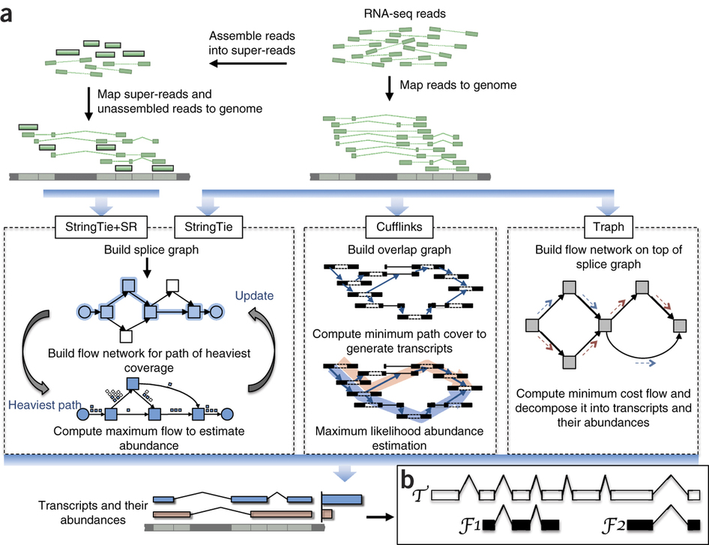
How does StringTie work?
StringTie iteratively extracts the heaviest path from a splice graph, constructs a flow network, computes maximum flow to estimate abundance, and then updates the splice graph by removing reads that were assigned by the flow algorithm. This process repeats until all reads have been assigned.
Group reads into clusters
Pertea et al. Nature Biotechnology, 2015
Notes:
Overview of the flow of the StringTie algorithm, compared to Cufflinks and Traph.
All methods begin with a set of RNA-seq reads that have been mapped to the genome. An optional secondary input to StringTie is a set of pre-assembled super-reads, designated as StringTie+SR. StringTie first groups reads into clusters. Then it creates a splice graph for each cluster (nodes represent exons or parts of exons, and paths through the graph represent possible splice variants). StringTie iteratively extracts the heaviest path from the splice graph, constructs a flow network, computes maximum flow to estimate abundance, and then updates the splice graph by removing reads that were assigned by the flow algorithm. This process repeats until all reads have been assigned.
(b) Annotated transcript T for which read data covers only the fragments F1 and F2. An assembler is given credit for a correct reconstruction of T if it correctly assembles F1 and F2.

Slide 10
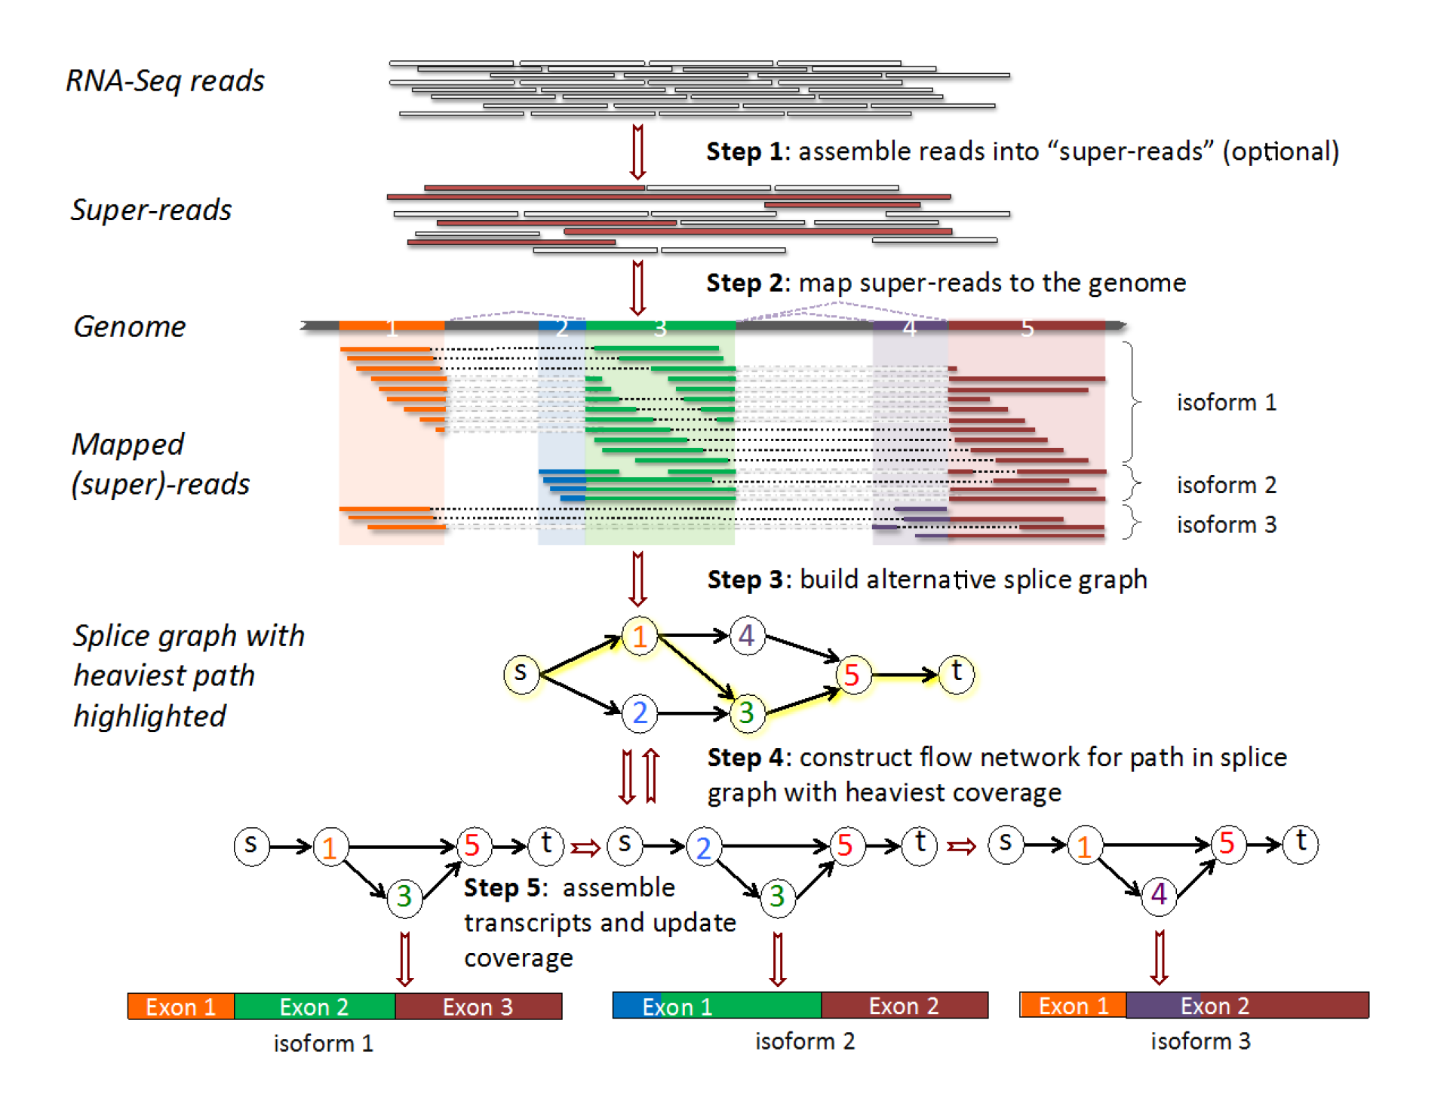
Construct splice graph, identify path with heaviest coverage, construct flow network, assemble transcript, remove reads and repeat
Notes:
The StringTie algorithm: RNA-seq reads are assembled into super-reads (Step 1) and then super-reads plus un-assembled reads are mapped to the genome (Step 2). In Step 3, mapped reads and super-reads are used to build an alternative splice graph. We use the path from source (s) to sink (t) with the heaviest coverage to build a flow network corresponding to the transcript represented by that path (Step 4). The maximum flow in this network represents the coverage of one assembled transcript, which is removed from the splice graph (Step 5). Steps 4 and 5 are repeated until no more transcripts can be assembled.

Slide 11
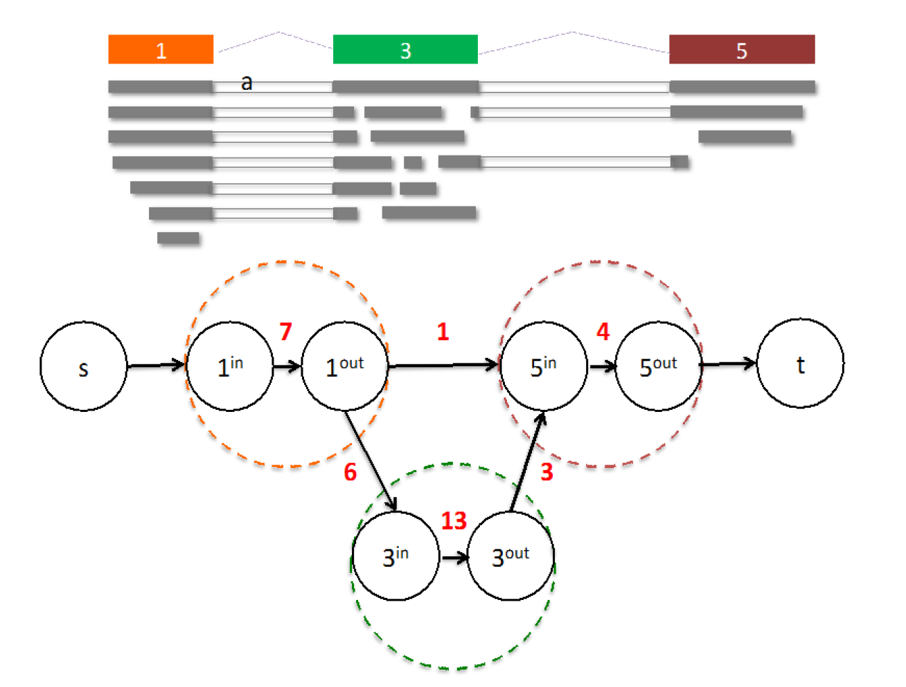
From flow network for each transcript, maximum flow is used to assemble transcript and estimate abundance
StringTie uses basic graph theory (splice graph), custom heuristics (heaviest path), more graph theory (flow network) and optimization theory (maximum flow). See StringTie paper for defintions and math.
Notes:
Flow network associated with a transcript (shown with colored nodes). 15 fragments (shown in grey) align to the transcript. Two nodes in the flow network are connected if a fragment starts and ends at those nodes. E.g., nodes 1 and 5 are connected because fragment (a) starts at node 1 and ends at node 5. For each colored node in the transcript, two nodes are created in the flow network. Capacities on edges (not connecting source or sink) are shown in red.
In the first node (corresponding to exon1) there are 7 fragments. One of these fragments is connected to exon5 (starts at beginning of exon1 and ends at end of exon5), while 6 fragments are connected to exon3. In the second node (corresponding to exon3) there are 13 fragments, of which 3 are connected to exon 5. The final node (corresponding to exon5) has 4 supporting fragments. The maximum flow is clearly 1 – 3 – 5.
StringTie estimates the coverage level of the transcript by solving a maximum-flow problem that determines the maximum number of fragments that can be associated with the chosen transcript.
The maximum flow problem is a well-studied problem in optimization theory.

Slide 12
StringTie -merge
Merge together all gene structures from all samples
Some samples may only partially represent a gene structure
Allows for the incorporation of known transcripts with assembled, potentially novel transcripts
For de novo or reference guided mode, we will rerun StringTie with the merged transcript assembly.
Pertea et al. Nature Protocols, 2016

Slide 13
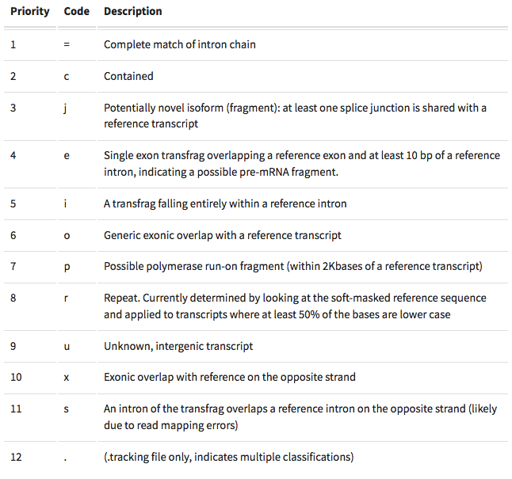
gffcompare
gffcompare will compare a merged transcript GTF with known annotation, also in GTF/GFF3 format
http://cole-trapnell-lab.github.io/cufflinks/cuffcompare/index.html#cuffcompare-output-files

Slide 14
Ballgown for Differential Expression
Parametric F-test comparing nested linear models
Two models are fit to each feature, using expression as the outcome
one including the covariate of interest (e.g., case/control status or time) and one not including that covariate.
An F statistic and p-value are calculated using the fits of the two models.
A significant p-value means the model including the covariate of interest fits significantly better than the model without that covariate, indicating differential expression.
We adjust for multiple testing by reporting q-values:
q < 0.05 the false discovery rate should be controlled at ~5%.
Frazee et al. (2014)

Slide 15
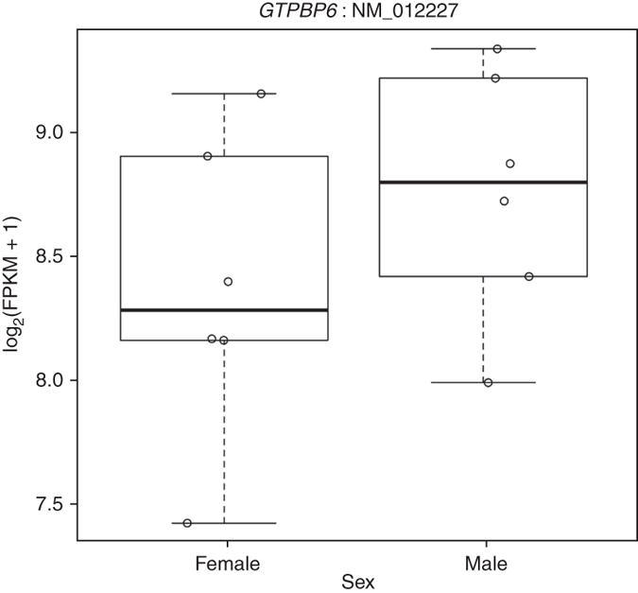
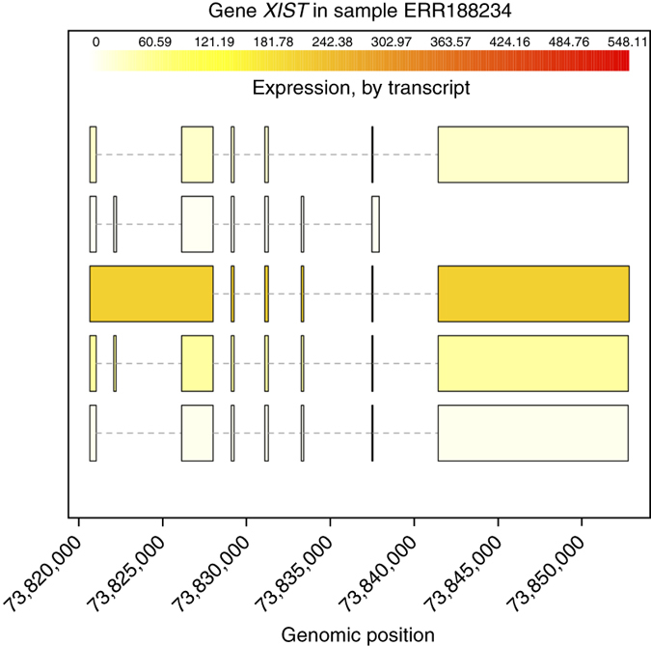
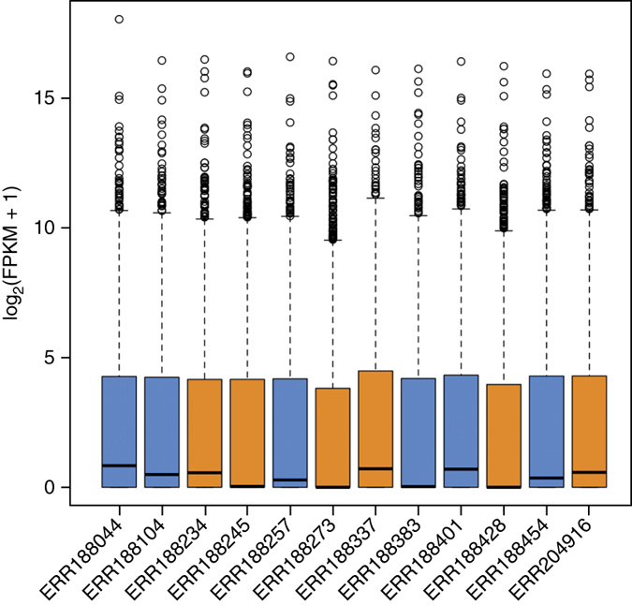
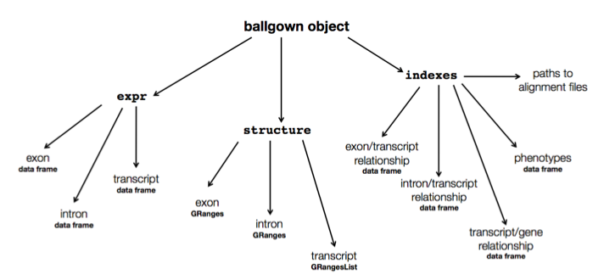
Ballgown for Visualization with R

Slide 16
Alternatives to FPKM
Raw read counts as an alternate for differential expression analysis
Instead of calculating FPKM, simply assign reads/fragments to a defined set of genes/transcripts and determine “raw counts”
Transcript structures could still be defined by something like cufflinks
HTSeq (htseq-count)
http://www-huber.embl.de/users/anders/HTSeq/doc/count.html
htseq-count --mode intersection-strict --stranded no --minaqual 1 --type exon --idattr transcript_id accepted_hits.sam chr22.gff > transcript_read_counts_table.tsv
Important caveat of ‘transcript’ analysis by htseq-count:
http://seqanswers.com/forums/showthread.php?t=18068

Slide 17
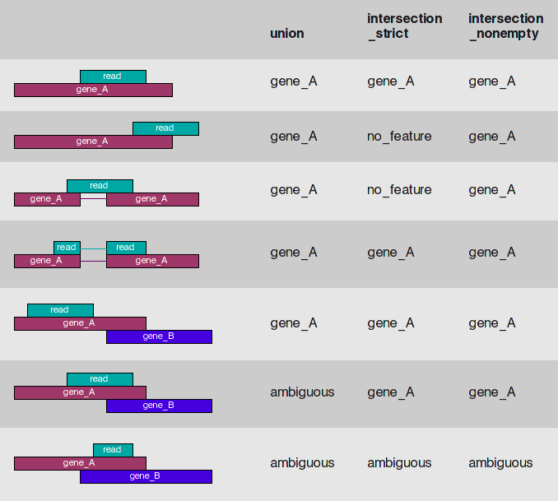
HTSeq-count basically counts reads supporting a feature (exon, gene) by assessing overlapping coordinates
Whether a read is counted depends on the nature of overlap and “mode” selected
Notes:
We recommend intersection_strict

Slide 18
Alternative differential expression methods
Raw count approaches
DESeq2 - http://www-huber.embl.de/users/anders/DESeq/
edgeR - http://www.bioconductor.org/packages/release/bioc/html/edgeR.html
Others…

Slide 19
‘FPKM/TPM’ expression estimates vs. ‘raw’ counts
Which should I use?
Long running debate with countless blogs and analyses arguing the advantages of each. The general consensus:
FPKM/TPM
When you want to leverage benefits of tuxedo suite
Isoform deconvolution
Good for visualization (e.g., heatmaps)
Calculating fold changes, etc.
Counts
More robust statistical methods for differential expression
Accommodates more sophisticated experimental designs with appropriate statistical tests

Slide 20
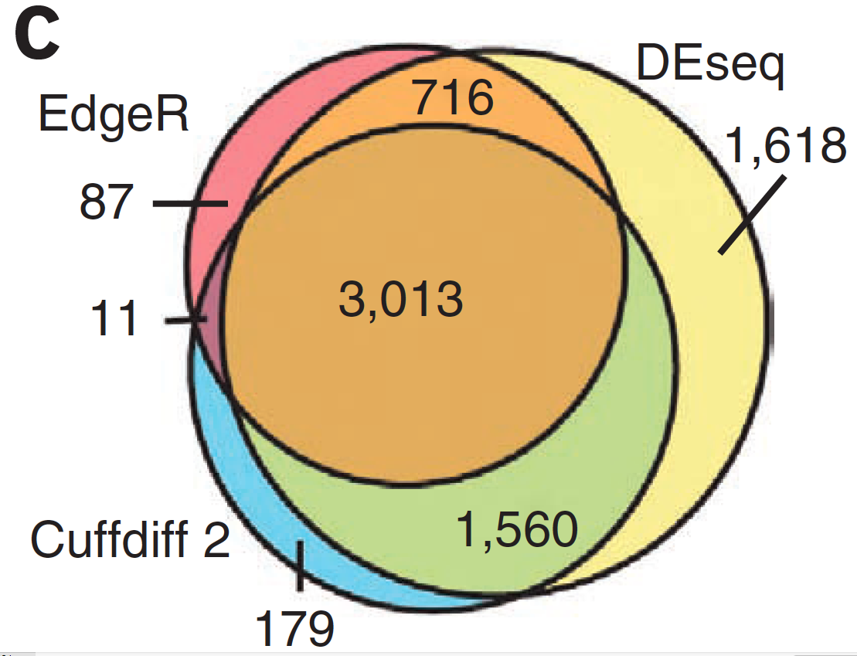
Multiple approaches advisable

Slide 21
Lessons learned from microarray days
Hansen et al. “Sequencing Technology Does Not Eliminate Biological Variability.” Nature Biotechnology 29, no. 7 (2011): 572–573.
Power analysis for RNA-seq experiments
http://euler.bc.edu/marthlab/scotty/scotty.php
RNA-seq need for biological replicates
http://www.biostars.org/p/1161/
RNA-seq study design
http://www.biostars.org/p/68885/

Slide 22
Multiple testing correction
As more attributes are compared, it becomes more likely that the treatment and control groups will appear to differ on at least one attribute by random chance alone.
Well known from array studies
10,000s genes/transcripts
100,000s exons
With RNA-seq, more of a problem than ever
All the complexity of the transcriptome
Almost infinite number of potential features
Genes, transcripts, exons, junctions, retained introns, microRNAs, lncRNAs, etc
Bioconductor multtest
http://www.bioconductor.org/packages/release/bioc/html/multtest.html

Slide 23
Downstream interpretation of expression analysis
Topic for an entire course
Expression estimates and differential expression lists from StringTie, Ballgown or other alternatives can be fed into many analysis pipelines
See supplemental R tutorial for how to format expression data and start manipulating in R
Clustering/Heatmaps
Provided by cummeRbund
For more customized analysis various R packages exist:
hclust, heatmap.2, plotrix, ggplot2, etc.
Classification
For RNA-seq data we still rarely have sufficient sample size and clinical details but this is changing
Weka is a good learning tool
RandomForests R package (biostar tutorial being developed)
Pathway analysis
IPA
Cytoscape
Many R/BioConductor packages: http://www.bioconductor.org/help/search/index.html?q=pathway
https://genviz.org/module%204/0003/12/31/Expression_Profiling_and_Visualization/

Slide 24
Introduction to tutorial
(Module 3)

Slide 25
HISAT2/StringTie/Ballgown RNA-seq Pipeline
Sequencing
Read alignment
Transcript compilation
Expression estimation
Differential expression
RNA-seq reads (2 x 100 bp)
HISAT2
StringTie
StringTie
Ballgown
Raw sequence data
(.fastq files)
Reference genome
(.fa file)
Gene annotation
(.gtf file)
Ballgown & R
Inputs
Visualization
Module 3

Slide 26




We are on a Coffee Break & Networking Session
Workshop Sponsors:

