Slide 1

Canadian Bioinformatics Workshops
www.bioinformatics.ca
bioinformaticsdotca.github.io

Slide 2


Slide 3
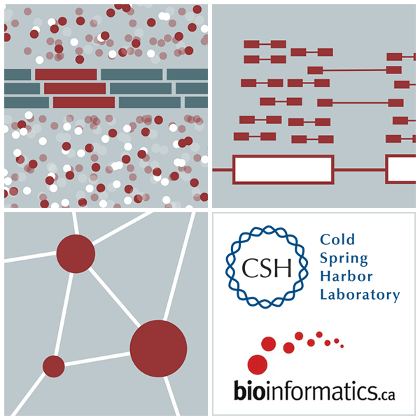

RNA-Seq Module 5 Discovery and Alternative Expression
Kelsy Cotto, Malachi Griffith, Chris Miller, Peter Ronning
High-Throughput Biology: From Sequence to Networks
March 11-17, 2019
Workshop icon

Slide 4
Learning objectives of the course
Module 1: Introduction to RNA Sequencing
Module 2: Alignment and Visualization
Module 3: Expression and Differential Expression
Module 4: Alignment Free Expression Estimation
Module 5: Isoform Discovery and Alternative Expression
Tutorials
Provide a working example of an RNA-seq analysis pipeline
Run in a ‘reasonable’ amount of time with modest computer resources
Self contained, self explanatory, portable

Slide 5
Learning objectives of module 5
Explore use of StringTie in modes that facilitate transcript/isoform discovery.
This still requires a reference genome sequence...

Slide 6
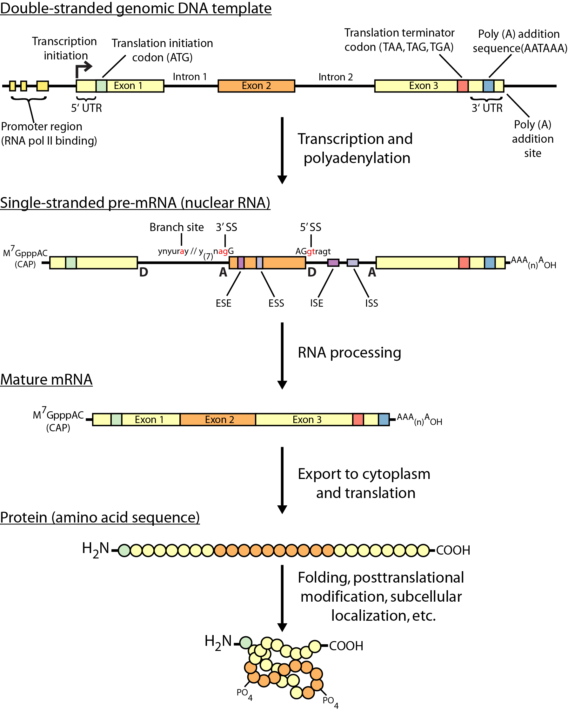
Review of gene expression

Slide 7
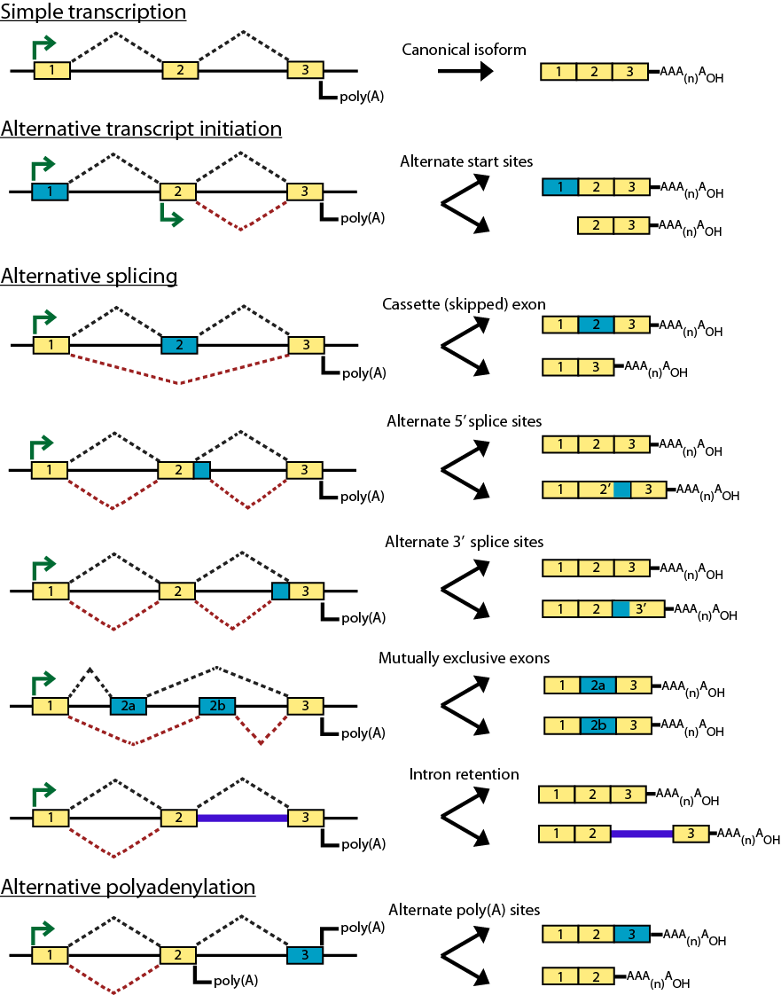
Types of alternative expression - part 1

Slide 8
Types of alternative expression – part 2

Slide 9
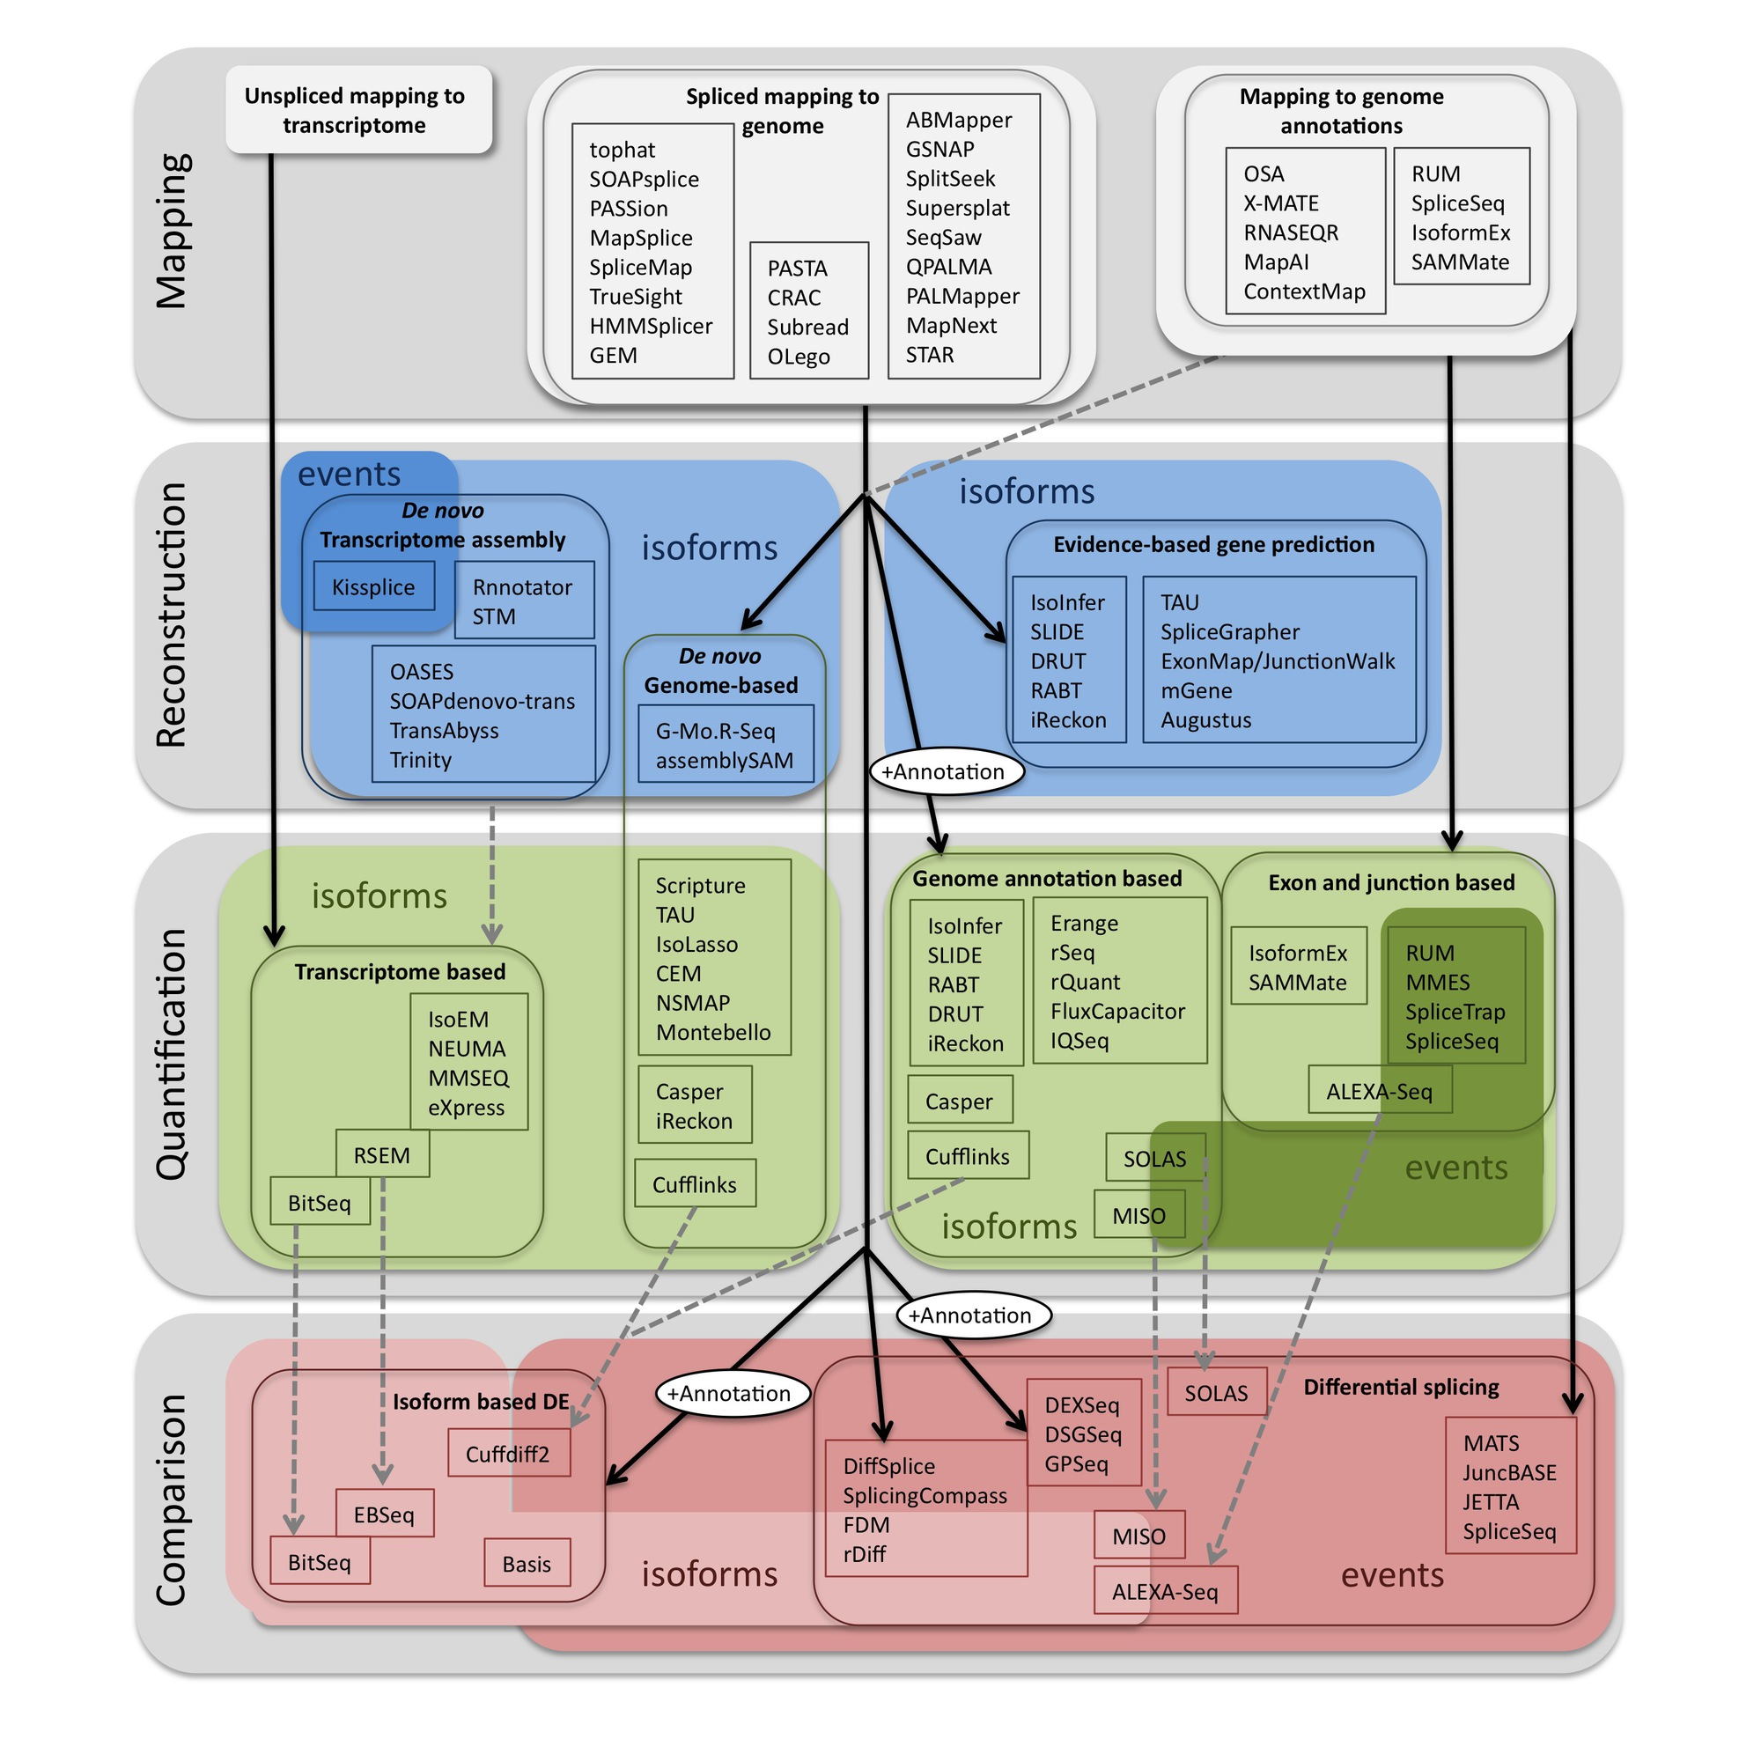
Methods to study splicing by RNA-seq
http://www.rna-seqblog.com/data-analysis/splicing-junction/methods-to-study-splicing-from-rna-seq/
http://arxiv.org/ftp/arxiv/papers/1304/1304.5952.pdf

Slide 10
Methods to study splicing by RNA-seq
http://www.rna-seqblog.com/data-analysis/splicing-junction/methods-to-study-splicing-from-rna-seq/
http://arxiv.org/ftp/arxiv/papers/1304/1304.5952.pdf

Slide 11
Useful resources and discussion
Best approach to predict novel and alternative splicing events from RNA-seq data
http://www.biostars.org/p/68966/
http://www.biostars.org/p/62728/
Alternative splicing detection
http://www.biostars.org/p/65617/
http://www.biostars.org/p/11695/
Identifying genes that express different isoforms in cancer vs normal RNA-seq data
http://www.biostars.org/p/50365/
Cufflinks / Cuffdiff Output - How are tests different?
http://www.biostars.org/p/13525/
Visualization of alternative splicing events using RNA-seq data
http://www.biostars.org/p/8979/

Slide 12
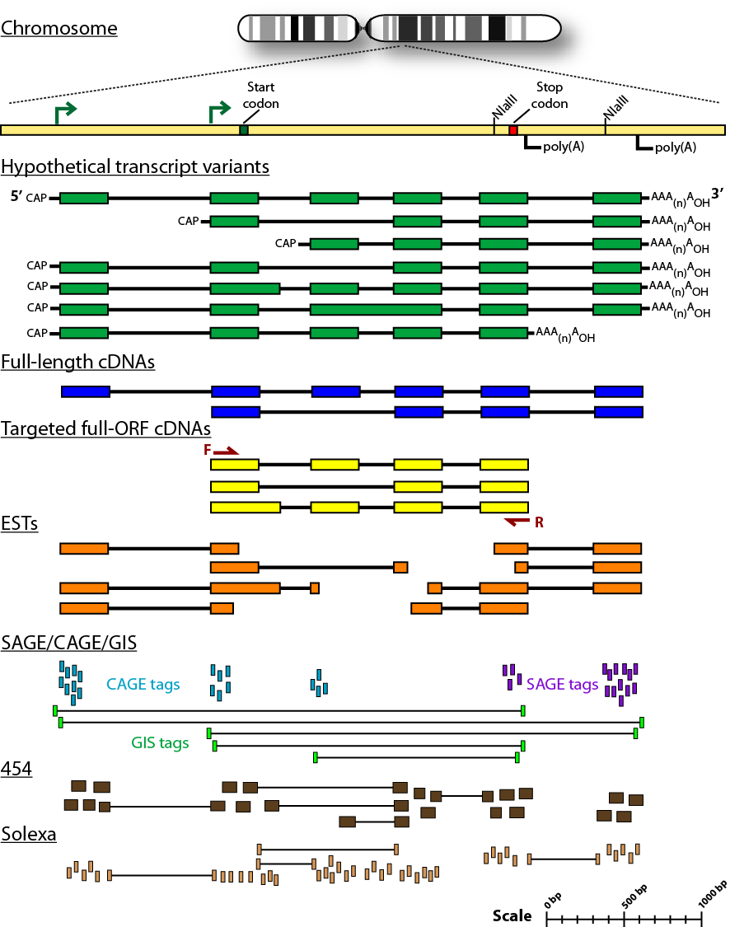
Sequencing methods for studying alternative isoforms

Slide 13
Introduction to tutorial
(Module 5)

Slide 14
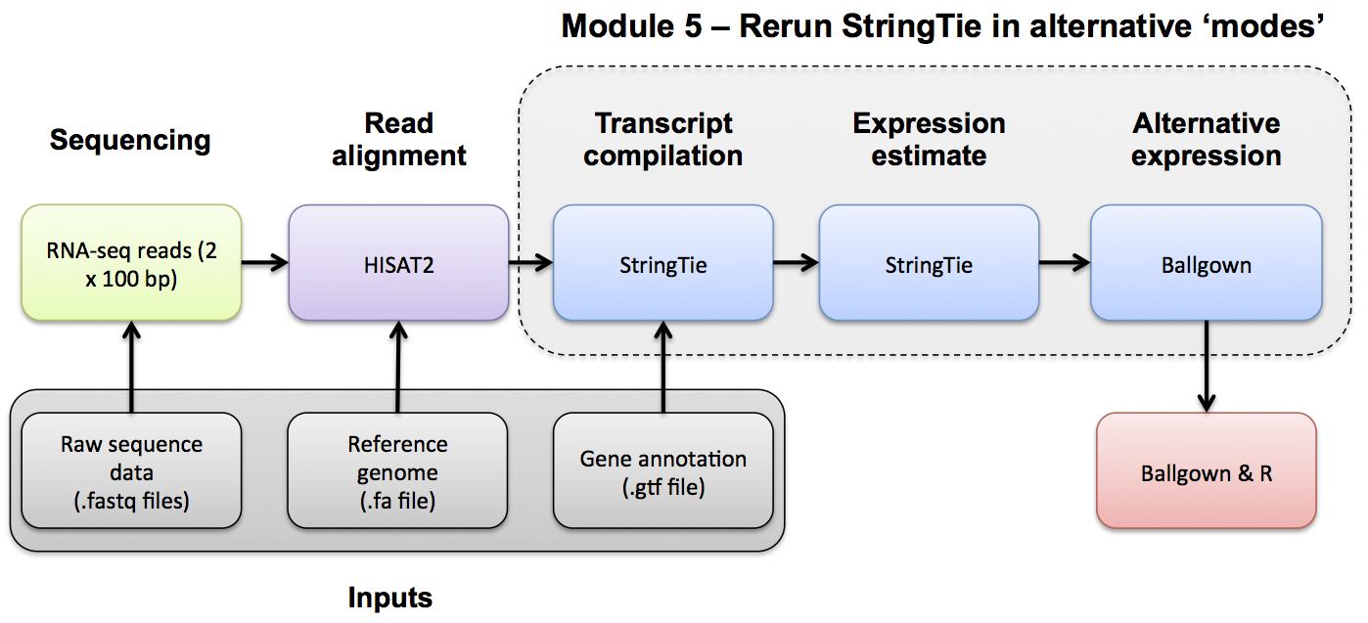
HiSat/StringTie/Ballgown RNA-seq Pipeline

Slide 15




We are on a Coffee Break & Networking Session
Workshop Sponsors:

