Slide 1
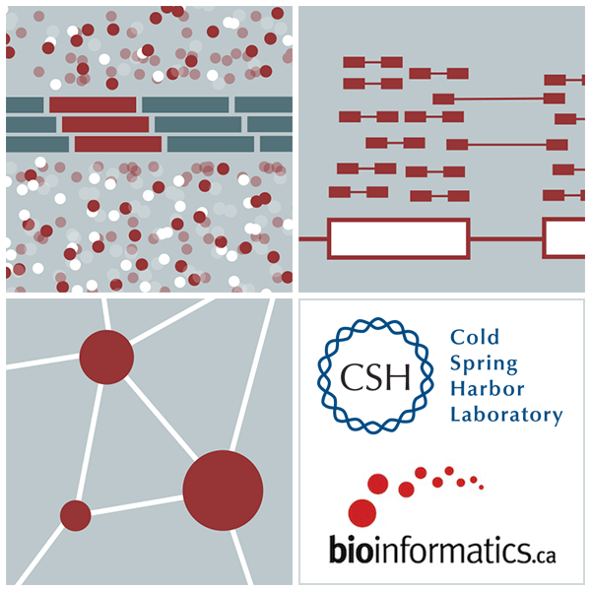
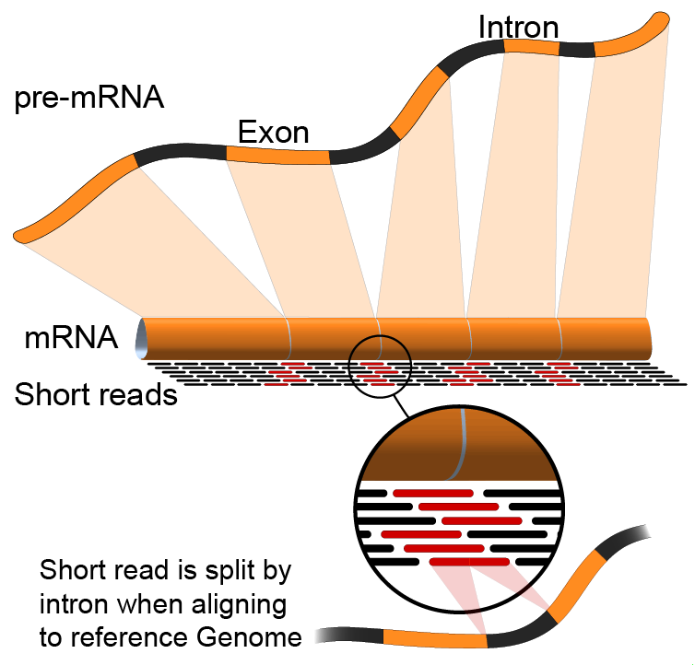

RNA-Seq Module 5 Alternative Splicing Analysis
Kelsy Cotto, Felicia Gomez,
Obi Griffith, Malachi Griffith, Huiming Xia
Advanced Sequencing Technologies & Applications
November 5- 16, 2019

Slide 2
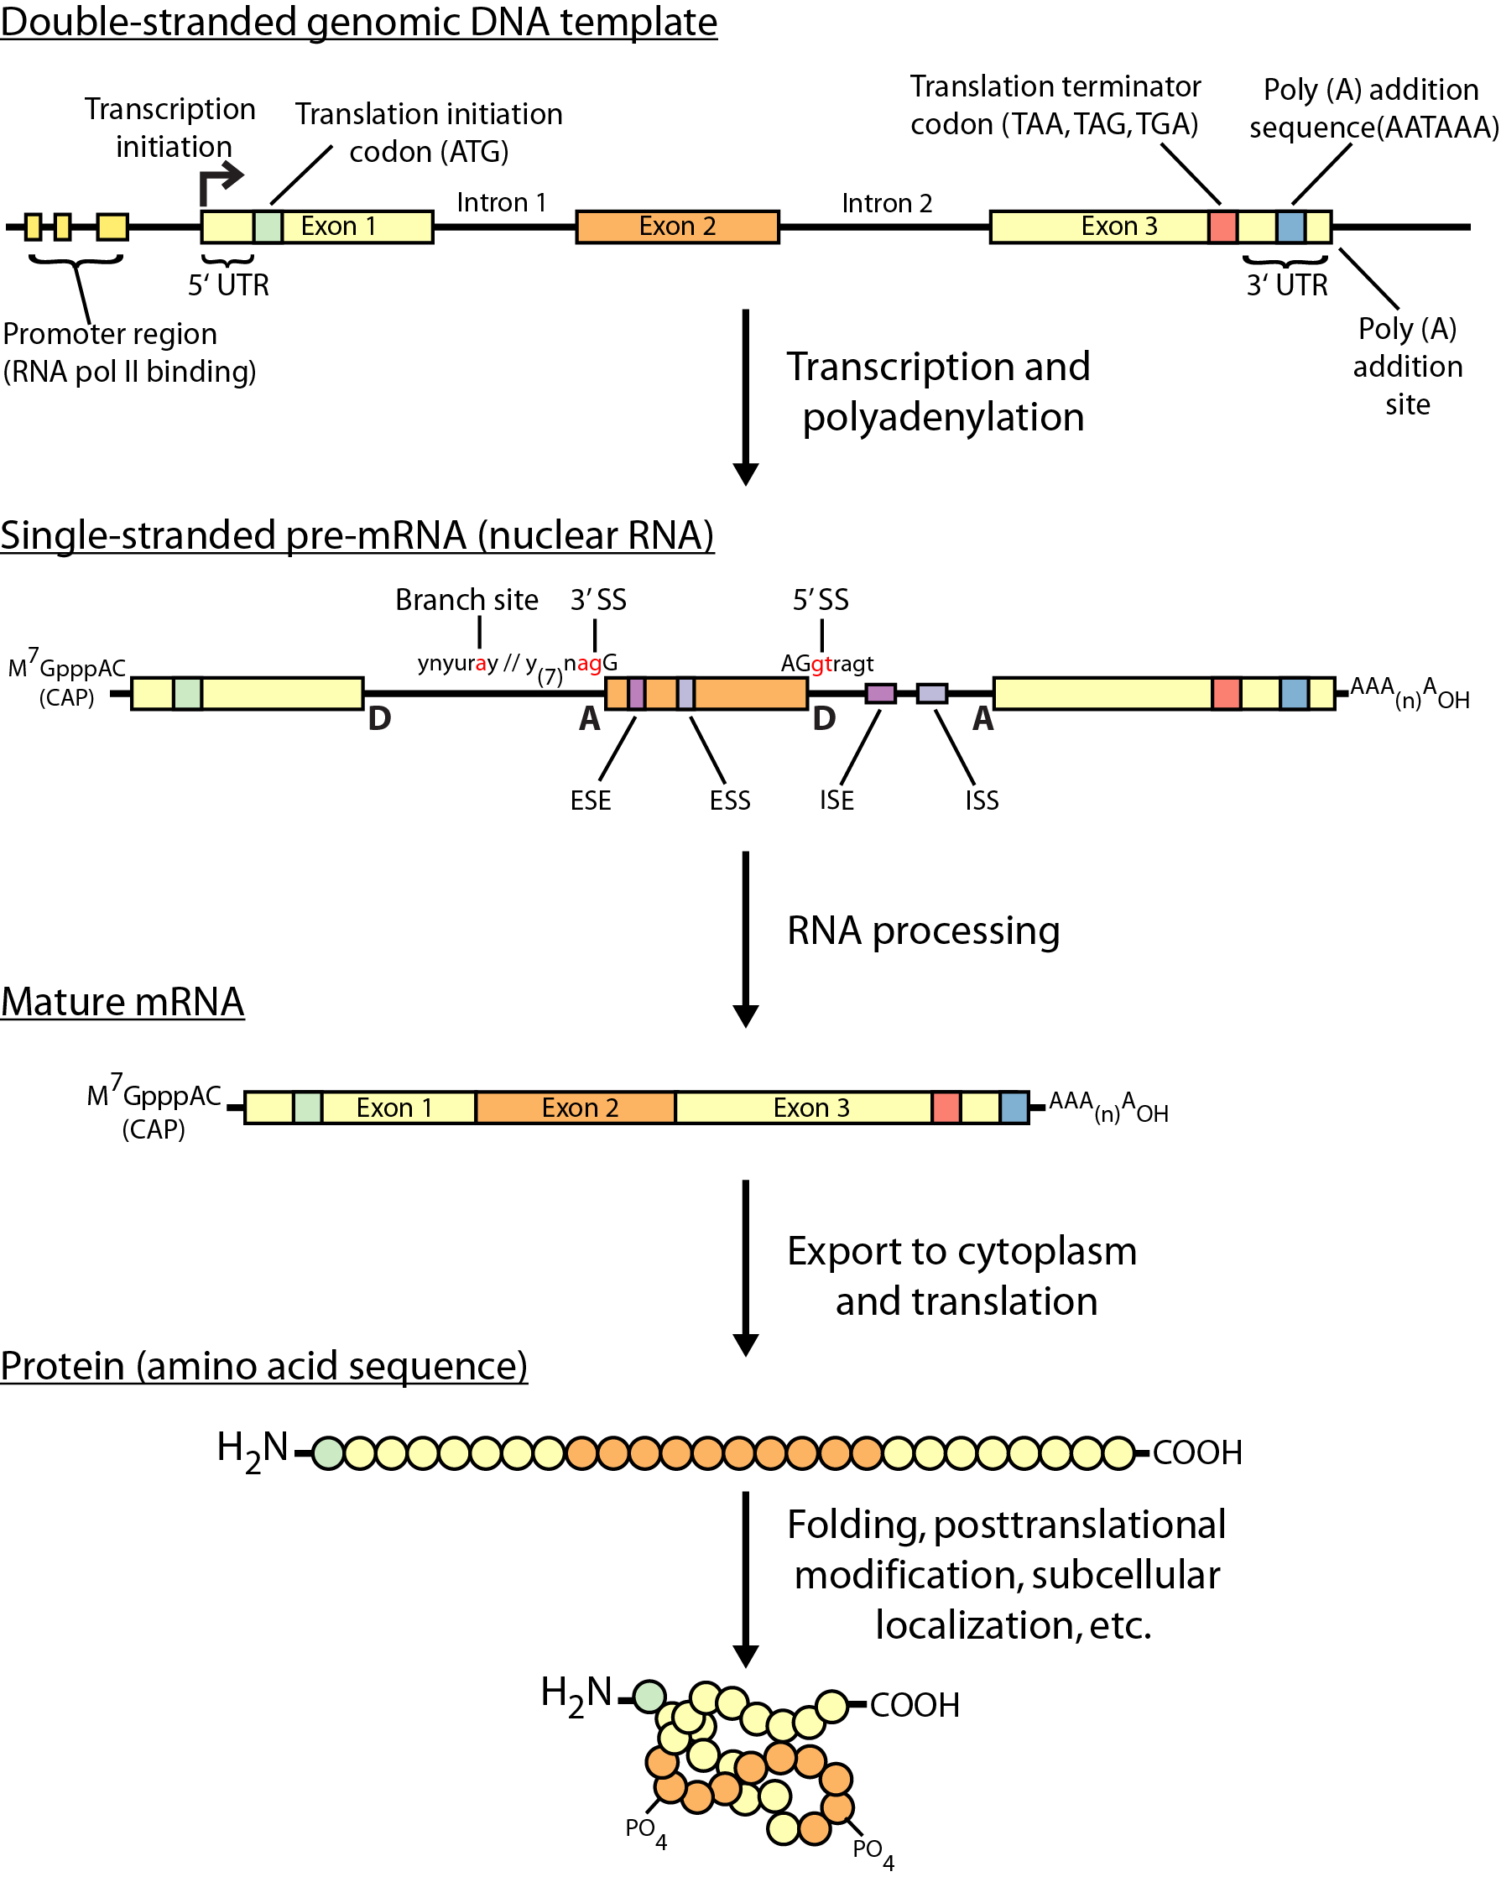
Review of gene expression

Slide 3
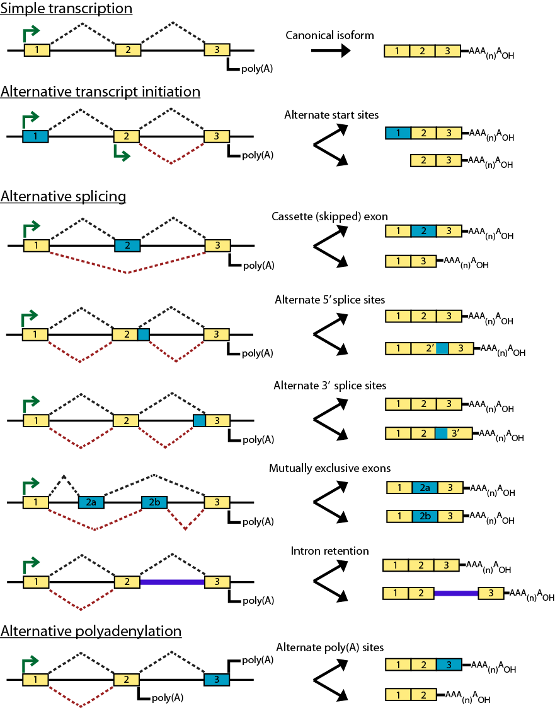
Types of alternative expression - part 1

Slide 4
Types of alternative expression – part 2

Slide 5
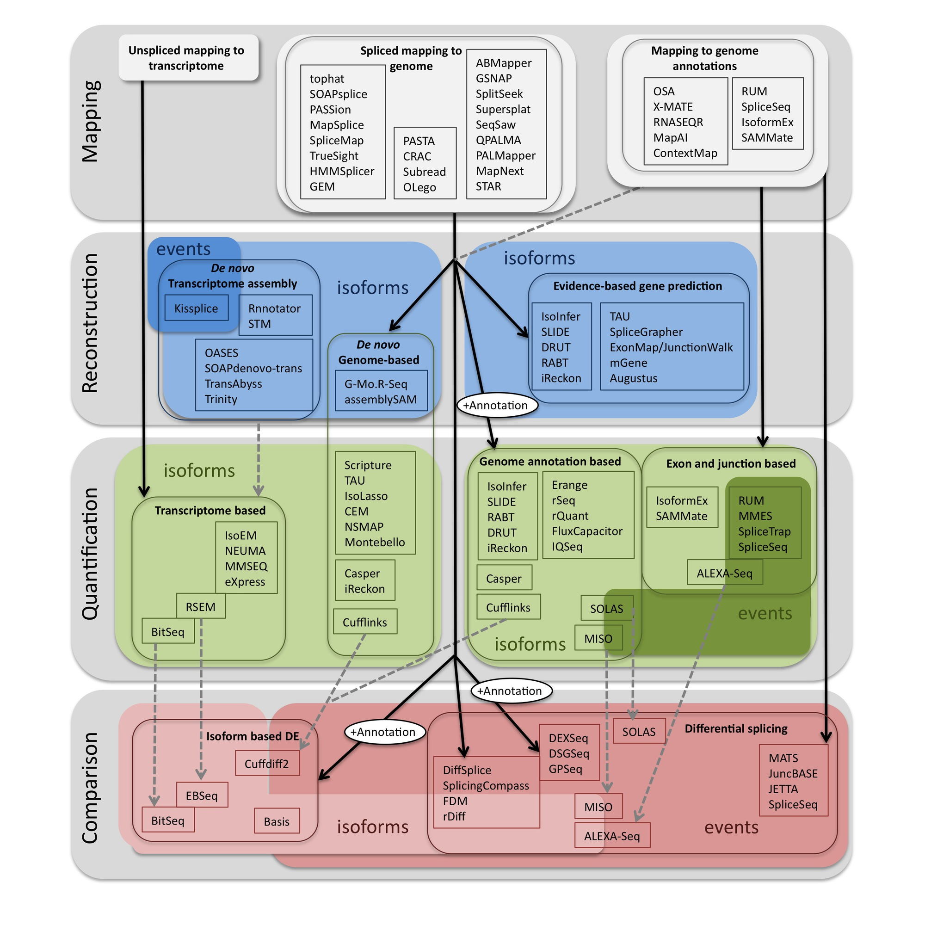
Methods to study splicing by RNA-seq
http://www.rna-seqblog.com/data-analysis/splicing-junction/methods-to-study-splicing-from-rna-seq/
http://arxiv.org/ftp/arxiv/papers/1304/1304.5952.pdf

Slide 6
Methods to study splicing by RNA-seq
http://www.rna-seqblog.com/data-analysis/splicing-junction/methods-to-study-splicing-from-rna-seq/
http://arxiv.org/ftp/arxiv/papers/1304/1304.5952.pdf

Slide 7
Useful resources and discussion
Best approach to predict novel and alternative splicing events from RNA-seq data
http://www.biostars.org/p/68966/
http://www.biostars.org/p/62728/
Alternative splicing detection
http://www.biostars.org/p/65617/
http://www.biostars.org/p/11695/
Identifying genes that express different isoforms in cancer vs normal RNA-seq data
http://www.biostars.org/p/50365/
Cufflinks / Cuffdiff Output - How are tests different?
http://www.biostars.org/p/13525/
Visualization of alternative splicing events using RNA-seq data
http://www.biostars.org/p/8979/

Slide 8
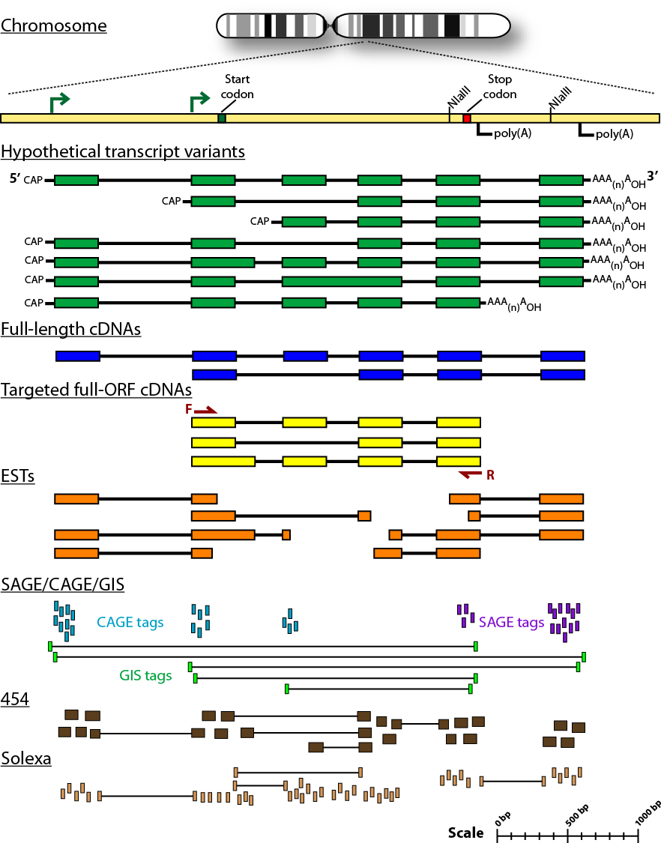
Sequencing methods for studying alternative isoforms

