Slide 1

JNTUH UNIVERSITY COLLEGE OF ENGINEERING MANTHANI CENTENARY COLONY, PANNUR,(V), RAMAGIRI(M) , PEDDAPALLI(D), TELANGANA- 505212 DEPARTMENT OF COMPUTER SCIENCE AND ENGINEERING (ARTIFICIAL INTELLIGENCE AND MACHINE LEARNING)
VIRTUAL MOUSE USING HAND GESTURES AND EYE MOVEMENTS
Under the guidance of:
Mr. NARAHARI AJMEERA,
Assistant Professor in CSE
Team Members:
B.SOUMYA | (21VD5A6615)
P.MAHESH BABU | (20VD1A6619)
V.AKSHAY KUMAR | (20VD1A6605)
K.NITHIN | (21VD5A6608)

Slide 2
CONTENTS
Introduction
Objective
Problem Statement
Existing System
Limitations
Proposed System
Advantages
System Requirements(Software & Hardware)
Scope
Model Design
Model Architecture
Implementation
Conclusion

Slide 3
INTRODUCTION
Traditional computer mouse were essential peripherals for navigating graphical user interfaces (GUIs).
The evolution to a virtual mouse concept continues the legacy, introducing intuitive hand gestures and interactions that reshape our digital engagement.
It helps the user to interact with a computer without any physical and hardware device to control mouse operations.
Instead of using more expensive sensors, a simple web camera can identify the gestures and perform the actions

Slide 4
INTRODUCTION
This new way lets you move the cursor by moving your hand, which is more natural
It's an example of how technology keeps improving to make our computer experiences better and more exciting.

Slide 5
OBJECTIVE
Our objective is to create a virtual mouse using web camera to interact with the computer in a more user friendly manner that can be alternative approach for traditional mouse.

Slide 6
PROBLEM STATEMENT
Physically disabled individuals encounter obstacles in computer interaction due to the unavailability of a technology that accommodates their needs.
Using traditional mice on various surfaces, causing unpredictable cursor movement and disrupting the user's interaction.
Amid contagious outbreaks, the lack of touchless computer interaction methods poses a problem. Conventional methods involving physical contact can exacerbate disease spread.

Slide 7
EXISTING SYSTEM
Existing consist of simple mouse application using colored tips for detection which are captured by web-Cam for cursor movements.
Colored finger tips serve as visual markers that can be easily tracked by cameras or sensors, enabling accurate recognition of hand movements and gestures.
Implementing colored finger tips doesn't require sophisticated hardware for gesture-based interaction.

Slide 8
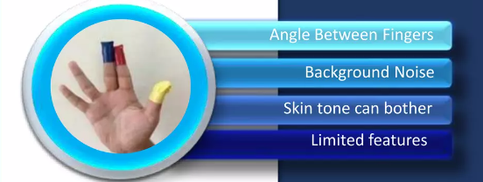
LIMITATIONS
Limited Features: The control scheme using colored fingertips may be limited in terms of the actions you can perform.
Ambiguity in Color Perception: Users with color blindness or difficulties in color perception might face challenges in accurately distinguishing and identifying colored finger tips.

Slide 9
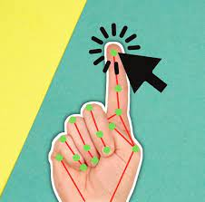
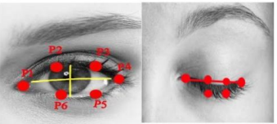
PROPOSED SYSTEM
The System works by Identifying the hand gestures and decides the position of cursor without using colored fingertips
Additionally system works by identifying the eye movements and decides cursor movements

Slide 10
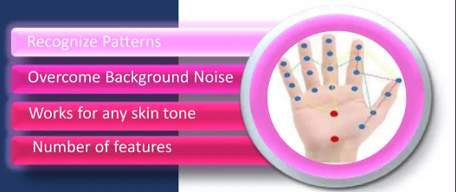
ADVANTAGES
Hand gesture and eye movement-based interactions reduce the physical strain associated with prolonged use of traditional input devices like a mouse
It helps to prevent the spread of contagious diseases by eliminating the need for human intervention and reducing dependency on devices to control the computer.

Slide 11
SOFTWARE REQUIREMENTS
HARDWARE REQUIREMENTS
Visual Studio-1.81v
Python (3.10 or above)
Libraries:
OpenCV
MediaPipe
PyAutoGUI
PyCaw
Processor –Intel core I5 or Above
RAM – 8GB or Above.
Hard Disk -512GB or Above

Slide 12
SCOPE
Virtual mouse controlled by hand and eye movements has promising applications in accessibility, virtual reality, and human-computer interaction.
It can enhance user experience for individuals with mobility challenges and find applications in gaming, healthcare, and immersive technologies.
The virtual mouse controlled by hand gestures enhances accessibility by eliminating the need for physical contact with shared devices.

Slide 13
start
MODEL DESIGN
User interface
(Eye or Hand)
ACTIVITY DIAGRAM
Capture the image frame
Palm /eye detection and tracking hand landmarks
Display the landmarks at real time
Perform the mouse events
End
13

Slide 14
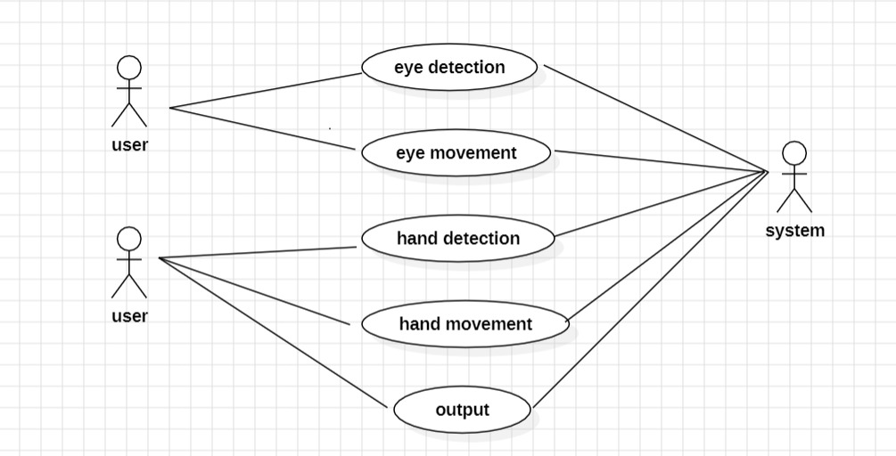
MODEL DESIGN
USE CASE DIAGRAM
14

Slide 15
MODEL ARCHITECTURE
It
Capturing
Recognition
Capture Video frame
Using opencv
Eye Landmarks Detection
Hand Landmarks Detection
Real time video processing
Performing Mouse Eventsh
Performing different Mouse Events by using Hand and Eye Movements.
15

Slide 16
IMPLEMENTATION
A user interface is created using Streamlit framework.
Hand and Eye Landmark Detection: Utilize MediaPipe's hand and eye landmark detection models to identify key points on the palm, fingers, and iris.
Gesture Recognition: Define hand gestures for mouse actions and extract relevant landmark features.
Mouse Event Simulation: Map recognized hand gestures to corresponding mouse events and utilize libraries like PyAutoGUI or AutoPy to simulate mouse actions.

Slide 17
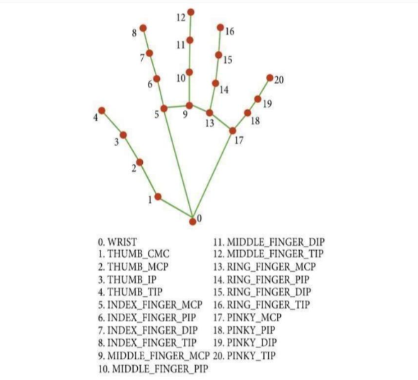
IMPLEMENTATION

Slide 18
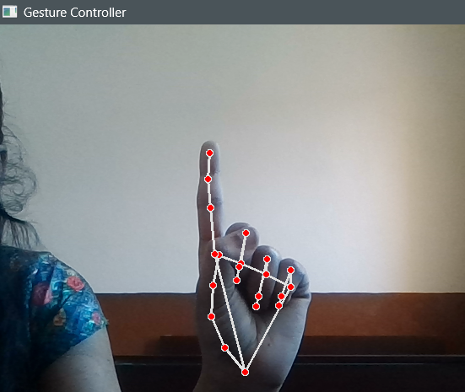
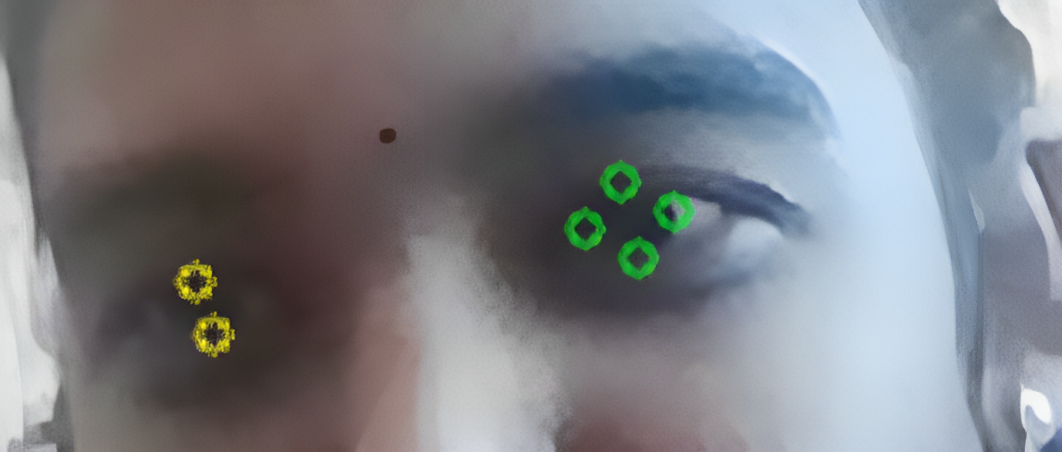
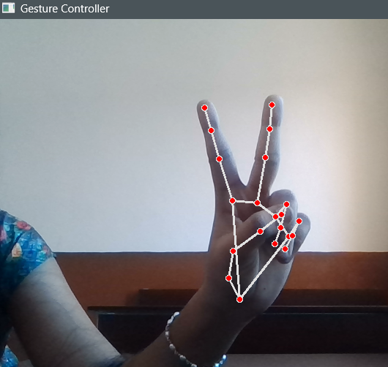
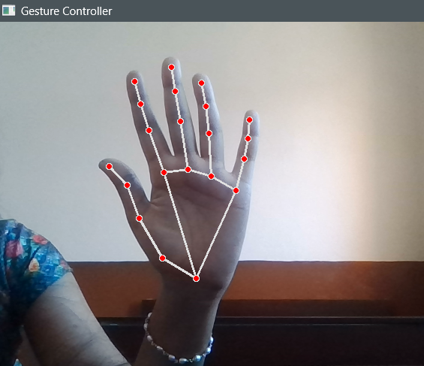
RESULT

Slide 19
CONCLUSION
Virtual mouse technology represents a significant step forward in HCI(Human Computer Interactions), offering a more natural, accessible, and versatile way to interact with computers.
Virtual mouse technology is poised to transform the way we interact with the digital world.

Slide 20
THANK YOU

