Slide 1

HUMAN EMOTION RECOGNITION USING EEG SIGNALS BASED ON SVM CLASSIFIER
Department of Electronics and Communication Engineering
Project Supervisor
Dr. Poli Lokeshwara Reddy, M.Tech., Ph.D
Assistant Professor
Department of ECE
Anurag University
Presented by
B.UJWAL (22EG104B62)
P.HARSHITH (22EG104B38)
CH.ARCHANA (22EG104B56)
B.KALYAN (22EG104B11)

Slide 2
CONTENTS
Abstract
Introduction
Literature Review
Objectives of the Proposed Work
Proposed Methodology
Simulation Results
Advantages
Applications
Conclusion & Future Scope
References

Slide 3
ABSTRACT
Emotion recognition through EEG signals has garnered significant interest due to its potential applications in diverse fields. Electroencephalography (EEG) measures brain activity and offers valuable insights into emotional states. EEG, as a non-invasive technique, captures brainwave patterns that correspond to different emotions, making it a promising tool for emotional analysis. This project focuses on utilizing EEG signals for emotion recognition using Support Vector Machine(SVM) classifier. The proposed methodology involves data acquisition, where EEG signals are collected, followed by Statistical feature extraction. Subsequently, the SVM classifier is employed to classify emotional states based on the extracted features. Evaluation metrics will assess the classifier's performance.

Slide 4
INTRODUCTION
Emotions play a crucial role in human behavior, cognition, and interpersonal interactions. Identifying and understanding emotional states are essential aspects of mental health, psychology, and human-computer interaction. EEG technology offers a non-invasive method to study and decipher the neural mechanisms underlying emotions by capturing the brain's electrical activity .EEG-based emotion recognition seeks to decode brainwave patterns associated with specific emotional responses. As individuals experience emotions, distinct patterns of electrical activity emerge within the brain, reflecting unique neural signatures for various emotional states. By analyzing these EEG signals, researchers aim to classify and interpret these patterns to infer emotions like happiness, sadness, excitement, or stress. Advancements in signal processing techniques, machine learning algorithms, and neuroscience have contributed significantly to the progress of EEG-based emotion recognition. Researchers employ sophisticated methods to preprocess EEG data, extract meaningful features, and utilize classification models to identify and categorize different emotional states based on brainwave patterns.

Slide 5
LITERATURE REVIEW
a | Journal Name /vol / page no | Title | Method | Advantages | Limitations
1. | 2016 Eighth International Conference on Ubiquitous and Future Networks (ICUFN) | EEG-based Emotion Recognition Approach for E-healthcare Applications | Uses EEG features (wavelet energy, modified energy, wavelet entropy,) and classifiers (QDA, k-NN, SVM) for emotion classification in patients (anger,sad,etc). | Utilizes EEG signals for non-intrusive emotional state detection in healthcare settings. | The robustness of emotion classification may depend on the quality and diversity of the dataset used for training the classifiers.
2. | 2018 IEEE International Conference on Electro/Information Technology | Emotion recognition based on PPG and EEG | the feasibility and effectiveness of utilizing both (PPG) and (EEG) signals for emotion recognition. | Comprehensive approach using both PPG and EEG signal | Feasibility and effectiveness may vary based on individual differences in physiological responses to emotion

Slide 6
3. | 2018 IEEE Int. Conf. Electro/Information Technol. | Emotion Recognition using Deep Neural Network with Vectorized Facial Features | The study explores the application of Deep Neural Networks (DNNs) for emotion recognition based on vectorized facial features. | Utilizes deep neural networks for more sophisticated emotion recognition. | Effectiveness may depend on the quality and diversity of the facial feature vectors used for training the DNN.

Slide 7
OBJECTIVES OF THE PROPOSED WORK
To compare Three Statistical Time Domain Features (Mean, Variance, Standard Deviation): Investigate and compare the efficacy of Mean, Variance, and Standard Deviation as statistical feature extraction methods for emotion classification from EEG signals. Determine the most accurate and informative feature set among these categories.
To evaluate Support Vector Machine(SVM) for Emotion Recognition:Investigate the effectiveness of the SVM classifier in precisely categorizing emotional states by leveraging statistical time domain features, with a focus on mean, variance, and standard deviation extracted from EEG data. Analyze how SVM optimally constructs hyperplanes, handles non-linear relationships, and utilizes statistical summary measures for accurate emotion recognition.
To optimize EEG-Based Emotion Sensing Pipeline: Evaluate the synergy between preprocessing, feature extraction, and classification stages in EEG-based emotion recognition. Aim to optimize the entire process to achieve enhanced accuracy and effectiveness in identifying and distinguishing emotional states using EEG signals.

Slide 8
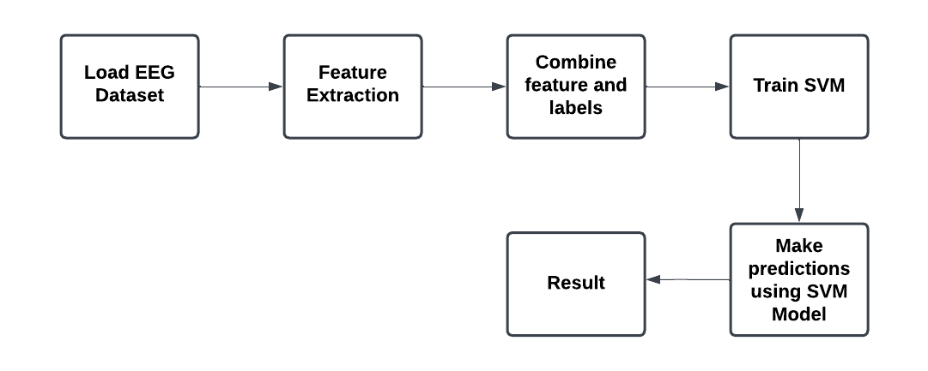
PROPOSED METHODOLOGY
Figure : Block diagram

Slide 9
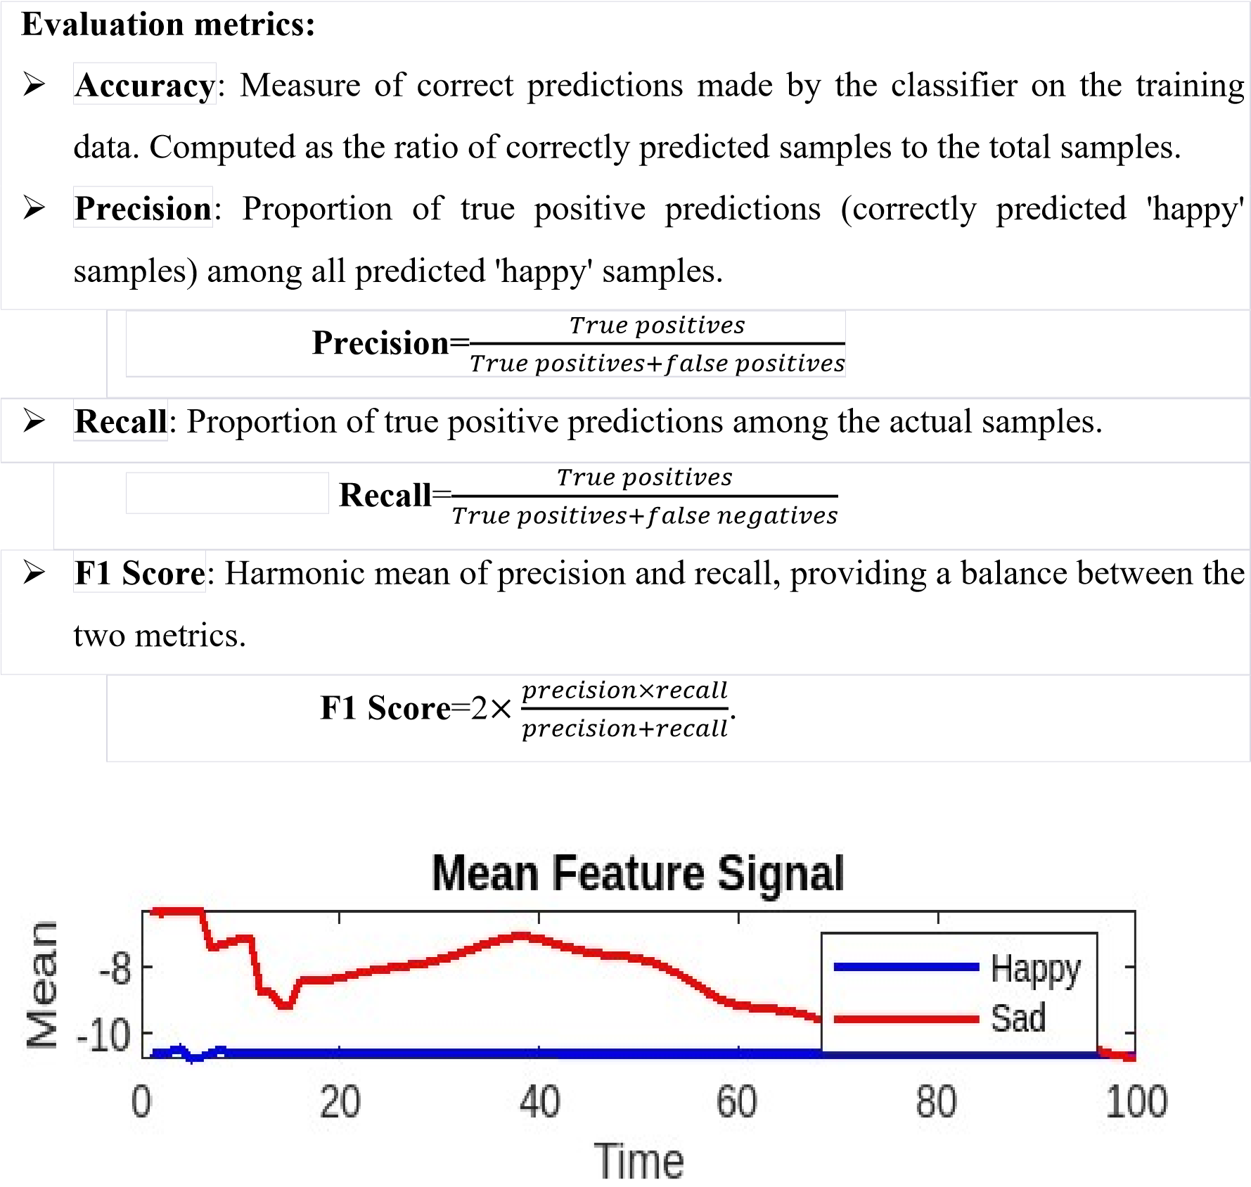
SIMULATION RESULTS
The implementation of the proposed method for emotion detection using EEG signals and the SVM classifier yielded compelling results, demonstrating the system's efficacy in accurately classifying emotional states. The following subsections provide a detailed analysis of the obtained results.

Slide 10
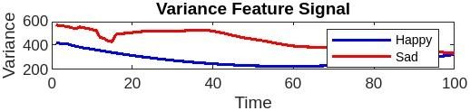
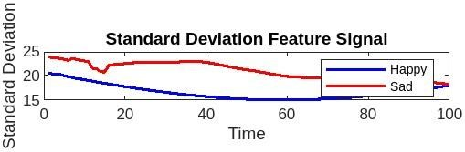
Fig :plot of mean features of given data
Fig: plotting of variance and standard deviation features of given data
Fig.6.2. workspace panel

Slide 11
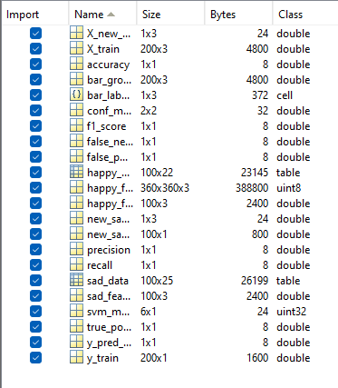

Fig: workspace
Fig: result

Slide 12
ADVANTAGES
Non-invasive
Real-time
Affordable
Portable
Direct
Versatile
Safe
Neurofeedback
Objective

Slide 13
APPLICATIONS
1.Affective Computing
2.Virtual Reality (VR) and Augmented Reality (AR)
3.Neurofeedback And Biofeedback
4.Healthcare and Clinical Diagnosis
5.Assistive Technologies
6.Education and Learning Environments
7.Market Research and Advertising
8.Stress and Fatigue Monitoring
9.Gaming Industry
10.User Experience Design
11.Emotion Research and Psychology Studies
12.Human Factors Engineering
13.Security and Lie Detection

Slide 14
CONCLUSION & FUTURE SCOPE
The project on emotion recognition using EEG signals and SVM classifier holds significant promise in advancing our understanding of human emotions and fostering the development of applications across diverse domains. Through the utilization of EEG signals, the project successfully taps into the intricate neural responses associated with different emotional states. The application of the Support Vector Machine (SVM) classifier contributes to the classification and interpretation of these signals, enabling the recognition of emotions such as happiness, sadness, fear, and calmness.The project's efficacy is underscored by the successful classification results obtained from the datasets, demonstrating the feasibility of using EEG signals for emotion recognition. The utilization of SVM adds a layer of robustness to the classification process, enhancing the project's potential for real-world applications.
Moving forward, the project offers numerous avenues for future exploration and refinement. Integration with other modalities, such as facial expressions or physiological signals, could enhance the accuracy and applicability of the emotion recognition system. The transition to real-time implementation would facilitate instantaneous emotional insights, particularly beneficial for human-computer interaction and virtual reality applications. Deep learning approaches, subject-independent models, and advanced feature extraction methods represent areas for further investigation, aiming to improve the system's sensitivity to subtle emotional nuances. Additionally, ethical considerations, user-specific adaptation, and validation across diverse demographics are pivotal in ensuring the project's responsible and inclusive deployment. As the project evolves, it holds the potential to contribute.

Slide 15
REFERENCES
[1] R. Alhalaseh and S. Alasasfeh, “Machine-Learning-Based Emotion Recognition System Using EEG Signals,” Computers, vol. 9, no. 4, p. 95, 2020.
[2] F. Parsia George, I. Mannafee Shaikat, P. Sultana Ferdawoos, M. Zavid Parvez and J. Uddin, “Recognition of emotional states using EEG signals based on time-frequency analysis and SVM classifier,” International Journal of Electrical and Computer Engineering, vol. 9, no. 2, pp. 1012-1020, 2019.
[3] S. K. Sharma, A. Sharma, S. K. Singh and A. K. Singh, “Classification of human emotions from EEG signals using SVM and LDA classifiers,” in 2015 2nd International Conference on Signal Processing and Integrated Networks (SPIN), Noida, India, 2015, pp. 618-622.
[4] S. K. Sharma, A. Sharma, S. K. Singh and A. K. Singh, “Emotion recognition from EEG signals using wavelet transform and SVM classifiers’ rbf kernel,” in 2019 4th International Conference on Information Systems and Computer Networks (ISCON), Mathura, India, 2019, pp. 1-5.
[5] A. K. Singh, S. K. Singh, A. Sharma and S. K. Sharma, “Emotion recognition from EEG signals using differential entropy feature and SVM,” in 2016 International Conference on Signal Processing and Communication (ICSC), Noida, India, 2016, pp. 370-374.
[6] Senthil Athithan, Abhishek Bhola, Naresh Poloju, K. Srinivas, Sandeep Mittal, "Emotion Detection using EEG Signals with Ensemble Learning", 2022 2nd International Conference on Technological Advancements in Computational Sciences (ICTACS), pp.335-342, 2022.
[7] Guofa Li, Delin Ouyang, Yufei Yuan, Wenbo Li, Zizheng Guo, Xingda Qu, Paul Green, "An EEG Data Processing Approach for Emotion Recognition", IEEE Sensors Journal, vol.22, no.11, pp.10751-10763, 2022.

Slide 16
[8] Akhilesh Kumar, Awadhesh Kumar, "DEEPHER: Human Emotion Recognition Using an EEG-Based DEEP Learning Network Model", The 8th International Electronic Conference on Sensors and Applications, pp.32, 2021.
[9] Jie Sun, Xuan Wang, Kun Zhao, Siyuan Hao, Tianyu Wang, "Multi-Channel EEG Emotion Recognition Based on Parallel Transformer and 3D-Convolutional Neural Network", Mathematics, vol.10, no.17, pp.3131, 2022.
[10] Lin Yuan-Pin et al., "EEG-Based Emotion Recognition in Music Listening", IEEE Trans. Biomed. Eng., vol. 57, no. 7, pp. 1798-1806, Jul. 2010.
[11] M. Bhatti, M. Majid, S. M. Anwar and B. Khan, "Human emotion recognition and analysis in response to audio music using brain signals", Comput. Hum. Behav., vol. 65, pp. 267-275, Dec. 2016
[12] B. Mauss and M. D. Robinson, “Measures of emotion: A review,” Cognition and Emotion, vol. 23, no. 2, pp. 209–237, 2009.
[13] J. Posner, J. A. Russell, and B. S. Peterson, “The circumplex model of affect: An integrative approach to affective neuroscience, cognitive development, and psychopathology,” Development and Psychopathology, vol. 17, no. 3, 2005.
[14] T. Musha, Y. Terasaki, H. A. Haque, and G. A. Ivamitsky, “Feature extraction from EEGs associated with emotions,” Artificial Life and Robotics, vol. 1, no. 1, pp.15-19, 1997.
[15] N. Thammasan, K. Moriyama, K.-I. Fukui, and M. Numao, “Familiarity effects in EEG-based emotion recognition,” Brain Informatics, vol. 4, no. 1, pp. 39-50, 2016.

Slide 17
THANK YOU

