Slide 1
Robustly Improve Precision by Stratified Randomization and Covariate Adjustment
Presenter: Bingkai Wang
For Novartis, Sep. 7, 2021

Slide 2


Two topics
Robustness
Valid inference when the model is arbitrarily mis-specified.
Precision
Increased power by stratified randomization and covariate adjustment.

Slide 3
A motivating example
CTN44 (Campbell et al., 2014) is a Phase 3 RCT evaluating internet-delivered treatment for substance abuse.
Treatment: Therapeutic Education System versus Treatment as usual.
Outcome: number of negative urine tests (continuous).
Stratified randomization: treatment allocation stratified by substance use and abstinence status at baseline (4 strata).
Other baseline variables: age, sex and urine laboratory result.
Estimand: average treatment effect.

Slide 4
A motivating example, cont’d
Current practice for Inference: the ANCOVA estimator
Regressing the outcome on treatment, randomization strata and other baseline variables.
Inference is based on normal distribution with estimates and variance output from the model fit.
Same procedure for trials using simple randomization or stratified randomization.
Questions
(Robustness) Is the ANCOVA estimator valid if the regression model is wrong?
(Precision) Does the stratified randomization make ANCOVA more precise?
Yes, if using robust standard error estimator
Yes, ~12% more precise in our example

Slide 5
The recent FDA guidance
Robustness
Need to focus on the “unconditional effect” using standardization.
(the conditional effect is not stable.)
Need to use robust standard error estimator: the “sandwich” estimator or bootstrap estimator.
(the nominal standard error is inaccurate if model is wrong)
Given the above conditions, the inference based on generalized linear models is robust.

Slide 6
The recent FDA guidance
Precision
Adjustment for prognostic baseline variables can improve precision.
FDA recommends that standard error computation account for the stratified randomization.
Otherwise, the standard error is likely to be overestimated.
However, limited details are provided on how to account for stratified randomization
This talk focuses on how to robustly combine the precision gain from stratified randomization and covariate adjustment.

Slide 7
Main results
For essentially all commonly used estimators used in the primary analysis of RCTs,
stratified randomization can robustly improve precision,
but such precision gain is usually ignored in practice.
We show how to improve precision by stratified randomization and covariate adjustment.
(Wang et al., 2020)

Slide 8
Outline
General theory
Examples
ANCOVA
Asymptotic results
MMRM
Setup
Estimators
The standardized logistic regression estimator
Doubly-robust weighted least square estimator
The Kaplan-Meier estimator

Slide 9
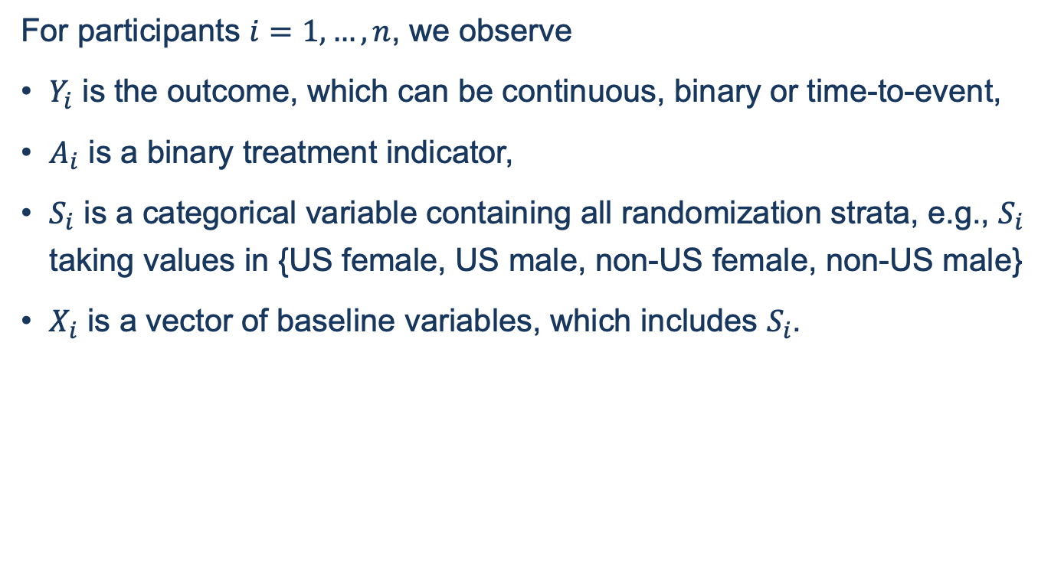
Setup: notations
For participants $i=1,…, n$, we observe
$Y_{i}$ is the outcome, which can be continuous, binary or time-to-event,
$A_{i}$ is a binary treatment indicator,
$S_{i}$ is a categorical variable containing all randomization strata, e.g., $S_{i}$ taking values in {US female, US male, non-US female, non-US male}
$X_{i}$ is a vector of baseline variables, which includes $S_{i}$.

Slide 10
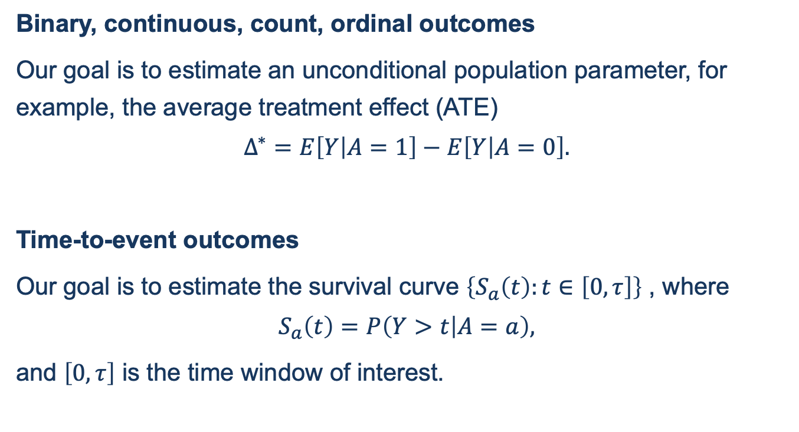
Setup: Estimands
Binary, continuous, count, ordinal outcomes
Our goal is to estimate an unconditional population parameter, for example, the average treatment effect (ATE)
$$Δ^{∗}=E\left[Y | A=1\right]−E\left[Y | A=0\right].$$
Time-to-event outcomes
Our goal is to estimate the survival curve $\left\{S_{a}\left(t\right):t∈\left[0,τ\right]\right\}$ , where
$$S_{a}\left(t\right)=P\left(Y>t | A=a\right),$$
and $\left[0,τ\right]$ is the time window of interest.

Slide 11
Setup: randomization
Simple randomization
Treatment are assigned by independent coin flips.
Treatment
1 | 1 | 1 | 0 | 0 | 1 | 1 | 1
F | M | F | F | F | M | M | M
Sex
Stratified randomization (used by 70% RCTs, Lin et al. 2015)
Treatment are assigned by permuted blocks.
Treatment is ensured to be balanced.
Female
1 | 0 | 1 | 0
0 | 0 | 1 | 1
Male
1 | 0 | 0 | 1
0 | 1 | 0 | 1

Slide 12
Estimators
M-estimators for binary, continuous, ordinal or count outcomes
The ANCOVA estimator for continuous outcomes.
The standardized logistic regression estimator for binary outcomes.
The doubly-robust weighted-least-square (DR-WLS) estimator that handles missing data under MAR.
The mixed-effects models for repeated measures (MMRM) for repeated measures of outcomes.
The targeted maximum likelihood estimators (TMLE).
The augmented IPW estimator.
The Kaplan-Meier estimator for the survival curve.

Slide 13
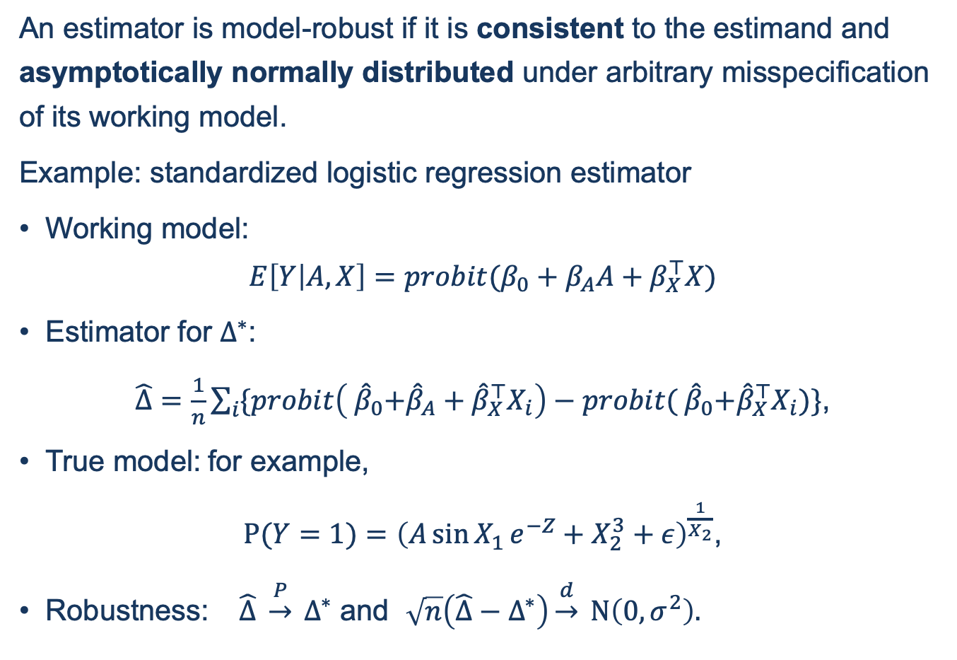
Robustness
An estimator is model-robust if it is consistent to the estimand and asymptotically normally distributed under arbitrary misspecification of its working model.
Example: standardized logistic regression estimator
Working model:
$$E\left[Y | A, X\right]=probit(β_{0}+β_{A}A+β_{X}^{⊤}X)$$
Estimator for $Δ^{∗}$:
$\hat{Δ}=\frac{1}{n}\sum_{i}{\{probit\left({ \hat{β}}_{0}+{\hat{β}}_{A}+{\hat{β}}_{X}^{⊤}X_{i}\right)−probit({ \hat{β}}_{0}+{\hat{β}}_{X}^{⊤}X_{i})}\}$,
True model: for example,
$P(Y=1)={\left(A\sin{X_{1}}e^{−Z}+X_{2}^{3}+ε\right)}^{\frac{1}{X_{2}}}$,
Robustness: $\hat{Δ} \underset{→}{P} Δ^{∗}$ and $\sqrt{n}\left(\hat{Δ}−Δ^{∗}\right)\underset{→}{d} N\left(0, σ^{2}\right).$

Slide 14
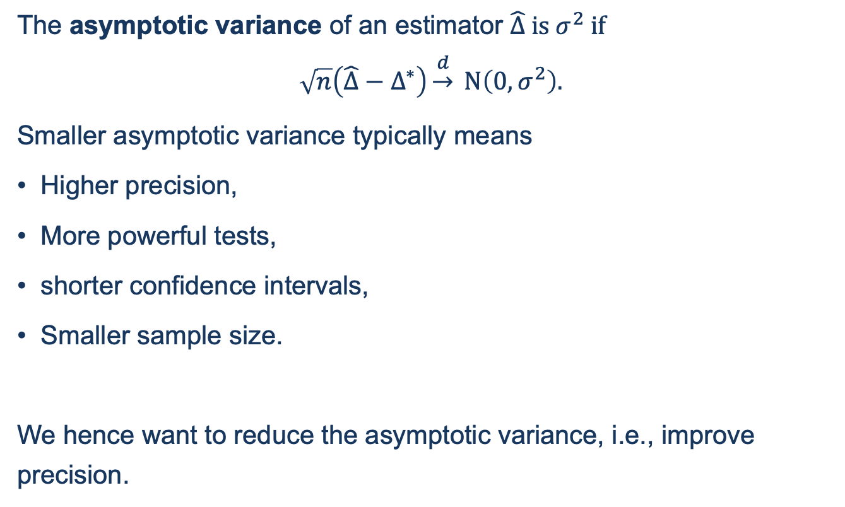
Precision
The asymptotic variance of an estimator $\hat{Δ}$ is $σ^{2}$ if
$$\sqrt{n}\left(\hat{Δ}−Δ^{∗}\right)\underset{→}{d} N\left(0, σ^{2}\right).$$
Smaller asymptotic variance typically means
Higher precision,
More powerful tests,
shorter confidence intervals,
Smaller sample size.
We hence want to reduce the asymptotic variance, i.e., improve precision.

Slide 15
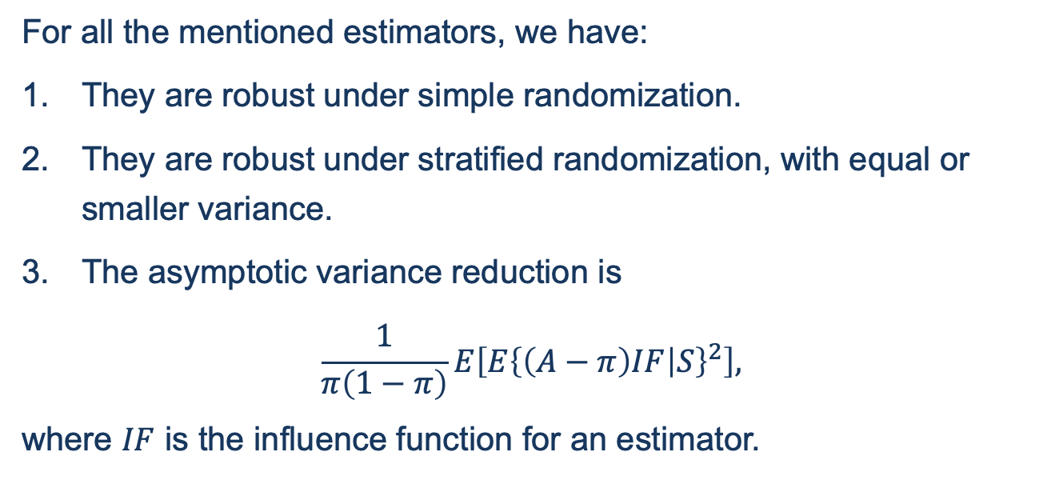
Asymptotic theory
For all the mentioned estimators, we have:
They are robust under simple randomization.
They are robust under stratified randomization, with equal or smaller variance.
The asymptotic variance reduction is
$$\frac{1}{π\left(1−π\right)}E\left[E{\left\{\left(A−π\right)IF | S\right\}}^{2}\right],$$
where $IF$ is the influence function for an estimator.

Slide 16
Implications of the theory
Under stratified randomization,
The standard practice is still robust if robust standard error is used.
However, we may waste power by standard practice.
By a simple adjustment to the standard error, we can avoid being conservative.

Slide 17
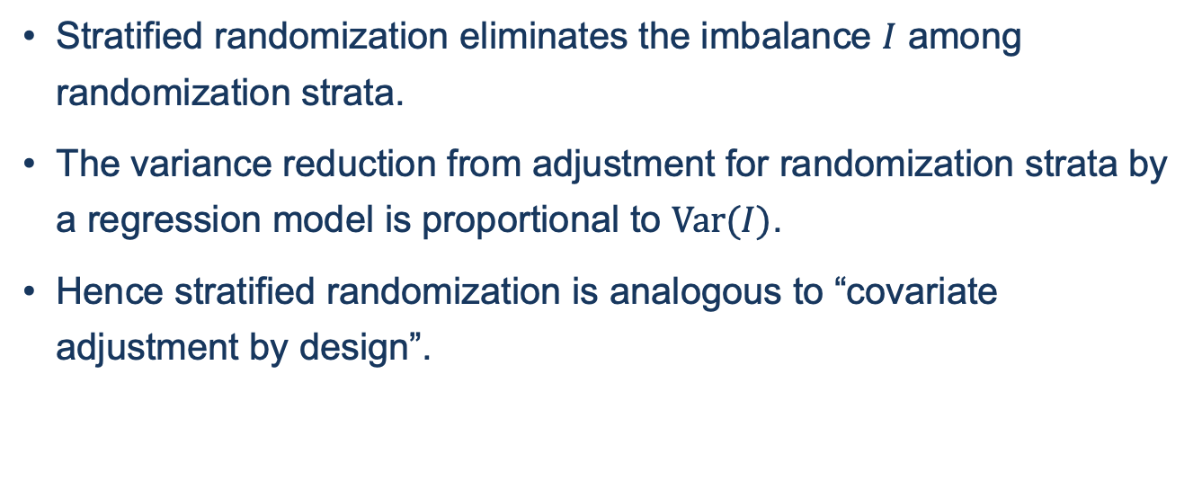
Why stratified randomization brings variance reduction?
Stratified randomization eliminates the imbalance $I$ among randomization strata.
The variance reduction from adjustment for randomization strata by a regression model is proportional to $Var(I)$.
Hence stratified randomization is analogous to “covariate adjustment by design”.

Slide 18
Related work
Shao et al. (2010); Shao and Yu (2013) proved the validity of the two-sample t-test under the biased-coin design assuming generalized linear model.
Ma et al. (2015, 2018) assumed a linear model and derived the asymptotic distribution of the test statistic of ATE for the ANCOVA estimator and a class of covariate-adaptive designs.
Bugni et al. (2018) established the asymptotic theory of the unadjusted estimator and the ANCOVA estimator (adjusting for strata only) of ATE for a wide range of covariate-adaptive designs.
Ye and Shao (2020) derived asymptotics for log-rank and score tests in survival analysis under covariate adaptive randomization.
Li and Ding (2020) established the asymptotic theory for the ANCOVA estimator under covariate-adaptive randomization in the randomization inference framework.
More recent papers: Yang et al. (2020); Ma et al. (2020); Ye et al.(2020).

Slide 19
Questions?

Slide 20




Examples
ANCOVA
Standardized logistic regression
MMRM
DR-WLS
Kaplan-Meier

Slide 21
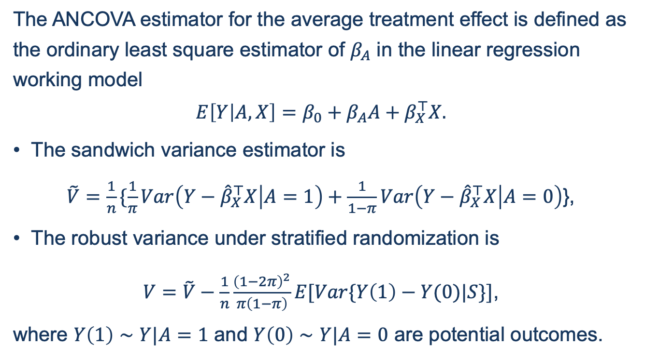
ANCOVA for continuous outcomes
The ANCOVA estimator for the average treatment effect is defined as the ordinary least square estimator of $β_{A}$ in the linear regression working model
$$E\left[Y | A,X\right]=β_{0}+β_{A}A+β_{X}^{⊤}X.$$
The sandwich variance estimator is
$\tilde{V}=\frac{1}{n}\{\frac{1}{π}Var\left(Y−{\hat{β}}_{X}^{⊤}X | A=1\right)+\frac{1}{1−π}Var\left(Y−{\hat{β}}_{X}^{⊤}X | A=0\right)$},
The robust variance under stratified randomization is
$V=\tilde{V}−\frac{1}{n}\frac{{\left(1−2π\right)}^{2}}{π\left(1−π\right)}E[Var\{Y\left(1\right)−Y(0)|S\}]$,
where $Y\left(1\right)∼Y|A=1$ and $Y\left(0\right)$ $∼Y|A=0$ are potential outcomes.

Slide 22
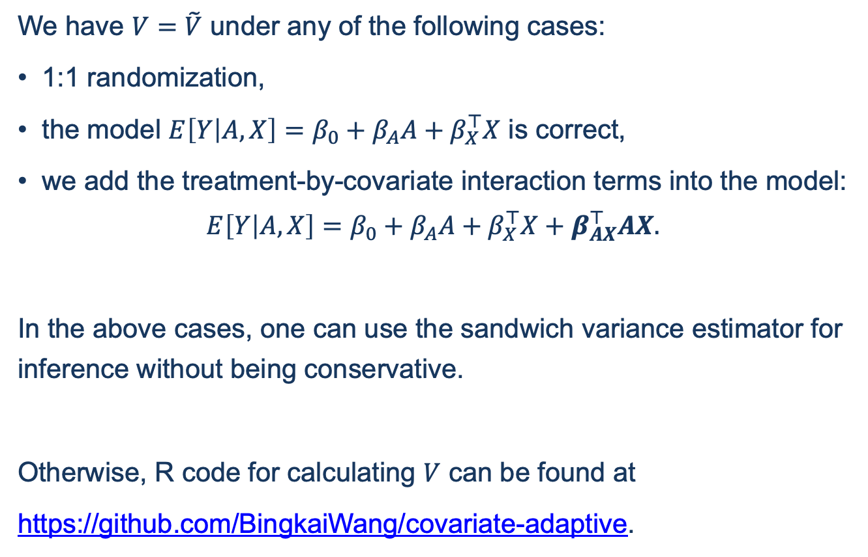
ANCOVA for continuous outcomes
We have $V=\tilde{V}$ under any of the following cases:
1:1 randomization,
the model $E\left[Y | A,X\right]=β_{0}+β_{A}A+β_{X}^{⊤}X$ is correct,
we add the treatment-by-covariate interaction terms into the model:
$$E\left[Y | A,X\right]=β_{0}+β_{A}A+β_{X}^{⊤}X+β_{AX}^{⊤}AX.$$
In the above cases, one can use the sandwich variance estimator for inference without being conservative.
Otherwise, R code for calculating $V$ can be found at
https://github.com/BingkaiWang/covariate-adaptive.

Slide 23
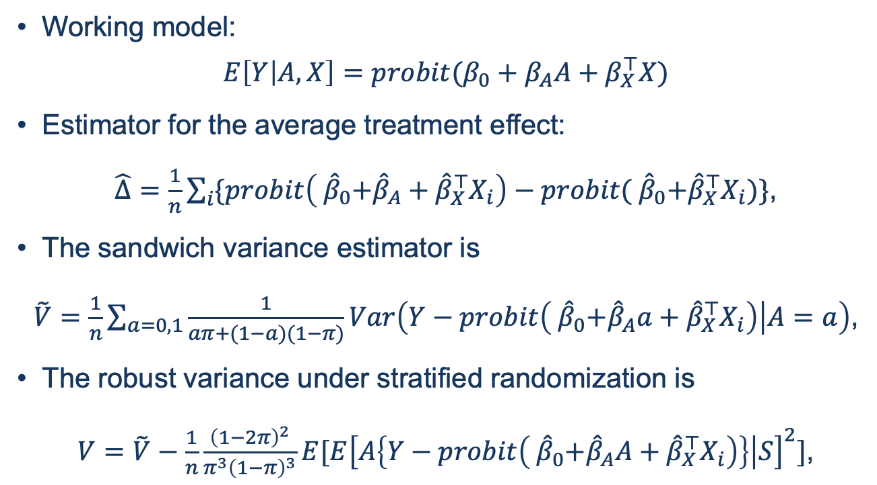
Standardized logistic regression for binary outcomes
Working model:
$$E\left[Y | A, X\right]=probit(β_{0}+β_{A}A+β_{X}^{⊤}X)$$
Estimator for the average treatment effect:
$\hat{Δ}=\frac{1}{n}\sum_{i}{\{probit\left({ \hat{β}}_{0}+{\hat{β}}_{A}+{\hat{β}}_{X}^{⊤}X_{i}\right)−probit({ \hat{β}}_{0}+{\hat{β}}_{X}^{⊤}X_{i})}\}$,
The sandwich variance estimator is
$\tilde{V}=\frac{1}{n}\sum_{a=0,1}{\frac{1}{aπ+(1−a)(1−π)}Var\left(Y−probit\left({ \hat{β}}_{0}+{\hat{β}}_{A}a+{\hat{β}}_{X}^{⊤}X_{i}\right) | A=a\right)}$,
The robust variance under stratified randomization is
$V=\tilde{V}−\frac{1}{n}\frac{{\left(1−2π\right)}^{2}}{π^{3}{\left(1−π\right)}^{3}}E[E{\left[A\left\{Y−probit\left({ \hat{β}}_{0}+{\hat{β}}_{A}A+{\hat{β}}_{X}^{⊤}X_{i}\right)\right\} | S\right]}^{2}]$,

Slide 24
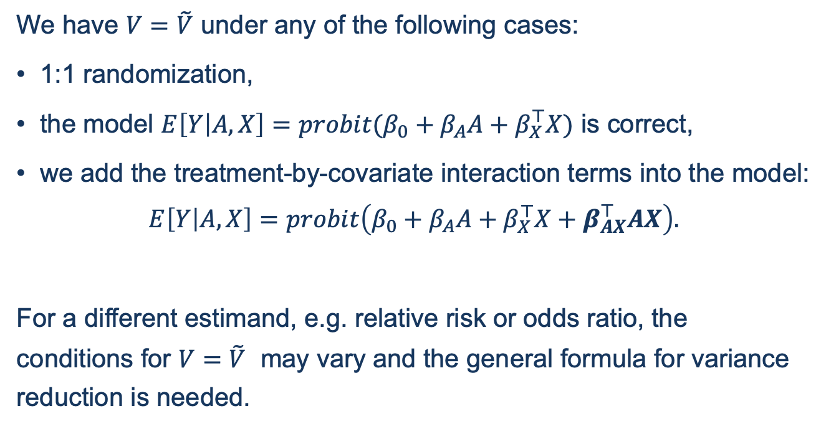
Standardized logistic regression for binary outcomes
We have $V=\tilde{V}$ under any of the following cases:
1:1 randomization,
the model $E\left[Y | A,X\right]=probit(β_{0}+β_{A}A+β_{X}^{⊤}X)$ is correct,
we add the treatment-by-covariate interaction terms into the model:
$$E\left[Y | A,X\right]=probit\left(β_{0}+β_{A}A+β_{X}^{⊤}X+β_{AX}^{⊤}AX\right).$$
For a different estimand, e.g. relative risk or odds ratio, the conditions for $V=\tilde{V}$ may vary and the general formula for variance reduction is needed.

Slide 25
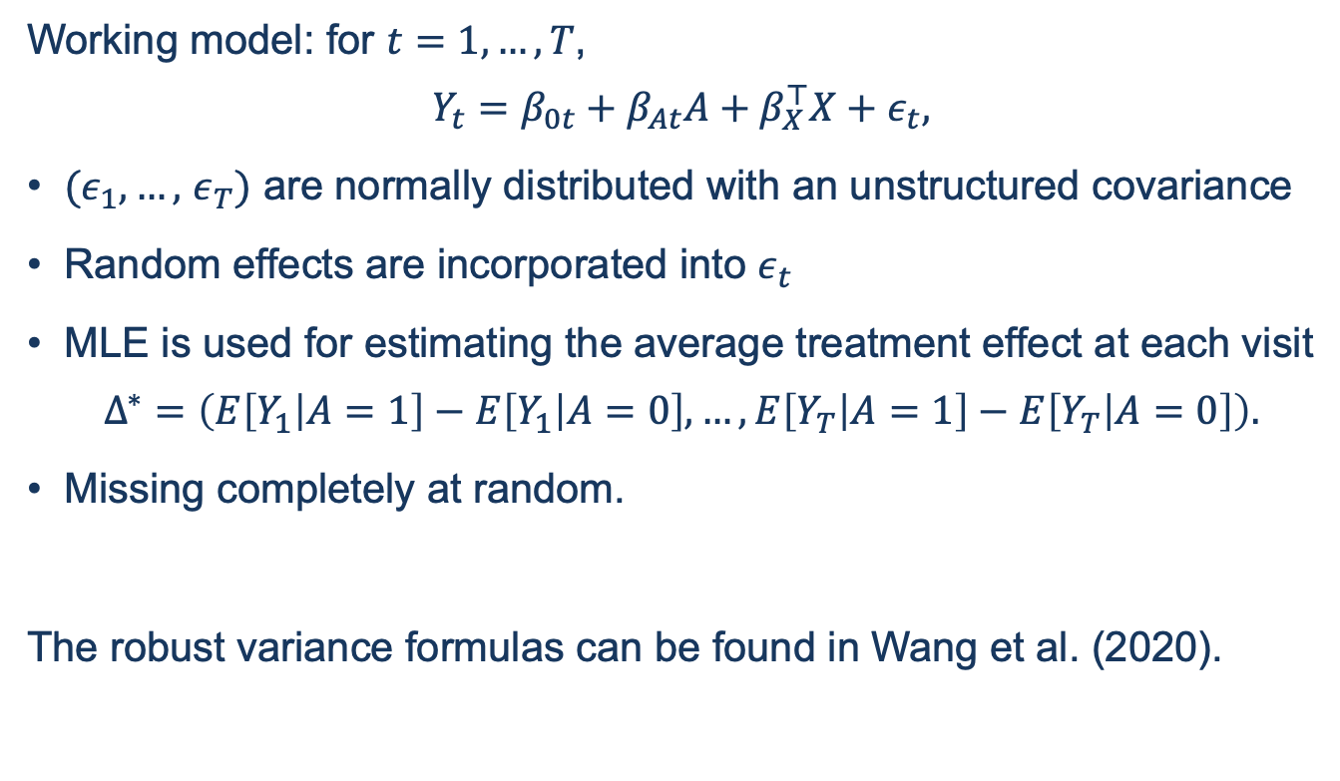
MMRM for repeated measures
Working model: for $t=1,…, T$,
$$Y_{t}=β_{0t}+β_{At}A+β_{X}^{⊤}X+ε_{t},$$
$(ε_{1},…,$ $ε_{T})$ are normally distributed with an unstructured covariance
Random effects are incorporated into $ε_{t}$
MLE is used for estimating the average treatment effect at each visit
$$Δ^{∗}=\left(E\left[Y_{1} | A=1\right]−E\left[Y_{1} | A=0\right],…,E\left[Y_{T} | A=1\right]−E\left[Y_{T} | A=0\right]\right).$$
Missing completely at random.
The robust variance formulas can be found in Wang et al. (2020).

Slide 26
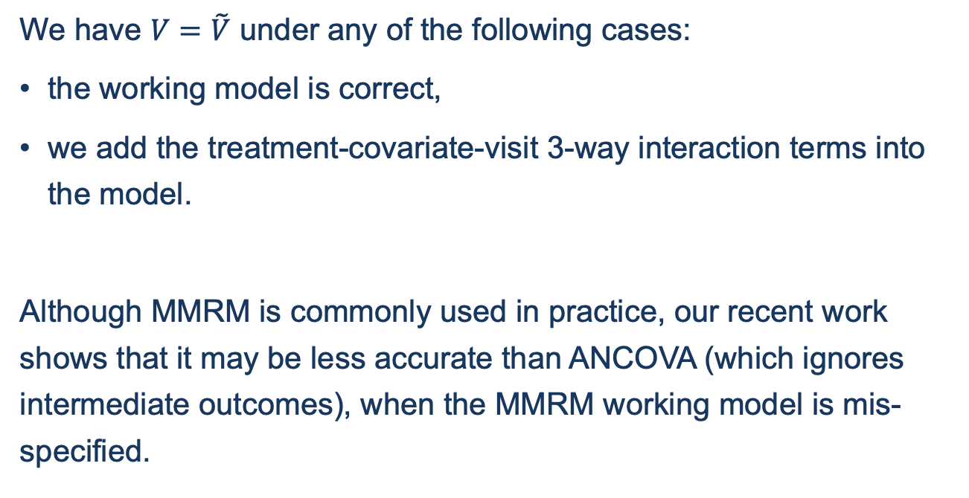
MMRM for repeated measures
We have $V=\tilde{V}$ under any of the following cases:
the working model is correct,
we add the treatment-covariate-visit 3-way interaction terms into the model.
Although MMRM is commonly used in practice, our recent work shows that it may be less accurate than ANCOVA (which ignores intermediate outcomes), when the MMRM working model is mis-specified.

Slide 27
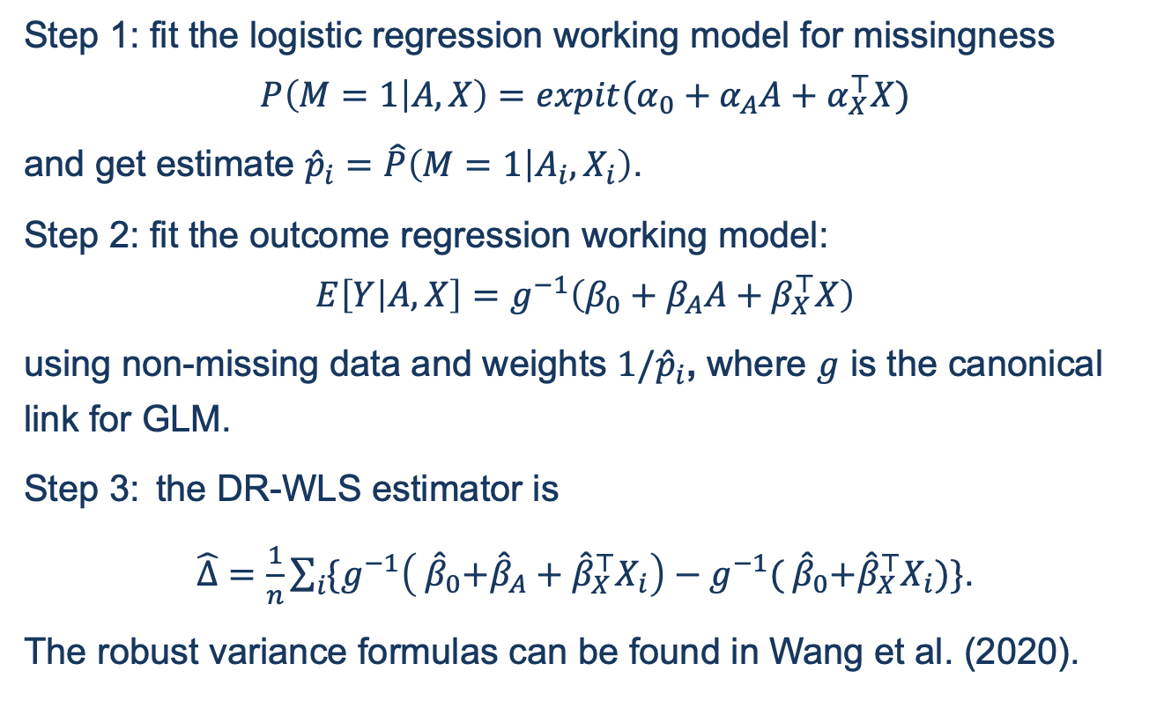
The DR-WLS estimator
Step 1: fit the logistic regression working model for missingness
$$P\left(M=1 | A,X\right)=expit(α_{0}+α_{A}A+α_{X}^{⊤}X)$$
and get estimate ${\hat{p}}_{i}=\hat{P}\left(M=1 | A_{i},X_{i}\right)$.
Step 2: fit the outcome regression working model:
$$E\left[Y | A,X\right]=g^{−1}\left(β_{0}+β_{A}A+β_{X}^{⊤}X\right)$$
using non-missing data and weights ${1/\hat{p}}_{i}$, where $g$ is the canonical link for GLM.
Step 3: the DR-WLS estimator is
$\hat{Δ}=\frac{1}{n}\sum_{i}{\{g^{−1}\left({ \hat{β}}_{0}+{\hat{β}}_{A}+{\hat{β}}_{X}^{⊤}X_{i}\right)−g^{−1}({ \hat{β}}_{0}+{\hat{β}}_{X}^{⊤}X_{i})}\}$.
The robust variance formulas can be found in Wang et al. (2020).

Slide 28
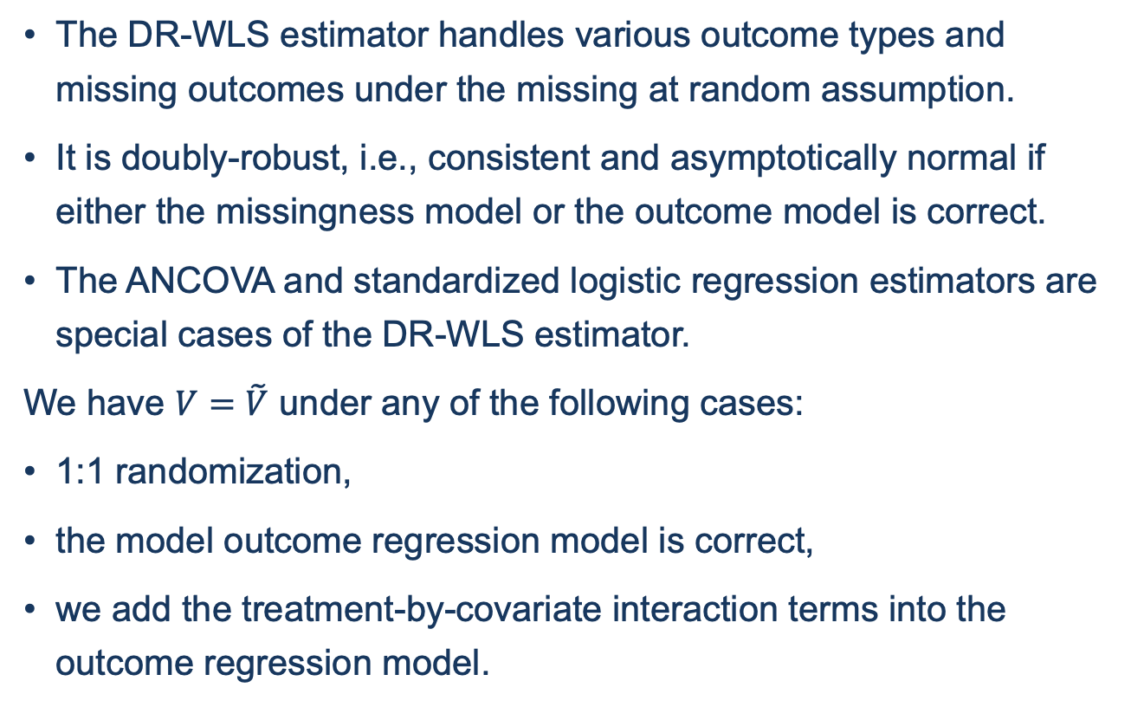
The DR-WLS estimator
The DR-WLS estimator handles various outcome types and missing outcomes under the missing at random assumption.
It is doubly-robust, i.e., consistent and asymptotically normal if either the missingness model or the outcome model is correct.
The ANCOVA and standardized logistic regression estimators are special cases of the DR-WLS estimator.
We have $V=\tilde{V}$ under any of the following cases:
1:1 randomization,
the model outcome regression model is correct,
we add the treatment-by-covariate interaction terms into the outcome regression model.

Slide 29
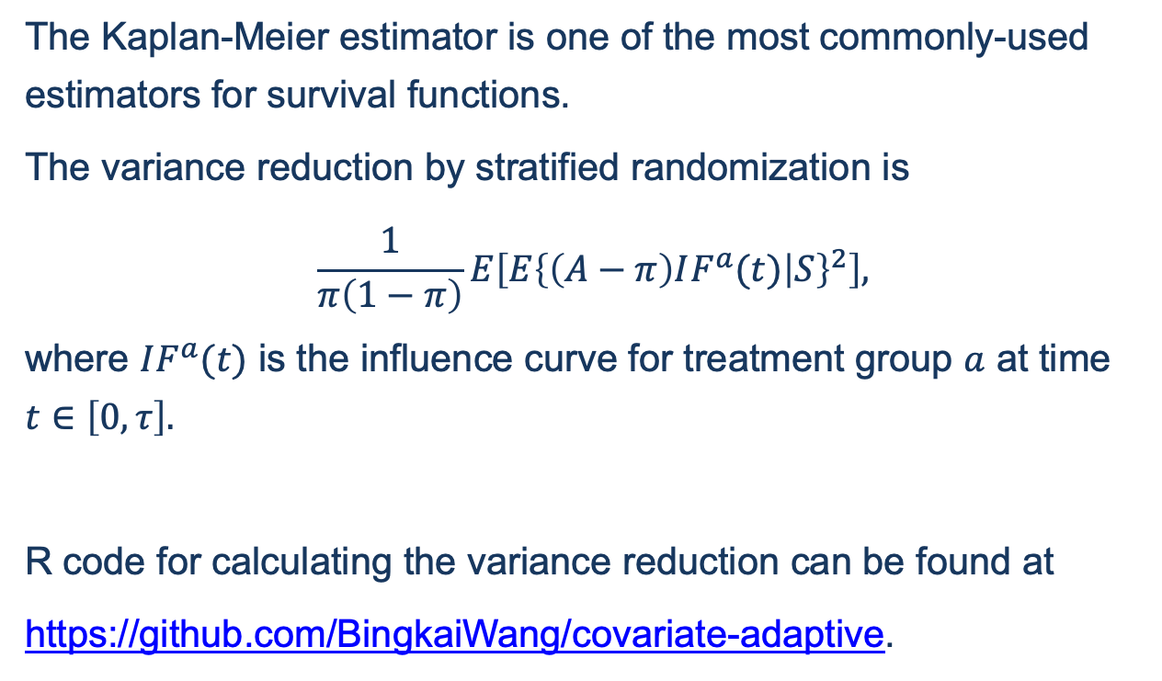
The Kaplan-Meier estimator
The Kaplan-Meier estimator is one of the most commonly-used estimators for survival functions.
The variance reduction by stratified randomization is
$$\frac{1}{π\left(1−π\right)}E\left[E{\left\{\left(A−π\right)IF^{a}(t) | S\right\}}^{2}\right],$$
where $IF^{a}(t)$ is the influence curve for treatment group $a$ at time $t∈\left[0,τ\right].$
R code for calculating the variance reduction can be found at
https://github.com/BingkaiWang/covariate-adaptive.

Slide 30
How much variance reduction?

Slide 31
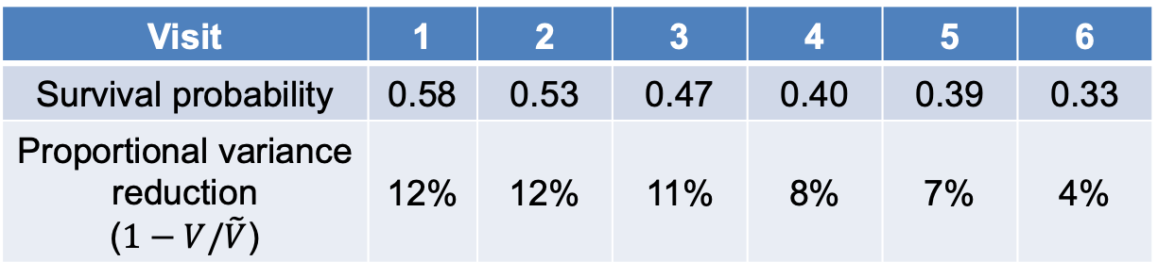
Data example 1: variance reduction due to stratified randomization
Trial: CTN44
Time-to-event outcome: time to abstinence
Group: Therapeutic Education System (treatment)
Estimator: the Kaplan-Meier estimator
Visit | 1 | 2 | 3 | 4 | 5 | 6
Survival probability | 0.58 | 0.53 | 0.47 | 0.40 | 0.39 | 0.33
Proportional variance reduction ($1−V/\tilde{V}$) | 12% | 12% | 11% | 8% | 7% | 4%

Slide 32
Data example 2: variance reduction due to covariate adjustment under stratified randomization
CTN03, CTN30 and CTN44 are RCTs of treatment of substance use disorder using stratified randomization.
CTN03 has binary outcomes and CTN30 and CTN44 have continuous outcomes, all being measures of treatment success.
Each study has∼5 baseline variables.
Study | Unadjusted estimator | Adjusted estimator | Proportional variance reduction
CTN03 | -0.11(-0.21, -0.01) | -0.10(-0.19, -0.02) | 35%
CTN30 | 0.02(-0.02, 0.05) | 0.01(-0.02, 0.04) | 17%
CTN44 | -0.09(-0.14, -0.03) | -0.09(-0.14, -0.03) | 2%

Slide 33

Discussion
Practical implications
When using stratified randomization, doing statistical inference with the correct variance can avoid being conservative.
Adjusting for a set of preplanned baseline variables may lead to substantial variance reduction.
Limitations
Our results cannot handle cases where some strata have few participants.
Our results cannot handle missing not at random.
New findings in academia
Practice in industry

Slide 34
Thanks to
Coauthors of this paper:
Ryoko Susukida,
Ramin Mojtabai,
Masoumeh Amin-Esmaeili,
Michael Rosenblum (PhD advisor)
Thanks to Dr. Dong Xi for organizing this session.
Thanks to Novartis for inviting me as a speaker.

Slide 35
Thank you!
The slides are available at
https://bingkaiwang.com.
The paper is available at
https://arxiv.org/abs/1910.13954.
The R code is available at https://github.com/BingkaiWang/covariate-adaptive.
Email:
bingkai.w@gmail.com

Slide 36
Acknowledgement
This project was supported by a research award from Arnold Ventures.
The information reported here results from secondary analyses of data from clinical trials conducted by the National Institute on Drug Abuse (NIDA). Specifically, data from NIDA–CTN-0003 (Suboxone (Buprenorphine/Naloxone) Taper: A Comparison of Two Schedules), NIDA-CTN-0030 (Prescription Opioid Addiction Treatment Study) and NIDA-CTN-0044 (Web-delivery of Evidence-Based, Psychosocial Treatment for Substance Use Disorders) were included. NIDA databases and information are available at (https://datashare.nida.nih.gov).
MR was supported by the Johns Hopkins Center of Excellence in Regulatory Science and Innovation, which is funded by the Food and Drug Administration (FDA) of the U.S. Department of Health and Human Services (HHS) as part of a financial assistance award (U01FD005942).
The contents are those of the author(s) and do not necessarily represent the official views of, nor an endorsement, by any of the aforementioned organizations, the FDA/HHS, nor the U.S. Government.

Slide 37
References
Bugni, F. A., I. A. Canay, and A. M. Shaikh (2018). Inference under covariate-adaptive randomization. Journal of the American Statistical Association 113(524), 1784–1796.
Campbell, A. N., E. V. Nunes, A. G. Matthews, M. Stitzer, G. M. Miele,D. Polsky, E. Turrigiano, S. Walters, E. A. McClure, T. L. Kyle, A. Wahle,P. Van Veldhuisen, B. Goldman, D. Babcock, P. Q. Stabile, T. Winhusen, and U. E. Ghitza (2014). Internet-delivered treatment for substance abuse: A multisite randomized controlled trial.A merican Journal ofPsychiatry 171(6), 683–690.
FDA (2020). COVID-19: Developing Drugs and Biological Products for Treatment or Prevention. U.S. Food and Drug Administration: CDER.
Kahan, B. C. and T. P. Morris (2012). Improper analysis of trials randomized using stratified blocks or minimisation. Stat. Med. 31(4), 328–340.
Li, X. and P. Ding (2020). Rerandomization and regression adjustment. Journal of the Royal Statistical Society: Series B (Statistical Methodology) 82(1), 241–268.
Lin, Y., M. Zhu, and Z. Su (2015). The pursuit of balance: An overview of covariate-adaptive randomization techniques in clinical trials. Contemporary Clinical Trials 45, 21 – 25. 10th Anniversary Special Issue.
Ma, W., F. Hu, and L. Zhang (2015). Testing hypotheses of covariate-adaptive randomized clinical trials. Journal of the American Statistical Association 110(510), 669–680.
Ma, W., Y. Qin, Y. Li, and F. Hu (2018). Statistical inference ofcovariate-adjusted randomized experiments. arXiv https://arxiv.org/abs/1807.09678.
Ma, W., F. Tu, and H. Liu (2020). Regression analysis for covariate-adaptive randomization: A robust and efficient inference perspective. arXiv https://arxiv.org/abs/2009.02287.
Shao, J. and X. Yu (2013). Validity of tests under covariate-adaptive biased coin randomization and generalized linear models. Biometrics 69(4),960–969.
Shao, J., X. Yu, and B. Zhong (2010). A theory for testing hypotheses under covariate-adaptive randomization. Biometrika 97(2), 347–360.
Yang, L., W. Ma, Y. Qin, and F. Hu (2020). Testing for treatment effect in covariate-adaptive randomized clinical trials with generalized linear models and omitted covariates. arXiv https://arxiv.org/abs/2009.04136.
Ye, T. and J. Shao (2020). Robust tests for treatment effect in survival analysis under covariate-adaptive randomization. Journal of the Royal Statistical Society: Series B (Statistical Methodology) 82(5), 1301–1323.
Ye, T., Y. Yi, and J. Shao (2020). Inference on average treatment effect under minimization and other covariate-adaptive randomization methods. arXiv https://arxiv.org/abs/2007.09576.

Slide 38
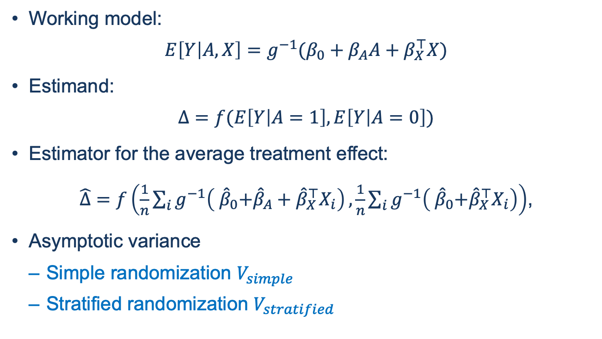
Discussion: GLM
Working model:
$$E\left[Y | A, X\right]=g^{−1}(β_{0}+β_{A}A+β_{X}^{⊤}X)$$
Estimand:
$$Δ=f(E\left[Y | A=1\right], E\left[Y | A=0\right])$$
Estimator for the average treatment effect:
$\hat{Δ}=f\left(\frac{1}{n}\sum_{i}{g^{−1}\left({ \hat{β}}_{0}+{\hat{β}}_{A}+{\hat{β}}_{X}^{⊤}X_{i}\right)},\frac{1}{n}\sum_{i}{g^{−1}\left({ \hat{β}}_{0}+{\hat{β}}_{X}^{⊤}X_{i}\right)}\right)$,
Asymptotic variance
Simple randomization $V_{simple}$
Stratified randomization $V_{stratified}$

Slide 39
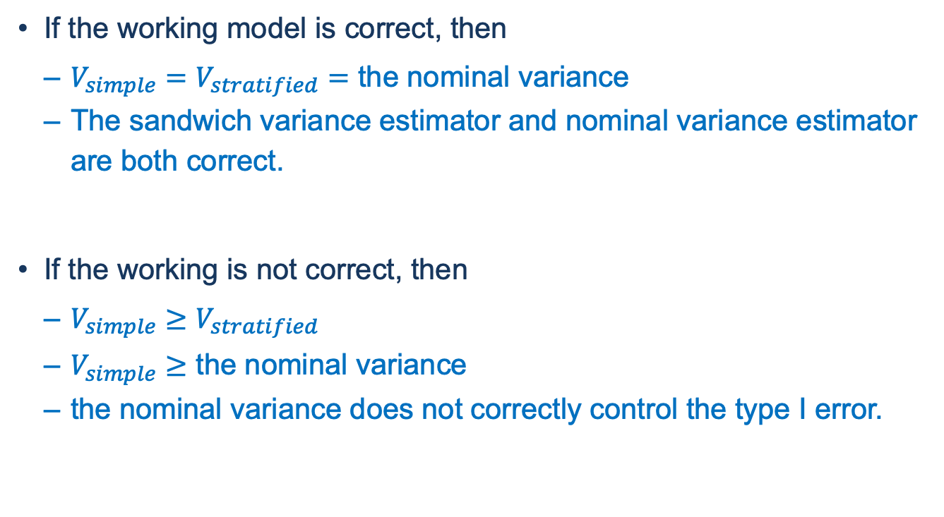
Discussion: is the working model correct?
If the working model is correct, then
$V_{simple}=V_{stratified}=$ the nominal variance
The sandwich variance estimator and nominal variance estimator are both correct.
If the working is not correct, then
$V_{simple}≥V_{stratified}$
$V_{simple}≥$ the nominal variance
the nominal variance does not correctly control the type I error.

Slide 40
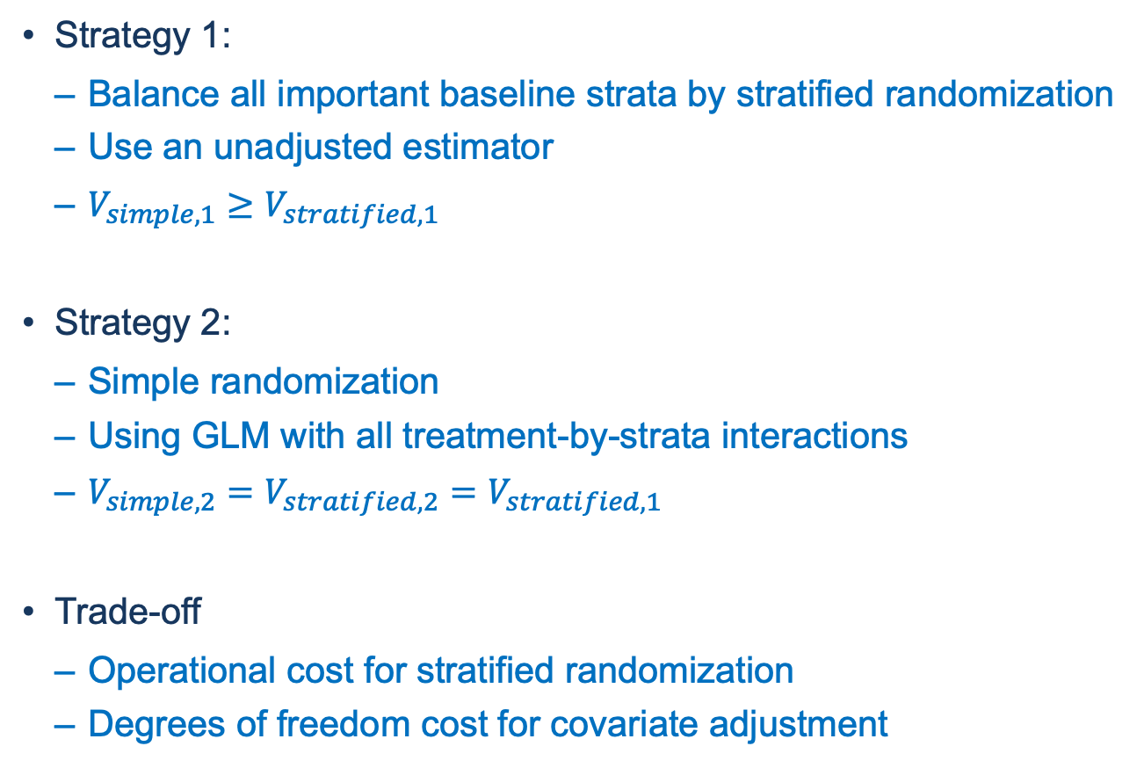
Discussion: balance by design or by adjustment?
Strategy 1:
Balance all important baseline strata by stratified randomization
Use an unadjusted estimator
$V_{simple,1}≥V_{stratified, 1}$
Strategy 2:
Simple randomization
Using GLM with all treatment-by-strata interactions
$V_{simple,2}=V_{stratified, 2}=V_{stratified, 1}$
Trade-off
Operational cost for stratified randomization
Degrees of freedom cost for covariate adjustment

Slide 41
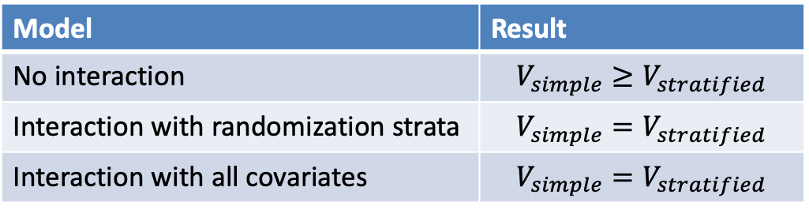
Question 1
Could you explain the role of interaction terms in the results (Corollary 1): no interaction, interaction with randomization strata, or interaction with all covariates?
In addition, interaction with all covariates has the smallest variance.
Model | Result
No interaction | $$V_{simple}≥V_{stratified}$$
Interaction with randomization strata | $$V_{simple}=V_{stratified}$$
Interaction with all covariates | $$V_{simple}=V_{stratified}$$

Slide 42
Question 2
Is there anything we must change in our practice?
One thing would be to use robust methods (Huber-White) more often, but in my view that is a separate topic. Sandwich estimators are used to be more robust to model misspecifications. If models are correct, this would lose rather than gain efficiency.
Regarding "balance", for sure, it would be great to achieve perfect balance for all potential covariates. Still, this does not come "for free". There are operational costs. From a more statistical perspective, there is a loss of degrees of freedom when estimating the variances within strata. Asymptotically, or for a single stratification factor, this may be irrelevant, but in finite samples, this limits the number of strata that can be used.
In summary: Wouldn't the recommendation to do block-randomization and to stratify only for a few covariates with a known strong impact on the response still hold?

Slide 43
Question 3
Do the results apply to count data?
How do I apply the approach to estimand? For example, if I use multiple imputation for treatment policy, guess I could still apply the approach to each imputed data, and then combine them with rubin’s rule?

