Slide 1
An Introduction to R
Nov 3rd, 2021
Binglan Li
Stanford Carpentry
Partially adapted from https://seandavi.github.io/ITR/index.html

Slide 2
What Is R?
Depending on who you ask
A statistical programming language
A software package
A toolkit for developing statistical and analytical tools
An extensive library of statistical and mathematical software and algorithms
A complete data science environment
…

Slide 3
Why R?
Cross-platform (Windows, MacOS, and Linux)
A vast number of statistical tools
Ability to produce publication-quality graphics
R scales for data science projects

Slide 4
At the End of the Workshop, You Will Be Able to
Basics
- Start R and RStudio
- Interact with the R console
- Know the difference between expressions and assignment
- Recognize valid and invalid R names
- Know how to access the R help system
- Know how to assign values to variables, find what is in R memory, and remove values from R memory
Understand data types and R-object types
Read and write files
- Load file
- Save RData or write to files
Programing & data manipulations
- Install and load a library
- Control structures and looping
- Know how to write a function
- Data visualization (default and advancecd)
- Ready for more advanced topics, e.g., data manipulation and data visualization

Slide 5

Getting R
R website:
http://cran.r-project.org/
Windows installer file:
https://cran.r-project.org/bin/windows/base/R-4.1.2-win.exe
Mac installer file:
https://cran.r-project.org/bin/macosx/base/R-4.1.2.pkg

Slide 6
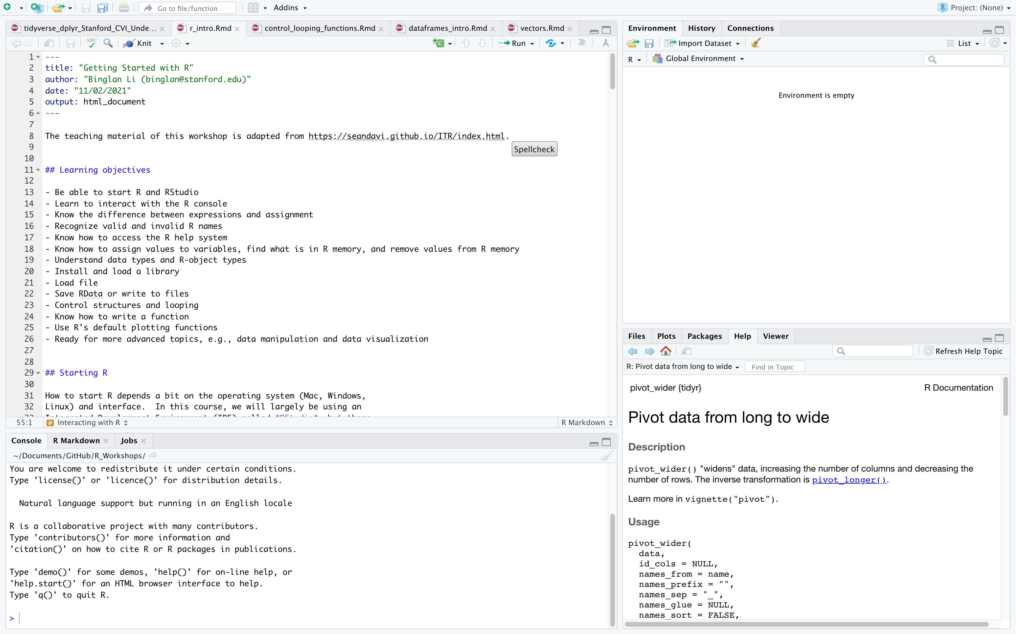
Rstudio is a front end to R.
It’s intended to provide the same user experience regardless of what kind of computer you’re using
Rstudio download link: http://www.rstudio.com/ide/download/desktop
Rstudio webpage: www.rstudio.org

Slide 7
Rstudio is divided into several panels
1. Scripts
3. Environment
2. Console
4. Help, etc.

Slide 8
Console in Rstudio is an interactive R
This is exactly how you will interact with R in saying a terminal or inside a R program.
“>” is a default prompt showing that R is waiting for a command.

Slide 9
Break
- We will take a break every 15-30 mins.
- Let’s check if R and Rstudio are working. Any question so far?

