Slide 1
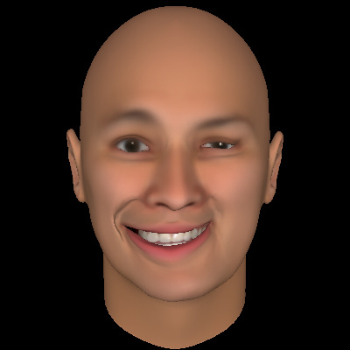

Slide 2
Brow height
right
Brow height
left
Brow Height:
Vertical distance from the mid-pupillary point to the superior border of the brow

Slide 3
Brow height
right
Brow height
left

Slide 4
Marginal reflex distance 1
right
Marginal reflex distance 1
left
Marginal Reflex Distance 1 (MRD1):
Vertical distance from the mid-pupillary point to the upper eyelid margin

Slide 5
Marginal reflex distance 1
right
Marginal reflex distance 1
left

Slide 6
Marginal reflex distance 2
right
Marginal reflex distance 2
left
Marginal Reflex Distance 2 (MRD2):
Vertical distance from the mid-pupillary point to the lower eyelid margin

Slide 7
Marginal reflex distance 2
right
Marginal reflex distance 2
left

Slide 8
Commissure excursion
Commissure Excursion:
Distance from midline vertical / lower lip vermillion junction point to the oral commissure

Slide 9
Commissure excursion
left

Slide 10
Smile angle
left
Smile Angle:
Angle between the horizontal plane at the midline vertical / lower lip vermillion junction point and the oral commissure

Slide 11
Smile angle
left

Slide 12
Commissure height
deviation
Commissure height deviation:
Vertical distance (red line) between the horizontal plane of the left and right oral commissure.

Slide 13
Commissure height
deviation

Slide 14
Upper lip height
deviation
Upper Lip Height Deviation:
Vertical distance (red line) between the horizontal planes taken from the upper lip vermillion border (red points) where they intersect with a vertical plane taken midway between the midline vertical (green line) and the oral commissure .

Slide 15
Upper lip height
deviation

Slide 16
Lower lip height
deviation
Lower Lip Height Deviation:
Vertical distance (red line) between the horizontal planes taken from the lower lip vermillion border points (red dots) where they intersect with a vertical plane (green dotted line) taken midway between the midline vertical (green line) and the oral commissure.

Slide 17
Lower lip height
deviation

Slide 18
Dental show
right
Dental show
left
Dental Show:
Vertical distance between the mucosal borders of the upper and lower lip along the vertical plane taken halfway between the midline vertical and the oral commissure

Slide 19
Dental show
right
Dental show
left

Slide 20
Palpebral fissure
height right
Palpebral fissure
height left

Slide 21
Palpebral fissure
height right
Palpebral fissure
height left
Palpebral Fissure Height :
Vertical distance between medial canthi of the two open lids

