Slide 1
TOPIC 12 · A2 PHYSICS
MOTION IN
A CIRCLE
v
F = mv²/r
圆周运动
Radian measure · angular speed · centripetal acceleration and force
弧度制 · 角速度 · 向心加速度与向心力
CIE 9702 · Paper 4 · Topic 12
Lecture Notes
Notes:
<!--pageType:cover-->

Slide 2
TOPIC 12 · CIE 9702 A2 PHYSICS
Learning Outcomes
学习目标 — 学完本章你应掌握以下内容
12.1 KINEMATICS OF UNIFORM CIRCULAR MOTION
BY THE END OF THIS TOPIC
Define the radian and express angular displacement in radians 定义弧度并用弧度表示角位移
学完本章，你将能够：
Understand and use the concept of angular speed 理解并使用角速度概念
12.1 Kinematics of uniform circular motion
匀速圆周运动的运动学
12.2 Centripetal acceleration and force
向心加速度与向心力
考试关联：Paper 4 Section A 常考圆周运动公式应用与受力分析。
Recall and use $ω=\frac{2π}{T}$ and $v=rω$
12.2 CENTRIPETAL ACCELERATION
Understand that a force of constant magnitude, always perpendicular to the motion, causes centripetal acceleration 理解恒大力且始终垂直于运动方向的力产生向心加速度
Understand that it causes circular motion with constant angular speed 理解它使物体做匀角速圆周运动
Recall and use $a=rω^{2}$ and $a=\frac{v^{2}}{r}$
Recall and use $F=mrω^{2}$ and $F=\frac{mv^{2}}{r}$
Topic 12 Motion in a Circle
02 / 13
Notes:
<!--pageType:content-->

Slide 3
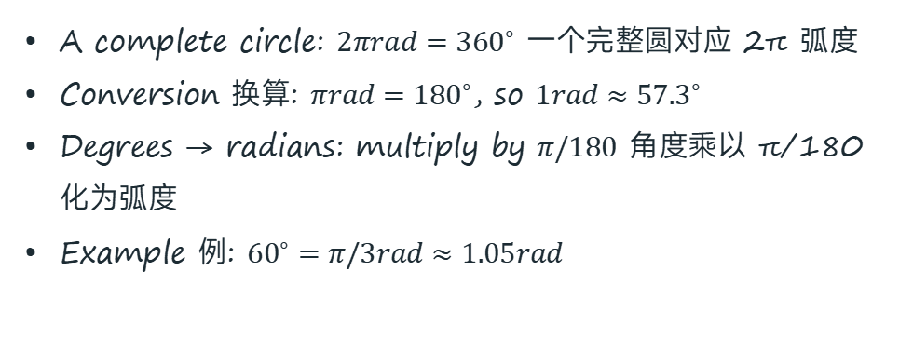

TOPIC 12 · CIE 9702 A2 PHYSICS
Radian Measure
弧度制 — 用弧长与半径之比来度量角
One radian (rad) is the angle subtended at the centre of a circle by an arc equal in length to the radius of the circle.
一弧度：弧长等于半径时所对的圆心角。
r
arc s = r 弧长
$$θ=\frac{s}{r}$$
s = arc length 弧长
r = radius 半径
r
θ = 1 rad
A complete circle: $2πrad={360}^{∘}$ 一个完整圆对应 2π 弧度
Conversion 换算: $πrad={180}^{∘}$, so $1rad≈{57.3}^{∘}$
Degrees → radians: multiply by $π/180$ 角度乘以 π/180 化为弧度
Example 例: ${60}^{∘}=π/3rad≈1.05rad$
Angle in radians 弧度数 = arc length ÷ radius
Topic 12 Motion in a Circle
03 / 13
Notes:
<!--pageType:content-->

Slide 4

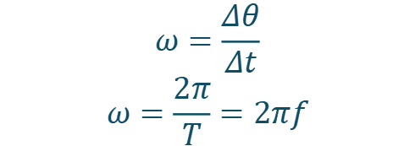
TOPIC 12 · CIE 9702 A2 PHYSICS
Angular Speed
角速度 — 单位时间内半径扫过的角度
Angular speed ω is the angle swept out by the radius per unit time. Unit: rad s⁻¹.
角速度：单位时间内半径扫过的角度，单位 rad s⁻¹。
r
v (tangent 切向)
$$ω=\frac{Δθ}{Δt}$$
$$ω=\frac{2π}{T}=2πf$$
T = period 周期
f = frequency 频率
ω, Δθ
Deriving v = rω 推导：
Arc length 弧长: $Δs=rΔθ$
Divide by $Δt$: $\frac{Δs}{Δt}=r\frac{Δθ}{Δt}$
Linear speed 线速度: $v=rω$
Object on a circular orbit: v tangent 沿切线, ω = v/r
Topic 12 Motion in a Circle
04 / 13
Notes:
<!--pageType:content-->

Slide 5

TOPIC 12 · CIE 9702 A2 PHYSICS
Centripetal Acceleration
向心加速度 — 方向始终指向圆心
Velocity is a vector — its direction changes even at constant speed, so the object accelerates. This centripetal acceleration is towards the centre of the circle.
速度是矢量：方向变化即有加速度；向心加速度指向圆心。
vA
a 指向圆心
$$a=\frac{v^{2}}{r}=rω^{2}$$
vB
A force of constant magnitude, always perpendicular to the motion, causes centripetal acceleration 恒大力、始终垂直于运动方向的力产生向心加速度
Proof idea 证明思路: Δv/v = Δs/r, then divide by Δt → a = v²/r（相似三角形）
Direction 方向: always towards the centre 始终指向圆心
v changes direction ⇒ Δv ≠ 0 ⇒ acceleration towards centre
Topic 12 Motion in a Circle
05 / 13
Notes:
<!--pageType:content-->

Slide 6

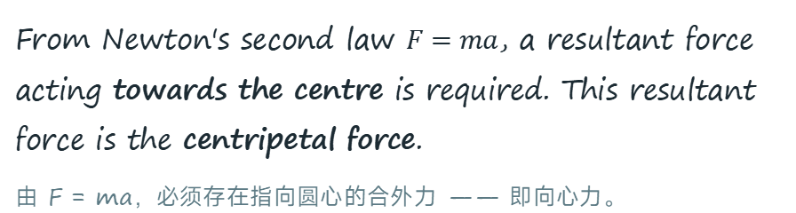
TOPIC 12 · CIE 9702 A2 PHYSICS
Centripetal Force
向心力 — 维持圆周运动的合外力
From Newton's second law $F=ma$, a resultant force acting towards the centre is required. This resultant force is the centripetal force.
由 F = ma，必须存在指向圆心的合外力 —— 即向心力。
F tension 张力
$$F=\frac{mv^{2}}{r}=mrω^{2}$$
v tangent 切向
It is NOT a new kind of force — it is the resultant of real forces. Sources 来源:
Tension in a string 绳中张力
Gravity on a satellite 卫星所受引力
Friction on cornering tyres 轮胎与路面摩擦力
Normal contact force on a banked track 倾斜路面支持力分量
If the string breaks, the ball flies off along the tangent — no centripetal force, no circle.
绳断后球沿切线方向飞出：没有向心力就没有圆周运动。
Ball on a string: tension provides the centripetal force
Topic 12 Motion in a Circle
06 / 13
Notes:
<!--pageType:content-->

Slide 7

TOPIC 12 · CIE 9702 A2 PHYSICS
Real-World Circular Motion
应用实例 — 谁提供了向心力？
SATELLITE IN ORBIT
CAR CORNERING
VERTICAL CIRCLE RIDE
friction → centre
Gravity provides the centripetal force, accelerating the satellite towards the centre of the Earth.
地球引力提供向心力（详见 Topic 13）。
Friction between tyres and road provides the centripetal force. On a banked road, the horizontal component of the normal force helps.
摩擦力提供向心力；路面倾斜时支持力水平分量辅助。
Bottom 底部: $R_{b}−W=\frac{mv^{2}}{r}$
Top 顶部: $R_{t}+W=\frac{mv^{2}}{r}$
座椅支持力底部大、顶部小；速度太小则顶部脱离座椅。
Topic 12 Motion in a Circle
07 / 13
Notes:
<!--pageType:content-->

Slide 8
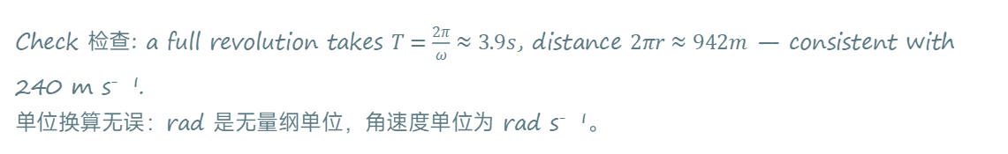

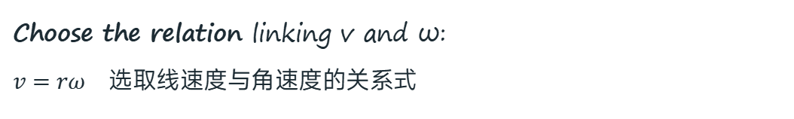
TOPIC 12 · CIE 9702 A2 PHYSICS
Worked Example 12A — Angular Speed
例题 12A — 由线速度求角速度
SOLUTION 解答
WORKED EXAMPLE 12A
Choose the relation linking v and ω:
$v=rω$ 选取线速度与角速度的关系式
1
A rocket makes a turn in a horizontal circle of radius 150 m. It is travelling at a speed of 240 m s⁻¹.
Calculate the angular speed of the aircraft.
火箭在半径 150 m 的水平圆上转弯，速率 240 m s⁻¹，求角速度。
2
Rearrange and substitute 代入数据:
$$ω=\frac{v}{r}=\frac{240}{150}$$
ω = 1.6 rad s⁻¹
Given 已知:
radius r = 150 m
linear speed v = 240 m s⁻¹
find 求: angular speed ω
Check 检查: a full revolution takes $T=\frac{2π}{ω}≈3.9s$, distance $2πr≈942m$ — consistent with 240 m s⁻¹.
单位换算无误：rad 是无量纲单位，角速度单位为 rad s⁻¹。
Topic 12 Motion in a Circle
08 / 13
Notes:
<!--pageType:content-->

Slide 9
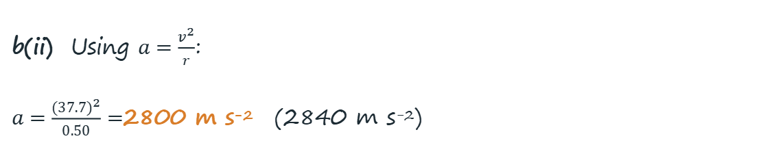
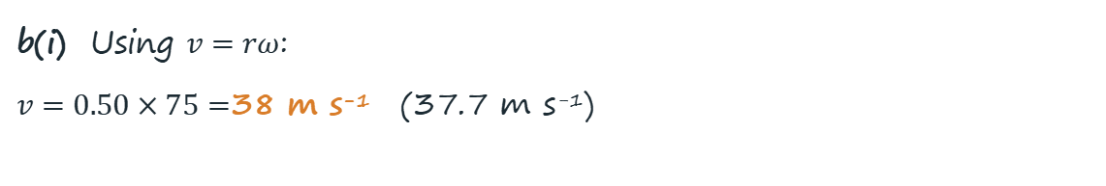
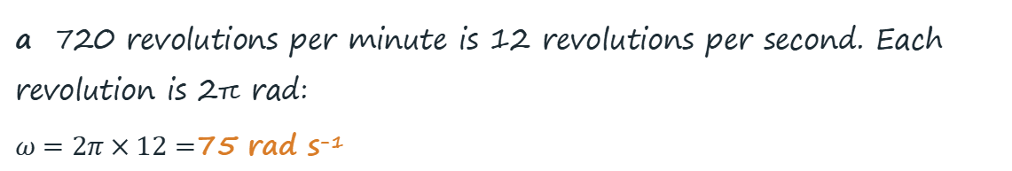
TOPIC 12 · CIE 9702 A2 PHYSICS
Worked Example 12B — Spin Dryer
例题 12B — 转速换算、线速度与向心加速度
SOLUTION 解答
WORKED EXAMPLE 12B
a 720 revolutions per minute is 12 revolutions per second. Each revolution is 2π rad:
$ω=2π×12=$75 rad s⁻¹
The drum of a spin dryer has a radius of 50 cm and rotates at 720 revolutions per minute.
a Show that the angular speed of the drum is about 75 rad s⁻¹.
b Calculate, for a point on the edge of the drum: (i) its linear speed; (ii) its acceleration towards the centre.
甩干机滚筒半径 50 cm，转速 720 转/分。
b(i) Using $v=rω$:
$v=0.50×75=$38 m s⁻¹ (37.7 m s⁻¹)
b(ii) Using $a=\frac{v^{2}}{r}$:
$a=\frac{(37.7)^{2}}{0.50}=$2800 m s⁻² (2840 m s⁻²)
Given 已知: r = 0.50 m
720 rev min⁻¹ = 12 rev s⁻¹
each revolution = 2π rad
Note 注意: convert radius to metres (cm → m) before substituting; keep unrounded values until the final step 中间结果保留更多有效数字。
Topic 12 Motion in a Circle
09 / 13
Notes:
<!--pageType:content-->

Slide 10


TOPIC 12 · CIE 9702 A2 PHYSICS
Worked Example 12C — Vertical Circle
例题 12C — 竖直圆周最高点临界速度
SOLUTION 解答
WORKED EXAMPLE 12C
Key idea 关键: water falls out if its weight exceeds the required centripetal force. At the critical (minimum) speed, gravity alone provides the centripetal force.
临界条件：重力恰好提供全部向心力。
A rope is tied to a bucket filled with water, and the bucket is swung in a vertical circle of radius 1.2 m.
What must be the minimum speed of the bucket at the highest point if the water is to stay in the bucket throughout the motion?
水桶在半径 1.2 m 的竖直圆上旋转，求最高点水不洒出的最小速度。
Set up the equation 列式:
$$\frac{mv^{2}}{r}=mg ⇒ v^{2}=gr$$
Substitute 代入: $v=\sqrt{gr}=\sqrt{9.81×1.2}$
mg
v = 3.4 m s⁻¹
Topic 12 Motion in a Circle
10 / 13
Notes:
<!--pageType:content-->

Slide 11
TOPIC 12 · CIE 9702 A2 PHYSICS
Class Practice
随堂练习 — 独立完成，答案见页底
QUESTION 1
A car is travelling along a circular path with linear speed 24 m s⁻¹ and angular speed 0.40 rad s⁻¹. What is the radius of curvature of the track?
汽车沿线速度 24 m s⁻¹、角速度 0.40 rad s⁻¹ 的圆形路径行驶，求轨道曲率半径。
QUESTION 2
A toy train moves round a circular track of diameter 0.60 m, completing one revolution in 10 s. Calculate: a the linear speed; b the angular speed; c the centripetal acceleration.
玩具火车在直径 0.60 m 的圆形轨道上每 10 s 转一圈，求线速度、角速度和向心加速度。
QUESTION 3
State how the centripetal force is provided for: a a planet orbiting the Sun; b a train on a curved track; c a passenger in a car going round a corner.
指出下列情形中向心力的来源：绕日行星、转弯的火车、转弯汽车中的乘客。
Answers: 1) r = v/ω = 24/0.40 = 60 m 2) a v = π×0.60/10 = 0.19 m s⁻¹; b ω = 2π/10 = 0.63 rad s⁻¹; c a = v²/r = 0.12 m s⁻² 3) a gravitational attraction of the Sun; b horizontal component of the normal reaction from the rails; c contact force (friction/normal) from the seat.
Topic 12 Motion in a Circle
11 / 13
Notes:
<!--pageType:content-->

Slide 12






TOPIC 12 · CIE 9702 A2 PHYSICS
Summary
小结 — 核心公式与关键概念
KEY FORMULAS 核心公式
$$θ=\frac{s}{r}$$
$$ω=\frac{2π}{T}=2πf$$
$$v=rω$$
angle in rad 弧度数 = arc ÷ radius 弧长/半径
angular speed 角速度；T 周期，f 频率，单位 rad s⁻¹
linear speed 线速度 = radius × angular speed 半径×角速度
$$a=\frac{v^{2}}{r}=rω^{2}$$
$$F=\frac{mv^{2}}{r}=mrω^{2}$$
$$v_{min}=\sqrt{gr}$$
centripetal acceleration 向心加速度，指向圆心
centripetal force 向心力 = m × a，为合外力
竖直圆最高点临界速度（重力恰供向心力）
KEY IDEAS 关键概念
Constant speed ≠ constant velocity: the direction changes, so the object accelerates towards the centre 速率不变≠速度不变，方向变化产生向心加速度。
The centripetal force is the resultant of real forces (tension, gravity, friction, normal force) — never an extra force 向心力是真实力的合力，不是额外的新力。
A force of constant magnitude, always perpendicular to motion, gives circular motion at constant angular speed 恒大力且始终垂直运动方向 ⇒ 匀角速圆周运动。
Topic 12 Motion in a Circle
12 / 13
Notes:
<!--pageType:content-->

Slide 13

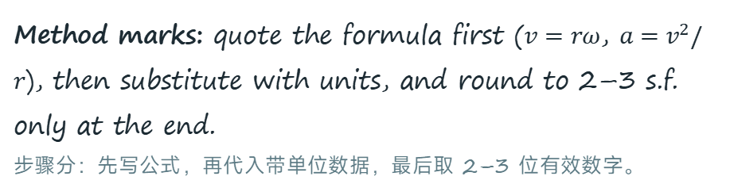
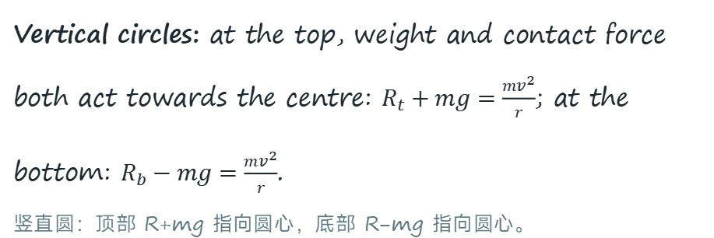
TOPIC 12 · CIE 9702 A2 PHYSICS
Exam Tips — Paper 4
备考提示 — 常见考法与易错点
Force diagrams: always draw the resultant force pointing towards the centre — never add "centripetal force" as an extra force on top of tension/gravity.
受力图：合外力指向圆心；向心力不是额外多画的力。
COMMON TRAP 易错辨析
"A satellite orbits the Earth. The forces on it are gravity plus a centripetal force pointing to the Earth's centre."
"卫星受引力和向心力两个力" — 这句话对吗？
Units: angular speed in rad s⁻¹; convert rev/min → rad/s and cm → m before substituting. Angles must be in radians, not degrees.
单位：ω 用 rad s⁻¹；先换算 rev/min、cm；角度必须用弧度。
Wrong. Gravity is the only force acting; it is the centripetal force (the resultant force towards the centre).
错误。引力是唯一存在的力，它本身就是向心力（指向圆心的合外力）。列出真实力 → 求合力 → 令其等于 mv²/r，切勿另加"向心力"。
Vertical circles: at the top, weight and contact force both act towards the centre: $R_{t}+mg=\frac{mv^{2}}{r}$; at the bottom: $R_{b}−mg=\frac{mv^{2}}{r}$.
竖直圆：顶部 R+mg 指向圆心，底部 R−mg 指向圆心。
Method marks: quote the formula first ($v=rω$, $a=v^{2}/r$), then substitute with units, and round to 2–3 s.f. only at the end.
步骤分：先写公式，再代入带单位数据，最后取 2–3 位有效数字。
$$F_{gravity}=\frac{mv^{2}}{r}$$
Topic 12 Motion in a Circle
13 / 13
Notes:
<!--pageType:content-->

