Slide 1
TOPIC 13 · A2 PHYSICS
GRAVITATIONAL
FIELDS
引力场
Field strength · Newton's law · orbits · potential
场强 · 万有引力定律 · 圆轨道 · 引力势
CIE 9702 · Paper 4 · Topic 13
Lecture Notes
Notes:
<!--pageType:cover-->

Slide 2
TOPIC 13 · CIE 9702 A2 PHYSICS
Learning Outcomes
学习目标 — 完成本主题后你应掌握的内容
13.1 Gravitational field 引力场
LEARNING
OUTCOMES
Understand a gravitational field as a field of force; define it as force per unit mass
Represent a gravitational field by means of field lines 用场线表示引力场
13.2 Gravitational force between point masses
Treat a uniform sphere as a point mass at its centre (from outside)
学习目标
Recall and use Newton's law of gravitation $F=\frac{Gm_{1}m_{2}}{r^{2}}$
Analyse circular orbits by linking gravitational and centripetal force
Understand the geostationary orbit 地球同步轨道 (24 h, equatorial, west to east)
By the end of this topic, you will be able to:
完成本主题学习后，你应能够：
13.3 Gravitational field of a point mass 点质量的场
Derive $g=\frac{GM}{r^{2}}$ from Newton's law and the definition of field
Recall and use $g=\frac{GM}{r^{2}}$
Explain why g is approximately constant near the Earth's surface
13.4 Gravitational potential 引力势
Define potential as work done per unit mass from infinity to the point
Use $φ=−\frac{GM}{r}$ for the field of a point mass
Understand potential energy of two point masses and use $E_{p}=−\frac{GMm}{r}$
Topic 13 Gravitational Fields
02 / 15
Notes:
<!--pageType:content-->

Slide 3

TOPIC 13 · CIE 9702 A2 PHYSICS
The Gravitational Field
引力场的概念 — 力场、场强定义与场线表示
A gravitational field is a region of space where a mass experiences a force. Every mass attracts every other mass.
引力场：质量在其中会受到力的空间区域；一切质量互相吸引。
radial field 放射状场
$$g=\frac{F}{m}$$
field strength = force per unit mass
unit: N kg⁻¹ (= m s⁻²) 单位
M
Field lines 场线: the arrow shows the direction of the force on a point mass 箭头即受力方向
Lines are smooth curves that never touch or cross 场线永不相交
The closer the lines, the stronger the field 场线越密，场越强
Field strength g is a vector 矢量, equal to the acceleration of free fall
Field of a point mass: lines converge on the centre 场线汇聚于质心
Topic 13 Gravitational Fields
03 / 15
Notes:
<!--pageType:content-->

Slide 4

TOPIC 13 · CIE 9702 A2 PHYSICS
Newton's Law of Gravitation
万有引力定律 — 平方反比的吸引力
Two point masses attract each other with a force proportional to the product of their masses and inversely proportional to the square of their separation.
两质点间的引力与质量乘积成正比，与间距平方成反比。
m₁
r
m₂
$$F=\frac{Gm_{1}m_{2}}{r^{2}}$$
G = 6.67 × 10⁻¹¹ N m² kg⁻²
r = separation of centres 质心间距
F
F
Valid for point masses, or spheres whose size ≪ separation 尺寸远小于间距时可视为质点
A uniform sphere acts as a point mass at its centre 均匀球体等效于质心处质点
Inverse-square 平方反比: doubling r quarters the force
Always attractive; equal and opposite on both masses 始终为吸引力
Equal and opposite attractive forces 等大反向的吸引力, r = centre-to-centre
Topic 13 Gravitational Fields
04 / 15
Notes:
<!--pageType:content-->

Slide 5
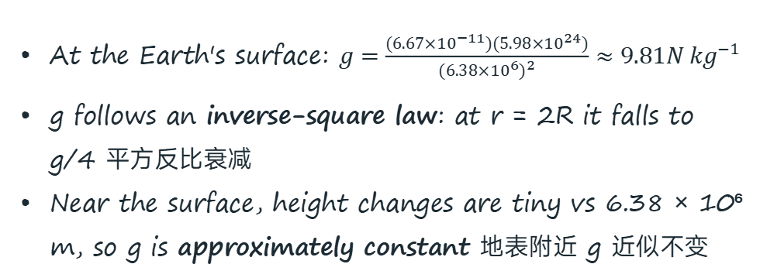

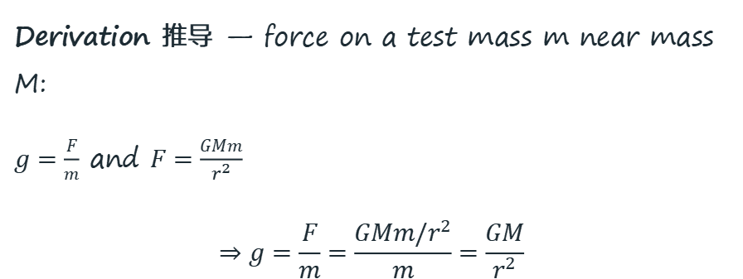
TOPIC 13 · CIE 9702 A2 PHYSICS
Field of a Point Mass: g = GM/r²
点质量的引力场强 — 由定义与万有引力定律推导
Derivation 推导 — force on a test mass m near mass M:
$g=\frac{F}{m}$ and $F=\frac{GMm}{r^{2}}$
$$⇒g=\frac{F}{m}=\frac{GMm/r^{2}}{m}=\frac{GM}{r^{2}}$$
$$g=\frac{GM}{r^{2}}$$
M = mass of the central body
r = distance from its centre 距质心
At the Earth's surface: $g=\frac{(6.67×{10}^{−11})(5.98×{10}^{24})}{(6.38×{10}^{6})^{2}}≈9.81{N kg}^{−1}$
g follows an inverse-square law: at r = 2R it falls to g/4 平方反比衰减
Near the surface, height changes are tiny vs 6.38 × 10⁶ m, so g is approximately constant 地表附近 g 近似不变
g ∝ 1/r² — field strength falls off rapidly with distance 随距离平方衰减
Topic 13 Gravitational Fields
05 / 15
Notes:
<!--pageType:content-->

Slide 6


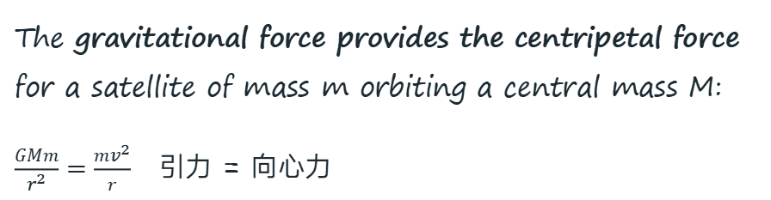
TOPIC 13 · CIE 9702 A2 PHYSICS
Circular Orbits
圆轨道分析 — 引力提供向心力
v
The gravitational force provides the centripetal force for a satellite of mass m orbiting a central mass M:
$\frac{GMm}{r^{2}}=\frac{mv^{2}}{r}$ 引力 = 向心力
r
Earth
M
F
$$v=\sqrt{\frac{GM}{r}}$$
orbital speed 轨道速度
m cancels — mass of satellite irrelevant
$$T^{2}=\frac{4π^{2}r^{3}}{GM}$$
T² ∝ r³ — Kepler's third law 开普勒第三定律
For the same central body, T²/r³ is constant 同一中心天体 T²/r³ 为定值
Closer orbits are faster and shorter-period 轨道越低，速度越大、周期越短
The satellite is continuously accelerating — not in equilibrium 卫星持续加速，并非平衡态
v is tangential 切向; F points to the centre 指向圆心
Topic 13 Gravitational Fields
06 / 15
Notes:
<!--pageType:content-->

Slide 7
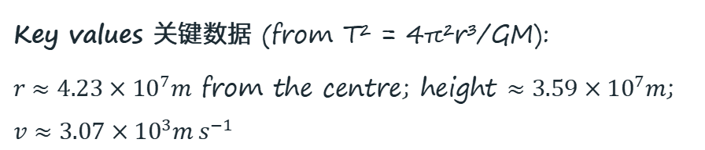
TOPIC 13 · CIE 9702 A2 PHYSICS
The Geostationary Orbit
地球同步轨道 — 通信卫星的"定点"轨道
A geostationary satellite remains above the same point on the Earth's surface. It must have:
period T = 24 h, same as the Earth's rotation 周期与地球自转相同
orbit directly above the Equator 轨道在赤道正上方
motion west to east, same direction as the Earth 自西向东
so it appears stationary from the ground 相对地面静止
T = 24 h · west → east
v
r
Equator
赤道
Key values 关键数据 (from T² = 4π²r³/GM):
$r≈4.23×{10}^{7}m$ from the centre; height $≈3.59×{10}^{7}m$; $v≈3.07×{10}^{3}{m s}^{−1}$
Uses 应用: communication and TV relay satellites — ground dishes can point in a fixed direction 天线可固定指向.
Equatorial orbit; satellite fixed above one ground point 定点于赤道上空
Topic 13 Gravitational Fields
07 / 15
Notes:
<!--pageType:content-->

Slide 8
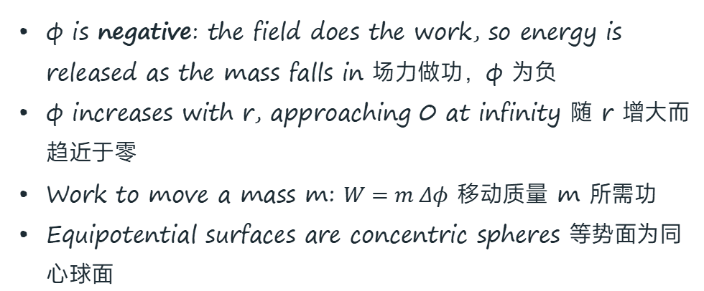

TOPIC 13 · CIE 9702 A2 PHYSICS
Gravitational Potential
引力势 — 从无穷远移动单位质量所做的功
The gravitational potential φ at a point is the work done per unit mass in bringing a small test mass from infinity to that point. Unit: J kg⁻¹.
引力势：把单位质量从无穷远移到该点所做的功。
equipotentials 等势面 (dashed)
M
∞, φ = 0
P
$$φ=−\frac{GM}{r}$$
zero of potential at infinity
无穷远处 φ = 0
m moved in from ∞ 移入
φ is negative: the field does the work, so energy is released as the mass falls in 场力做功，φ 为负
φ increases with r, approaching 0 at infinity 随 r 增大而趋近于零
Work to move a mass m: $W=m Δφ$ 移动质量 m 所需功
Equipotential surfaces are concentric spheres 等势面为同心球面
r
The field does work as m moves in, so φ(P) < 0 场力做功，φ 为负
Topic 13 Gravitational Fields
08 / 15
Notes:
<!--pageType:content-->

Slide 9

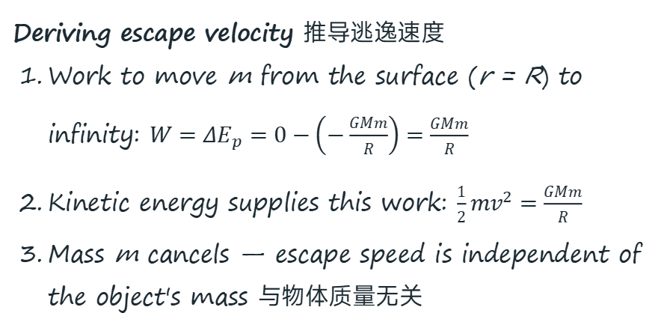

TOPIC 13 · CIE 9702 A2 PHYSICS
Potential Energy & Escape Velocity
引力势能与逃逸速度 — 从地表挣脱引力束缚所需的最小速度
$$E_{p}=mφ=−\frac{GMm}{r}$$
m = test mass 质量
r = centre distance 质心距
Deriving escape velocity 推导逃逸速度
Work to move m from the surface (r = R) to infinity: $W=ΔE_{p}=0−\left(−\frac{GMm}{R}\right)=\frac{GMm}{R}$
Kinetic energy supplies this work: $\frac{1}{2}mv^{2}=\frac{GMm}{R}$
Mass m cancels — escape speed is independent of the object's mass 与物体质量无关
$$v_{esc}=\sqrt{\frac{2GM}{R}}$$
Earth 地球:
v ≈ 11.2 km s⁻¹
Both φ and Ep are negative and rise towards 0 as r → ∞ 均为负值并随 r 增大趋于零
Topic 13 Gravitational Fields
09 / 15
Notes:
<!--pageType:content-->

Slide 10
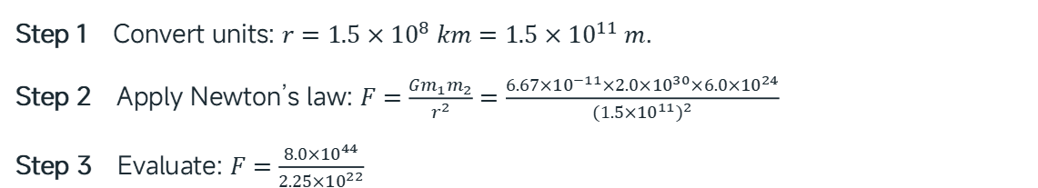
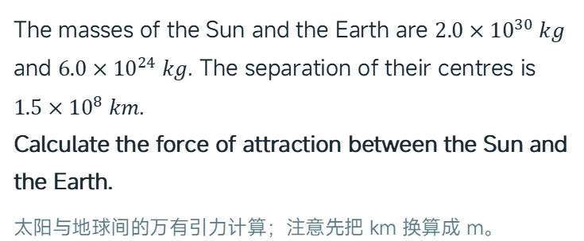
TOPIC 13 · CIE 9702 A2 PHYSICS
Worked Example 13A
例题解析
WORKED EXAMPLE 13A
SOLUTION 解答
The masses of the Sun and the Earth are $2.0×{10}^{30} kg$ and $6.0×{10}^{24} kg$. The separation of their centres is $1.5×{10}^{8} km$.
Calculate the force of attraction between the Sun and the Earth.
太阳与地球间的万有引力计算；注意先把 km 换算成 m。
Step 1 Convert units: $r=1.5×{10}^{8} km=1.5×{10}^{11} m$.
Step 2 Apply Newton’s law: $F=\frac{Gm_{1}m_{2}}{r^{2}}=\frac{6.67×{10}^{−11}×2.0×{10}^{30}×6.0×{10}^{24}}{(1.5×{10}^{11})^{2}}$
Step 3 Evaluate: $F=\frac{8.0×{10}^{44}}{2.25×{10}^{22}}$
Answer $F≈3.6×{10}^{22} N$
Topic 13 Gravitational Fields
10 / 15
Notes:
<!--pageType:content-->

Slide 11
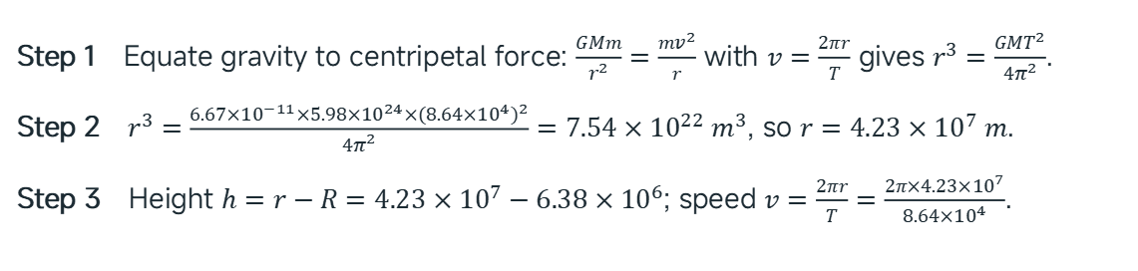

TOPIC 13 · CIE 9702 A2 PHYSICS
Worked Example 13B
例题解析
WORKED EXAMPLE 13B
SOLUTION 解答
For a geostationary satellite, calculate: (a) the height above the Earth’s surface; (b) the speed in orbit.
(Radius of Earth $R=6.38×{10}^{6} m$; mass of Earth $M=5.98×{10}^{24} kg$; period $T=24 h=8.64×{10}^{4} s$.)
同步卫星高度与速度；r 是到地心的距离，高度要减去地球半径。
Step 1 Equate gravity to centripetal force: $\frac{GMm}{r^{2}}=\frac{mv^{2}}{r}$ with $v=\frac{2πr}{T}$ gives $r^{3}=\frac{GMT^{2}}{4π^{2}}$.
Step 2 $r^{3}=\frac{6.67×{10}^{−11}×5.98×{10}^{24}×(8.64×{10}^{4})^{2}}{4π^{2}}=7.54×{10}^{22} m^{3}$, so $r=4.23×{10}^{7} m$.
Step 3 Height $h=r−R=4.23×{10}^{7}−6.38×{10}^{6}$; speed $v=\frac{2πr}{T}=\frac{2π×4.23×{10}^{7}}{8.64×{10}^{4}}$.
Answer (a) $h≈3.6×{10}^{7} m$ (b) $v≈3.1×{10}^{3} {m s}^{−1}$
Topic 13 Gravitational Fields
11 / 15
Notes:
<!--pageType:content-->

Slide 12
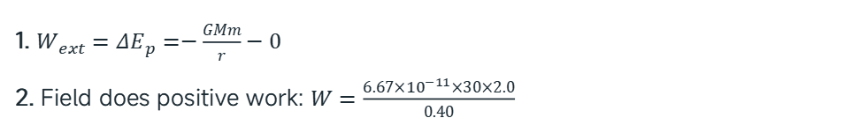
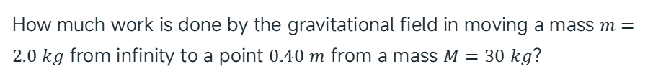
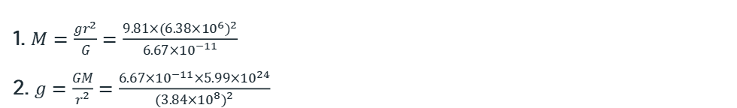
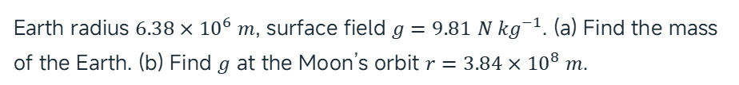
TOPIC 13 · CIE 9702 A2 PHYSICS
Worked Examples 13C & 13D
例题解析
WORKED EXAMPLE 13C
WORKED EXAMPLE 13D
Earth radius $6.38×{10}^{6} m$, surface field $g=9.81 {N kg}^{−1}$. (a) Find the mass of the Earth. (b) Find $g$ at the Moon’s orbit $r=3.84×{10}^{8} m$.
How much work is done by the gravitational field in moving a mass $m=2.0 kg$ from infinity to a point $0.40 m$ from a mass $M=30 kg$?
1. $M=\frac{gr^{2}}{G}=\frac{9.81×(6.38×{10}^{6})^{2}}{6.67×{10}^{−11}}$
2. $g=\frac{GM}{r^{2}}=\frac{6.67×{10}^{−11}×5.99×{10}^{24}}{(3.84×{10}^{8})^{2}}$
1. $W_{ext}=ΔE_{p}=−\frac{GMm}{r}−0$
2. Field does positive work: $W=\frac{6.67×{10}^{−11}×30×2.0}{0.40}$
Answer (a) $5.99×{10}^{24} kg$ (b) $2.7×{10}^{−3} {N kg}^{−1}$
Answer $W=1.0×{10}^{−8} J$
Topic 13 Gravitational Fields
12 / 15
Notes:
<!--pageType:content-->

Slide 13
TOPIC 13 · CIE 9702 A2 PHYSICS
Class Practice
随堂练习
Q1
Pluto has mass $1.2×{10}^{22} kg$ and the Sun has mass $2.0×{10}^{30} kg$. Calculate the force of attraction between them when their separation is $5.9×{10}^{9} km$.
Q2
A meteorite of mass 220 kg falls from rest at infinity to the Earth’s surface ($M=6.0×{10}^{24} kg$, $R=6.4×{10}^{6} m$). Calculate (a) its change in gravitational potential energy; (b) the speed at which it strikes the Earth.
Q3
Explain why gravitational potential $φ$ is negative everywhere, and what the zero of potential is. 为什么引力势处处为负？
Answers Q1 $4.6×{10}^{16} N$ Q2 (a) $−1.4×{10}^{10} J$ (b) $1.1×{10}^{4} {m s}^{−1}$ Q3 potential is defined zero at infinity; the field does positive work pulling mass in, so potential decreases below zero.
Topic 13 Gravitational Fields
13 / 15
Notes:
<!--pageType:content-->

Slide 14








TOPIC 13 · CIE 9702 A2 PHYSICS
Summary
本章小结
KEY FORMULAS 核心公式
$$g=\frac{F}{m}$$
$$F=\frac{Gm_{1}m_{2}}{r^{2}}$$
$$g=\frac{GM}{r^{2}}$$
field strength 场强定义
Newton’s law 万有引力
point mass 点质量场强
$$v=\sqrt{\frac{GM}{r}}$$
$$T^{2}=\frac{4π^{2}r^{3}}{GM}$$
$$φ=−\frac{GM}{r}$$
orbital speed 轨道速度
orbital period 轨道周期
potential 引力势
$$E_{p}=−\frac{GMm}{r}$$
$$v_{esc}=\sqrt{\frac{2GM}{R}}$$
potential energy 引力势能
escape velocity 逃逸速度
KEY IDEAS 核心思想
• A gravitational field is a region where a mass experiences a force; field strength is force per unit mass. 场强=单位质量受力。
• Gravity provides the centripetal force for orbits — this links Topics 12 & 13. 引力充当向心力是轨道问题的核心。
• Potential and potential energy are negative because zero is set at infinity. 无穷远为零点 ⇒ 势能处处为负。
Topic 13 Gravitational Fields
14 / 15
Notes:
<!--pageType:content-->

Slide 15
TOPIC 13 · CIE 9702 A2 PHYSICS
Exam Tips
备考提示
Use the centre-to-centre distance r, not the height above the surface — the most common loss of marks. 用质心间距而非高度。
State that gravity provides the centripetal force before writing $\frac{GMm}{r^{2}}=\frac{mv^{2}}{r}$ — this earns the first mark. 先写"引力提供向心力"。
Negative sign: $φ$ and $E_{p}$ are negative; work done by the field bringing mass in from infinity is positive. 分清"场做功"与"外力做功"符号。
Convert all units to SI: km → m, hours → s. Quote $G=6.67×{10}^{−11} {N m}^{2} {kg}^{−2}$ from the data sheet. 统一 SI 单位。
Geostationary answers need all four conditions: 24 h period, above the Equator, west to east, same point above ground. 同步轨道条件要写全。
Topic 13 Gravitational Fields
15 / 15
Notes:
<!--pageType:content-->

