Slide 1
₿
Optimizing Prompts for Extracting
Bitcoin Price Predictions
from News Articles
Bingrui Yang · John Kim · Milo Stern
Occidental College

Slide 2
MOTIVATION
Noisy Signals
24/7, Ever-Changing Format
Bitcoin is one of the most volatile assets in the world
Trader base is younger, more informal language + platforms
Emerging support technologies adapt quickly
No markets–never closes
Decentralized and scheduled events by design
Updates can happen in hidden places
Our Goal
Why Prompt Optimization
Use news articles as a proxy for information stream
Utilize prompt optimization to extract features
Use an author as a case study to examine feasibility
Data is costly to harvest and label
As a result, fine tuning became unrealistic
Allows model comparison without changing weights
Motivation

Slide 3
RESEARCH QUESTIONS
Q1
Does GEPA produce prompts that improve structured extraction of forward-looking Bitcoin sentiment compared to the shared seed prompt?
Q2
Which model best recovers human-labeled direction and confidence on the held-out Bitcoin news test set using its optimized prompt?
Pipeline: GEPA optimization → Cross-model test evaluation → QWK agreement analysis → Author-level trust demo
Research Questions

Slide 4
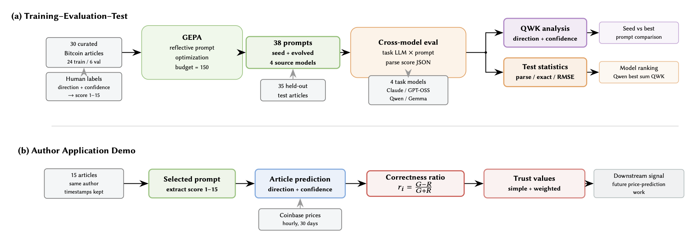

PIPELINE OVERVIEW
Pipeline

Slide 5
DATA & SCORING SYSTEM
24
6
35
15
Train
Validation
Test
Author
GEPA optimization
Prompt selection
Final evaluation
Trust demo
Unified 1–15 Score: s = Δ + c (Developed for GEPA)
Direction
Offset (Δ)
Confidence (c)
Score Range
Bearish −1
0
1 – 5
1 – 5
Neutral 0
5
1 – 5
6 – 10
Bullish +1
10
1 – 5
11 – 15
Data & Scoring

Slide 6
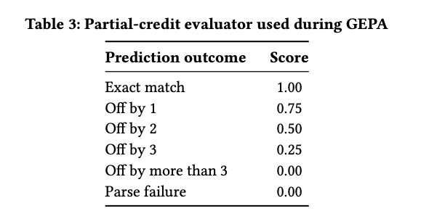
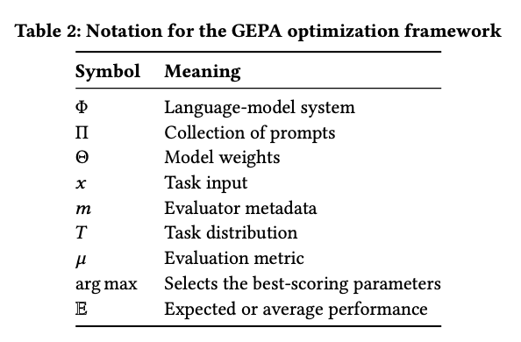
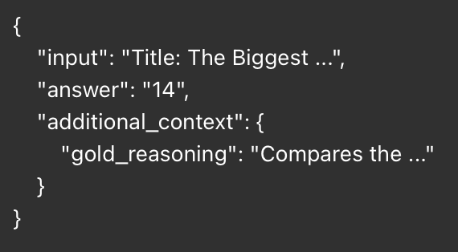
GEPA: Genetic-Pareto - a prompt optimizer that thoroughly incorporates natural language reflection to learn high-level rules from trial and error.
01
Limitation - Metric
Partial credit based on absolute distances on the 1-15 scale
Issue: 9 -> 11 only moves by 2 points, but crosses a clear theoretical boundary of neutral to bullish
Future: Use an evaluation metric that gives little to 0 credit for boundary violations

Slide 7
GEPA OPTIMIZATION METHOD - KEY TERMS
Rollout: Running one candidate prompt on one or more training articles to see what score the task model predicts.
Budget: The maximum number of evaluator calls GEPA is allowed to spend during optimization. (In our case, set to 150)
Iteration: One GEPA loop where it selects existing prompt candidate(s), proposes a new prompt, tests it, and either keeps or discards it.
Candidate: One specific prompt version being tested by GEPA.
Pareto Frontier: The filtered set of prompts that are useful because each one is best or competitive on at least some examples, instead of only keeping the single best average prompt.
Mutate: Creating a new prompt by reflecting on one existing prompt’s mistakes and rewriting it.
Merge: Creating a new prompt by combining useful parts from two existing prompts.
Minibatch: A small sampled group of training articles used to quickly test whether a new prompt seems promising.
Evaluator: The scoring function that compares the model’s predicted score with the human gold score and returns partial credit plus feedback (In our case, the metric shown before) .
Feedback: The text generated by the evaluator that explains whether the prediction was correct, too bullish, too bearish, or failed to parse, and including human reasoning.
Task Model: The LLM that actually reads the Bitcoin article and outputs {"score": ...}.
Reflection Model: The LLM that reads feedback and writes a revised prompt.
(In our case, task and reflection model are the same)
Method

Slide 8
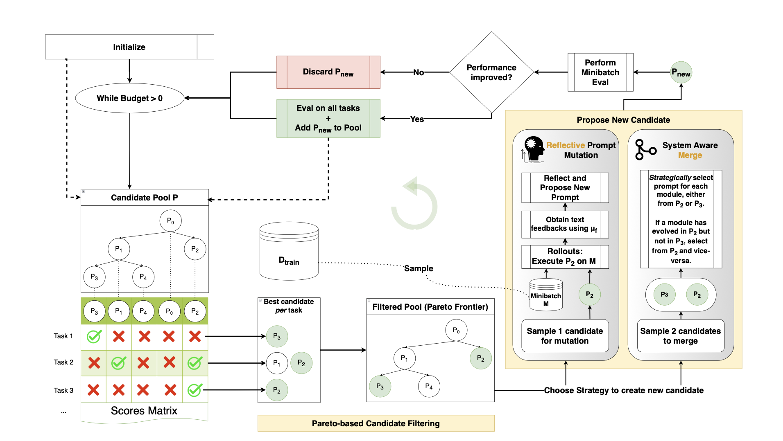
GEPA OPTIMIZATION METHOD
Method

Slide 9
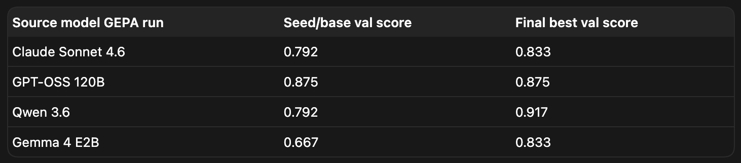
STAGE 1 — GEPA RESULTS
Source Model
Candidates
Accepted
#Words for best prompt
Growth
Claude Sonnet 4.6
11
10
615
6.68×
GPT-OSS 120B
7
6
92 (seed)
1.00×
Qwen 3.6
11
10
714
7.76×
Gemma 4 E2B
9
8
259
2.82×
Total
38
34
—
—
3 of 4
GPT-OSS
38 total
models grew prompts significantly (1.0×–7.76×)
selected its own seed as best
prompt candidates across 65 optimization iterations
Stage 1 Results

Slide 10
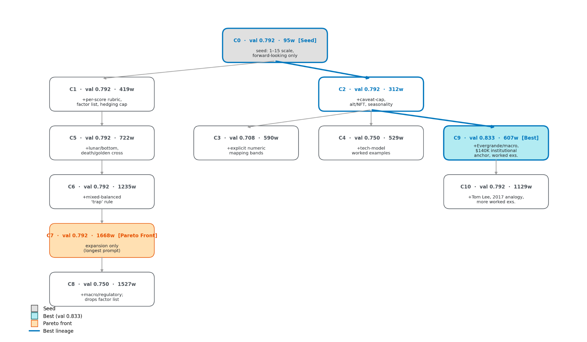
STAGE 1 — GEPA PROMPT EVOLUTION TREE for CLAUDE SONNET 4.6
Evolution Tree

Slide 11
STAGE 2 — TEST EVALUATION (35 held-out articles)
Task Model
Parse Rate
Exact Acc. (on all prompt candidates)
Direction Acc. (on all prompt candidates)
RMSE
Claude Sonnet 4.6 (1330 preds)
81.3%
13%
65.5%
2.17
GPT-OSS 120B (1330 preds)
99.6%
22.3%
77%
2.85
Qwen 3.6 (805 preds)
82.2%
24.6%
76.0%
2.82
Gemma 4 E2B (1330 preds)
100%
23.6%
67.2%
3.57
Limitation - Mechanical Failures
02
03
Limitation - Mechanical Failures
Dataset Size
Reasoning models like Claude sometimes returned step-by-step reasoning before expected output
Our scripts can only handle {"score": <integer>} when running comparisons
Qwen had timeout issues with longer prompts
Some calls hit 700-second timeouts; the run was killed after 22 hours.
Reasoning models like Claude sometimes returned step-by-step reasoning before expected output
Our scripts can only handle {"score": <integer>} when running comparisons
Qwen had timeout issues with longer prompts
Some calls hit 700-second timeouts; the run was killed after 22 hours.
Only 24 training and 6 validation articles were used for GEPA
Validation accuracy looked high: 83.3% for 3 models
Test exact accuracy was much lower: 13–24.7%
This suggests overfitting; the seed prompt often beat the GEPA-best prompt on the held-out test set
Stage 2
Stage 2

Slide 12
Stage 3 - Quadratic Weighted Kappa - a more comprehensive analysis
QWK measures agreement between two raters on an ordered scale while accounting for agreement that could happen by chance. It penalizes larger disagreements more heavily than small ones, so predicting confidence 3 instead of 4 is treated as much less severe than predicting 1 instead of 4.
RMSE: average size of numeric prediction errors in the original score units, with bigger errors penalized more because errors are squared.
QWK: measures agreement on an ordered rating scale relative to chance agreement.
RMSE answers “how far off are the predictions?”
QWK answers “how well do predictions agree with gold labels, accounting for label distribution and chance?”
We are doing QWK respectively to “direction” and “confidence”, then sum them together.

Slide 13
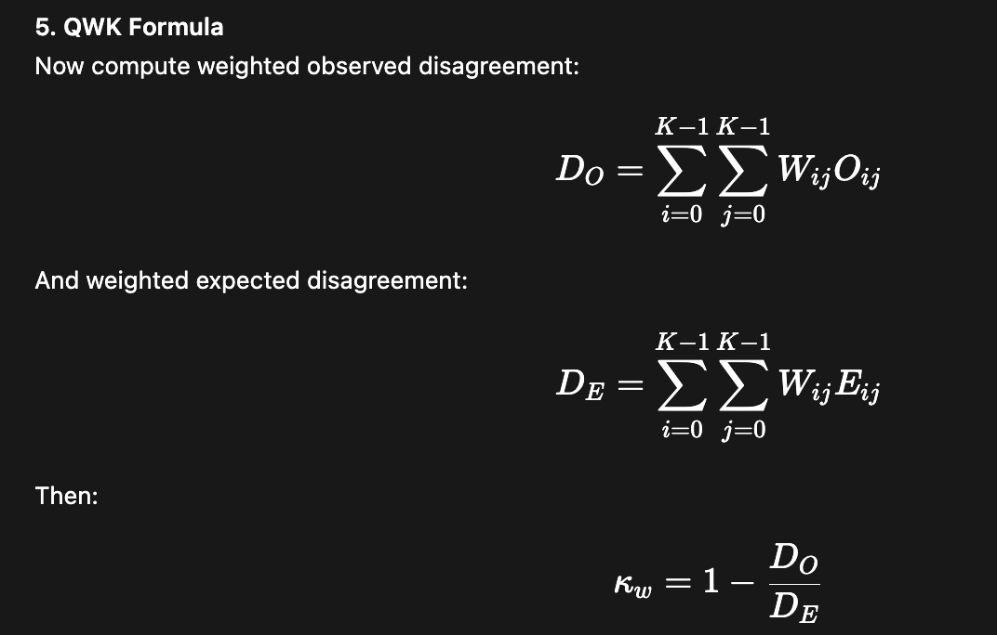
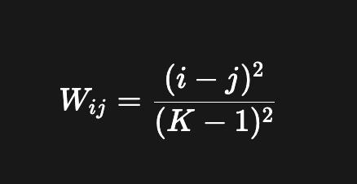
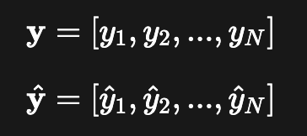
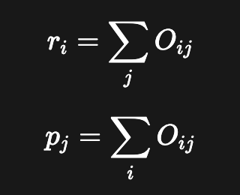
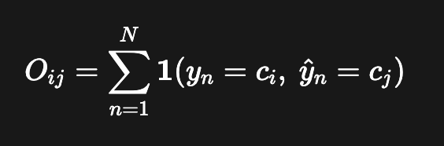
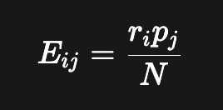
Stage 3 - Quadratic Weighted Kappa - a more comprehensive analysis
Predictions and labels are combined linearly as a vector across articles
3. Build a weight matrix
4. Expected Matrix - estimates what the confusion matrix would look like under chance agreement, while preserving the gold and prediction label distributions.
First compute row and column totals:
Then:
2. Build a confusion matrix

Slide 14
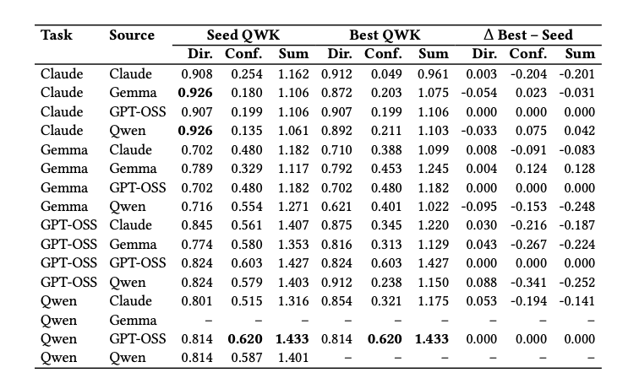
QWK — SEED VS GEPA-BEST PROMPT
QWK Seed vs Best

Slide 15
QWK — SEED VS GEPA-BEST PROMPT
2 / 14
4 / 14
8 / 14
Improved
Unchanged
Declined
Combined QWK (Direction + Confidence) — 14 comparisons with both seed & best available
Key Pattern: Direction–Confidence Tradeoff
GEPA prompts often improved direction QWK while hurting confidence QWK.
Example: GPT-OSS + Qwen prompt → Dir +0.088 but Conf −0.341 (sum −0.252)
1.433 best sum
+0.128 Δ
−0.252 Δ worst
Qwen task + GPT-OSS seed
Gemma task + Gemma source
GPT-OSS + Qwen prompt
QWK Seed vs Best

Slide 16
QWK — OVERALL MODEL PERFORMANCE
Direction QWK
Confidence QWK
Claude 4.6
0.873
Claude 4.6
0.137
Gemma E2B
0.636
Gemma E2B
0.338
GPT-OSS 120B
0.792
GPT-OSS 120B
0.270
Qwen 3.6
0.794
Qwen 3.6
0.385
0.385
0.0
0.2
0.4
0.6
0.8
1.0
0.0
0.1
0.2
0.3
0.4
Qwen 3.6 wins combined QWK (1.178) — best confidence (0.385) + competitive direction (0.794)
Claude leads direction (0.873) but low confidence (0.137) — alignment compresses scores toward band center
Gemma: perfect parse coverage but lowest combined QWK — formatting ≠ label agreement
QWK Per Model

Slide 17
DISCUSSION
Why Qwen Won
Why Claude Compressed Confidence
Qwen's reasoning-oriented design (thinking budget, explicit chain-of-thought) helps track multiple evidence pieces to produce graded confidence scores.
Heavy post-training for safety & alignment makes Claude conservative around hedged financial language, compressing scores toward the middle of each band.
Discussion

Slide 18
Did it work?
Can the system measurably predict Bitcoin prices?
Evolution Tree

Slide 19
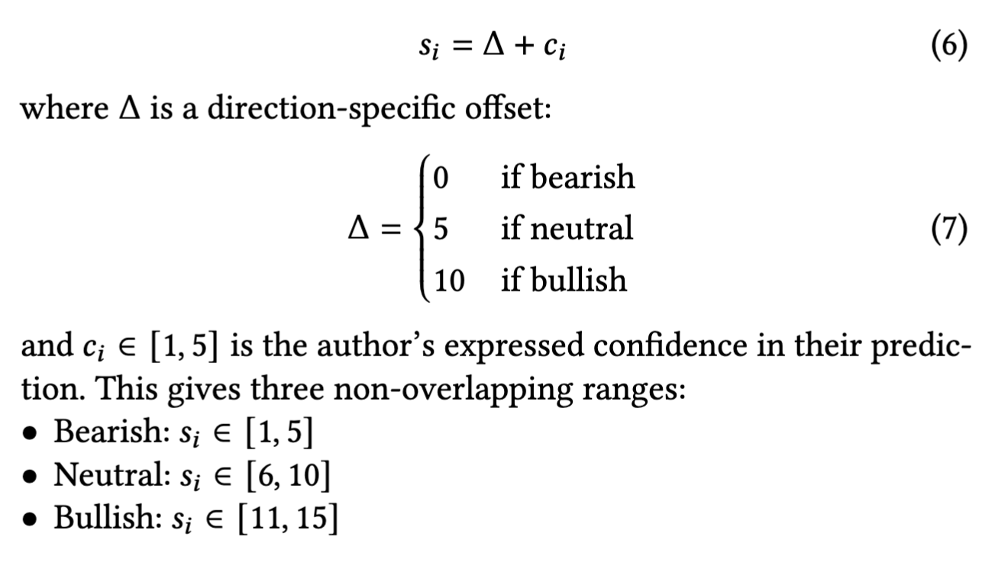
AUTHOR TRUSTWORTHINESS — METHOD
15 Articles
(same author)
Qwen + GEPA
Prompt → Score
Coinbase API
hourly prices 30d
Ratio Calculations
(Green vs Red)
Trust Score
τ_simple & τ_weighted
→
→
→
→
Author Method

Slide 20
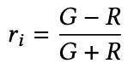
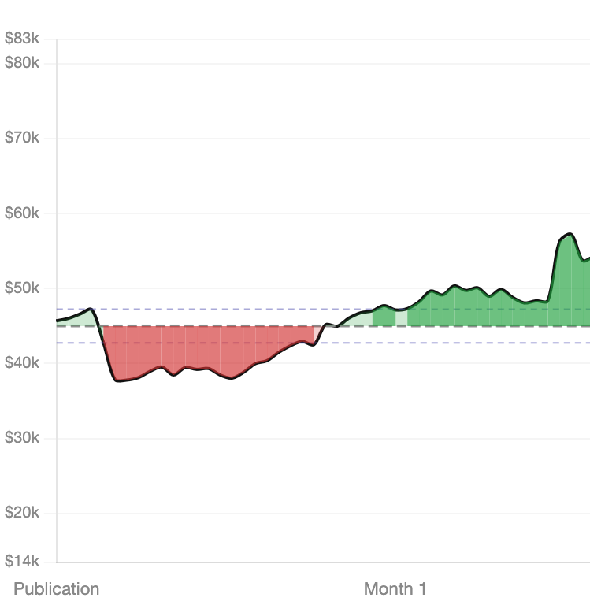
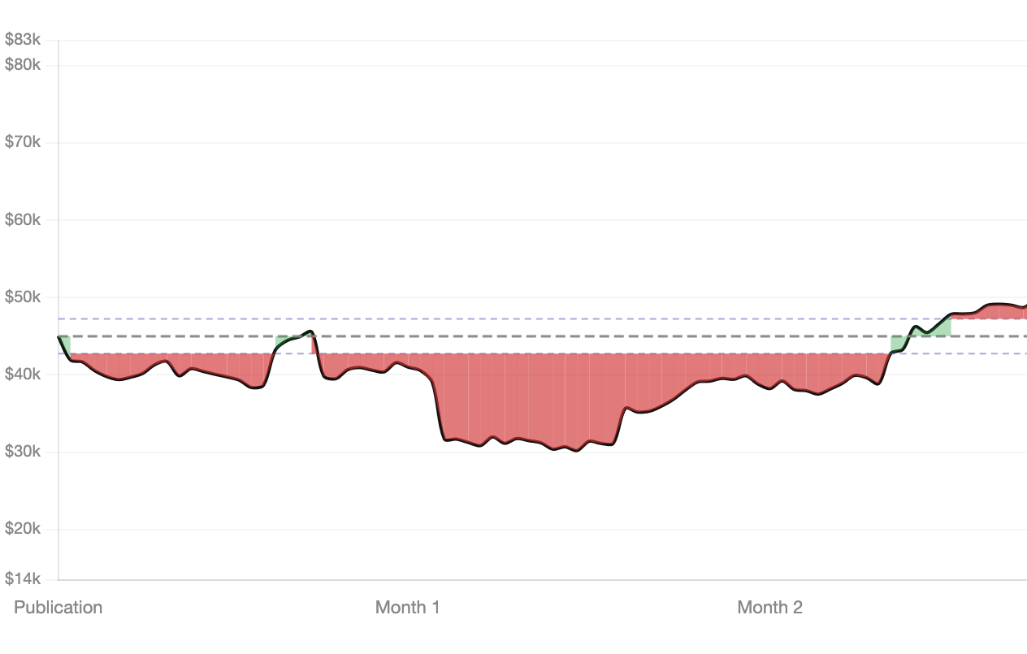
AUTHOR TRUSTWORTHINESS — METHOD
Author Method

Slide 21
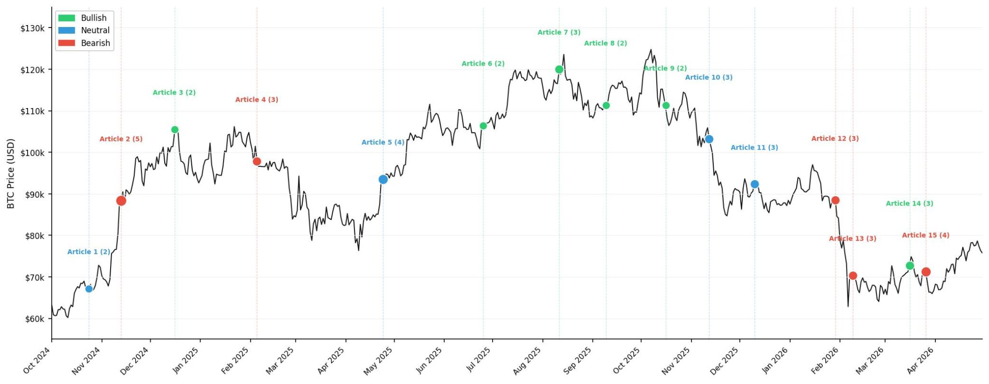
AUTHOR RESULTS — the Timeline
PnL & BTC Movement

Slide 22
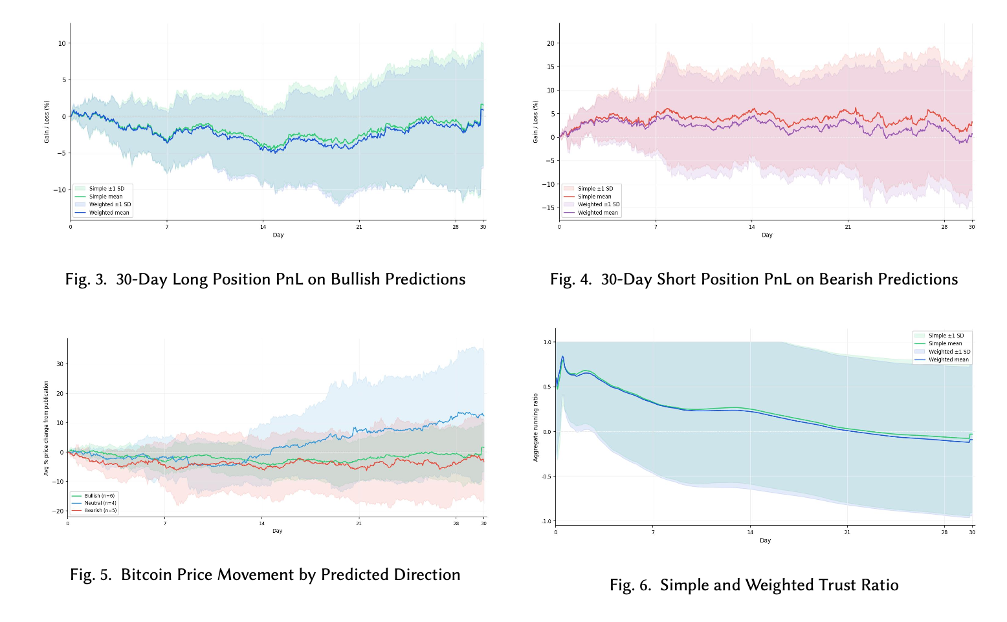
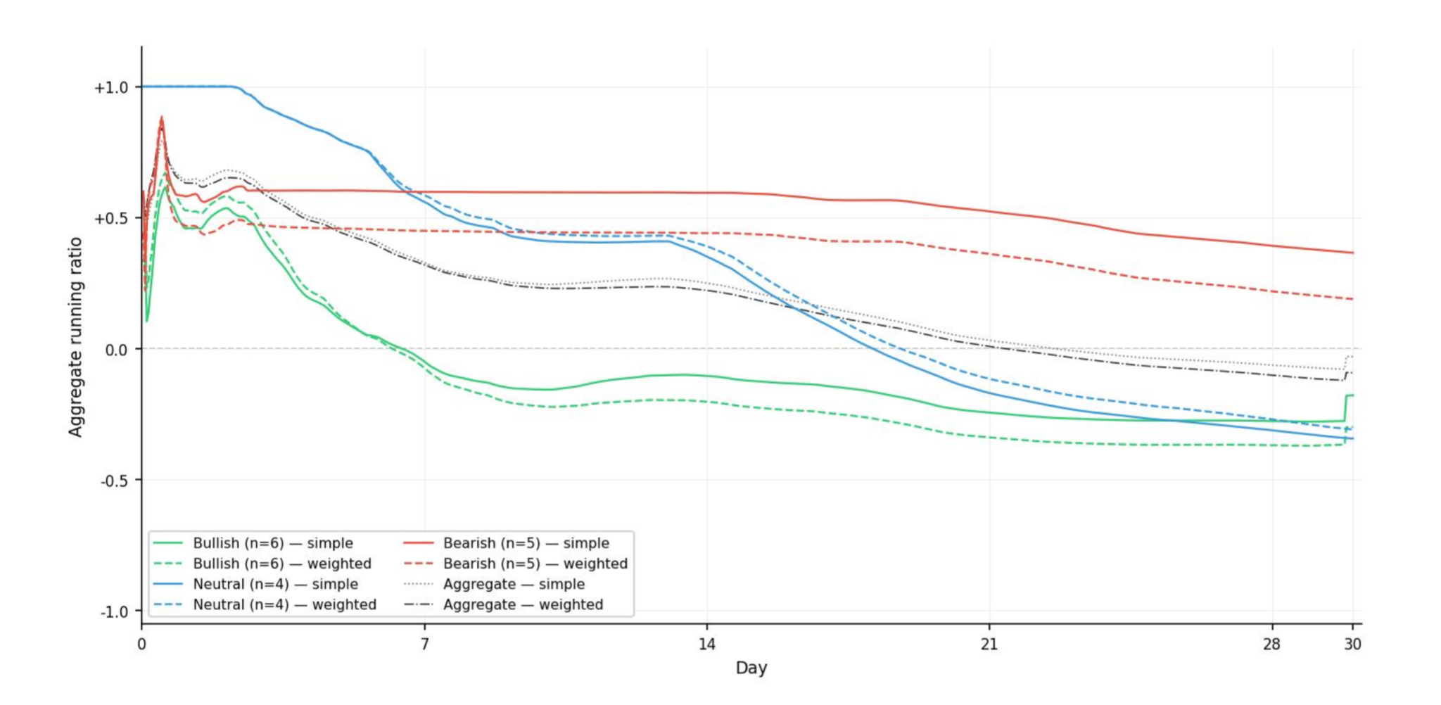
AUTHOR RESULTS — Figs 3–6 from Paper
Alice
Bob
Carlie
Dimitri.

Slide 23
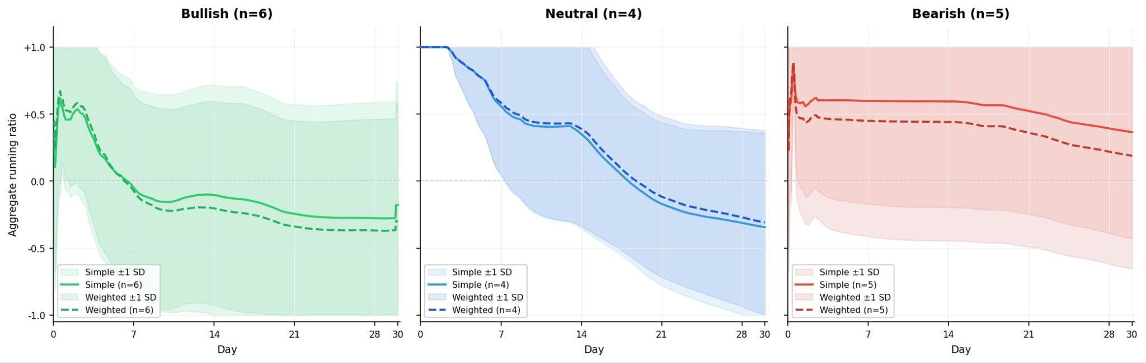
Aggregate
Dimitri.

Slide 24
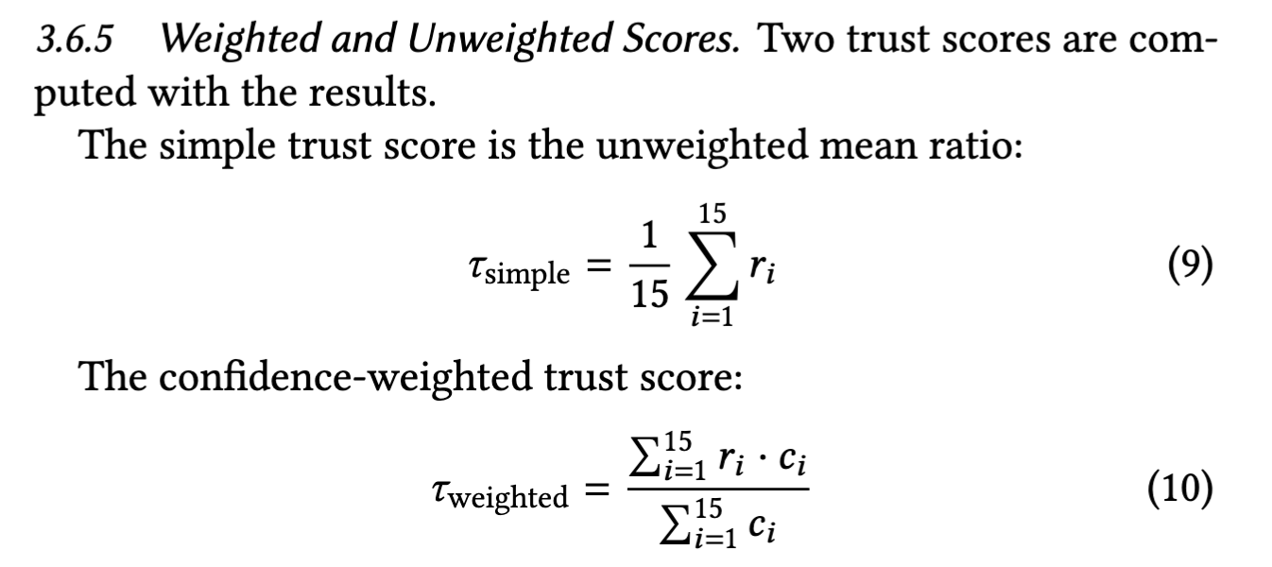

Slide 25
AUTHOR RESULTS — Figs 3–6 from Paper
Alice
Bob
Carlie
Dimitri.

Slide 26
CONCLUSION
₿
Q1
Mixed — GEPA generated richer domain-specific prompts, but GEPA-best did not consistently beat the seed on test QWK.
Q2
Qwen 3.6 wins overall — best confidence calibration (0.385) + competitive direction (0.794) = highest combined QWK (1.178).
Future Work
Larger, more diverse labeled dataset
Direction-aware training metric (penalize boundary crossings)
Expand author trust analysis across more authors, time windows & market conditions
Conclusion

