Slide 1
Help employers analyze workplace equity data
Team -White_House-2540
Presenters:
Shih-Chieh Lee, Jiangyuan Lin, Yihan Wang, Bingxian Chen

Slide 2
Dimensions
Diversity by Occupational Level
Designated Group Diversity
Intersectionality:
Diversity Varies in Industry <- Representation Rate

Slide 3


Slide 4
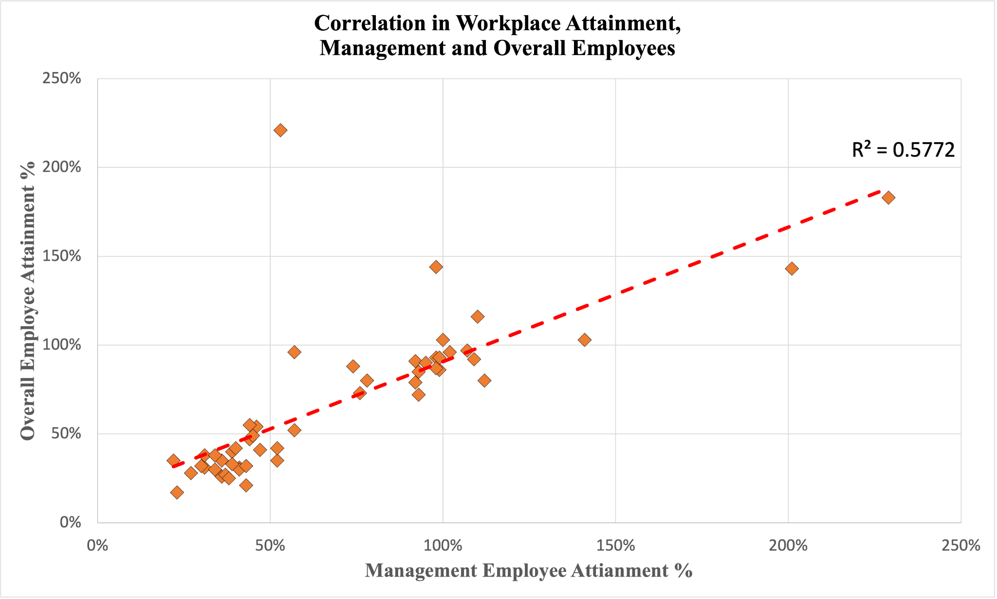
Attainment Rate Analysis-Comparison with Overall Census
Management vs. Overall
Moderate Correlation
Positive Association

Slide 5
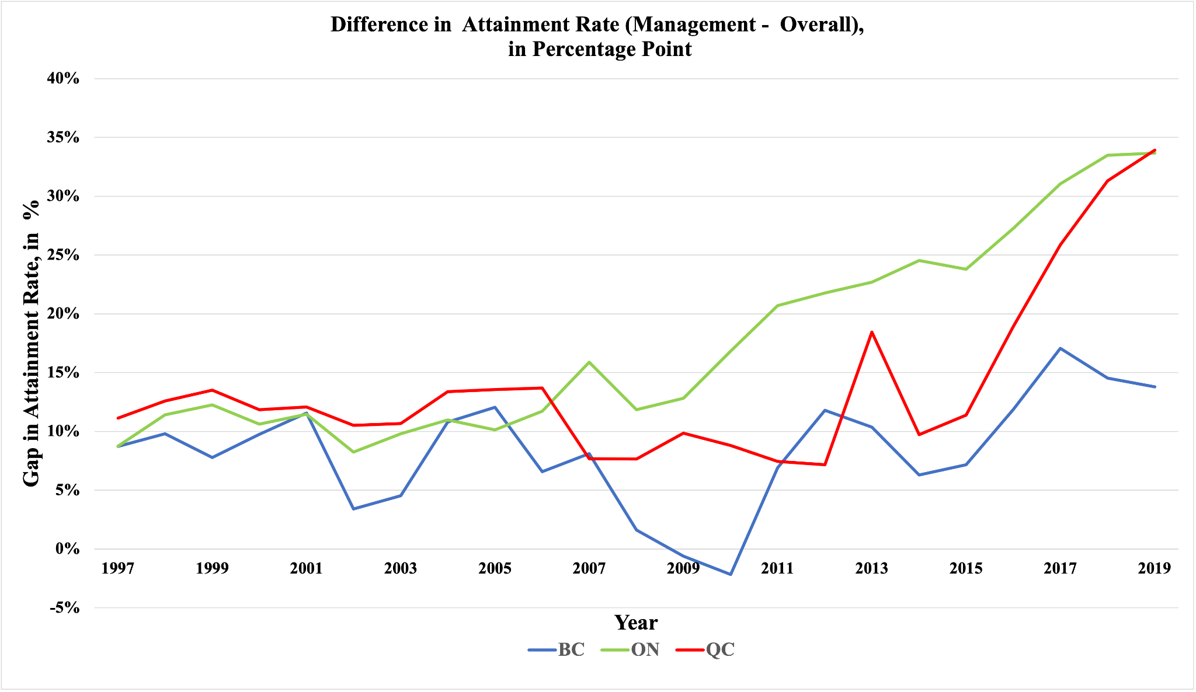
Difference in Attainment rate
Location <- BC, ON, QC
Difference Increasing Trend

Slide 6


Slide 7
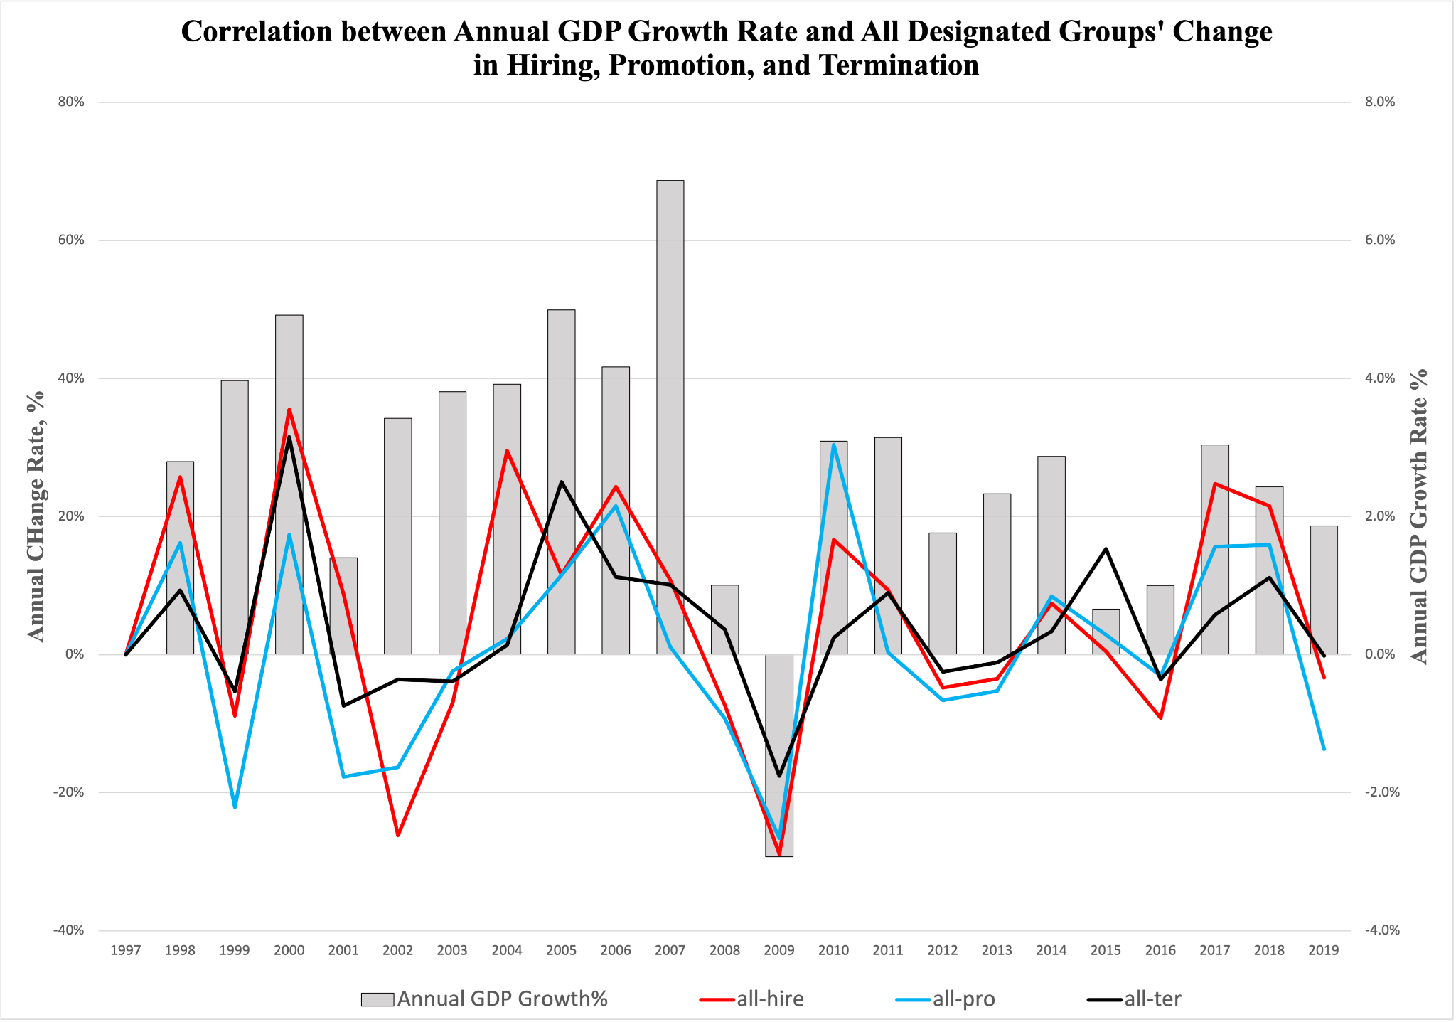
GDP Growth Rate and All Designed Groups’ Association
Hiring
Promotion
Termination
Correlation: Medium to Strong
However, Simpson’s Paradox

Slide 8
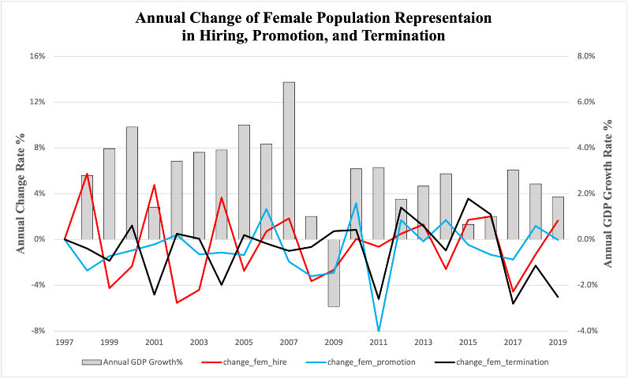
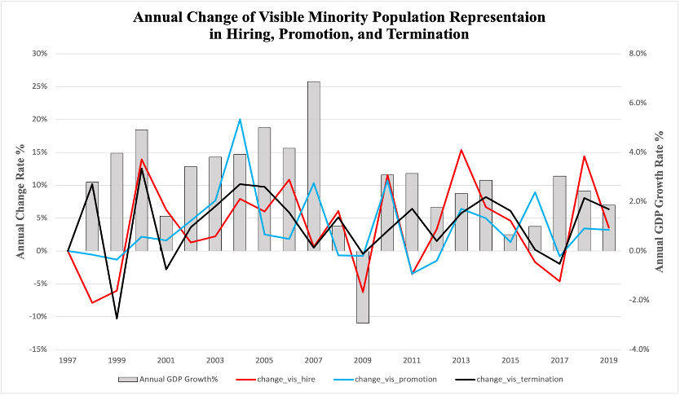
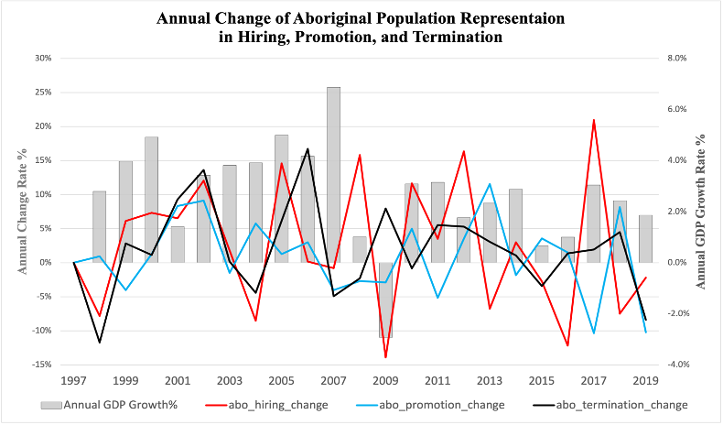
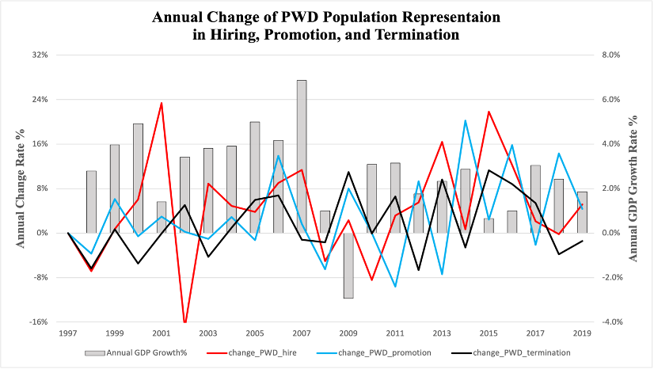
Analysis by Individual Designated Groups

Slide 9
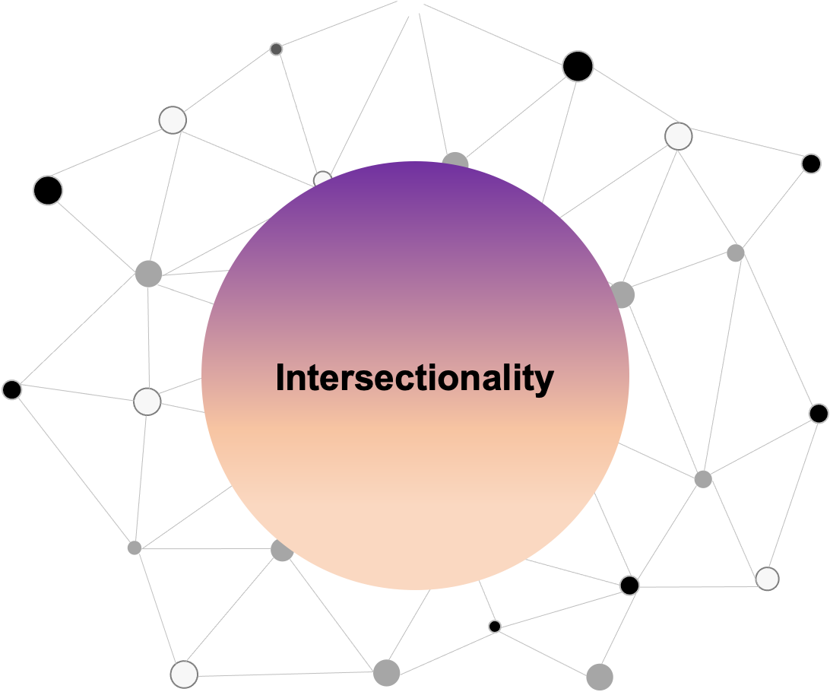

Slide 10
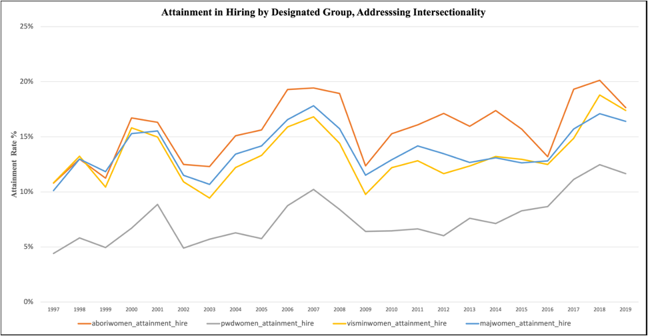
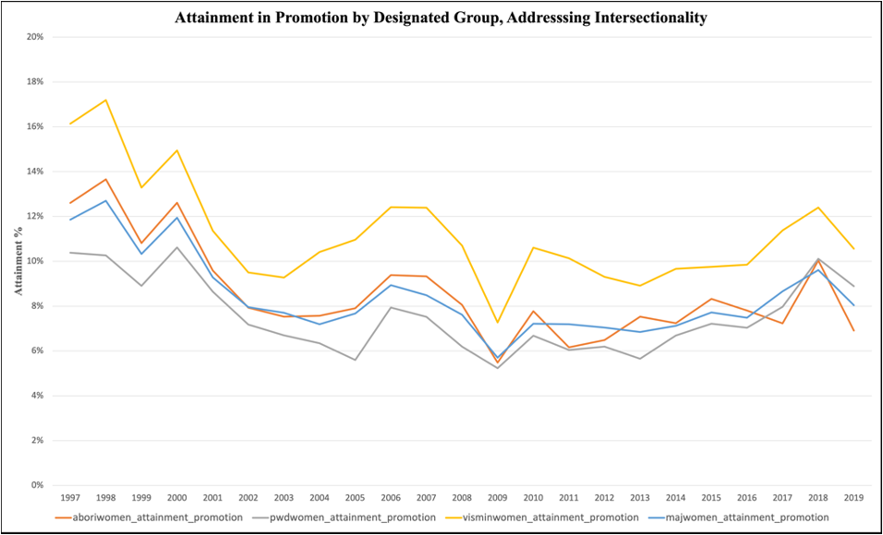
Attainment Rate Analysis-Designed Group
Hiring <- Mostly Increasing Trend
Aboriginal <- Highest
PWD <- Lowest
Promotion <- Decreasing Trend
Visible Minority <- Highest
PWD <- Lowest

Slide 11


Slide 12
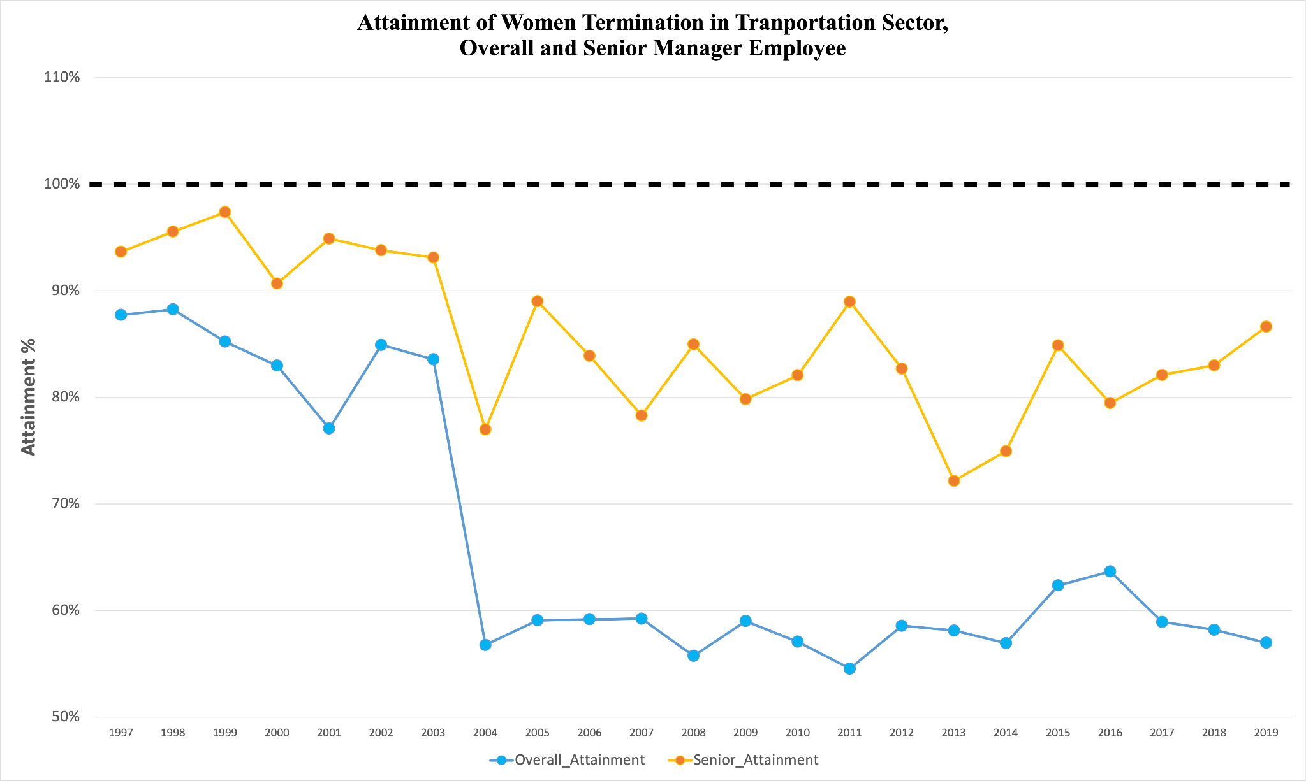
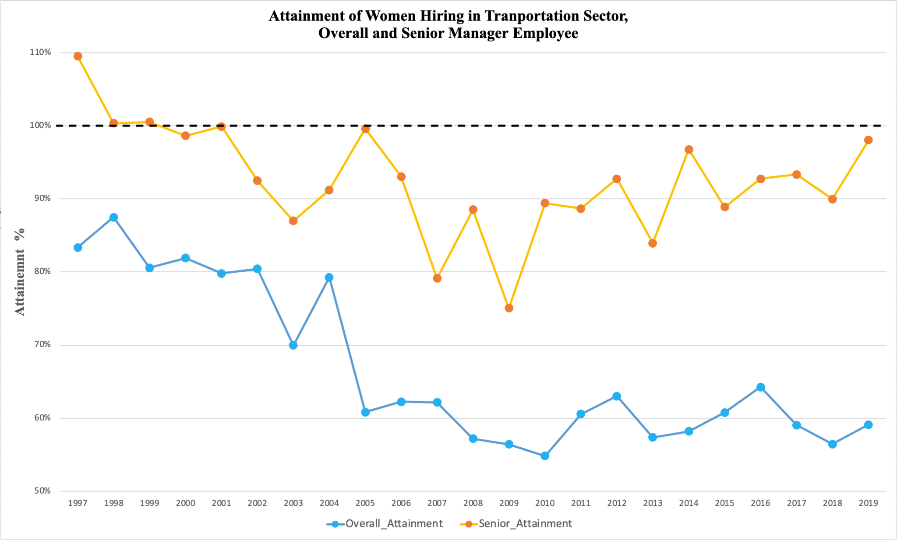
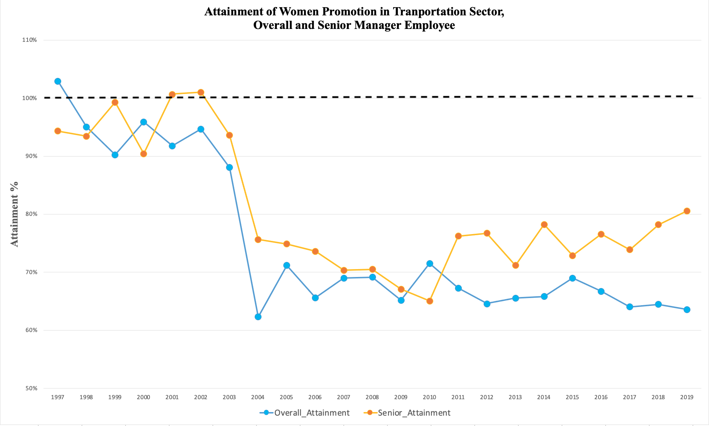
Hiring & Promotion & Termination in Transportation Sector <- Attainment Rate
Gaps between Senior Level vs. Overall
Outcome - Decrease Compare to the Initial Value

Slide 13
Thank you!

