Slide 1
Memory Virtualization
Brian Kocoloski
CSE 522S – Advanced Operating Systems
Washington University in St. Louis
St. Louis, MO 63130

Slide 2
Memory Virtualization
We’re used to virtual addresses which get mapped to physical addresses
But what about guest addresses? How do they map to host addresses?
Virtualization adds another level of indirection that the hypervisor has to deal with

Slide 3
(x86) Supervisor Mode
Virtualization extensions – hardware updates in recent processors to make virtualization more efficient
Without extensions, we need to run guest code in ring-3 to prevent it from corrupting shared hardware
E.g., what if the guest ran in ring-0? It could update its page tables to map any physical memory – major security issue

Slide 4
(x86) Virtualization Extensions
Virtualization extensions allow us to run guest code directly in ring 0 but to do so safely thanks to a new orthogonal privilege mode, supervisor mode
Ring 3, Guest Mode
P1
Ring 0, Guest Mode
Guest OS
P2
Ring 3, Supervisor Mode
Ring 0, Supervisor Mode
Hypervisor + Host OS
Hardware

Slide 5
(x86) Rings and Supervisor Modes
Rings and supervisor mode are architecture specific (ARM is a lot different than x86)
Intel/AMD (x86)
VMX root (host mode) VMX non-root (guest mode)
Everything in this discussion pertains to x86, though ARM does have some similarities
The basic idea of the virtualization extensions is to duplicate some of the hardware to add a second level of virtualization

Slide 6
(x86) Nested Page Tables
Without VMX support, we can’t let the guest directly update its page tables
mov cr3, 0x….
Such an instruction needs to be trapped and emulated by something like QEMU (we’ll talk about how in a bit)
But with VMX support, we can actually let the guest modify cr3 directly

Slide 7
Paging Review (use of control registers)
CPU instruction: WR R1, 0x0000 cd00 2240 6c90
Step 1: Get Top-level page table address
Control Register (x86: CR3;
ARM: CP15 c2)
MMU
WR 0x0000 cd00 2240 6c90
Top level page table address (a)

Slide 8
Example 0x0000 cd00 2240 6c90
1010 1011 0000 0000 0010 0010 0100 0000 0110 1010 1001 0000
( 342 0 274 6 2704 )
Index | Page
0
…
342 | b
…
511
Grab the
2704’th byte
in this page
Physical Page (4KB)
a
Index | Page
0 | c
…
…
…
511
Index | Page
0
…
274 | d
…
511
Index | Page
0
…
6 | e
…
511

Slide 9
Address Translation
Virtual Address Space
Physical Address Space

Slide 10
Address Translation
VM 1 Virtual Address Space
VM 2 Virtual Address Space
Can’t VMs corrupt each other’s memory?
Physical Address Space

Slide 11
Address Translation
VM 1 Virtual Address Space
VM 2 Virtual Address Space
VM 1 Guest Physical Address Space
VM 2 Guest Physical Address Space
Host Physical Address Space

Slide 12
Address Translation
Solution is to add another level of indirection
Second level of virtualization
Virtual -> Intermediate Physical -> Physical
More commonly thought of as:
Guest virtual -> Guest Physical -> Host Physical
The guest ”thinks” it is mapping physical memory, but it is really mapping just another type of virtual memory

Slide 13
Virtualizing Memory in Software
Three abstractions of memory:
0
4GB
Current Guest Process
Guest OS
Virtual
Address Spaces
0
4GB
Virtual RAM
Virtual
Frame
Buffer
Virtual
Devices
Virtual
ROM
Guest Physical
Address Spaces
0
4GB
RAM
Devices
Frame
Buffer
ROM
Host Physical
Address Space
Source: http://www.cs.cmu.edu/~412/lectures/L04_VTx.pptx

Slide 14
Shadow Page Tables
VMM maintains shadow page tables that map guest virtual pages directly to host physical pages.
Guest modifications to V->GP tables synced to VMM V->HP shadow page tables.
Guest OS page tables marked as read-only.
Modifications of page tables by guest OS -> trapped to VMM.
Shadow page tables synced to the guest OS tables
Source: http://www.cs.cmu.edu/~412/lectures/L04_VTx.pptx

Slide 15
Set CR3 by guest OS (1)
Guest
Page Table
Guest
Page Table
Guest
Page Table
Virtual CR3
Real CR3
Shadow
Page Table
Shadow
Page Table
Shadow
Page Table
Source: http://www.cs.cmu.edu/~412/lectures/L04_VTx.pptx

Slide 16
“Shadow” the update in the host OS (2)
Guest
Page Table
Guest
Page Table
Guest
Page Table
Virtual CR3
Real CR3
Shadow
Page Table
Shadow
Page Table
Shadow
Page Table
Source: http://www.cs.cmu.edu/~412/lectures/L04_VTx.pptx

Slide 17
Shadow Page Tables
Shadow paging relies on support for trapping updates to either (1) cr3, or (2) any of the page tables pointed to by cr3
Hypervisor is invoked when the guest tries to modify cr3 or the page tables
This is called a VM-exit
Hypervisor then “shadows” the update, and can also perform a memory translation from GPA to HPA if the guest is mapping a new memory region
Source: http://www.cs.cmu.edu/~412/lectures/L04_VTx.pptx

Slide 18
Guest adds new page mapping (to GPA P) (1)
Map new GPA P
Guest
Page Table
Guest
Page Table
Guest
Page Table
Virtual CR3
Real CR3
Shadow
Page Table
Shadow
Page Table
Shadow
Page Table
Source: http://www.cs.cmu.edu/~412/lectures/L04_VTx.pptx

Slide 19
Write to the PTE causes VM-exit; hypervisor maps PTE to HPA (say P’) (2)
Map new GPA P
Guest
Page Table
Guest
Page Table
Guest
Page Table
Virtual CR3
Real CR3
Map new HPA P’
Shadow
Page Table
Shadow
Page Table
Shadow
Page Table
Source: http://www.cs.cmu.edu/~412/lectures/L04_VTx.pptx

Slide 20
Drawbacks: Shadow Page Tables
Need to handle trap (often called VM exit) on all page table updates (and context switches)
Processor moves from vmx non-root (guest mode) to vmx root (host mode)
Similar to a CPU context switch, but actually more expensive
Maintaining consistency between guest page tables and shadow page tables leads to frequent traps if guest has frequency switches or page table updates
Loss of performance due to TLB flush on every “world-switch”
Memory overhead due to shadow copying of guest page tables
Source: http://www.cs.cmu.edu/~412/lectures/L04_VTx.pptx

Slide 21
Nested / Extended Page Tables
Extended page-table mechanism (EPT) used to support the virtualization of physical memory.
Guest-physical addresses are translated by traversing a set of EPT paging structures to produce physical addresses that are used to access memory.
i.e., the hardware gives us a 2nd set of page tables to do the translation without needing VMM intervention
Of course, the VMM is still responsible for setting up the EPT, but this generally only needs to be done once at guest boot time
Source: http://www.cs.cmu.edu/~412/lectures/L04_VTx.pptx

Slide 22
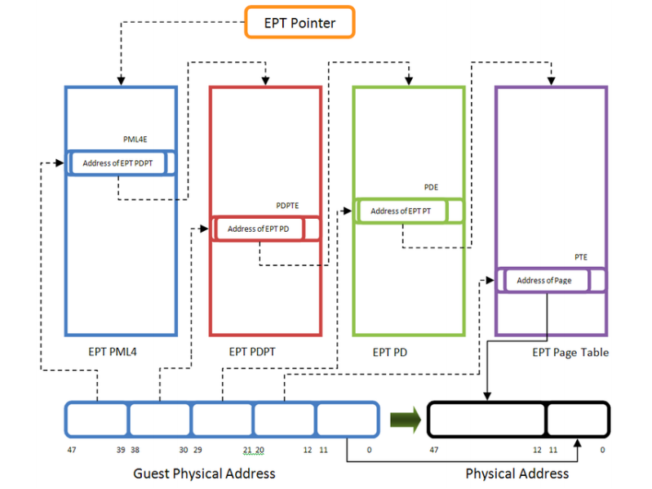
Source: https://www.exploit-db.com/docs/45546

Slide 23
Advantages: EPT
Simplified VMM design (no need to maintain any “shadow” state or complex software MMU structures)
Guest page table modifications need not be trapped, hence VM exits reduced.
Reduced memory footprint compared to shadow page table algorithms.
Source: http://www.cs.cmu.edu/~412/lectures/L04_VTx.pptx

Slide 24
Disadvantages: EPT
TLB miss is very costly since guest-physical address to machine address needs an extra EPT walk for each stage of guest-virtual address translation.
Source: http://www.cs.cmu.edu/~412/lectures/L04_VTx.pptx

Slide 25
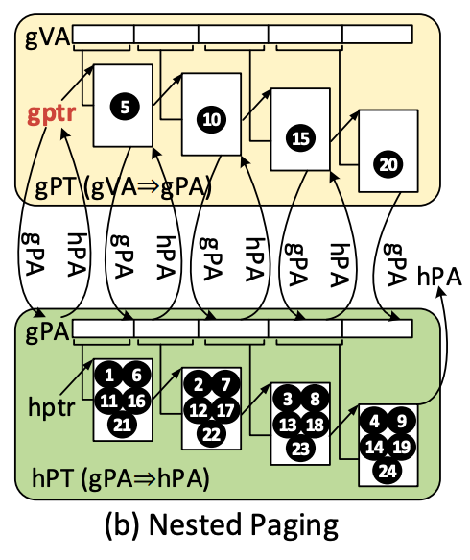
Source: https://research.cs.wisc.edu/multifacet/papers/isca16_agile_paging.pdf

Slide 26
Studio
Today’s studio gives you experience measuring performance of memory bound workloads in native and virtualized environments
Again uses QEMU/KVM on your Raspberry Pi
Think about what types of workloads would benefit from shadow paging and what type would benefit from nested paging

