Slide 1
I/O Virtualization
Brian Kocoloski
CSE 522S – Advanced Operating Systems
Washington University in St. Louis
St. Louis, MO 63130

Slide 2
I/O Virtualization
With virtualization extensions, I/O devices are now generally the hardest to efficiently virtualize
Approaches
Device emulation
I/O paravirtualization
Direct device assignment

Slide 3
Device Emulation
Hypervisor emulates a device that appears to the guest as a real piece of hardware
What does a “real” piece of hardware look like?
Something with special memory regions
Something with connections to system buses for control+data transfer
Connections to IRQ lines to raise interrupts
Etc.

Slide 4
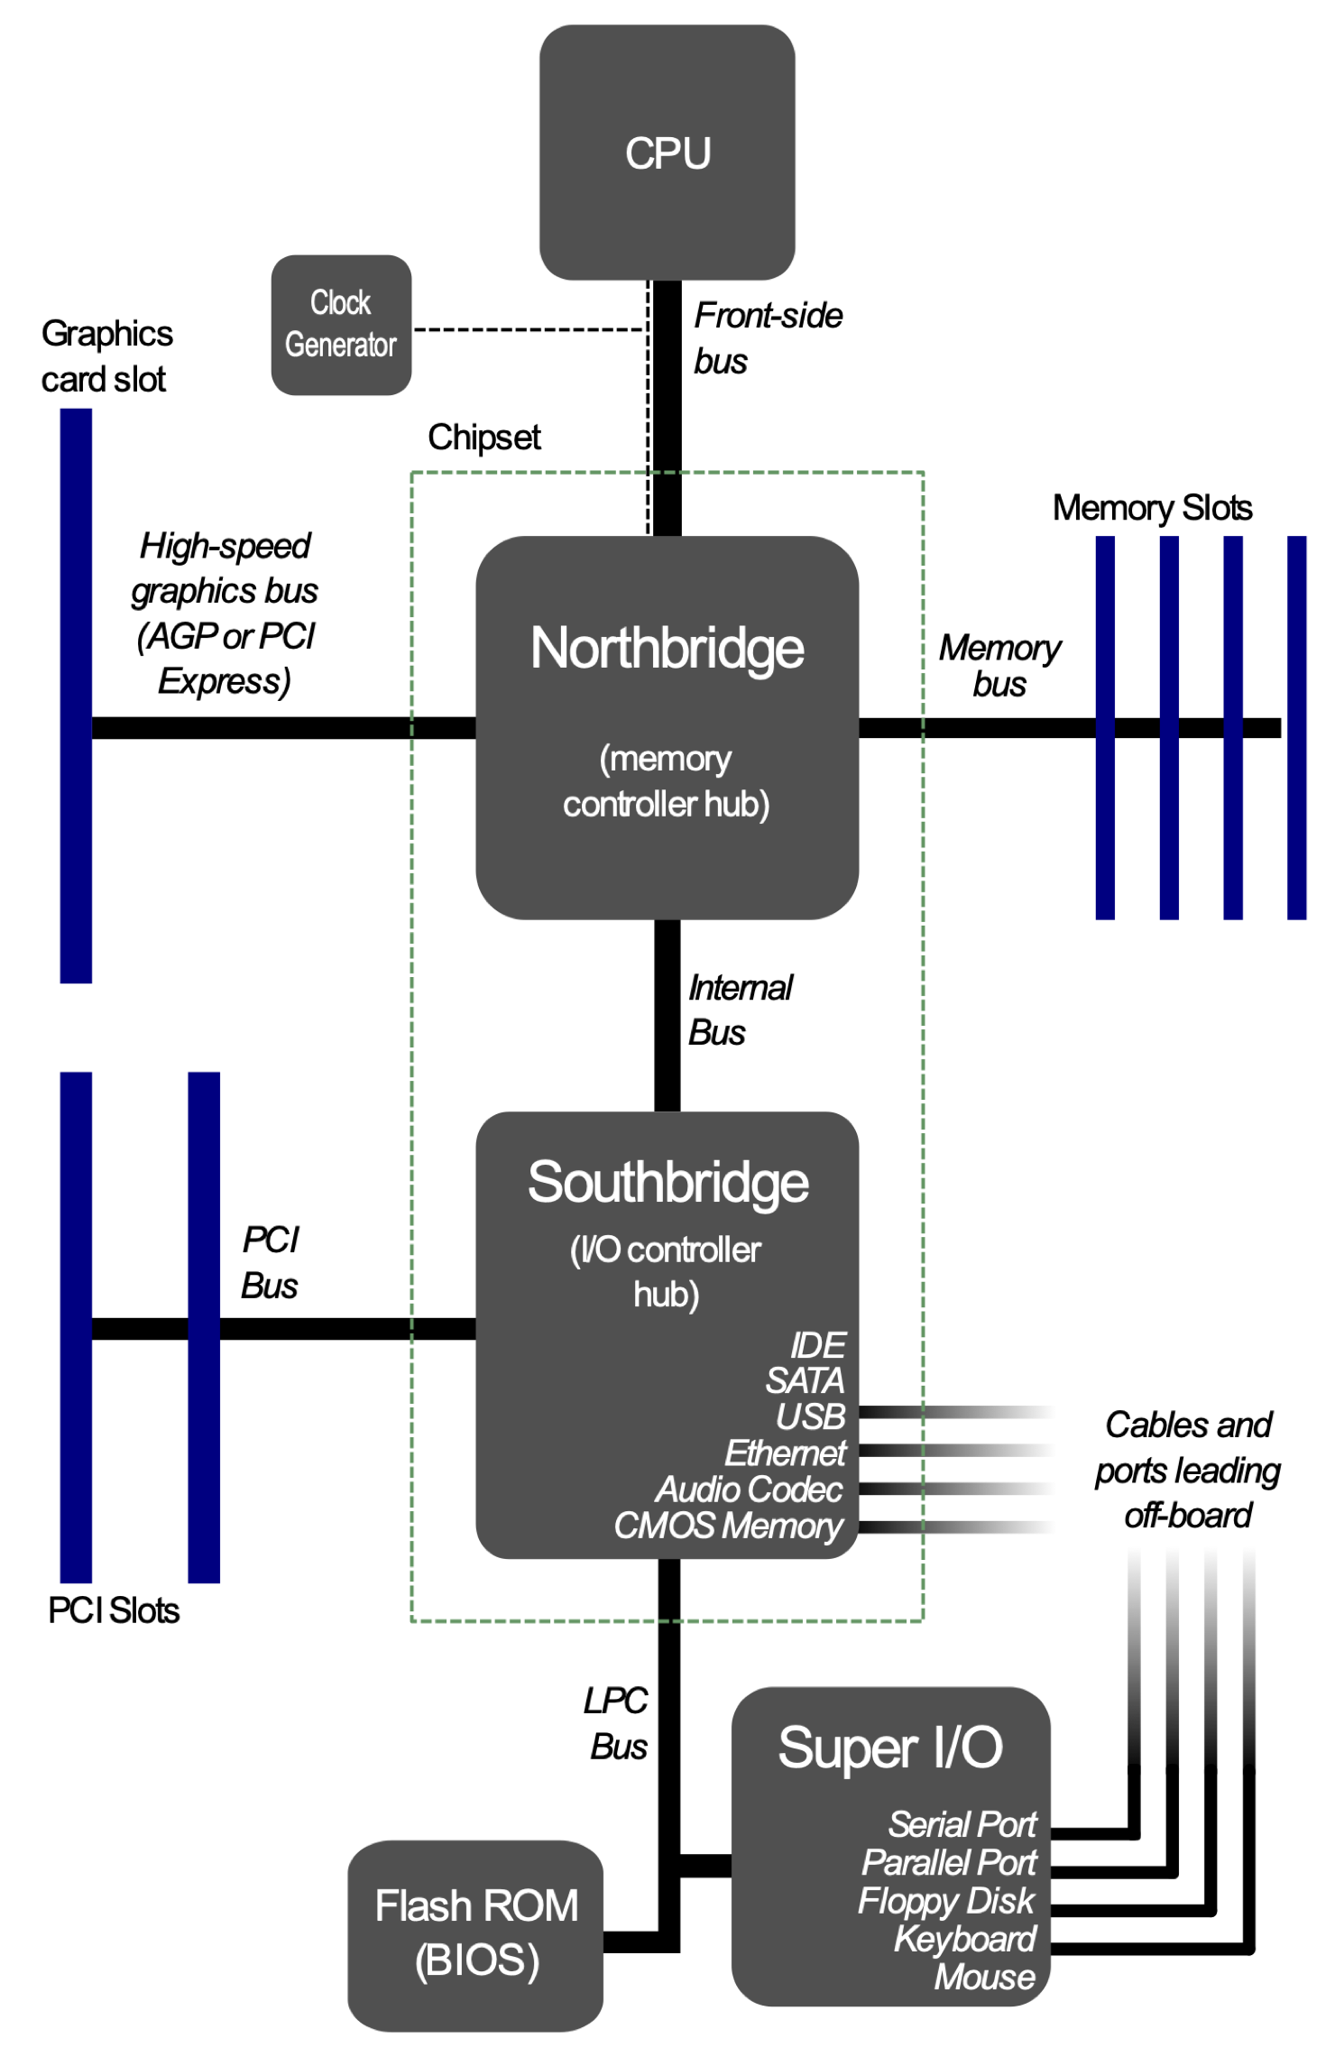

Slide 5
Emulating a Hard Disk Drive (HDD)
E.g., for an HDD, hypervisor might have to emulate
Frontside bus to connect CPU to Northbridge
Northbridge+Internal Bus+Southbridge
PCI bus and/or IDE bus
Hard drive internals
Special physical memory regions correspond to device memory
I/O pins
How do drivers typically communicate with devices?
Memory mapped I/O (MMIO)
Read/write to I/O ports

Slide 6
Pros/Cons of Emulation
Support unmodified guest operating systems
Including device drivers
The emulated devices are indistinguishable from real hardware (notwithstanding performance differences)
Most kernels already provide drivers for buses, SATA/IDE/USB controllers, and some common devices (Ethernet cards, SD cards, etc.)
This makes it easier to port OSes to a virtual machine environment
Increases hypervisor complexity
Must emulate buses, bridges, devices
Significant performance overhead
Lots of ”trap+emulate” behavior needed to handle
Reads/write to special MMIO regions (these are not just raw physical memory) – the device does things in response to memory accesses
I/O port access (same as above – device reacts to this)

Slide 7
Device Memory Management
Three abstractions of memory:
0
4GB
Current Guest Process
Guest OS
Virtual
Address Spaces
0
4GB
Virtual RAM
Virtual
Frame
Buffer
Virtual
Devices
Virtual
ROM
Guest Physical
Address Spaces
0
4GB
RAM
Devices
Frame
Buffer
ROM
Host Physical
Address Space
Source: http://www.cs.cmu.edu/~412/lectures/L04_VTx.pptx

Slide 8
Device Paravirtualization
Rather than emulate exact device specifications, what if the hypervisor exposed a simpler interface?
Guest <-> hypervisor “device” interactions could be designed to avoid some virtualization overhead
Instead of issuing memory/IO operations that must be trapped+emulated, the guest could ask the hypervisor to perform a higher level operation (e.g., write some data to a hard drive)

Slide 9
e.g., Paravirtual network card
Hypervisor exposes interfaces to the guest for sending or receiving packets
No need to emulate buses/controllers
No need to emulate device memory or I/O ports
Guest drivers are explicitly programmed to use these hypervisor interfaces rather than standard device interfaces
What do hypervisor interfaces look like?
Hypercalls -- akin to a system call, this is an explicit request for the hypervisor to do some activity
Hypercalls can correspond to high level activities – no need to be low-level device operations
E.g., send/recv data rather than working at the device level

Slide 10
virtio
QEMU/KVM support for paravirtualization
Based on the knowledge that many paravirtual drivers have similar ways of communicating with the hypervisor
E.g., use of ring buffers for data transfer, interrupt enabling/disabling
Provides a set of abstractions that makes it easier to develop new paravirtual drivers in the future
In today’s studio, you will use
virtio-blk-device (paravirtual block device)
virtio-net-device (paravirtual network device)

Slide 11
Pros/Cons of Paravirtualization
Simpler hypervisor design
Higher performance than device emulation
Guest <-> host interactions optimized for virtual machine environment
Requires changes to guest OS
Drivers for regular hardware are not used
Need to be customized for the underlying hypervisor
Still some performance overhead
Better than emulation, but still requires significant hypervisor support
Hypercalls are just a specific form of trap – still expensive

Slide 12
Device Assignment
Last approach is to directly assign hardware devices to the VM
Has some similarities to device emulation
Hypervisor still emulates things like buses+bridges
Guest sees the device as a “real” device
However, device memory regions are mapped directly into the guest (via IOMMU)
Obviates the need to trap accesses to device memory, since they are issued directly to the real hardware

Slide 13
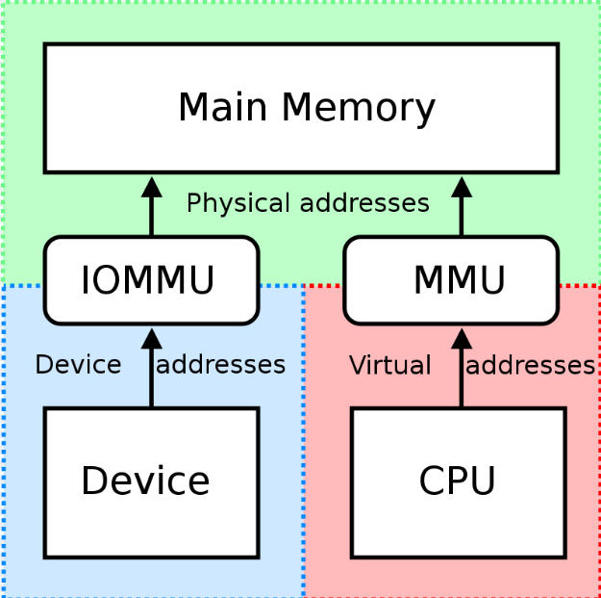
IOMMU vs MMU
Source:
https://en.wikipedia.org/wiki/Input%E2%80%93output_memory_management_unit

Slide 14
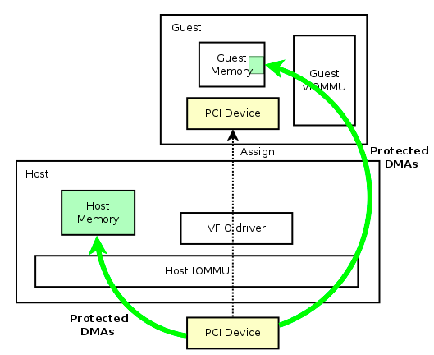
Device Assignment in QEMU
Source:
https://wiki.qemu.org/Features/VT-d

Slide 15
Device Assignment
Device characteristics are emulated to create a virtual device that looks almost exactly like the host device
Differences
Hardware addresses changed from host physical to guest physical
When guest driver accessed guest physical addresses, they are translated to host physical through the IOMMU
Then the IOMMU issues them to the real PCI device on the host
This is very similar to the way the extended page tables (EPT) works for regular memory regions

Slide 16
IOMMU vs EPT
0
4GB
Current Guest Process
Guest OS
Virtual
Address Spaces
0
4GB
Virtual RAM
Virtual
Frame
Buffer
Virtual
Devices
Virtual
ROM
Guest Physical
Address Spaces
EPT
IOMMU
0
4GB
RAM
Devices
Frame
Buffer
ROM
Host Physical
Address Space

Slide 17
Pros/Cons of Direct Device Assignment
Very high performance
Operations that transfer data do not require hypervisor intervention (other than setting up IOMMU page tables, which can be done ahead of time, not during data transfer)
Does not require changes to guest OS
Device seems like a real device (because it actually is)
Requires special hardware
IOMMUs not found in many lower end devices
Requires dedication of real hardware to the VM
Cannot assign hardware that we don’t have, which is possible with emulation or paravirtualization

Slide 18
Studio
Today’s studio gives you experience measuring performance of paravirtual device interfaces
Again uses QEMU/KVM on your Raspberry Pi
Exposure to utilities for measuring networking and file I/O performance

