Slide 1
E81 CSE 522S: Advances Operating Systems Fall 2020
Department of Computer Science & Engineering
Washington University, St. Louis MO
James Orr
james.orr@cse.wustl.edu
*Thanks to Brian Kocoloski, Chris Gill, and David Ferry who developed much of this material in previous iterations of the course

Slide 2
Three Goals for Students
Build deep understanding about OS operation and design principles
Additional mechanisms that we did not cover in 422: real-time, virtualization, etc.
Additional OS design models beyond Linux: VMs, unikernels, etc.
Enrich skills for monitoring the runtime operation of an OS
New features of monitoring tools, e.g., event queries for kernelshark
The scientific method (hypothesis, prediction, experiment, analysis, repeat)
Gain further experience enforcing/evaluating OS behavior
E.g., forensics for memory, file system, processes/threads, timing
As in CSE 422, the studios will help you gain experience and expertise to use in the lab assignments
Analyzing + developing code in experimental kernels

Slide 3
Course Environment
As in CSE 422, our OS of choice is the Linux kernel
General ubiquity and open source availability
This course is again designed around the Raspberry Pi 3
Avoids modifying the kernel on machines others may need to use
Can quickly re-deploy a new version of the kernel if the one running locks up
“Personal computing” at its best ☺
The Raspberry Pi family is based on the ARM processor architecture
Will occasionally mention x86 differences, where relevant

Slide 4
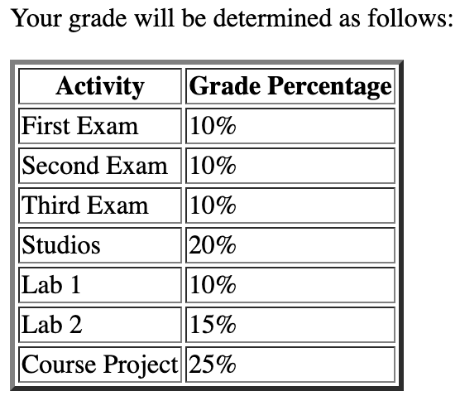
Grading

Slide 5
Course Textbooks
Linux Kernel Development, 3rd Ed., by Robert Love, 2010.
- A great starting resource for kernel hackers
- Focused on kernel design and implementation
Google is your friend!
- Linux is widely documented
- Lots of other resources exist for Linux mechanisms and features
- We will also provide links to key resources on the course web site
Linux System Programming, by Robert Love, 2013.
- Focused on userspace programming instead of in-kernel issues
- Heavy IPC focus: pipes, sockets, signals, etc.

Slide 6
Warnings from Previous Students
“You program in C to reconfigure a Linux Kernel on a Raspberry Pi. Prepare to optimize your workflow for testing, and brush up on C – you'll be using it a lot.”
“I had trouble doing studios because I never made it to class. So I was always playing catch–up and stressed out by the studios.”

Slide 7
A Typical Class
About 20 minutes of lecture discussing that day’s readings and course topic
This semester lectures will be recorded and should be watched before hand
In-class office hours and studio time
Studios
Offer direct experience working with (and within) the kernel
Familiarize students with key tools and techniques for using, profiling, analyzing, and extending kernel features.
Work in groups of up to 3 students

Slide 8
Words of Advice (from experience)
Kernel hacking requires a lot of patience (and thought)
Your systems will crash
It’s important to optimize your work environment to handle frequent crashes and reboots
Work efficiently but persistently
Start early, fail (or succeed) quickly, iterate rapidly, progress steadily over time
A few tips for this course (to avoid problems we’ve seen already)
Brush up on your C and shell bash scripting!

Slide 9
Today’s Studio(s)
Downloading and Compiling the Linux kernel
Installing the Linux kernel on your RPi3
Compile the kernel here
Install the kernel here
linuxlab cluster

