Slide 1
User-level Memory
Chris Gill, David Ferry, Brian Kocoloski, James Orr
CSE 422S - Operating Systems Organization
Washington University in St. Louis
St. Louis, MO 63130

Slide 2
Virtual Memory Areas
Recall virtual/physical memory relationship
Pages are mapped to virtual memory
Virtual addresses require translation
Virtual Address Translation:
Process A
Process B
Virtual Address
Page #
Offset
4KB
4KB
4KB
4KB
4KB
4KB
Physical Page
Phys.
Addr

Slide 3
Process Address Spaces
Each user space process has an address space
Pointer to mm_struct (inside struct task_struct) is non-NULL in user processes only (i.e., 0 for kernel threads)
Stores the list of available memory areas (vm_area_struct , or “VMA”)
Identifies code, data, heap, and stack segments
Is reference counted (mm_count is 2+ if shared)
Address space has a flat range of addresses
E.g., 0 to 4294967295 for our 32-bit RPi 3s
Can only access certain portions
Segmentation fault occurs if the process accesses an address outside its allowed address segments

Slide 4
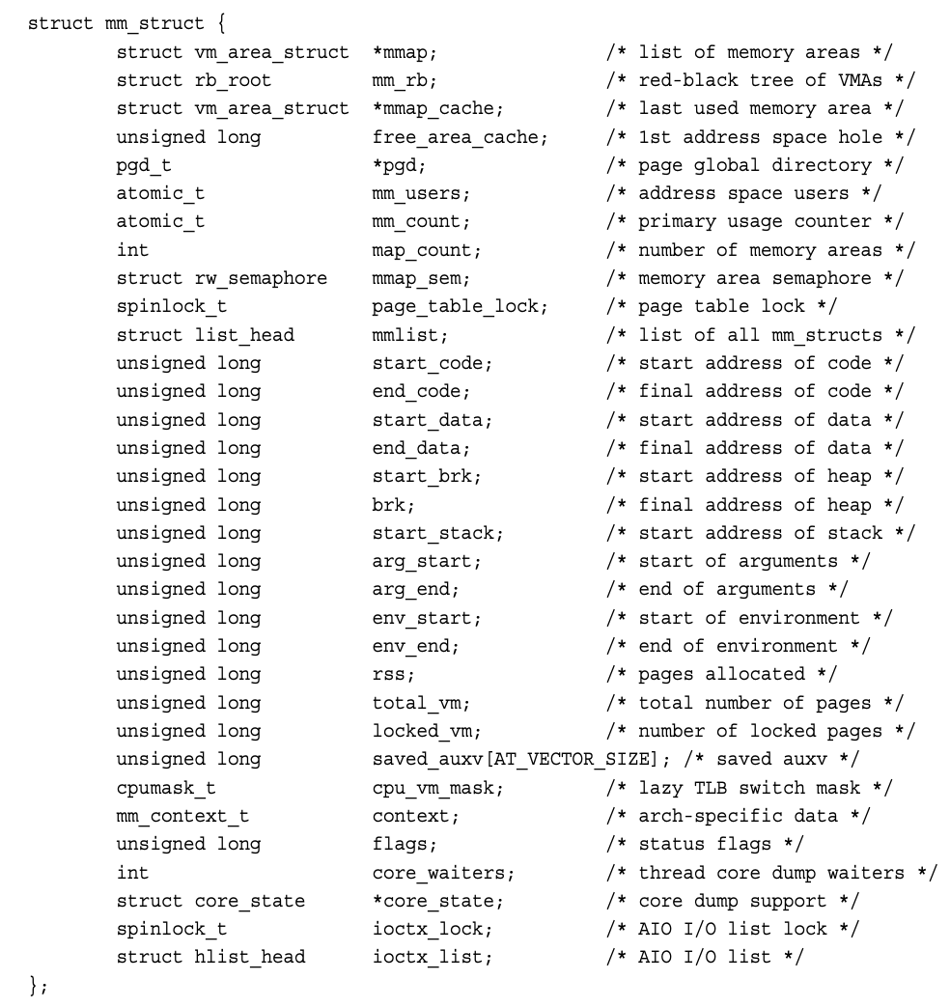

Slide 7
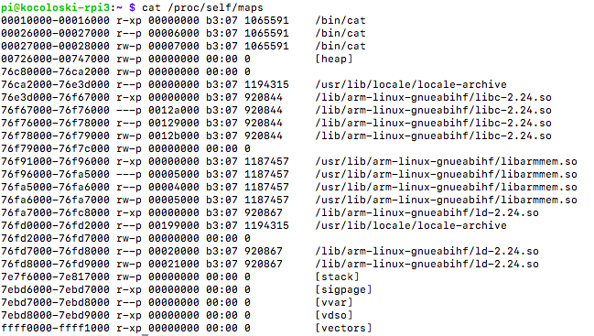
/proc/<pid>/maps
The valid virtual addresses in a process
$ cat /proc/self/maps

Slide 8
/proc/<pid>/maps
The valid virtual addresses in a process
$ cat /proc/self/maps
Executable code
Read-only static data
Read/write static data

Slide 10
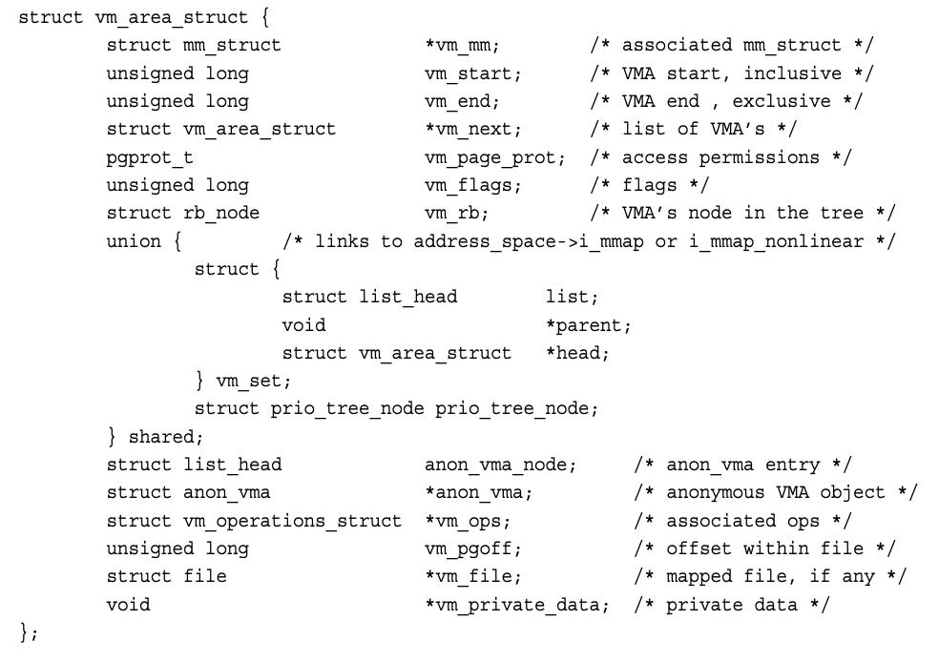

Slide 11
/proc/<pid>/maps
The valid virtual addresses in a process
$ cat /proc/self/maps

Slide 12
Paging Review
PML
Linux terminology for 4-level page tables
PML: Page Map Level
PGD: Page Global Directory
PMD: Page Middle Directory
PTE: Page Table Entry
PGD
PMD
PTE
Physical Page (4KB)

Slide 13
Forking and Copy-on-Write
Recall from CSE 422, that Linux relies on a technique called copy-on-write (CoW)
CoW is used to make process creation fast
All virtual memory segments in the parent process can be accessed by the child process
But as soon as either the parent or child writes to a memory location, their address spaces point to different physical pages
Relies on the virtual memory subsystem (including paging on paged-systems)

Slide 14
Metadata in Page Table Entries
Index | MetaData (r/w/x) (present) | Page Address for next level of page table
0
…
342 | P: 0 R: 1 W:0 X: 0 | 0x1234….
…
511
Recall the metadata bits within page table entries
Present (P): is the next level of page table (or the physical page address, if we’re at the last level) present?
R/W/X: three separate bits indicating whether the memory is readable, writable, and/or executable

Slide 15
Fork + CoW
PML
PML
Process A (“parent”)
Process B (“child”)
PGD
PGD
PMD
PMD
Set PTEs as “unwritable”
PTE
PTE
Physical Page (4KB)

Slide 16
Fork + CoW
PML
PML
Process A (“parent”)
Process B (“child”)
PGD
PGD
PMD
Physical Page (4KB)
PMD
As soon as either A or B writes to the page
Page fault (because PTE unwritable)
Allocate new physical page
Update both PTEs to be writable
PTE
New Physical Page (4KB)
PTE

Slide 17
Kernel Source Pointers
kernel/fork.c
_do_fork()
call copy_process()
copy_process
call copy_mm()
copy_mm
call dup_mm()
dup_mm
call dup_mmap()
dup_mmap
call copy_page_range()
mm/memory.c
copy_page_range
Recursively copies all page table entries over this address range

Slide 18
Shared Memory use is Efficient
Shared Memory refers
to situations where
different processes
access same physical
pages
Same address translation as usual
Virtual addresses map to same physical page(s)
Page(s) can be readable/ writable by both processes, writable by one process / readable by the other, etc.
Process A
Virtual Address
Process B
Virtual Address
Page #
Offset
Offset
Page #
Physical Page

Slide 19
Shared Memory Concepts
Processes may share physical memory region
Communicate by modifying memory values
Kernel only invoked at creation & deletion
Reads/writes incur standard memory use costs
Physical Address (e.g. 0x1000)
Process A
1
Process B
1
shm_ptr
2
shm_ptr
3
5
8
13

Slide 20
Shared Memory
PML
Process A
PML
Process B
Some virtual address in process A maps to the same physical address as some virtual address in process B
Do the virtual addresses have to be the same if the physical addresses are?
PGD
PGD
PMD
PMD
PTE
Physical Page (4KB)
PTE

Slide 21
“vFork” and thread creation
PML
PML
Process A (“parent”)
Process B (“child”)
PGD
Any virtual address maps to the same physical address in both processes A and B
Main benefit of vfork()
Page tables do not need to be copied in new process/ thread
What types of programs would benefit from this?
PMD
PTE
Physical Page (4KB)

Slide 22
Memory Mapping and Unmapping
Kernel creates a new address interval
The do_mmap function specifies access permissions, may back it with a file (or may leave it anonymous)
The do_munmap function removes the interval from the process address space
May use vm_area_cachep (slab allocation)
User processes also may initiate memory mapping
Via the mmap() C library function
Useful for shared memory based communication between processes: see man 7 shm_overview

Slide 23
Today’s Studio: Using Shared Memory in Linux
Three steps to use shared memory
Create a shared file descriptor via shm_create()
Resize shared region via ftruncate()
Map region into process via mmap()
Shared regions are identified by name
Creator can specify user-level permissions

Slide 24
Shared Memory Caveats
Basic interface: void* (untyped pointer)
Programmer must impose organization on shared memory region, manipulate the pointer accordingly
E.g., casting pointer to specific type according to how sharing processes have laid out memory use
Provides multi-threaded-like environment
But concurrency libraries (and others) may or may not work when shared across processes
E.g. pthreads’ PTHREAD_PROCESS_SHARED etc.
May need to write your own concurrency code!

