Slide 1
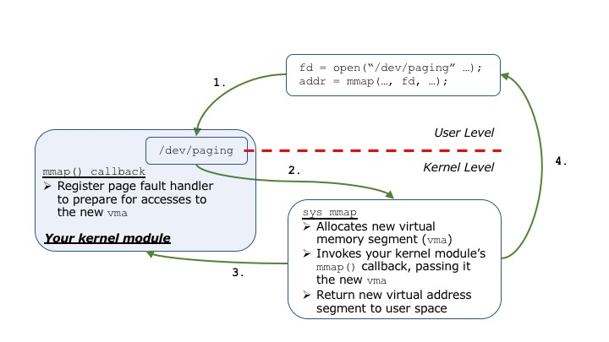
Program ⬅➔ /dev/paging ⬅➔kmod ⬅➔mem
User space program connects via /dev/paging “device file” to kernel module, which manages memory paging.

Slide 2
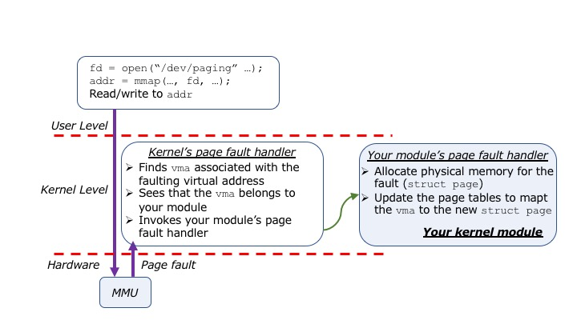
Demand paging vs. Pre-paging Modes
By default, kernel module sets up demand paging, but can load it all up front instead (called pre-paging), using the same operations that implemented demand paging (if demand paging mode is set to 0 at kmod load time).

Slide 3
Lab 3 Write-up
As you work, please again record your observations
It’s a good idea to read the entire assignment, plan and design a bit before starting to work on it, and build and test each stage before moving on to the next one.
You’ll run, report, and analyze different experiments
Comparing performance with demand paging vs. pre-paging
For dense_mm program with sizes 64, 128, 256, 512
You’ll report min, max, mean, median and std dev for 10 runs of each of those individual experiments
You’ll also plot experiment data in charts, and analyze results of each experiment to identify differences and similarities

