Slide 1
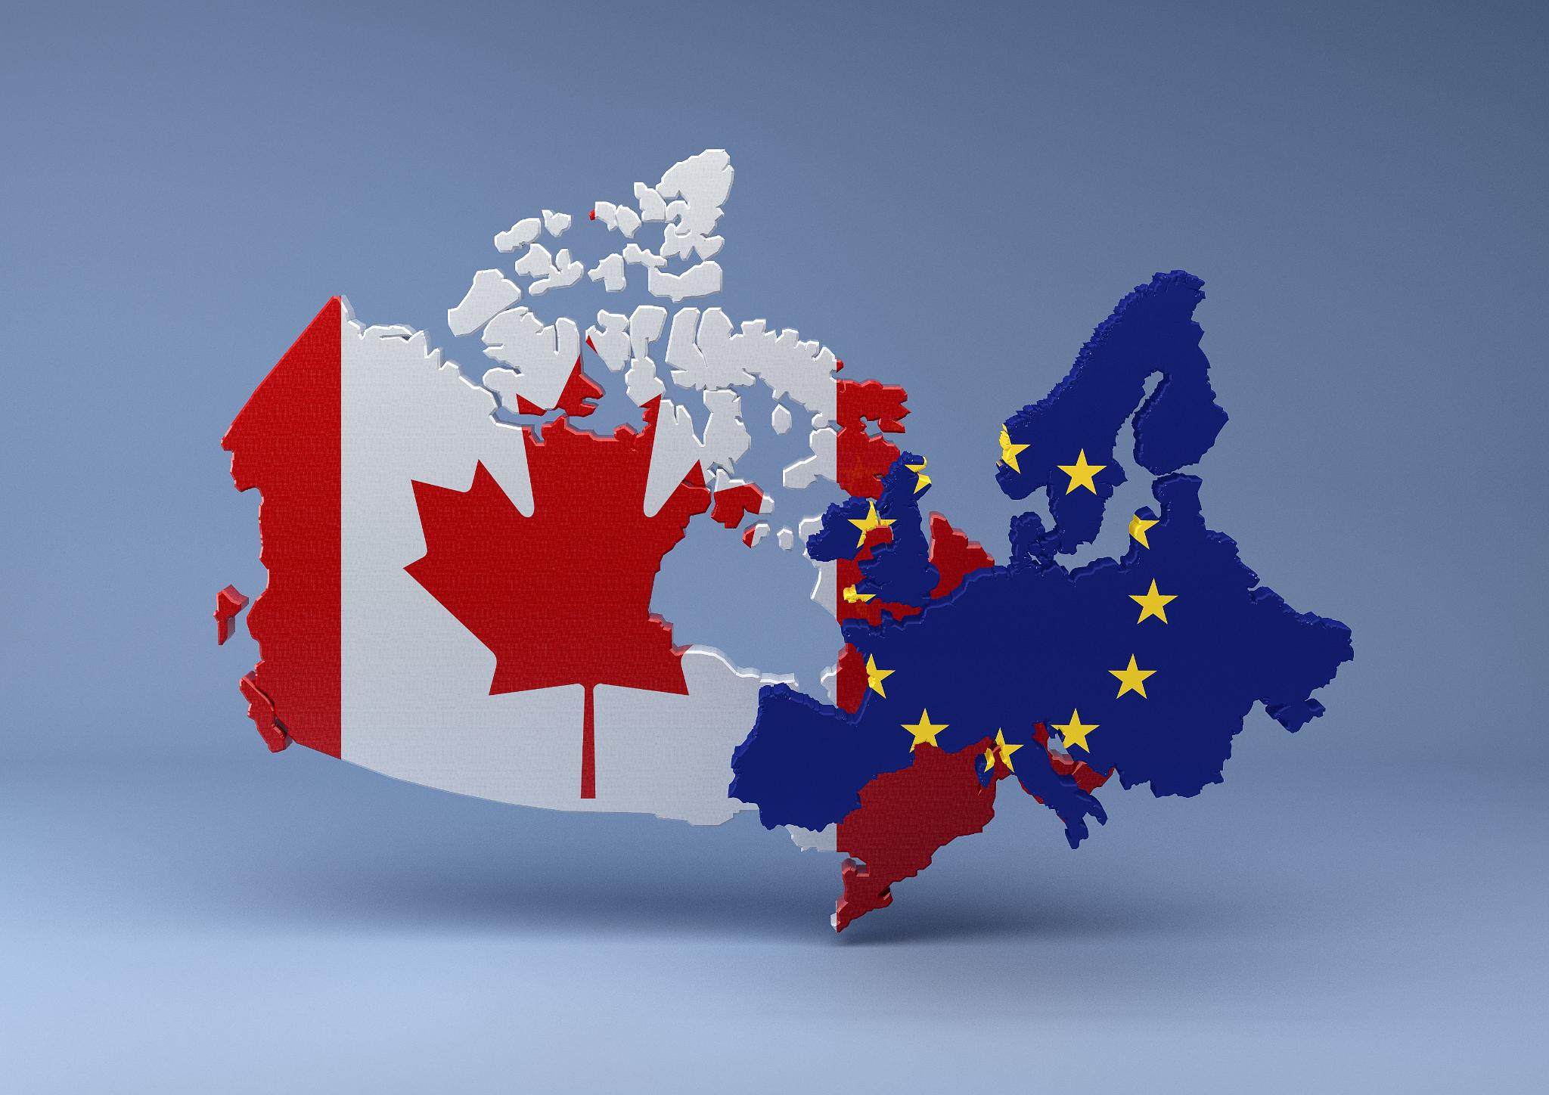
CETA Opportunities and Issues
Cerase Dagostino
Georgios Ellinas
Miguel Van de Goor
Joep Hermus
Hemal Kanji
Joost Melchers
Binh Nguyen
- November 2016 -

Slide 2

Contents
1. What is CETA?
2. Benefits and Opportunities From CETA
3. CETA Issues and Criticism

Slide 3
Contents
1. What is CETA?
2. Benefits and Opportunities From CETA
3. CETA Issues and Criticism

Slide 4

What is CETA?

Slide 5
What is CETA?
Summary

Slide 6
What is CETA?
Key questions

Slide 7
Contents
1. What is CETA?
2. Benefits and Opportunities From CETA
3. CETA Issues and Criticism

Slide 8

Benefits and Opportunities from CETA
Why free trade is beneficial?
The Theory of Absolute Advantages
(Adam Smith, 1776)
The Theory of Comparative Advantages
(David Ricardo, 1817)

Slide 9

Benefits and Opportunities from CETA
Cheese
Double the quota imported from the EU to about 30,000 tons per year.
Wine & Hard liquor
Weaken the trade barrier and making European products less expensive.
Drugs
Canada has agreed to adopt EU measures on “patent term restoration”. Drug makers will get an extra 2 years of patent protection.
Business takeover
Canadian government will increase the threshold to review foreign takeovers involving an EU company from $1-bil. to $1.5-bil. (except for the airline, cultural & telecommunications).

Slide 10

Benefits and Opportunities from CETA
Meat
Guaranteed access to European markets for 50,000 tons of Canadian beef and 80,000 tons pork.
Vehicles
Vehicles that are ≥ 50% Canadian-made will enjoy open access into the EU market.
Canada will be allowed to import up to 100,000 vehicles/year that are at least 20% Canadian-made.
Canadian consumers won’t have to pay 6.1% tariff on European imports.
Tariffs
99 per cent of EU tariff lines will be duty-free and Canadian products will become more competitive in the EU market.

Slide 11
Benefits and Opportunities from CETA
Professional certifications
Recognize professional certifications of each other’s jurisdictions. Potential groups : architects, engineers, accountants, foresters.
Banking
Deeper links between the Canadian and European banking sectors.
The EU estimates that half of the overall expected GDP gains will come from liberalizing the trade in services, including in the banking sector.
Canada says the deal will open new markets for its domestic banking sector, while ensuring it can maintain government rules for the sector.

Slide 12
Benefits and Opportunities from CETA
Mutual:
Canada and Europe will recognize professional certifications of each other’s jurisdictions. Potential groups are: architects, engineers. In the future can be accountants and foresters.
Deeper links between the Canadian and European banking sectors. The EU estimates that half of the overall expected GDP gains will come from liberalizing the trade in services, including in the banking sector. Canada says the deal will open new markets for its domestic banking sector, while ensuring it can maintain government rules for the sector.

Slide 13
Contents
1. What is CETA?
2. Benefits and Opportunities From CETA
3. CETA Issues and Criticism

Slide 14
CETA Issues and Criticism

