Slide 2

OOP PROJECT: ELECTRICAL CIRCUIT SIMULATOR
Course: Object Oriented Programming – IT3100E
Lecturer: Ph.D. Nguyen Thi Thu Trang
Team member:
Nguyen Thanh Binh - 20210106
Le Ngoc Binh - 20214878
Truong Gia Bach – 20210087
Vu Lam Anh - 20214876

Slide 3
Contents
Task assignment
Problem statement
Use-case diagram
General class diagram
Class diagrams for detailed package
Explanation of OOP techniques in our design
Demo scenario

Slide 4
01
Task assignment

Slide 5
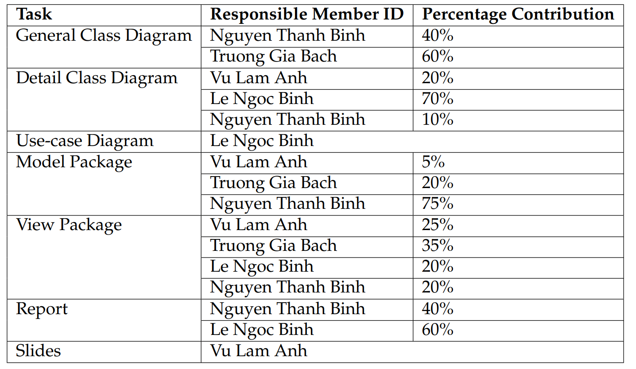
1. Task assignment

Slide 6
02
Problem statement

Slide 7
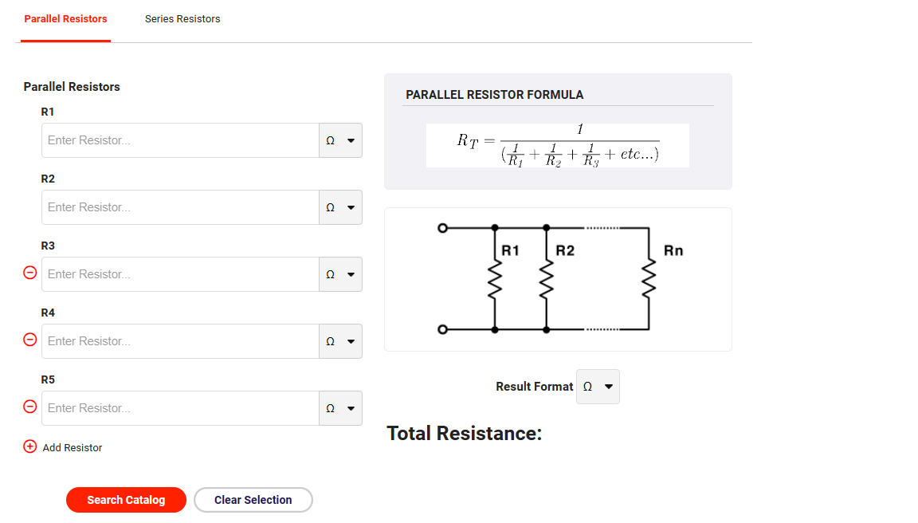
2. Problem statement
In this project, our group needs to create an Electrical Circuit Simulator that let users build an electrical circuit and perform circuit analysis on it.
Specific requirement :
Model:
Build class for circuit
Build class for electrical circuit element: resistors, capacitors, inductors, Ohm’s law, DC voltage source, AC voltage source
GUI design:
Demonstrate two types of circuits: parallel circuit and serial circuit and let user to choose one or two tabs in the navigation bar
Circuit construction: Each circuit will allow the user to pick a single voltage source and several electrical elements
Circuit diagram: After the user has constructed the circuit and press the submit button, the simulator will show the corresponding circuit diagram
Circuit analysis: Make a table compute voltage, current intensity and resistance for each electrical element
Short circuit: Detect short circuit and inform the user
Figure 1: Sample simulator GUI

Slide 8
03
Use-case diagram

Slide 9
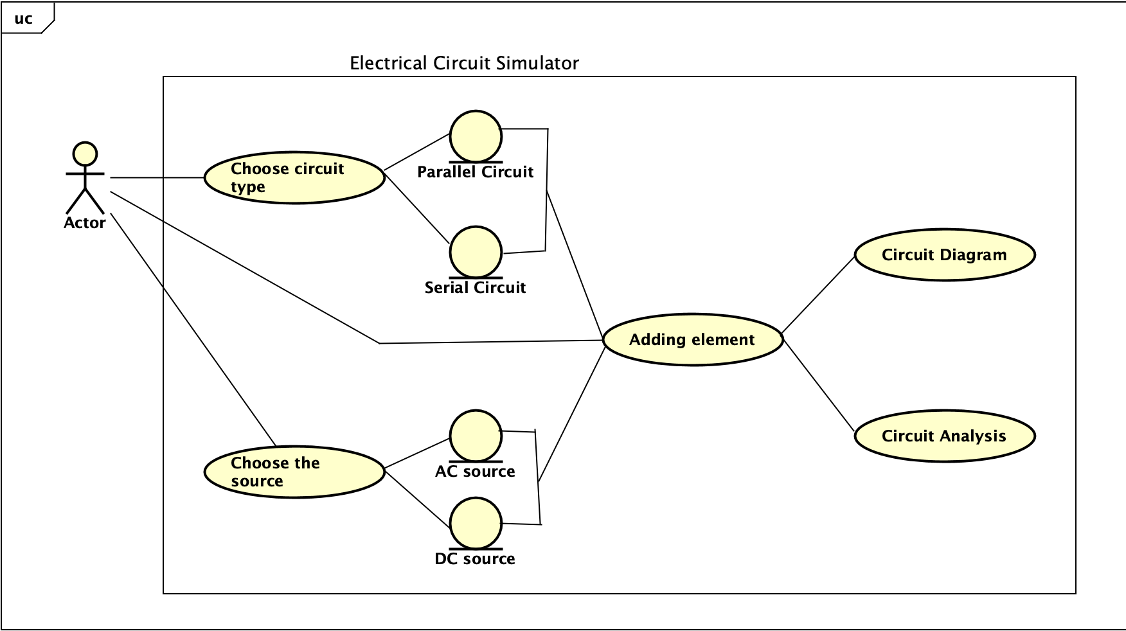
3. Use-case diagram
Figure 2: Use-case diagram

Slide 10
04
General class diagram

Slide 11
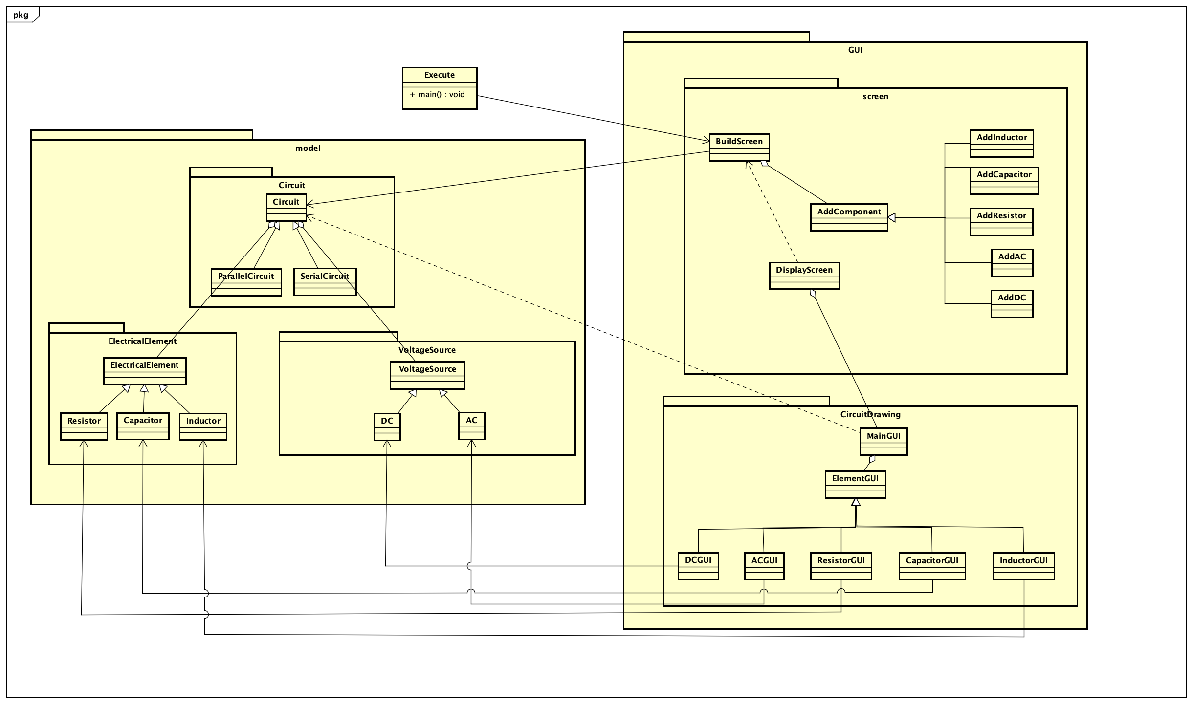
4. General class diagram
Our General Class Diagram consists of 3 packages:
Package model
Package GUI
Package Execute
Figure 2: General class diagram

Slide 12
05
Class diagram for detailed package

Slide 13
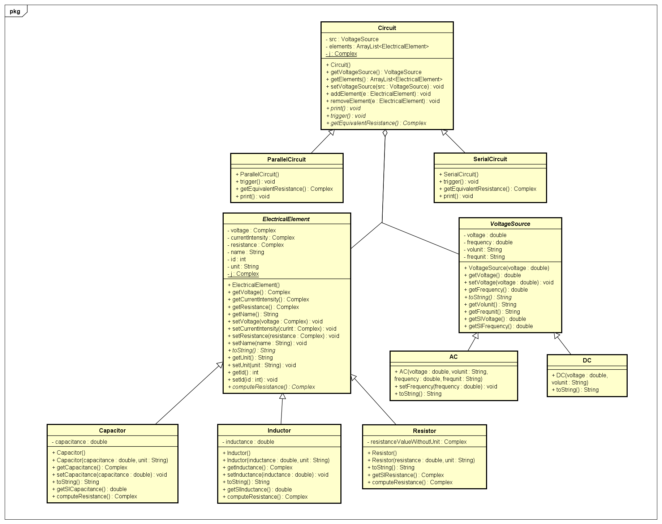
5. Class diagram for detailed package
5.1 Class diagram for model package
Figure 3: model package class diagram

Slide 14
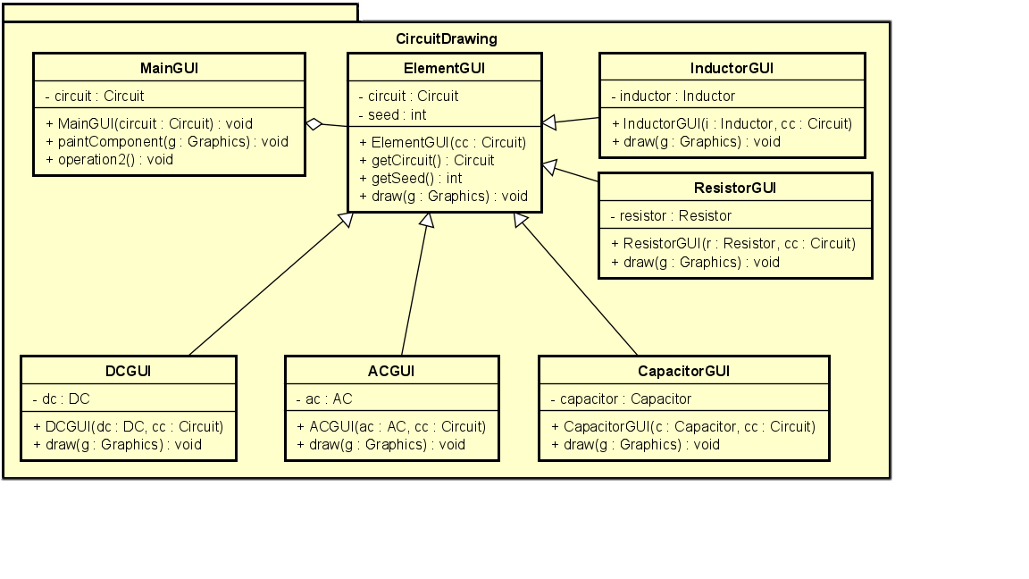
5. Class diagram for detailed package
5.2 Class diagram for GUI package
5.2.1 Class diagram for CircuitDrawing package
Figure 4: CircuitDrawing package class diagram

Slide 15
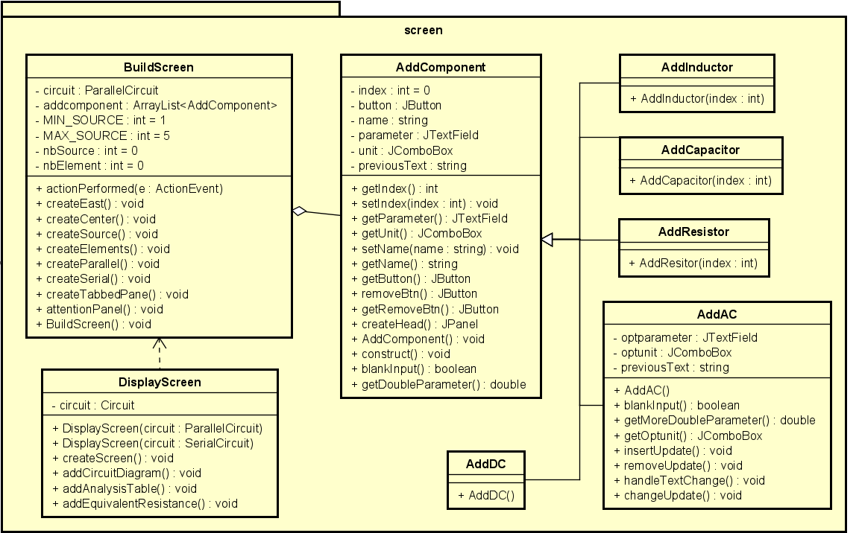
5. Class diagram for detailed package
5.2 Class diagram for GUI package
5.2.2 Class diagram for screen package
Figure 5: screen package class diagram

Slide 16
06
Explanation of OOP techniques in our design

Slide 17
6. Explanation of OOP techniques in our design
6.1 In model package
Inheritance:
The class of parallel circuit and serial circuit inherits a abstract class: Circuit
Similarly, capacitor, resistor and inductor inherits a abstract class: ElectricalElement
Same with voltage source, AC voltage source and DC voltage source inherits abstract
class: VoltageSource.
Aggregation:
Circuit class is an aggregate of one VoltageSource and many ElectricalElement
Polymorphism:
When computing equivalent resistance, we just need use getEquivalentResistance() method of Circuit. Then based on type of circuit, it will compute equivalent resistance corresponding to that types of Circuit
In trigger() method in we just use computeResistance() method of ElectricalElement and based on types of electrical element, it will compute resistance corresponding to that types of electrical element
Similarly, with print() method in Circuit and toString() method in ElectricalElement and in VoltageSource.

Slide 18
6. Explanation of OOP techniques in our design
6.2 In CircuitDrawing package
Inheritance:
List of class for drawing element in circuit diagram: ACGUI, DCGUI, InductorGUI, CapacitorGUI, ResistorGUI inherits attributes and method of abstract class: ElementGUI
Aggregation:
MainGUI class is an aggregate of ElementGUI, so that in MainGUI, we can draw a circuit with voltage source AC or DC with several electrical element such as Resistor, Capacitor or Inductor.

Slide 19
6. Explanation of OOP techniques in our design
6.3 In screen package
Inheritance:
Those class for adding electrical element: AddInductor, AddCapacitor, AddResistor, AddAC and AddDC inherits attributes and method of abstract class: AddComponent
Aggregation:
BuildScreen class is an aggregate of one Circuit and many AddComponent
DisplayScreen class consists MainGUI object from DrawingCircuit package help us to show the
circuit diagram
Dependency :
DisplayScreen class depends on BuildScreen class because only then after BuildScreen object is created and user press “submit” button, DisplayScreen is created.

Slide 20
07
Demo scenario

Slide 21
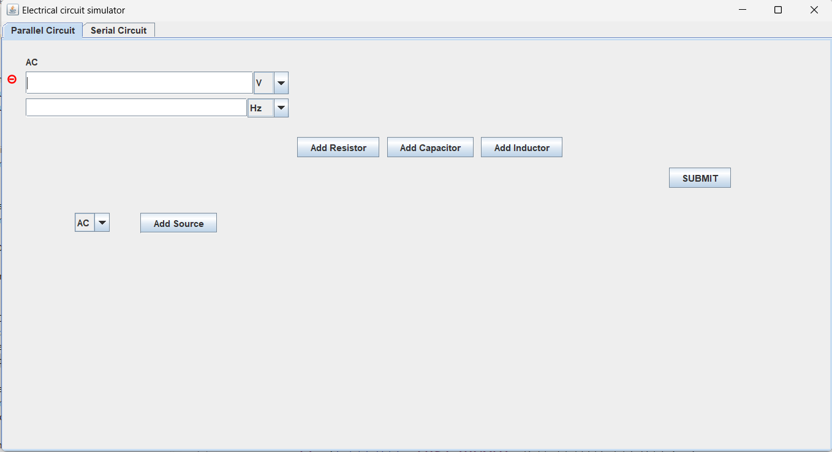
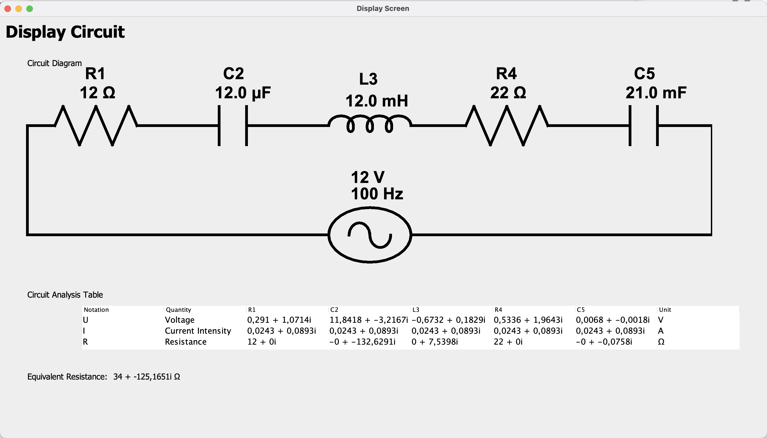
7. Demo scenario
Link video demo : https://youtu.be/_s2489ocm9w

Slide 22
THANK YOU !

