Slide 1

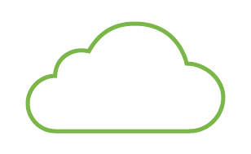





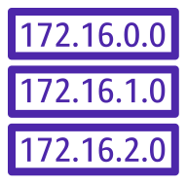





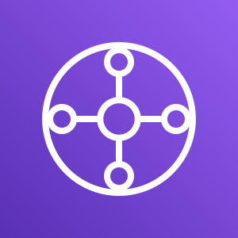
Meraki Branches
Auto VPN
Meraki Branches
AWS Cloud
Meraki Dashboard
Internet gateway
Availability Zone 1
Availability Zone 2
SD-WAN VPC
Public subnet
Public Route
Table
Public subnet
Amazon CloudWatch
Meraki vMX
Meraki vMX
10.249.0.0/24
10.249.1.0/24
TGW subnet
TGW subnet
AWS Lambda
TGW ENI
TGW ENI
10.249.2.0/24
10.249.3.0/24
10.249.0.0/16
AWS Transit Gateway
AWS Secrets Manager
AWS TGW Route Table
Workload VPCs
Workload VPCs
10.250.0.0/16
10.251.0.0/16

