Slide 1

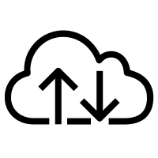

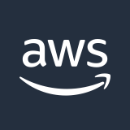
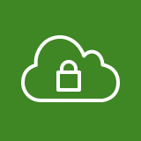
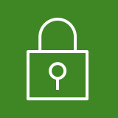
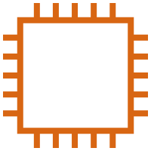
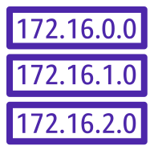

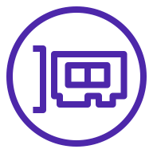

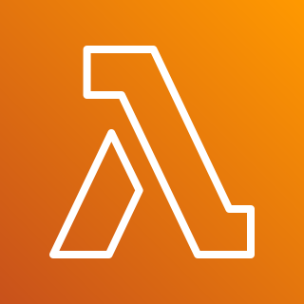
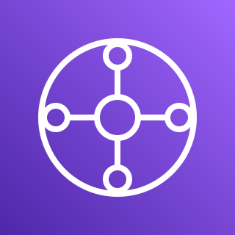
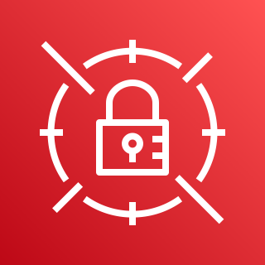
Meraki branches
Auto VPN
AWS Cloud
Internet gateway
Availability Zone 1
Availability Zone 2
Meraki dashboard
SD-WAN VPC
Public subnet
Public subnet
Meraki vMX
Meraki vMX
Private subnet
Route table
Private subnet
Elastic network interface
Elastic network interface
Amazon CloudWatch
AWS Lambda
AWS Transit Gateway
AWS Secrets Manager

Slide 2
AWS Cloud
Meraki branches
Auto VPN
Availability Zone 1
Internet gateway
Availability Zone 2
Meraki dashboard
VPC
Public subnet
Public subnet
Meraki vMX
Public route table
Meraki vMX
Private subnet
Private subnet
Elastic network interface
Elastic network interface
Security domain
AWS Transit Gateway
Transit Gateway route table
Amazon CloudWatch
AWS Lambda
AWS Secrets Manager

Slide 3
AWS Cloud
Meraki branches
Meraki Auto VPN
Internet gateway
Meraki dashboard
Availability Zone 1
Availability Zone 2
VPC
Public subnet
Public subnet
Amazon CloudWatch
Meraki vMX
Public route table
Meraki vMX
Private subnet
Private subnet
AWS Lambda
Elastic network interface
Elastic network interface
AWS Secrets Manager
Transit Gateway route table
AWS Transit Gateway

Slide 4
AWS Cloud
Meraki branches
Meraki Auto VPN
Internet gateway
Meraki dashboard
Availability Zone 1
Availability Zone 2
SD-WAN VPC
Public subnet
Public subnet
AWS Lambda
Meraki vMX
Public route table
Meraki vMX
Private subnet
Private subnet
Amazon CloudWatch
Elastic network interface
Elastic network interface
AWS Secrets Manager
Transit gateway route table
AWS Transit Gateway
Workload VPCs

