Slide 1

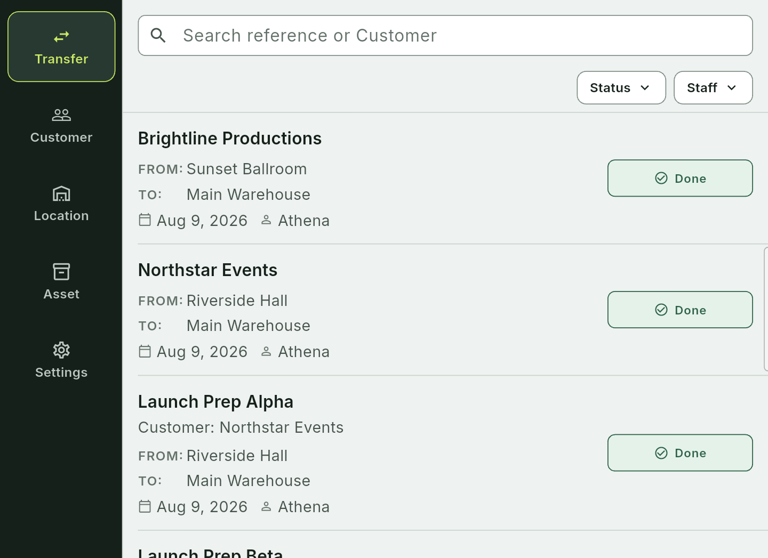
FINAL PROJECT • CSW430
Etrelay:
Rental Operations
A mobile equipment transfer management system for AV rental teams
Lecturers
Tran Van Tai
Nguyen Hoang Ly
TRAN KHANH BINH
2231200127 • INDIVIDUAL PROJECT
12 JUL — 12 AUG 2026
Mobile Application Development
Notes:
Good morning. This is my CSW430 Mobile Application Development project, Etrelay: Rental Operations. It is an individual project about tracking AV equipment movement. I will briefly explain the problem, the architecture, the implementation, and the verified results.

Slide 2
CSW430 • MOBILE APPLICATION DEVELOPMENT
02
Why this project?
The operational gap is not inventory alone — it is movement accountability.
A transfer is more than a row in a spreadsheet.
01
PLANNED
Expected assets and quantities
AV teams need one record that explains what should move, what actually moved, what returned, and who performed the action.
02
MOVED
Dispatch and partial movement
PROJECT RESPONSE
RETURNED
03
Customers + Locations + Assets + Transfers
Received, damaged, outstanding
ETRELAY: RENTAL OPERATIONS
TRAN KHANH BINH • 2231200127
Notes:
The main problem is movement accountability. An inventory list alone cannot explain what was planned, what was dispatched, what was returned, and who performed each action. Etrelay connects customers, locations, assets, and transfers into one operational workflow.

Slide 3
CSW430 • MOBILE APPLICATION DEVELOPMENT
03
Objectives and scope
A complete course-sized slice of a real product — with sensitive launch details excluded.
29
MOBILE
Build an Android app with at least 20 topic-appropriate screens.
primary screens
BACKEND
Connect Flutter to a self-developed REST API and local PostgreSQL.
verified in the source inventory
IN SCOPE
DATA
Support auth, profile, list/detail, CRUD, QR identity and transfer lifecycle.
Auth • catalogs • assets • QR • transfers • evidence • history
BOUNDARY
No secrets, pricing or private production details
ETRELAY: RENTAL OPERATIONS
TRAN KHANH BINH • 2231200127
Notes:
The project objectives were to build an Android application with more than 20 relevant screens, connect it to a self-developed REST API and a local PostgreSQL database, and support authentication, profiles, CRUD, QR identity, and transfer operations. Production secrets and commercial details are intentionally outside the academic scope.

Slide 4
CSW430 • MOBILE APPLICATION DEVELOPMENT
04
Project plan
One student owns every phase: analysis, design, implementation, testing and presentation.
ANALYZE
DESIGN
BUILD
TEST
DOCUMENT
12–16 Jul
15–19 Jul
18 Jul–4 Aug
30 Jul–9 Aug
5–12 Aug
Requirements research
UX + database
Flutter + Node REST API
Flutter + REST API tests
Report + slides
INDIVIDUAL DELIVERY MODEL
No fictional team members. The same person can explain every design and implementation decision.
ETRELAY: RENTAL OPERATIONS
TRAN KHANH BINH • 2231200127
Notes:
I completed the project individually. The work was organised into analysis, design, implementation, testing, and documentation. This plan allowed the requirements, database, API, Flutter screens, tests, report, and presentation to be completed as one connected deliverable.

Slide 5
CSW430 • MOBILE APPLICATION DEVELOPMENT
05
Main feature system
The transfer lifecycle is the spine; catalogs, assets, evidence and access support it.
1
PREPARE
2
DISPATCH
3
RETURN
4
HISTORY
AUTH + COMPANY
CUSTOMERS + LOCATIONS
SERIALIZED + BULK ASSETS
QR + PRIVATE EVIDENCE
Adaptive phone + large-screen layouts • loading / empty / error / recovery states
ETRELAY: RENTAL OPERATIONS
TRAN KHANH BINH • 2231200127
Notes:
The transfer lifecycle is the centre of the system. A user prepares a transfer, dispatches the selected equipment, records the return, and reviews the history. Customers, locations, assets, QR scanning, and evidence support this lifecycle.

Slide 6
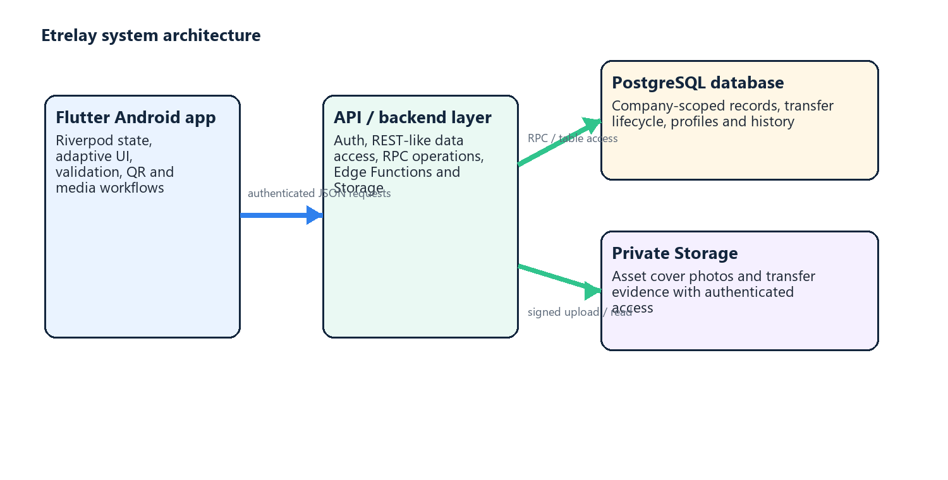
CSW430 • MOBILE APPLICATION DEVELOPMENT
06
Technology and architecture
Flutter, a self-developed REST API, and a local relational database.
MOBILE
Flutter • Dart • Riverpod
BACKEND / API
Node.js • Express • Zod
DATABASE
PostgreSQL • pg • indexes
PRIVATE MEDIA
Local JWT authentication
Flutter → Node.js + Express REST API → local PostgreSQL. Local JWT provides identity only.
ETRELAY: RENTAL OPERATIONS
TRAN KHANH BINH • 2231200127
Notes:
The assessed architecture is Flutter and Dart on the mobile side, Node.js and Express for the custom REST API, and PostgreSQL for persistence. Riverpod supports Flutter state management, Zod validates API input, and local JWT authentication provides the user identity. The main data flow is Flutter, then REST API, then PostgreSQL.

Slide 7
CSW430 • MOBILE APPLICATION DEVELOPMENT
07
Analysis: users and authorization
Flutter controls visibility; backend authorization remains authoritative.
O
OWNER
S
STAFF
• Manage company settings and invitations
• Perform all operational workflows
• Control team membership and access
• View permitted company records
• Prepare, dispatch and return assigned transfers
• Scan QR and add operational evidence
COMPANY ADMIN + OPERATOR
AUTHORIZED OPERATOR
ETRELAY: RENTAL OPERATIONS
TRAN KHANH BINH • 2231200127
Notes:
The Owner manages company and operational access, while Staff performs permitted operational actions. Customers are business contacts rather than authenticated application users. Although Flutter controls what is visible, authorization is enforced by the backend, so a client cannot bypass ownership or access rules.

Slide 8
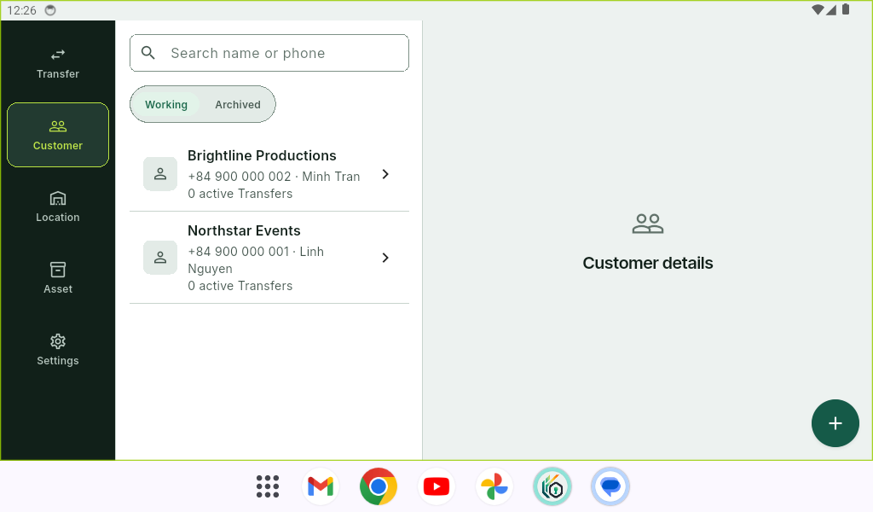
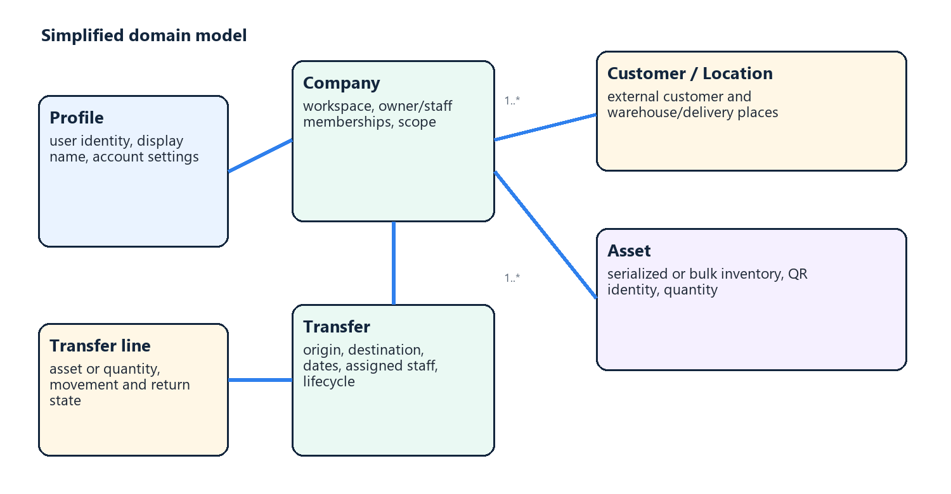
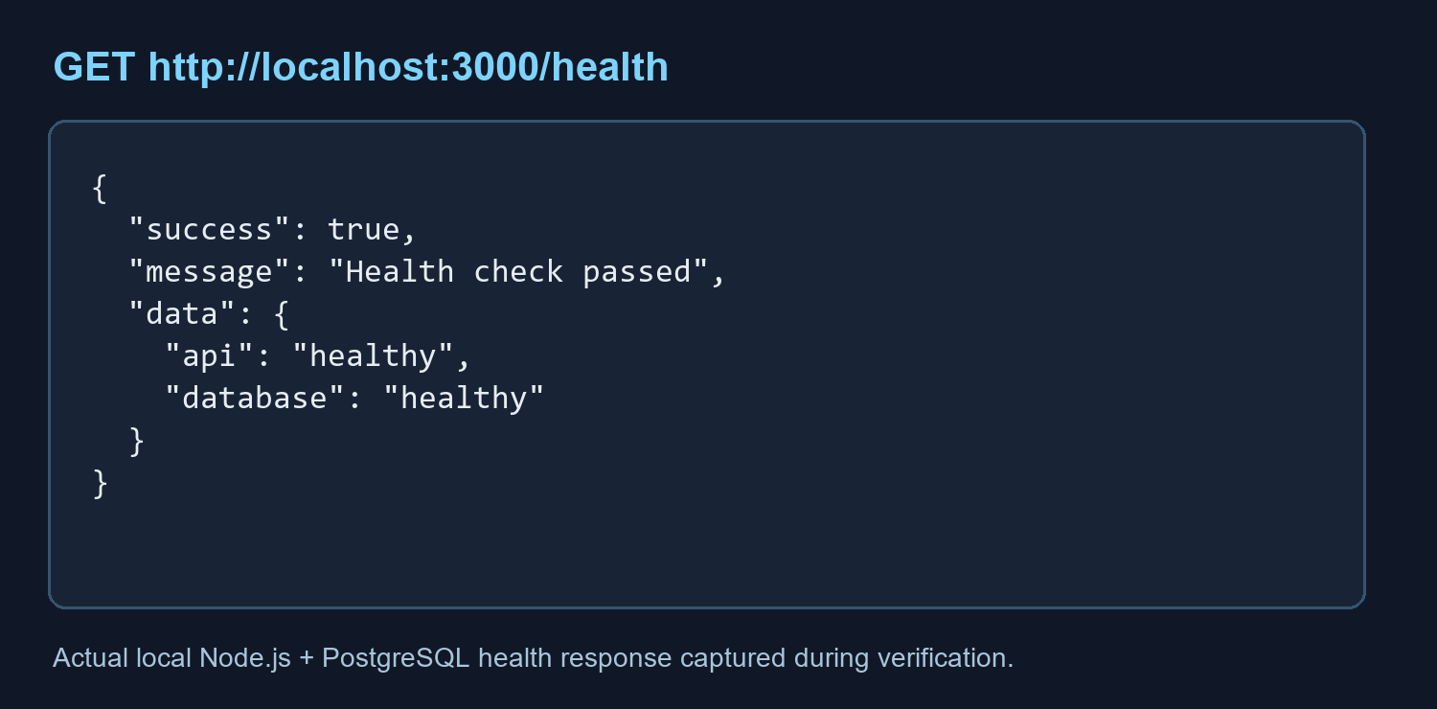
CSW430 • MOBILE APPLICATION DEVELOPMENT
08
Database and API contract
Nine explicit Node.js + Express REST endpoints returning JSON.
COURSE API MINIMUM
1
Login
6
Get detail
2
Register
7
Create
3
Get profile
8
Update
4
Update profile
9
Delete
5
Get list
RUNTIME EVIDENCE • local Customer data
{ "success": true, "data": { … } }
ETRELAY: RENTAL OPERATIONS
TRAN KHANH BINH • 2231200127
Notes:
The backend implements the nine required API capabilities: login, register, get and update profile, list and detail retrieval, create, update, and delete. Each route returns a consistent JSON response envelope. This is the custom API required by the course; it is not replaced by a backend-as-a-service product.

Slide 9
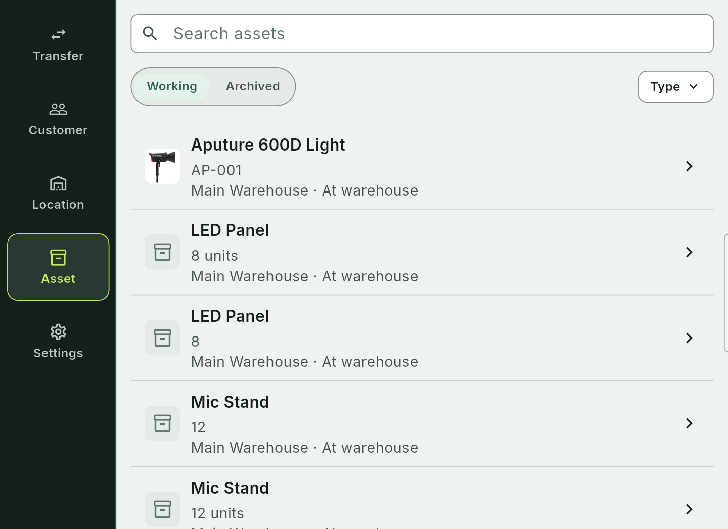
CSW430 • MOBILE APPLICATION DEVELOPMENT
09
Runtime UI and screen coverage
Authenticated Etrelay screens captured on the connected Android Studio emulator.
TRANSFER LIST
Search • filters • state badges • ownership
ASSET LIST
Serialized • bulk • warehouse • working state
ETRELAY: RENTAL OPERATIONS
TRAN KHANH BINH • 2231200127
Notes:
The runtime interface covers authentication, transfers, assets, locations, customers, QR functions, and evidence. The screens use consistent navigation and provide loading, empty, success, validation, and error states. These emulator views show the application side of the architecture.

Slide 10
CSW430 • MOBILE APPLICATION DEVELOPMENT
10
Testing and verified results
Verification of Flutter, REST API and local demo components.
127
29
9
9
Flutter tests
primary screens
REST API tests
REST endpoints
Workflow, widgets and failure recovery
Above the course minimum of 20
Health, validation, auth and ownership
Required course capabilities
✓
flutter analyze
PASS — no issues found
Local database + emulator smoke: final runtime check
ETRELAY: RENTAL OPERATIONS
TRAN KHANH BINH • 2231200127
Notes:
The project was verified with Flutter analysis, Flutter tests, backend API tests, and the local runtime setup. The results include 127 Flutter tests, 29 primary screens, nine REST API tests, and all nine required REST endpoints. The local database and emulator workflow were also checked.

Slide 11
CSW430 • MOBILE APPLICATION DEVELOPMENT
11
Demonstration path
A short sequence proving the required mobile–REST API–database workflow.
01
02
03
04
05
06
SIGN IN
PROFILE
CUSTOMERS
CREATE
UPDATE
DELETE
Call Node login API
Read/update profile API
List/detail through REST API
Add a Customer through REST API
Edit or archive Customer
Verify ownership and JSON response
RUNTIME EVIDENCE • API health, login, profile and Customer CRUD on the Android Studio emulator.
ETRELAY: RENTAL OPERATIONS
TRAN KHANH BINH • 2231200127
Notes:
For the live demonstration, I will sign in through the Node login API, open the profile, load the customer list and detail, create a customer, update or archive it, and finally delete it. This sequence demonstrates the mobile client, API, database persistence, validation, and ownership checks together.

Slide 12
CSW430 • MOBILE APPLICATION DEVELOPMENT
12
Limitations and future work
Clear boundaries make the academic claim stronger, not weaker.
CURRENT LIMITS
BACKEND EXPLANATION
Express owns REST routes, Zod validation and PostgreSQL queries. Local JWT identifies users only.
• Emulator screenshots use demonstration data only
• Local-only demonstration: no cloud/Play Store deployment
• No commercial launch details in the academic report
REPORTING
OFFLINE SYNC
NOTIFICATIONS
SUS STUDY
FUTURE WORK
ETRELAY: RENTAL OPERATIONS
TRAN KHANH BINH • 2231200127
Notes:
The current version is a local academic demonstration and uses demonstration data only. It is not deployed to the Play Store or a cloud server. Future work could add offline synchronisation, notifications, a usability study, and a production deployment process.

Slide 13
CSW430 • CONCLUSION
Etrelay demonstrates a complete mobile application slice.
Mobile UI • backend/API • PostgreSQL • authentication • CRUD • QR • transfer lifecycle • testing
Ready for presentation
Custom REST API implemented • local runtime demonstration ready
Questions & demonstration
ETRELAY: RENTAL OPERATIONS
TRAN KHANH BINH • 2231200127
Notes:
In conclusion, Etrelay demonstrates a complete course-sized mobile application slice: Flutter UI, custom backend API, PostgreSQL database, authentication, CRUD, QR support, transfer lifecycle, and testing. The implementation is ready for the local demonstration. Thank you, and I am ready for questions.

Slide 14
CSW430 • MOBILE APPLICATION DEVELOPMENT
14
References
Selected academic sources supporting usability, inventory traceability and API security.
MOBILE + UX
INVENTORY + SECURITY
Harrison, Flood & Duce (2013) — mobile usability Weichbroth (2020) — usability literature review Nielsen (1994) — usability heuristics Chen et al. (2014) — OAuth for mobile apps
Fett, Kusters & Schmitz (2016) — OAuth 2.0 security Sethi, Peltonen & Aura (2019) — secure device pairing Dane, Michael & Wamba (2010) — RFID inventory control Mathaba et al. (2017) — IoT inventory management Sriram et al. (2021) — RFID supply-chain review
Full list: 25 references in the project report.
ETRELAY: RENTAL OPERATIONS
TRAN KHANH BINH • 2231200127
Notes:
These references support the project decisions around mobile usability, inventory traceability, API security, authentication, and software architecture. The full report contains the complete reference list; this slide shows only selected sources.

