Slide 1

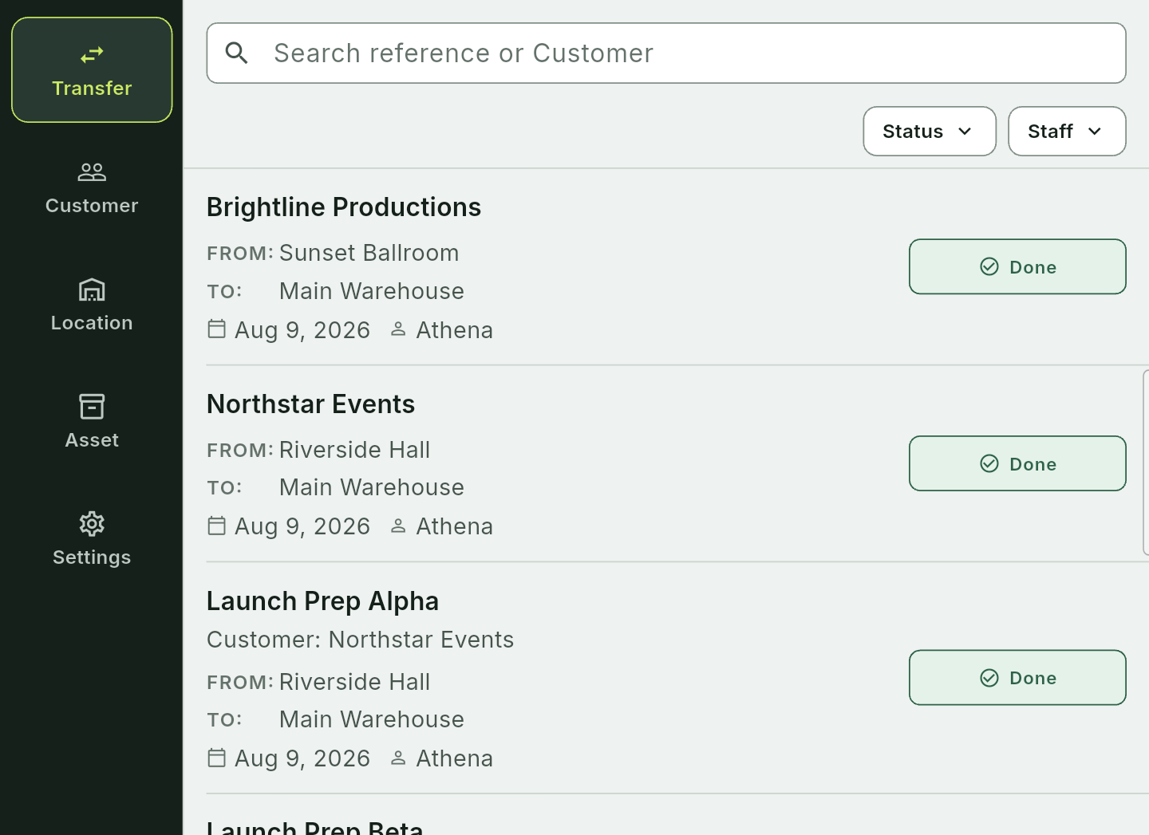
FINAL PROJECT • CSW430
Etrelay:
Rental Operations
A mobile equipment transfer management system for AV rental teams
Lecturers
Tran Van Tai
Nguyen Hoang Ly
TRAN KHANH BINH
2231200127 • INDIVIDUAL PROJECT
12 JUL — 12 AUG 2026
Mobile Application Development

Slide 2
CSW430 • MOBILE APPLICATION DEVELOPMENT
02
Why this project?
The operational gap is not inventory alone — it is movement accountability.
A transfer is more than a row in a spreadsheet.
01
PLANNED
Expected assets and quantities
AV teams need one record that explains what should move, what actually moved, what returned, and who performed the action.
02
MOVED
Dispatch and partial movement
PROJECT RESPONSE
RETURNED
03
Customers + Locations + Assets + Transfers
Received, damaged, outstanding
ETRELAY: RENTAL OPERATIONS
TRAN KHANH BINH • 2231200127

Slide 3
CSW430 • MOBILE APPLICATION DEVELOPMENT
03
Objectives and scope
A complete course-sized slice of a real product — with sensitive launch details excluded.
29
MOBILE
Build an Android app with at least 20 topic-appropriate screens.
primary screens
BACKEND
Connect Flutter to a self-developed REST API and local PostgreSQL.
verified in the source inventory
IN SCOPE
DATA
Support auth, profile, list/detail, CRUD, QR identity and transfer lifecycle.
Auth • catalogs • assets • QR • transfers • evidence • history
BOUNDARY
No secrets, pricing or private production details
ETRELAY: RENTAL OPERATIONS
TRAN KHANH BINH • 2231200127

Slide 4
CSW430 • MOBILE APPLICATION DEVELOPMENT
04
Project plan
One student owns every phase: analysis, design, implementation, testing and presentation.
ANALYZE
DESIGN
BUILD
TEST
DOCUMENT
12–16 Jul
15–19 Jul
18 Jul–4 Aug
30 Jul–9 Aug
5–12 Aug
Requirements research
UX + database
Flutter + Node REST API
Flutter + REST API tests
Report + slides
INDIVIDUAL DELIVERY MODEL
No fictional team members. The same person can explain every design and implementation decision.
ETRELAY: RENTAL OPERATIONS
TRAN KHANH BINH • 2231200127

Slide 5
CSW430 • MOBILE APPLICATION DEVELOPMENT
05
Main feature system
The transfer lifecycle is the spine; catalogs, assets, evidence and access support it.
1
PREPARE
2
DISPATCH
3
RETURN
4
HISTORY
AUTH + COMPANY
CUSTOMERS + LOCATIONS
SERIALIZED + BULK ASSETS
QR + PRIVATE EVIDENCE
Adaptive phone + large-screen layouts • loading / empty / error / recovery states
ETRELAY: RENTAL OPERATIONS
TRAN KHANH BINH • 2231200127

Slide 6
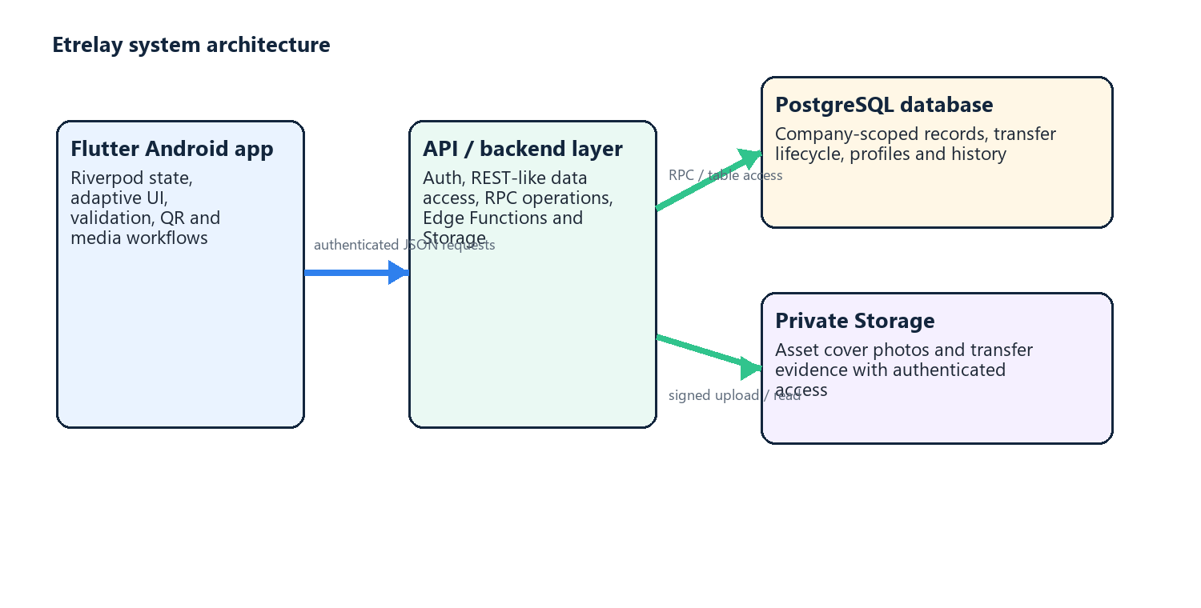
CSW430 • MOBILE APPLICATION DEVELOPMENT
06
Technology and architecture
Flutter, a self-developed REST API, and a local relational database.
MOBILE
Flutter • Dart • Riverpod
BACKEND / API
Node.js • Express • Zod
DATABASE
PostgreSQL • pg • indexes
PRIVATE MEDIA
Local JWT authentication
Flutter → Node.js + Express REST API → local PostgreSQL. Local JWT provides identity only.
ETRELAY: RENTAL OPERATIONS
TRAN KHANH BINH • 2231200127

Slide 7
CSW430 • MOBILE APPLICATION DEVELOPMENT
07
Analysis: users and authorization
Flutter controls visibility; backend authorization remains authoritative.
O
OWNER
S
STAFF
• Manage company settings and invitations
• Perform all operational workflows
• Control team membership and access
• View permitted company records
• Prepare, dispatch and return assigned transfers
• Scan QR and add operational evidence
COMPANY ADMIN + OPERATOR
AUTHORIZED OPERATOR
ETRELAY: RENTAL OPERATIONS
TRAN KHANH BINH • 2231200127

Slide 8
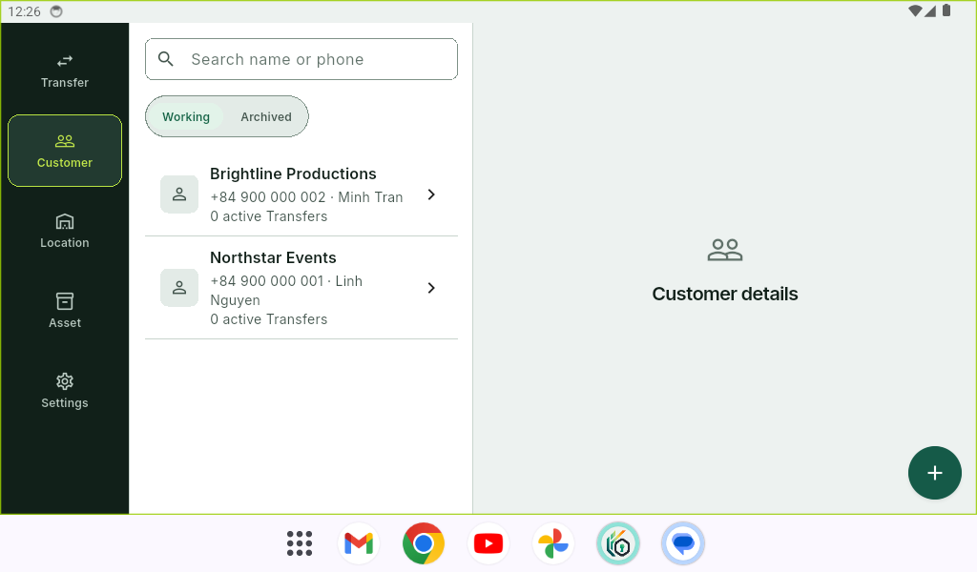
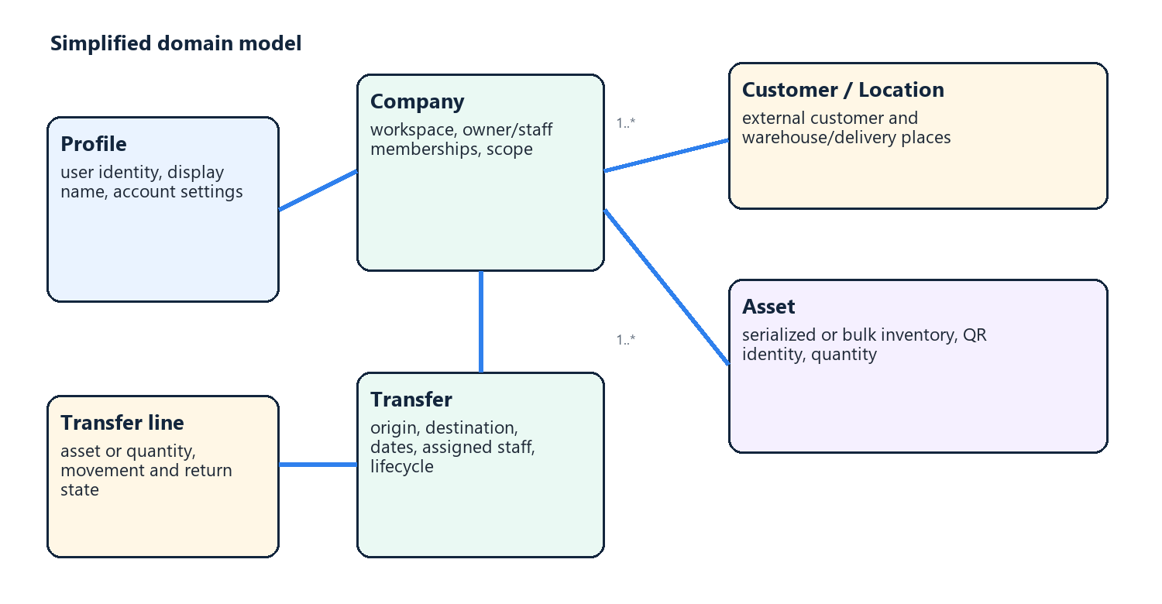
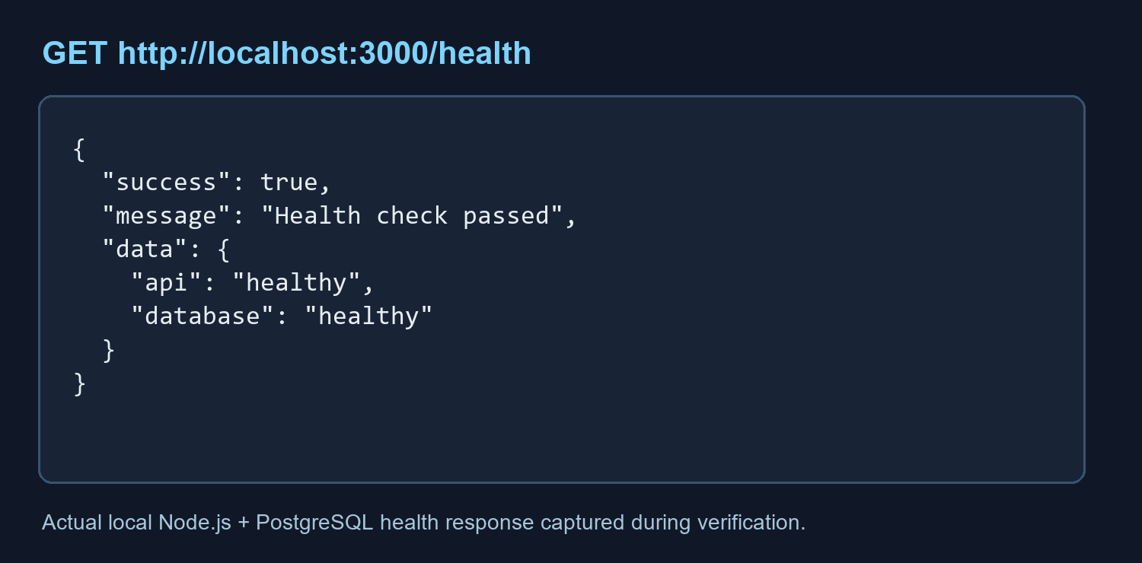
CSW430 • MOBILE APPLICATION DEVELOPMENT
08
Database and API contract
Nine explicit Node.js + Express REST endpoints returning JSON.
COURSE API MINIMUM
1
Login
6
Get detail
2
Register
7
Create
3
Get profile
8
Update
4
Update profile
9
Delete
5
Get list
RUNTIME EVIDENCE • local Customer data
{ "success": true, "data": { … } }
ETRELAY: RENTAL OPERATIONS
TRAN KHANH BINH • 2231200127

Slide 9
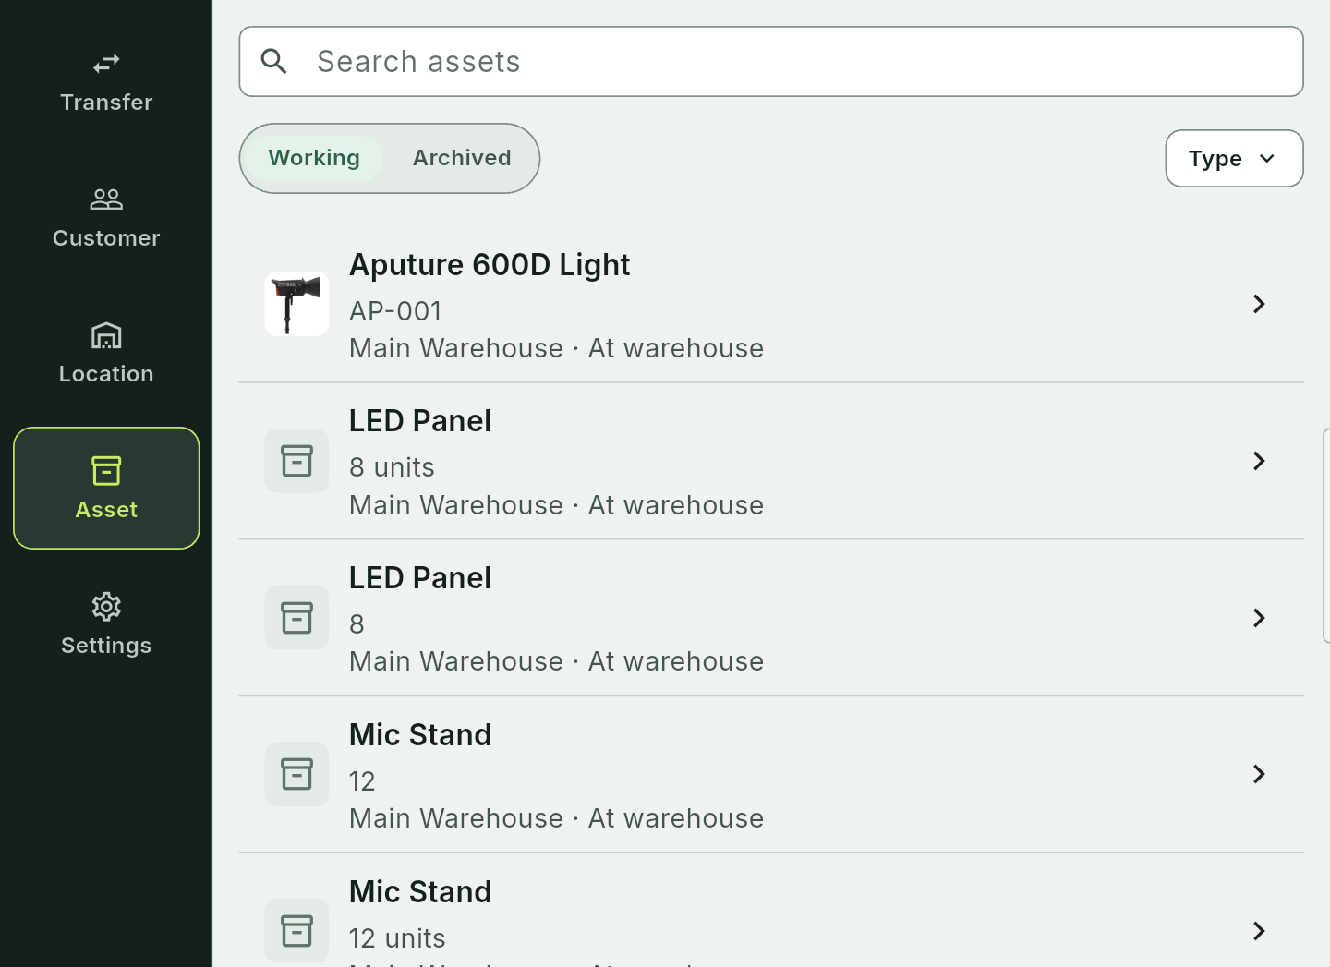
CSW430 • MOBILE APPLICATION DEVELOPMENT
09
Runtime UI and screen coverage
Authenticated Etrelay screens captured on the connected Android Studio emulator.
TRANSFER LIST
Search • filters • state badges • ownership
ASSET LIST
Serialized • bulk • warehouse • working state
ETRELAY: RENTAL OPERATIONS
TRAN KHANH BINH • 2231200127

Slide 10
CSW430 • MOBILE APPLICATION DEVELOPMENT
10
Testing and verified results
Verification of Flutter, REST API and local demo components.
127
29
9
9
Flutter tests
primary screens
REST API tests
REST endpoints
Workflow, widgets and failure recovery
Above the course minimum of 20
Health, validation, auth and ownership
Required course capabilities
✓
flutter analyze
PASS — no issues found
Local database + emulator smoke: final runtime check
ETRELAY: RENTAL OPERATIONS
TRAN KHANH BINH • 2231200127

Slide 11
CSW430 • MOBILE APPLICATION DEVELOPMENT
11
Demonstration path
A short sequence proving the required mobile–REST API–database workflow.
01
02
03
04
05
06
SIGN IN
PROFILE
CUSTOMERS
CREATE
UPDATE
DELETE
Call Node login API
Read/update profile API
List/detail through REST API
Add a Customer through REST API
Edit or archive Customer
Verify ownership and JSON response
RUNTIME EVIDENCE • API health, login, profile and Customer CRUD on the Android Studio emulator.
ETRELAY: RENTAL OPERATIONS
TRAN KHANH BINH • 2231200127

Slide 12
CSW430 • MOBILE APPLICATION DEVELOPMENT
12
Limitations and future work
Clear boundaries make the academic claim stronger, not weaker.
CURRENT LIMITS
BACKEND EXPLANATION
Express owns REST routes, Zod validation and PostgreSQL queries. Local JWT identifies users only.
• Emulator screenshots use demonstration data only
• Local-only demonstration: no cloud/Play Store deployment
• No commercial launch details in the academic report
REPORTING
OFFLINE SYNC
NOTIFICATIONS
SUS STUDY
FUTURE WORK
ETRELAY: RENTAL OPERATIONS
TRAN KHANH BINH • 2231200127

Slide 13
CSW430 • CONCLUSION
Etrelay demonstrates a complete mobile application slice.
Mobile UI • backend/API • PostgreSQL • authentication • CRUD • QR • transfer lifecycle • testing
Ready for presentation
Custom REST API implemented • local runtime demonstration ready
Questions & demonstration
ETRELAY: RENTAL OPERATIONS
TRAN KHANH BINH • 2231200127

Slide 14
CSW430 • MOBILE APPLICATION DEVELOPMENT
14
References
Selected academic sources supporting usability, inventory traceability and API security.
MOBILE + UX
INVENTORY + SECURITY
Harrison, Flood & Duce (2013) — mobile usability Weichbroth (2020) — usability literature review Nielsen (1994) — usability heuristics Chen et al. (2014) — OAuth for mobile apps
Fett, Kusters & Schmitz (2016) — OAuth 2.0 security Sethi, Peltonen & Aura (2019) — secure device pairing Dane, Michael & Wamba (2010) — RFID inventory control Mathaba et al. (2017) — IoT inventory management Sriram et al. (2021) — RFID supply-chain review
Full list: 25 references in the project report.
ETRELAY: RENTAL OPERATIONS
TRAN KHANH BINH • 2231200127

