Slide 1


Boston Housing Market Analysis
By Binyam Siyum
Data Analytics Project – October 2025
Notes:
Hello good afternoon everyone my name is binyam
This project analyzes the Boston Housing Market dataset to identify key factors influencing median home values .

Slide 2
What is Data Analytics?
Business Questions
Data Understanding and Preparation
Data Visualization and Exploratory Data Analysis (EDA)
Regression Analysis
Conclusion and Recommendations/Business Decision
Hypothesis Testing and Decision Making
Notes:
Data analytics is the process of examining raw data to discover patterns, trends, and insights that support decision-making.
And there are 6 main steps, the first thing is business questions, and then data preparation, exploratory data analysis, regression analysis, hypothesis testing and business decision we will see each steps for Boston housing market analysis.

Slide 3

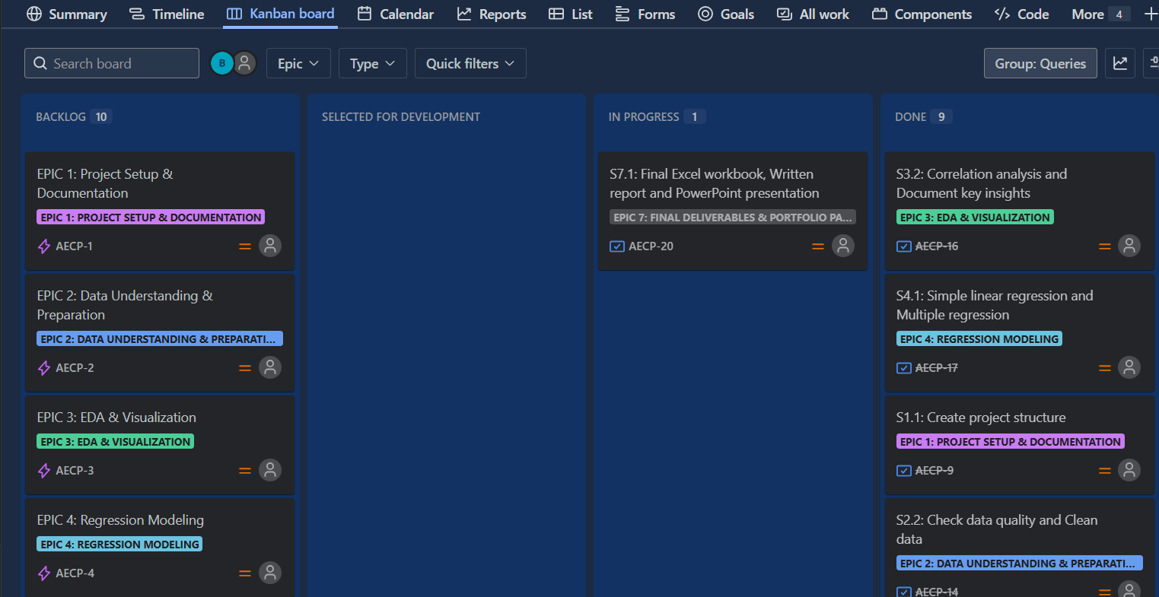
Project Task Management Using Jira Kanban Board
EPIC
Story
Task
Notes:
I created Jira Kanban board to visualize progress and manage the project efficiently.
Organized project workflow from Epic → Story → Task for better clarity and tracking.

Slide 4


Business Question
Which factors most significantly influence the median value of homes in the Boston Housing Market?
Notes:
The Boston Housing Market dataset contains various houses in different areas around Boston, collected in the 1970s.
506 observations, 13 variables
1 Dependent variable(median value of homes(MEDV) and 12 independent variables

Slide 5
Data Preparation
Data Loading
Data Exploration
Data Cleaning
Load the Boston Dataset
Identify and handle outliers
Lower bound = Q1 – 1.5 * IQR
Upper bound = Q3 + 1.5 * IQR
Address any missing value
Check duplicate rows
Ensure data consistency
Descriptive Statistics
Notes:
upload the Boston dataset and create data dictionary and data information after we cloned the raw data
In data exploration I calculated the descriptive statistics (mean, median, mode, standard deviation, quartiles using excel functions) and identify data types of each columns
For data cleaning I found a lot of outliers that are real value but extreme high and extreme low value and I replaced outliers above the upper bound by upper bound and outliers below the lower bound by lower bound

Slide 6
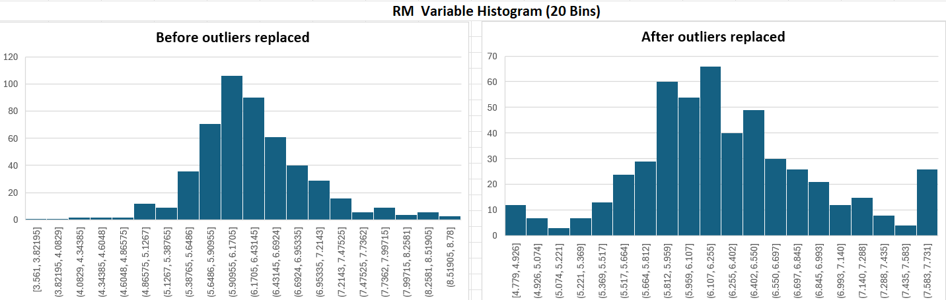
Data Visualization and Exploratory Data Analysis (EDA)-Univariate Analysis
RM appears normally distributed.
Notes:
One of the independent variable is number of rooms (RM) and it looks like normally distributed

Slide 7
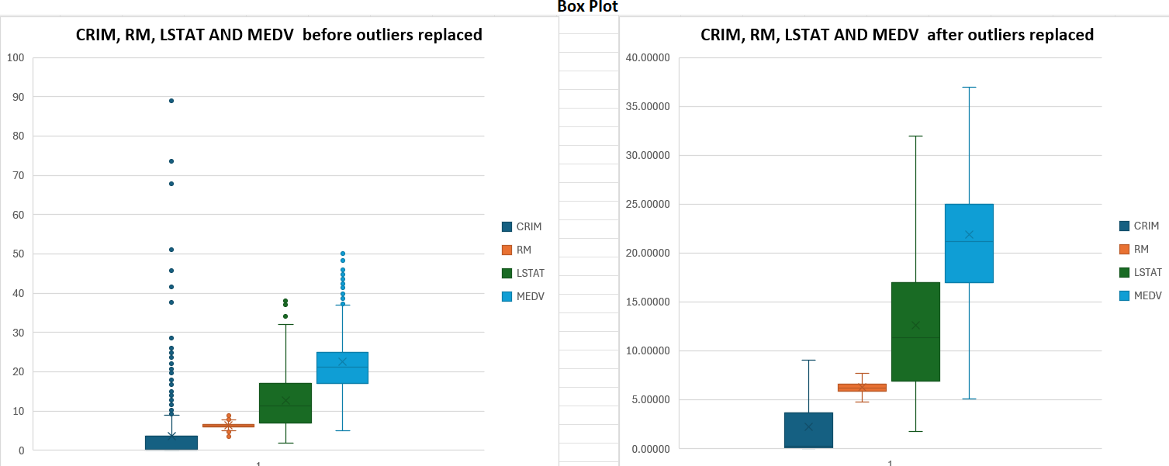
Data Visualization and Exploratory Data Analysis (EDA)-Univariate Analysis
Box plots confirmed clean data after outlier replacement.

Slide 8
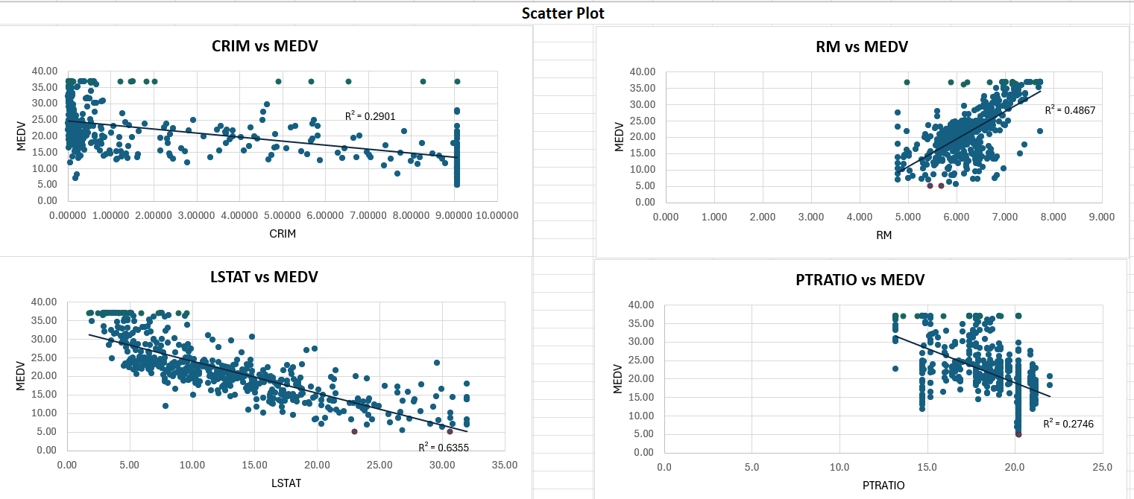
Data Visualization and Exploratory Data Analysis (EDA)-Bivariate Analysis
RM vs MEDV: Positive relationship.
PTRATIO, CRIM & LSTAT vs MEDV: negative relationships.
Upper bound are colored green and lower bound are colored red
Notes:
And this is a scatter plot chart between each 4 independent variable with median value(MEDV)(dependent variable
CRIM, LSTAT, and PTRATIO have negative correlations with MEDV.
In the scatter plot, upper bound points are colored green and lower bound points are colored red for clearer visualization.

Slide 9
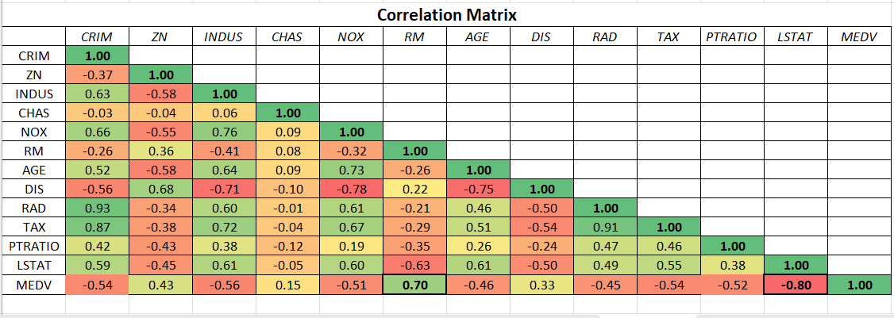
Data Visualization and Exploratory Data Analysis (EDA)-Bivariate Analysis
RM vs MEDV: Strong positive correlation.
LSTAT vs MEDV: Strong negative correlation.
RAD vs TAX has 0.91 one can be removed in the multiple regression model to avoid multicollinearity.

Slide 10
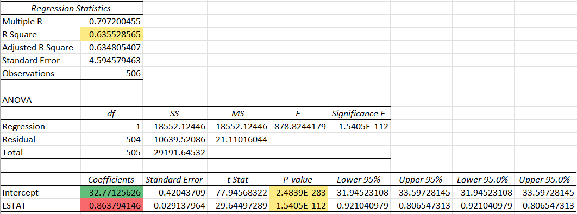
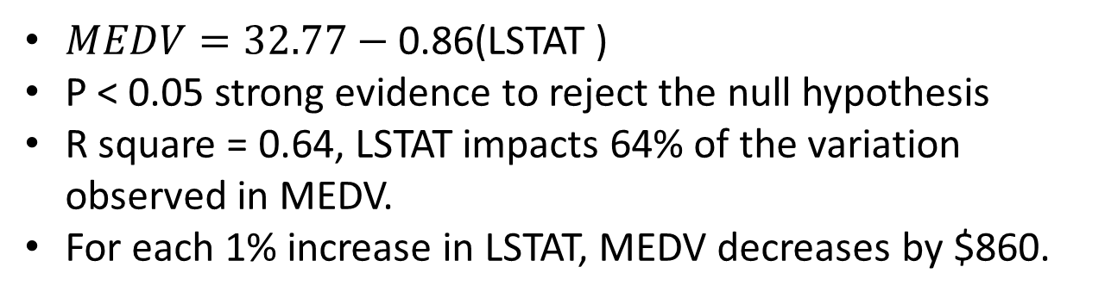
Simple Linear Regression/LSTAT vs MEDV
$MEDV=32.77−$ 0.86(LSTAT )
P < 0.05 strong evidence to reject the null hypothesis
R square = 0.64, LSTAT impacts 64% of the variation observed in MEDV.
For each 1% increase in LSTAT, MEDV decreases by $860.
Notes:
Null hypothesis(H0) = lower status of the population(LSTAT) has no impact on median value.

Slide 11
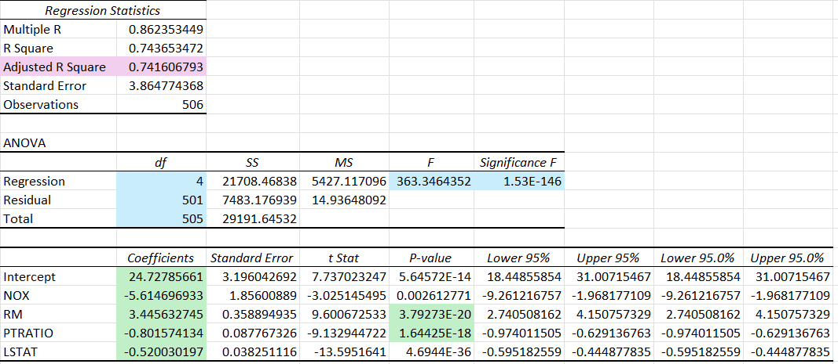
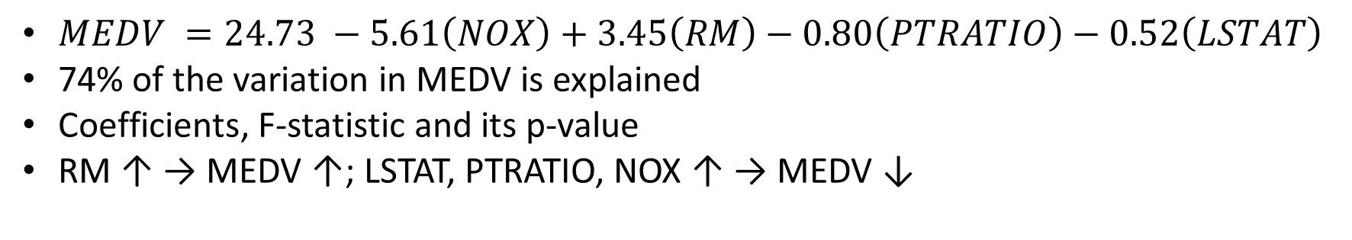
Multiple Regression/RM,NOX,LSTAT,PTRATIO vs MEDV
$MEDV =24.73 −5.61\left(NOX\right)+3.45\left(RM\right)−0.80\left(PTRATIO\right)−0.52\left(LSTAT\right)$
74% of the variation in MEDV is explained
Coefficients, F-statistic and its p-value
RM ↑ → MEDV ↑; LSTAT, PTRATIO, NOX ↑ → MEDV ↓

Slide 12


Hypothesis Testing and Decision Making
P value from multiple regression
Is RM a significant predictor of MEDV?
Is PTRATIO a significant predictor of MEDV?
P < 0.05
RM and PTRATIO are significant predictor of MEDV.
More rooms tend to have higher median values.
Lower student–teacher ratios tend to have higher median home values.
3.79273E-20
1.64425E-18

Slide 13

Conclusion and Recommendations
Stakeholders
Real Estate Developers and Construction Groups:
Homebuyers
Urban Planners
Real Estate Agents
Notes:
For real estate developers and construction groups: Invest in neighborhood security (e.g., install surveillance cameras, gated access, and better lighting) to reduce CRIM levels and increase property values.
When building new properties, increase the number of rooms to raise the median home value (MEDV). More spacious homes tend to attract higher market prices.
For home buyers: Consider areas with lower crime, cleaner air, and stronger community infrastructure for better long-term value.
For urban planners: Focus on improving environmental quality and education resources, as these factors can enhance neighborhood home values.
For real estate agents: Emphasize homes with more rooms (RM) as a key driver of price.

Slide 14
Thank you!

