Slide 1
Chapter 2
Programming Language Syntax

Slide 2
computer languages must be precise.
syntax and semantics must be specified
Distinguishing between syntax and semantics is useful for at least two reasons.
very similar semantics but very different syntax
there are some very efficient and elegant algorithms

Slide 3
Syntax
how we specify the structural rules of a programming language
Programmers
Relies on regular expressions and context-free grammars, which specify how to generate valid programs.
how a compiler identifies the structure of a given input program.
Compilers
Relies on scanners and parsers, which recognize program structure.

Slide 4
Formal specification of syntax requires a set of rules.
Three kinds of formal rules:
Concatenation,
Alternation(choice among a finite set of alternatives),
“Kleene closure” (repetition an arbitrary number of times).
One additional kind of rule:
Recursion (creation of a construct from simpler instances of the same construct).

Slide 5
Defined in terms of the first three rules is called a regular set/regular language.
Generated by regular expressions and recognized by scanners
If we add recursion is called a context-free language (CFL).
Generated by context-free grammars (CFGs) and recognized by parsers.

Slide 6
Regular Expressions
A regular expression is one of the following:
A character
The empty string, denoted by ε
Two regular expressions concatenated
Two regular expressions separated by | (i.e., or)
A regular expression followed by the Kleene star * (concatenation of zero or more strings)

Slide 7
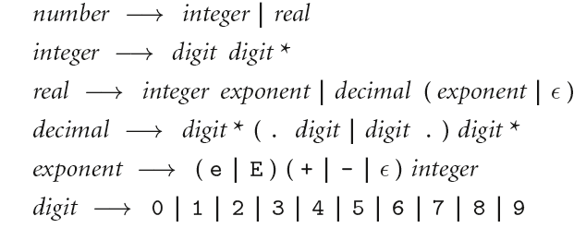
Regular Expressions
Numerical constants accepted by a simple hand-held calculator:

Slide 8
Context-Free Grammars
The notation for context-free grammars (CFG) is sometimes called Backus-Naur Form (BNF)
A CFG consists of
A set of terminals T
A set of non-terminals N
A start symbol S (a non-terminal)
A set of productions

Slide 9
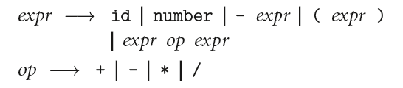
Context-Free Grammars
Context-Free Grammars

Slide 10
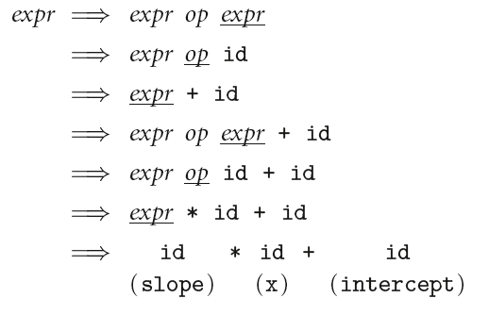
Context-Free Grammars
In this grammar, generate the string "slope * x + intercept"

Slide 11
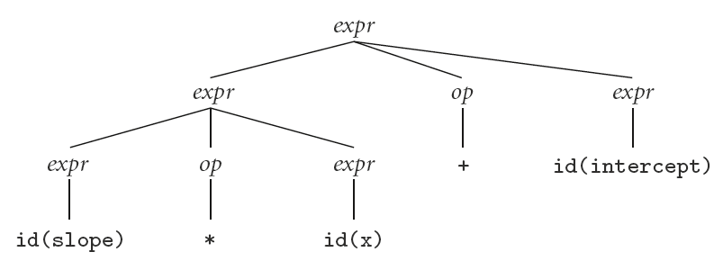
Context-Free Grammars
Parse tree for expression grammar for "slope * x + intercept"

Slide 12
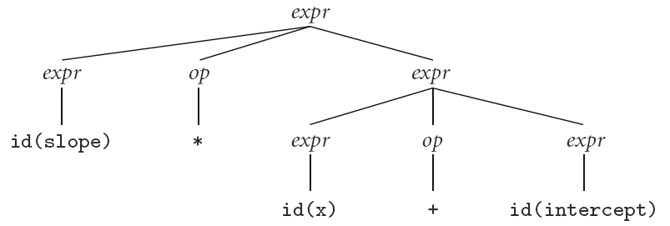
Context-Free Grammars
Alternate (less desirable) Parse tree for "slope * x + intercept"
Our grammar is ambiguous

Slide 13
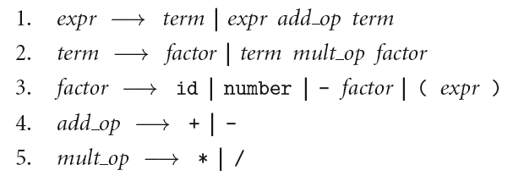
Context-Free Grammars
A better version because it is unambiguous and captures precedence

Slide 14
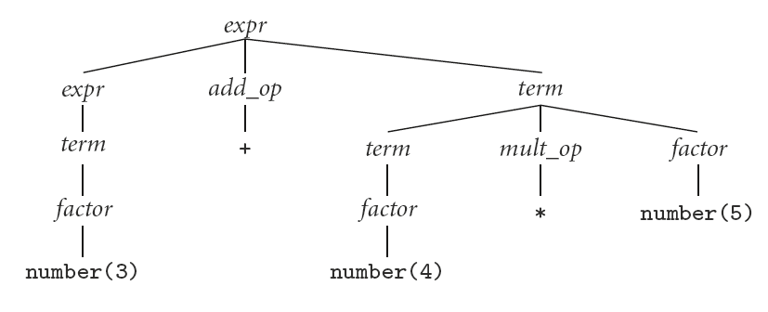
Context-Free Grammars
Parse tree expression grammar for 3 + 4 * 5

Slide 15
Context-Free Grammars
Exercise
Write a Parse tree expression grammar for 10 – 4 – 3, with left associativity

Slide 16
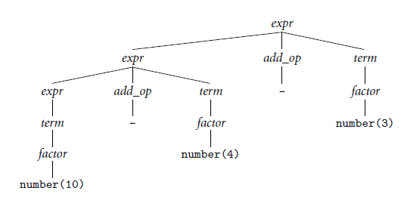
Context-Free Grammars
Parse tree expression grammar for 10 – 4 – 3, with left associativity

Slide 17
Scanning
Recall scanner is responsible for
removing comments
(often) dealing with pragmas (i.e., significant comments)
saving text of identifiers, numbers, strings
saving source locations (file, line, column) for error messages

Slide 18
Scanning
Suppose we are building an ad-hoc (hand-written) scanner for Pascal:
We read the characters one at a time with look-ahead
If it is one of the one-character tokens { ( ) [ ] < > , ; = + - etc } we announce that token
If it is a ., we look at the next character
If that is a dot, we announce .
Otherwise, we announce . and reuse the look-ahead

Slide 19
Scanning
Finite automata can be generated automatically from a set of regular expressions making it easy to regenerate a
scanner when token definitions change.
deterministic finite automaton (DFA)
there is never more than one possible outgoing transition (arrow) labeled by that character.

Slide 20
Scanning
scanner generator implements the conversion as a series of three separate steps.
1. converts the regular expressions into a nondeterministic finite automaton (NFA).
there are epsilon transitions,
more than one outgoing transition labeled by the same character.
2. translates the NFA into an equivalent DFA
3. space optimization
minimum possible number of states.

Slide 21
Scanning
We run the machine over and over to get one token after another
Nearly universal rule:
always take the longest possible token from the input thus foobar is foobar and never f or foo or foob
more to the point, 3.14159 is a real const and never 3, ., and 14159
Regular expressions "generate" a regular language; DFAs "recognize" it

Slide 22
Scanning
Scanners tend to be built three ways
ad-hoc
semi-mechanical pure DFA (usually realized as nested case statements)
table-driven DFA
Ad-hoc generally yields the fastest, most compact code by doing lots of special-purpose things, though good automatically-generated scanners come very close

Slide 23
Scanning
Note that the rule about longest-possible tokens means you return only when the next character can't be used to continue the current token
the next character will generally need to be saved for the next token
In some cases, you may need to peek at more than one character of look-ahead in order to know whether to proceed

Slide 24
Reading Assignment - Parsing

Slide 25
Parsing
Terminology:
context-free grammar (CFG)
symbols
terminals (tokens)
non-terminals
production
derivations (left-most and right-most - canonical)
parse trees
sentential form

Slide 26
Parsing
By analogy a context-free grammar (CFG) is a generator for a context-free language (CFL)
a parser is a language recognizer
There is an infinite number of grammars for every context-free language
not all grammars are created equal

Slide 27
Parsing
It turns out that for any CFG we can create a parser that runs in O(n^3) time
There are two well-known parsing algorithms that permit this
Early's algorithm
Cooke-Younger-Kasami (CYK) algorithm
O(n^3) time is clearly unacceptable for a parser in a compiler - too slow

Slide 28
Parsing
Fortunately, there are large classes of grammars for which we can build parsers that run in linear time
The two most important classes are called LL and LR
LL stands for 'Left-to-right, Leftmost derivation'.
LR stands for 'Left-to-right, Rightmost derivation’

Slide 29
Parsing
LL parsers are also called 'top-down', or 'predictive' parsers.
They construct a parse tree from the root down, predicting at each step which production will be used to expand the current node, based on the next available token of input.
LR parsers are also called 'bottom-up', or 'shift-reduce' parsers.
They construct a parse tree from the leaves up, recognizing when a collection of leaves or other nodes can be joined together as the children of a single parent.

Slide 30
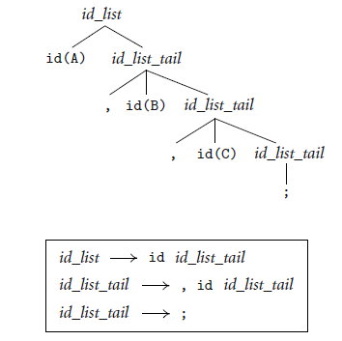
Parsing
Example (Top-down)
For the string A, B, C;

Slide 31
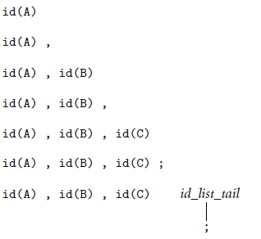
Parsing
Example (bottom-up parsing)
For the string A, B, C;

Slide 32
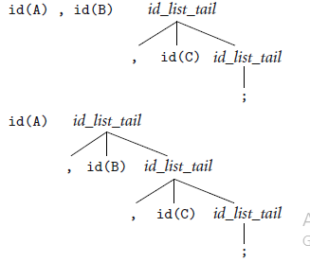
Parsing
Example (bottom-up parsing)
For the string A, B, C;

Slide 33
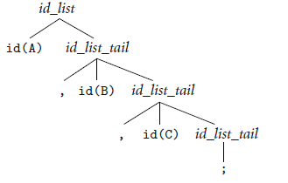
Parsing
Example (bottom-up parsing)
For the string A, B, C;

