Slide 1
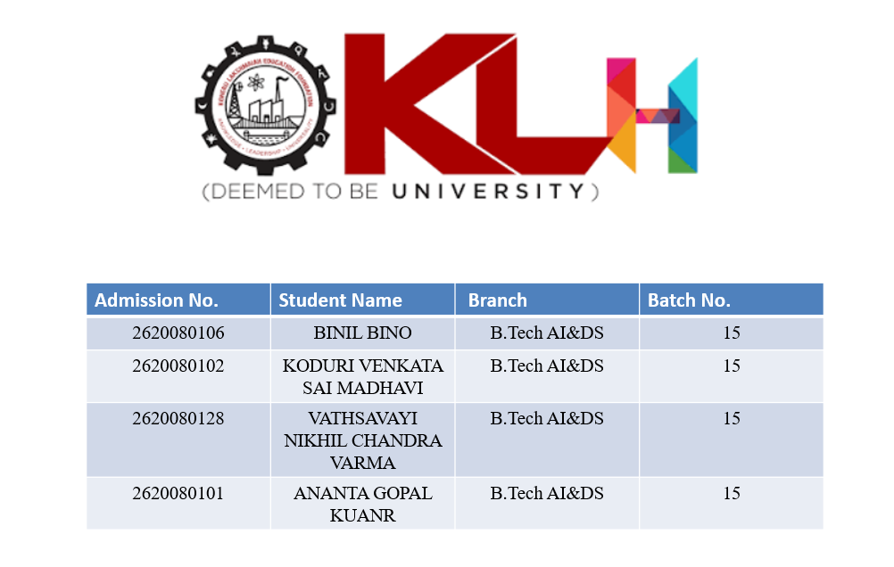

Slide 2
DIGITAL DESIGN & COMPUTER ARCHITECTURE
Design and Simulation of an
8-Bit Arithmetic Logic Unit (ALU)
DDCA Project | Design & Simulation of 8-Bit ALU | Group 15
1 / 11

Slide 3
01 | INTRODUCTION
Background & Domain Overview
What is an ALU?
Why 8-Bit?
Project Focus
The Arithmetic Logic Unit is the core computational engine of a CPU. It performs all arithmetic and logical operations required by a processor.
An 8-bit ALU processes two 8-bit operands and is the foundational building block used in educational processors and simple microcontrollers.
This project designs, implements (Logisim / HDL), and simulates an 8-bit ALU that supports essential arithmetic and logic operations under control signals.
DDCA Project | Design & Simulation of 8-Bit ALU | Group 15
2 / 11

Slide 4
02 | PROBLEM STATEMENT
Need for a Functional 8-Bit ALU
THE PROBLEM
THE NEED
Modern processors contain complex ALUs, but students need a clear, verifiable design to understand the fundamentals.
Key limitations of existing educational approaches:
• Lack of unified arithmetic + logic unit
• Incomplete operation sets
• Missing status flags and verification
• Hard to simulate and debug
A complete, modular 8-bit ALU that:
• Combines arithmetic & logic in one unit
• Uses clear control/select signals
• Supports simulation & verification
• Produces status flags (Carry, Zero…)
• Serves as a learning foundation for processor design
DDCA Project | Design & Simulation of 8-Bit ALU | Group 15
3 / 11

Slide 5
03 | OBJECTIVES
Specific Goals of the Project
01
Design
Develop a complete 8-bit ALU architecture that integrates both arithmetic and logical operations.
02
Implement
Realize the design in Logisim (circuit) and/or HDL with selectable operations via control signals.
03
Simulate
Test the ALU with diverse 8-bit input combinations and operation codes to verify correctness.
04
Verify
Confirm correct results and status flag behavior for representative test cases and edge conditions.
DDCA Project | Design & Simulation of 8-Bit ALU | Group 15
4 / 11

Slide 6
04 | LITERATURE / EXISTING SYSTEM
Previous Approaches & Limitations
Separate Units
Many educational designs treat adder and logic gates as independent circuits, making it hard to see the unified ALU concept.
Limited Operations
Basic projects often support only ADD/SUB or only a few logic gates, omitting a complete operation set.
No Flag Generation
Status flags (Carry, Zero, Overflow) are frequently omitted, reducing realism for processor design.
Weak Verification
Few student projects systematically simulate all opcodes and boundary conditions with documented results.
DDCA Project | Design & Simulation of 8-Bit ALU | Group 15
5 / 11

Slide 7
05 | PROPOSED SYSTEM
Our 8-Bit ALU Solution
Unified Design
Rich Operation Set
Single functional unit combining arithmetic and logic paths selected by opcode.
ADD, SUB, AND, OR, XOR, NOT (+ optional INC/DEC) via 3-bit control.
Status Flags
Simulation Ready
Carry / Borrow and Zero flags generated for realistic processor behavior.
Fully testable in Logisim with documented waveforms and truth tables.
DDCA Project | Design & Simulation of 8-Bit ALU | Group 15
6 / 11

Slide 8
06 | SYSTEM ARCHITECTURE
Block Diagram of the 8-Bit ALU
Input A
8-bit
Arithmetic
Unit
(ADD / SUB)
F
8-bit
→
MUX
Operation
Select
Input B
8-bit
→
→
Logic Unit
(AND / OR
XOR / NOT)
Opcode
3-bit Select
Flags
C / Z
DDCA Project | Design & Simulation of 8-Bit ALU | Group 15
7 / 11

Slide 9
07 | METHODOLOGY & IMPLEMENTATION
Design Steps & Working Principle
1
Specify operations & opcode encoding (3-bit)
OPCODE TABLE
2
Design 8-bit adder/subtractor (2’s complement)
Sel | Op | Function
000 | ADD | A + B
001 | SUB | A − B
010 | AND | A ∧ B
011 | OR | A ∨ B
100 | XOR | A ⊕ B
101 | NOT | ∼A
3
Build parallel logic gates for AND/OR/XOR/NOT
4
Use MUX to select final result based on opcode
5
Generate Carry and Zero flags
6
Implement in Logisim & create test vectors
DDCA Project | Design & Simulation of 8-Bit ALU | Group 15
8 / 11

Slide 10
08 | RESULTS & DISCUSSION
Simulation Verification
Representative test cases verified in simulation (Logisim / waveform):
A (dec) | B (dec) | Op | Expected | Result
13 | 7 | ADD | 20 | ✓ Pass
13 | 7 | SUB | 6 | ✓ Pass
170 | 204 | AND | 136 | ✓ Pass
170 | 204 | XOR | 102 | ✓ Pass
45 | 0 | OR | 45 | ✓ Pass
255 | 1 | ADD | 0 (C=1) | ✓ Pass
DDCA Project | Design & Simulation of 8-Bit ALU | Group 15
9 / 11

Slide 11
09 | CONCLUSION
Achievements & Summary
Successfully designed
An 8-bit ALU integrating arithmetic and logical operations under a unified control scheme.
Fully simulated & verified
All selected operations produce correct results; Carry and Zero flags behave as expected.
Educational foundation
The modular design serves as a clear learning platform for understanding CPU datapath components.
Future scope
Extend with shift/rotate, more flags, FPGA implementation, or integration into a simple 8-bit processor.
DDCA Project | Design & Simulation of 8-Bit ALU | Group 15
10 / 11

Slide 12
THANK YOU
Questions & Discussion
Group 15 • B.Tech AI & DS • DDCA Project
BINIL BINO • KODURI VENKATA SAI MADHAVI
VATHSAVAYI NIKHIL CHANDRA VARMA • ANANTA GOPAL KUANR
DDCA Project | Design & Simulation of 8-Bit ALU | Group 15
11 / 11

