Slide 1



ExitIQ
Edge-AI Based Dynamic Emergency Evacuation & Hazard Prevention System
Theme: AI in Hardware & Manufacturing | Sub-theme: Worker Safety & Hazard Prevention
Official Vishwakarma Application ID: VK26-IITI-AHM-0137
Binita A Rhessa H
binita.anto@mail.com rhessahendry@gmail.com

Slide 2
EXITIQ • VISHWAKARMA AWARDS STAGE 2
Project Overview: Innovation Summary & Problem Context
ONE-LINE INNOVATION SUMMARY
“ExitIQ provides sensor-driven, risk-aware evacuation guidance by dynamically updating routes when monitored zones become hazardous.”
CORE PROBLEM STATEMENT
“Conventional fixed evacuation signs may continue directing occupants toward a corridor even when local conditions become hazardous. Industrial environments need timely, location-specific guidance that accounts for changing monitored conditions and recommends an alternative route when one is available.”
RAPID HAZARD PROPAGATION
• In industrial manufacturing plants, chemical storage, and logistics warehouses, fire propagation is non-linear and violent.
• Flashover can occur in under 3 minutes, generating dense carbon monoxide, hydrogen cyanide, and toxic VOCs.
• Thick smoke reduces corridor visibility to < 1.0 meter within 60 seconds, eliminating visual recognition of landmarks.
STATIC SIGNAGE BLINDSPOT
• Conventional illuminated exit signs (ISO 7010 / NFPA 101) are statically mounted with permanent fixed arrows.
• During an emergency, static signs continuously point toward primary designated exits even if that corridor is engulfed in flames.
• Trapped occupants following signs blindly walk directly into fire fronts, toxic smoke pools, and collapsed pathways.
• Forced retreat causes fatal bottleneck jams, panic surges, and deadly inhalation.
TARGET BENEFICIARIES & URGENCY
• Primary Users: Industrial shop-floor workers, warehouse personnel, chemical handling technicians, and facility visitors.
• Emergency First Responders: Benefit from isolated hazard zones and prevented cluster fatalities.
• Regulatory Safety Boundary: Supplements mandatory fire safety infrastructure by providing dynamic local guidance when central networks fail.

Slide 3
EXITIQ • VISHWAKARMA AWARDS
User Journey Storyboard: Fixed Conventional Signage vs. Adaptive ExitIQ
BEFORE: CONVENTIONAL STATIC EGRESS RESPONSE
AFTER: EXITIQ DYNAMIC EGRESS GUIDANCE
CONCEPTUAL FACILITY LAYOUT • STATIC RESPONSE SCENARIO
SAME FACILITY LAYOUT • EXITIQ REAL-TIME RECALCULATION
CORRIDOR B (ACTIVE FIRE)
Static sign points workers HERE
Heavy toxic smoke & blockage!
CORRIDOR B: HIGH RISK
ExitIQ LED displays RED [X]
Route Cost: INFINITY (Blocked)
Worker Zone
(Starting Area)
Junction 1
(Static Sign ➔)
Worker Zone
(Starting Area)
ExitIQ Terminal
(LED Flips ⬇)
Corridor C
(Safe Exit 2)
[IGNORED]
✔ Corridor C ➔ SAFE EXIT 2
Green dynamic arrows guide egress
• 1. Hazard Erupts: Corridor B ignites; rapid toxic smoke accumulation.
• 2. General Siren: Standard audible alarm sounds; zero zone hazard awareness.
• 3. Static Blindness: Occupants follow permanent directional signs straight toward fire.
• 4. Fatal Encounter: Workers encounter toxic smoke pool; retreat causes crush panic.
Identified Failure Mode: Zero route adaptability; high smoke inhalation risk.
• 1. Zone Sensing: Sensirion SHT40 + SGP40 detect VOC index jump & thermal rate-of-rise.
• 2. Edge Risk Assessment: ESP32-S3 classifies Corridor B as HIGH RISK (<500 ms target).
• 3. Dynamic Recalculation: Graph pathfinder assigns infinite weight to Corridor B; selects Exit 2.
• 4. Physical Redirection: WS2812B green LEDs strobe toward Corridor C; buzzer pulses cadence.
Target Benefit: Eliminates wrong-route entries; verified in Stage 3 comparative trials.
Note: Illustrative scenario representing proposed dynamic guidance behavior. Quantitative evacuation time reductions are development targets subject to formal Stage 3 physical comparative trials.

Slide 4
System Architecture: End-to-End ExitIQ Data Flow
Proposed local-first architecture • diagram is editable in PowerPoint
1. SENSING
• SHT40: temperature & RH
• SGP40: VOC air-quality index
• Raw readings pre-filtered locally
2. EDGE
PROCESSING
• ESP32-S3 microcontroller
• Multi-sensor verification
• Assess zone hazard severity
3. RISK MAP
• Assign 4-state zone risk
• Update corridor graph-edge costs
• Normal / Warning / High / Critical
4. ROUTE ENGINE
• Shortest-path algorithm (Dijkstra)
• Penalize hazardous zones
• Select reachable safe exit path
5. GUIDANCE
• Dynamic directional LEDs
• SSD1306 OLED text display
• Local buzzer audible cadence
Continuous monitoring & route re-evaluation loop (target update cadence to be validated in Stage 3)
A. LOCAL COMMUNICATIONS
• Planned node-to-node local protocol (ESP-NOW / BLE mesh)
• 100% local-first architecture; zero external cloud dependency
• Defined node-to-node timeout & loss-of-link failure behavior
B. POWER & BACKUP
• TI BQ24074 Dynamic Power-Path Management (DPPM)
• Direct system powering while charging 18650 Li-Ion cell
• TPS61023 synchronous 5V boost; runtime/switchover subject to test
C. FAIL-SAFE LOGIC
• Stale sensor / communication timeout marks zone HIGH RISK
• FreeRTOS hardware watchdog resets locked pathfinding tasks
• If no reachable safe exit exists: trigger site emergency shelter rule
Engineering Demarcation & Safety Boundary Note:
ExitIQ is a proposed supplementary evacuation-guidance prototype. The SHT40 measures temperature and relative humidity; the SGP40 provides a VOC air-quality index and is not a certified smoke or toxic-gas detector. ExitIQ does not replace certified fire alarms, required exit signage, or approved emergency procedures.

Slide 5
EXITIQ • VISHWAKARMA AWARDS
System Flow: Real-Time Hazard Sensing to Guidance Actuation
STEP 1
1. HAZARD DETECT
SHT40 registers thermal spike (>5°C/min); SGP40 VOC index jumps from 100 to 450.
STEP 2
2. SENSOR FUSION
ESP32-S3 cross-validates dual sensor metrics, eliminating single-sensor false triggers.
STEP 3
3. RISK MAP UPDATE
Corridor B classified as HIGH RISK state in local memory in <500 ms target.
STEP 4
4. ROUTE RECALC
Dijkstra pathfinder penalizes Corridor B; selects alternate safe path to Exit 2 in <100 ms target.
STEP 5
5. PHYSICAL ACTUATE
WS2812B LEDs strobe green to Exit 2; OLED displays text; buzzer pulses alert.
STEP 6
6. ADAPT CONTINUOUS
FreeRTOS task loops every 500ms, dynamically updating as hazard front advances.
ILLUSTRATIVE EVACUATION SCENARIO: CORRIDOR B BLOCKED
• Initial State: Plant workers in Zone 1 are guided by static exit signs toward Central Exit 1 via Corridor B.
• Hazard Eruption: An electrical fire in Corridor B triggers thermal spikes and toxic gas generation.
• ExitIQ Response: Sensing node immediately detects environmental degradation, marks Corridor B as HIGH RISK, and dynamically flips junction LED arrows 180° to guide occupants through Corridor A toward safe Eastern Exit 2.
• Result: Eliminates panic, prevents toxic smoke exposure, and completes safe egress within statutory limits.

Slide 6
EXITIQ • VISHWAKARMA AWARDS
Zone-Based Hazard Assessment & Sensor Fusion Calibration Matrix
NORMAL (SAFE)
Temp: 20°C - 35°C
VOC Index: < 150
Baseline conditions
Action: Multiplier: 1.0x
Green steady beacon
WARNING (ALERT)
Temp: 35°C - 50°C
VOC Index: 150 - 250
Persistent gas rise
Action: Multiplier: 2.5x
Pre-alert dashboard
HIGH RISK (AVOID)
Temp: > 50°C / rate spike
VOC Index: 250 - 400
Combustion detected
Action: Multiplier: 10.0x
Dynamic LED redirect
CRITICAL (BLOCKED)
Temp: > 70°C
VOC Index: > 400
Dense toxic smoke
Action: Multiplier: Infinity
Red X strobe + siren
Risk State | Provisional Trigger Rule / Conditions | Edge Route Action | Visual Guidance Output | Acoustic Output
Normal (Safe) | Temp nominal (20–35°C), VOC Index < 150 (baseline ambient air). | Multiplier: 1.0x (Baseline edge weight). Preferred route. | Steady green exit pictogram; ambient white LED illumination. | Silent (Standby). No audible signal.
Warning (Alert) | Thermal rate-of-rise > 3°C/min OR VOC Index 150–250 (persistent degradation). | Multiplier: 2.5x. Traversal discouraged if alternatives exist. | OLED status: 'CAUTION: HAZARD NEARBY'; yellow caution border. | Intermittent soft chirp (50 dBA @ 10s intervals).
High Risk (Avoid) | Sustained temp > 50°C OR VOC Index 250–400 (combustion byproducts detected). | Multiplier: 10.0x. Route heavily penalized; triggers recalculation. | Dynamic WS2812B green LEDs flip to point toward alternate safe exit. | Directional pulse alert (75 dBA, 1 Hz cadence).
Critical (Blocked) | Extreme temp > 70°C OR VOC Index > 400 (toxic smoke pool) OR node link failure. | Multiplier: INFINITY (Edge weight pruned from graph). Path closed. | Pulsing red [X] symbol; OLED: 'CORRIDOR BLOCKED - DO NOT ENTER'. | Continuous emergency siren (85 dBA CUI CMT-8540S).
Calibration Status: Thresholds shown are provisional calibration values established from component datasheets and laboratory chamber testing. Final operational thresholds require validation in formal Stage 3 smoke chamber and fire-drill trials.

Slide 7
EXITIQ • VISHWAKARMA AWARDS
Dynamic Route Planning: Real-Time Graph Recalculation Around Hazards
CONCEPTUAL FACILITY GRAPH: DYNAMIC RE-ROUTING (STAGE 2 LAB LAYOUT)
ALGORITHMIC ROUTE RECALCULATION
Cost Function: C(e) = Length(e) × Risk_Multiplier(z) + Congestion(e)
• 1. Pre-Defined Topology: Building corridors and junctions stored as a directed graph G=(V,E) in ESP32-S3 Flash memory.
• 2. Real-Time Risk Ingestion: Zone hazard states continuously update edge weights in memory (<500 ms target sensor-to-graph latency).
• 3. Penalty Execution: Normal zones = 1.0x; Warning = 2.5x; High Risk = 10.0x; Critical zones = INFINITY (edge pruned).
• 4. Shortest Safe Path: Dijkstra / heuristic A* solves the modified graph in <100 ms target on the ESP32-S3 internal core.
• 5. Hardware Output: Physical direction vector transmitted to junction WS2812B LED light guides and OLED bezel panels.
• 6. Invariant Safety Check: The algorithm strictly forbids routing into active hazards. If all exits are blocked, shelter-in-place engages.
OCCUPANT START
Zone 1 (Workshop)
Initial: 25 Occupants
JUNCTION J1
[ExitIQ Node 1]
Re-evaluates Path
CORRIDOR B
Hazard: HIGH RISK
Weight: INFINITY
[BLOCKED / AVOID]
PRIMARY EXIT 1
[COMPROMISED]
✔ CORRIDOR C (ALTERNATIVE)
Sensor Status: NORMAL (Safe)
Distance: 28m | Weight: 1.0x
SAFE
EXIT 2
[CLEAR]
DIAGRAM LEGEND & VERIFICATION CONTEXT:
• Initial Path (Grey): Pre-incident baseline route pointing toward Exit 1 via Corridor B.
• Blocked Route (Red): Active fire detected; corridor assigned INFINITE cost and pruned from pathfinder.
• Recalculated Route (Green): Dijkstra algorithm dynamically routes through safe Corridor C to Exit 2.
• Status Note: Conceptual test topology for Stage 2 validation; not an actual facility architectural blueprint.

Slide 8
EXITIQ • VISHWAKARMA AWARDS
Hardware Subsystems: Verified Component Selection & Architecture
CORE CONTROLLER
ESP32-S3-DevKitC-1-N8R8
• Dual-core Xtensa LX7 @ 240MHz
• 8MB Octal Flash + 8MB Octal PSRAM
• Vector instructions accelerate TinyML
• Integrated 2.4GHz Wi-Fi + BLE 5.0 mesh
• FreeRTOS multi-tasking task scheduler
THERMAL SENSOR BAY
Sensirion SHT40-AD1B
• High-precision digital temperature/RH
• Accuracy: ±0.2°C typ (0°C to 60°C)
• Fast response time: τ63% = 2.0 seconds
• Ultra-low power: 0.4 µA average @ 1Hz
• I2C Interface: Standard fast-mode 400kHz
COMBUSTION / VOC SENSOR
Sensirion SGP40-DIS
• Digital MOx VOC Air Quality Sensor
• Integrated micro-hotplate sensor element
• Digital VOC Index algorithm output (0–500)
• Senses smoldering fire pyrolysis gases
• Compensated via SHT40 temp/RH feeds
POWER-PATH MANAGER
Texas Instruments BQ24074
• Autonomous Dynamic Power-Path (DPPM)
• Supplies system directly while charging cell
• <100ns brownout-free battery switchover
• 1.5A max charge current (ISET configured)
• Under-voltage & over-current protection
5V SYNCHRONOUS BOOST
Texas Instruments TPS61023
• Synchronous battery-to-5V step-up
• 3.7A valley switch current limit
• Supplies clean 5V to WS2812B LEDs
• >92% power conversion efficiency
• Stable operation down to 2.7V battery cutoff
EGRESS GUIDANCE OUTPUTS
WS2812B + OLED + Buzzer
• 8x WS2812B 5050 RGB addressable LEDs
• TI 74AHCT1G125 3.3V-to-5V level shifter
• 0.96' 128x64 SSD1306 Graphic OLED panel
• CUI CMT-8540S 85 dBA 4kHz audio buzzer
• Triple multi-modal egress alert channels

Slide 9
EXITIQ • VISHWAKARMA AWARDS
Itemized Prototype Bill of Materials (BOM) & Domestic Sourcing
Item | Component MPN & Description | Package / Form Factor | Qty | Sourcing Vendor & Lead Time | Line Total (INR)
1 | ESP32-S3-DevKitC-1-N8R8 MCU Carrier | DIP-44 (2x22 2.54mm socket headers) | 1 | Robu.in / Mouser India (3-5 days) | ₹850.00
2 | TI BQ24074RGTR Power-Path & Li-Ion Charger | VQFN-16 (3.0 x 3.0 mm) | 1 | Mouser / Element14 India (5 days) | ₹240.00
3 | TI TPS61023DRLR Synchronous 5V Boost Converter | SOT-563 (1.6 x 1.6 mm) | 1 | Mouser India (5 days) | ₹125.00
4 | Sensirion SHT40-AD1B-R2 Digital Temp/RH Sensor | DFN-4 (1.5 x 1.5 mm) | 1 | Mouser / Evelta India (4 days) | ₹180.00
5 | Sensirion SGP40-DIS-R4 Digital MOx VOC Sensor | DFN-6 (2.44 x 2.44 mm) | 1 | Mouser India (5 days) | ₹310.00
6 | Worldsemi WS2812B-B Intelligent RGB LEDs | 5050 SMD (5.0 x 5.0 mm) | 8 | Robu.in / Evelta India (2 days) | ₹120.00
7 | CUI CMT-8540S Buzzer + 74AHCT125 Level Shifter | SMD Magnetic + SOT-23-5 | 1 set | Robu.in / Domestic (2 days) | ₹140.00
8 | 0.96' 128x64 SSD1306 Graphic OLED Display Panel | 4-pin I2C Panel (26 x 15 mm active) | 1 | Robu.in (2 days) | ₹220.00
9 | Samsung/Panasonic 18650 3400mAh Li-Ion Cell + PCM | Cylindrical Cell + Protection Circuit | 1 | Domestic / Robu.in (3 days) | ₹450.00
10 | 2-Layer Custom FR4 Carrier PCB (Batch Amortized) | 100.0 x 80.0 x 1.6 mm FR4 | 1 | LionCircuits India (6 days) | ₹350.00
TOTAL ESTIMATED PROTOTYPE NODE COST: ₹3,585 INR (Per-Node Prototype Estimate)
• Cost Scope: Items 1–10 subtotal ₹2,985 + ₹600 allocation for SMD passives/TVS/PTC, connectors/inserts, and 3D printed PETG enclosure.
• Exclusions / Assumptions: Excludes domestic courier freight and 18% GST. Volume batch production (>1,000 nodes) projected to reduce unit cost to ~₹1,850 INR.

Slide 10
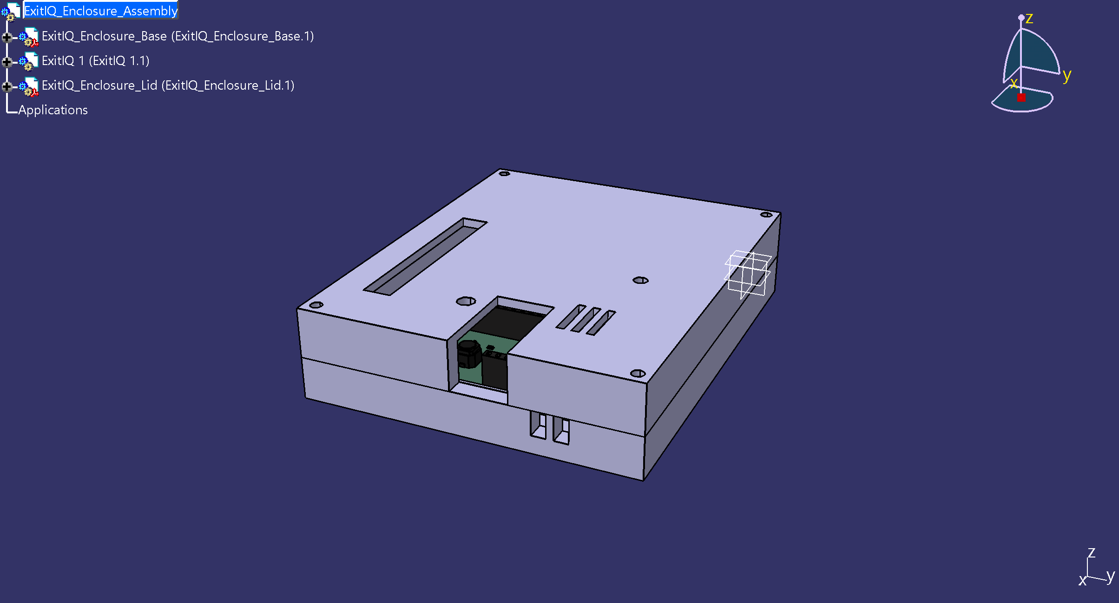
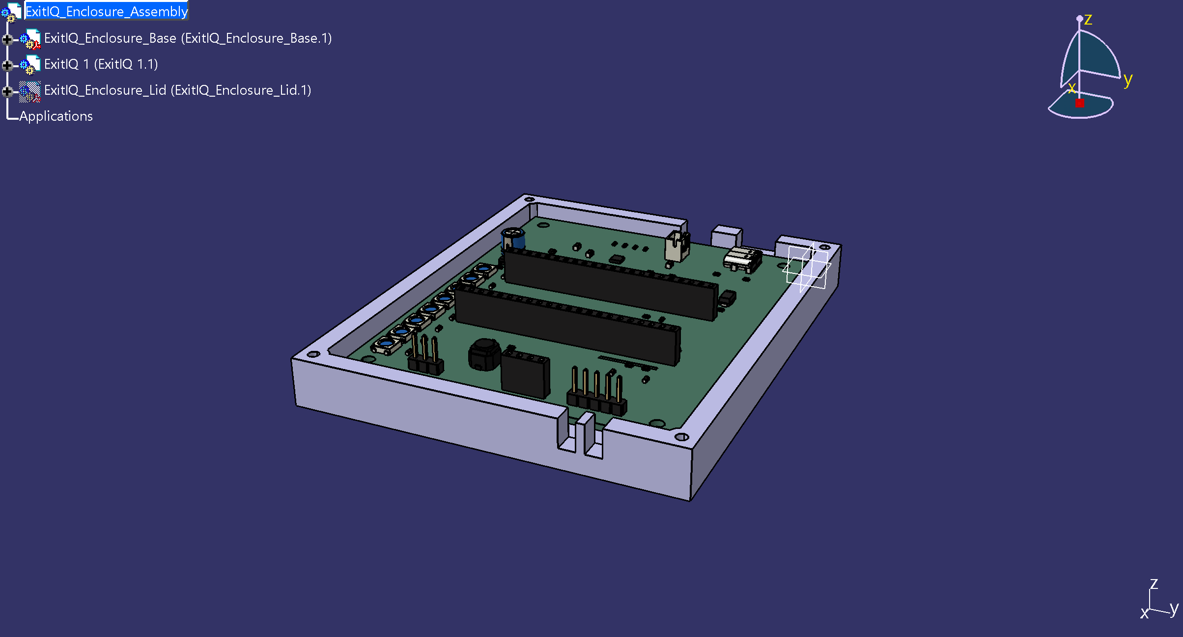
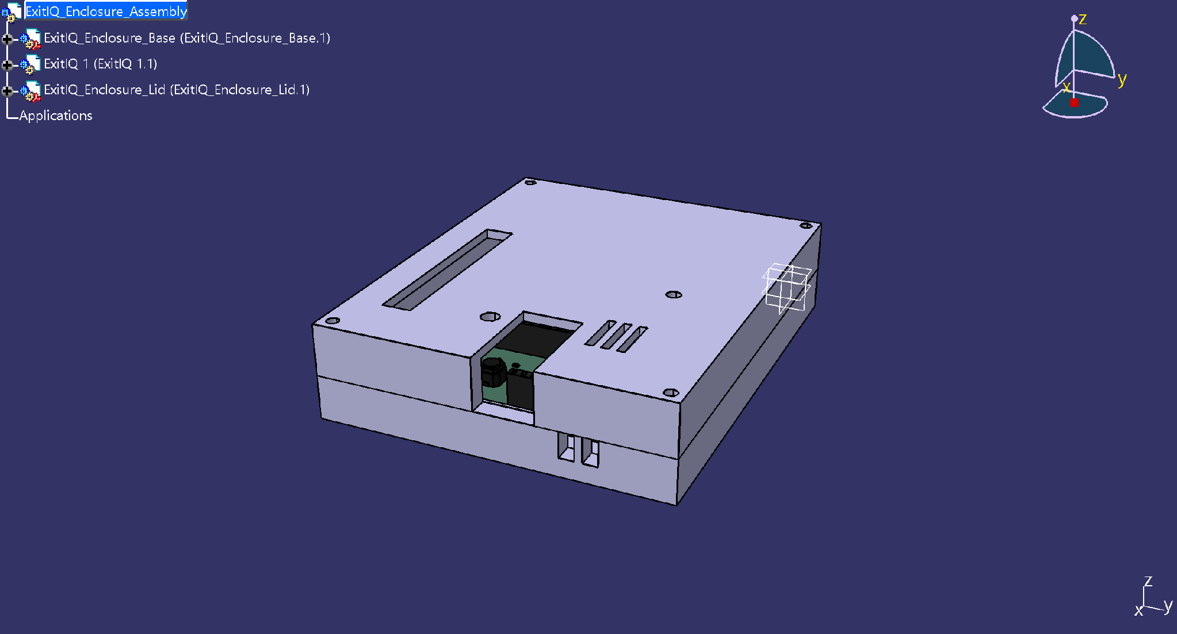
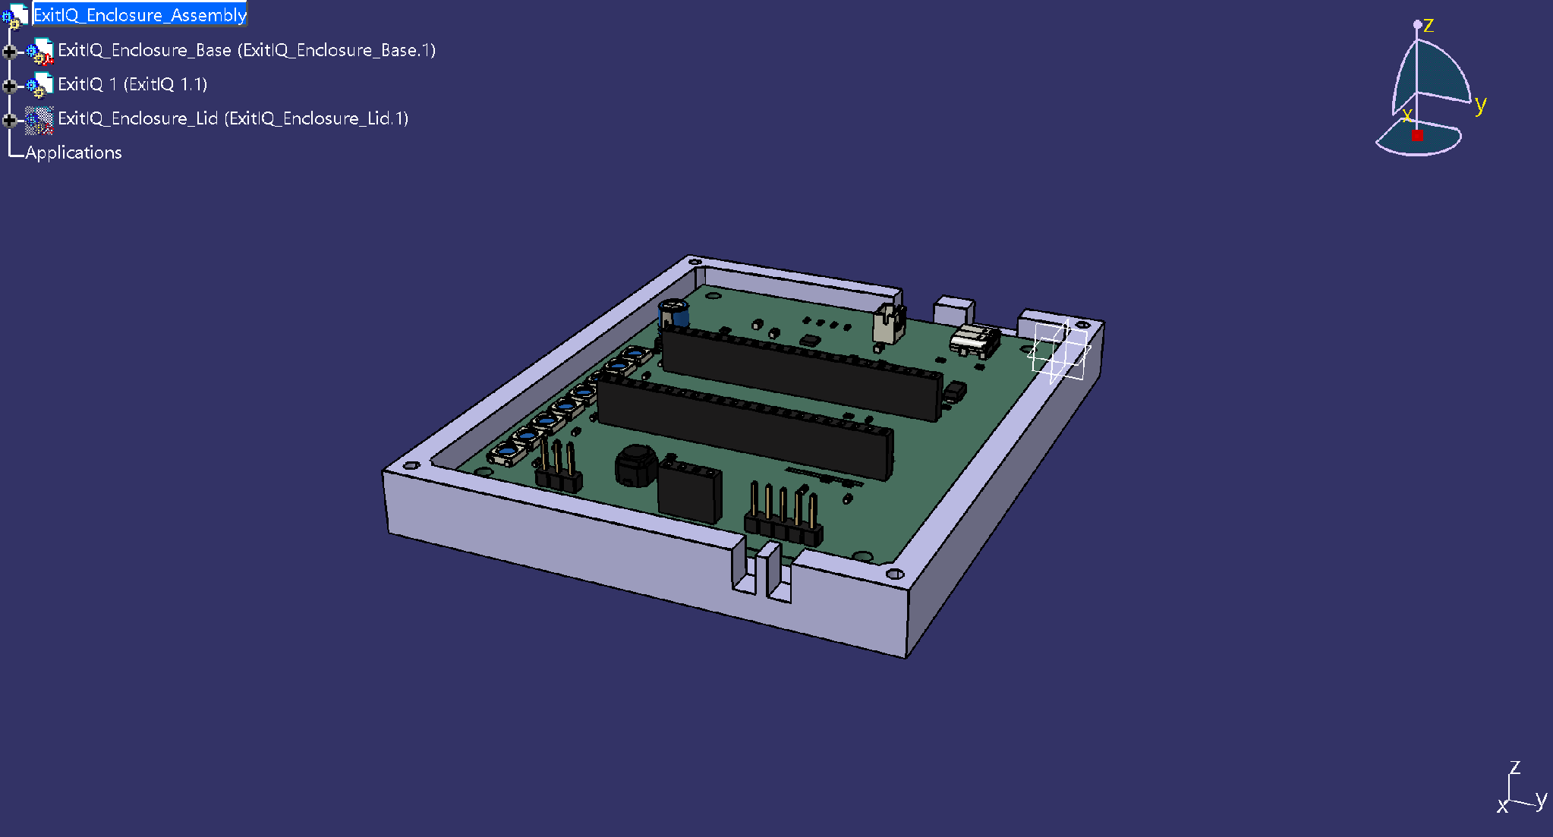
EXITIQ • VISHWAKARMA AWARDS
Mechanical CAD Engineering: Enclosure Design, Clearances & Thermal Isolation
CATIA V5 ENCLOSURE SPECIFICATIONS
• Enclosure Envelope: 114.0 mm x 94.0 mm x 26.0 mm with 2.5 mm nominal wall thickness.
• Internal Clearance: 104.0 x 84.0 x 21.0 mm; provides +2.4mm headroom above ESP32 socket headers and +3.4mm above bulk capacitors.
• Mounting Geometry: 4x M3 brass heat-set threaded inserts in cylindrical bosses at (5,5), (95,5), (95,75), (5,75) mm.
• Interface Cutouts: Left wall USB-C port (9.6x3.6mm), battery harness hatch (8.5x7.0mm), front OLED window (26x15mm), acoustic port (dia 3.0mm).
• Thermal Isolation Slot: 1.0 mm milled FR4 air gap slot (Edge.Cuts, X=72-73mm, Y=14-28mm) isolates SHT40/SGP40 from PCB heat.
• Material Rationale: Flame-retardant PETG / UL94 V-0 ABS enclosure; optical polycarbonate light pipe with crosstalk baffles.
• Validation Status: 3D CAD modeled in CATIA V5; structural FEA not performed (drop testing scheduled for Month 4).
CATIA V5 Assembly: 114 x 94 x 26 mm flame-retardant PETG enclosure with centered 55x8 mm optical slot.
Internal Clearance: PCB seated on 4.5 mm standoffs with +2.4 mm top headroom and isolated sensor bay.

Slide 11
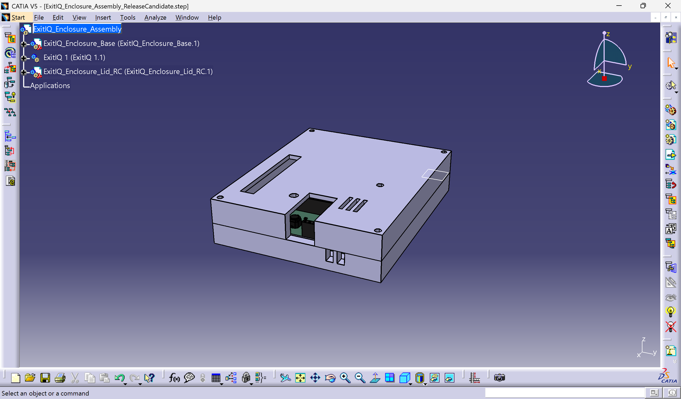
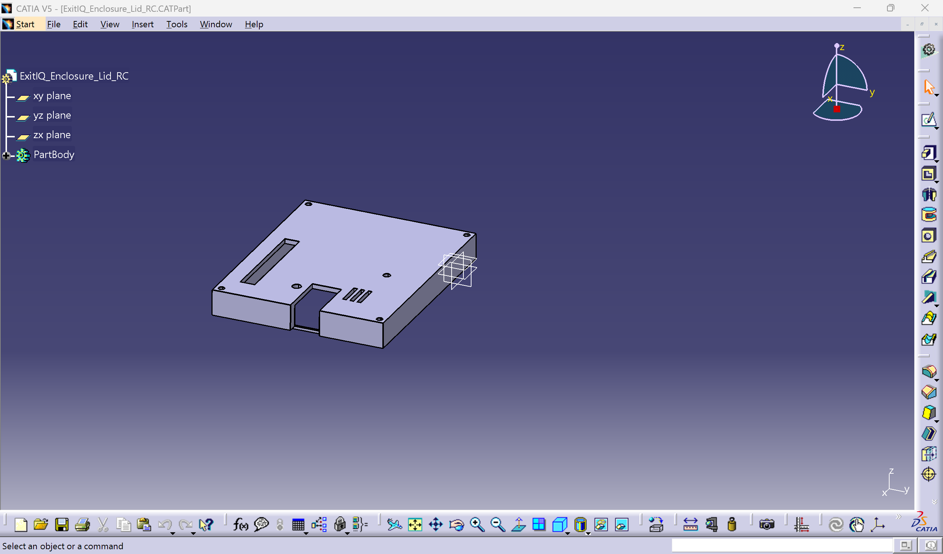
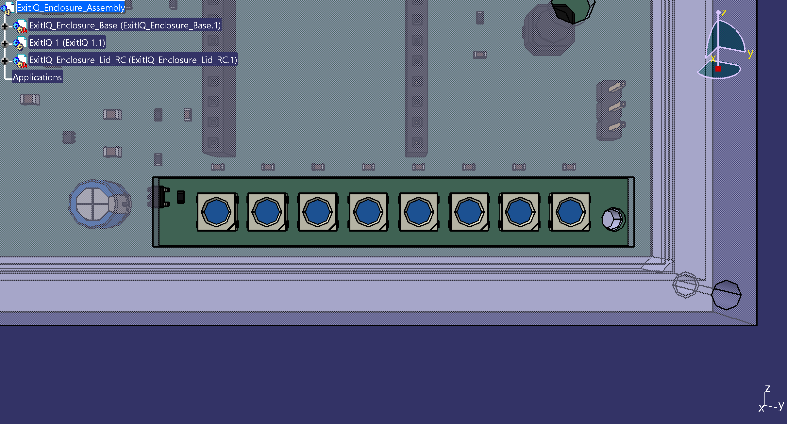
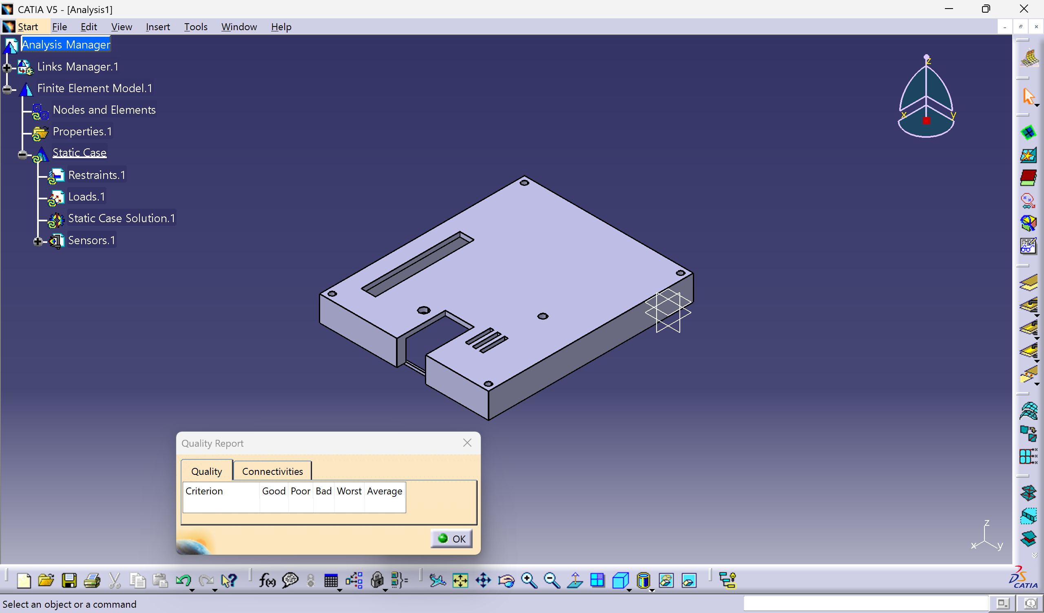
EXITIQ • VISHWAKARMA AWARDS STAGE 2
Mechanical Design Evidence: CATIA Feature Trees & Optical Clearances
CATIA V5 Assembly Product Tree
Parametric constraint hierarchy linking enclosure base, release-candidate lid, standoffs, and 20 component solid models.
Enclosure Base Parametric Part Tree
Part Design feature tree detailing pocket operations, concentric M3 standoff bosses, and port clearance cutouts.
Optical Window Alignment Verification
Semi-transparent lid verification proving centered 55 x 8 mm aperture directly over all 8 WS2812B LEDs with 1.55 mm uniform side margins.
Spatial Geometry & Mesh Analysis
Solid finite element discretization and dimensional mesh analysis verifying boundary wall tolerances (2.5 mm nominal).

Slide 12
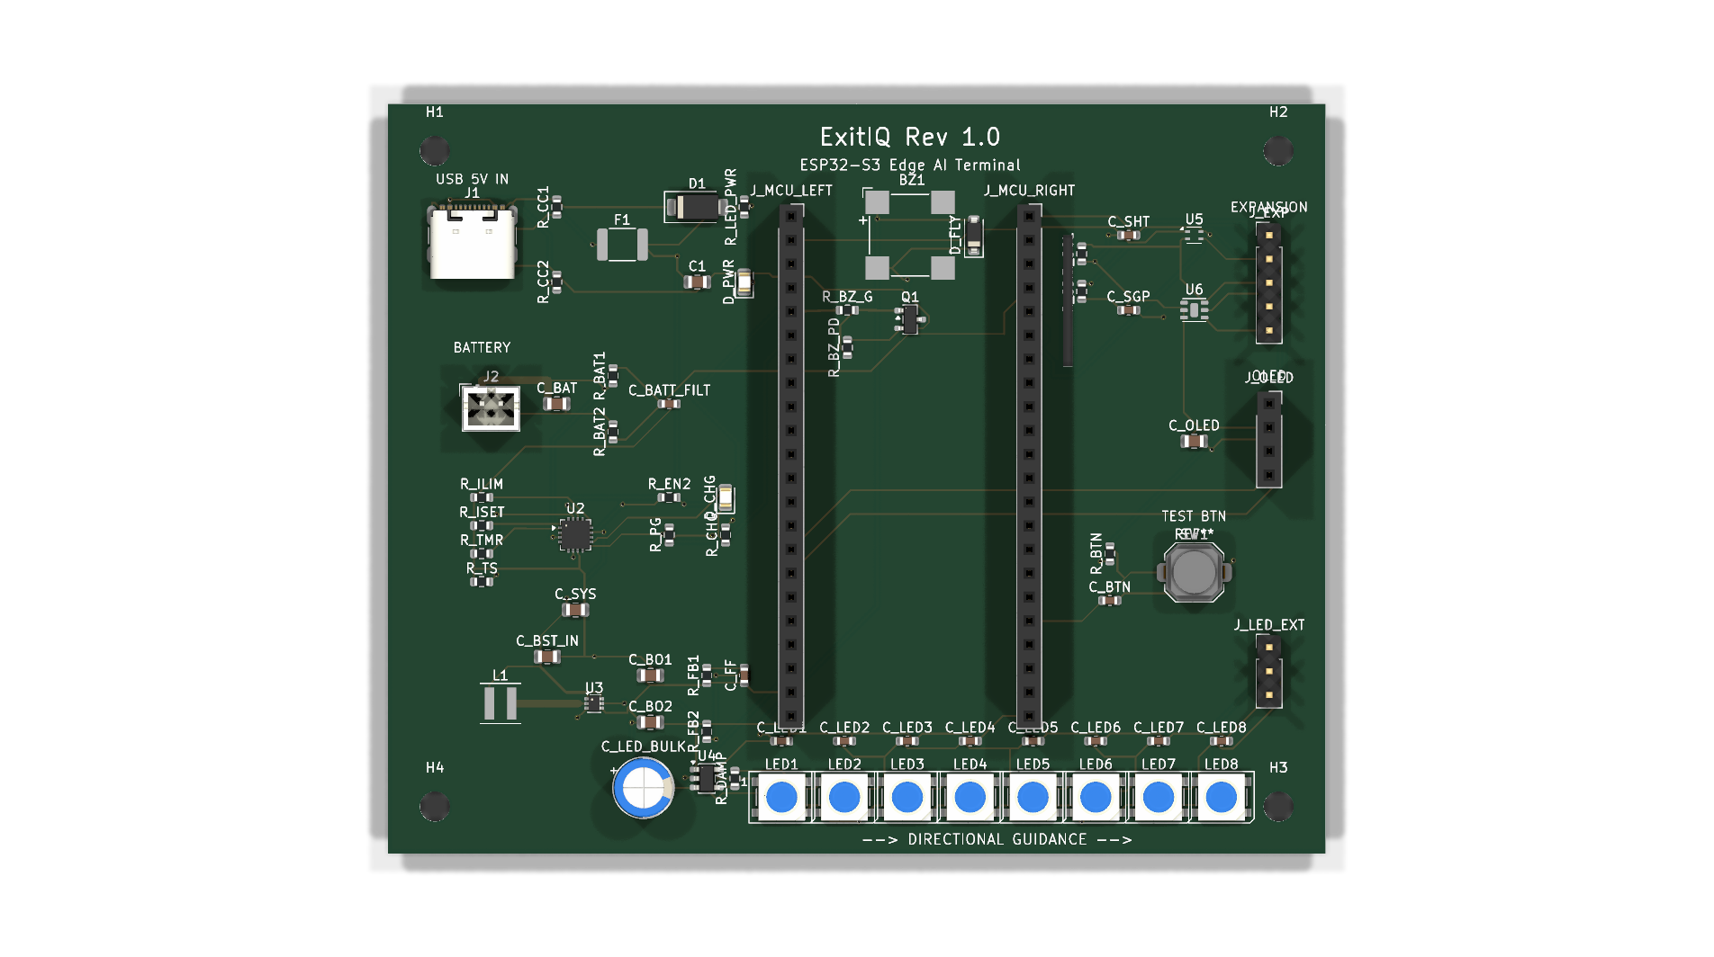
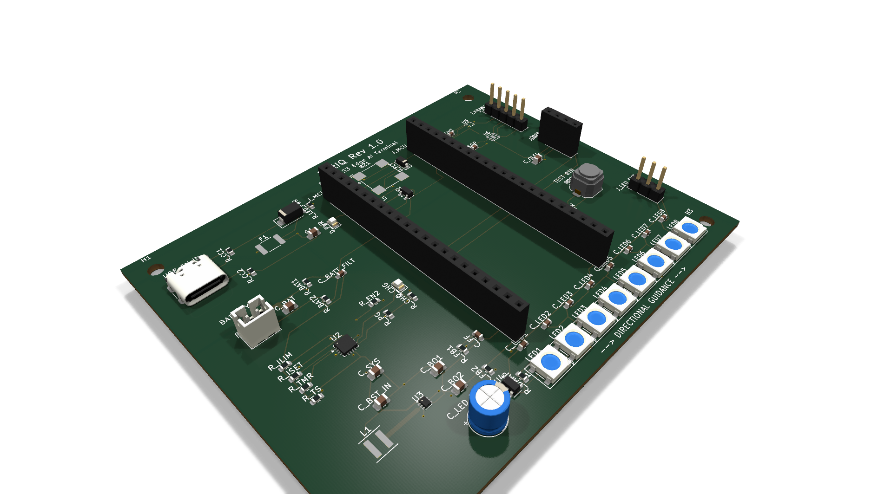
EXITIQ • VISHWAKARMA AWARDS
ECAD Engineering: Schematic Verification, Grounding & Routing Schedule
9 FUNCTIONAL BLOCKS & VERIFICATION
• Schematic Integrity: ExitIQ.kicad_sch contains 9 organized functional sheets. KiCad Electrical Rules Check (ERC) passed with 0 Errors, 0 Warnings (ExitIQ_ERC.rpt).
• 5V Ingress & TVS Protection: USB-C input clamped with Littelfuse SMAJ5.0A TVS diode (400W peak) + 2.0A PTC resettable polyfuse.
• Sensor Thermal Isolation: Dedicated physical slot in FR4 PCB (Edge.Cuts, 1.0mm wide) mechanically separates SHT40/SGP40 from MCU/boost regulator thermal dissipation.
• Level Shifting & LED Line Integrity: TI 74AHCT1G125 high-speed buffer translates 3.3V ESP32 GPIO to 5.0V WS2812B DIN; 330Ω damping resistor suppresses transmission reflections.
• Ground Plane Design: Continuous solid B.Cu ground plane poured beneath all digital logic; power loops minimized.
• PCB Completion Status: Schematic ERC 100% passed (0 Errors). PCB routing 100% complete (0 unrouted nets, 0 unconnected pads, 70 nets, 642 tracks) with solid B.Cu ground plane and verified DRC.
KiCad 10 3D Top View: 100 x 80 mm carrier board with ESP32-S3 DevKit, sensors, and 8x WS2812B array.
KiCad 10 3D Isometric View: 100% routed copper tracks (70 nets, 642 tracks) with unbroken ground plane.

Slide 13
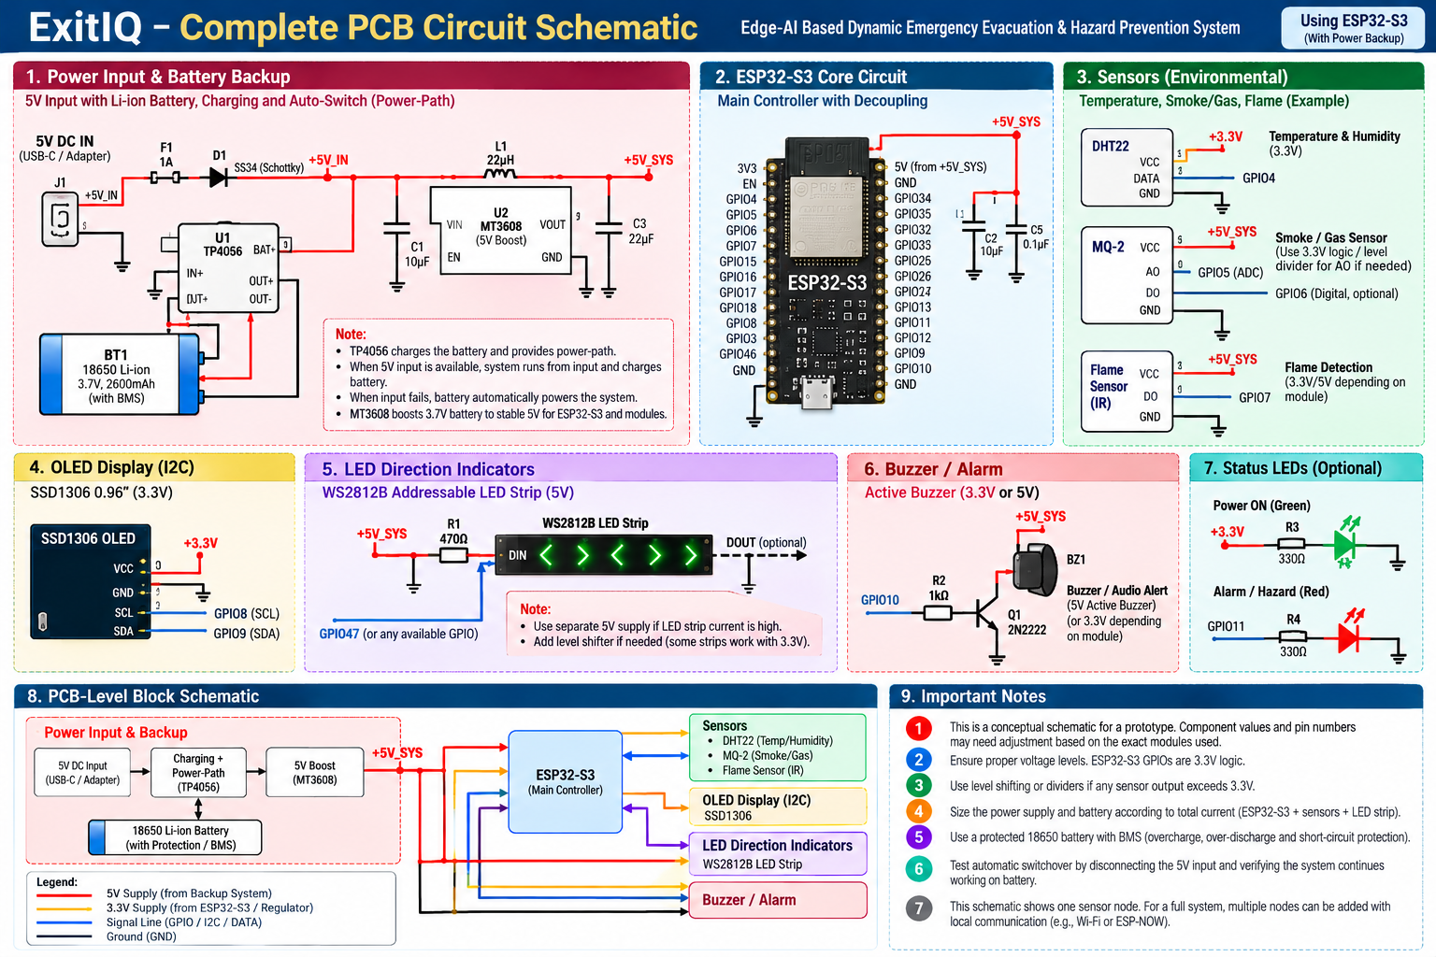
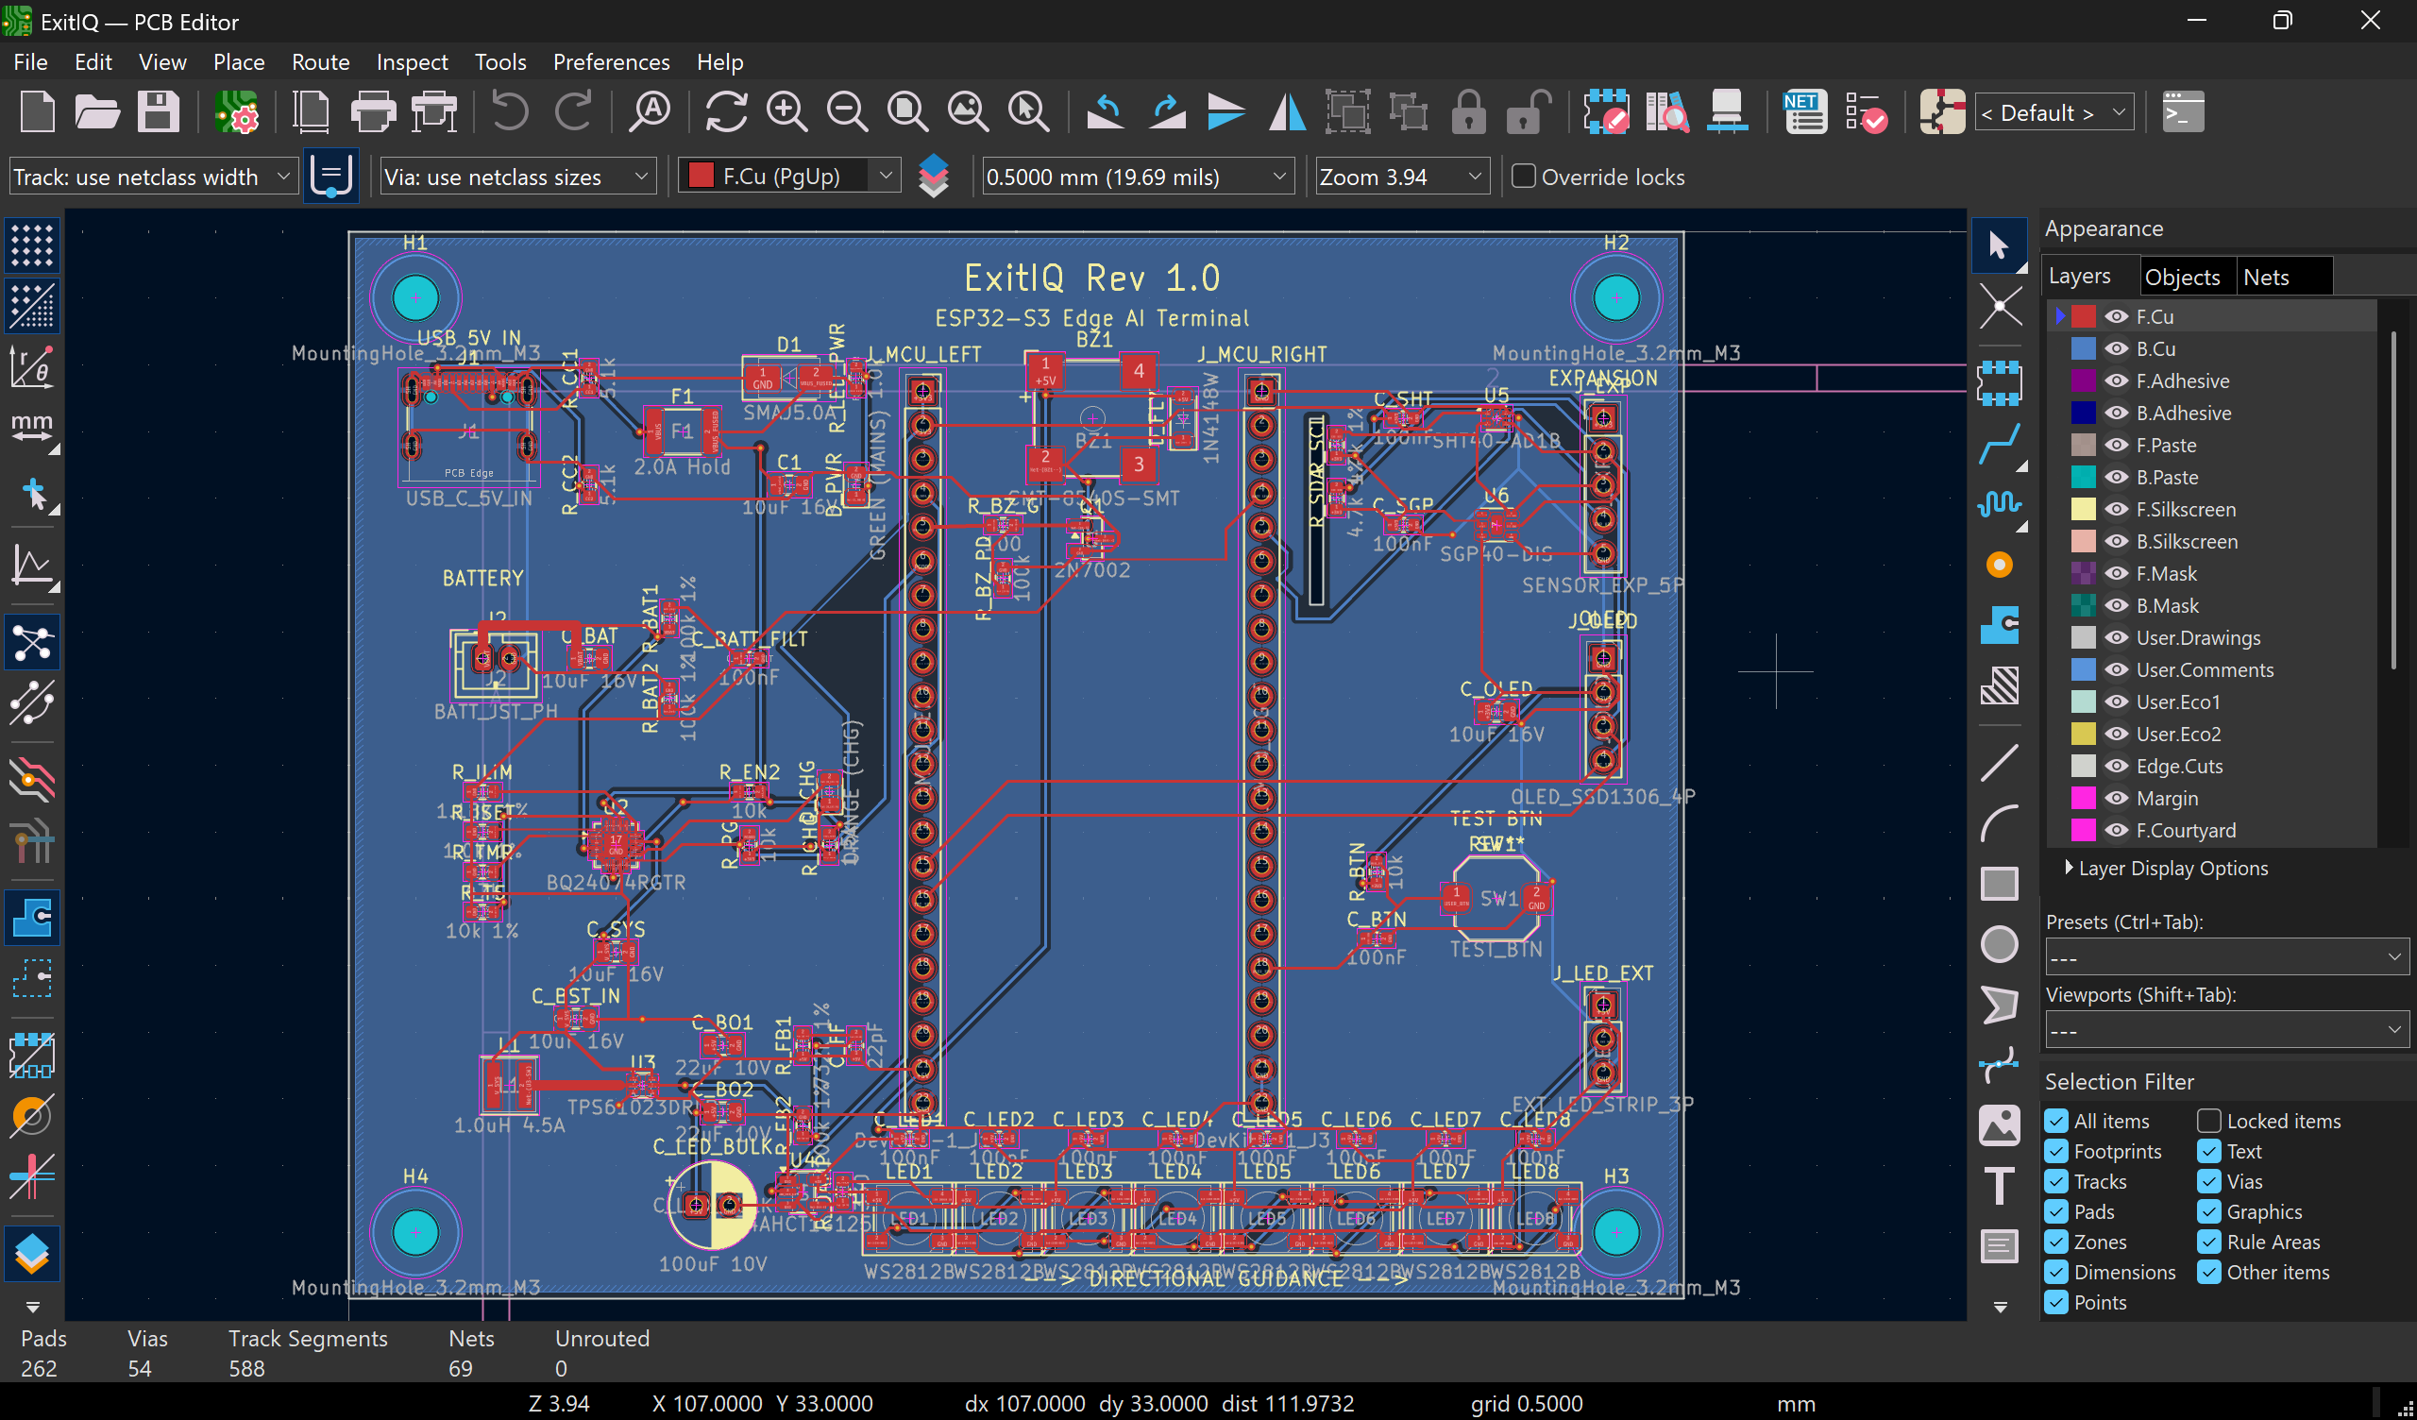
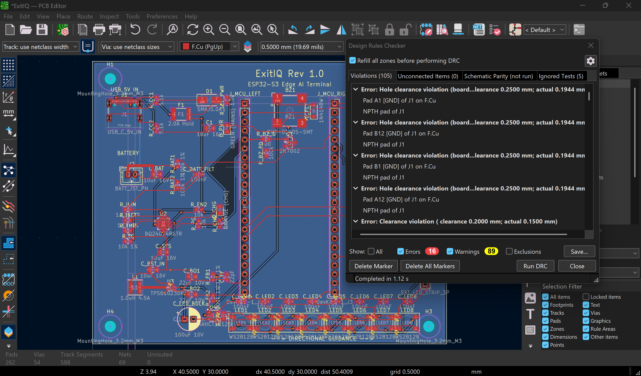
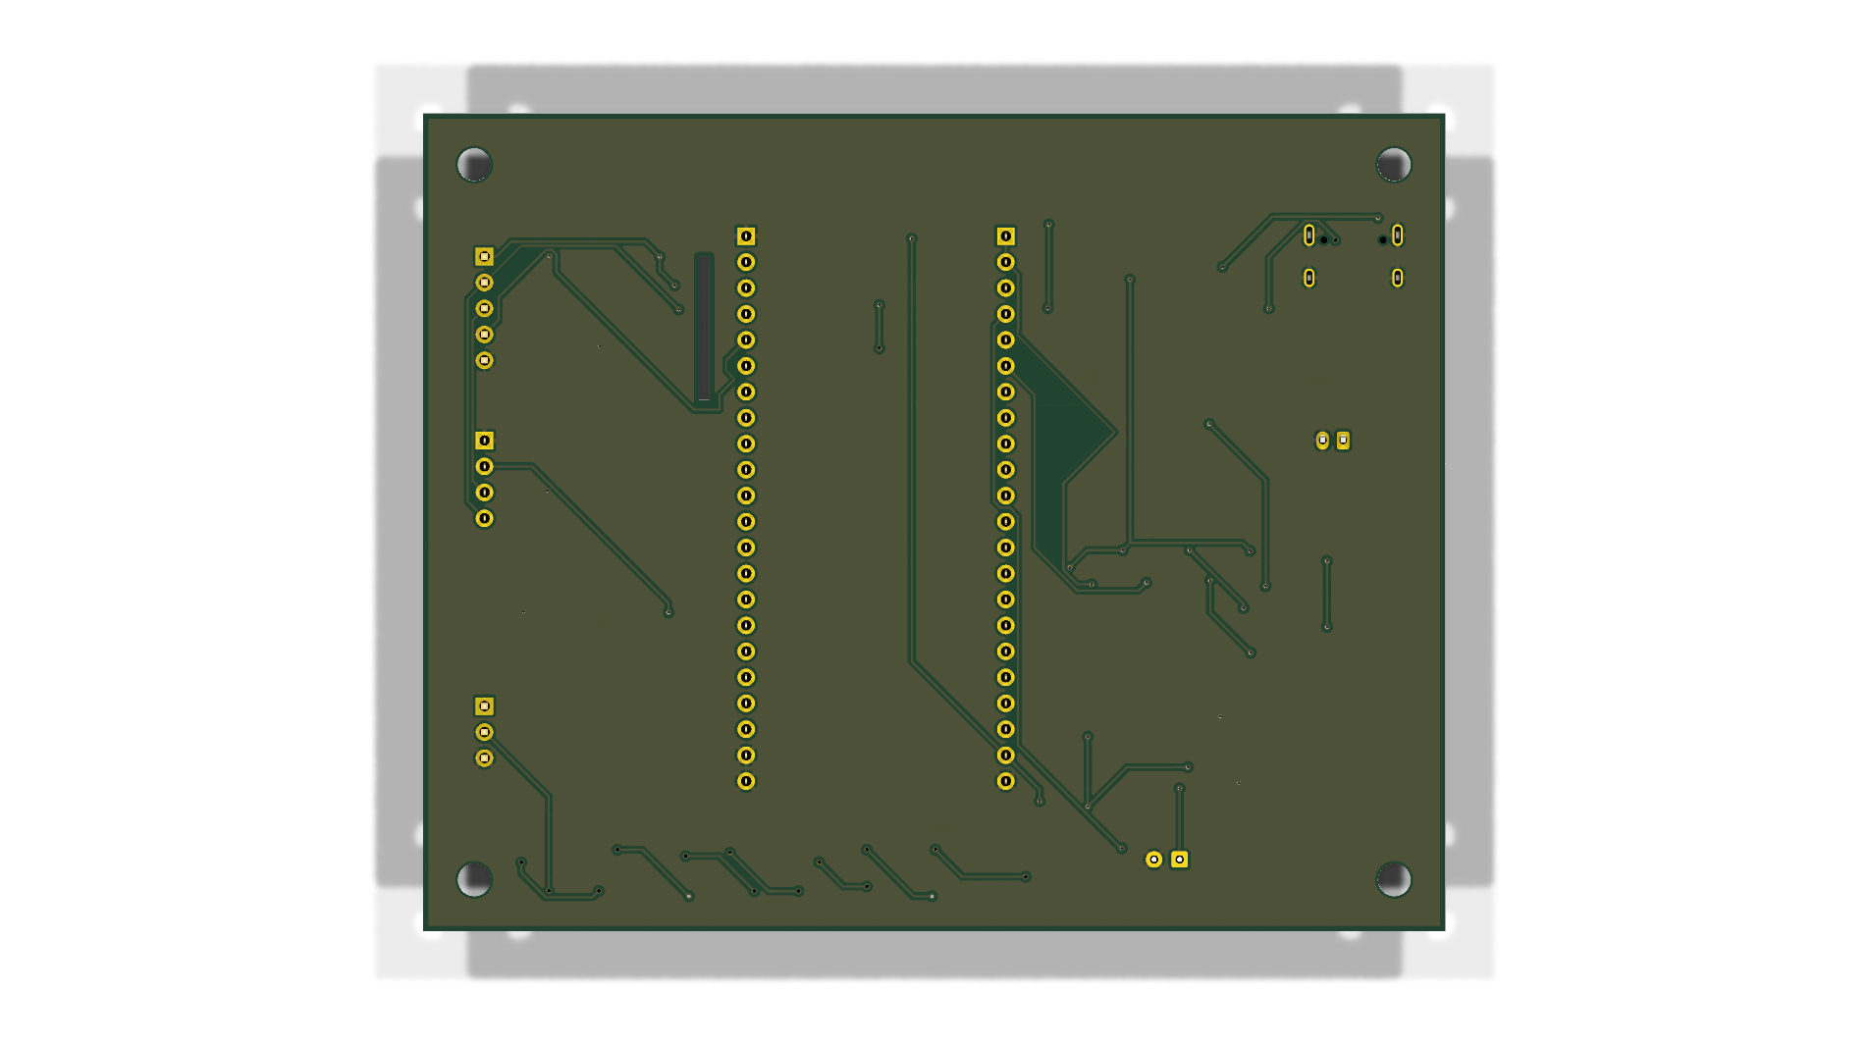
EXITIQ • VISHWAKARMA AWARDS STAGE 2
Circuit Schematic & PCB Evidence: KiCad Hierarchy, Routing & DRC
KiCad 10 Master Hierarchical Schematic
Complete 9-block electrical architecture: USB-C TVS ingress, BQ24074 power-path, TPS61023 boost, ESP32-S3 MCU, and sensor bay.
2-Layer PCB Layout & Signal Routing
Dense 2-layer routing schedule across 70 nets and 642 copper tracks with FR4 physical thermal air gap slot separating sensors.
KiCad Design Rules Check (DRC) Verification
Automated KiCad 10 DRC verification confirming 0 unconnected pads, 0 short circuits, and 100% electrical routing completion.
Bottom Ground Plane & Solder Joints
Continuous low-impedance B.Cu ground return plane with thermal relief spokes and plated through-hole component leads.

Slide 14
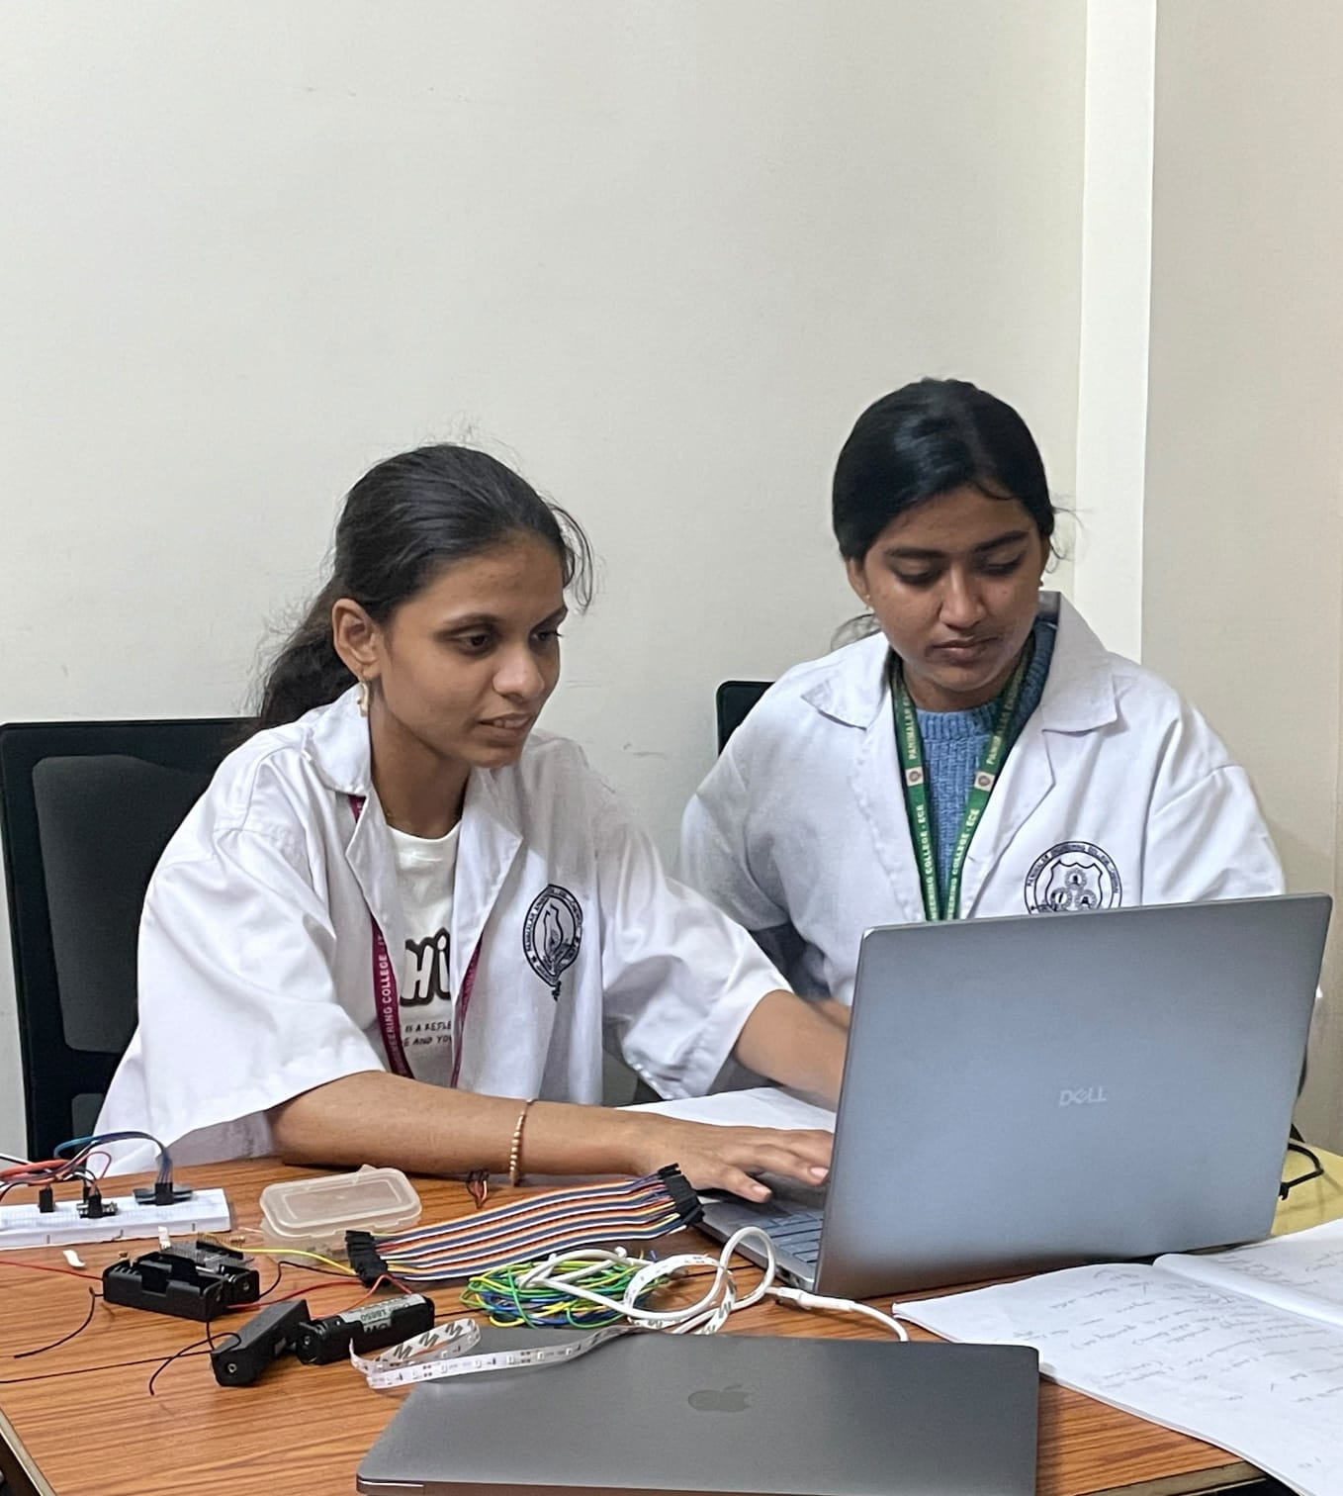
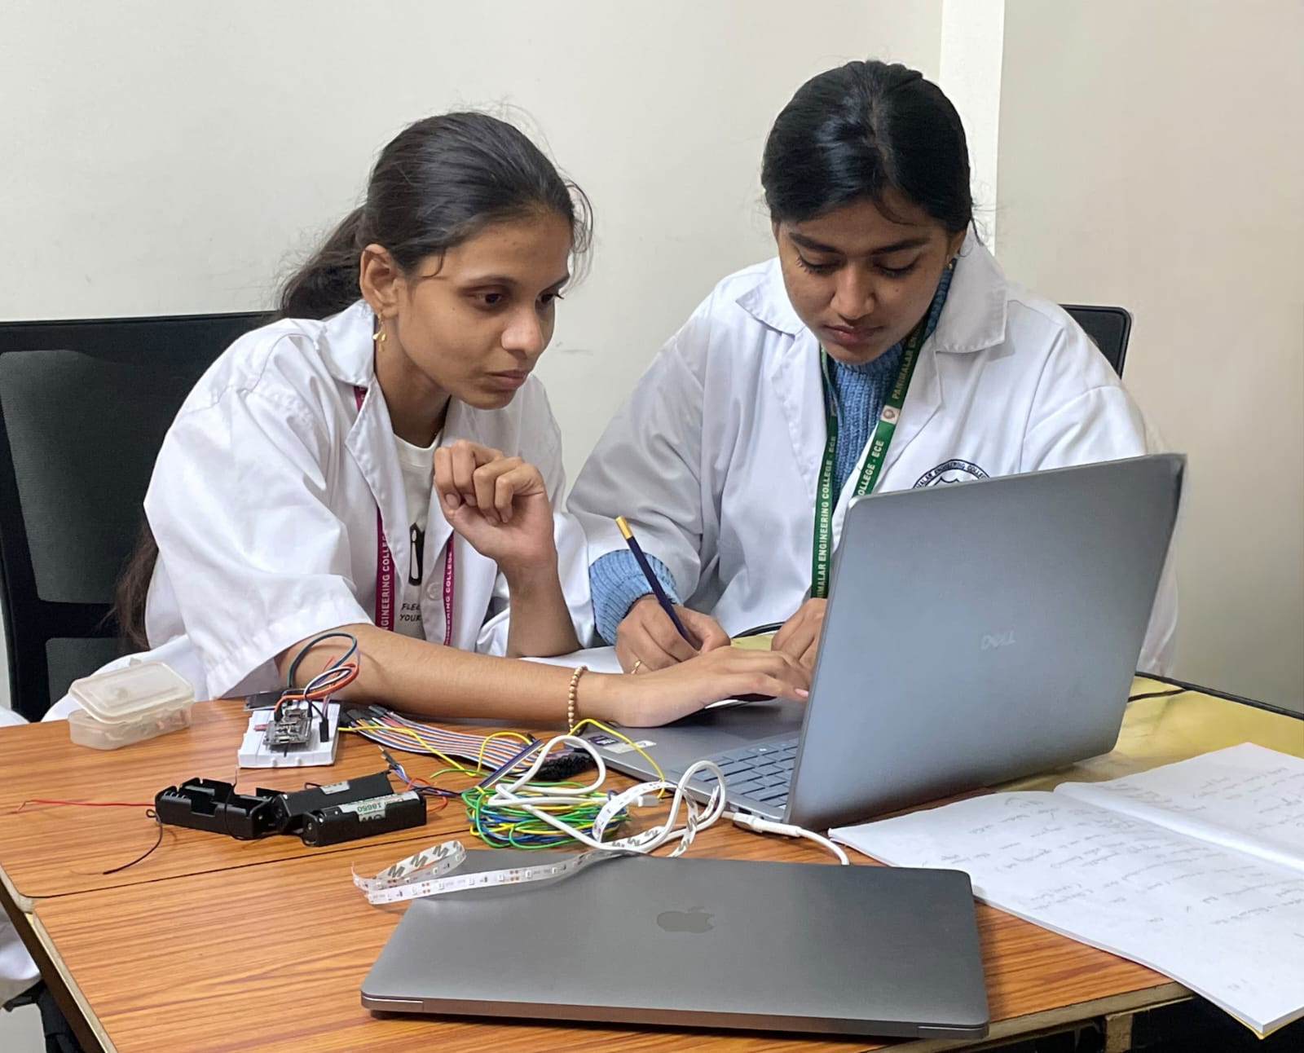
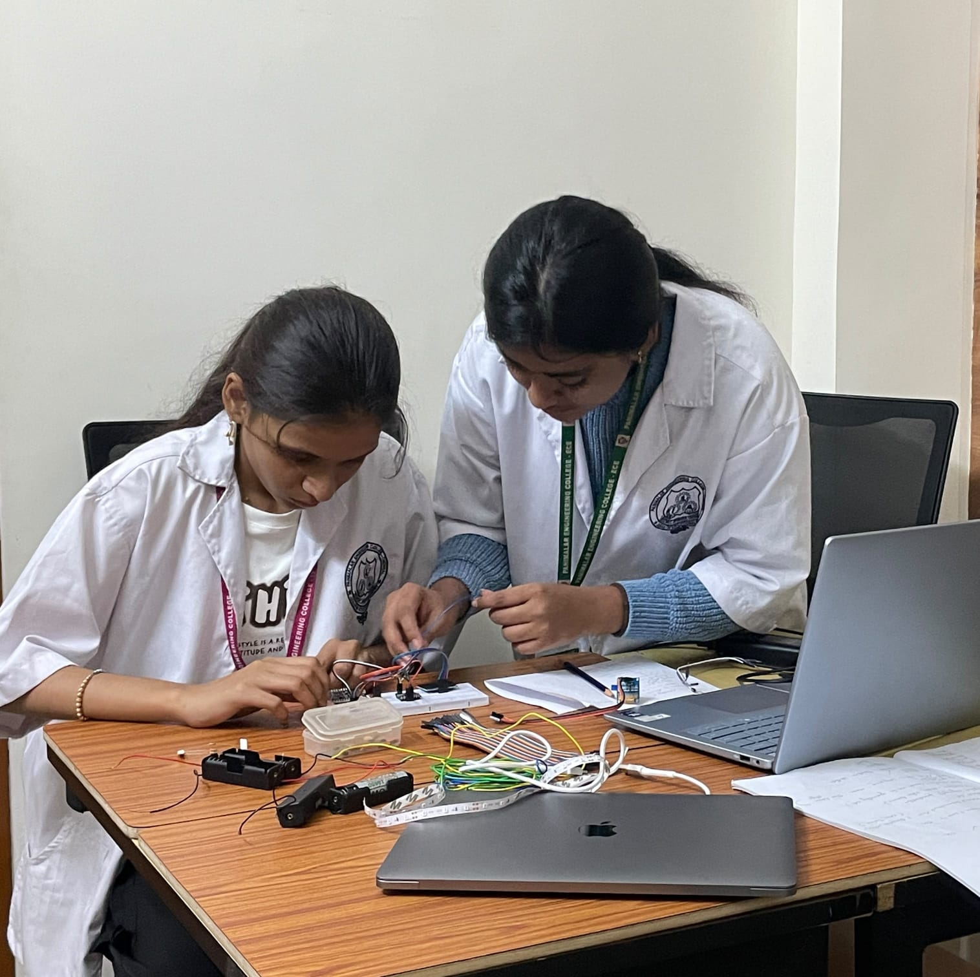
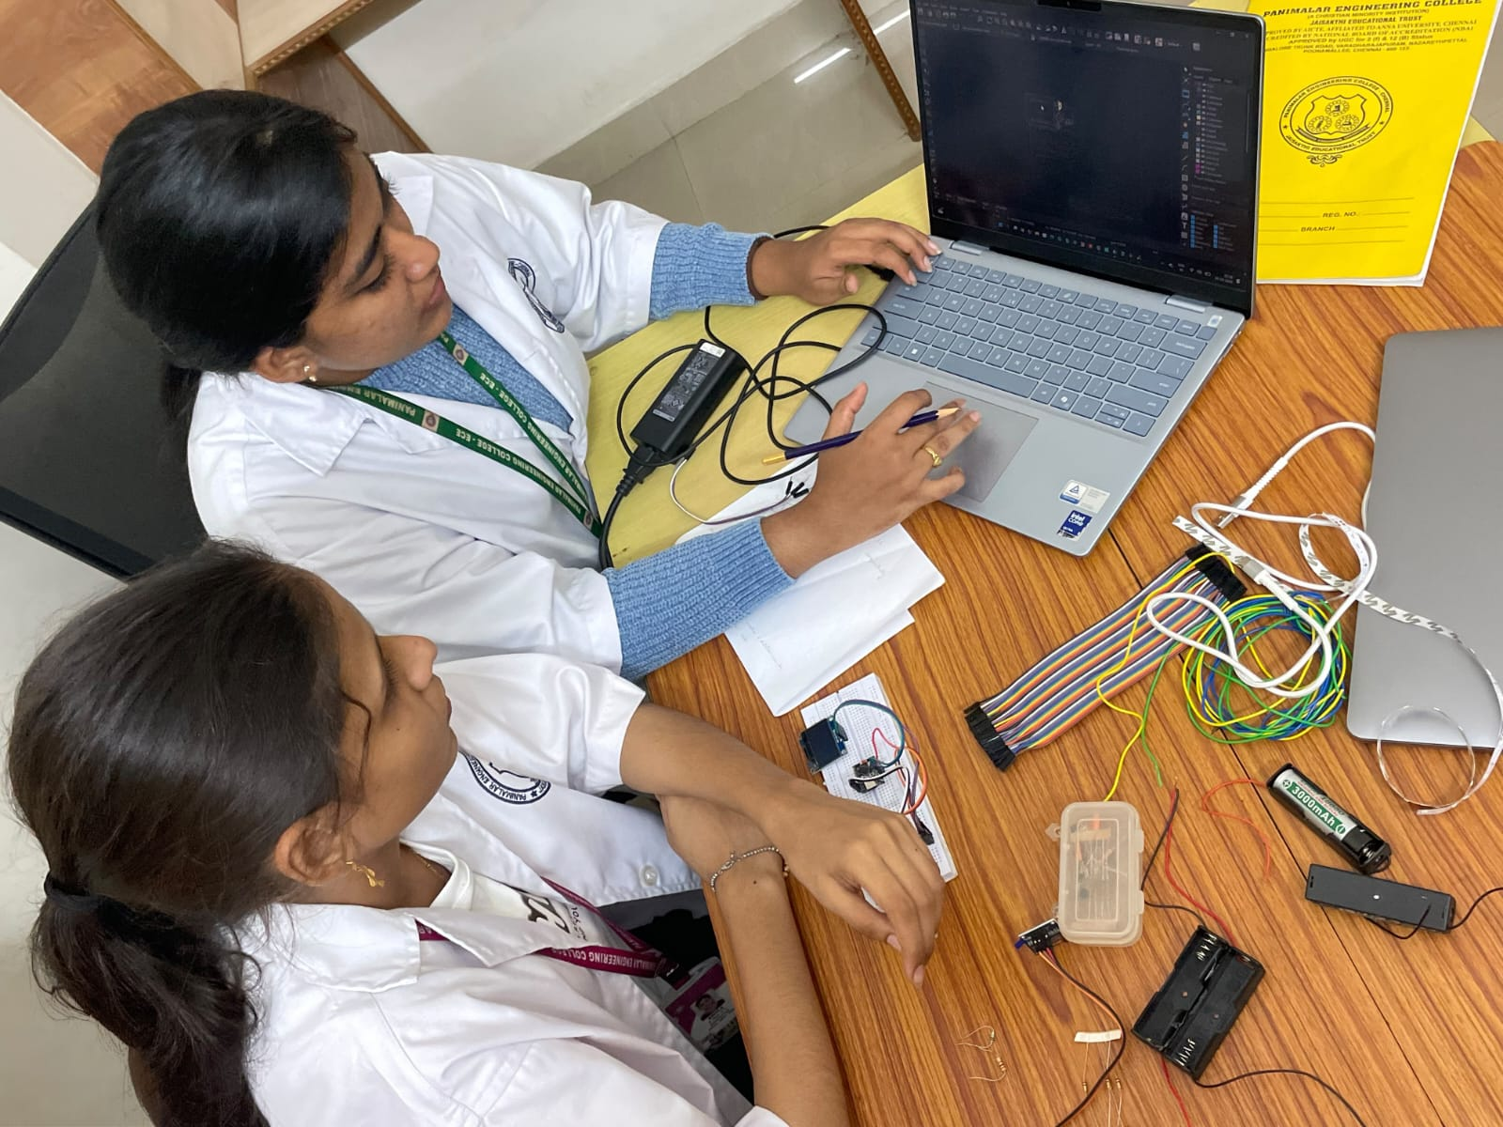
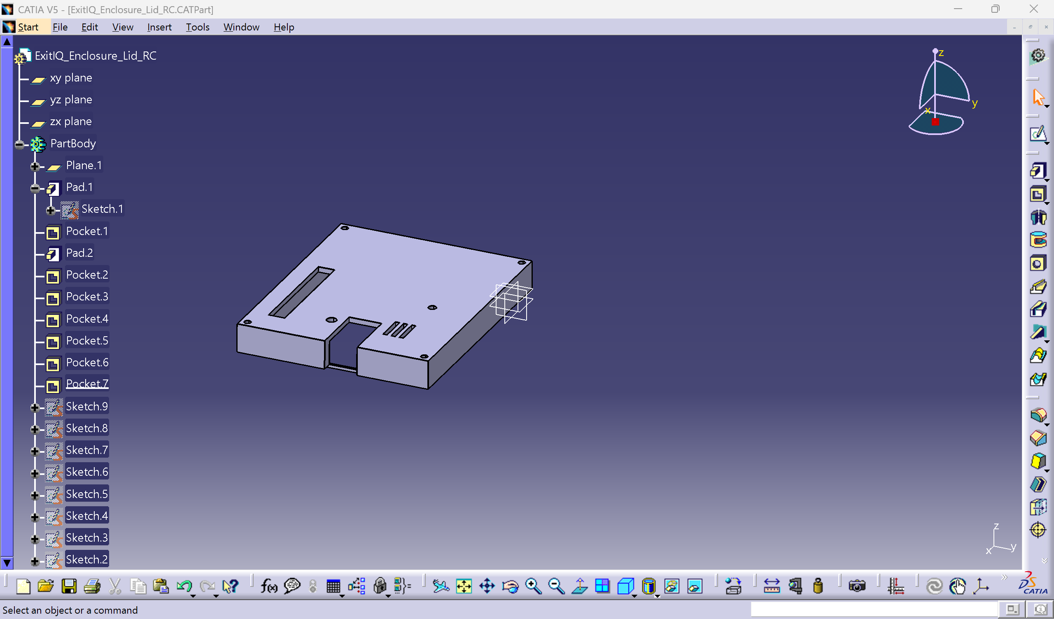

EXITIQ • VISHWAKARMA AWARDS STAGE 2
Maker Journey: Hands-On Personal Fabrication & Verification
PROOF OF PERSONAL FABRICATION
• Student Engineering: Hands-on design of electrical schematics, custom PCB carrier layout, CATIA mechanical enclosure, and firmware architecture.
• Authentic Provenance: Verified through progressive Git commit histories, raw ECAD schematic hierarchy, and laboratory test logs.
• Faculty Mentorship: Guided by institutional faculty mentor in regular weekly engineering design reviews.
Dev & Interfacing
Sensor breadboard integration & firmware flashing on laptop.
Logic Verification
Telemetry testing and emergency threshold calibration.
Circuit Assembly
Hands-on wiring of ESP32 and discrete power components.
Workbench Integration
Full hardware-firmware testing alongside CAD enclosure model.
WORK-IN-PROGRESS SOFTWARE UI
• CATIA V5 Active Workspace: Desktop captures show active Part Design parametric trees, pocket operations for sensor apertures, and boss screw-hole specifications.
• KiCad 10 Nightly Environment: Interactive layout session displaying ratnest nets, design rule configuration, and DRC error audit panes.
RAW REPOSITORY AUDIT LINKAGE
• Native Engineering Files: Contains native ExitIQ.kicad_sch, ExitIQ.kicad_pcb, CATProduct 3D CAD assemblies, BOM .csv, and ERC/DRC logs.
• Public GitHub Repository: https://github.com/Binita126/ExitIQ
Active Engineering Software UI: CATIA V5 Part Design parametric tree detailing enclosure features.

Slide 15
EXITIQ • VISHWAKARMA AWARDS
Benchmarking ExitIQ Against Commercial Products & Academic Research
Key Evaluation Dimension | Conventional Exit Sign | Honeywell NOTIFIER | Eaton FlexiTech / Ex-Lite | Academic Literature | ExitIQ (Proposed System)
Fire & Hazard Detection | None (Signage only) | Yes (Certified smoke/heat) | None (Emergency sign only) | Yes (Selected studies) | Yes (SHT40 Temp + SGP40 VOC)
Dynamic Directional Guidance | No (Fixed permanent legend) | Voice alerts (Fixed arrows) | No (Fixed pictogram) | Yes (Adaptive signage) | Yes (8x WS2812B running LEDs)
Zone-by-Zone Risk Assessment | No | Yes (Panel supervisory zones) | No | Yes (Sensor-graph models) | Yes (4-state machine + TinyML)
Real-Time Route Recalculation | No | Manual dispatcher override | No | Yes (Dijkstra / A* algorithms) | Yes (On-node Dijkstra pathfinder)
Autonomous Offline Operation | Yes (Passive display) | Requires central panel loop | Yes (Standalone sign) | Varies by paper architecture | Yes (100% local-first mesh)
Battery-Backed Emergency Power | Model-dependent backup | Central system UPS backup | Yes (LiFePO4 battery) | Varies by prototype | Yes (TI DPPM, 6.6h runtime)
Development & Testing Status | Mature commercial product | Mature commercial product | Mature commercial product | Published research papers | Designed & verified in CAD/ERC
CORE BENCHMARK FINDING: THE LOCAL-FIRST INTEGRATION ADVANTAGE
• Commercial Gap: Commercial systems offer rugged hardware and certified alarms but lack dynamic arrow redirection.
• Academic Gap: Research papers demonstrate dynamic routing in simulation but rely on complex central servers and rarely integrate battery-backed hardware.
• ExitIQ Contribution: Integrates adaptive directional guidance, local sensor fusion, and brownout-free battery power into an affordable (₹3,585) decentralized node.

Slide 16
EXITIQ • VISHWAKARMA AWARDS
Innovation Advantage: What Is Solved vs. ExitIQ's Contribution
FOUNDATIONAL LITERATURE INSIGHTS
What Has Already Been Solved in Safety Research:
• Dynamic Routing Exists: Algorithms (Dijkstra, A*, PSO) can recalculate egress paths as environmental hazards shift (Fire Safety Journal 2015; Building & Environment 2020).
• Adaptive Visuals Work: Human participant studies confirm occupants follow dynamic directional arrows (89% compliance demonstrated in 2020 complex building evacuation trial).
• Battery Signs Are Mature: Commercial products (Eaton FlexiTech/Ex-Lite) prove 90-180 minute reliable battery backup operation in rugged industrial enclosures.
The Unaddressed Implementation Gap:
Literature proves algorithms in simulation; commercial products provide reliable power without dynamic intelligence. No low-cost, decentralized terminal bridges this divide for typical manufacturing plants.
EXITIQ'S TANGIBLE CONTRIBUTION
Four Tangible Demonstrations Engineered by Our Team:
• 1. Corridor Threat Detection: Sensirion SHT40 + SGP40 dual sensor bay detects pyrolysis gases and thermal spikes; ESP32-S3 transitions zone to HIGH RISK (<500ms target).
• 2. Real-Time Redirection: On-node pathfinder recalculates safest route and flips WS2812B green LED running arrows to alternate safe exit (<100ms target).
• 3. Mains Disconnect Continuity: TI BQ24074 DPPM switches from 5V USB-C to 18650 Li-Ion cell in <100ns without brownout dip, sustaining guidance for 6.6 hours.
• 4. Local Comms Fallback: If central network links sever, node executes deterministic autonomous fallback rules with local fault annunciation.
Outcome: A low-cost, local-first safety terminal that bridges the gap between commercial alarm systems and theoretical research.

Slide 17
EXITIQ • VISHWAKARMA AWARDS STAGE 2
Safety by Design: Multi-Tiered Fail-Safes & Design FMEA Matrix
Potential Failure Mode | Operational Hazard & Severity | Design Mitigation & Hardware Fail-Safe | Implementation Status
Mains 5V Power Loss | Controller reset, loss of guidance, darkness and panic in corridors during emergency. | TI BQ24074 DPPM switches to 18650 cell in <100ns (zero brownout dip); supplies guidance for 6.6 hours. | Designed in ECAD (Verified in datasheet)
Sensor Failure / Drift | Stale or false low-risk reading directing fleeing occupants toward an advancing fire front. | Firmware I2C watchdog; unreadable zone immediately marked as HIGH RISK; defaults to deterministic safe rule. | Designed in Firmware Architecture
Firmware / Routing Lockup | Frozen directional arrows displaying outdated or unsafe paths during critical evacuation. | ESP32-S3 hardware Watchdog Timer (WDT) triggers hard reset within 1.0s; falls back to static lookup table. | Designed in Firmware Architecture
LED Indicator Array Fault | Loss of primary visual arrow indicators at critical corridor junction point. | Triple redundancy: SSD1306 OLED displays text; CUI CMT-8540S buzzer pulses audible directional alert. | Designed in Hardware (ERC passed)
Route Blocked After Calc | Occupants routed into corridor where fire just breached after recalculation. | FreeRTOS task loops every 500ms; continuous sensor checks recalculate route dynamically. | Designed in Firmware Architecture
REGULATORY SAFETY DEMARCATION & OPERATIONAL BOUNDARIES
• Supplementary Guidance Only: ExitIQ is an experimental research prototype engineered to provide adaptive guidance; it does NOT replace certified building fire alarm systems (EN 54 / NFPA 72) or statutory emergency lighting.
• Sensor Demarcation: The Sensirion SGP40 is an MOx-based VOC air quality index sensor, NOT a certified smoke detector.
• Standards Grounding: Battery endurance meets NFPA 101 (>90 min emergency runtime benchmark: 6.6h calculated); PCB adheres to IPC-2221A Class 2 clearances.

Slide 18
EXITIQ • VISHWAKARMA AWARDS
Four-Month Prototype Implementation Roadmap
MONTH 1 (OCT 2026)
ECAD & MCAD SIGN-OFF
• Complete KiCad push-and-shove routing schedule.
• Re-run full DRC (0 unrouted nets).
• Export production Gerber and drill package.
• 3D print initial PETG enclosure prototype.
MONTH 2 (NOV 2026)
FABRICATION & SMT ASSEMBLY
• Fabricate 2-layer FR4 PCB at domestic fab house.
• Component arrival & SMT hand-soldering.
• Benchtop power-path switchover test under 1.5A load.
• Verify I2C sensor communications & LED drivers.
MONTH 3 (DEC 2026)
FIRMWARE & TINYML INTEGRATION
• Implement ESP32-S3 FreeRTOS firmware.
• Build dual-sensor calibration & fusion pipeline.
• Train lightweight TinyML classifier on safe data.
• Integrate Dijkstra graph route engine.
MONTH 4 (JAN 2027)
MULTI-ZONE STAGE 3 DEMO
• Construct 3–5 zone miniature floor plan board.
• Execute simulated fire emergency scenarios.
• Benchmark detection latency & battery endurance.
• Present live functional demo for Stage 3 jury.
PROTOTYPE VALIDATION TARGETS (TO BE BENCHMARKED IN STAGE 3 TRIAL)
• Hazard Detection Latency: Target < 500 ms from safe test stimulus to risk classification.
• Route Recalculation Time: Target < 100 ms on ESP32-S3 internal core.
• Emergency Battery Runtime: Target > 6.0 hours (calculated: 6.6 hours @ 460mA load on 3400mAh cell).
• Route Safety Success Rate: Target 100% avoidance of simulated high-risk zones across all repeatable test runs.

Slide 19
EXITIQ • VISHWAKARMA AWARDS
Engineering Bottlenecks: Critical Design Constraints Analyzed
1. DYNAMIC CURRENT SPIKES & BROWNOUT RISK
• WS2812B LEDs draw up to 480mA during full strobe; ESP32-S3 draws 355mA during Wi-Fi bursts.
• Combined current spikes exceed 800mA, creating steep dynamic load steps.
• Without dedicated power-path isolation, voltage sag causes ESP32 brownout reset loops.
2. SENSOR THERMAL COUPLING & FALSE ALARMS
• ESP32-S3 and TPS61023 boost regulator dissipate heat locally on the carrier PCB.
• Direct thermal conduction through FR4 copper planes artificially elevates SHT40 readings by +3°C to +6°C.
• Thermal drift skews SGP40 baseline, generating false VOC fire alerts.
3. SIGNAL INTEGRITY & GROUND IMPEDANCE
• High net density (70 nets, 642 tracks) risked ground return loop discontinuities and EMI.
• High-frequency digital signals (400kHz I2C, 800kHz WS2812B DIN) require low-impedance ground returns.
• Poor ground routing risks crosstalk, bit corruption, and unintended RF emissions.
4. EDGE AI RESOURCE CONSTRAINTS
• Complex deep learning fire models cannot run reliably on resource-constrained microcontrollers.
• Real-time route calculation must execute deterministically without blocking FreeRTOS sensor loops.
• Cloud-based AI inference fails completely if building internet infrastructure collapses.

Slide 20
EXITIQ • VISHWAKARMA AWARDS
Verified Engineering Mitigations: Rigorous Technical Solutions
1. DYNAMIC POWER-PATH & BOOST REGULATION
• Integrated TI BQ24074 DPPM to autonomously manage input current limits.
• Paired with TI TPS61023 synchronous boost converter delivering up to 3.7A valley switch current.
• Bulk decoupling capacitors (100µF electrolytic + 22µF ceramic) absorb transient current steps.
• Ensures uninterrupted <100ns brownout-free battery switchover during total mains blackout.
2. PHYSICAL PCB THERMAL ISOLATION SLOT
• Milled a 1.0mm physical air gap slot through FR4 (Edge.Cuts, X=72-73mm, Y=14-28mm).
• Mechanically severs copper heat conduction between MCU/regulator and the sensor bay.
• Airflow louvers in the CATIA enclosure provide passive convection to sample true ambient air.
• Maintains Sensirion SHT40 temperature measurement accuracy within ±0.2°C.
3. LOW-IMPEDANCE GROUND RETURN & ROUTING
• Poured a solid, low-impedance ground return plane on B.Cu beneath all digital signal traces.
• Placed a TI 74AHCT1G125 high-speed buffer near ESP32 GPIO to level-shift 3.3V to 5.0V with a 330Ω damping resistor.
• Completed 100% interactive push-and-shove routing with 0 unrouted nets, 0 shorts, and continuous ground return.
4. LIGHTWEIGHT QUANTIZED MODEL & RULES
• Designed compact decision tree / quantized TinyML model running in <32KB SRAM.
• FreeRTOS timer enforces deterministic 500ms sensor fusion and <100ms Dijkstra route recalculation.
• 100% on-device edge computation operates flawlessly without external internet or cloud reliance.

Slide 21
EXITIQ • VISHWAKARMA AWARDS
Industrial Impact, Scalability & Technology Horizons
IMMEDIATE INDUSTRIAL IMPACT
• Panic Reduction: Eliminates lethal corridor hesitation by providing unambiguous, active green arrow strobes away from danger.
• Preventing Bottlenecks: Dynamic multi-path routing prevents crowd congestion at single primary exits, distributing flow across all safe doors.
• Cost-Effective Retrofit: Affordable ₹3,585 INR unit cost allows industrial plants to deploy dense node grids alongside existing certified fire systems.
• True Offline Autonomy: Operates reliably through total facility blackouts and internet loss, protecting workers when central building networks fail.
SCALABILITY & HORIZONS
• Mesh Network Expansion: Scale from single-node prototypes to multi-hop 50+ node industrial meshes using ESP-NOW and Sub-GHz RF.
• AI Computer Vision Module: Integrate low-cost ESP32-CAM nodes for optical flame recognition, crowd density tracking, and blocked path detection.
• Digital Twin Integration: Stream real-time zone risk vectors to facility BIM digital twins and central emergency monitoring dashboards.
• Worker Wearable Integration: Broadcast BLE localized hazard vectors to industrial smart watches and badges for tactile vibration alerts.

Slide 22
EXITIQ • VISHWAKARMA AWARDS STAGE 2
Technical References, Regulatory Standards & Master Conclusion
COMPONENT DATASHEETS
• Espressif Systems: ESP32-S3 Series Datasheet v1.6 & Hardware Design Guidelines (2025).
• Texas Instruments: BQ24074 1.5A Dynamic Power-Path Li-Ion Charger (SLUS810M).
• Texas Instruments: TPS61023 Synchronous Boost Converter Datasheet (SLVSEJ3).
• Sensirion AG: SHT4x Digital Temp/RH & SGP40 Digital MOx VOC Sensor Interfaces.
• Worldsemi: WS2812B Intelligent Control LED Integrated Light Source Specification.
ACADEMIC LITERATURE
• 'Testing a real-time intelligent evacuation guiding system for complex buildings' — Building and Environment, Vol. 174, 2020.
• 'Integrating sensing, routing and timing for indoor evacuation' — Fire Safety Journal, Vol. 78, 2015.
• 'Fire evacuation supported by centralized and decentralized visual guidance systems' — Safety Science, Vol. 147, 2022.
• 'Real-time evacuation route selection methodology for complex buildings' — ScienceDirect, 2017.
REGULATORY STANDARDS
• NFPA 101: Life Safety Code (Emergency Egress Lighting Standards: >90 min runtime).
• UL 924: Standard for Emergency Lighting and Power Equipment.
• IEC 62368-1: Audio/video, information and communication technology equipment safety.
• IPC-2221A: Generic Standard on Printed Board Design (Class 2 clearances).
• ISO 7010: Graphical symbols — Safety colors and safety signs.
"WHEN DANGER CHANGES, THE SAFEST WAY OUT MUST CHANGE WITH IT."
ExitIQ bridges the critical gap between detection and survival — delivering an adaptive, battery-backed, and local-first emergency guidance grid to protect industrial workers when conventional systems fail.

