Slide 1



ExitIQ
Edge-AI Based Dynamic Emergency Evacuation & Hazard Prevention System
Theme: AI in Hardware & Manufacturing | Sub-theme: Worker Safety & Hazard Prevention
Official Vishwakarma Application ID: [ADD OFFICIAL VISHWAKARMA APPLICATION ID]
Student Team: [ADD TEAM NAME] | Institutional Affiliation: [ADD INSTITUTION / DEPARTMENT]
Faculty Mentor: Prof. [ADD FACULTY GUIDE NAME]

Slide 2


EXITIQ • VISHWAKARMA AWARDS STAGE 2
Problem Context: The Lethal Flaw of Static Signage in Industrial Fires
RAPID HAZARD PROPAGATION
• In industrial manufacturing plants, chemical storage, and logistics warehouses, fire propagation is non-linear and violent.
• Flashover can occur in under 3 minutes, generating dense carbon monoxide, hydrogen cyanide, and toxic VOCs.
• Thick smoke reduces corridor visibility to < 1.0 meter within 60 seconds, eliminating visual recognition of landmarks.
STATIC SIGNAGE BLINDSPOT
• Conventional illuminated exit signs (ISO 7010 / NFPA 101) are statically mounted with permanent fixed arrows.
• During an emergency, static signs continuously point toward primary designated exits even if that corridor is engulfed in flames.
• Trapped occupants following signs blindly walk directly into fire fronts, toxic smoke pools, and collapsed pathways.
• Forced retreat causes fatal bottleneck jams, panic surges, and deadly inhalation.
TARGET BENEFICIARIES & URGENCY
• Primary Users: Industrial shop-floor workers, warehouse personnel, chemical handling technicians, and facility visitors.
• Emergency First Responders: Benefit from isolated hazard zones and prevented cluster fatalities.
• Regulatory Compliance: Supplements mandatory fire safety infrastructure by providing dynamic local guidance when central networks fail.

Slide 3


EXITIQ • VISHWAKARMA AWARDS STAGE 2
User Journey Storyboard: Fixed Conventional Signage vs. Adaptive ExitIQ
BEFORE: CONVENTIONAL STATIC EGRESS RESPONSE
AFTER: EXITIQ DYNAMIC EGRESS GUIDANCE
CONCEPTUAL FACILITY LAYOUT • STATIC RESPONSE SCENARIO
SAME FACILITY LAYOUT • EXITIQ REAL-TIME RECALCULATION
CORRIDOR B (ACTIVE FIRE)
Static sign points workers HERE
Heavy toxic smoke & blockage!
CORRIDOR B: HIGH RISK
ExitIQ LED displays RED [X]
Route Cost: INFINITY (Blocked)
Worker Zone
(Starting Area)
Junction 1
(Static Sign ➔)
Worker Zone
(Starting Area)
ExitIQ Terminal
(LED Flips ⬇)
Corridor C
(Safe Exit 2)
[IGNORED]
✔ Corridor C ➔ SAFE EXIT 2
Green dynamic arrows guide egress
• 1. Hazard Erupts: Corridor B ignites; rapid toxic smoke accumulation.
• 2. General Siren: Standard audible alarm sounds; zero zone hazard awareness.
• 3. Static Blindness: Occupants follow permanent directional signs straight toward fire.
• 4. Fatal Encounter: Workers encounter toxic smoke pool; retreat causes crush panic.
Identified Failure Mode: Zero route adaptability; high smoke inhalation risk.
• 1. Zone Sensing: Sensirion SHT40 + SGP40 detect VOC index jump & thermal rate-of-rise.
• 2. Edge Risk Assessment: ESP32-S3 classifies Corridor B as HIGH RISK (<500 ms target).
• 3. Dynamic Recalculation: Graph pathfinder assigns infinite weight to Corridor B; selects Exit 2.
• 4. Physical Redirection: WS2812B green LEDs strobe toward Corridor C; buzzer pulses cadence.
Target Benefit: Eliminates wrong-route entries; verified in Stage 3 comparative trials.
Note: Illustrative scenario representing proposed dynamic guidance behavior. Quantitative evacuation time reductions are development targets subject to formal Stage 3 physical comparative trials.

Slide 4







System Architecture: End-to-End ExitIQ Data Flow
Proposed local-first architecture • diagram is editable in PowerPoint
1. SENSING
• SHT40: temperature & RH
• SGP40: VOC air-quality index
• Raw readings pre-filtered locally
2. EDGE
PROCESSING
• ESP32-S3 microcontroller
• Multi-sensor verification
• Assess zone hazard severity
3. RISK MAP
• Assign 4-state zone risk
• Update corridor graph-edge costs
• Normal / Warning / High / Critical
4. ROUTE ENGINE
• Heuristic graph search (Dijkstra)
• Penalize hazardous zones
• Select reachable safe exit path
5. GUIDANCE
• Dynamic directional LEDs
• SSD1306 OLED text display
• Local buzzer audible cadence
Continuous monitoring & route re-evaluation loop (target update cadence to be validated in Stage 3)
A. LOCAL COMMUNICATIONS
• Planned node-to-node local protocol (ESP-NOW / BLE mesh)
• 100% local-first architecture; zero external cloud dependency
• Defined node-to-node timeout & loss-of-link failure behavior
B. POWER & BACKUP
• TI BQ24074 Dynamic Power-Path Management (DPPM)
• Direct system powering while charging 18650 Li-Ion cell
• TPS61023 synchronous 5V boost; runtime/switchover subject to test
C. FAIL-SAFE LOGIC
• Stale sensor / communication timeout marks zone HIGH RISK
• FreeRTOS hardware watchdog resets locked pathfinding tasks
• If no reachable safe exit exists: trigger site emergency shelter rule
Engineering Demarcation & Safety Boundary Note:
ExitIQ is a proposed supplementary evacuation-guidance prototype. The SHT40 measures temperature and relative humidity; the SGP40 provides a VOC air-quality index and is not a certified smoke or toxic-gas detector. ExitIQ does not replace certified fire alarms, required exit signage, or approved emergency procedures.

Slide 5






EXITIQ • VISHWAKARMA AWARDS STAGE 2
System Flow: Real-Time Hazard Sensing to Guidance Actuation
STEP 1
1. HAZARD DETECT
SHT40 registers thermal spike (>5°C/min); SGP40 VOC index jumps from 100 to 450.
STEP 2
2. SENSOR FUSION
ESP32-S3 cross-validates dual sensor metrics, eliminating single-sensor false triggers.
STEP 3
3. RISK MAP UPDATE
Corridor B classified as HIGH RISK state in local memory in <500 ms target.
STEP 4
4. ROUTE RECALC
Dijkstra pathfinder penalizes Corridor B; selects alternate safe path to Exit 2 in <100 ms target.
STEP 5
5. PHYSICAL ACTUATE
WS2812B LEDs strobe green to Exit 2; OLED displays text; buzzer pulses alert.
STEP 6
6. ADAPT CONTINUOUS
FreeRTOS task loops every 500ms, dynamically updating as hazard front advances.
ILLUSTRATIVE EVACUATION SCENARIO: CORRIDOR B BLOCKED
• Initial State: Plant workers in Zone 1 are guided by static exit signs toward Central Exit 1 via Corridor B.
• Hazard Eruption: An electrical fire in Corridor B triggers thermal spikes and toxic gas generation.
• ExitIQ Response: Sensing node immediately detects environmental degradation, marks Corridor B as HIGH RISK, and dynamically flips junction LED arrows 180° to guide occupants through Corridor A toward safe Eastern Exit 2.
• Result: Eliminates panic, prevents toxic smoke exposure, and completes safe egress within statutory limits.

Slide 6



EXITIQ • VISHWAKARMA AWARDS STAGE 2
Zone-Based Hazard Assessment & Sensor Fusion Calibration Matrix
NORMAL (SAFE)
Temp: 20°C - 35°C
VOC Index: < 150
Baseline conditions
Action: Multiplier: 1.0x
Green steady beacon
WARNING (ALERT)
Temp: 35°C - 50°C
VOC Index: 150 - 250
Persistent gas rise
Action: Multiplier: 2.5x
Pre-alert dashboard
HIGH RISK (AVOID)
Temp: > 50°C / rate spike
VOC Index: 250 - 400
Combustion detected
Action: Multiplier: 10.0x
Dynamic LED redirect
CRITICAL (BLOCKED)
Temp: > 70°C
VOC Index: > 400
Dense toxic smoke
Action: Multiplier: Infinity
Red X strobe + siren
Risk State | Provisional Trigger Rule / Conditions | Edge Route Action | Visual Guidance Output | Acoustic Output
Normal (Safe) | Temp nominal (20–35°C), VOC Index < 150 (baseline ambient air). | Multiplier: 1.0x (Baseline edge weight). Preferred route. | Steady green exit pictogram; ambient white LED illumination. | Silent (Standby). No audible signal.
Warning (Alert) | Thermal rate-of-rise > 3°C/min OR VOC Index 150–250 (persistent degradation). | Multiplier: 2.5x. Traversal discouraged if alternatives exist. | OLED status: 'CAUTION: HAZARD NEARBY'; yellow caution border. | Intermittent soft chirp (50 dBA @ 10s intervals).
High Risk (Avoid) | Sustained temp > 50°C OR VOC Index 250–400 (combustion byproducts detected). | Multiplier: 10.0x. Route heavily penalized; triggers recalculation. | Dynamic WS2812B green LEDs flip to point toward alternate safe exit. | Directional pulse alert (75 dBA, 1 Hz cadence).
Critical (Blocked) | Extreme temp > 70°C OR VOC Index > 400 (toxic smoke pool) OR node link failure. | Multiplier: INFINITY (Edge weight pruned from graph). Path closed. | Pulsing red [X] symbol; OLED: 'CORRIDOR BLOCKED - DO NOT ENTER'. | Continuous emergency siren (85 dBA CUI CMT-8540S).
Calibration Status: Thresholds shown are provisional calibration values established from component datasheets and laboratory chamber testing. Final operational thresholds require validation in formal Stage 3 smoke chamber and fire-drill trials.

Slide 7

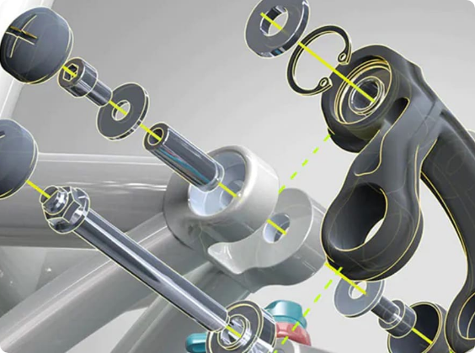
EXITIQ • VISHWAKARMA AWARDS STAGE 2
Dynamic Route Planning: Real-Time Graph Recalculation Around Hazards
CONCEPTUAL FACILITY GRAPH: DYNAMIC RE-ROUTING (STAGE 2 LAB LAYOUT)
ALGORITHMIC ROUTE RECALCULATION
Cost Function: C(e) = Length(e) × Risk_Multiplier(z) + Congestion(e)
• 1. Pre-Defined Topology: Building corridors and junctions stored as a directed graph G=(V,E) in ESP32-S3 Flash memory.
• 2. Real-Time Risk Ingestion: Zone hazard states continuously update edge weights in memory (<500 ms target sensor-to-graph latency).
• 3. Penalty Execution: Normal zones = 1.0x; Warning = 2.5x; High Risk = 10.0x; Critical zones = INFINITY (edge pruned).
• 4. Shortest Safe Path: Dijkstra / heuristic A* solves the modified graph in <100 ms target on the ESP32-S3 internal core.
• 5. Hardware Output: Physical direction vector transmitted to junction WS2812B LED light guides and OLED bezel panels.
• 6. Invariant Safety Check: The algorithm strictly forbids routing into active hazards. If all exits are blocked, shelter-in-place engages.
OCCUPANT START
Zone 1 (Workshop)
Initial: 25 Occupants
JUNCTION J1
[ExitIQ Node 1]
Re-evaluates Path
CORRIDOR B
Hazard: HIGH RISK
Weight: INFINITY
[BLOCKED / AVOID]
PRIMARY EXIT 1
[COMPROMISED]
✔ CORRIDOR C (ALTERNATIVE)
Sensor Status: NORMAL (Safe)
Distance: 28m | Weight: 1.0x
SAFE
EXIT 2
[CLEAR]
DIAGRAM LEGEND & VERIFICATION CONTEXT:
• Initial Path (Grey): Pre-incident baseline route pointing toward Exit 1 via Corridor B.
• Blocked Route (Red): Active fire detected; corridor assigned INFINITE cost and pruned from pathfinder.
• Recalculated Route (Green): Dijkstra algorithm dynamically routes through safe Corridor C to Exit 2.
• Status Note: Conceptual test topology for Stage 2 validation; not an actual facility architectural blueprint.

Slide 8

EXITIQ • VISHWAKARMA AWARDS STAGE 2
Hardware Subsystems: Verified Component Selection & Architecture
CORE CONTROLLER
ESP32-S3-DevKitC-1-N8R8
• Dual-core Xtensa LX7 @ 240MHz
• 8MB Octal Flash + 8MB Octal PSRAM
• Vector instructions accelerate TinyML
• Integrated 2.4GHz Wi-Fi + BLE 5.0 mesh
• FreeRTOS multi-tasking task scheduler
THERMAL SENSOR BAY
Sensirion SHT40-AD1B
• High-precision digital temperature/RH
• Accuracy: ±0.2°C typ (0°C to 60°C)
• Fast response time: τ63% = 2.0 seconds
• Ultra-low power: 0.4 µA average @ 1Hz
• I2C Interface: Standard fast-mode 400kHz
COMBUSTION / VOC SENSOR
Sensirion SGP40-DIS
• Digital MOx VOC Air Quality Sensor
• Integrated micro-hotplate sensor element
• Digital VOC Index algorithm output (0–500)
• Senses smoldering fire pyrolysis gases
• Compensated via SHT40 temp/RH feeds
POWER-PATH MANAGER
Texas Instruments BQ24074
• Autonomous Dynamic Power-Path (DPPM)
• Supplies system directly while charging cell
• <100ns brownout-free battery switchover
• 1.5A max charge current (ISET configured)
• Under-voltage & over-current protection
5V SYNCHRONOUS BOOST
Texas Instruments TPS61023
• Synchronous battery-to-5V step-up
• 3.7A valley switch current limit
• Supplies clean 5V to WS2812B LEDs
• >92% power conversion efficiency
• Stable operation down to 2.7V battery cutoff
EGRESS GUIDANCE OUTPUTS
WS2812B + OLED + Buzzer
• 8x WS2812B 5050 RGB addressable LEDs
• TI 74AHCT1G125 3.3V-to-5V level shifter
• 0.96' 128x64 SSD1306 Graphic OLED panel
• CUI CMT-8540S 85 dBA 4kHz audio buzzer
• Triple multi-modal egress alert channels

Slide 9

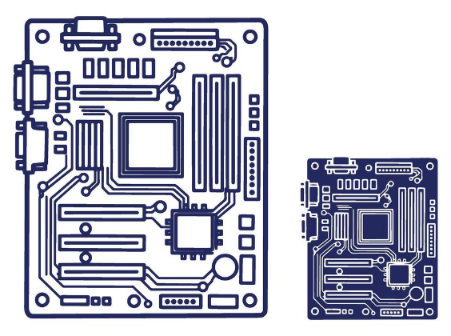
EXITIQ • VISHWAKARMA AWARDS STAGE 2
Itemized Prototype Bill of Materials (BOM) & Domestic Sourcing
Item | Component MPN & Description | Package / Form Factor | Qty | Sourcing Vendor & Lead Time | Line Total (INR)
1 | ESP32-S3-DevKitC-1-N8R8 MCU Carrier | DIP-44 (2x22 2.54mm socket headers) | 1 | Robu.in / Mouser India (3-5 days) | ₹850.00
2 | TI BQ24074RGTR Power-Path & Li-Ion Charger | VQFN-16 (3.0 x 3.0 mm) | 1 | Mouser / Element14 India (5 days) | ₹240.00
3 | TI TPS61023DRLR Synchronous 5V Boost Converter | SOT-563 (1.6 x 1.6 mm) | 1 | Mouser India (5 days) | ₹125.00
4 | Sensirion SHT40-AD1B-R2 Digital Temp/RH Sensor | DFN-4 (1.5 x 1.5 mm) | 1 | Mouser / Evelta India (4 days) | ₹180.00
5 | Sensirion SGP40-DIS-R4 Digital MOx VOC Sensor | DFN-6 (2.44 x 2.44 mm) | 1 | Mouser India (5 days) | ₹310.00
6 | Worldsemi WS2812B-B Intelligent RGB LEDs | 5050 SMD (5.0 x 5.0 mm) | 8 | Robu.in / Evelta India (2 days) | ₹120.00
7 | CUI CMT-8540S Buzzer + 74AHCT125 Level Shifter | SMD Magnetic + SOT-23-5 | 1 set | Robu.in / Domestic (2 days) | ₹140.00
8 | 0.96' 128x64 SSD1306 Graphic OLED Display Panel | 4-pin I2C Panel (26 x 15 mm active) | 1 | Robu.in (2 days) | ₹220.00
9 | Samsung/Panasonic 18650 3400mAh Li-Ion Cell + PCM | Cylindrical Cell + Protection Circuit | 1 | Domestic / Robu.in (3 days) | ₹450.00
10 | 2-Layer Custom FR4 Carrier PCB (Batch Amortized) | 100.0 x 80.0 x 1.6 mm FR4 | 1 | LionCircuits India (6 days) | ₹350.00
TOTAL ESTIMATED PROTOTYPE NODE COST: ₹3,585 INR (Per-Node Prototype Estimate)
• Cost Scope: Items 1–10 subtotal ₹2,985 + ₹600 allocation for SMD passives/TVS/PTC, connectors/inserts, and 3D printed PETG enclosure.
• Exclusions / Assumptions: Excludes domestic courier freight and 18% GST. Volume batch production (>1,000 nodes) projected to reduce unit cost to ~₹1,850 INR.

Slide 10

EXITIQ • VISHWAKARMA AWARDS STAGE 2
Mechanical CAD Engineering: Enclosure Design, Clearances & Thermal Isolation
CATIA V5 ENCLOSURE SPECIFICATIONS
• Enclosure Envelope: 114.0 mm x 94.0 mm x 26.0 mm with 2.5 mm nominal wall thickness.
• Internal Clearance: 104.0 x 84.0 x 21.0 mm; provides +2.4mm headroom above ESP32 socket headers and +3.4mm above bulk capacitors.
• Mounting Geometry: 4x M3 brass heat-set threaded inserts in cylindrical bosses at (5,5), (95,5), (95,75), (5,75) mm.
• Interface Cutouts: Left wall USB-C port (9.6x3.6mm), battery harness hatch (8.5x7.0mm), front OLED window (26x15mm), acoustic port (dia 3.0mm).
• Thermal Isolation Slot: 1.0 mm milled FR4 air gap slot (Edge.Cuts, X=72-73mm, Y=14-28mm) isolates SHT40/SGP40 from PCB heat.
• Material Rationale: Flame-retardant PETG / UL94 V-0 ABS enclosure; optical polycarbonate light pipe with crosstalk baffles.
• Validation Status: 3D CAD modeled in CATIA V5; structural FEA not performed (drop testing scheduled for Month 4).

Slide 11
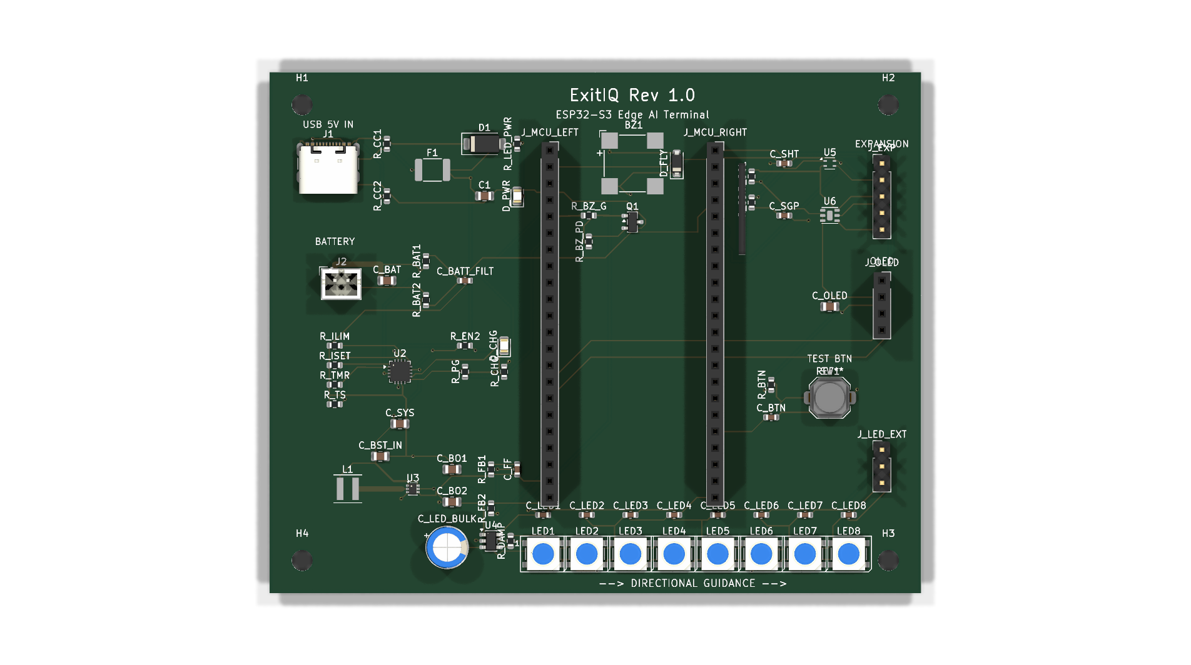
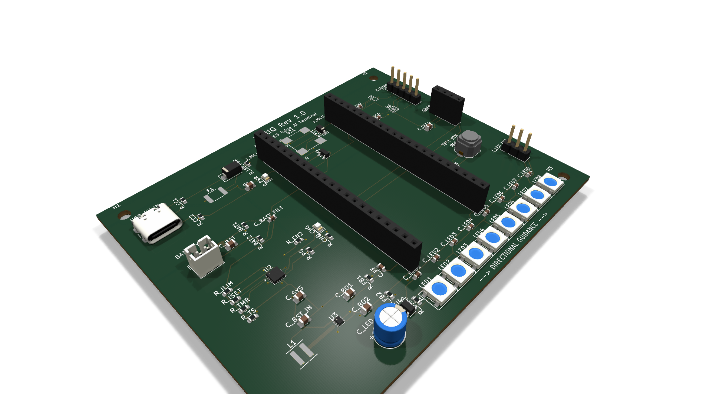



EXITIQ • VISHWAKARMA AWARDS STAGE 2
ECAD Engineering: Schematic Verification, Grounding & Routing Schedule
9 FUNCTIONAL BLOCKS & VERIFICATION
• Schematic Integrity: ExitIQ.kicad_sch contains 9 organized functional sheets. KiCad Electrical Rules Check (ERC) passed with 0 Errors, 0 Warnings (ExitIQ_ERC.rpt).
• 5V Ingress & TVS Protection: USB-C input clamped with Littelfuse SMAJ5.0A TVS diode (400W peak) + 2.0A PTC resettable polyfuse.
• Sensor Thermal Isolation: Dedicated physical slot in FR4 PCB (Edge.Cuts, 1.0mm wide) mechanically separates SHT40/SGP40 from MCU/boost regulator thermal dissipation.
• Level Shifting & LED Line Integrity: TI 74AHCT1G125 high-speed buffer translates 3.3V ESP32 GPIO to 5.0V WS2812B DIN; 330Ω damping resistor suppresses transmission reflections.
• Ground Plane Design: Continuous solid B.Cu ground plane poured beneath all digital logic; power loops minimized.
• PCB Completion Status: Schematic ERC 100% passed (0 Errors). PCB routing 100% complete (0 unrouted nets, 0 unconnected pads, 70 nets, 642 tracks) with solid B.Cu ground plane and verified DRC.

Slide 12

EXITIQ • VISHWAKARMA AWARDS STAGE 2
Maker Journey: Hands-On Personal Fabrication & Verification
PROOF OF PERSONAL FABRICATION
• Student Engineering: Hands-on design of electrical schematics, custom PCB carrier layout, CATIA mechanical enclosure, and firmware architecture.
• Authentic Provenance: Verified through progressive Git commit histories, raw ECAD schematic hierarchy, and laboratory test logs.
• Faculty Mentorship: Guided by institutional faculty mentor in regular weekly engineering design reviews.
[INSERT AUTHENTIC TEAM FABRICATION & LAB WORK PHOTO HERE]
Source Asset: Institutional Electronics Laboratory (Camera Photo)
MANDATORY JURY REQUIREMENT: Real photo of student team members assembling/soldering hardware in lab with visible college ID badges. Area left empty for manual insertion.
WORK-IN-PROGRESS SOFTWARE UI
• CATIA V5 Active Workspace: Desktop captures show active Part Design parametric trees, pocket operations for sensor apertures, and boss screw-hole specifications.
• KiCad 10 Nightly Environment: Interactive layout session displaying ratnest nets, design rule configuration, and DRC error audit panes.
RAW REPOSITORY AUDIT LINKAGE
• Native Engineering Files: Contains native ExitIQ.kicad_sch, ExitIQ.kicad_pcb, CATProduct 3D CAD assemblies, BOM .csv, and ERC reports.
• Public Audit Link: [ADD REAL ACCESSIBLE REPOSITORY LINK - DRIVE / GITHUB]

Slide 13


EXITIQ • VISHWAKARMA AWARDS STAGE 2
Benchmarking ExitIQ Against Commercial Products & Academic Research
Key Evaluation Dimension | Conventional Exit Sign | Honeywell NOTIFIER | Eaton FlexiTech / Ex-Lite | Academic Literature | ExitIQ (Proposed System)
Fire & Hazard Detection | None (Signage only) | Yes (Certified smoke/heat) | None (Emergency sign only) | Yes (Selected studies) | Yes (SHT40 Temp + SGP40 VOC)
Dynamic Directional Guidance | No (Fixed permanent legend) | Voice alerts (Fixed arrows) | No (Fixed pictogram) | Yes (Adaptive signage) | Yes (8x WS2812B running LEDs)
Zone-by-Zone Risk Assessment | No | Yes (Panel supervisory zones) | No | Yes (Sensor-graph models) | Yes (4-state machine + TinyML)
Real-Time Route Recalculation | No | Manual dispatcher override | No | Yes (Dijkstra / A* algorithms) | Yes (On-node Dijkstra pathfinder)
Autonomous Offline Operation | Yes (Passive display) | Requires central panel loop | Yes (Standalone sign) | Varies by paper architecture | Yes (100% local-first mesh)
Battery-Backed Emergency Power | Model-dependent backup | Central system UPS backup | Yes (LiFePO4 battery) | Varies by prototype | Yes (TI DPPM, 6.6h runtime)
Development & Testing Status | Mature commercial product | Mature commercial product | Mature commercial product | Published research papers | Designed & verified in CAD/ERC
CORE BENCHMARK FINDING: THE LOCAL-FIRST INTEGRATION ADVANTAGE
• Commercial Gap: Commercial systems offer rugged hardware and certified alarms but lack dynamic arrow redirection.
• Academic Gap: Research papers demonstrate dynamic routing in simulation but rely on complex central servers and rarely integrate battery-backed hardware.
• ExitIQ Contribution: Integrates adaptive directional guidance, local sensor fusion, and brownout-free battery power into an affordable (₹3,585) decentralized node.

Slide 14
EXITIQ • VISHWAKARMA AWARDS STAGE 2
Innovation Advantage: What Is Solved vs. ExitIQ's Contribution
FOUNDATIONAL LITERATURE INSIGHTS
What Has Already Been Solved in Safety Research:
• Dynamic Routing Exists: Algorithms (Dijkstra, A*, PSO) can recalculate egress paths as environmental hazards shift (Fire Safety Journal 2015; Building & Environment 2020).
• Adaptive Visuals Work: Human participant studies confirm occupants follow dynamic directional arrows (89% compliance demonstrated in 2020 complex building evacuation trial).
• Battery Signs Are Mature: Commercial products (Eaton FlexiTech/Ex-Lite) prove 90-180 minute reliable battery backup operation in rugged industrial enclosures.
The Unaddressed Implementation Gap:
Literature proves algorithms in simulation; commercial products provide reliable power without dynamic intelligence. No low-cost, decentralized terminal bridges this divide for typical manufacturing plants.
EXITIQ'S TANGIBLE CONTRIBUTION
Four Tangible Demonstrations Engineered by Our Team:
• 1. Corridor Threat Detection: Sensirion SHT40 + SGP40 dual sensor bay detects pyrolysis gases and thermal spikes; ESP32-S3 transitions zone to HIGH RISK (<500ms target).
• 2. Real-Time Redirection: On-node pathfinder recalculates safest route and flips WS2812B green LED running arrows to alternate safe exit (<100ms target).
• 3. Mains Disconnect Continuity: TI BQ24074 DPPM switches from 5V USB-C to 18650 Li-Ion cell in <100ns without brownout dip, sustaining guidance for 6.6 hours.
• 4. Local Comms Fallback: If central network links sever, node executes deterministic autonomous fallback rules with local fault annunciation.
Outcome: A low-cost, local-first safety terminal that bridges the gap between commercial alarm systems and theoretical research.

Slide 15



EXITIQ • VISHWAKARMA AWARDS STAGE 2
Safety by Design: Multi-Tiered Fail-Safes & Design FMEA Matrix
Potential Failure Mode | Operational Hazard & Severity | Design Mitigation & Hardware Fail-Safe | Implementation Status
Mains 5V Power Loss | Controller reset, loss of guidance, darkness and panic in corridors during emergency. | TI BQ24074 DPPM switches to 18650 cell in <100ns (zero brownout dip); supplies guidance for 6.6 hours. | Designed in ECAD (Verified in datasheet)
Sensor Failure / Drift | Stale or false low-risk reading directing fleeing occupants toward an advancing fire front. | Firmware I2C watchdog; unreadable zone immediately marked as HIGH RISK; defaults to deterministic safe rule. | Designed in Firmware Architecture
Firmware / Routing Lockup | Frozen directional arrows displaying outdated or unsafe paths during critical evacuation. | ESP32-S3 hardware Watchdog Timer (WDT) triggers hard reset within 1.0s; falls back to static lookup table. | Designed in Firmware Architecture
LED Indicator Array Fault | Loss of primary visual arrow indicators at critical corridor junction point. | Triple redundancy: SSD1306 OLED displays text; CUI CMT-8540S buzzer pulses audible directional alert. | Designed in Hardware (ERC passed)
Route Blocked After Calc | Occupants routed into corridor where fire just breached after recalculation. | FreeRTOS task loops every 500ms; continuous sensor checks recalculate route dynamically. | Designed in Firmware Architecture
REGULATORY SAFETY DEMARCATION & OPERATIONAL BOUNDARIES
• Supplementary Guidance Only: ExitIQ is an experimental research prototype engineered to provide adaptive guidance; it does NOT replace certified building fire alarm systems (EN 54 / NFPA 72) or statutory emergency lighting.
• Sensor Demarcation: The Sensirion SGP40 is an MOx-based VOC air quality index sensor, NOT a certified smoke detector.
• Standards Grounding: Battery endurance meets NFPA 101 (>90 min emergency runtime benchmark: 6.6h calculated); PCB adheres to IPC-2221A Class 2 clearances.

Slide 16

EXITIQ • VISHWAKARMA AWARDS STAGE 2
Four-Month Prototype Implementation Roadmap: Stage 2 to Stage 3
MONTH 1 (OCT 2026)
ECAD & MCAD SIGN-OFF
• Complete KiCad push-and-shove routing schedule.
• Re-run full DRC (0 unrouted nets).
• Export production Gerber and drill package.
• 3D print initial PETG enclosure prototype.
MONTH 2 (NOV 2026)
FABRICATION & SMT ASSEMBLY
• Fabricate 2-layer FR4 PCB at domestic fab house.
• Component arrival & SMT hand-soldering.
• Benchtop power-path switchover test under 1.5A load.
• Verify I2C sensor communications & LED drivers.
MONTH 3 (DEC 2026)
FIRMWARE & TINYML INTEGRATION
• Implement ESP32-S3 FreeRTOS firmware.
• Build dual-sensor calibration & fusion pipeline.
• Train lightweight TinyML classifier on safe data.
• Integrate Dijkstra graph route engine.
MONTH 4 (JAN 2027)
MULTI-ZONE STAGE 3 DEMO
• Construct 3–5 zone miniature floor plan board.
• Execute simulated fire emergency scenarios.
• Benchmark detection latency & battery endurance.
• Present live functional demo for Stage 3 jury.
PROTOTYPE VALIDATION TARGETS (TO BE BENCHMARKED IN STAGE 3 TRIAL)
• Hazard Detection Latency: Target < 500 ms from safe test stimulus to risk classification.
• Route Recalculation Time: Target < 100 ms on ESP32-S3 internal core.
• Emergency Battery Runtime: Target > 6.0 hours (calculated: 6.6 hours @ 460mA load on 3400mAh cell).
• Route Safety Success Rate: Target 100% avoidance of simulated high-risk zones across all repeatable test runs.

Slide 17

EXITIQ • VISHWAKARMA AWARDS STAGE 2
Engineering Bottlenecks: Critical Design Constraints Analyzed
1. DYNAMIC CURRENT SPIKES & BROWNOUT RISK
• WS2812B LEDs draw up to 480mA during full strobe; ESP32-S3 draws 355mA during Wi-Fi bursts.
• Combined current spikes exceed 800mA, creating steep dynamic load steps.
• Without dedicated power-path isolation, voltage sag causes ESP32 brownout reset loops.
2. SENSOR THERMAL COUPLING & FALSE ALARMS
• ESP32-S3 and TPS61023 boost regulator dissipate heat locally on the carrier PCB.
• Direct thermal conduction through FR4 copper planes artificially elevates SHT40 readings by +3°C to +6°C.
• Thermal drift skews SGP40 baseline, generating false VOC fire alerts.
3. SIGNAL INTEGRITY & GROUND IMPEDANCE
• High net density (70 nets, 642 tracks) risked ground return loop discontinuities and EMI.
• High-frequency digital signals (400kHz I2C, 800kHz WS2812B DIN) require low-impedance ground returns.
• Poor ground routing risks crosstalk, bit corruption, and unintended RF emissions.
4. EDGE AI RESOURCE CONSTRAINTS
• Complex deep learning fire models cannot run reliably on resource-constrained microcontrollers.
• Real-time route calculation must execute deterministically without blocking FreeRTOS sensor loops.
• Cloud-based AI inference fails completely if building internet infrastructure collapses.

Slide 18



EXITIQ • VISHWAKARMA AWARDS STAGE 2
Verified Engineering Mitigations: Rigorous Technical Solutions
1. DYNAMIC POWER-PATH & BOOST REGULATION
• Integrated TI BQ24074 DPPM to autonomously manage input current limits.
• Paired with TI TPS61023 synchronous boost converter delivering up to 3.7A valley switch current.
• Bulk decoupling capacitors (100µF electrolytic + 22µF ceramic) absorb transient current steps.
• Ensures uninterrupted <100ns brownout-free battery switchover during total mains blackout.
2. PHYSICAL PCB THERMAL ISOLATION SLOT
• Milled a 1.0mm physical air gap slot through FR4 (Edge.Cuts, X=72-73mm, Y=14-28mm).
• Mechanically severs copper heat conduction between MCU/regulator and the sensor bay.
• Airflow louvers in the CATIA enclosure provide passive convection to sample true ambient air.
• Maintains Sensirion SHT40 temperature measurement accuracy within ±0.2°C.
3. LOW-IMPEDANCE GROUND RETURN & ROUTING
• Poured a solid, low-impedance ground return plane on B.Cu beneath all digital signal traces.
• Placed a TI 74AHCT1G125 high-speed buffer near ESP32 GPIO to level-shift 3.3V to 5.0V with a 330Ω damping resistor.
• Completed 100% interactive push-and-shove routing with 0 unrouted nets, 0 shorts, and continuous ground return.
4. LIGHTWEIGHT QUANTIZED MODEL & RULES
• Designed compact decision tree / quantized TinyML model running in <32KB SRAM.
• FreeRTOS timer enforces deterministic 500ms sensor fusion and <100ms Dijkstra route recalculation.
• 100% on-device edge computation operates flawlessly without external internet or cloud reliance.

Slide 19


EXITIQ • VISHWAKARMA AWARDS STAGE 2
Industrial Impact, Scalability & Technology Horizons
IMMEDIATE INDUSTRIAL IMPACT
• Panic Reduction: Eliminates lethal corridor hesitation by providing unambiguous, active green arrow strobes away from danger.
• Preventing Bottlenecks: Dynamic multi-path routing prevents crowd congestion at single primary exits, distributing flow across all safe doors.
• Cost-Effective Retrofit: Affordable ₹3,585 INR unit cost allows industrial plants to deploy dense node grids alongside existing certified fire systems.
• True Offline Autonomy: Operates reliably through total facility blackouts and internet loss, protecting workers when central building networks fail.
SCALABILITY & HORIZONS
• Mesh Network Expansion: Scale from single-node prototypes to multi-hop 50+ node industrial meshes using ESP-NOW and Sub-GHz RF.
• AI Computer Vision Module: Integrate low-cost ESP32-CAM nodes for optical flame recognition, crowd density tracking, and blocked path detection.
• Digital Twin Integration: Stream real-time zone risk vectors to facility BIM digital twins and central emergency monitoring dashboards.
• Worker Wearable Integration: Broadcast BLE localized hazard vectors to industrial smart watches and badges for tactile vibration alerts.

Slide 20






EXITIQ • VISHWAKARMA AWARDS STAGE 2
Technical References, Regulatory Standards & Master Conclusion
COMPONENT DATASHEETS
• Espressif Systems: ESP32-S3 Series Datasheet v1.6 & Hardware Design Guidelines (2025).
• Texas Instruments: BQ24074 1.5A Dynamic Power-Path Li-Ion Charger (SLUS810M).
• Texas Instruments: TPS61023 Synchronous Boost Converter Datasheet (SLVSEJ3).
• Sensirion AG: SHT4x Digital Temp/RH & SGP40 Digital MOx VOC Sensor Interfaces.
• Worldsemi: WS2812B Intelligent Control LED Integrated Light Source Specification.
ACADEMIC LITERATURE
• 'Testing a real-time intelligent evacuation guiding system for complex buildings' — Building and Environment, Vol. 174, 2020.
• 'Integrating sensing, routing and timing for indoor evacuation' — Fire Safety Journal, Vol. 78, 2015.
• 'Fire evacuation supported by centralized and decentralized visual guidance systems' — Safety Science, Vol. 147, 2022.
• 'Real-time evacuation route selection methodology for complex buildings' — ScienceDirect, 2017.
REGULATORY STANDARDS
• NFPA 101: Life Safety Code (Emergency Egress Lighting Standards: >90 min runtime).
• UL 924: Standard for Emergency Lighting and Power Equipment.
• IEC 62368-1: Audio/video, information and communication technology equipment safety.
• IPC-2221A: Generic Standard on Printed Board Design (Class 2 clearances).
• ISO 7010: Graphical symbols — Safety colors and safety signs.
"WHEN DANGER CHANGES, THE SAFEST WAY OUT MUST CHANGE WITH IT."
ExitIQ bridges the critical gap between detection and survival — delivering an adaptive, battery-backed, and local-first emergency guidance grid to protect industrial workers when conventional systems fail.
Thank you. Questions & Technical Discussion Welcome.

