Slide 1
DSA

Slide 2
Linear data structure
organizing the data so that it can be used efficiently
elements arranged in a sequential order
each element is connected to its previous and next element in a single level.
This linear arrangement implies a clear predecessor and successor for each element except for the first and last elements.

Slide 3
Linear data structure
Sequential Access: traverse one element after another.
Single Level: Elements are stored at a single level, without any hierarchy or branching.
Order of Elements: The order of elements is significant, and operations like insertion, deletion, and traversal are performed in a linear sequence.
Memory Allocation: Memory is allocated in a contiguous block (for arrays) or through linked nodes (for linked lists), ensuring a linear arrangement.

Slide 4
NonLinear data structure
do not have a sequential order.
They involve hierarchical (tree) or networked (graph) relationships between elements, making them suitable for representing more complex relationships.
Tree: Hierarchical structure with a root element and child elements forming subtrees.
Graph: Networked structure with nodes connected by edges, capable of representing various relationships like social networks or transportation systems.

Slide 5
Stack
linear data structure
LIFO
Last element added is removed first
Push, Pop, Peek/Top, IsEmpty

Slide 6
Stack
55
22
33
33
22
55

Slide 7
Stack- Usages
function call managing
function
Frame append
Func call
Frame Pop

Slide 8
Stack- Usages
keeping track of function calls.
Expression Evaluation and Syntax Parsing:
Stacks are used in evaluating expressions (infix, postfix, prefix) and parsing expressions in compilers.
2 + 3, i++, ++i
Undo Mechanism
Backtracking Algorithms: Such as solving puzzles (e.g., maze, Sudoku) Depth-First Search (DFS): In graph algorithms, stacks are used to implement DFS.

Slide 9
Queue
Linear data structure
FIFO
Enqueue
Dequeue
Peek/Front
IsEmpty

Slide 10
Queue
enqueue
Front/head
Rear/back
Ram
Shyam
Hari
Sita
Ram
dequeue

Slide 11
Queue- usage
Order Processing Systems: Queues can manage tasks like printer spooling, where print jobs are processed in the order they are received.
Breadth-First Search (BFS): In graph algorithms, queues are used to implement BFS.
Real-time Systems: Handling tasks in real-time systems where tasks are processed in the order of arrival.
Resource Sharing: Managing processes in a time-sharing system or managing threads in multi-threading environments.
Message Queues: In distributed systems for handling communication between different components or services.

Slide 12
Linked List
linear data structure
each element (node) contains a reference (link) to the next element in the sequence.
Types of linked lists:
singly linked lists,
doubly linked lists, and
circular linked lists.
Insert, Delete, Search, Traverse

Slide 13
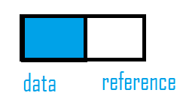
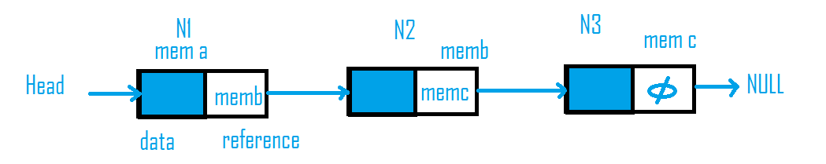
Linked List

Slide 14
Linked List-Usage
Dynamic Memory Allocation: Linked lists are useful for implementing data structures like stacks, queues, and graphs because they can grow and shrink in size dynamically.
Efficient Insertions/Deletions: Inserting or deleting elements in the middle of the list is more efficient than with arrays, especially if the size of the data is unknown or changes frequently.
Implementation of Other Data Structures
Real-time Applications: Where memory overhead is critical, and elements are continuously added or removed, such as in real-time data streams.

Slide 15
Array vs linked List
Array : Insertion/ deletion : O(n)
Access element: O(1)
Linked List:Insertion/ deletion: O(1), O(n)
Access element: O(1),O(n)

Slide 16
Node
Node
Node
Node

Slide 17
Singly linked list
data
next
data
next
data
next
Φ

Slide 18
Singly linked list Append
data1
next
data2
next
data3
next
Φ
data4
next

Slide 19
Singly linked list Append
data1
next
data2
next
data3
next
data4
next
Φ

Slide 20
Singly linked list insert Begin
data1
next
data2
next
data3
next
Φ
Data_n
next

Slide 21
Singly linked list Insert Begin
Data_n
next
data1
next
data2
next
data3
next
Φ

Slide 22
Using class and object add two numbers and display the final result
Find the largest and smallest number

Slide 23
class Node:
def __init__(self,data):
self.data = data
self.next =None
def display(self):
print(f"data is {self.data} and linked to {self.next}")
n1 = Node(22)
n1.display()
n2 = Node(33)
n2.display()

Slide 24
class Node:
def __init__(self,data):
self.data = data
self.next =None
class LinkedList:
def __init__(self):
self.head = None
def traversethelist(self):
if self.head is None:
print("Empty")
else:
a = self.head
while a is not None:
print(a.data,end=' ')
a = a.next
n1 = Node(22)
n2 = Node(33)
n3 = Node(55)
l1 = LinkedList()
l1.head = n1
n1.next = n2
n2.next = n3
l1.traversethelist()

Slide 25
class Node:
def __init__(self,data):
self.data = data
self.next = None
class LList:
def __init__(self):
self.head = None
def printLL(self):
if self.head is None:
print("Empty")
else:
n = self.head
while n:
print(n.data)
n=n.next
def add_start(self,data):
node1 = Node(data)
node1.next = self.head
self.head = node1
l = LList()
l.add_start(222)
l.add_start(242)
l.add_start(232)
l.printLL()

Slide 26
class Node:
def __init__(self,data):
self.data = data
self.next =None
class LinkedList:
def __init__(self):
self.head = None
def traversethelist(self):
if self.head is None:
print("Empty")
else:
a = self.head
while a is not None:
print(a.data,end=' ')
a = a.next
n1 = Node(22)
n2 = Node(33)
n3 = Node(55)
l1 = LinkedList()
l1.head = n1
n1.next = n2
n2.next = n3
l1.traversethelist()

