Slide 1
Extreme Programming
Kiran Pamnany

Slide 2
Software Engineering
Computer programming as an engineering profession rather than an art or a craft
Meet expectations:
  Functionality
  Reliability
  Cost
  Delivery schedule

Slide 3
Methodologies
Methodology: codified set of recommended practices
No consensus:
  Waterfall model
  Spiral model
  Rational Unified Process (RUP)
  Extreme Programming (XP)

Slide 4
Classic process steps
Requirements Analysis
Specification
Design and Architecture
Coding
Testing
Documentation
Maintenance

Slide 5
Waterfall model
Proposed in 1970 by W. W. Royce
Development flows through steps:
  Requirements analysis
  Architectural design
  Detailed design
  Coding, debugging and unit testing
  Integration and system testing
  Deployment, operation and maintenance

Slide 6
Waterfall model (cont.)
Pros:
  Track progress easily due to clear stages
  Easily identifiable milestones and deliverables
Cons:
  Inflexible: difficult to respond to changing requirements
  Design and coding discover requirements inconsistencies
  Some problems not discovered until system testing

Slide 7
Spiral model
Defined in 1986 by Barry Boehm
Modified waterfall
Software is developed in a series of incremental releases
Early releases are prototypes
Later releases become increasingly complete
Receive feedback after each release

Slide 8
Spiral model (cont.)
Pros:
  Systematic and stepwise, but in an iterative framework
  Estimates get more realistic as work progresses
  Some ability to cope with changing requirements
Cons:
  Time-intensive process
  Not extensively used

Slide 9
Rational Unified Process (RUP)
Defined in 1997 by Grady Booch, Ivar Jacobson and James Rumbaugh
General framework to describe specific development processes
Designed to be tailored for a given software project with consideration for its size and type
Recognized to be particularly applicable to large projects with large teams

Slide 10
RUP Phases
Inception
  Shared understanding of the system with the customer
Elaboration
  Architecture to build the system
Construction
  Developing the system
Transition
  Customer takes ownership of system

Slide 11
RUP Guidelines
Develop iteratively
  Deal with changing requirements
  Address high risk items as the highest priority tasks at each iteration
  Ideally, each iteration has an executable release
Manage requirements
  Document functionality, constraints, design decisions, business requirements
  Define use cases and scenarios

Slide 12
RUP Guidelines (cont.)
Use component architecture
  For extensibility and reusability (CORBA/COM)
Model software visually
  Abstraction using UML
Verify software quality
  Plan quality control and assessment
  Involve all team members
Control changes to software
  Use secure workspaces

Slide 13
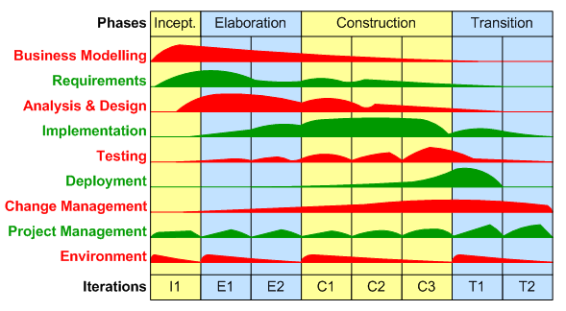
RUP Workflows - Typical Project
(Source: George Stepanek, 2004)

Slide 14
RUP Criticism
‘High ceremony methodology’
Bureaucratic: process for everything
Slow: must follow process to comply
Excessive overhead: rationale, justification, documentation, reporting, meetings, permission

Slide 15
Extreme Programming (XP)
Formulated in 1999 by Kent Beck, Ward Cunningham and Ron Jeffries
Agile software development methodology (others: Scrum, DSDM)
Developed in reaction to high ceremony methodologies

Slide 16
XP: Why?
Previously:
  Get all the requirements before starting design
  Freeze the requirements before starting development
  Resist changes: they will lengthen schedule
  Build a change control process to ensure that proposed changes are looked at carefully and no change is made without intense scrutiny
  Deliver a product that is obsolete on release

Slide 17
XP: Embrace Change
Recognize that:
  All requirements will not be known at the beginning
  Requirements will change
Use tools to accommodate change as a natural process
Do the simplest thing that could possibly work and refactor mercilessly
Emphasize values and principles rather than process

Slide 18
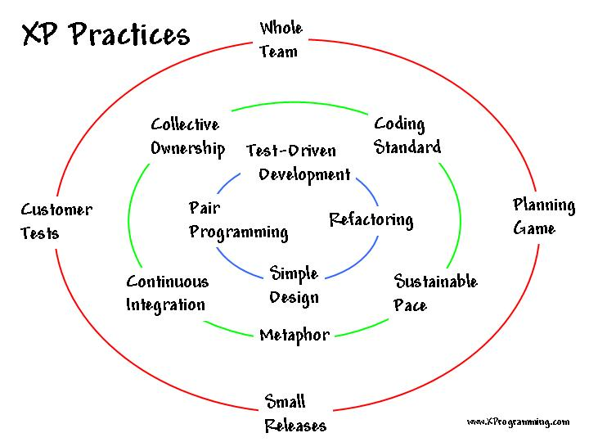
XP Practices
(Source: http://www.xprogramming.com/xpmag/whatisxp.htm)

Slide 19
XP Practices: Whole Team
All contributors to an XP project are one team
Must include a business representative--the ‘Customer’
  Provides requirements
  Sets priorities
  Steers project
Team members are programmers, testers, analysts, coach, manager
Best XP teams have no specialists

Slide 20
XP Practices: Planning Game
Two key questions in software development:
  Predict what will be accomplished by the due date
  Determine what to do next
Need is to steer the project
Exact prediction (which is difficult) is not necessary

Slide 21
XP Practices: Planning Game
XP Release Planning
  Customer presents required features
  Programmers estimate difficulty
  Imprecise but revised regularly
XP Iteration Planning
  Two week iterations
  Customer presents features required
  Programmers break features down into tasks
  Team members sign up for tasks
  Running software at end of each iteration

Slide 22
XP Practices: Customer Tests
The Customer defines one or more automated acceptance tests for a feature
Team builds these tests to verify that a feature is implemented correctly
Once the test runs, the team ensures that it keeps running correctly thereafter
System always improves, never backslides

Slide 23
XP Practices: Small Releases
Team releases running, tested software every iteration
Releases are small and functional
The Customer can evaluate or in turn, release to end users, and provide feedback
Important thing is that the software is visible and given to the Customer at the end of every iteration

Slide 24
XP Practices: Simple Design
Build software to a simple design
Through programmer testing and design improvement, keep the software simple and the design suited to current functionality
Not a one-time thing nor an up-front thing
Design steps in release planning and iteration planning
Teams design and revise design through refactoring, through the course of the project

Slide 25
XP Practices: Pair Programming
All production software is built by two programmers, sitting side by side, at the same machine
All production code is therefore reviewed by at least one other programmer
Research into pair programming shows that pairing produces better code in the same time as programmers working singly
Pairing also communicates knowledge throughout the team

Slide 26
XP Practices: Test-Driven Development
Teams practice TDD by working in short cycles of adding a test, and then making it work
Easy to produce code with 100 percent test coverage
These programmer tests or unit tests are all collected together
Each time a pair releases code to the repository, every test must run correctly

Slide 27
XP Practices: Design Improvement
Continuous design improvement process called ‘refactoring’:
  Removal of duplication
  Increase cohesion
  Reduce coupling
Refactoring is supported by comprehensive testing--customer tests and programmer tests

Slide 28
XP Practices: Continuous Integration
Teams keep the system fully integrated at all times
Daily, or multiple times a day builds
Avoid ‘integration hell’
Avoid code freezes

Slide 29
XP Practices: Collective Code Ownership
Any pair of programmers can improve any code at any time
No ‘secure workspaces’
All code gets the benefit of many people’s attention
Avoid duplication
Programmer tests catch mistakes
Pair with expert when working on unfamiliar code

Slide 30
XP Practices: Coding Standard
Use common coding standard
All code in the system must look as though written by an individual
Code must look familiar, to support collective code ownership

Slide 31
XP Practices: Metaphor
XP Teams develop a common vision of the system
With or without imagery, define common system of names
Ensure everyone understands how the system works, where to look for functionality, or where to add functionality

Slide 32
XP Practices: Sustainable Pace
Team will produce high quality product when not overly exerted
Avoid overtime, maintain 40 hour weeks
‘Death march’ projects are unproductive and do not produce quality software
Work at a pace that can be sustained indefinitely

Slide 33
XP Values
Communication
Simplicity
Feedback
Courage

Slide 34
XP Values: Communication
Poor communication in software teams is one of the root causes of failure of a project
Stress on good communication between all stakeholders--customers, team members, project managers
Customer representative always on site
Paired programming

Slide 35
XP Values: Simplicity
‘Do the Simplest Thing That Could Possibly Work’
  Implement a new capability in the simplest possible way
  Refactor the system to be the simplest possible code with the current feature set
‘You Aren’t Going to Need It’
  Never implement a feature you don’t need now

Slide 36
XP Values: Feedback
Always a running system that delivers information about itself in a reliable way
The system and the code provides feedback on the state of development
Catalyst for change and an indicator of progress

Slide 37
XP Values: Courage
Projects are people-centric
Ingenuity of people and not any process that causes a project to succeed

Slide 38
XP Criticism
Unrealistic--programmer centric, not business focused
Detailed specifications are not written
Design after testing
Constant refactoring
Customer availability
12 practices are too interdependent

Slide 39
XP Thoughts
The best design is the code.
Testing is good. Write tests before code. Code is complete when it passes tests.
Simple code is better. Write only code that is needed. Reduce complexity and duplication.
Keep code simple. Refactor.
Keep iterations short. Constant feedback.

Slide 40
Software Quality: Another View
A programmer presenting an elegant but ‘inefficient’ solution, talks of the inelegant but ‘efficient’ solution
[…] but your solution doesn’t work: if the solution doesn’t have to work, then Begin..End is a valid solution. Gerald Weinberg, ‘The Psychology of Computer Programming’, 1972

Slide 41
Software Quality: Another View
[…] software engineering has accepted as its charter “How to program if you cannot.” E.W. Dijkstra, ‘The Cruelty of Really Teaching Computer Science’, 1988
Computer programming as a branch of mathematics--formal provability of a program is a major criterion for correctness
Program correctness is ‘constitutional’; an incorrect program is worthless or of negative worth

Slide 42
Formal Verification
The act of proving or disproving a system’s correctness with respect to a formal specification or property, using formal methods
System types include FSM, Petri nets, timed and hybrid automata, cryptographic protocols, combinatorial circuits, etc.
Properties to be verified are described in temporal logics; approaches include state space enumeration, abstract interpretation, etc.

Slide 43
Formal Methods
Mathematical techniques for the specification, development and verification of software and hardware systems
Classified as:
  Denotational semantics
  Operational semantics
  Axiomatic semantics

Slide 44
The Way Forward?
‘High ceremony’ software engineering methodologies in disfavor
Agile software development methodologies in increasing use, but with significant criticism
Formal methods will never have a significant impact until they can be used by people that don’t understand them. T. Melham

