Slide 1
IBM Bob Gujarat State level Hackathon Project Submission
“Exploring the Power of Agentic AI with IBM Granite and IBM Bob”

Slide 2

Project Tile – Nutrition Agent
Domain of Project – Healthcare
Student Name | Recent Passport Photo | Email ID | Mobile number [WhatsApp]
BINIT SHAW |  | binitb938@gmail.com | 6289480810

Slide 3
Problem Statement -
Problem Statement : Nutrition Agent
The Challenge
Good nutrition is the foundation of health, but individuals often struggle with diet planning, portion control, and tracking nutritional intake. Information about healthy diets, disease-specific nutrition, and food composition is scattered across unreliable sources. Without personalized, real-time guidance, many fail to maintain balanced diets or make informed food choices.
The Objective
Build an AI-powered Nutrition Agent that delivers personalized dietary insights and guidance for individuals, families, and health professionals. The solution should:
Personalized Diet Plans – Recommend meals based on age, health conditions, allergies, cultural preferences, and fitness goals.
Food Data RAG Retrieval – Fetch and summarize nutritional values (calories, macros, vitamins) from reliable sources.
Diet Tracking & Feedback – Allow users to log meals via text, images, or voice, and provide instant nutritional analysis.
Preventive Health Focus – Suggest diets for chronic disease management (e.g., diabetes-friendly or heart-healthy plans).
Multi-Agent System –
Nutrition Knowledge Agent (fetches nutritional data)
Diet Recommendation Agent (personalized meal plans)
Health Advisory Agent (preventive health suggestions)
Food Log & Feedback Agent (meal tracking + analysis)
Visualization Dashboard – Show daily/weekly nutrient intake, deficiencies, and progress toward health goals.

Slide 4
Proposed Solution -
1. System Architecture
A multi-agent framework will be designed, where each agent specializes in a specific nutrition-related task. These agents will collaborate to deliver personalized, real-time dietary guidance.
Nutrition Knowledge Agent
  Uses Retrieval-Augmented Generation (RAG) to fetch nutritional data from trusted sources (USDA, WHO, FSSAI).
  Summarizes food composition: calories, macros, vitamins, minerals.
  Provides contextual insights (e.g., “Bananas are rich in potassium, good for heart health”).
Diet Recommendation Agent
  Generates personalized diet plans based on:
    Age, gender, BMI, allergies, cultural preferences, fitness goals.
    Disease-specific needs (diabetes-friendly, heart-healthy, weight-loss).
  Uses reinforcement learning to refine recommendations based on user feedback.
Health Advisory Agent
  Focuses on preventive health.
  Suggests dietary modifications for chronic disease management.
  Provides alerts for nutrient deficiencies and lifestyle risks.
Food Log & Feedback Agent
  Enables meal logging via text, image recognition, or voice input.
  Performs instant nutritional analysis (e.g., “Your lunch had 600 kcal, 20g protein, 15g fat”).
  Gives corrective feedback (“Consider adding fiber to balance your meal”).

Slide 5
2. Core Features
Personalized Diet Plans 🥗 Tailored recommendations for individuals, families, and professionals.
Food Data RAG Retrieval 📊 Reliable nutritional data fetched and summarized in real-time.
Diet Tracking & Feedback 📱 Multi-modal input (text, image, voice) for meal logging and instant analysis.
Preventive Health Focus ❤️ Chronic disease–specific diet suggestions and proactive alerts.
Visualization Dashboard 📈
  Daily/weekly nutrient intake charts.
  Deficiency alerts (e.g., “Low Vitamin D this week”).
  Progress tracking toward fitness/health goals.
3. Technical Implementation
Data Layer:
  Food composition databases (USDA, FSSAI, WHO).
  Disease-specific nutrition guidelines.
AI Layer:
  NLP for text-based queries.
  Computer Vision for food image recognition.
  Speech-to-text for voice-based logging.
  RAG for reliable nutritional data retrieval.
Integration Layer:
  APIs for fitness trackers, wearables, and health apps.
  Secure storage with compliance (HIPAA/GDPR).
Visualization Layer:
  Interactive dashboards (Power BI / custom web app).
  Nutrient breakdowns, progress charts, and recommendations
4. Expected Outcomes
Improved dietary awareness and adherence.
Reduced risk of chronic diseases through preventive nutrition.
Empowerment of individuals and health professionals with reliable, personalized insights.
Centralized, trustworthy nutrition guidance replacing scattered sources.

Slide 6
Technology Used
IBM Bob platform -For designing and orchestrating multi-agent workflows visually
IBM Grainte model - for eg – ibm-granite-3-2-8b – For natural language understanding, reasoning, and personalization
IBM Cloud – It provides the infrastructure to build, deploy, and scale the Nutrition Agent efficiently. IBM Cloud enables a reliable, secure, and scalable environment for deploying the Nutrition Agent.

Slide 7
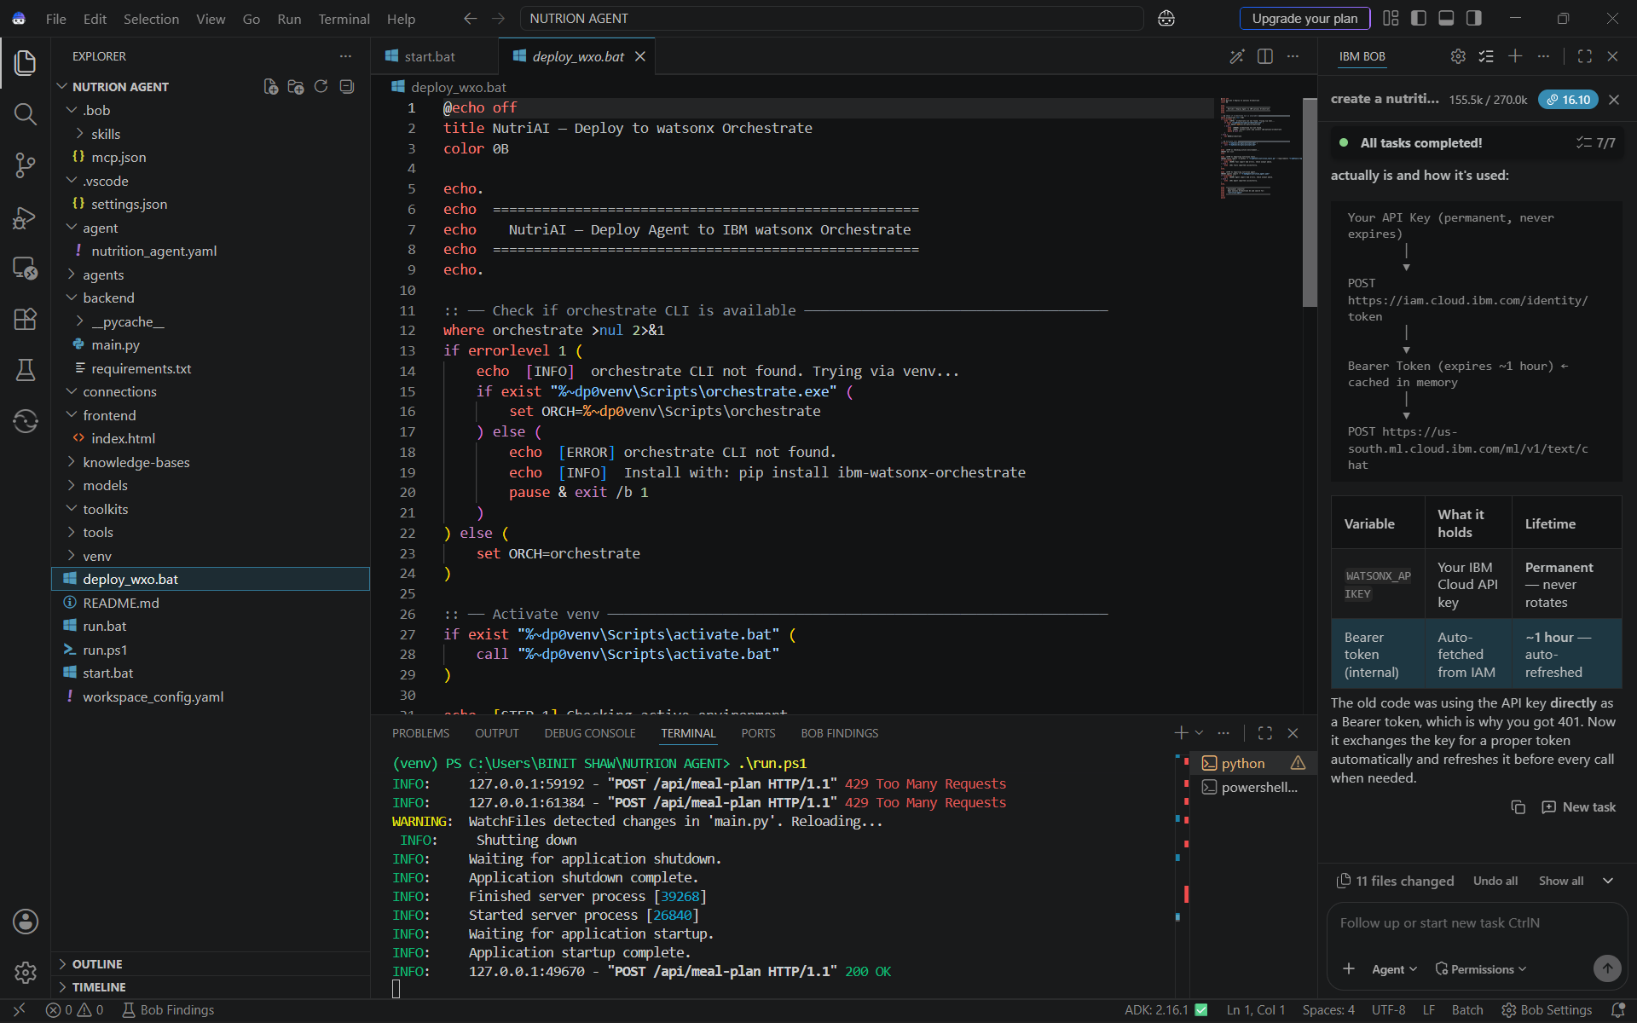
Required Files created using IBM bob -

Slide 8
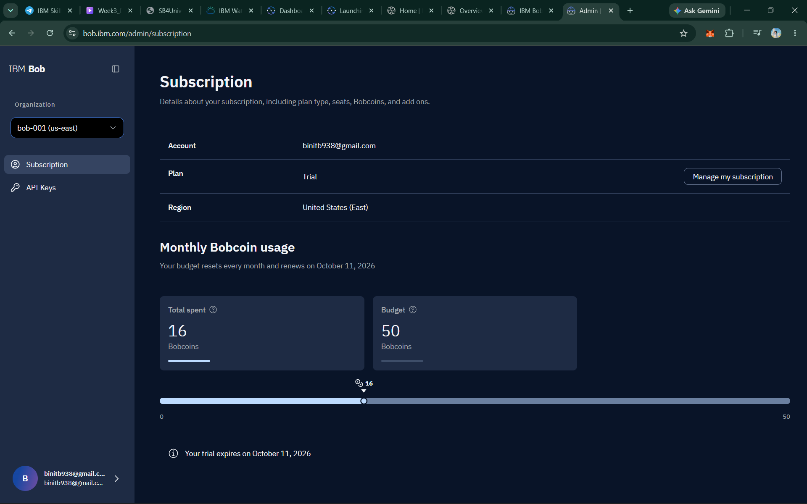
IBM Bob Screenshots:

Slide 9
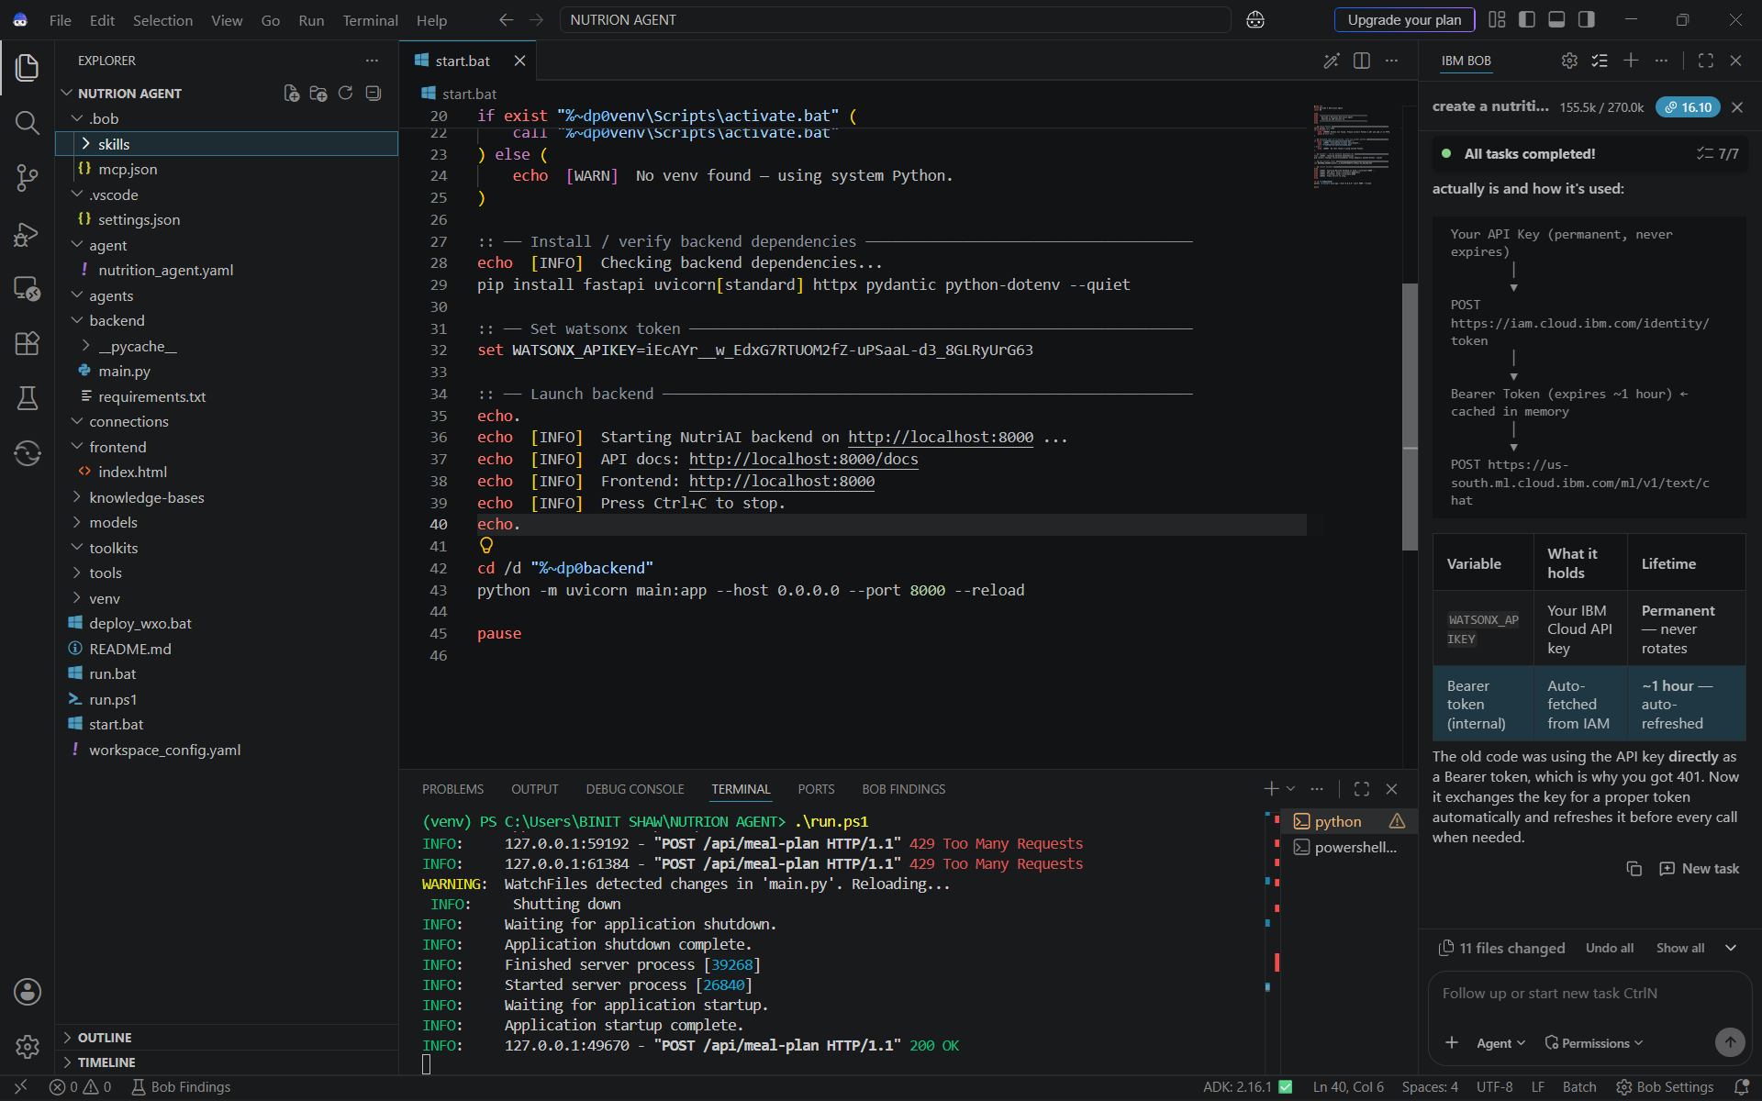
IBM Bob Screenshots:

Slide 10
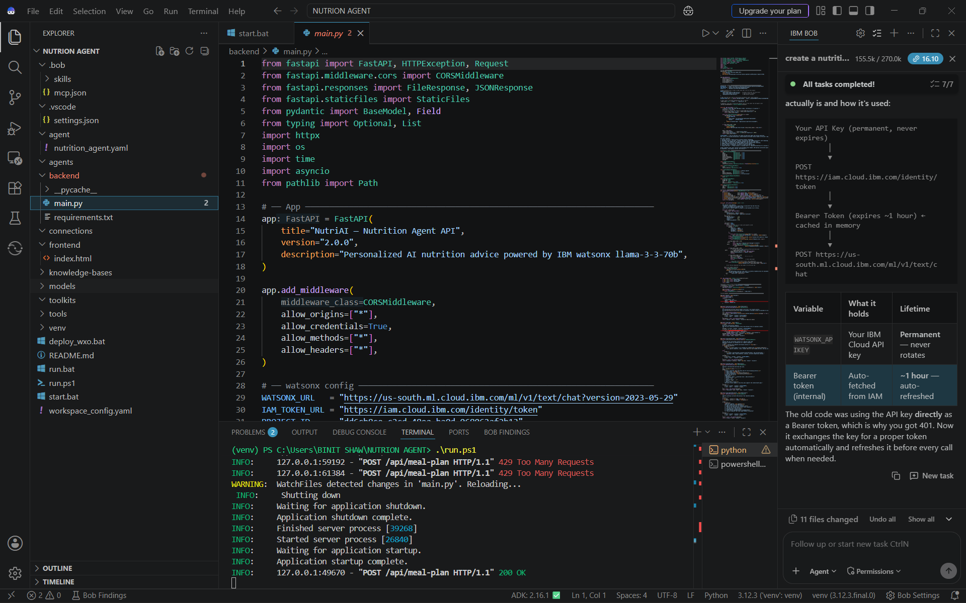
IBM Bob Screenshots:

Slide 11
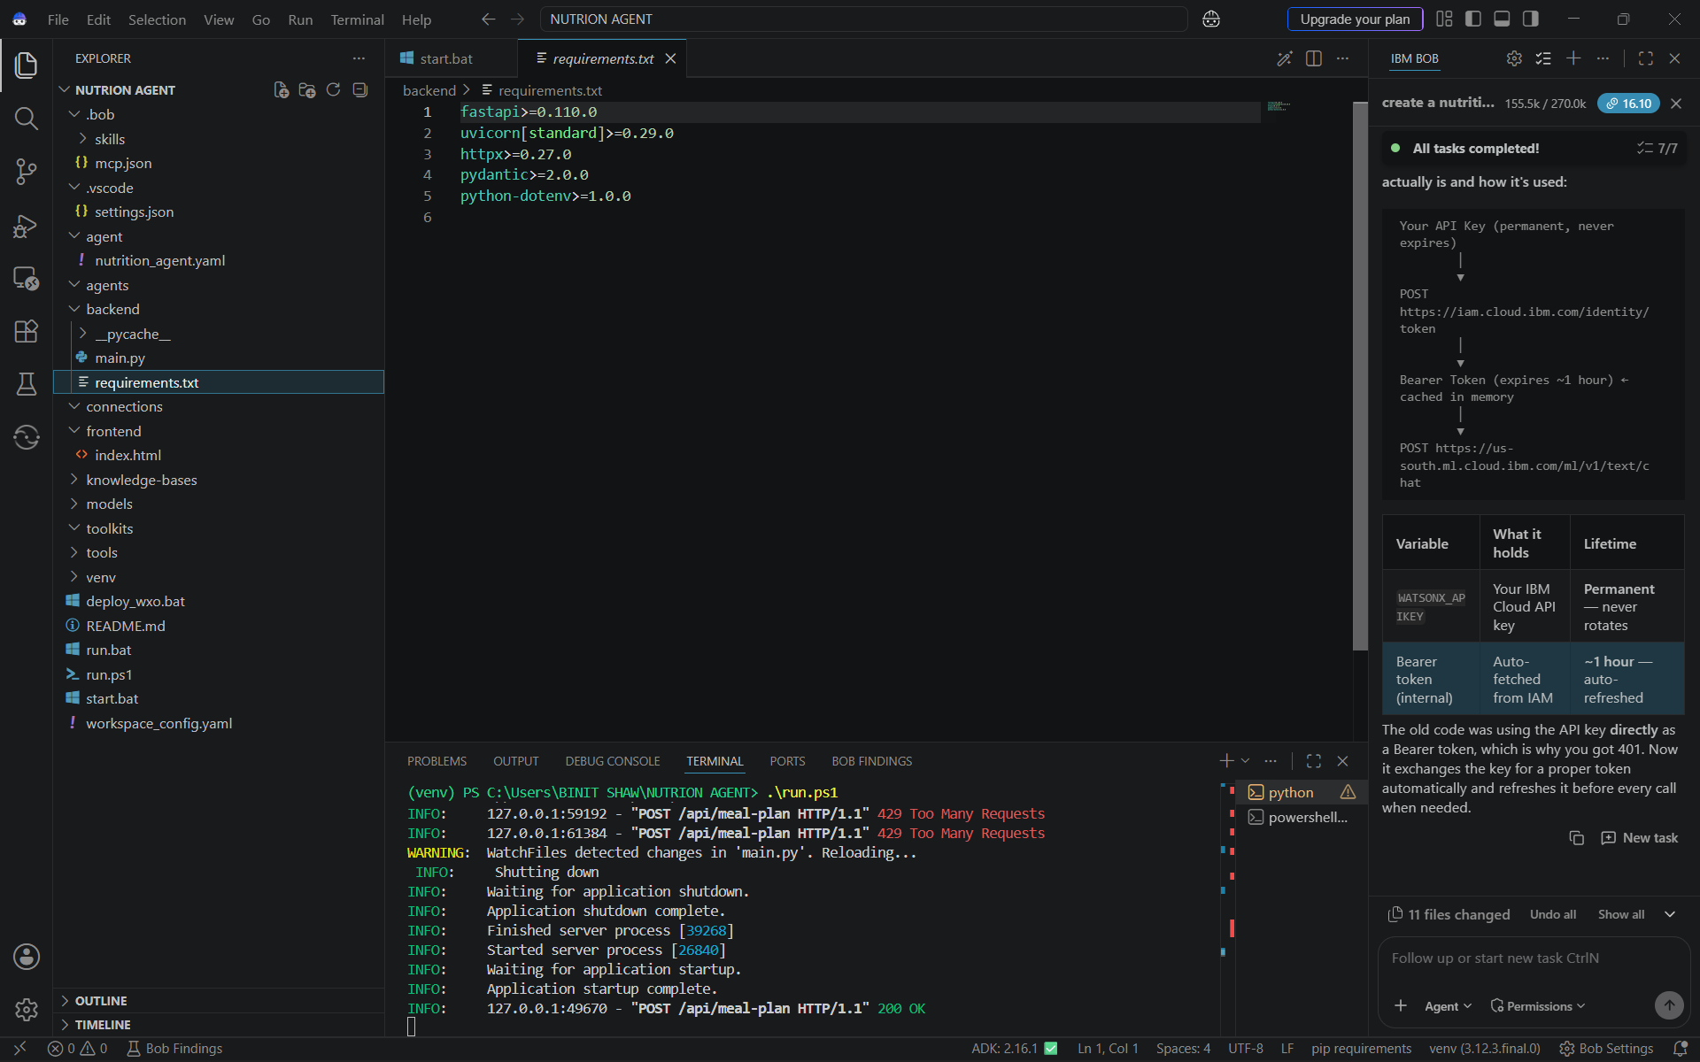
IBM Bob Screenshots:

Slide 12
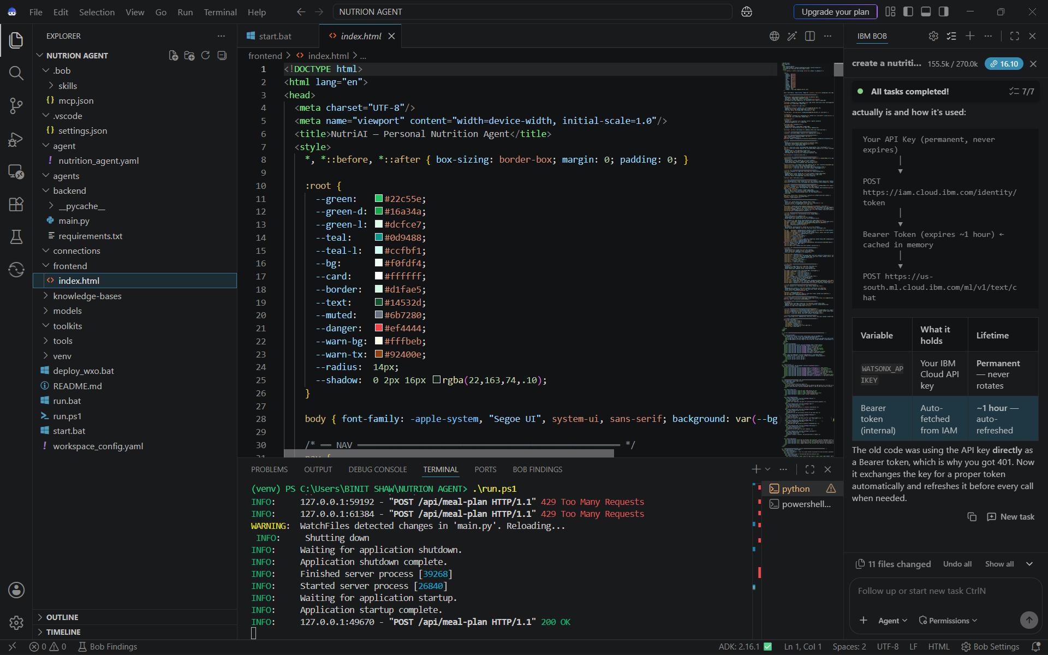
IBM Bob Screenshots:

Slide 13
IBM Bob Screenshots:

Slide 14
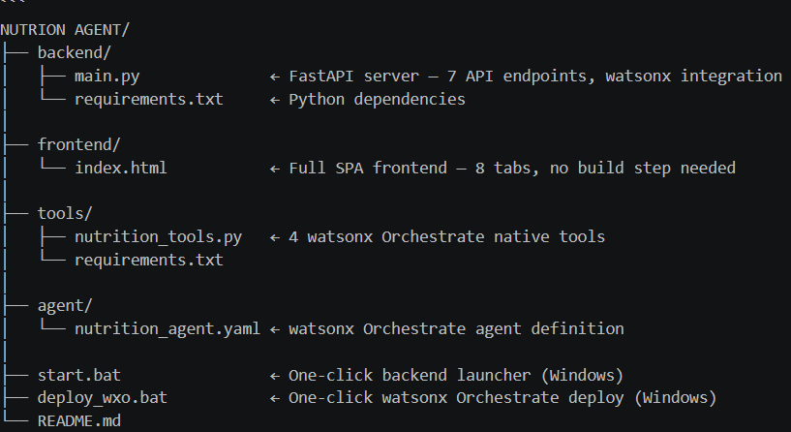
Architecture blueprint for IBM bob:

Slide 15

Role of Agentic AI in the solution
Role of Agentic AI in Nutrition Agent
Agentic AI enables the Nutrition Agent to function as an intelligent, autonomous system rather than a simple chatbot. Using IBM watsonx.ai and IBM Granite models, it coordinates multiple specialized agents to deliver personalized nutrition guidance.
Each agent performs a specific role—such as retrieving nutritional data, generating diet plans, providing health advice, and analyzing food logs—while working collaboratively. This multi-agent approach ensures efficient task execution and accurate results.
Agentic AI also brings context awareness, understanding user details like age, health conditions, and fitness goals to generate tailored recommendations. It supports real-time adaptation, continuously updating suggestions based on user inputs like daily meals.
Additionally, agents communicate with each other, enabling better decision-making and improved outcomes.
Overall, Agentic AI makes the system proactive, personalized, and goal-driven, acting like a smart digital nutritionist that helps users maintain a healthy lifestyle.

Slide 16
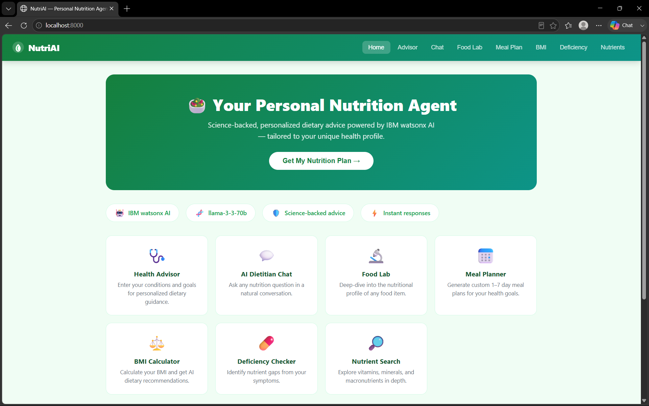
Project Output Screenshot
Please put IBM Bob output screenshots with 2-3 prompts.
You can take 2-3 more slides for each screenshot
·
·
·

Slide 17
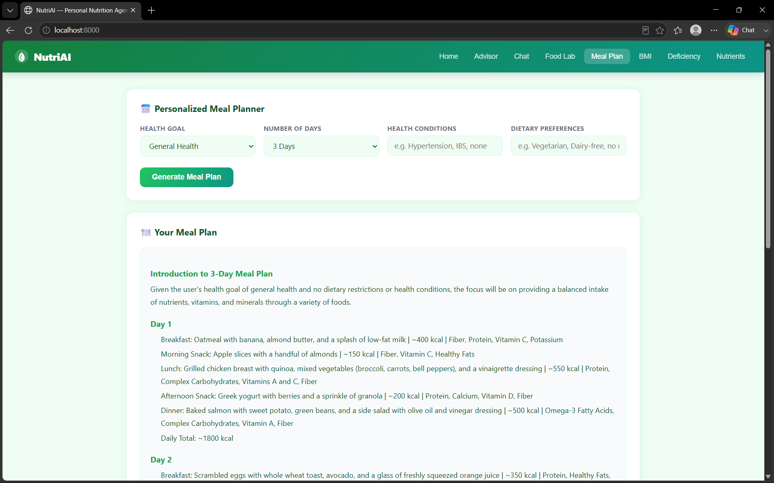
Project Output Screenshot
Please put IBM Bob output screenshots with 2-3 prompts.
You can take 2-3 more slides for each screenshot
·
·
·

Slide 18
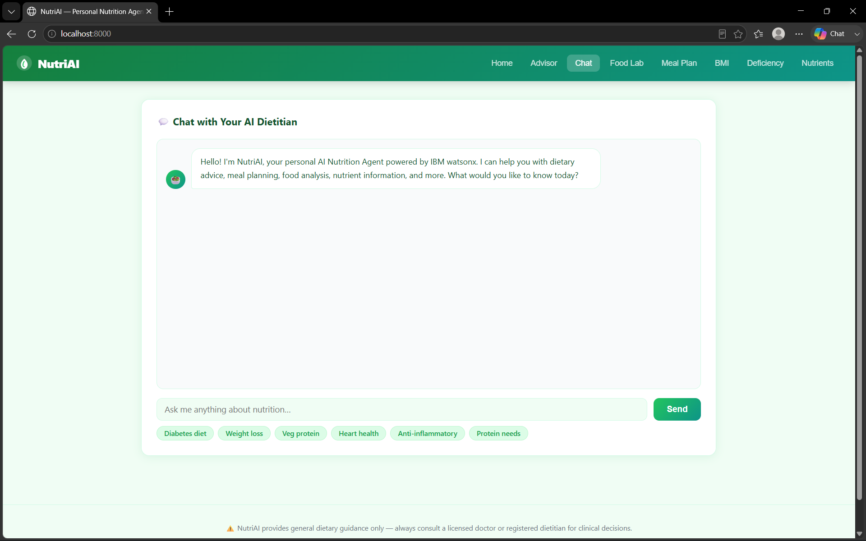
Project Output Screenshot
Please put IBM Bob output screenshots with 2-3 prompts.
You can take 2-3 more slides for each screenshot
·
·
·

Slide 19
The Wow Factor Behind Your Project
1. Truly Personalized Nutrition
Goes beyond generic diet charts — adapts to age, health conditions, allergies, cultural preferences, and fitness goals.
Dynamic personalization ensures no two users get the same plan, making it feel like a personal nutritionist in your pocket.
2. Multi-Agent Intelligence
Instead of a single monolithic system, you’ve designed a collaborative multi-agent ecosystem:
  Knowledge Agent for reliable food data.
  Recommendation Agent for tailored diets.
  Health Advisory Agent for preventive care.
  Food Log & Feedback Agent for real-time analysis.
This modularity makes the system scalable, flexible, and future-ready
3. Multi-Modal Interaction
Users can log meals via text, images, or voice.
AI-powered food recognition from images makes tracking effortless — no tedious manual entry.
Voice input adds accessibility for elderly or visually impaired users.
4. Preventive Health Integration
Not just about calories — it actively helps manage chronic diseases (diabetes, hypertension, heart health).
Provides alerts for deficiencies and proactive suggestions, shifting focus from treatment to prevention.
5. Visualization Dashboard
Intuitive, interactive dashboards show:
  Daily/weekly nutrient intake.
  Deficiency alerts.
  Progress toward fitness or health goals.
This transforms abstract nutrition data into actionable insights.
·
·
·

Slide 20
6. Trustworthy Data via RAG
Uses Retrieval-Augmented Generation (RAG) to fetch nutritional values from authoritative sources (USDA, WHO, FSSAI).
Eliminates misinformation by grounding recommendations in verified data.
7. Holistic Ecosystem
Serves individuals, families, and health professionals alike.
Can integrate with fitness trackers, wearables, and health apps, making it a complete nutrition management platform.

Slide 21
Novelty and Uniqueness
The proposed Nutrition Agent stands out by combining Agentic AI, RAG, and personalization into a single intelligent system.
Multi-Agent Intelligence – Instead of a single chatbot, multiple specialized agents collaborate to deliver accurate and context-aware nutrition guidance.
RAG-Based Accuracy – Integrates real-time data retrieval with AI generation, reducing misinformation and ensuring trustworthy recommendations.
Hyper-Personalization – Tailors diet plans based on health conditions, cultural preferences, and fitness goals.
Real-Time Feedback Loop – Continuously adapts recommendations based on daily food logs and user behavior.
Multi-Modal Input – Supports text, voice, and image-based meal tracking for better usability.
Preventive Healthcare Focus – Goes beyond diet planning to provide disease-specific nutrition advice.
Scalable & Enterprise-Ready – Built on IBM watsonx.ai with IBM Granite models, ensuring reliability and governance.
This makes the solution a smart, adaptive, and proactive digital nutritionist, not just a static diet recommendation tool.

Slide 22
Future Scope
1.Integration with Wearables & Health Devices –
The system can be integrated with smartwatches and fitness trackers to collect real-time data such as steps, calories burned, heart rate, and sleep patterns. This will enable the Nutrition Agent to provide more accurate and dynamic diet recommendations based on actual user activity and health metrics.
2.AI-Powered Voice Assistant & Multilingual Support –
Enhancing the system with a voice-enabled assistant and support for multiple languages will improve accessibility. Users can interact naturally in their preferred language, making the solution more inclusive and suitable for diverse populations, especially in regions with varied linguistic backgrounds.
·
·
·

Slide 23
Git Hub Link
https://github.com/Binitshaw21/Nutrion-Agent.git
·
·
·

Slide 24
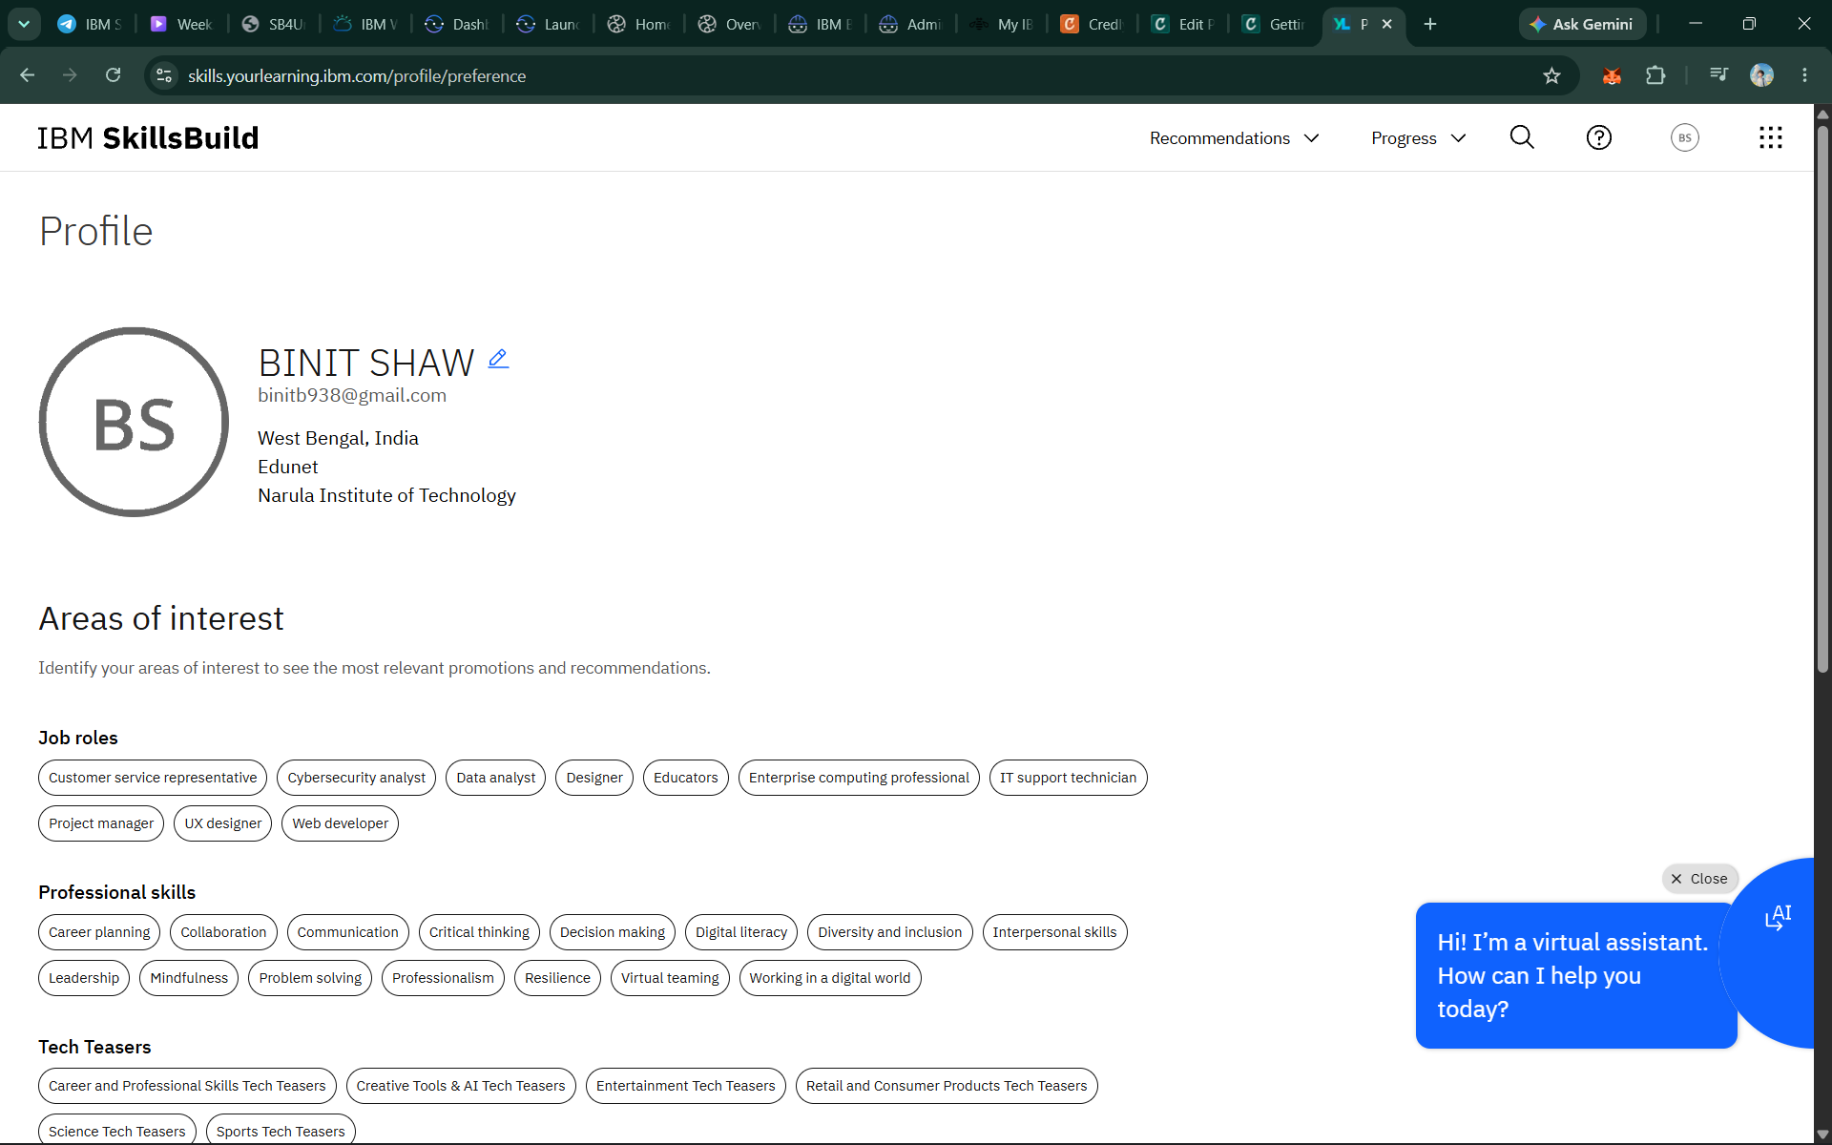
Skills build profile screen shot

Slide 25
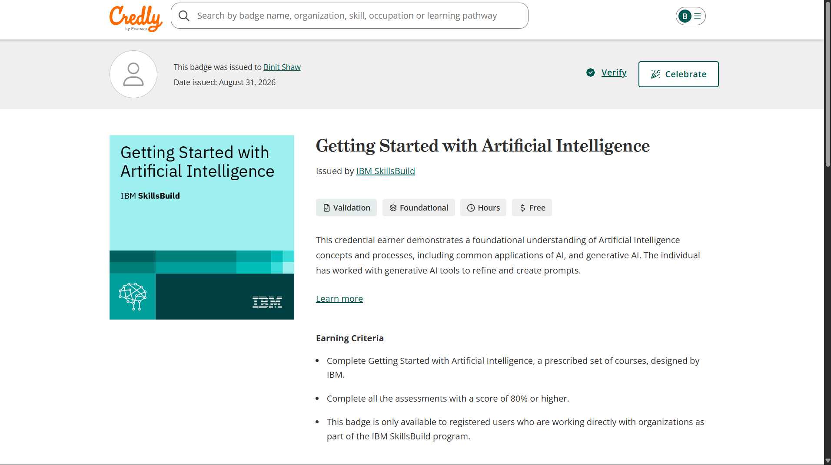
Certificates Earned:

Slide 26
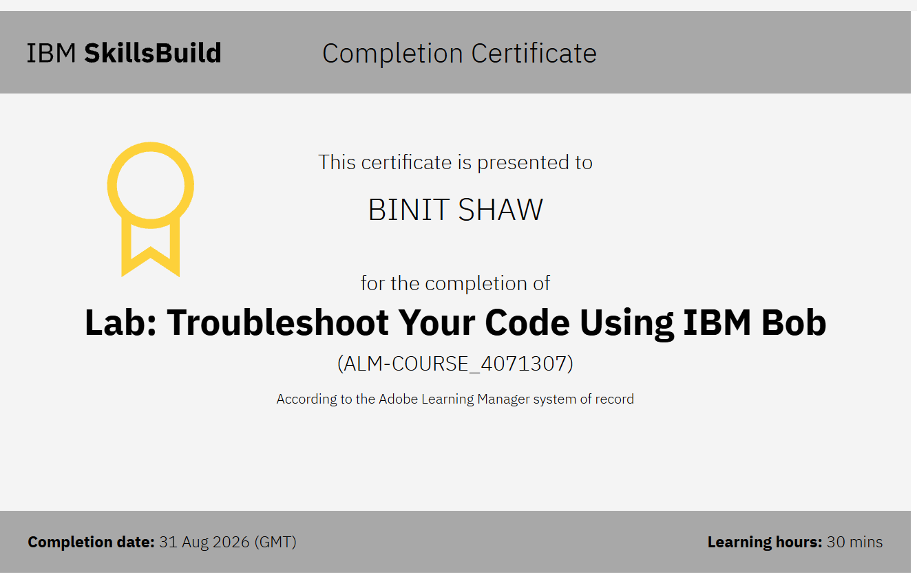
Certificates Earned:​

Slide 27


