Slide 1


WLLD
CAMPAIGN ASSOCIATE — ASSIGNMENT SUBMISSION
Hi, I'm Kunal
and this is my pitch for why I belong on the WLLD team.
MY 60 SECONDS COVER:
60-SECOND VIDEO GOES HERE
Quick intro — name, what I do, brands I've worked with
Why I'm excited for the Campaign Associate role
Thank you to WLLD for the opportunity
The campaign I loved + why (5-6 sharp points)
Task 1: “The Campaign I Absolutely Loved.” Paste your video link/embed here after recording — slide design is otherwise final.
OPEN VIDEO
01 / 09

Slide 2

TASK 1
The Campaign I Absolutely Loved
Campaign: Ariel India — “#ShareTheLoad” (2015–2022, multi-wave). A long-running campaign confronting household gender roles — one of the most awarded and culturally impactful Indian campaigns of the decade.
60-SECOND SCRIPT — WHAT TO SAY, IN ORDER
Hi, I'm Kunal — GTM Strategist & Growth Consultant. I've worked with Zepto, Britannia, Angel One, and boAt on growth campaigns.
Genuinely excited about the Campaign Associate role at WLLD — I've already collaborated with your team on campaigns and would love to join full-time.
The campaign I loved: Ariel India's “#ShareTheLoad,” 2015–2022.
Simple execution — TV + digital, no exotic locations, no huge production — but the emotional return was massive.
What stuck with me: it's honest, culturally grounded, and still unforgettable years later.
It won Cannes Lions and moved product off shelves — proof that purpose and sales aren't opposites.
Thank you to WLLD for this opportunity.
02 / 09

Slide 3

TASK 2
Meme Radar Test
5 memes circulating right now — where they're showing up, why they're working, and how a brand could ride them without forcing it
“Ek-ek cup chai aur bola jaaye?”
“Dekh raha hai na Binod”
“Mogambo Khush Hua”
Source: Panchayat (S3/S4) — Bhushan's line
Where:
Instagram Reels, X, WhatsApp/group chats
Why it works:
Universal, low-effort relatability — fits literally any “let's pause and regroup” moment, from work fatigue to long meetings.
Brand fit:
Any F&B or workplace brand can caption a chai/break moment with this — zero forcing needed, the line already means “time for a breather.”
Source: Panchayat — Bhushan to Bhutkun
Where:
Instagram meme pages (@theviralfever, @rvcjinsta), X
Why it works:
Captures shared disbelief at something absurd — the addressee 'Binod' has become shorthand for 'can you believe this.'
Brand fit:
Works for brands reacting to industry news, a competitor's move, or an absurd customer-service moment — self-aware brand commentary.
Source: Mr. India (1987) — Amrish Puri's villain line
Where:
Instagram Reels, X, WhatsApp — used by literally every generation
Why it works:
One of Bollywood's most quoted villain lines ever — used sarcastically for 'unexpected joy,' works across every age group, which almost no meme does.
Brand fit:
Perfect for any brand celebrating a win, a launch, or even a customer's smug victory — instantly funny without needing context.
“Don't underestimate the power of a common man”
Disappointed Indian Guy
Source: Chennai Express (2013) — Shah Rukh Khan's line
Where:
Instagram Reels, X, WhatsApp — resurfaces constantly in underdog moments
Why it works:
A full decade old and still gets pulled out every time someone overlooked wins big — genuinely timeless, not a passing trend.
Brand fit:
Great for brands telling small-business, underdog, or first-time-buyer success stories — instantly recognisable, adds drama for free.
Source: Cricket fan Sarim Akhtar's viral reaction shot
Where:
Instagram, X, global meme pages — also huge outside India
Why it works:
One of the few Indian-origin memes that went fully global — the face alone communicates 'devastated' with zero text needed.
Brand fit:
Great for brands reacting to a missed deal, a sold-out item, or any 'we feel your pain' moment — universally understood, instantly relatable.
03 / 09

Slide 4




TASK 3
If I Ran Nykaa's Internet Personality
Brief: Nykaa is launching a major sale. Goal — stronger, louder presence on X (Twitter) and Reddit to drive conversation and engagement around it.
3 Tweets
2 Reddit Posts
The Strategy
Short, punchy, screenshot-worthy. Built to be shared and quote-tweeted, not just liked.
Written in Reddit's native voice — frank, self-aware, no corporate gloss.
Why this approach builds real conversation, not just impressions.
“POV: your cart has 14 items, the sale ends in 6 hours...”
Posted in r/IndianSkincareAddicts + r/india
Conversation > broadcast, on both platforms
→ See next 2 slides for the actual tweets, Reddit posts, and the engagement logic behind them.
04 / 09

Slide 5



TASK 3 — PART A
3 Tweets for Nykaa's Sale
@NykaaWoman
@NykaaWoman
@NykaaWoman
Sale Campaign
Sale Campaign
Sale Campaign
POV: your cart has 14 items, the sale ends in 6 hours, and you're explaining to yourself why you "need" a 6th lip tint. We get it. We built the sale around exactly this moment.
Things that are not on sale: your skin texture anxiety at 1am, your group chat's opinions, your ex. Things that ARE on sale: literally everything that helps with all three. Starts now.
We asked our team to pick ONE thing they're restocking this sale without asking finance first. The answers got heated. Reply with yours — we're judging, lovingly.
Relatable + screenshot bait
Thread-starter, quote-tweetable
Drives replies + UGC
05 / 09

Slide 6
TASK 3 — PART B
2 Reddit Posts for Nykaa's Sale
r/IndianSkincareAddicts
r/india
Posted by u/nykaa_official
Posted by u/nykaa_official
Honest q: is the Nykaa sale actually worth waiting for, or should I just buy now?
Nykaa sale is back — unpopular opinion: the real win is the return policy, not the discount
Not a plant, genuinely asking before I impulse-buy. Their sale starts this week — anyone tracked actual price drops on serums/sunscreens in past sales vs regular price? Want real numbers, not "it's a great deal" marketing speak.
Everyone's talking % off but nobody mentions you can actually return half-used products if they don't suit you. That's rarer than people think for Indian beauty e-comm. Sale starts [date], dropping this here before my wishlist disappears.
Why it works: Posted with transparency — inviting scrutiny instead of avoiding it builds trust with a skeptical sub.
Why it works: Reframes the sale around a genuinely useful, lesser-known angle — gives Reddit something to debate/upvote beyond "discount post."
06 / 09

Slide 7
TASK 3 — PART C
Why This Builds Real Engagement
1
Conversation > Broadcast
2
Native to each platform
Tweets ask a question or invite a reply instead of just announcing the sale — engagement becomes the content, not an afterthought.
Twitter copy is punchy and shareable; Reddit copy drops the brand voice and sounds like a real person posting, because that sub will call out anything that smells like an ad.
3
Self-aware, not salesy
4
Built to be screenshotted
Acknowledging the absurdity of impulse-buying or asking Reddit to fact-check the sale builds trust instead of skepticism.
Each piece is short and quotable enough to live outside the platform — in group chats, in screenshots, in other threads.
07 / 09

Slide 8

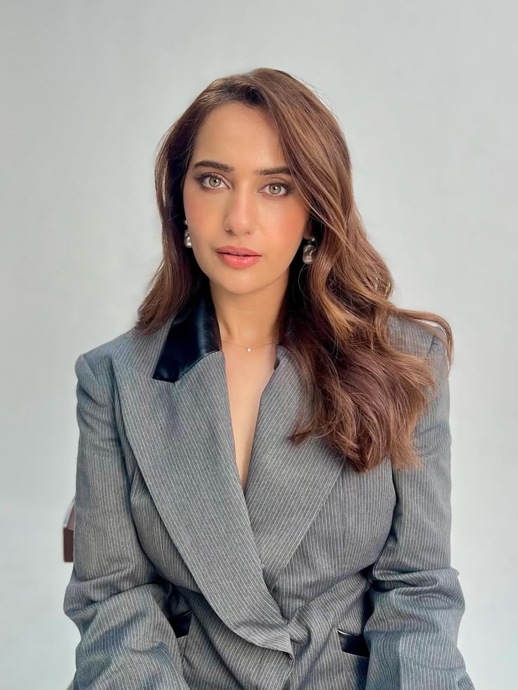
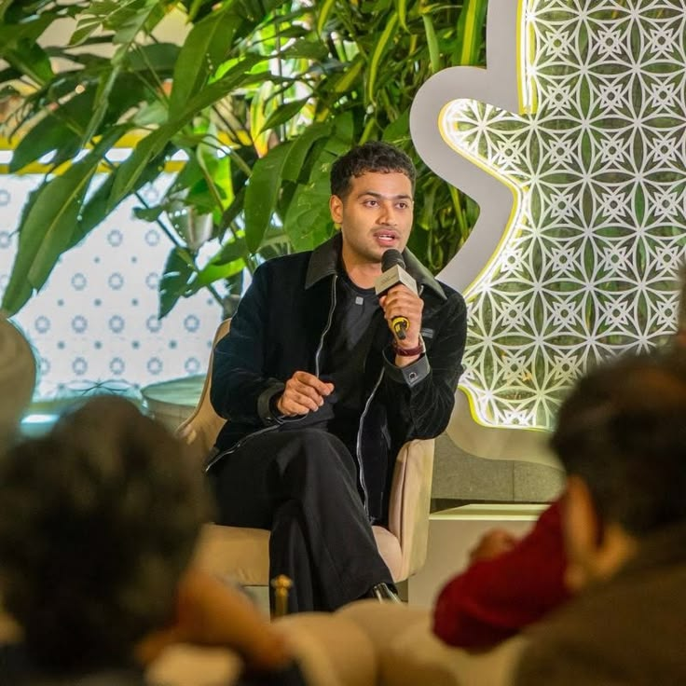
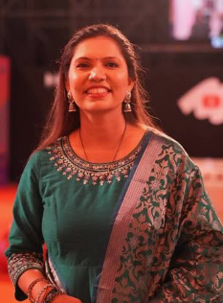
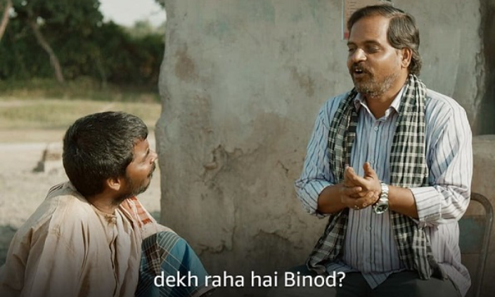
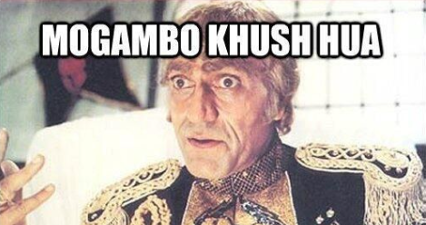


TASK 4
Internet Moodboard — My Personality
3 CREATORS I FOLLOW
KK
Kusha Kapila
RS
Raj Shamani
KS
Kabita Singh
@kushakapila · Lifestyle / comedy
@rajshamani · Business / podcast / entrepreneurship
@kabitaskitchen · Food
“Turns everyday desi-life chaos into characters everyone recognises — sharp writing, not just a pretty feed.”
“Pulls in wildly different kinds of people — founders, athletes, creators — and always finds the angle that turns into a real talking point online.”
“No-nonsense recipes, consistent voice for years — proof a simple format can still outlast every trend cycle.”
2 FAVORITE MEMES
1 BRAND I LOVE
“Dekh raha hai na Binod”
Mogambo Khush Hua
Their social team treats every reply and caption like a punchline, not a brand-safety checklist — and they've kept that voice consistent for years across IPL moment-marketing, X banter, and ad campaigns. Rare for a brand that big to still feel this unfiltered.
Source: Panchayat — my go-to whenever something is mildly chaotic and words aren't enough.
Source: Mr. India (1987) — the ultimate reaction for any unexpectedly great moment.
08 / 09

Slide 9


Thank You,
Genuinely grateful for the chance to take this on — WLLD's been on my radar for a while for how it builds campaigns, and getting to think like part of the team for a few days, even just for this assignment, was honestly fun.
Kunal · +919725746345 · kunalbinjewar8@gmail.com · LinkedIn
“Kuch toh log kahenge, logon ka kaam hai kehna” — but I'd love for what you say about this submission to be: hire them.

