Slide 1

SIH-2020
Software edition
Organization – Government of Bihar
Group Name – Code Junkies
Members –
Rahul Thapa (Leader)
Bhuswarna Kashyap
Binong Kiri Bey
Dip Jyoti Dutta
Kanishka Sharma
Rahul Nath
Problem Statement ID – PK413
College Code – 1-3510626477
FLASH MILK

Slide 2
P
ROBLEM
STATEMENT
Use satellite data and artificial intelligence to monitor crop production across India.
Use standard dataset available from NASA/ISRO for this purpose.
This kind of data will be helpful to predict production of crop with schedule and help government develop a procurement plan for the same.

Slide 3
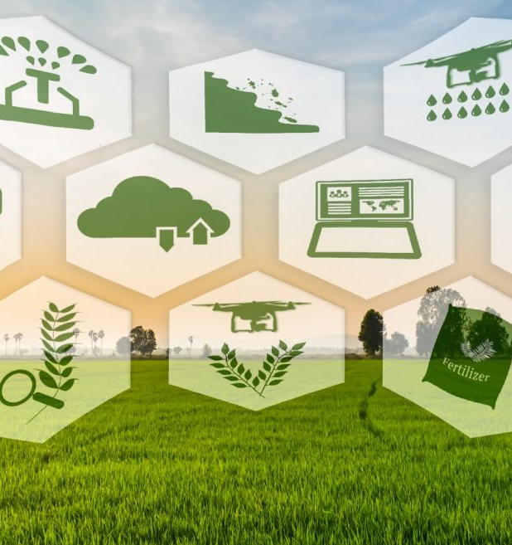
SOLUTION
Using machine learning, accurately predicting the production of crops in order to build a prediction system by using historical land use data from ISRO/NASA.
User friendly interface for farmers (and third party users) which contains the output information related to the crops, such as harvest time, market trend etc.
A government login page for government to get a better visualization of the agricultural sector and to develop a better procurement plan accordingly for the crops and compensate farmers more effectively.

Slide 4
User Case Diagram
Land use data from NASA/ISRO
Registration
Government
User login
ML model uses data to make prediction
User adds actual data
User can view the predicted data
Farmers/3rd party login

Slide 5
Technologies Used
Regression using scikit-learn
Node.js
React
Pandas
Bootstrap
Express
HTML
Flask
CSS
JavaScript

Slide 6


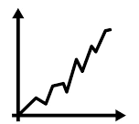

Parameters Related To
Crop Prediction
Harvest Schedule
Fertilizer
The act of removing a crop from where it was growing and moving it to a more secure location for processing, consumption, or storage.
Fertilizers (containing plant nutrients such as nitrogen, phosphorus, and potassium) maintains the soil fertility, so as to grow nutritious and healthy crops.
Market Trend
Temperature
An upward trend in prices for a crop can indicate profitable production opportunities and may lead to some farmers ceasing to grow a crop where prices are declining.
High air temperature reduces the growth of shoots and in turn reduces root growth. High soil temperature is more crucial as damage to the roots is severe resulting in substantial reduction in shoot growth.

Slide 7
Showstoppers
1.
5.
Predict the production of crop using Machine Learning.
Digitization of land use records for better accessibility.
2.
4.
Graphical visualization of the predicted data.
Ability to compare the predicted data and the actual data.
3.
Ability of farmers to easily login and add their own data.

Slide 8
Future Work
Building this particular application in the regional languages, so that it would be more comfortable for farmers.
Giving details about micronutrients also.
1.
3.
4.
A generalized prediction model for various crops by considering other parameters like humidity and solar radiation can be developed.
Crop disease detection and prevention.
2.

Slide 9
Day 1 Progress Report
Created Linear Regression Model
Created Flask API to get and post data to python model
Created dashboard with visualizations for farmers
Created a yield prediction and crop recommendation system
Integrated ML models with React+Node js web application

Slide 10
Thank You

