Slide 1
Implementation and results of Spatiotemporal Multi-Graph Convolution Network for Ride-hailing Demand Forecasting
Binqing Wu

Slide 2
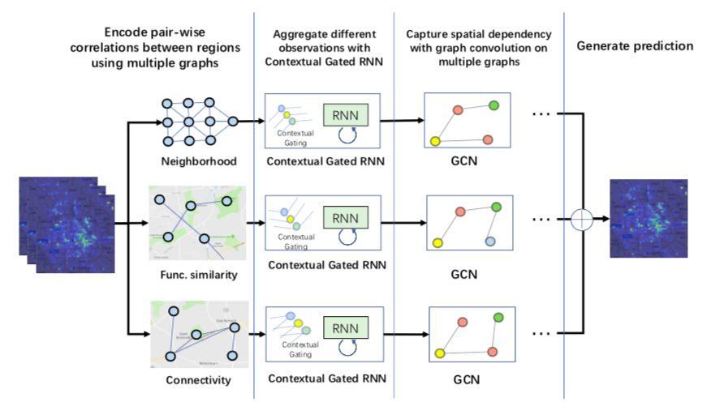
system architecture of St-mgcn
CGRNN
Channel-wise attention
LSTM
ST-MGCN

Slide 3
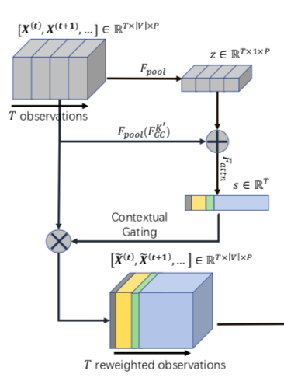
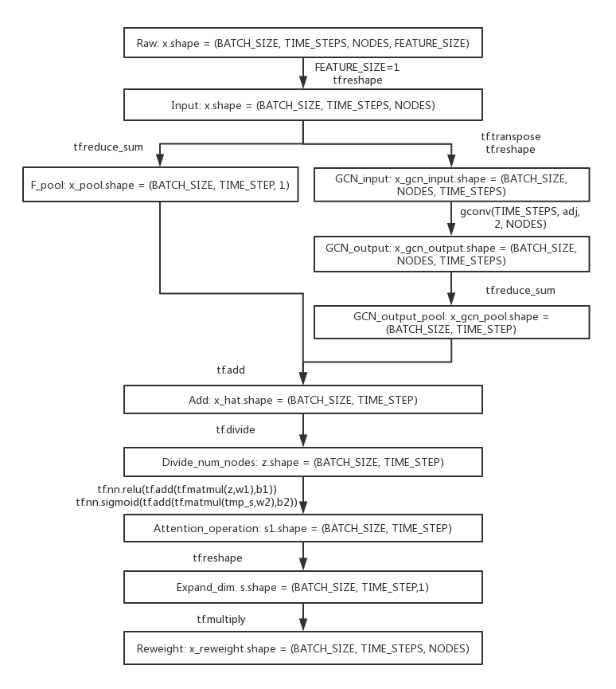
CGRNN Channel- wise attention
Produce region descriptions using the global average pooling over the input and its graph convolution output for each observation
Transfer the summarized vector z into weights which are used to scale each observation.

Slide 4
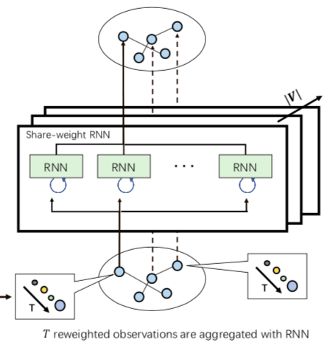
CGRNN LSTM (one-way)
Split the reweight X (BATCH_SIZE, TIME_STEP, NODES) into NODES x X’ (BATCH_SIZE, TIME_STEP, 1) [tf.split]
Each X’ runs LSTM
Concat NODES x X_lstm_each_node_output (BATCH_SIZE, 1, HIDDEN_UNITS) into one tensor X_lstm_output (BATCH_SIZE, NODES, HIDDEN_UNITS) [tf.concat]

Slide 5
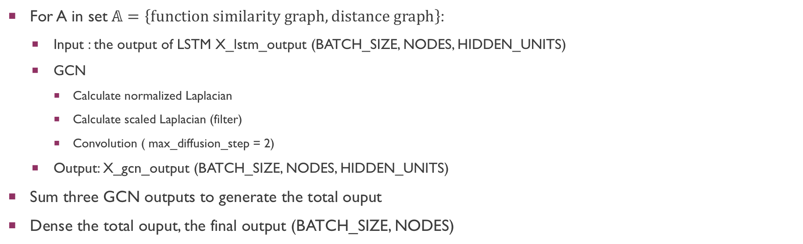
ST-MGCN (Chevb-net)
For A in set$𝔸=\left\{function similarity graph, distance graph\right\}$:
Input : the output of LSTM X_lstm_output (BATCH_SIZE, NODES, HIDDEN_UNITS)
GCN
Calculate normalized Laplacian
Calculate scaled Laplacian (filter)
Convolution ( max_diffusion_step = 2)
Output: X_gcn_output (BATCH_SIZE, NODES, HIDDEN_UNITS)
Sum three GCN outputs to generate the total ouput
Dense the total ouput, the final output (BATCH_SIZE, NODES)

Slide 6
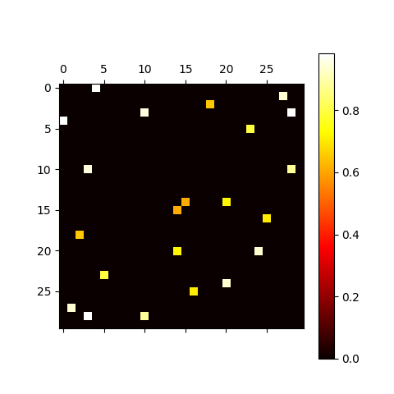
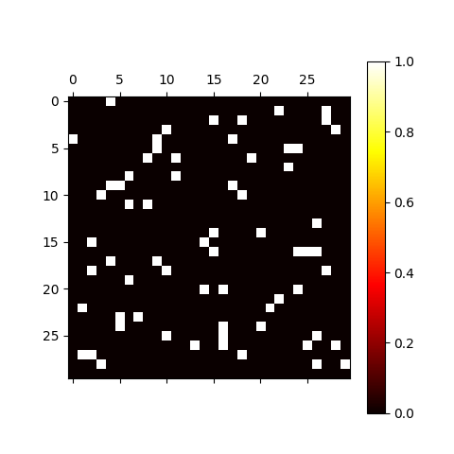
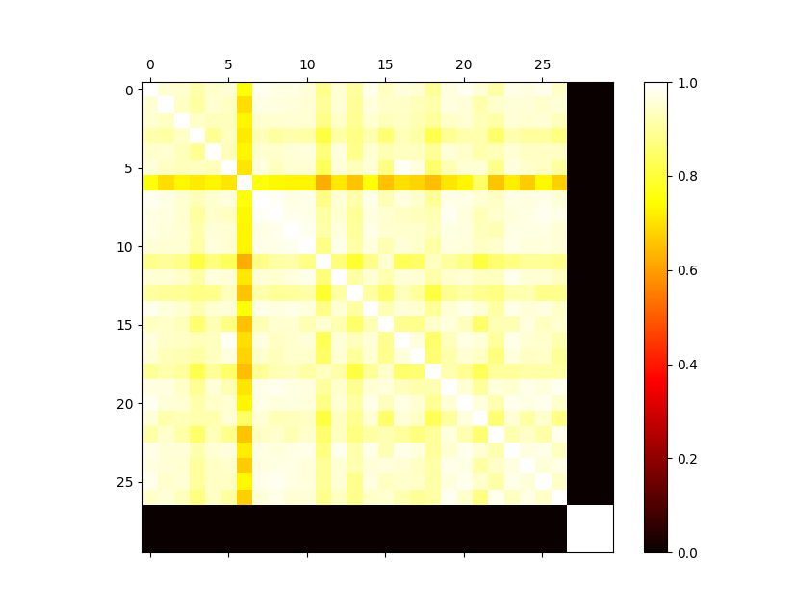
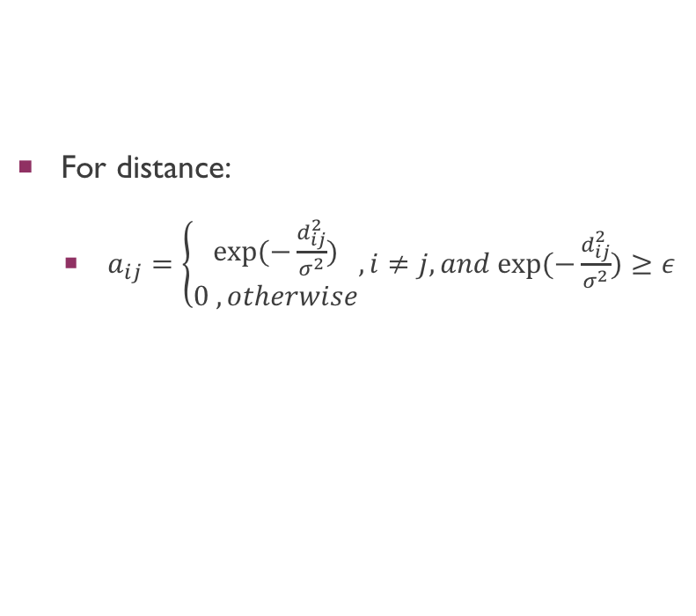
Data pre-processing
For distance:
$a_{ij}=\left\{\begin{aligned}exp⁡(−\frac{d_{ij}^{2}}{σ^{2}}) \\ 0 , otherwise\end{aligned}, i≠j, and exp⁡(−\frac{d_{ij}^{2}}{σ^{2}})≥ε⁡\right.$
Sparse！
For connection:
provided
For similarity:
POI -> cosine similarity

Slide 7
Results
Dataset:
40days.
The standard time interval is set to 5 minutes.
Each node contains 288 data points per day
Total data 40 x 288 x 30
Settings:
TIME_STEPS = 12, BATCH_SIZE = 32
HIDDEN_UNITS = 16, LEARNING_RATE = 0.001
EPOCH = 50, NODES = 30
INPUT_SIZE = 30, OUTPUT_SIZE = 30
TRAIN_EXAMPLES = 6400, VAL_EXAMPLES = 800
TEST_EXAMPLES = 1600,NUM_LAYER = 3
Performance comparison of different approaches
Approach | RMSE (best)
Tplus1PredectT | 35.804
LSTM (One-way ) | 29.434
ST-MGCN (no attention) | 20.391
ST-MGCN (attention) | 23.518

Slide 8
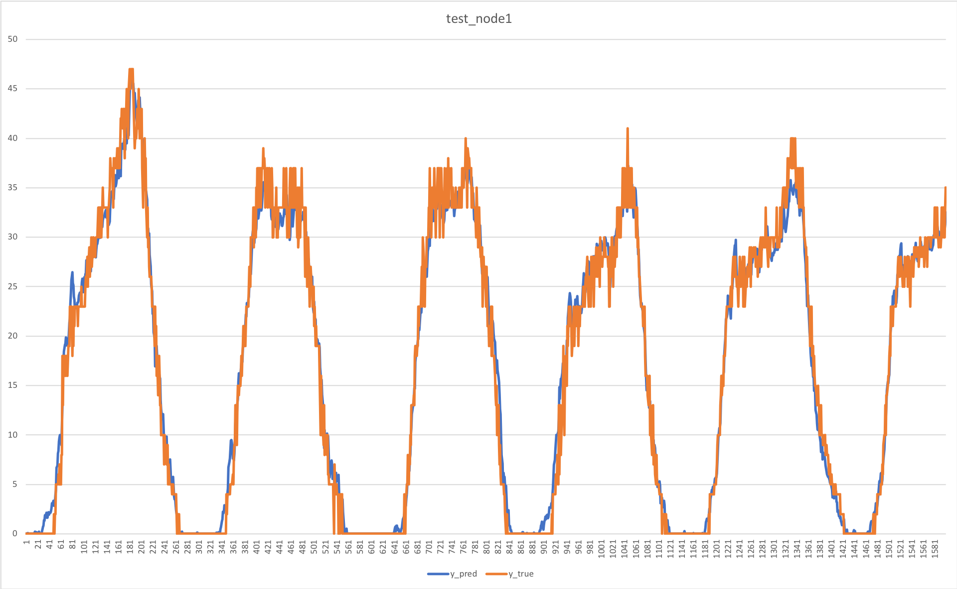
Comparison between the real demands and predicted demands
1600 instances
Model parameters:
Type: STMGCN (no attention)
RMSE: 20.391
Test RMSE: 24.736

Slide 9
difficulties
Use 30 nodes to run a shared RNN 30 times, not use all nodes to run the RNN once
If use all nodes, the order and relations of each node will be disorganized
Have to split the input into 30 tensor, run the shared RNN 30 times, concat 30 results into one tensor
The connection of LSTM and GCN
The output of LSTM should be reshaped into a fixed-shape tensor
Otherwise, GCN can not handle. BUG!

Slide 10
reflections
For model, more complex, much better ? No!
In this case, the dataset is relatively small, the model with attention does not work as efficient as that without attention
Sometimes the simplest one works well.
Just use t+1 as the prediction of t. Around 1000 times faster than ST-MGCN (no attention) when running 20 epochs
For data pre-precessing, keeping the data sparse is important
Adjust the distance matrix, the sparse one works better than dense one. Faster, more accurate.

Slide 11
Future work
Innovation:
Change RNN structure
Change data pre-processing methods
Problem:
The results of ST-MGCN (attention/no attention) increase or decrease periodically. Why?
Batch size? Has adjusted 32, 64, the results are still periodical.

Slide 12
What I do in this summer camp
Read Papers (see in REF)
Learn the theoretical knowledge of LSEM, GCN
Learn how to use keras, tensorflow
Implement LSTM. ST-MGCN
Write learning reports

Slide 13
acknowledgement
Associate Professor Lin Chen
https://person.zju.edu.cn/lc
(https://scholar.google.com/citations?user=Vxi9eakAAAAJ&hl=zh-CN)
Teaching Assistant Weiqi Chen

Slide 14
reference
Paper Ref:
1.[Semi-supervised classification with graph convolutional networks (Thomas N. Kipf, etc)](https://arxiv.org/pdf/1609.02907.pdf)
2.[Spaio-temporal graph convolutional networks: A deep learning Framework for traffic forecasting (Bing Yu, etc)](https://arxiv.org/pdf/1709.04875.pdf)
3.[Diffusion convolutional recurrent neural network: data-driven traffic forecasting (Yaguang Li, etc)](https://arxiv.org/pdf/1707.01926.pdf)
4.[Spatiotemporal Multi-Graph Convolution Network for Ride-hailing Demand Forecasting （Xu Geng, Yaguang Li, etc)](http://www-scf.usc.edu/~yaguang/papers/aaai19_multi_graph_convolution.pdf)
5.[Convolutional Neural Networks on Graphs with Fast Localized Spectral Filtering](https://arxiv.org/pdf/1606.09375.pdf)
Code Ref:
1.[Graph Convolutional Networks](http://tkipf.github.io/graph-convolutional-networks/)
2.[DCRNN](https://github.com/liyaguang/DCRNN)

