Slide 1
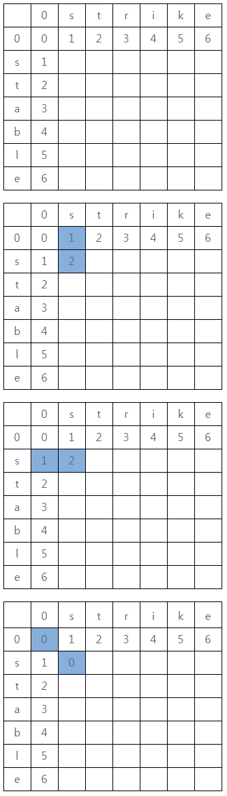
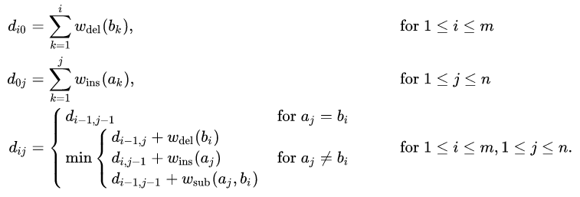
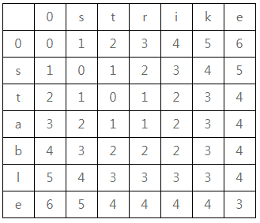
Reference Sites :
https://calyfactory.github.io/editdistance/
https://twinparadox.tistory.com/186
https://baihuqian.github.io/2018-08-15-edit-distance/
How do you know difference of two words?
How to calculate a distance of two words?
In the case of numbers or vectors, it is easy to get the difference.
But it is difficult in the case of words.
You can represent it to use the minium count of following 3 operations.
a) Insert a character
b) Delete a character
c) Replace a character
Idea : Dynamic programming
E[n,m] = E[n-1, m-1] // Replace nth character in A word with mth character in B word.
E[n,m] = E[n, m-1] // Delete nth character in A word.
E[n,m] = E[n-1, m] // Insert mth character in B word to A word.
E[n,m] = min(E[n,m-1]+1, E[n-1,m]+1, E[n-1,m-1]+a)

