Slide 1

Trends and Possibilities in the city of New York & Comparison of neighborhoods of Toronto and New York.

Slide 2
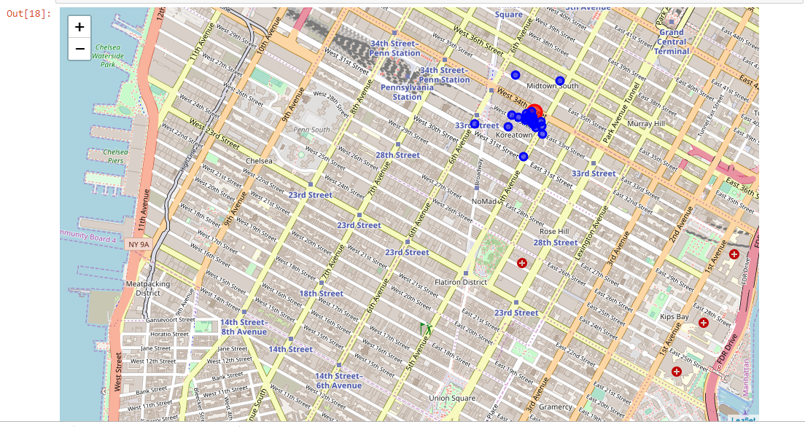
Places to visit near Empire State Building

Slide 3
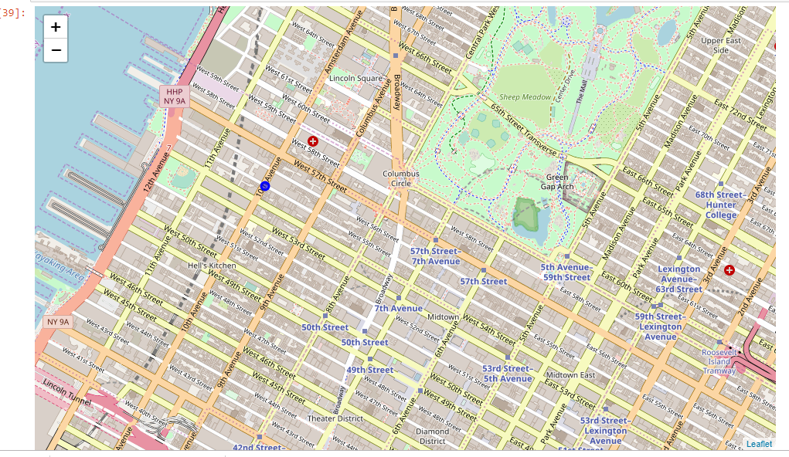
Trending Venue near Four Season, NY

Slide 5
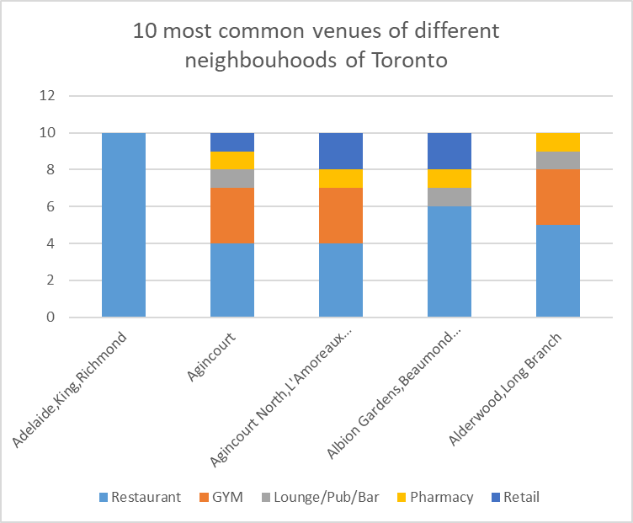

Slide 7
